Slide 1
Building a Comprehensive End-to-End Testing Suite for "Demowebshop" E-commerce Application Using Cypress
By Akhil Janapatla

Slide 2
Introduction
Objective:
To create end-to-end testing suite for the “Demowebshop" e-commerce platform that ensures functionality across critical user scenarios. Integrate the CI/CD pipelines for automation testing and deployment.
Technologies Used:
Cypress: Automated testing framework for UI and end-to-end testing
JavaScript: Main scripting language for writing test cases
Node.js: Back-end runtime environment for executing JavaScript code
Git: Version control for managing code changes
GitHub Actions(CI/CD pipeline): Continuous Integration/Continuous Deployment pipeline with GitHub Actions to automate testing and deployment

Slide 3
Key Features and Scenarios Tested
Homepage Navigation: Ensures the homepage loads with all essential UI elements.
Product Search: Verifies that the search functionality displays relevant product results.
Product Detail View: Confirms that product details, including images and descriptions are visible.
Cart Management: Validates adding, removing products and updating the cart.
User Registration & Login: Automates the registration and login process for users.
Checkout Process: Tests the complete cart checkout, including payment and order confirmation.
Intercepting Requests: Mocks API requests to simulate different responses.
Data Management: Uses Cypress fixtures to handle test data such as usernames, passwords.

Slide 4
Test case: Homepage Navigation
Objective: This test should verify that the homepage loads successfully, ensuring that the presence of categories/specific categories are visible.
Steps:
Visit the URL: https://demowebshop.tricentis.com.
Verify the logo is visible on the webpage.
Check if the category list is displayed.
Confirm the "Books" category is present.
Confirm the "Computers" category is present.

Slide 5
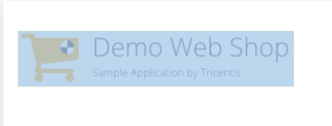
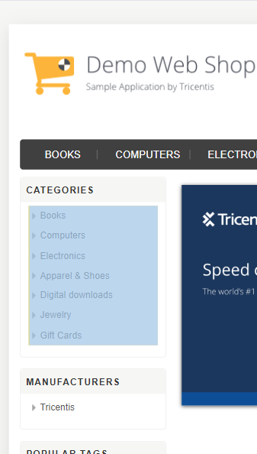
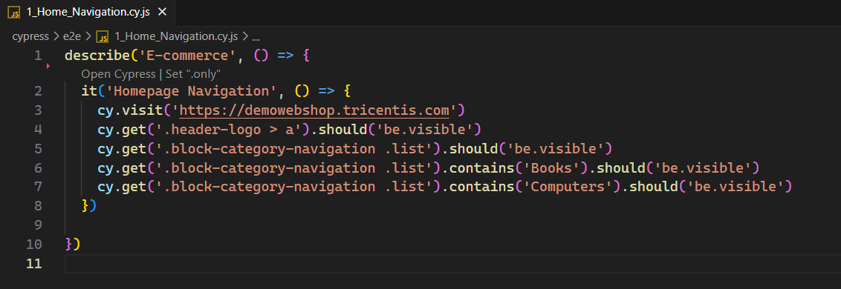
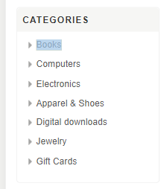
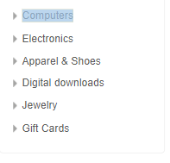
Results Observed:
The website logo was visible on the homepage.
The category list in the homepage is visible.
Both "Books" and "Computers" categories were present on the homepage.

Slide 6
Test case: Product Search
Objective: Test the search functionality by verifying search results for different product keywords.
Steps:
Visit the URL: https://demowebshop.tricentis.com
Enter "computer" in the search box and view the results.
Verify that the search results include the term "computer."
Enter "gift card" in the search box and view the results.
Verify that the search results include the term “Gift Card”.

Slide 7
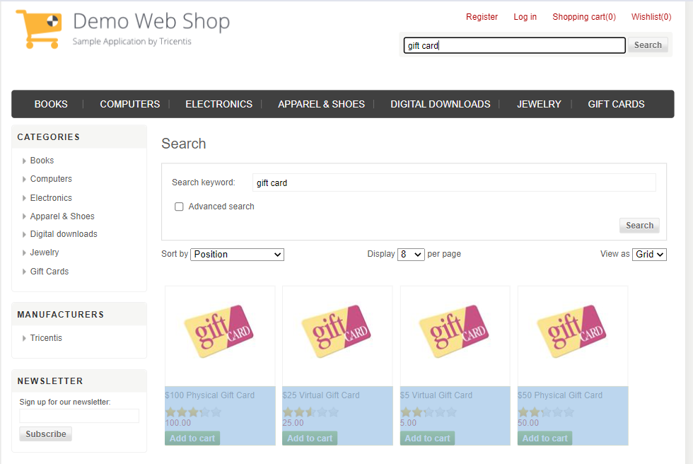
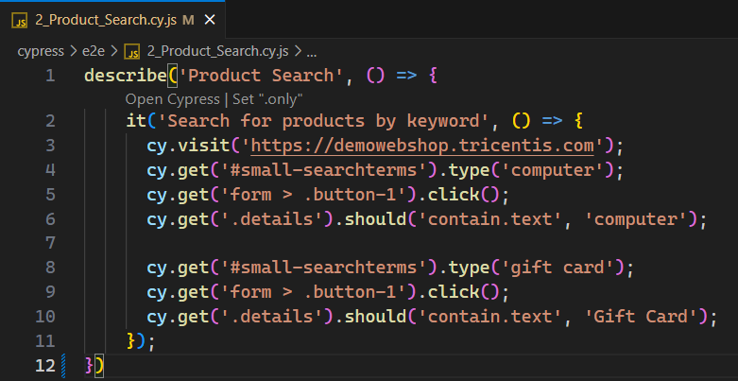
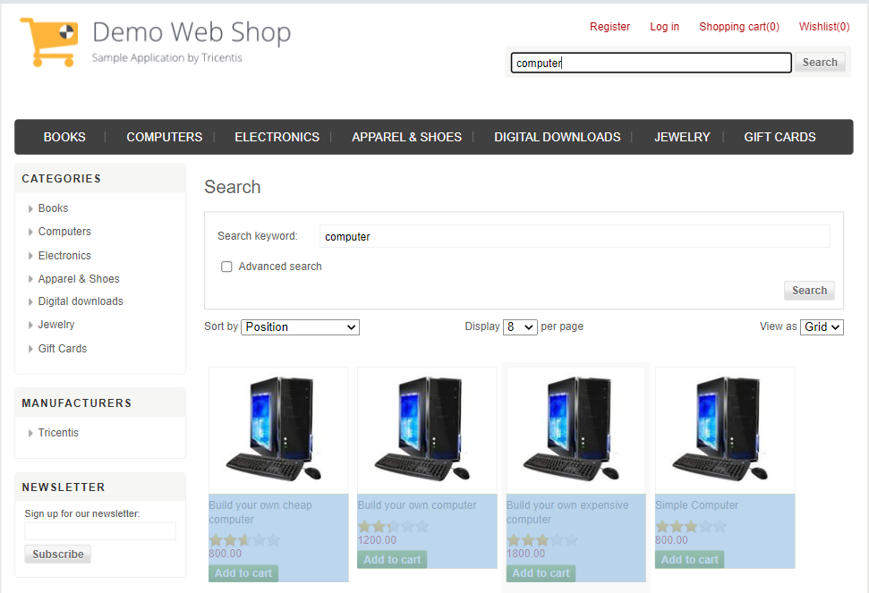
Results Observed:
Search results for "computer" include relevant products.
Search results for "gift card" include relevant products.

Slide 8
Test case: Product Details
Objective: Verify that product details are displayed correctly and validate the 'Add to Cart' functionality.
Steps:
Visit the homepage and search for "computer."
Select the product "Build your own cheap computer."
Verify product details and features.
Add the product to the cart and confirm.

Slide 9
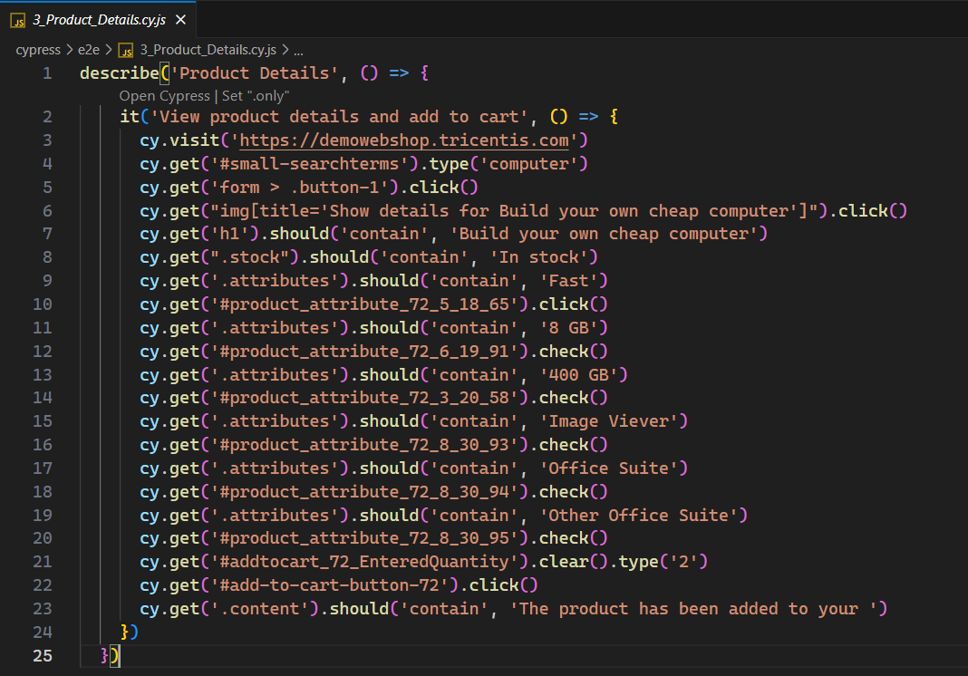
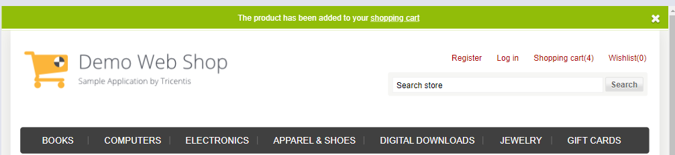
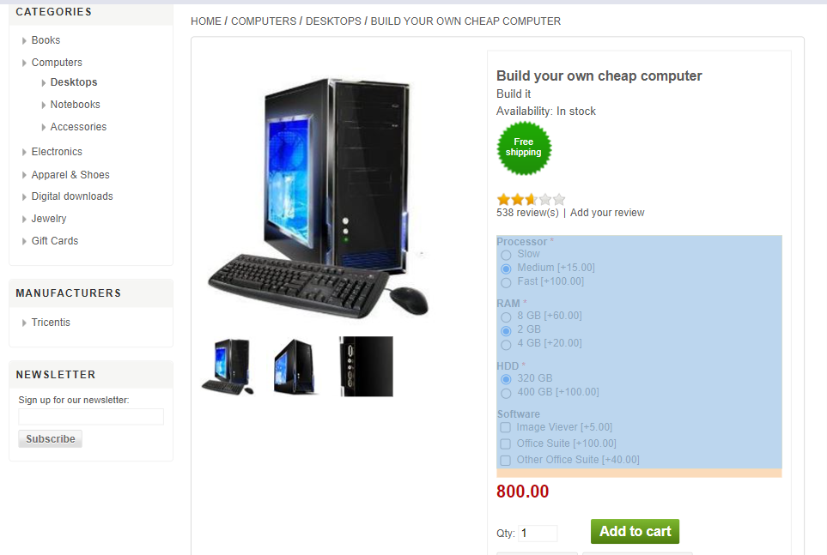
Results Observed:
Product title is "Build your own cheap computer" with stock status "In stock."
Product features and selected options are correct.
Product is successfully added to the cart with a confirmation message.

Slide 10
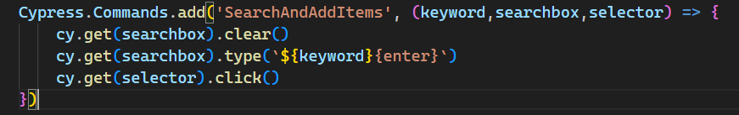
Test case: Cart Management
Objective: Test cart management functionalities including adding, removing items and updating the cart.
Steps:
Visit the URL: https://demowebshop.tricentis.com
Use the custom command cy.SearchAndAddItems() to add items to the cart.
Navigate to the shopping cart.
Validate the total number of items in the cart
Validate the total cart value.
Remove specific items from the cart.
Validate the updated total number of items and cart value.

Slide 11
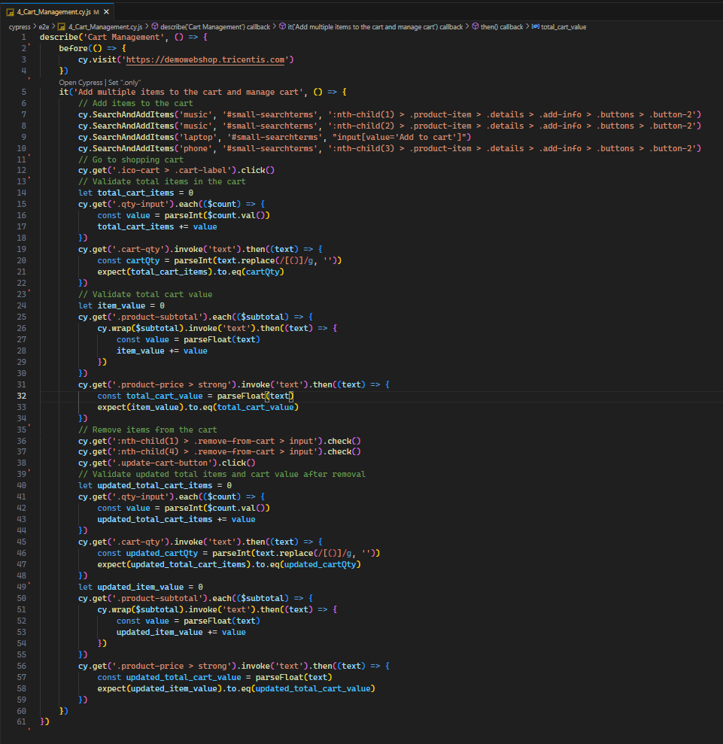
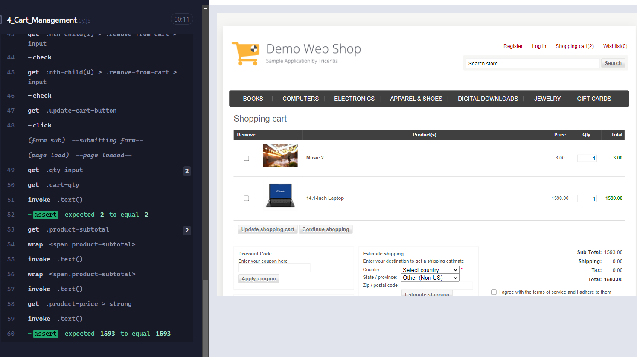
Results Observed:
Total items in the cart match the displayed quantity.
Total cart value matches the sum of the items' values.
Updated total items and cart value are correct after removing items.

Slide 12
Test Case: User Registration
Objective: Test user registration with valid inputs and invalid inputs for validation and registration.
Steps:
Visit the registration page https://demowebshop.tricentis.com/register
Enter valid details including username and password.
Submit the registration form.
Verify successful registration and user visibility in the account section.
Enter no details in the form and verify the errors are visible.

Slide 13
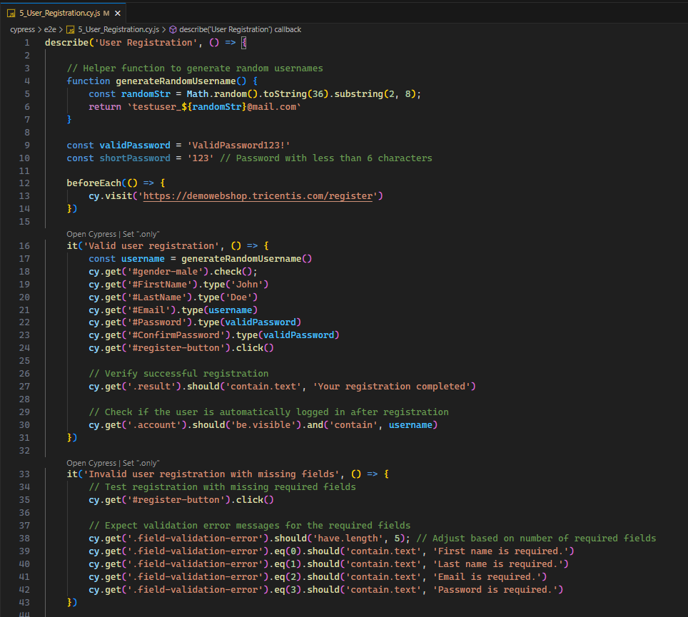
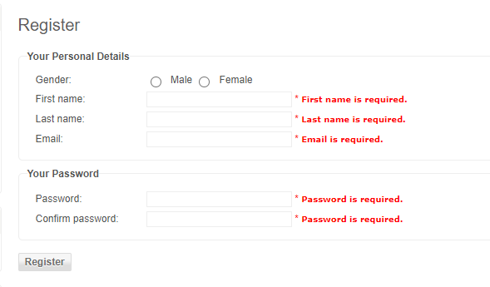
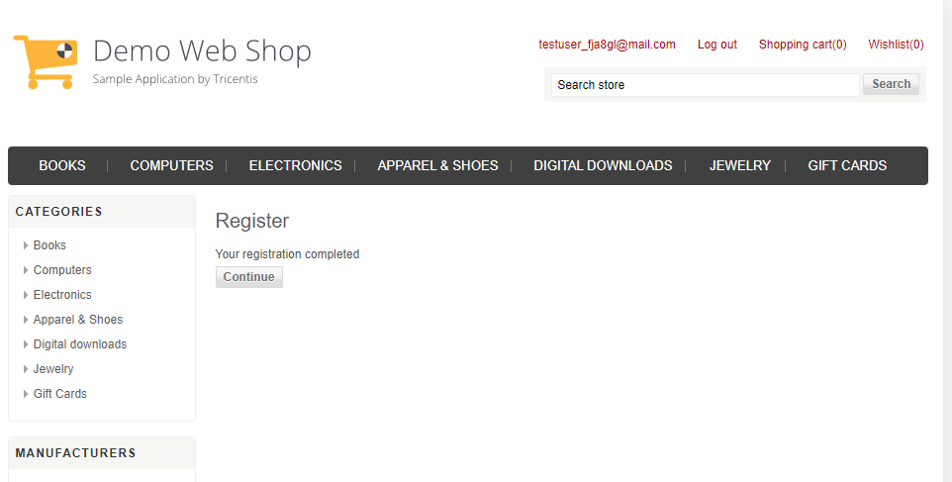
Results Observed:
Successful registration and confirmation message
Error messages for missing fields are displayed

Slide 14
Test Case: User Login/Logout
Objective: Test login and logout functionalities to ensure they work with both valid and invalid credentials.
Steps:
Visit the login page: https://demowebshop.tricentis.com/login
Enter valid credentials and login.
Verify successful login by checking user account details and the logout button.
Perform logout and verify success.
Attempt login with invalid credentials and verify the error message.
Re-login with valid credentials and verify successful login.

Slide 15
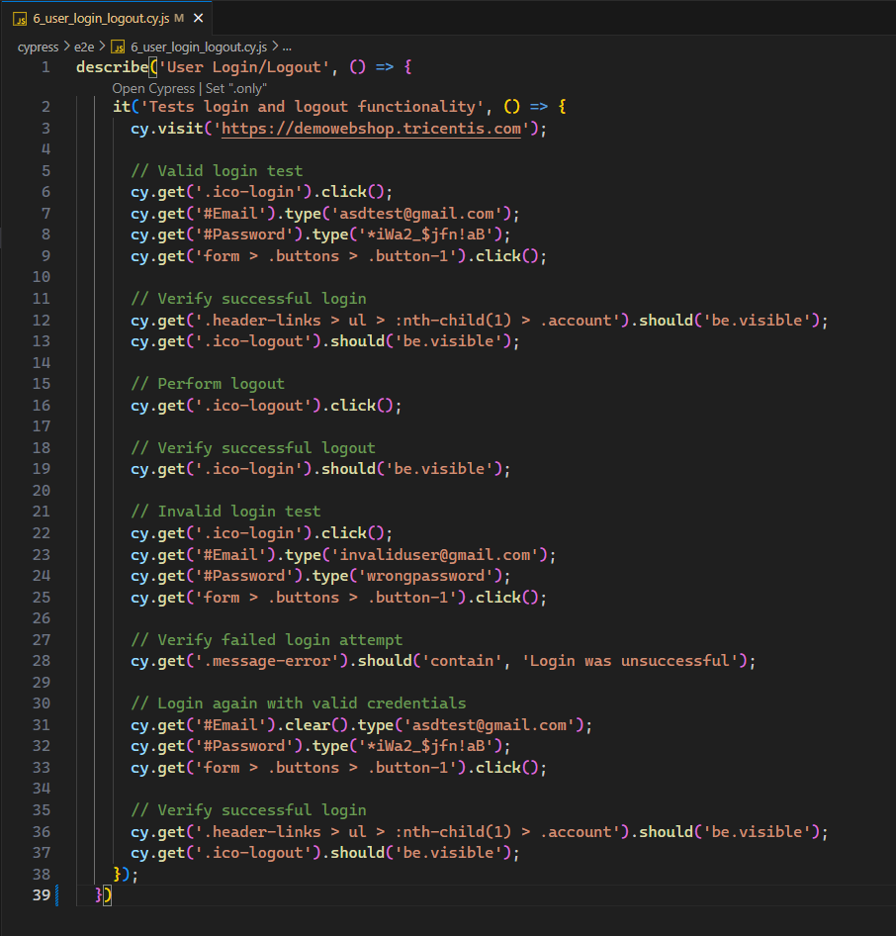
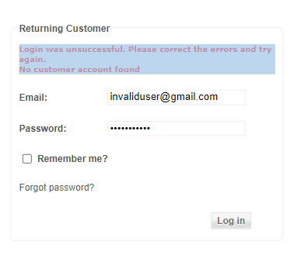
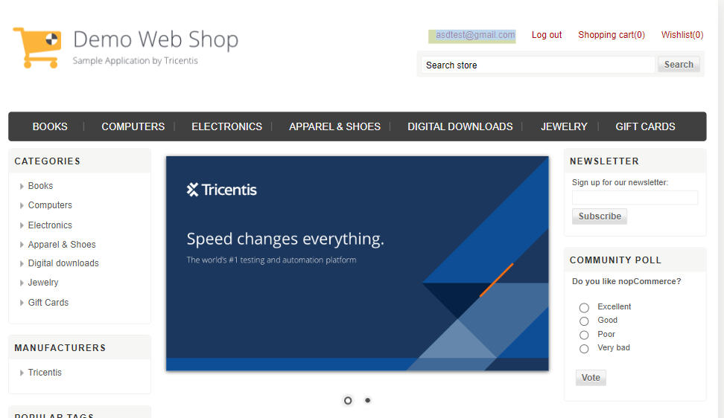
Results Observed:
Successful login and logout.
Error message for failed login attempt.
Successful login after a failed attempt.

Slide 16
Test Case: Cart Checkout
Objective: Test the checkout process, including order placement and confirmation.
Steps:
Visit the homepage: https://demowebshop.tricentis.com
Add multiple items to the cart using the custom command.
Log in with valid credentials.
Navigate to the cart and proceed to checkout.
Complete checkout steps, including billing, shipping, and payment.
Confirm the order and verify the order confirmation message.

Slide 17
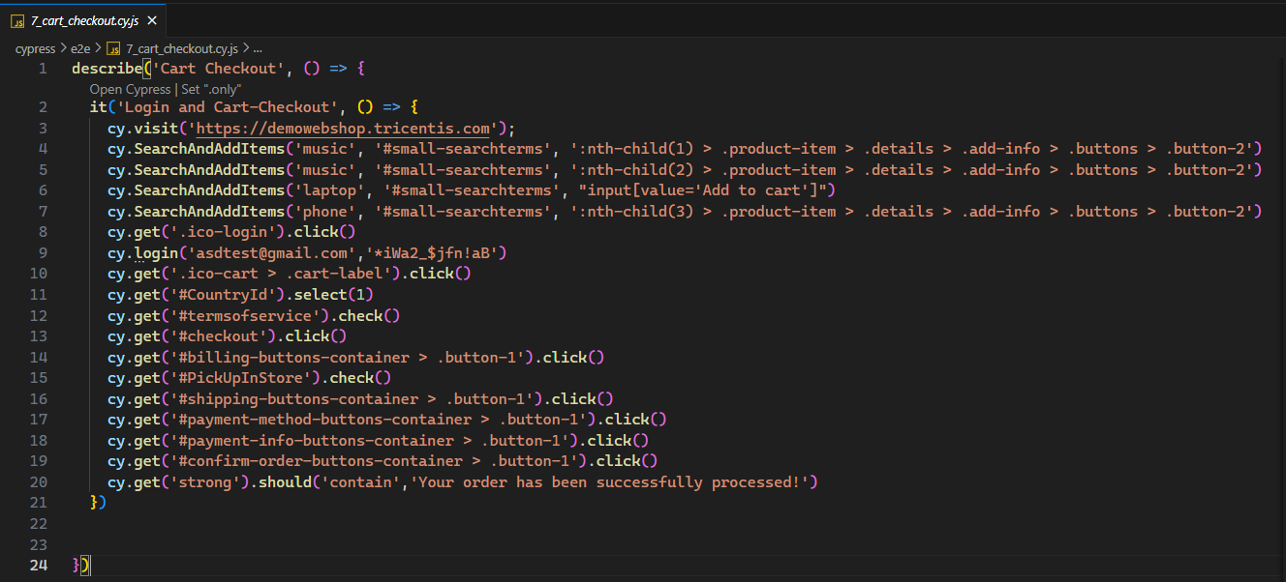
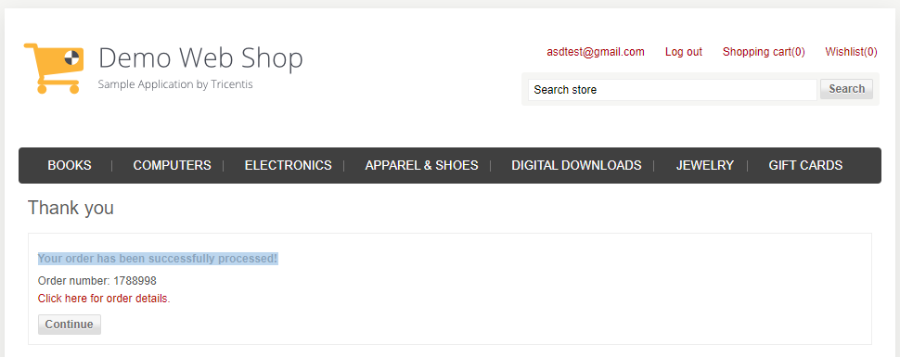
Results Observed:
Successful checkout with an order confirmation message.

Slide 18
Custom Commands
Objective: Simplify test scripts by creating reusable commands for common actions to improve maintainability and readability.
Steps:
Create a custom command using Cypress.Commands.add()
Implemented the command in the test scenarios to replace repetitive code. We created login and add to cart custom commands
Verify that the command performs as expected in different test cases.

Slide 19
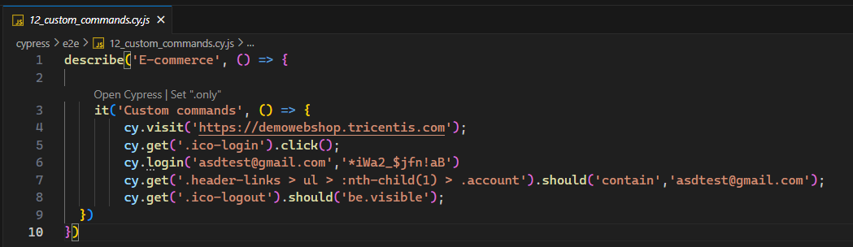
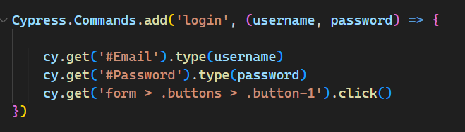
Results Observed:
The custom command executes the desired action correctly and consistently across different test scenarios.

Slide 20
Mocking and Stubbing
Objective:
Mock API Response with cy.intercept()
Steps and Results:
Navigate to Demowebshop homepage
Mock the API response for the login request using cy.intercept() with a status code of 200 and sample user data.
Simulate a user clicking the login button

Slide 21
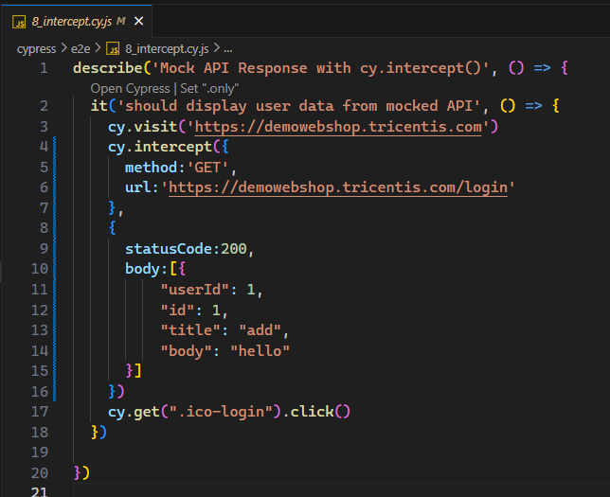
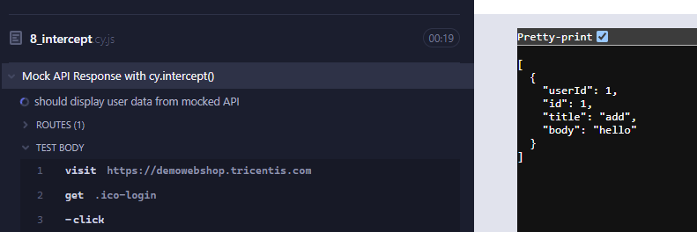
Results Observed:
The login request is intercepted successfully.
The mocked user data is returned.
The login process proceeds based on the mocked API response.

Slide 22
Handling Authentication
Objective: Manage authentication states efficiently within tests, and creating token for login credentials
Steps:
Store authentication tokens or credentials in localStorage.
Retrieved the tokens and simulate logged-in states in your tests.
Perform actions that require authentication and verify their success.
Ensure proper handling of login and logout scenarios.

Slide 23
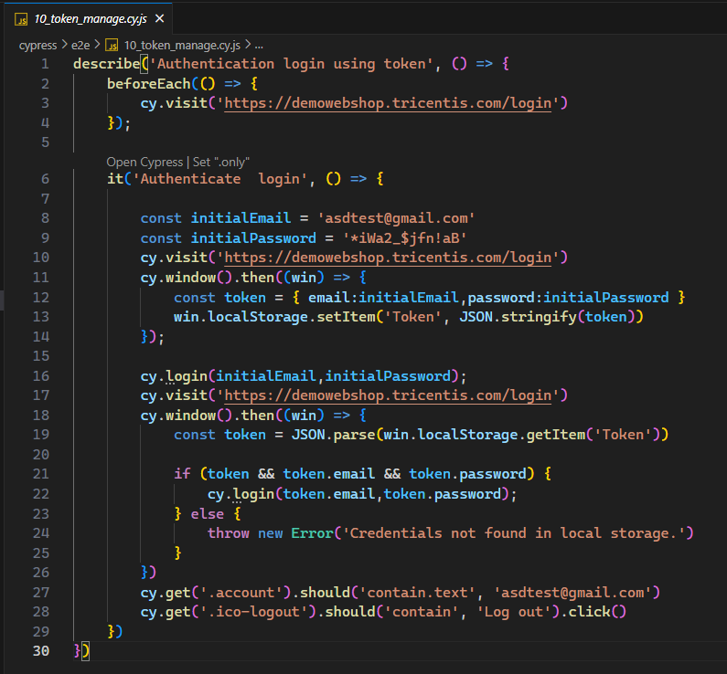
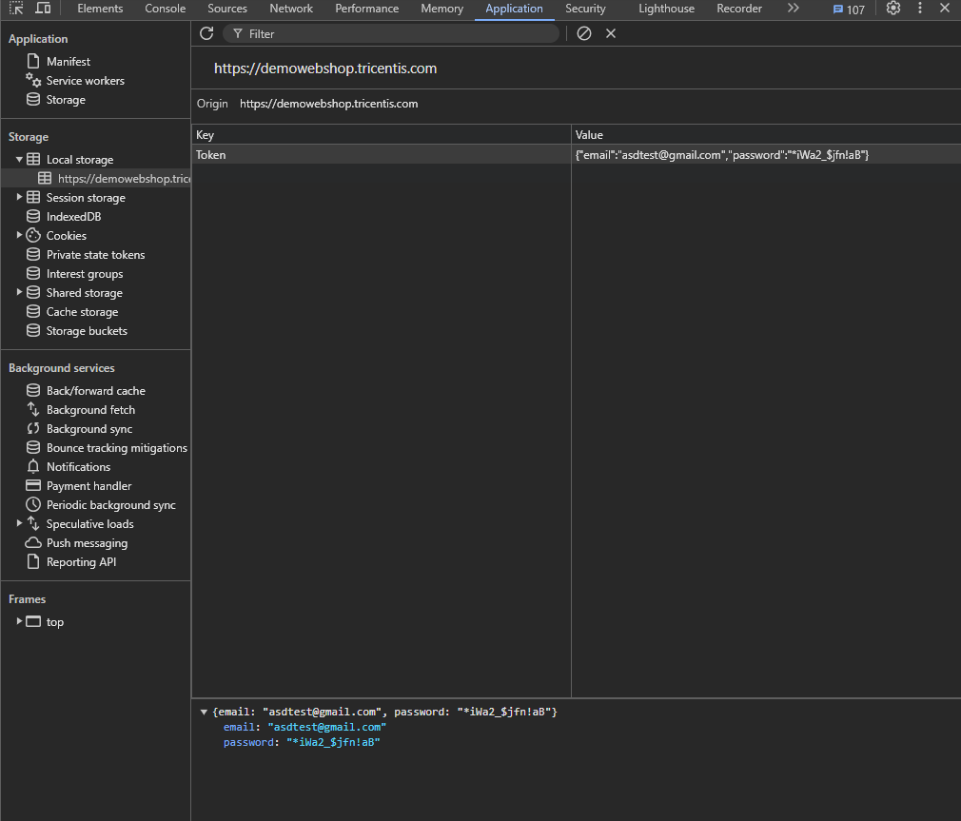
Results Observed:
The application should recognize the stored authentication state, allowing access to features that require login.

Slide 24
Data Management
Objective: Manage test data using fixtures to retrieve the data during test scenarios.
Steps:
Create fixture files with the required test data.
Load the fixture data using cy.fixture() in your tests.
Use the loaded data in various test scenarios.
Update fixtures as needed to accommodate changes in test requirements.

Slide 25
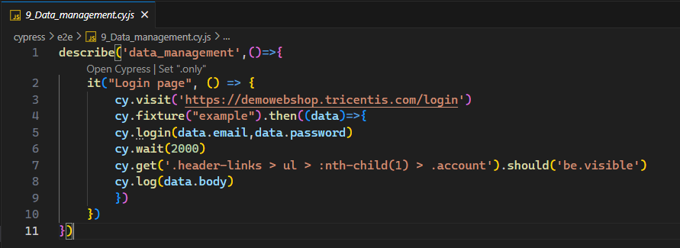
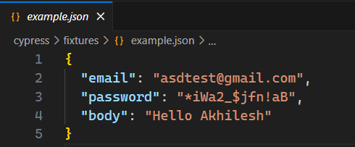
Results Observed:
Tests execute with consistent and reliable data provided by fixtures, ensuring repeatable and accurate test scenarios.

Slide 26
Visual Testing
Objective: Detect visual changes by comparing current screenshots with baseline images to ensure UI consistency.
Steps:
Capture screenshots of the application’s UI during test execution.
Compare these screenshots with baseline images using cypress-image-diff-js plugin.
Review any visual differences detected by the comparison tool.
Adjust baseline images if intentional changes are made to the UI.

Slide 27
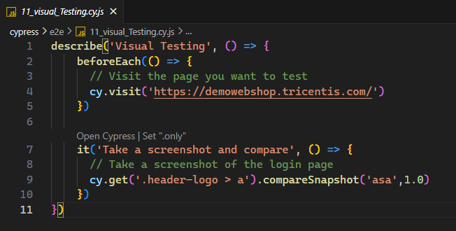
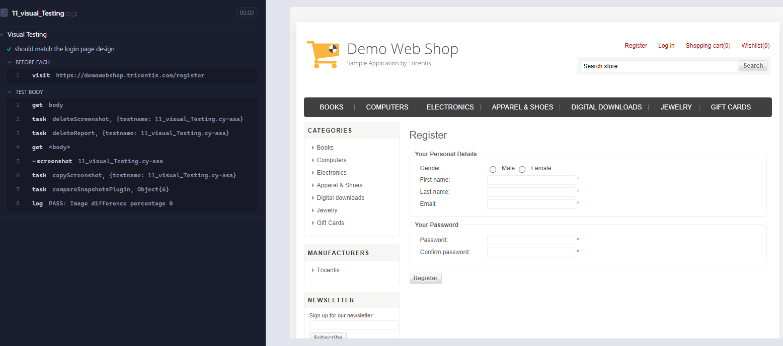
Results Observed:
The UI should match the baseline images within an acceptable threshold, indicating no unintended visual changes.

Slide 28
CI/CD pipeline using GitHub
Objective: Automate the execution of Cypress tests within a CI/CD pipeline to ensure tests are run with each code change and provide immediate feedback.
Steps:
Configured a CI/CD tool GitHub Actions to trigger Cypress tests on code commits or pull requests.
Monitor the pipeline for test execution results and address any issues that arise.
Review test reports and logs to ensure all tests pass successfully.

Slide 29
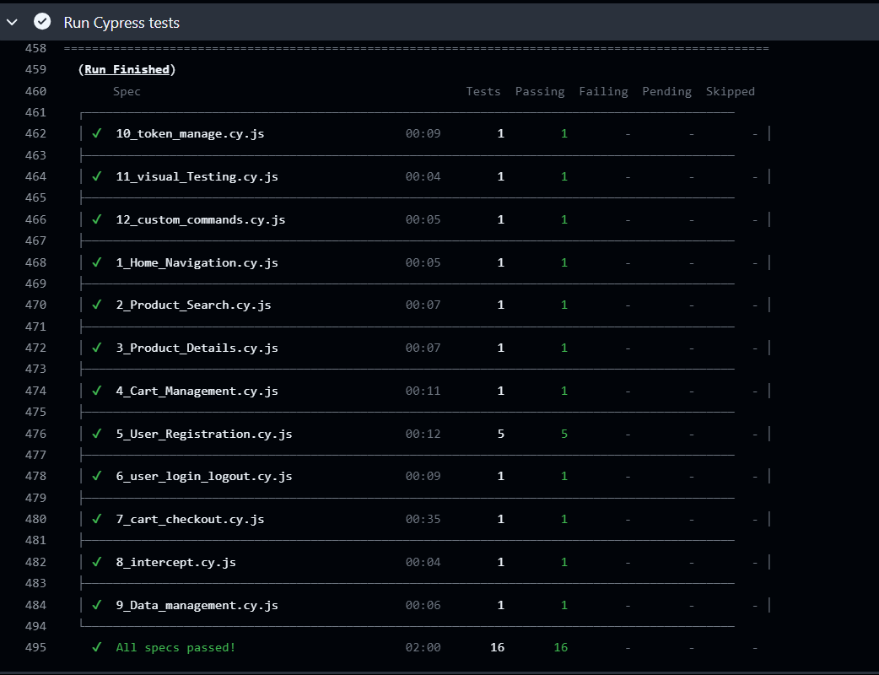
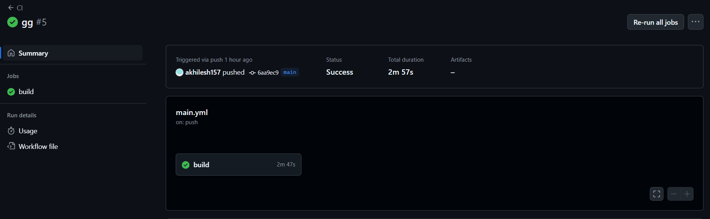
Results Observed:
Automated test execution on code changes, with results reported back to the CI/CD system for prompt issue detection.

Slide 30
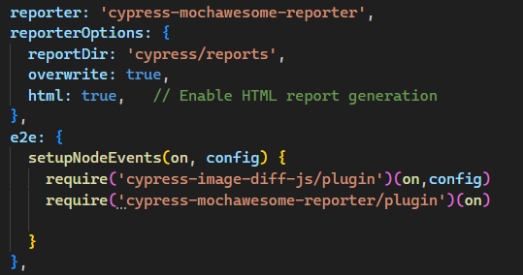
Reporting
Objective: Generate comprehensive test reports that provide insights into the results of test executions, and help in analysis and debugging.
Steps:
Configure Cypress to use a Mochawesome reporter for generating test reports.
Run tests to generate reports in the desired format (HTML or Json).
Review the reports to analyze test results and identify any issues.

Slide 31
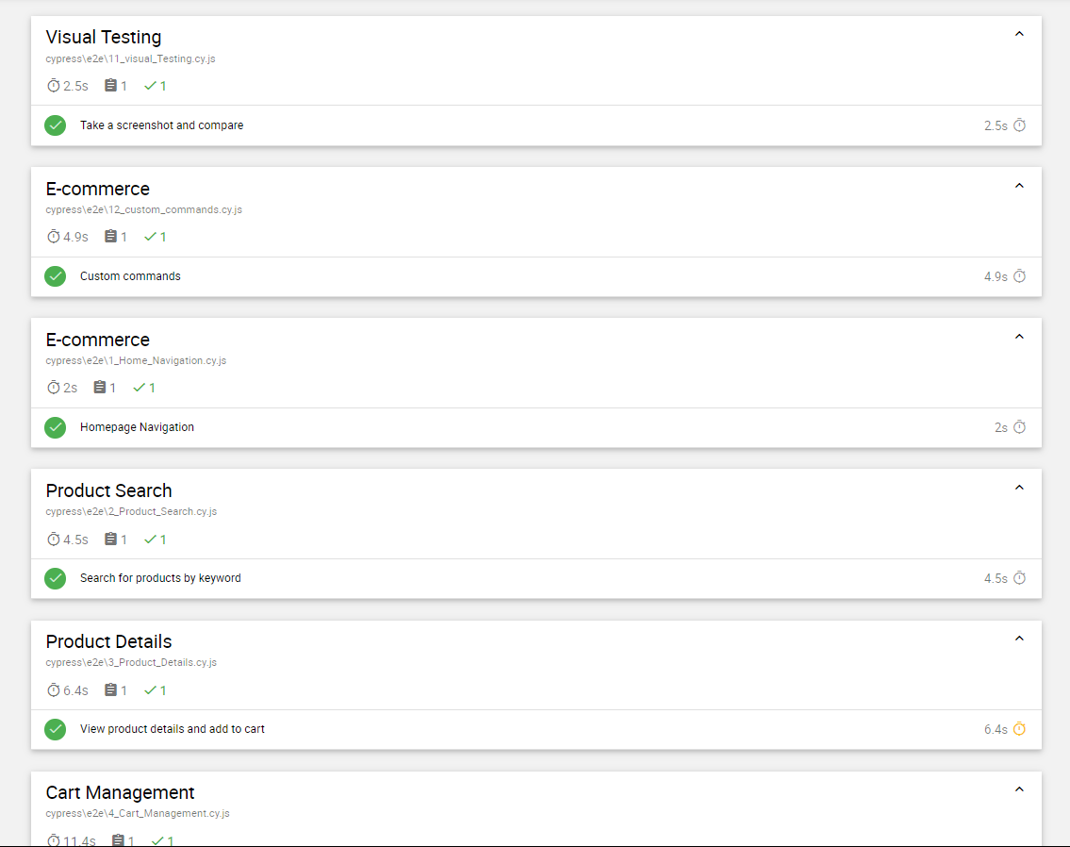
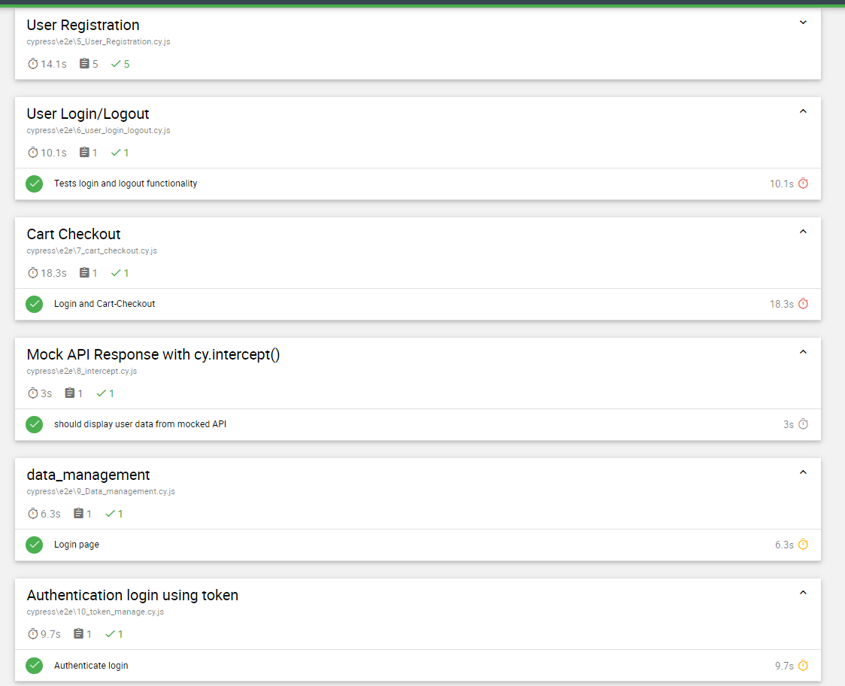
Results Observed:
Detailed test reports are generated, providing a clear summary of test execution and results.

Slide 32
Debugging
Objective: Create visual evidence of the application's state during test execution.
Steps:
Enable screenshot and video recording features in Cypress.
Capture screenshots and videos during test execution to provide visual context.
Review the captured evidence to diagnose test failures and issues.
Adjust tests or application code based on insights gained from the visual evidence.

Slide 33
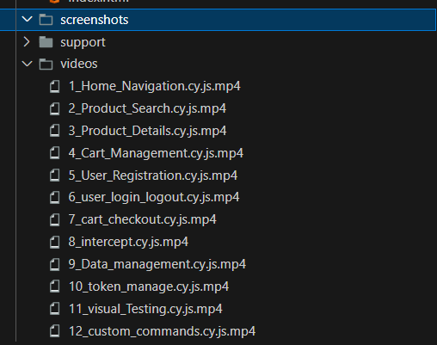

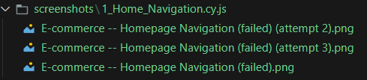
Results Observed:
Visual evidence is captured, providing context for diagnosing and addressing test failures effectively. *Note: Intentionally failed a test case to generate the Screenshots

Slide 34
Challenges and Solutions
Challenges Faced:
Secure Authentication
Test Data Management
CI/CD Integration
Managing Long and Repetitive Code
Debugging Failed Test Cases
Solutions:
Manage Dynamic Content: Implemented effective waits and retries to handle dynamic content variations.
Streamline Code: Applied custom commands to minimize repetitive code and improve maintainability.
Secure Authentication and Test Data Management: Used fixtures to ensure consistent test data handling and secure token storage.
CI/CD Integration: Automated testing and deployment through GitHub Actions, ensuring smooth integration with the CI/CD pipeline.
Enhance Debugging and Reporting: Captured visual evidence of application states during test execution and generated HTML reports to aid in debugging.

Slide 35
Future Aspects
Expanding Test Coverage:
Incorporate additional user scenarios and edge cases as the application evolves.
Improved Test Data Management:
Develop more test data and more complex fixtures to simulate various scenarios.
Parallel Test Execution:
Utilize parallel test execution to reduce test run times and speed up the execution

Slide 36
Conclusion
Created a end-to-end testing suite for MyDemoshop ensures that the application remains functional, reliable, and performant across various user scenarios. By addressing current challenges and planning for future improvements, we can enhance the quality of the testing process, adapt to evolving requirements, and deliver a better user experience. Effective use of testing tools, test management, and seamless integration with CI/CD pipelines will contribute to a successful and sustainable testing strategy.

Slide 37
Thank you

