Slide 1
DATA VIZ
Team member: Akhilesh T S
Email: tsakhilesh12@gmail.com
Phone: 9445769936

Slide 2
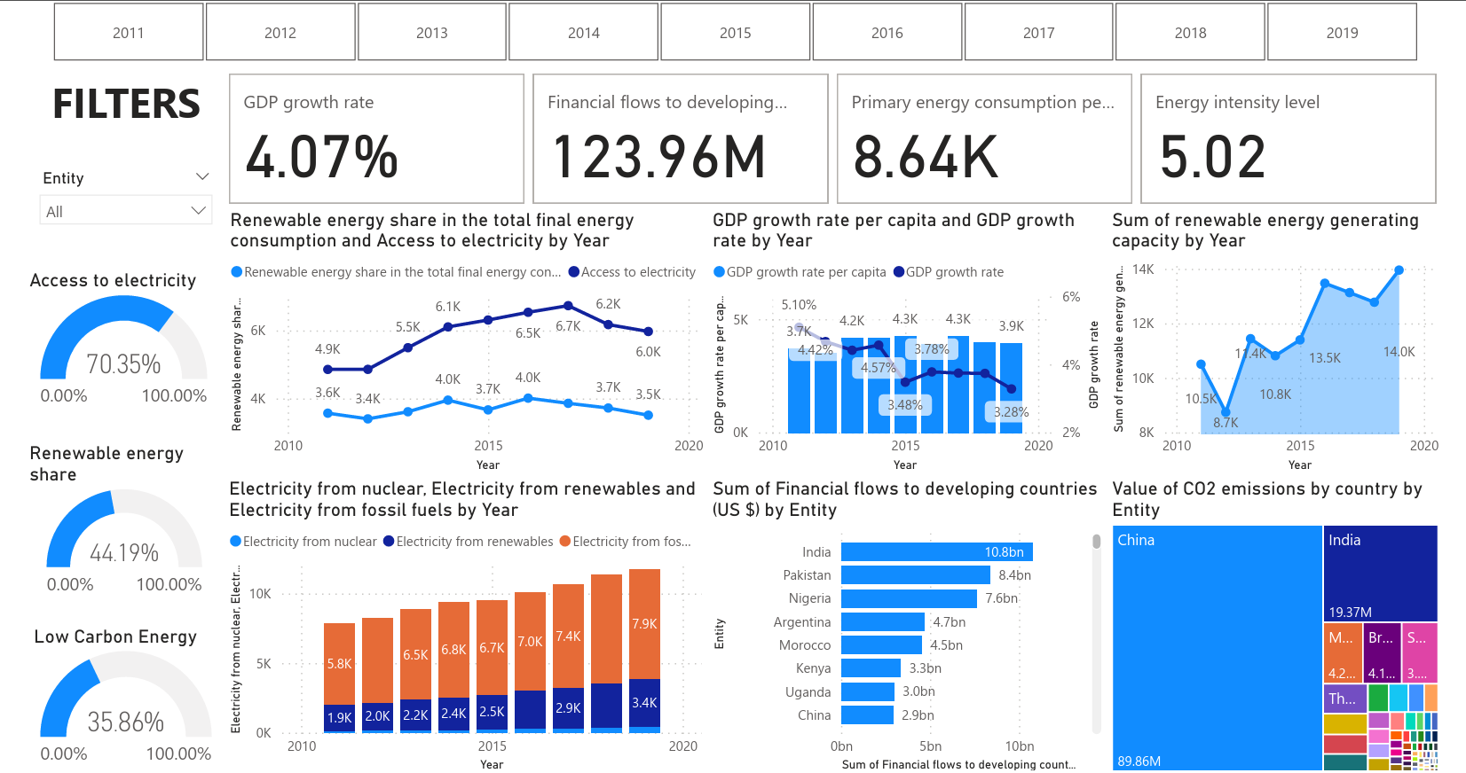

Slide 3
UNDERSTANDING THE DASHBOARD
Growth of renewable energy and access to electricity trends are studied using a line chart
Matrix representation showing the top countries in terms of GDP growth rate, access to electricity and renewable energy share.
Share of electricity from nuclear sources, renewables and fossil fuels is studied with stacked column chart
Financial flows into each country over the years is studied using stacked bar chart
CO2 emissions by each country is studied using tree map
Name cards representing GDP growth rate, primary energy consumption, financials flowing into the country and energy intensity is represented
Gauge meters representing Access to electricity, renewable energy share and low carbon energy is studied
Filters represented using Entity and years for specific visualisation

Slide 4
ANSWER TO PROBLEM A
The annual GDP growth rate for countries worldwide is at 4.07%.
Access to electricity is widespread, with around 70.35% of the global population having reliable access.
Renewable energy resources collectively contribute to a share of 44.19% in the global energy mix.
A significant portion, specifically 35.86%, of the total energy sources is derived from low carbon energy production.
China stands out as the leading contributor to CO2 emissions, necessitating focused efforts to reduce its environmental impact.

Slide 5
ANSWER TO PROBLEM B
Ethiopia boasts the highest GDP growth rate globally, averaging an impressive 9.47%.
Antigua and Barbuda, Barbados, and Uzbekistan have achieved universal access to electricity, ensuring 100% coverage for their populations.
Somalia takes the lead in renewable energy share, averaging an impressive 94.83% in its energy composition.
Among developed countries, India stands out with the highest financial flows.

