Slide 1

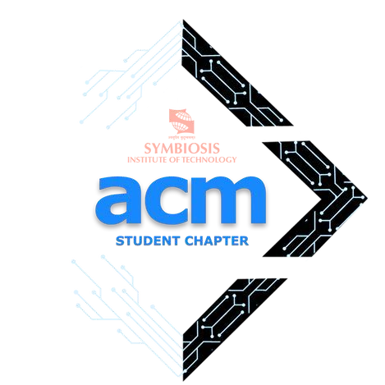


TECHVORTEX 2.0
Team Name & Members: The Qubits - Akhilesh T S

Slide 2
TELL US ABOUT YOURSELF
⚬ Student of SASTRA University currently pursuing 4th year
⚬ Secured 3rd place in TATA Communications Hackathon
⚬ Won several competitions involving Data analysis and Machine Learning

Slide 3
Selected Problem Statement
Domain Chosen: AI/ML and Cyber Security
⚬ The increasing frequency of zero-day exploits and ransomware attacks highlights the need for advanced detection methods that can quickly adapt to new, unseen threats.
⚬ Traditional security systems often fail to identify evolving threats in real time, making it essential to develop AI-driven systems capable of continuous, real-time network traffic monitoring.
⚬ Capturing crucial details such as IP addresses, communication protocols, and metadata from network traffic is critical for detecting abnormal behavior indicative of malicious activity.

Slide 4
Tech Stack
⚬ Streamlit: Web-based user interface framework for easy interaction and
visualization.
⚬ Pandas: Data manipulation and analysis for handling CSV files.
⚬ Joblib: Model serialization/deserialization for loading the pre-trained ML
model.
⚬ Matplotlib: Data visualization to generate pie charts for attack statistics.
⚬ Machine Learning (RandomForest Classifier: Pre-trained model (likely classification-based) used to predict intrusions from processed data.

Slide 5
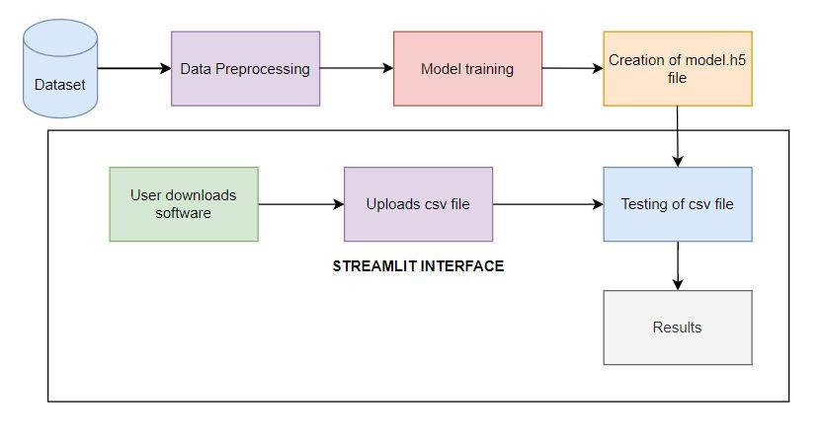
Detailed Description of the Solution

Slide 6
How is your solution different?
⚬ Real-Time Intrusion Detection: The system processes network traffic data from CSV files and detects intrusions in real-time using a machine learning model.
⚬ Pre-trained models analyze uploaded data for abnormal patterns or malicious activities, classifying records as either normal or attack traffic.
⚬ Provides clear insights into detected threats, including the percentage of attack traffic and specific samples of detected intrusions.
⚬ Utilizes graphical visualizations (like pie charts) to help users quickly understand the proportion of normal traffic versus attacks.

Slide 7
Future Possible Enhancements
⚬ Real-Time Data Streaming: Implement real-time data processing to detect and respond to intrusions as they occur.
⚬ Advanced Data Visualization: Enhance visualizations with additional tools like heatmaps and time-series plots for deeper analysis of attack patterns.
⚬ Model Performance Monitoring: Include features to track and display model performance metrics and support periodic model updates.
⚬ User Authentication and Access Control: Introduce user authentication and
role-based access control to secure the application and manage user permissions effectively.

Slide 8
Risks/ Challenges / Dependencies
⚬ Data Quality and Integrity: Ensuring that the uploaded CSV files are correctly formatted, complete, and free from errors is crucial for accurate detection and analysis.
⚬ Model Accuracy and Performance: The effectiveness of intrusion detection heavily depends on the quality and performance of the machine learning model. Regular updates and validation are needed to maintain accuracy.
⚬ Real-Time Processing Challenges: Implementing real-time data streaming and analysis can be complex and resource-intensive, requiring robust infrastructure and efficient algorithms.
⚬ Security and Privacy Concerns: Handling sensitive data and ensuring the application’s security against potential attacks or unauthorized access is essential to protect user data and system integrity.

Slide 9
Acceptance Criteria Coverage
How many aspects of the problem statement have
been covered?
⚬ AI/ML
⚬ Cyber Security

Slide 10
Result Analysis
⚬ Random Forest Classifier used that predicts approximately 99% accuracy
⚬ Scalable system with more different types of attacks
⚬ F1-score, ROC AUC curve and other metrics generate good results with respect to the Intrusion Detection System

Slide 11
Key Contributions
⚬ Interactive Web Interface: Provides a user-friendly interface via Streamlit for easy data upload, processing, and visualization, making intrusion detection accessible even to non-technical users.
⚬ Automated Intrusion Detection: Utilizes a pre-trained machine learning model to automatically analyze network traffic and detect potential security threats, reducing the need for manual inspection.
⚬ Real-Time Threat Visualization: Incorporates visual tools, such as pie charts, to clearly present the results of intrusion detection, helping users quickly understand the nature and extent of potential attacks.
⚬ Customizable and Extensible Framework: Offers a modular and flexible framework that can be extended with real-time data processing, additional visualizations, and advanced model management, supporting future enhancements and adaptability.

Slide 12
Conclusion
⚬ Effective Threat Detection: The implemented IDS successfully utilizes real-time network traffic monitoring and AI-driven algorithms to accurately detect and differentiate between benign and malicious activities, addressing the challenge of zero-day attacks and ransomware.
⚬ Real-Time Performance: The system demonstrates efficient performance in detecting threats with low latency, ensuring timely identification and mitigation of potential security breaches.
⚬ Visual and Metric Insights: The Streamlit interface provides clear visualizations and metrics, such as accuracy, precision, and ROC curves, facilitating a comprehensive understanding of the system’s performance and areas for improvement.
⚬ User Feedback Integration: By incorporating user feedback, the project ensures that the system remains adaptable and responsive to real-world needs, paving the way for continuous enhancement and effectiveness in evolving threat landscapes.

Slide 13
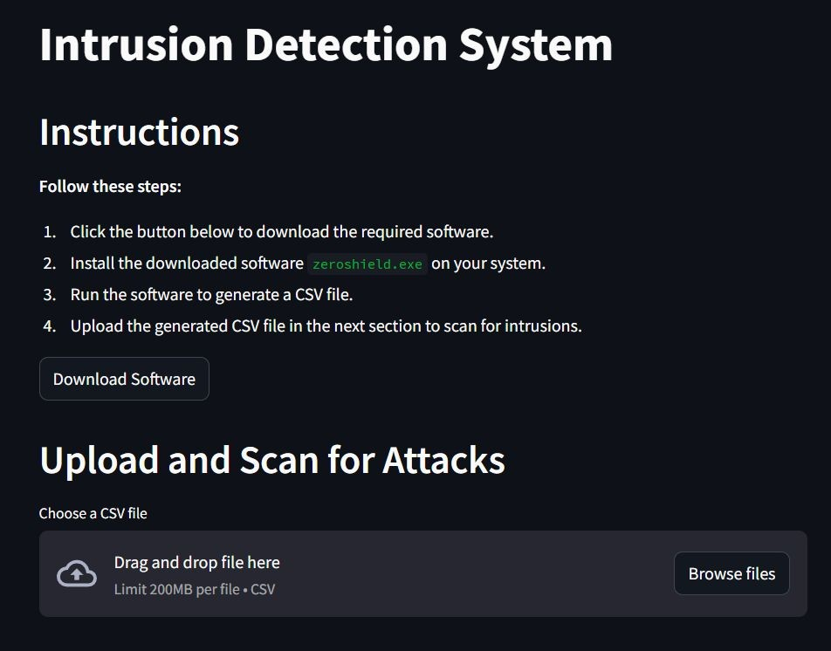
Anything Else ?
⚬ Github link: https://github.com/akhilesh1709/Intrusion-detection-system

Slide 14
User Interface

