Slide 1
Insights hr analytics
Akhilesh T S
SASTRA University
B.Tech CSE core

Slide 2
Contents
About Data
Goals/ Business Questions
Python Analysis
Conclusion
Recommendation

Slide 3
About Data
Data : Messages dataset with 3513 rows and 4 columns. Employees dataset with 665 rows and 4 columns.
The data comprises messages exchanged among employees and the respective departments in which they are employed.
DATASET source: https://unstop.com/hackathons/insights-x-egs-pillay-engineering-college-910034

Slide 4
Goals/ Business Questions
Which departments are the most active?
Which employee has the highest number of connections?
Who are the most influential employees and departments?
Which departments should focus on efforts for enhanced collaboration

Slide 5

ANALYSIS BY PYTHON

Slide 6
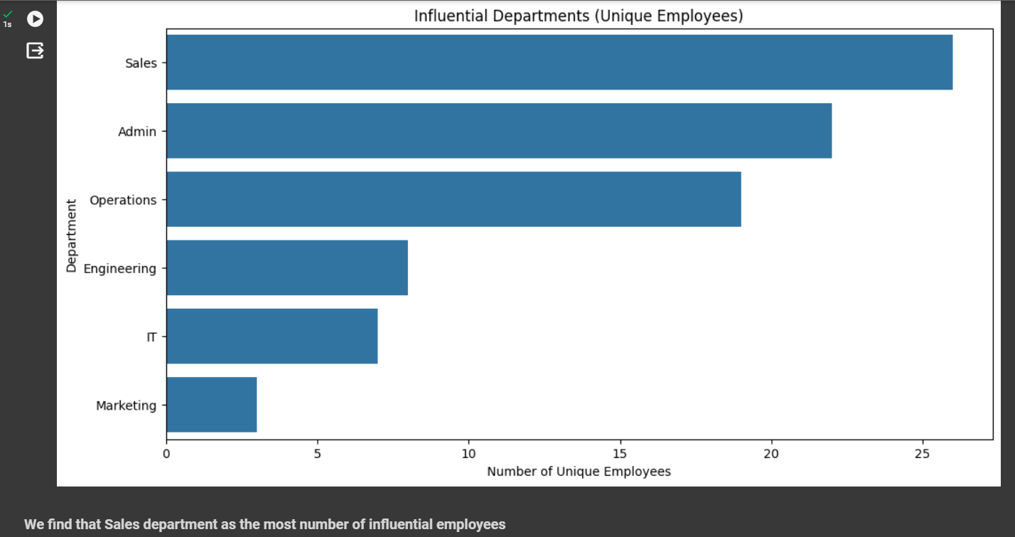
The most common shipping mode preferred is Standard Class as the price for shipping is low and most of the times is takes the same time as second class and sometimes it is also delivered on the same day.

Slide 7
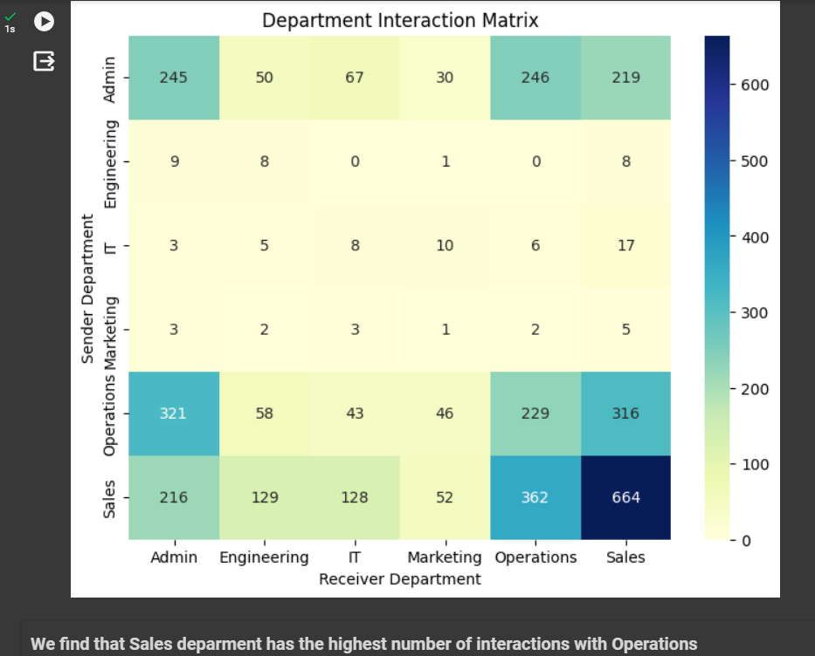

Slide 8
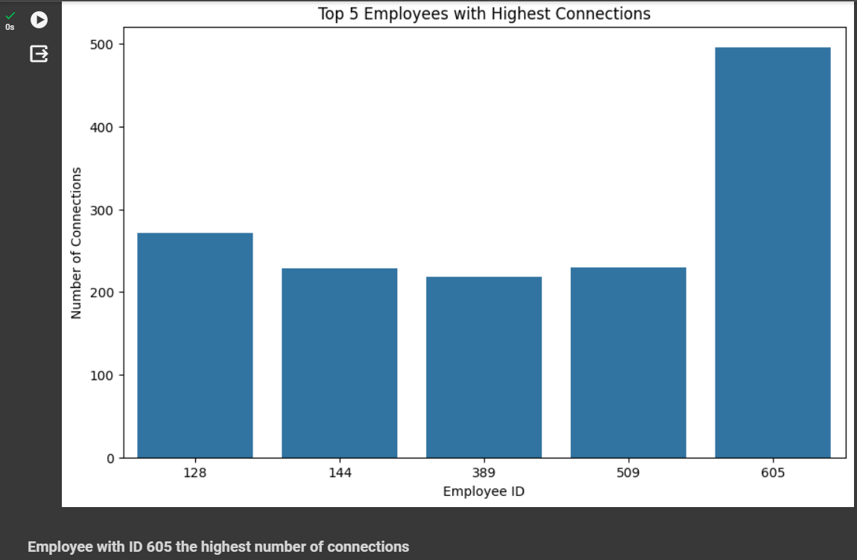

Slide 9
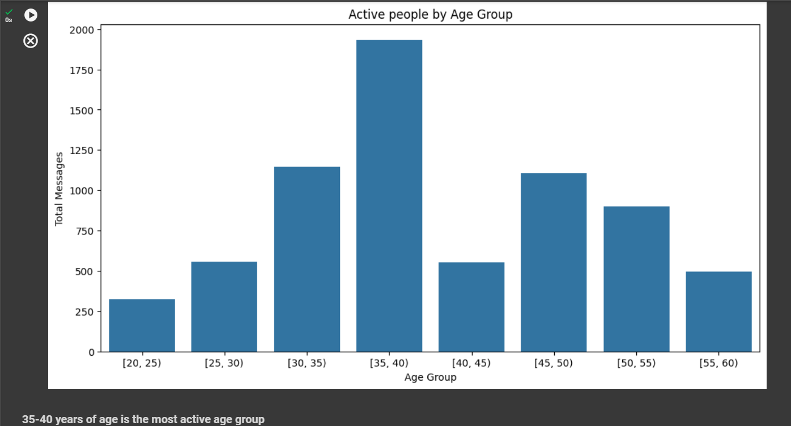

Slide 10
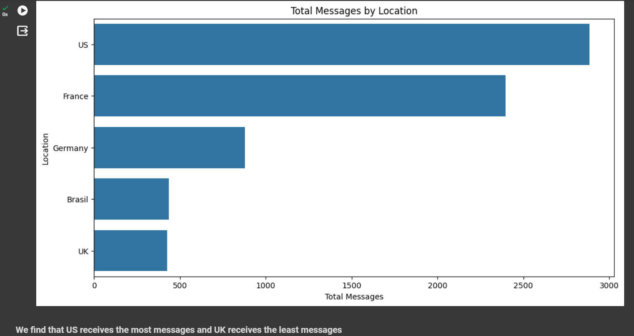

Slide 11
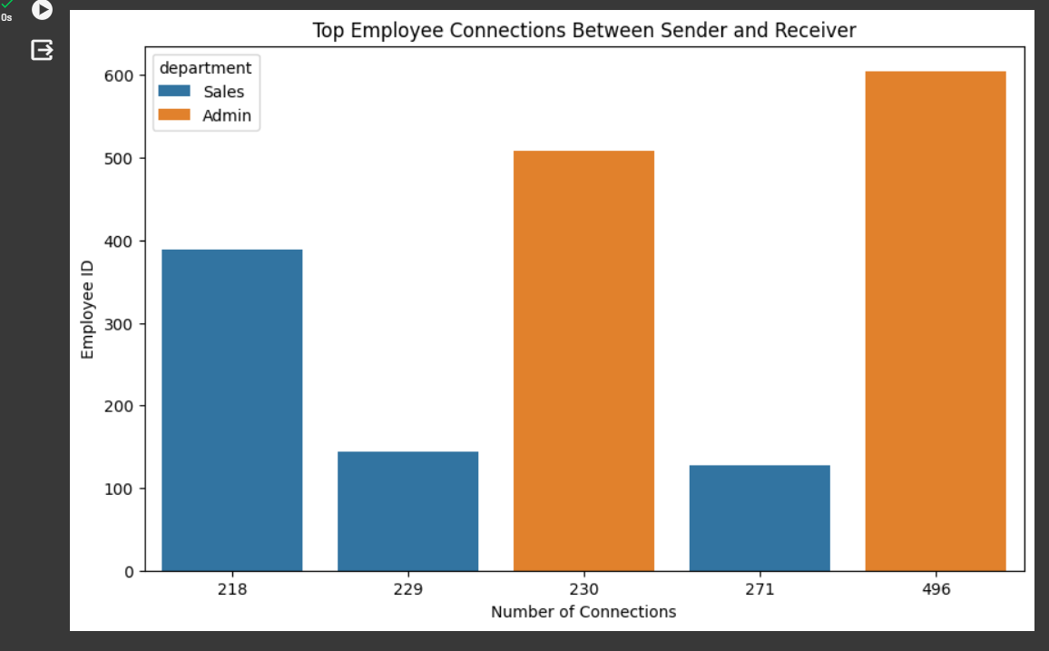

Slide 12
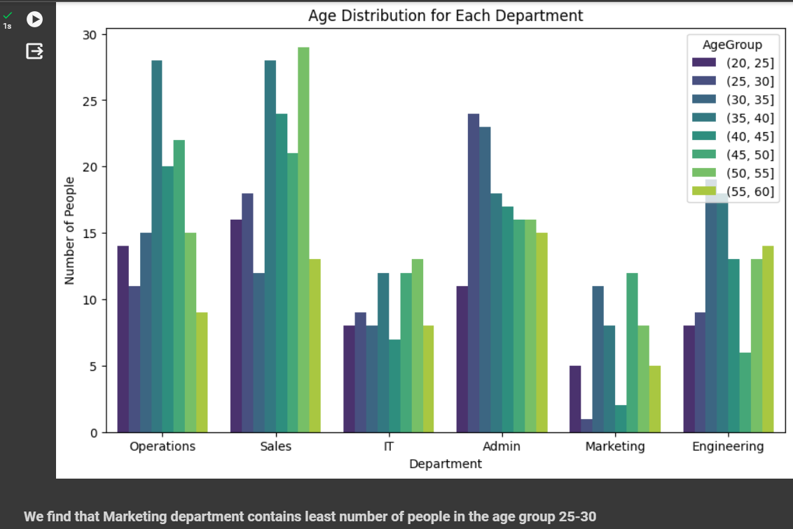

Slide 13
Conclusions
Sales has influential employees.
Sales engages most, especially with Operations.
Employee 605 has the most connections.
The U.S. leads in message flow.
Admin has top connections, closely followed by Sales.
7-8 am is the peak communication time.

Slide 14
Recommendations
Boost Marketing department interaction by implementing targeted engagement strategies.
Diversify age groups in Marketing for a more dynamic team.
Increase overall involvement of Marketing professionals through collaborative initiatives.
Address Brazil's uneven departmental distribution with strategic workforce planning.

