Slide 1

BOSTON HOUSING CASE STUDY
SUREDDI AKHILESH
M14828693
7047-002

Slide 2
PROBLEM STATEMENT
Do we know what the best machine learning algorithm out there is ?
It is always dependent on how you tune your model and how your data reacts to it.
Goal of the case study was to apply 7 different machine learning methods learned in the course to the data of Boston Housing and compare the results to see which fares better in this case.

Slide 3
SUMMARY
LINEAR REGRESSION: Assumption of linear relationship (turned out to be the worst model even with variable selection).
REGRESSION TREE: Nonlinear modeling . Better than regression model.
RANDOM FOREST: Reducing variance . Lead to overfitting with very low in sample MSE.
BOOSTING: Initial in sample MSE was 0.04. Had to reduce the number of tress for better MSPE.
GENERALIZED ADDITIVE MODEL: Another non-linear model . Did better than regression trees.
K-NEAREST NEIGHBOURS: Close to regression trees and linear regression.
NEURAL NETWORKS: Most complex model. Performed better as expected.

Slide 4
RESULTS TABLE
METHOD | IN SAMPLE MSE | OUT OF SAMPLE MSPE
NEURAL NETWORKS | 4.95 | 8.38
BOOSTING | 1.51 | 12.90
RANDOM FOREST | 2.26 | 16.98
GENERALIZED ADDITIVE MODEL | 7.56 | 17.18
K-NEAREST NEIGHBOURS | 25.65 | 25.64
REGRESSION TREE | 16.16 | 25.83
LINEAR REGRESSION | 20.52 | 31.11

Slide 5
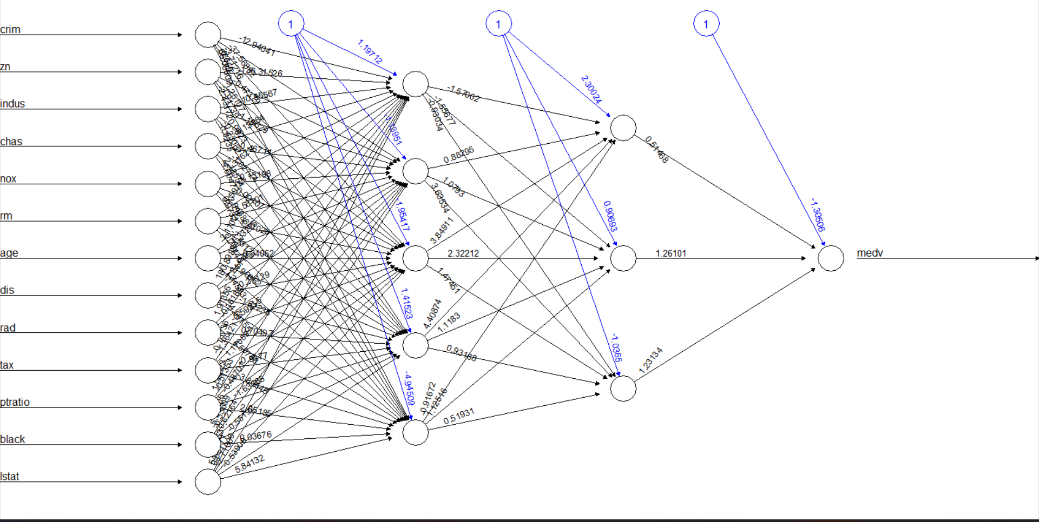
RECOMMENDATION
Within this entire process, my best model turned out to be Neural Networks with the lowest out of sample MSPE of 8.38
Since neural networks are black box models, we cannot interpret the figure in anyway to better solve this
There are other tuning parameters available though

Slide 6
DISCUSSION
Our study builds upon previous research that has explored the use of machine learning algorithms, such as linear regression and random forests, to model the Boston Housing dataset.
However, we argue that these approaches may not fully capture the complex and non-linear relationships between the housing prices and the various features of the dataset.
To address this, we propose using neural networks as our modeling approach, which have been shown to outperform other methods in previous studies (Kandasamy and Avila, 2016).
We will also incorporate regularization techniques, such as dropout and weight decay, to prevent overfitting and improve generalization performance.
References:
Kandasamy, S. and Avila, L. (2016). Neural networks for the prediction of housing prices using the Boston Housing dataset. International Journal of Computer Science and Information Security, 14(12), 814-821.
Harrison D. and Rubinfeld D. (1978), “Hedonic Housing Prices and the Demand for Clean Air,” Journal of Environmental Economics and Management, Volume 5, Issue 1, Pages 81-102.
Breiman, L. (2001). Random forests. Machine Learning, 45(1), 5-32.

