Slide 1


EXPLAINABLE AI-BASED
DIABETIC RETINOPATHY SCREENING IN RURAL AREAS
Robust retinal image analysis for rural telemedicine
Python • Deep Learning • Computer Vision • Simulink
Team name:- CODEX
Team Members:-
1.Akhilesh
2.Karthik K M

Slide 2
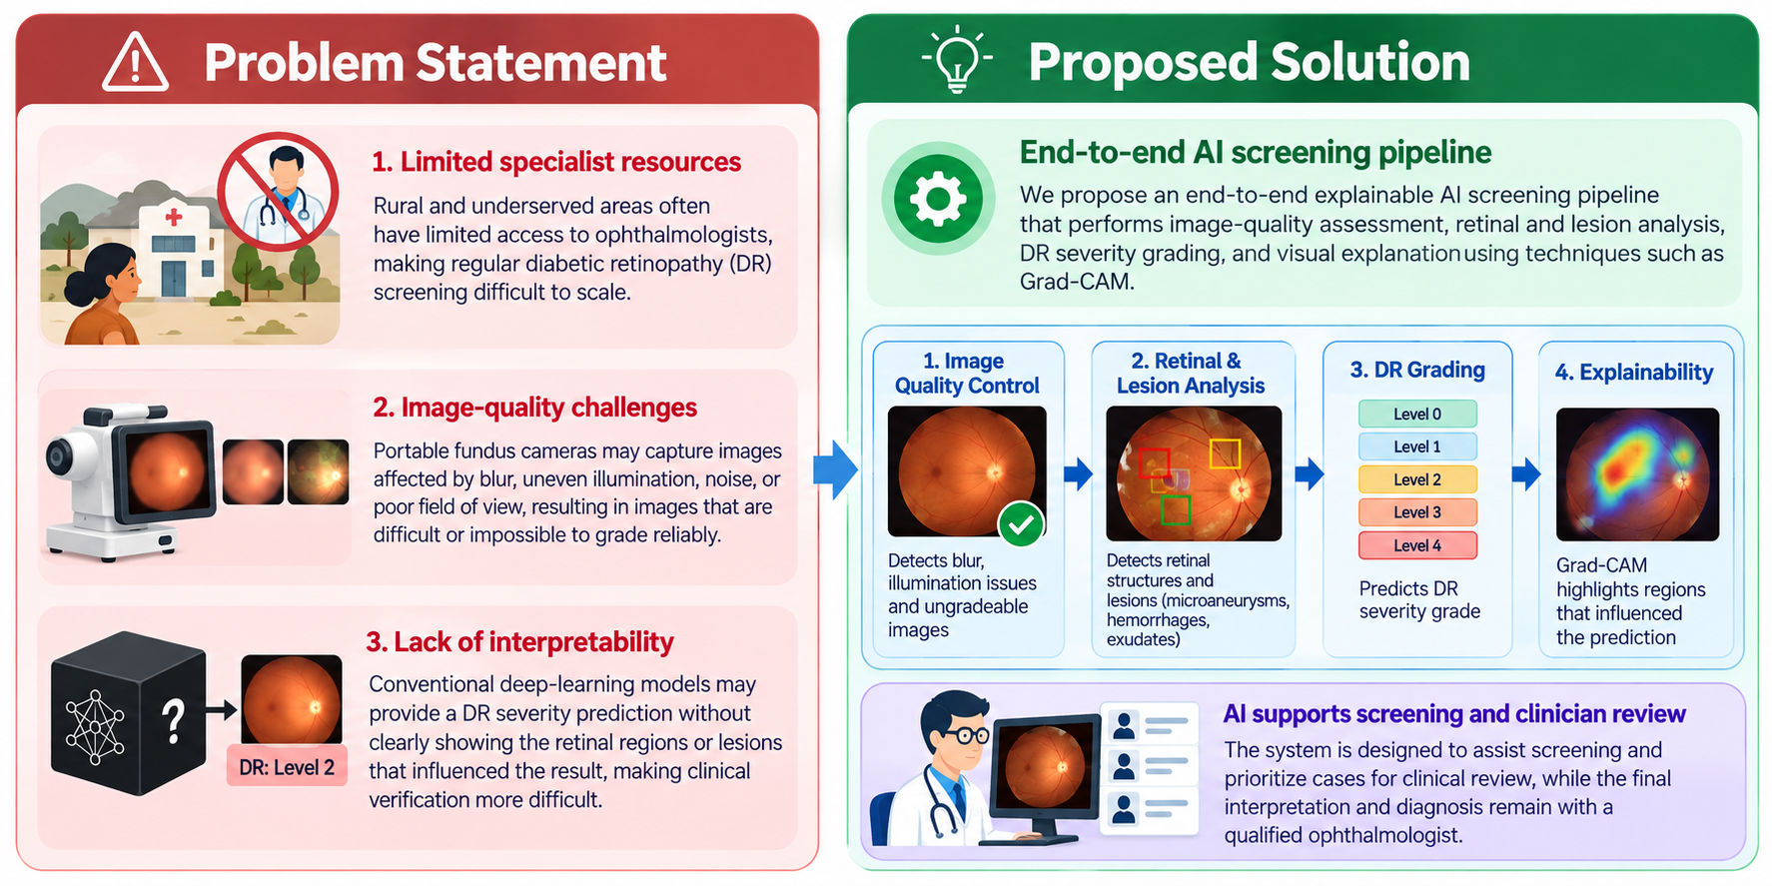
Problem & Proposed Solution
• Rural DR screening is difficult to scale because specialist ophthalmology resources are limited.
• Portable fundus cameras can produce blurred, poorly illuminated or otherwise ungradeable images.
• Black-box predictions are difficult for clinicians to validate quickly.
• Proposed solution: an end-to-end AI screening pipeline with quality control, retinal/lesion analysis, DR grading and explainability.
• AI supports screening and clinician review; it is not presented as an autonomous diagnosis.

Slide 3
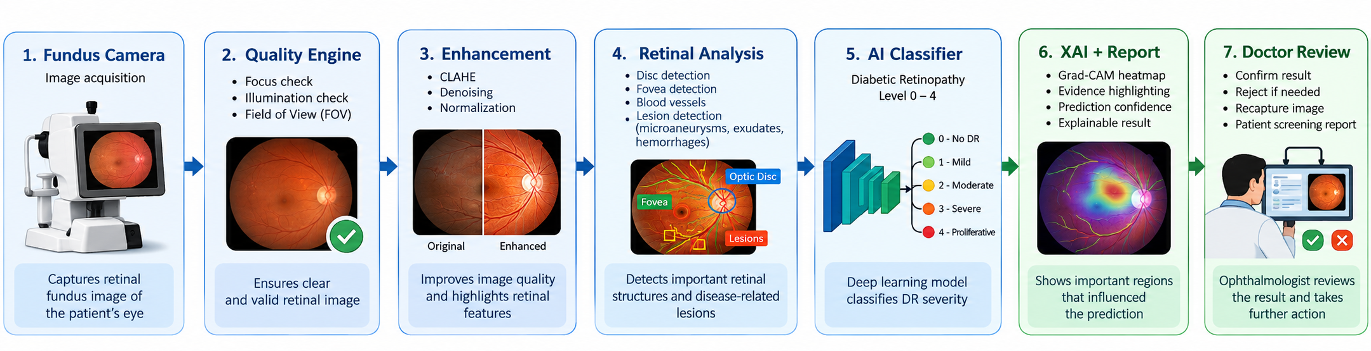
System Architecture
Fundus Camera
Quality Engine
Enhancement
Retinal Analysis
AI Classifier
XAI + Report
Doctor Review
Image acquisition
Focus • Illumination • FOV
CLAHE • Denoising • Normalization
Disc • Fovea • Vessels • Lesions
DR Level 0–4
Grad-CAM • Evidence • Confidence
Confirm • Reject • Recapture
Python AI pipeline + MATLAB image processing + Simulink deployment/resource simulation

Slide 4
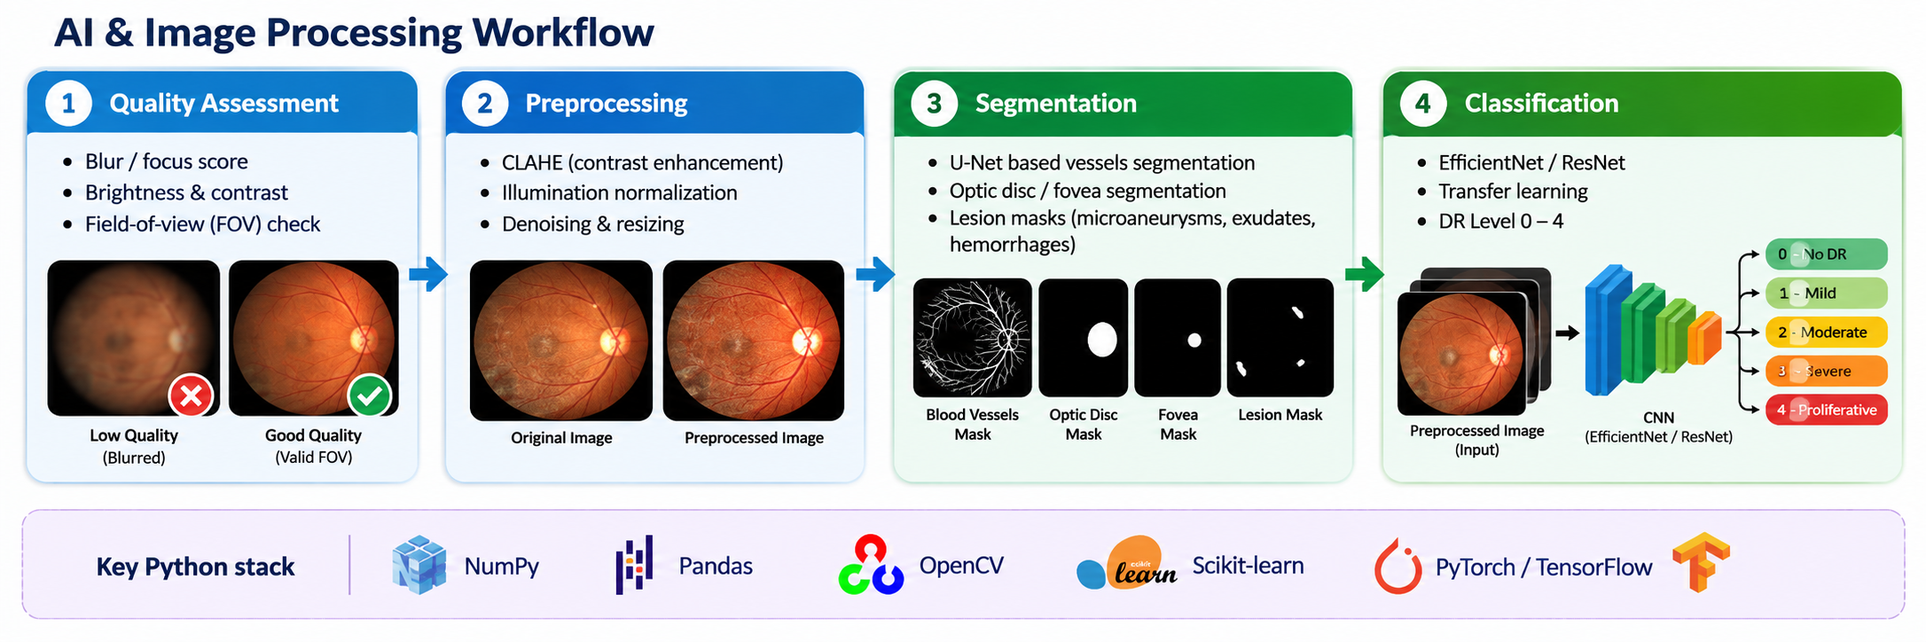
AI & Image Processing Workflow
Quality Assessment
Preprocessing
Segmentation
Classification
Blur/focus score
Brightness & contrast
Field-of-view check
CLAHE
Illumination normalization
Denoising & resizing
U-Net based vessels
Optic disc / fovea
Lesion masks
EfficientNet / ResNet
Transfer learning
DR Level 0–4
Key Python stack
NumPy • Pandas • OpenCV • Scikit-learn • PyTorch/TensorFlow

Slide 5
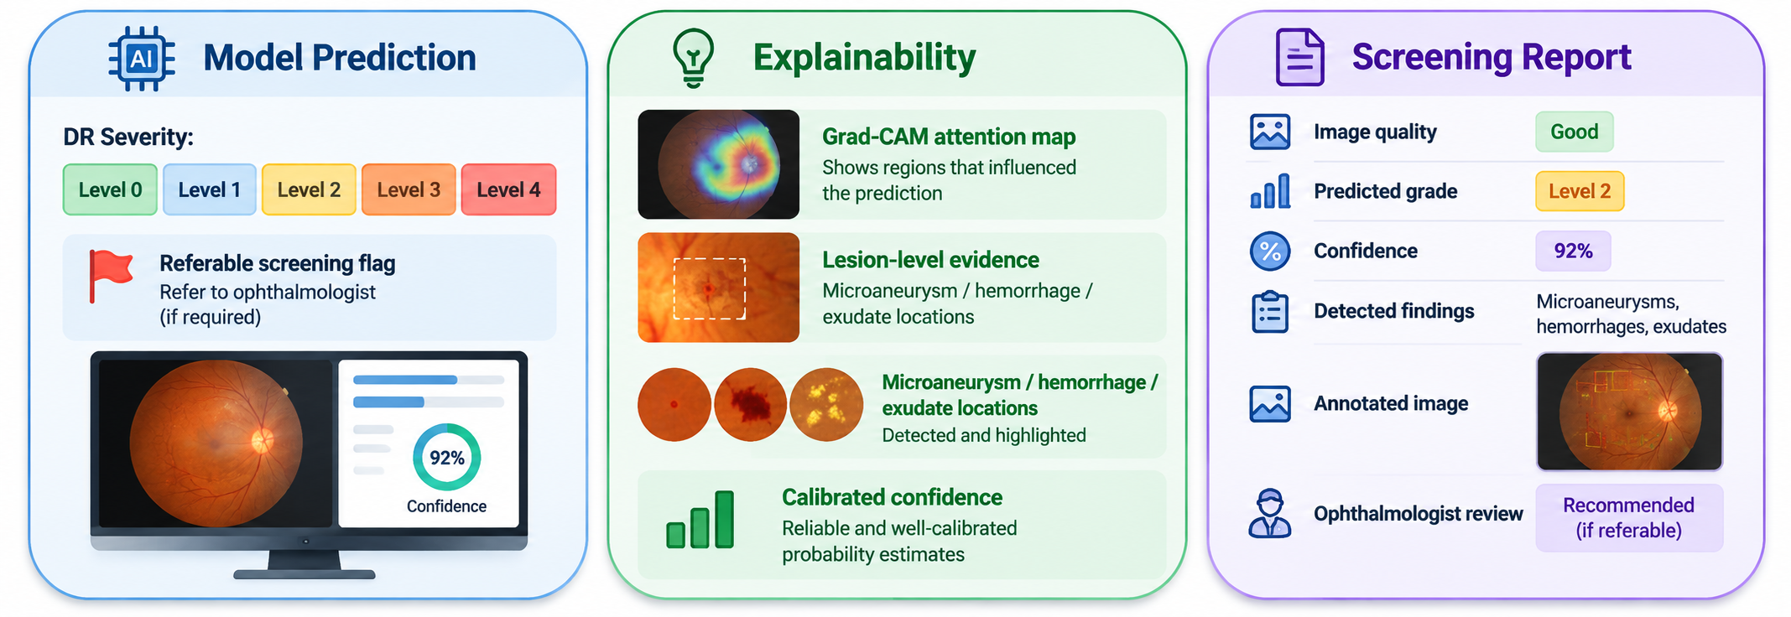
Explainability & Clinical Output
Model Prediction
Explainability
Screening Report
DR Severity:
Level 0 / 1 / 2 / 3 / 4
Referable screening flag
Grad-CAM attention map
Lesion-level evidence
Microaneurysm / hemorrhage / exudate locations
Calibrated confidence
Image quality
Predicted grade
Confidence
Detected findings
Annotated image
Ophthalmologist review
Human-in-the-loop: AI provides evidence → ophthalmologist validates the screening result.

Slide 6
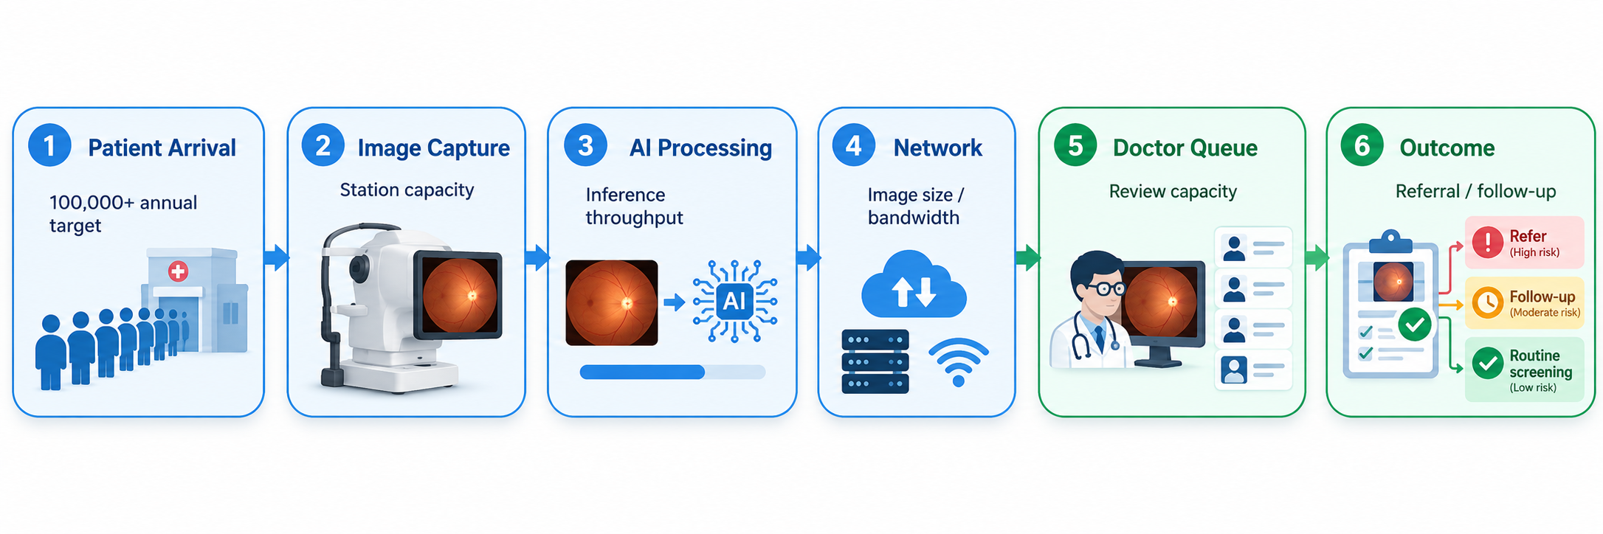
Simulink Telemedicine Workflow
Patient Arrival
Image Capture
AI Processing
Network
Doctor Queue
Outcome
100,000+ annual target
Station capacity
Inference throughput
Image size / bandwidth
Review capacity
Referral / follow-up
• Measure queue length, processing time, throughput and resource utilization.
• Test different numbers of screening stations, AI servers and ophthalmologist reviewers.
• Use simulation results to study district-level capacity and bottlenecks.

Slide 7
Datasets, Validation & Implementation Plan
Datasets
Validation
Target & Roadmap
APTOS 2019: DR grading (0–4)
IDRiD: lesion-level analysis + grading
External dataset: generalization testing
Patient-level train/validation/test split
Sensitivity & specificity for referable DR
ROC-AUC, PR-AUC, F1, calibration
Robustness to image-quality variation
Target: >90% sensitivity and >85% specificity
Phase 1: quality + classifier + Grad-CAM
Phase 2: segmentation + lesions
Phase 3: API/dashboard + Simulink
Fundus image → quality decision → DR grade → explainable evidence → clinical report → telemedicine simulation

