Slide 1




I526 Applied Machine Learning
RISK ASSESSMENT FOR HOME CREDIT APPLICANTS​
PHASE – 3
Spring 2022​
GROUP - 7
amandyar@iu.edu
jagchau@iu.edu
spasupu@iu.edu
hvalivet@iu.edu
Akhilesh Gowda Mandya Ramesh
Jagrut Chaudhari
Sumanth Pasupuleti
Harsha Valiveti

Slide 2
Abstract:
The project that we are working on is Home Credit Default Risk (HCDR). We are aiming to build a machine learning model that accurately assesses the risk for lenders. There are multiple parameters that need to be considered for optimally predicting if the client will be defaulting. The parameters that can be used are occupation, credit history, age, location, credit card usage, cash balance, and others. Therefore when evaluating a loan application, we will look at these parameters and help financial organisations make the best decisions possible for a long-term business.
Our Project is being implemented in 3 phases. In this Phase i.e Phase 3, We continued our experiments by implementing hyperparameter tuning to XGBoost, ADA Boost, Gradient Boost algorithm's to determine the best test accuracy. We proceeded with Neural Network with fine-tuned data to alter epochs, learning rate, batch size, optimisers parameters to get the best results possible. The Neural Network turned out to be one of the best experiments with a test AUC of 74%.

Slide 3
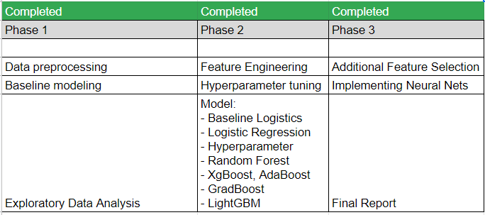
Phases and Activities

Slide 4
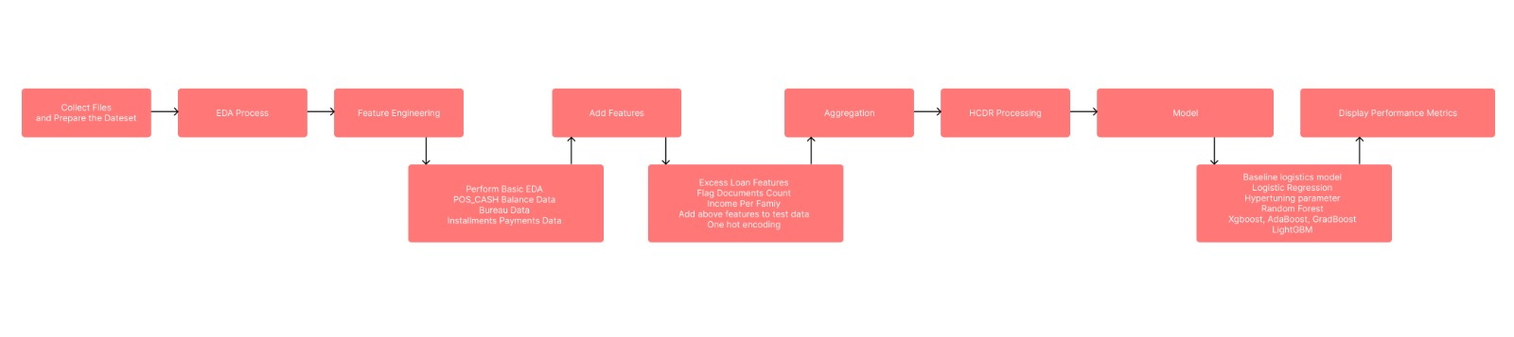
Key Tasks flow diagram

Slide 5
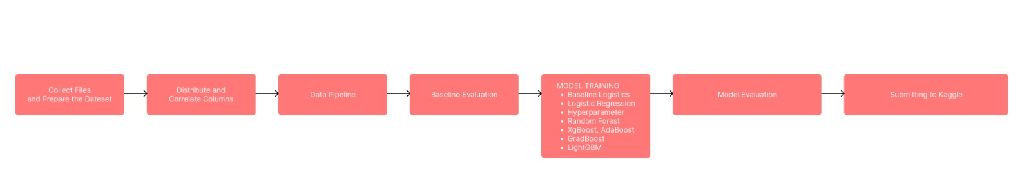
Pipeline Flow

Slide 6
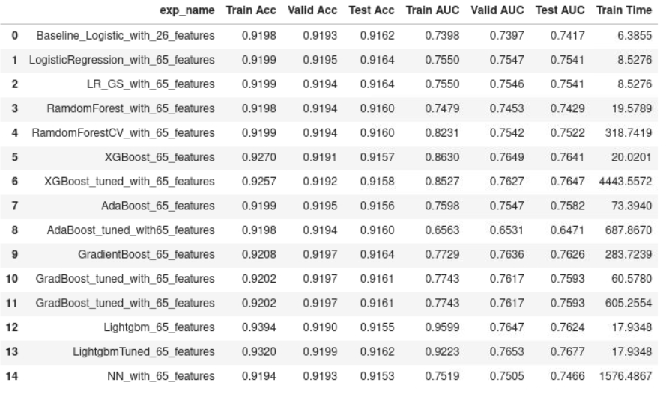
Experimental results

Slide 7
Results Comparison
Phase | Best AUC | Focus | Best Model | Kaggle Score
Phase1 | 0.75 | Baseline Modeling | Logistic Regression | 0.67
Phase2 | 0.76 | Feature Engineering/ Hyperparameter Tuning | LightGBM | 0.75
Phase3 | 0.76 | Neural Network | LightGBM | 0.75
Our Neural Net Model in Phase 3 achieved less AUC score (0.744) when compared to Phase 2 LightGBM (0.76)

Slide 8
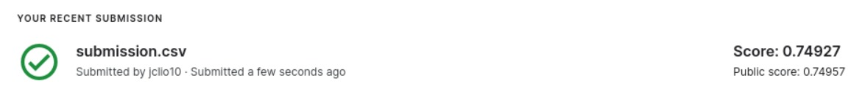
Kaggle Submission

Slide 9
Conclusion
- In this phase our main focus was to implement a neural network, test and compare it with other models.
- Test accuracy for our neural network model is 0.74 AUC, on the other hand LightGBM's score is 0.76.
- Neural network took a lot more time to train than the LightGBM model as shown in the experimental results table.
- All in all, LightGBM tuned model is the best so far in our experimentation with best accuracy and least train time.
- For future scope we would like to tune neural network parameters to get a better accuracy with some additional feature engineering to get better scores.

