Slide 1
Amplitude Modulation
Lecture - 1
The modulating Signal
The AM signal
The Carrier Signal
By:
Dr. Akhilesh Kumar Gupta

Slide 2

Modulation
Modulating Signal: or or
Carrier signal: High frequency signal whose property varies according to message signal.
Message Signal
Baseband Signal
Information carrying Signal
Modulation is the process in which specific properties of a carrier signal (a high-frequency signal) are varied in accordance with the instantaneous value of the baseband signal (a low-frequency signal).
Modulated signal: The resultant signal obtained by combining the modulating signal and carrier signal is called modulated signal.
Notes:
Modulation process ko start krne se phle, isme use hone different types of signals ko samjh lete hai.
Modulating signal: ye wo signal hota hai jo information yani message ko carry krta hai. Isiliye isko messaye signal ya information carrying signal bhi khte hai. It is also called baseband signal.
Modulation process me signal ki koi property change hoti hai. Chaliye ex example se samjhne ki kosish krte hai ki kis signal ki propert change hoti hai.
Suppose aap apne friend ko phone krte hai aur khte hai hello, yha pr hello ek message hai. Ab agar iski property ko change krke isko modulate krte hai to aapka friend isko hilo suntan hai aur hilne lagta hai. Yha pr message corrupt ho gya.
Iska matlab koi aur signal hi signal hai jiski property change hoti hai. Wo signal carrier signal kahlata hai.
Therefore modulation is defined as
After modulation, carrier signal aur modulating signal ke combination se obtain signal modulated signal kaha jata hai.

Slide 3
Notes:
Simply agar mathematical signal ki baat aati hai, to sabse phle mind me sin signal ya cos signal aata hai. Amplitude modulation ke is lecture me hm log cos signal ko reference signal mate hue study karenge.
Hm log message signal ko

Slide 4
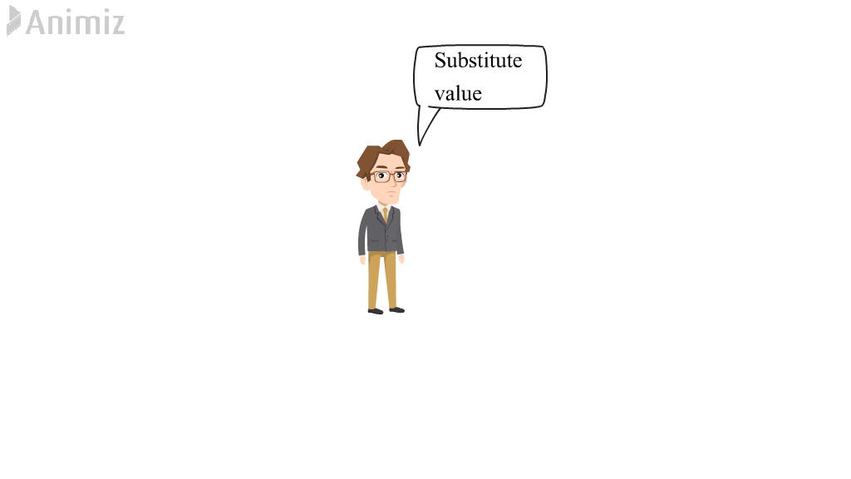
Amplitude Modulation
As the name indicates the term “Amplitude”, in this approach, the amplitude of the carrier signal is varied in accordance with the instantaneous value of modulating signal.
जैसा कि नाम "आयाम" शब्द को इंगित करता है, इस दृष्टिकोण में, वाहक सिग्नल का आयाम, मॉड्यूलेटिंग सिग्नल के तात्कालिक मान के अनुसार बदलता है ।
The Modulated Signal
The Modulating Signal
The Carrier Signal

Slide 5
Amplitude Modulation
Modulation Index - The ratio between the amplitudes of the modulating signal and carrier, expressed by the equation:
Modulation index is also known as depth of modulation, degree of modulation and modulation factor.
Bandwidth- The bandwidth of AM wave is twice the bandwidth of the baseband signal.

Slide 6
Power content in AM signal
The power of any signal is the mean square value of that signal.
किसी सिग्नल की पॉवर उस सिग्नल का औसत वर्ग मान होती है ।
The AM signal :
Sidebands Power:
Therefore, total AM power is given by
Carrier Power:

Slide 7
Power content and Transmission Efficiency of AM signal
The power of any signal is the mean square value of that signal.
किसी सिग्नल की पॉवर उस सिग्नल का औसत वर्ग मान होती है ।
The AM signal :
Therefore, total
AM power is given by
For 100 percent modulation m_{a} = 1

