Slide 1
AVETH’S FORGE HACKATHON 2026
REPAIRROUTE
Smarter APS inspection for faulty trucks
Which faulty trucks should we inspect first?
A ranked inspection queue that makes workshop capacity and missed-fault cost visible.
Working demo
repairroute.onrender.com
Cost-aware decision support for existing truck faults
Notes:
RepairRoute identifies whether an existing fault warrants APS inspection. It does not predict future failures.

Slide 2
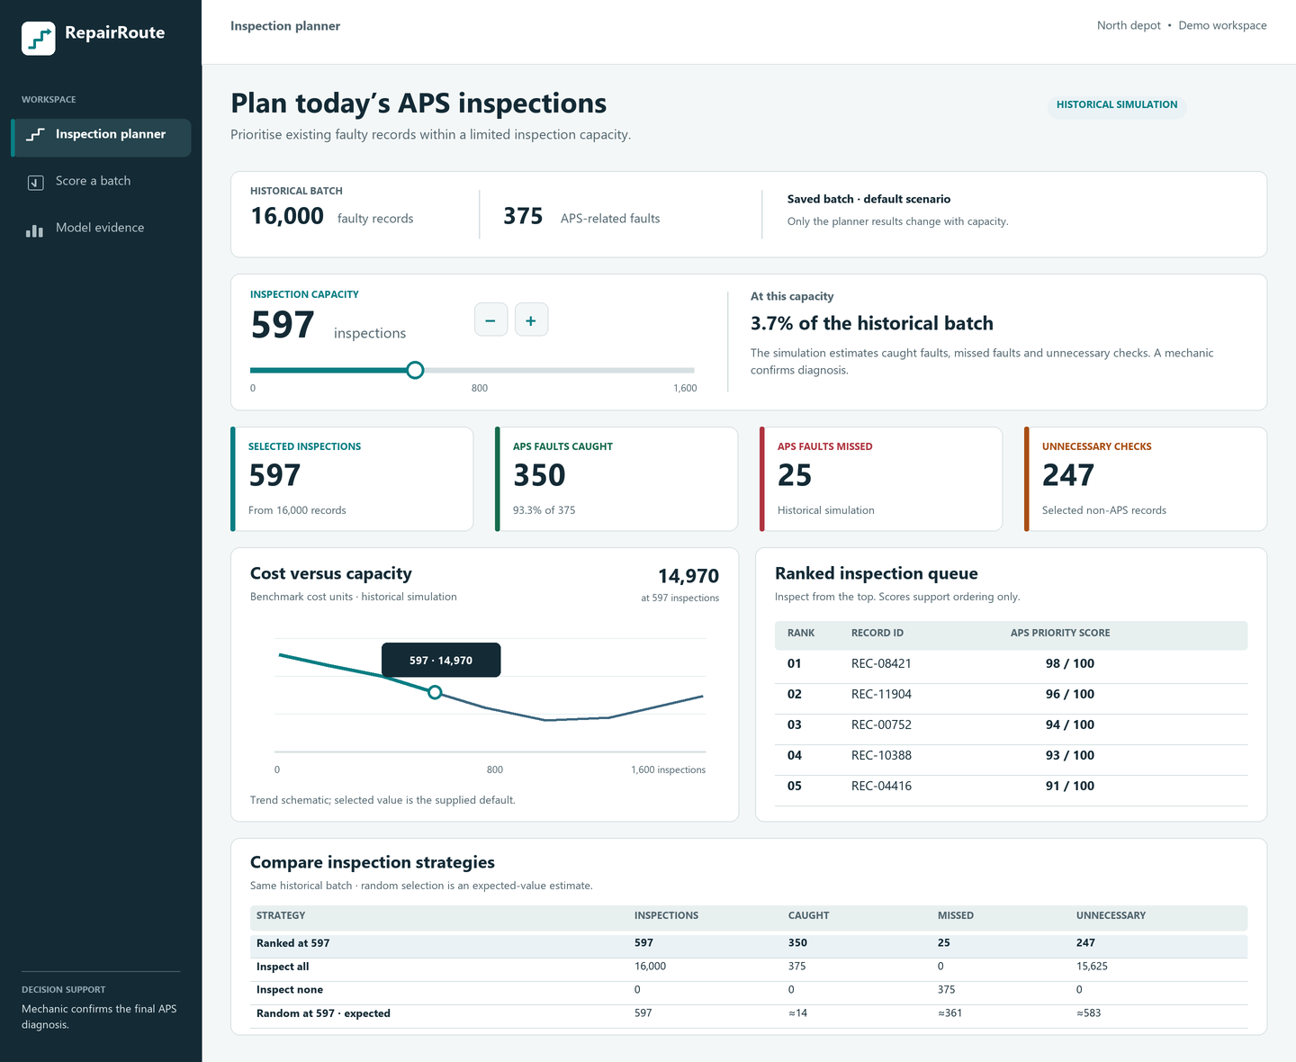
REPAIRROUTE
AVETH’S FORGE
2026
RepairRoute
HOW IT ADDRESSES THE PROBLEM
Rank existing faults
A trained model orders Scania-format records for APS inspection.
Plan around capacity
The manager chooses inspection slots and sees caught, missed, and unnecessary checks.
Keep the decision human
Mechanics confirm APS faults and decide what to repair.
WHAT MAKES IT USEFUL
The queue connects model output to a specific workshop action and compares it with inspect-all and inspect-none baselines.
repairroute.onrender.com
2
Notes:
Product screen is a design preview. The working app is available at https://repairroute.onrender.com/.

Slide 3
TECHNICAL APPROACH
AVETH’S FORGE
2026
RepairRoute
DATA AND MODEL
Scania APS records
Validation selection
Held-out test
RepairRoute API
→
→
→
60,000 training rows
170 anonymised features
Choose the inspection cutoff
using benchmark cost
16,000 records
Fixed evaluation reported
Saved model + ranked queue
FastAPI web service
DECISION RULE
10 × unnecessary APS checks + 500 × missed APS faults
Costs are benchmark units from the dataset. Model training does not run when a user opens the website.
repairroute.onrender.com
3
Notes:
HistGradientBoostingClassifier, trained on 48,000 rows with 12,000 for validation. Fixed test result uses the separate 16,000-row test file. The model score is a ranking score, not a calibrated probability.

Slide 4
FEASIBILITY AND VIABILITY
AVETH’S FORGE
2026
RepairRoute
WORKING PROTOTYPE
LIMITS AND NEXT STEPS
One service
Historical, anonymised data
Responsive website, FastAPI endpoints, saved model, and historical scores.
Current fleet data and workshop labels are needed before operational use.
No database needed for the demo
Human review remains essential
Committed artifacts serve the historical planner. CSV uploads are scored on request.
The score cannot identify the failed component or prescribe a repair.
Reproducible evidence
Deployment path
Training script, fixed test metrics, source attribution, and automated checks.
Connect to fault records, measure local costs, monitor drift, and audit decisions.
repairroute.onrender.com
4
Notes:
Live demo: https://repairroute.onrender.com/. GitHub: https://github.com/akhileshkancharla/repairroute. Free hosting can have cold starts.

Slide 5
IMPACT AND BENEFITS
AVETH’S FORGE
2026
RepairRoute
HELD-OUT TEST RESULT
BENCHMARK COST
597
inspections
out of 16,000 faults
RepairRoute
14,970
350 caught
25 missed
Inspect all
156,250
93.3% APS recall
72.0% F1 score
Inspect none
187,500
90.4% lower benchmark cost than inspecting every record
These costs compare historical decisions. They are not measured currency savings.
repairroute.onrender.com
5
Notes:
Fixed threshold was selected on validation data before test evaluation. Cost: 10 units per unnecessary check and 500 per missed APS fault. Precision 58.6%, accuracy 98.3%.

Slide 6
RESEARCH AND REFERENCES
AVETH’S FORGE
2026
RepairRoute
DATASET
APS Failure at Scania Trucks, Scania CV AB, UCI Machine Learning Repository
archive.ics.uci.edu/dataset/421/aps+failure+at+scania+trucks
DOI 10.24432/C51S51
IMPLEMENTATION AND DEMO
Working app: repairroute.onrender.com
Source code and model method: github.com/akhileshkancharla/repairroute
SCOPE OF THE CLAIM
Prioritises existing truck faults for APS inspection. A mechanic confirms diagnosis. Slider changes are retrospective simulations.
repairroute.onrender.com
6
Notes:
UCI dataset DOI: https://doi.org/10.24432/C51S51. The public dataset is licensed CC BY 4.0 according to its source page.

