Slide 1

Department of Information Technology VIGNAN’S INSTITUTE OF INFORMATION TECHNOLOGY
Packet Filtering using Machine Learning
Under The Esteemed Guidance of
Ch. Srinivasa Reddy, _{M.Tech}
Assistant Professor/Associate Professor/Professor
IT Department
Presented By
Batch No: 04
K V S P AKHILESH(18L31A1201)
G O S MANIKANTA(18L31A1248)
T SRAVANTHI(18L31A1234)
S SANDEEP RAHUL(18L31A1273)
T SAI LAKSHMI(18L31A1231)
Date:26/05/2022 05
Department of Information Technology
Page No:1

Slide 2
CONTENTS
Abstract
Existing System
Proposed System
Software and Hardware Requirements
Methodology
Architecture
Use Case Diagram
Sequence Diagram
Class Diagram
Graphs
Results
Date
Department of Information Technology
Page No:2
:26/05/2022

Slide 3
ABSTRACT
The Intrusion detection System (IDS) is the first line of defense for any network against any cyberattacks. The rapid increase in internet-connected devices due to the implementation of IoT and Industry 4.0 poses a significant challenge for the IDS to process a massive amount of network traffic to segregate the cyberattacks from benign traffic. This project has proposed a machine learning based Intrusion Prevention System that can detect Intrusion by analyzing network traffic behavior and stop the attacks.
Date:26/05/2022
Department of Information Technology
Page No:3

Slide 4
PROBLEM STATEMENT
Now-a-days Internet is very important for the communication. We can do lots of things on the internet like searching, images, videos etc. We are using the internet for our personal work or commercial work. But we are not sure our data is secure. We transfer the data from source to destination. While transferring from source to destination we do not know data transferred correctly to the destination because there may be different types of attacks involved. So we need to ensure that our network is protected from such attacks.
Date
Department of Information Technology
Page No:4
:26/05/2022

Slide 5
EXISTING SYSTEM
An Intrusion Prevention System works by actively scanning forwarded network traffic for malicious activities and known attack patterns.
The IPS engine analyzes network traffic and continuously compares the bitstream with its internal signature database for known attack patterns.
An IPS might drop a packet determined to be malicious, and follow up this action by blocking all future traffic from the attacker’s IP address.
Legitimate traffic can continue without any perceived disruption in service.
An IPS will typically record information related to observed events, notify security administrators, and produce reports. To help secure a network, an IPS can automatically receive Prevention and security updates in order to continuously monitor and block emerging Internet threats.
Intrusion Prevention Systems can also perform more complicated observation and analysis, such as watching and reacting to suspicious traffic patterns or packets. Detection mechanisms can include:
Address matching
HTTP string and substring matching
Generic pattern matching
TCP connection analysis
Packet anomaly detection
Traffic anomaly detection
TCP/UDP port matching
Date
Department of Information Technology
Page No:5
:26/05/2022

Slide 6
PROPOSED SYSTEM
Although there are many methods to detect and prevent the security attacks on a network, the attacks are also becoming sophisticated and it is been very difficult to detect them using pre-defined rules.
Several machine learning algorithms can be used to effectively detect a network intrusion and thus preventing them.
A dataset that contain data packets with 43 different types of features with more than 40000 records with different types of attacks is used for training.
This data is trained using various Machine Learning Algorithms and an effective algorithm is used to generate the final model.
This model is used predict the intrusion level on a network on every packet that is coming in to the network.
If a packet is detected as a packet that is causing intrusion, that packet is dropped and further the ip address is blocked from sending or receiving the packets.
In this way the Intrusion Prevention can be taken to the next level.
Date
Department of Information Technology
Page No:6
:26/05/2022

Slide 7
SOFTWARE AND HARDWARE REQUIREMENTS
Language – Python ( 3.8 and above )
Modules
Pandas - for data manipulation and analysis
NumPy - to process multi-dimensional arrays
Matplotlib – plotting library for python
Seaborn – for statistical graphs in python
Time – for calculating the training and testing times
Dataset - KDD Cup 1999
Properties
Size (before preprocessing) - 4898431 rows × 43 columns
Size (after preprocessing) - 4898431 rows × 33 columns
Train Data Size – 3281948 rows x 31 columns
Test Data Size – 1616483 rows x 31 columns
Split factor - 0.33
Date
Department of Information Technology
Page No:7
:26/05/2022

Slide 8
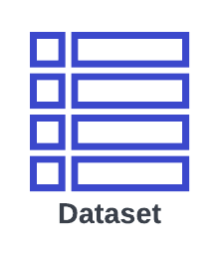



METHODOLOGY
Training
ML Model
Predict(request)
Prediction
Request Packet
Packet Filtering Firewall
Request Packet
Response Packet
Client
Prediction==1
True
Date:26/05/2022
Department of Information Technology
Page No:8

Slide 9

USE CASE DIAGRAM
Capturing Packets
ML Model
Predicting the threat level of packet
Dropping the packets or blocking the IP
Date:26/05/2022
Department of Information Technology
Page No:9

Slide 10
SEQUENCE DIAGRAM
Client
Intrusion Prevention System
Machine Learning Model
Server
2. Threat prediction
1. Client Request packet
3. Predicted Result
4. Packet is sent to server
5. IP blocked if threat is detected
6. Response from Server
Date:26/05/2022
Department of Information Technology
Page No:10

Slide 11
CLASS DIAGRAM
Model
Predict()
2
3
IPS
Server
Src_ip dst_ip src_mac dst_mac
Client
Capture() Drop() Pass() check()
4
IP address MAC address
1
Request() Response()
Request() Response()
5
Date:26/05/2022
Department of Information Technology
Page No:11

Slide 12
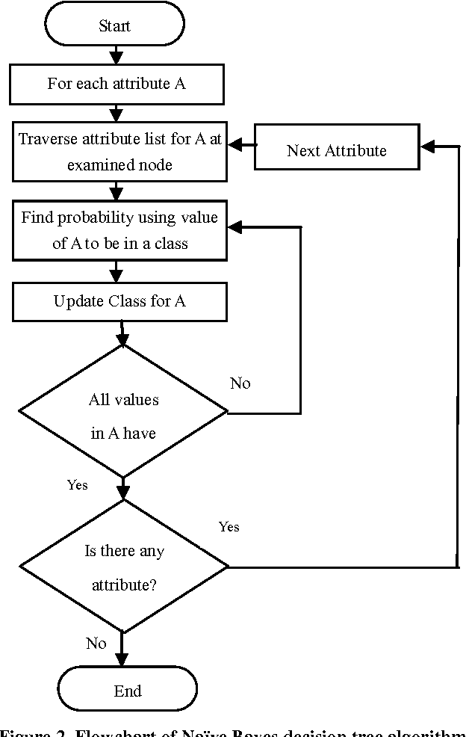
ARCHITECTURE
NAÏVE BAYES
The Naive Bayes, a supervised classification algorithm is a probabilistic classifier.
It is based on probability models that incorporate strong independence assumptions.
The independence assumptions often do not have an impact on reality. Therefore they are considered as naive.
Training Accuracy : 92.51%
Testing Accuracy : 92.49%
Date:26/05/2022
Department of Information Technology
Page No:12

Slide 13
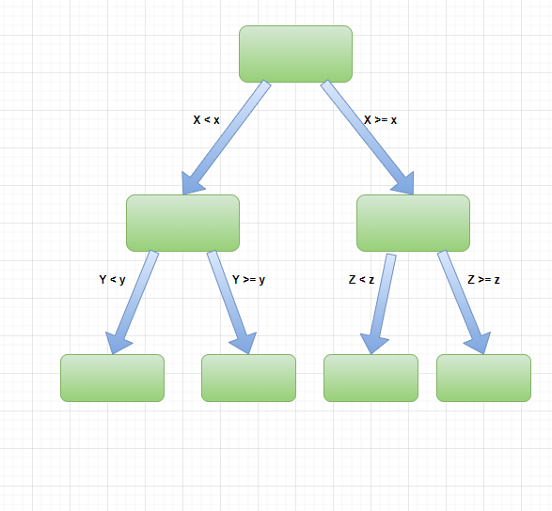
ARCHITECTURE
Decision Tree
A decision tree, a supervised learning algorithm, is a type of flowchart that simplifies the decision-making process by breaking down the different paths of action available.
Decision trees also showcase the potential outcomes involved with each path of action.
Training Accuracy : 99.61%
Testing Accuracy : 99.61%
Date:26/05/2022
Department of Information Technology
Page No:13

Slide 14
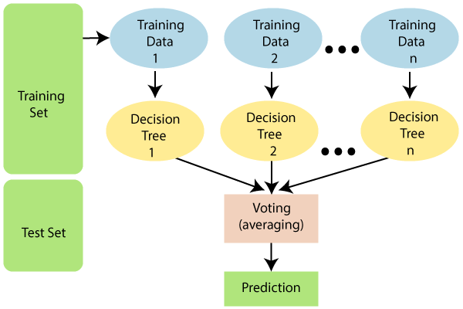
ARCHITECTURE
Random Forest
Random forest is a Supervised Machine Learning Algorithm that is used widely in Classification and Regression problems.
It is a type of an ensembling technique.
It builds decision trees on different samples and takes their majority vote for classification and average in case of regression.
Training Accuracy : 99.99%
Testing Accuracy : 99.98%
Date:26/05/2022
Department of Information Technology
Page No:14

Slide 15
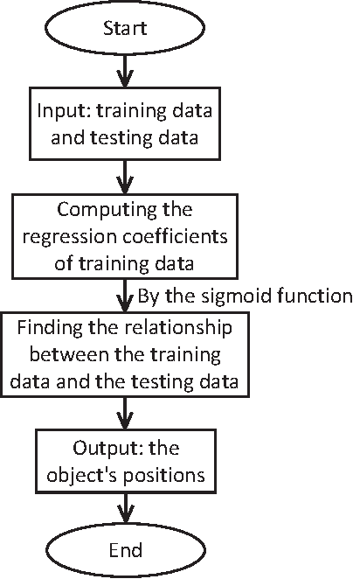
ARCHITECTURE
Logistic Regression
Logistic Regression is used to understand the relationship between the dependent variable and one or more independent variables by estimating probabilities using a logistic regression equation.
Logistic Regression is used to handle the classification problems.
Training Accuracy : 99.78%
Testing Accuracy : 99.78%
Date:26/05/2022
Department of Information Technology
Page No:15

Slide 16
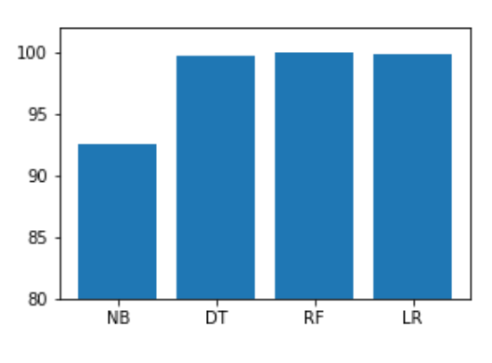
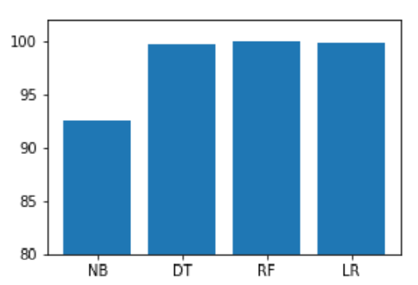
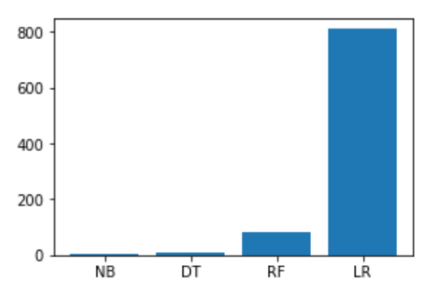
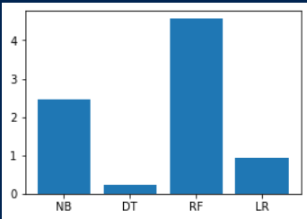
GRAPHS
Training Accuracy
Testing Accuracy
Training Time
Testing Time
Date:26/05/2022
Department of Information Technology
Page No:16

Slide 17
RESULTS
Algorithm | Training Accuracy | Testing Accuracy
Naïve Bayes | 92.51 | 92.49
Decision Tree | 99.61 | 99.61
Random Forest | 99.99 | 99.98
Logistic Regression | 99.78 | 99.78
Final Model – Random Forest
Date:26/05/2022
Department of Information Technology
Page No:15

Slide 18
THANK YOU
09/04/2022 09/04/2022 09/04/2022
Date
Department of Information Technology
Page No:18
:26/05/2022

