Slide 1
Idea/Approach Details
Theme : Other
Title of the Project/Idea : Controlling applications using Hands and Fingers.
Team Name : fs0ci3ty
College Name : VIGNAN’S INSTITUTE OF INFORMATION TECHNOLOGY
SNO | Name of the Candidate | Studying Year | Course | Role
1 | K V S P AKHILESH | 3 | IT | Team Lead
2 | P SHANMUK | 3 | IT | Team Member
3 | Sk SAMEER | 3 | IT | Team Member
4 | Ch V MUKESH | 3 | IT | Team Member

Slide 2
ABSTRACT : Using this project we can make a non-touch based display into a touch enabled display.
We came with an idea of using opencv to detect the finger motion and thereby maintaining the pointer integration by coordinating with the finger.

Slide 3
Describe your idea / Solution / Prototype here :
A simple multimedia touch projector which is handy to use anywhere with the help of
short power supply like power bank or even with a battery. A combination of computer
(multimedia applications) and projector with a touch capability.Hear the term touch is
basically not a touch screen its referd to sensing the hand motion and position which then be
converted into a cursor motion or position.

Slide 4
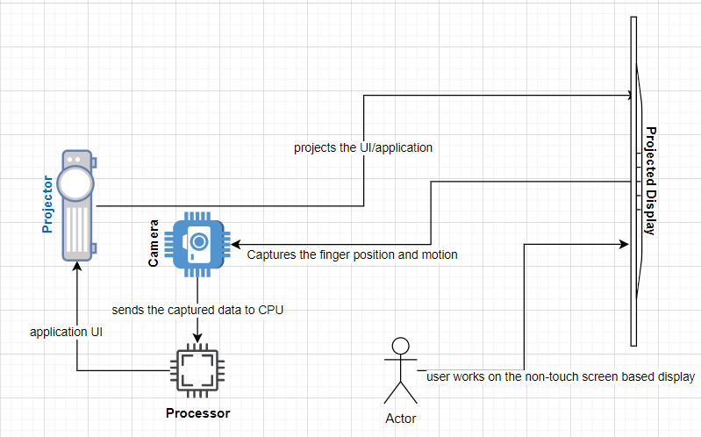
Describe your Technology stack here:
python
IoT
opencv
Describe your Use Case here

Slide 5
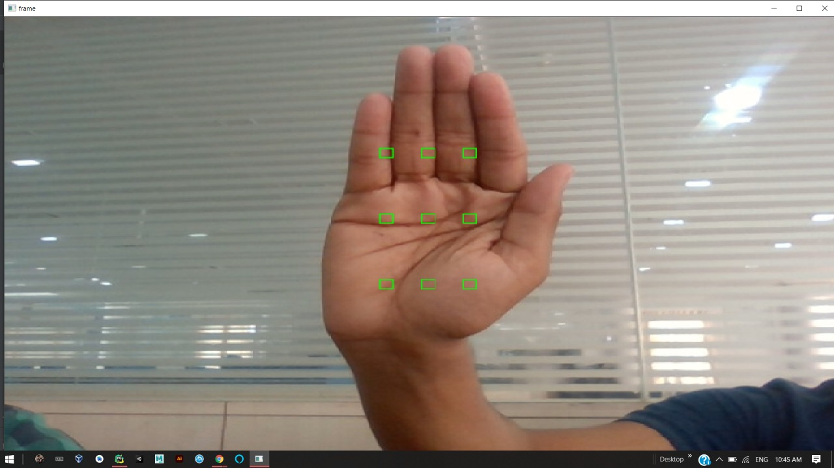
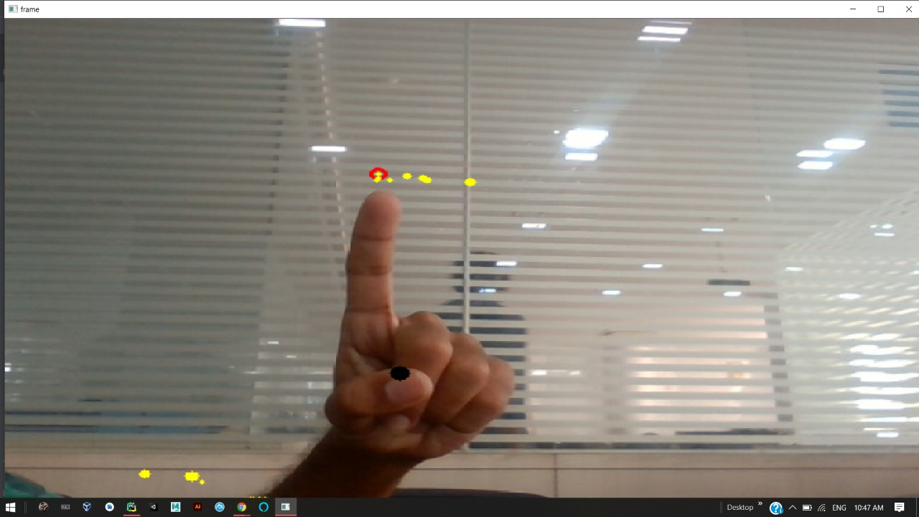
Output:
1.Hand colour detection
2.Controlling cursor movement using fingertip

