Slide 1
Road To DevOps In 2025
Akhilesh Mishra

Slide 2
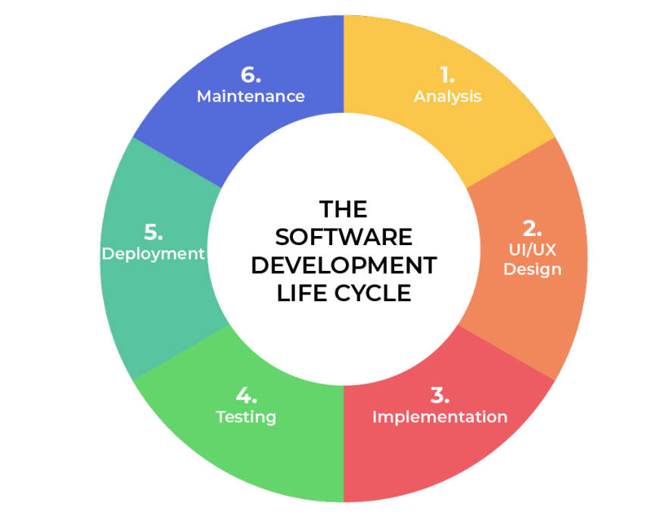
The SDLC refers to the overall process of planning, creating, testing, deploying, and maintaining software applications.
It typically involves several phases, such as requirements gathering, design, development, testing, deployment, and maintenance.

Slide 3
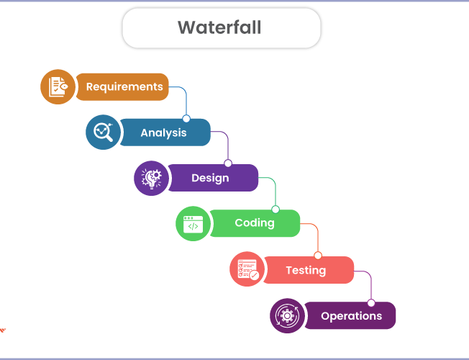
Waterfall —Old ways of SDLC
Linear and sequential approach to software development
Distinct phases: requirements gathering, design, development, testing, and deployment
Emphasis on comprehensive planning and documentation upfront
Limited flexibility for changes once the project has begun
Longer development cycles and delayed feedback from end-users

Slide 4
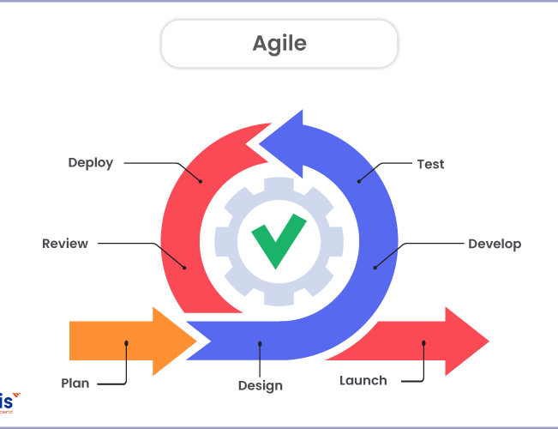
Agile — Improvement over Waterfall
Iterative and incremental approach to software development
Emphasis on working software over comprehensive documentation
Encourages collaboration and communication between cross-functional teams
Accommodates changes and incorporates user feedback throughout the development process
Delivers working software in shorter iterations, enabling faster time-to-market and user validation

Slide 5
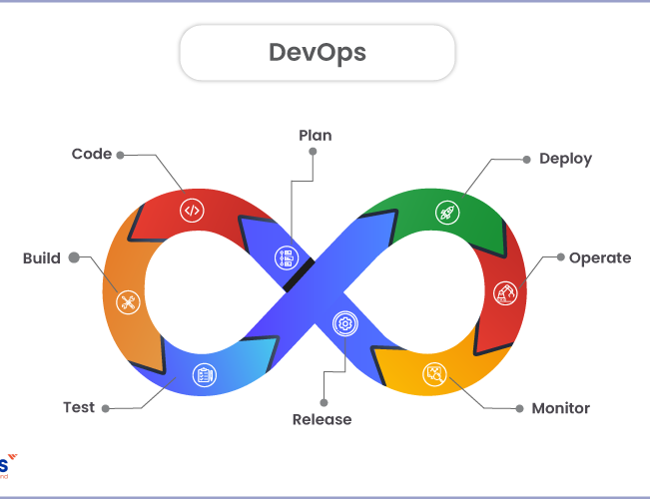
DevOps — Improvement over Agile
Extends Agile principles to include operations and infrastructure
Focuses on continuous integration, continuous delivery, and continuous deployment (CI/CD)
Automates build, test, and deployment processes to enable frequent and reliable releases
Encourages collaboration and shared responsibility between development and operations teams
Enables faster feedback loops, improved quality, and increased agility in delivering software updates and features

Slide 6
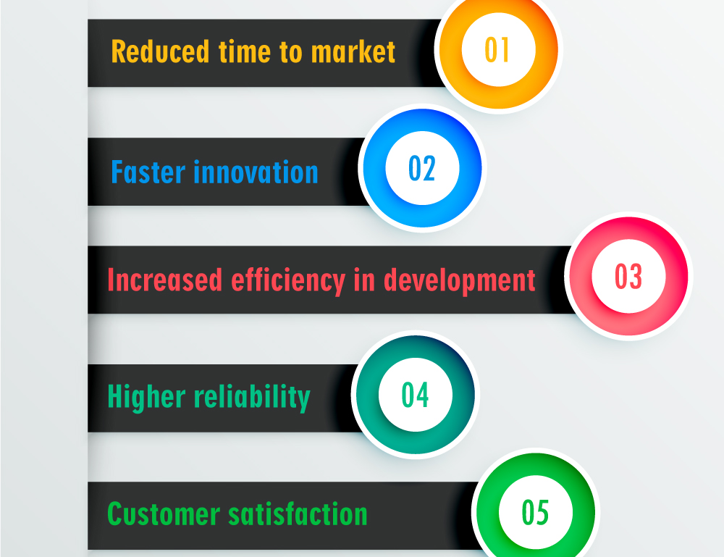
Why DevOps adoption is growing?
DevOps bridges the gap between development and operations teams, fostering collaboration and efficiency.
The DevOps approach enables faster time-to-market, improved quality, and enhanced customer satisfaction.
By automating processes and leveraging continuous integration and delivery (CI/CD), DevOps accelerates software release cycles.
DevOps encourages a culture of shared responsibility, breaking down silos and promoting cross-functional teamwork
DevOps enables businesses to respond quickly to changing market demands and customer needs.
It promotes a focus on continuous improvement, allowing teams to learn, adapt, and optimize their processes.
As the importance of software continues to grow, DevOps will play an increasingly critical role in driving innovation and business success.

Slide 7
Must Have Skills:1
Linux:
File/Directory management —Create, delete, copy, move, rename, find, file parsing, permissions, etc
Package manager —Yum, apt, apt-get, def, etc
Process and resource management —Resource usage(Memory, disk, cpu, IO) and Process management (PS)
Basic Networking
Input/output redirection, awk, cut, tail, head, pipe, alias, etc
Bash:
Basic bash with input, multiline commands, etc
Variables and Conditional statements
Loops and arrays
Output parsing, data manipulation
Exit codes and scripts arguments

Slide 8
Must Have Skills:2
Docker:
Basic docker build and run commands
Writing Dockerfile, pushing/pulling Docker images to and from public/private repositories
Docker networking and volumes
Best practises for writing Docker file
Docker-compose to run multiple containers with dependencies
Networking:
IP Addressing: Knowledge of IP addressing schemes, including IPv4 and IPv6, and understanding how to subnet and allocate IP addresses efficiently with CIDR blocks
Network Security: Familiarity with firewalls, VPNs, and other security measures to protect network resources and prevent unauthorized access.
Network Troubleshooting: Ability to diagnose and resolve network issues using tools like ping, traceroute, and packet analyzers (e.g., Wireshark) for effective problem-solving.
Load Balancing: Knowledge of load balancing techniques and technologies (such as HAProxy or Nginx) to distribute network traffic efficiently and ensure high availability.
DNS, TCP/UDP, HTTP/HTTPS, VPN, SSL

Slide 9
Must Have Skills:3
Git and GitHub
Familiarity with GitHub UI
Basic Git commands such as pull, push, merge, rebase
Resolving git conflicts
Branching strategies used in companies
CI tool (GitHub Action or Jenkins):
Basic syntax and events that triggers to CI pipeline
Reusable workflows
Using marketplace actions (for Github Actions)
Security credentials management
Building complex pipelines

Slide 10
Must Have Skills:4
Cloud Platform(At least 1):
Cloud Networking: Understanding of cloud networking concepts, such as Virtual Private Cloud (VPC), subnets, and security groups, for deploying and managing applications in cloud environments.
Cloud storage such as persistent volumes, object storage and file share
Identity and access management in detail.
Compute services (Such as EC2 in AWS)
Container services (Such as ECS and EKS in AWS)
Serverless Functions(such as Lambda in AWS, and cloud Function in GCP)
Terraform(IAC tool):
Basic syntax, provider, state management
Different variable types, locals, resource and data source blocks, output block
Writing/using private and public modules
Loops, conditional statement, dynamic block
Most used builtin functions

Slide 11
Must Have Skills:5
Kubernetes
Architecture, fundamental concepts
Deploying micro services in Kubernetes using services, ingress and load balancers
Namespace, RBAC, service accounts, context switching
Scaling nodes and pods (HPA, VPA)
Troubleshooting deployment failures and misconfiguration
HELM, operators,
Probes, volumes, daemon set, stateful sets
Python:
Basic syntax, data structures, functions, recursion, basic OOP
Conditional statements, loops, running system command, parsing the output
Making API calls, manipulating json data, reading from files and writing to files
Writing basic automation scripts using the Cloud provider SDK

Slide 12
Good to have skills(You can get into DevOps without them)
Ansible(Configuration management tool)
Used to bake images and configure the server
ArgoCD(GitOps tool)
Used to deploy the application in Kubernetes.
Prometheus (Logging)
Grafana (Dashboarding and monitoring tool)
Elasticsearch(Log storage tool)
Database fundamentals
SQL
Development skills (Will be very useful in coming years)
Cloud certifications

Slide 13
Phase 1
Learn Fundaments
Use blogs and Youtube videos to learn fundamentals
Start with Linux and networking, followed by Docker
Then Start with Cloud fundamental and explore the Cloud resources using consoles
Try basic Terraform, write simple resources
Learn Kubernetes fundamentals
Explore Git and GitHub Actions
Then explore the concepts around CICD tool. I recommend GitHub Actions as it is easy to get started and simple to learn
Learn basic Python and bash

Slide 14
Phase 2
Get hands on
Try to build basic projects using 2-3 tools at same time
Build a 3-tier architecture with Cloud console
Deploy 2 3-tier infra using Terraform
Deploy a Dockerized application on Could VM
Deploy a multi container application with Docker-compose
Write basic bash and python scripts to do something meaningful
Write a GitHub Action pipeline to build and deploy the application in cloud VM
Deploy a simple application in Minikube(kubernetes)
Use the different Kubernetes components and kubectl CLI in minikube
Use a simple HELM chart to deploy prometheus and grafana in minikube
Write a GitHub Action workflow to lint and test the code and also include devsecops tools such as checkoff for terraform and sonar cube

Slide 15
Phase 3
Build complex projects
Here you will build complex real world projects that simulate real scenarios.
Deploy a complete Kubernetes cluster on Cloud using Terraform
Deploy a microservices based application in Kubernetes cluster following best practices
Use Github actions pipeline to build all the services and deploy them with ArgoCD
Upgrading the Cluster
Build complex Terraform modules and use the to deploy a scalable infra across multiple environments
Build reusable GitHub Actions workflows and use them at multiple places
Follow the devsecops best practises in CICD pipelines and use GitHub Advance security features
Build complex automation that solves a real problem
Explore the cost optimisation and build automation to automate the cost monitoring and control
Explore databases logs and sql
Build a complicated branching strategy to deploy application across multiple environments(dev, test, prod)

Slide 19
Youtube resources
https://livingdevops.com/devops/best-devops-resources-to-learn-devops/
GitHub resources
https://github.com/akhileshmishrabiz/Devops-zero-to-hero
https://github.com/akhileshmishrabiz/python-for-devops
https://github.com/akhileshmishrabiz/web-app-on-aws-ecs
https://github.com/akhileshmishrabiz/flaskapp-awsec2
Simple Devops projects
https://livingdevops.com/python/build-your-first-api-with-complete-crud-operations/
https://awstip.com/terraform-to-deploy-aws-lambda-function-with-s3-trigger-4c8e231d5f0c?sk=d0ac19b8c5c0316a6aed535d9f461090
https://awstip.com/securely-connect-ec2-instances-to-s3-buckets-via-private-network-with-vpc-gateway-endpoint-78e03356a9e7?sk=575902d3c8ed33bd18390165e9bf13ab
https://towardsaws.com/learning-terraform-on-aws-let-me-show-how-its-done-31e38618ac6c?sk=0a3c6252f2917a175f8813ab6b25432e
https://towardsaws.com/continuously-build-deploy-python-web-app-on-aws-with-github-action-a9de1421898c?sk=9be65762df1f58070460ee26bd291a65
https://levelup.gitconnected.com/run-multi-container-web-app-with-docker-compose-8f4ad698e8e9?sk=5aead1507d204769ac49e1ac1ca66c47
https://livingdevops.com/devops/everything-you-need-to-know-about-docker/
https://livingdevops.com/terraform/how-to-use-terraform-functions/
https://livingdevops.com/devops/migrating-rds-postgres-database-with-python/
https://livingdevops.com/devops/python-lambda-layers-with-terraform-github-actions/

