Slide 1


Build a shinning career in devops
By: Akhilesh Mishra

Slide 2


Webinar Agenda
Introduction to DevOps
Software Development Life Cycle
Why DevOps Skills are in Demand
Essential Skills for a DevOps Career
Building Your DevOps Skillset
Career Paths in DevOps
Tips for Advancing Your DevOps Career
Q&A Session

Slide 3
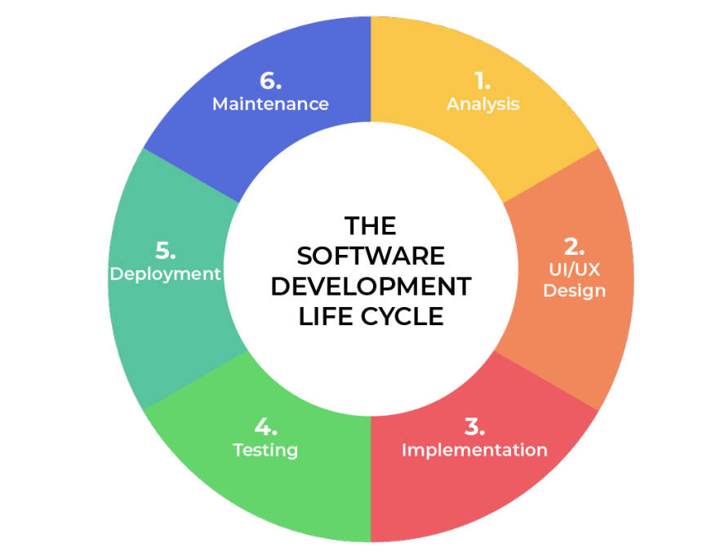
Software Development Life Cycle (SDLC)
The SDLC refers to the overall process of planning, creating, testing, deploying, and maintaining software applications.
It typically involves several phases, such as requirements gathering, design, development, testing, deployment, and maintenance.

Slide 4
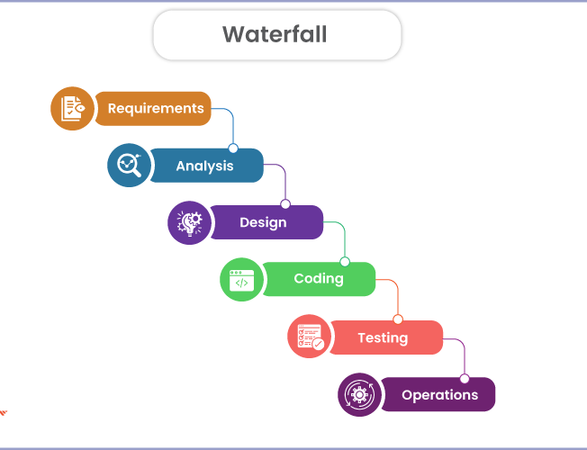
What is Waterfall model of SDLC?
Requires planning every step (requirements, design, code, testing, release, updates) before starting
Once you start a step, it's hard to go back and change things.
Works well for small projects with clear requirements that won't change much.

Slide 5
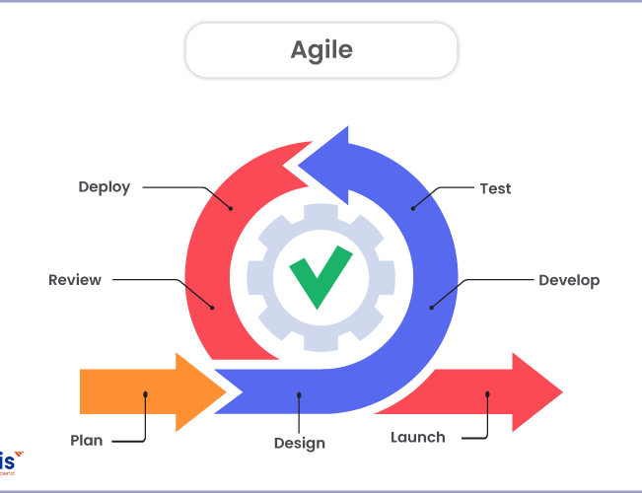
What is AGILE model of SDLC?
Build in short bursts (sprints), testing and getting feedback along the way
Change plans if needed based on feedback – faster response to change
Everyone works together closely
Works well for projects where requirements might change, or new ideas pop up

Slide 6
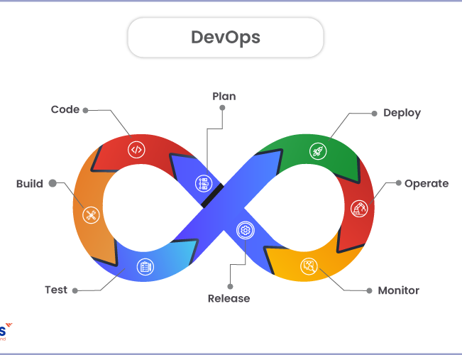
What is Devops model of sdlc?
Developers and operations folks collaborate seamlessly.
Use automation and tools to do repetitive tasks – faster software delivery
Release the software in smaller chunks
Constantly monitor and gather feedback to improve the process

Slide 7
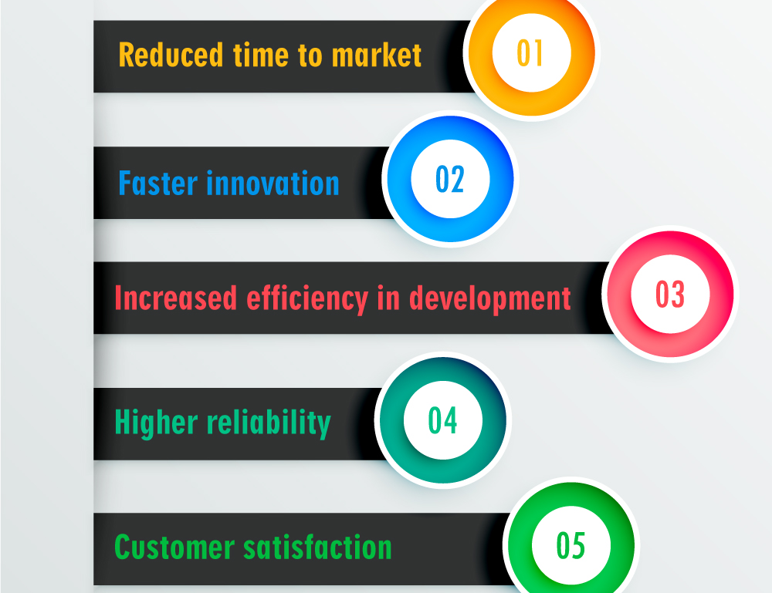
Why to use Devops?
DevOps shrinks the gap between development and operations, allowing for faster feature releases and updates, giving you a competitive edge.
DevOps integrates testing and monitoring throughout the process, catching bugs early and delivering higher quality software.
DevOps breaks down silos between development and operations, fostering collaboration and boosting team morale.
Repetitive tasks become a thing of the past with DevOps automation, freeing up your team for more strategic work.
DevOps thrives on adaptability, allowing you to respond quickly to new ideas and market shifts.
DevOps is a continuous improvement cycle, helping you constantly learn and evolve, keeping you ahead of the game.

Slide 8
Why DevOps Skills are in Demand
Industry Trends and Market Demand
Increased Adoption of Agile and DevOps Practices
Impact of DevOps on Business Success

Slide 9
Essential Skills for a DevOps Career
Technical Proficiency (Scripting, Automation, Cloud Computing)
Collaboration and Communication Skills
Problem-Solving and Critical Thinking
Continuous Learning and Adaptability

Slide 10
Devops Tools to get into devops
One Cloud platform
One Infra As Code Tool
One Scripting Language
One CICD Tool
One Version Control Tool
Basic Linux
Docker
Kubernetes

Slide 11
Building Your DevOps Skillset
Training and Certification Programs
Hands-On Experience with DevOps Tools and Technologies
Participation in Open-Source Projects and Communities
Networking and Mentorship Opportunities

Slide 12
Career Paths in DevOps
DevOps Engineer
Site Reliability Engineer (SRE)
Automation Engineer
Release Manager
DevOps Consultant

Slide 13
Tips for Advancing Your DevOps Career
Stay Updated with Industry Trends and Best Practices
Seek Feedback and Mentorship
Continuously Improve Your Technical and Soft Skills
Explore New Tools and Technologies
Build a Professional Network

Slide 14
Q&A Session
Open Floor for Questions and Discussion

Slide 15
Thank You for Attending!
Akhilesh Mishra
Linkedin: linkedin.com/in/akhilesh-mishra-0ab886124
Topmate: topmate.io/akhilesh_mishra
Email: akhileshmishra@livingdevops.com, akhileshmishra121990@gmail.com
Medium Blog: medium.com/@akhilesh-mishra

Slide 16
Feedback Matters
MAMATA PANIGRAHI
Linkedin: https://www.linkedin.com/in/mamata-panigrahi-a827b8148/
Topmate: https://topmate.io/mamata_panigrahiEmail:
mamatapanigrahi64@gmail.com
mamta.promo@gmail.com
Medium Blog: https://medium.com/@mamta.promo

