Slide 1
K6
JMeter Vs K6-
JMeter needs java or JDK installed while K6 does not need node JS ,it just need k6 bundle.
JMeter comes with UI while K6 is without UI. It supports highly configurable test design, can be written in git , hence it can be version controlled. Easier setup
Performance Testing using Postman Canary
Download Postman Canary Postman Canary: For Mac, Windows, & Linux
2. Create Collection
3. Run Collection
4. Go to Performance Tab
5. Enter Virtual users ,Time duration for test and Ramp up period.
6. Performance Test with Postman Canary | by Alex Rodriguez | Medium

Slide 2
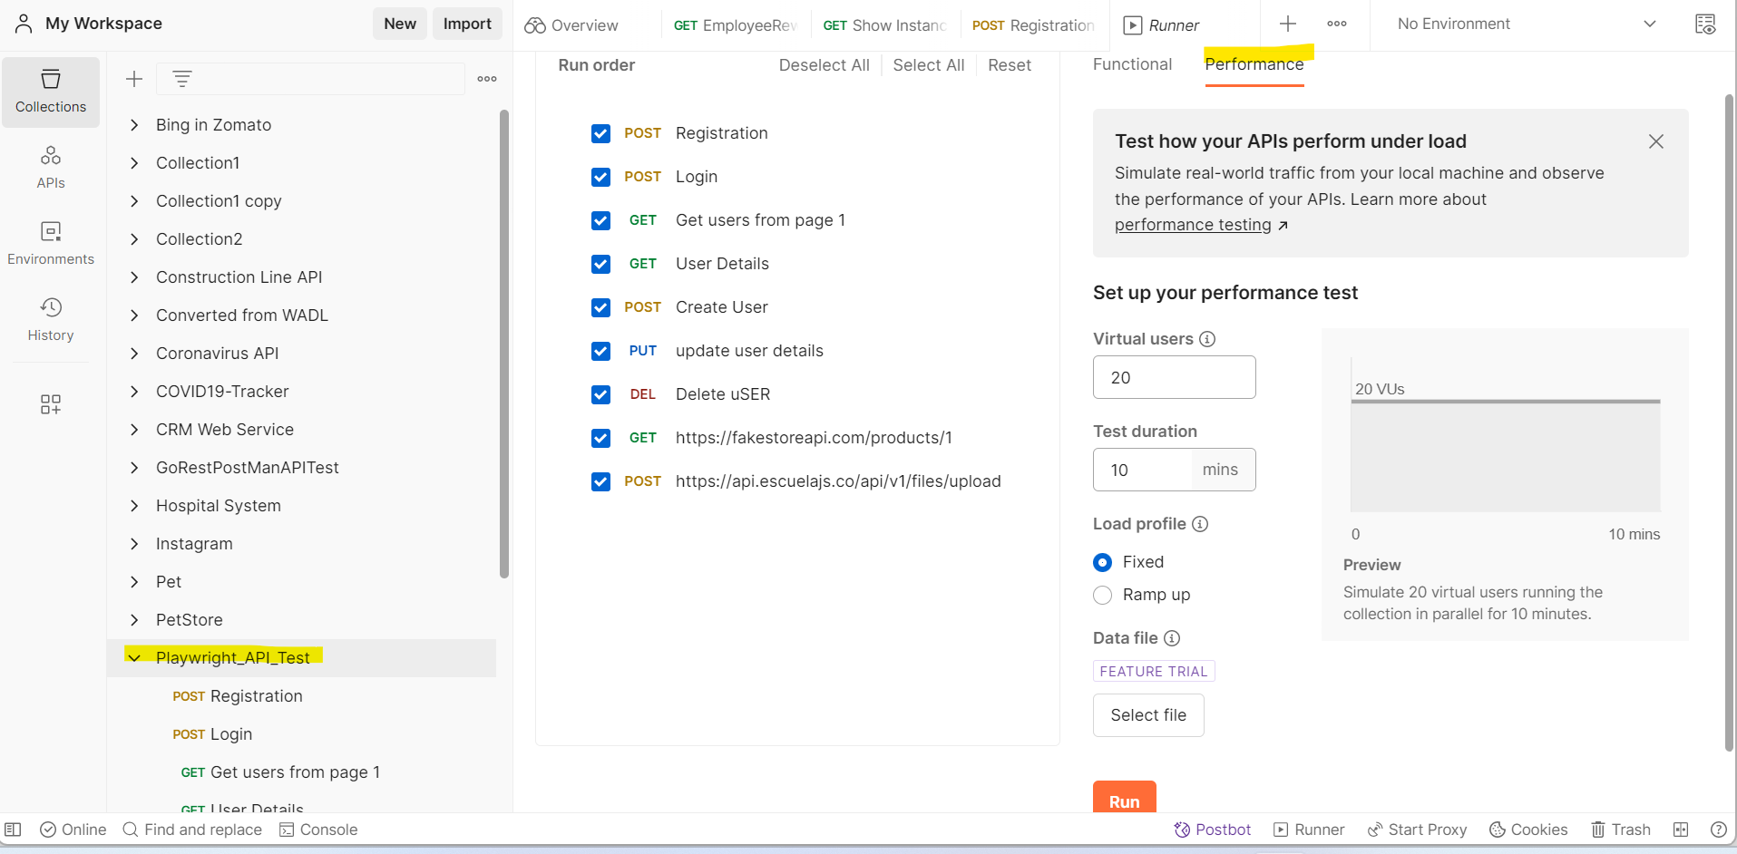
Postman Canary – Performance Testing using Postman

Slide 3
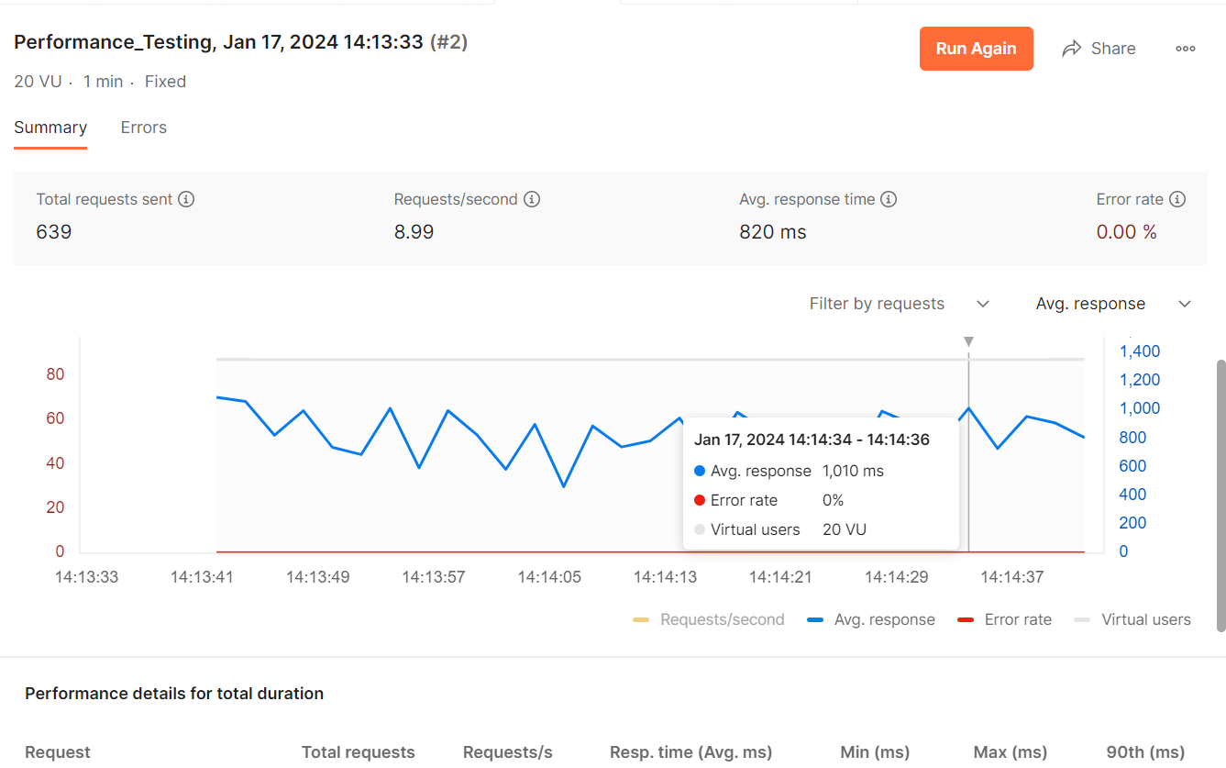
Performance Report

Slide 4
K6 with Postman
Grafana K6 is very powerful load testing tool which can be used to simulate hundreds of user requests concurrently whilst providing data visualization and monitoring. It can generate real time dashboards and reports in Grafana and Datadog.
NewMan- Newman is a command-line tool for running and automating API requests created in Postman.
PostBot- Its new feature in Postman which can generate test cases based on response of API.

Slide 5
Why K6 with Postman ? This will help tester to test performance/load/stress testing of APIs in the beginning of the development. It is kind of approach for shift left and helps to identify performance issues in early phase. We can easily convert postman collection to K6 script.
Prerequisite
Node.js https://nodejs.org/en
K6 https://k6.io/open-source/
Newman https://www.npmjs.com/package/newman
VS Code https://code.visualstudio.com/download
Postman https://www.postman.com/downloads/(Postbot AI & NewMan)
Postman-to-k6 https://www.npmjs.com/package/@apideck/postman-to-k6
GitHub Actions

Slide 6
Detailed Steps- 1
Install prerequisites to complete the setup.
Create a collection , add requests and send requests.
Go to Test tab and click on Postbot, generate tests and save requests.
Create npm project using `npm init –y`
Add a folder as Collection and Environment, export from Postman and add in project.
In order to run collection from command line Install newman `npm install newman –save –dev`.
In order to run the postman collections using K6, first we will need to convert postman collection files to k6 files using postman-to-k6 node package. `npm i @apideck/postman-to-k6`

Slide 7
Detailed Steps- 2
8. Commands to run postman collections using Newman :
"newman run ./collections/Playwright_API_Test.postman_collection.json -e ./enviornments/UAT.postman_environment.json"
9. Commands to convert postman collections to K6 :
"postman-to-k6 ./collections/Performance_Testing.postman_collection.json -e ./enviornments/Performance_Env.postman_environment.json -o k6-script.js"
10.Commands to execute K6 script :
"k6 run k6-script.js --summary-trend-stats=\"avg,p(90),p(99.9),p(99.99),count\" --out json=test.csv"

Slide 8
Running Multiple Collections together
In the previous approach we might have to create multiple scripts for each collection.
As an enhancement we added a file ‘convert_postman_k6.js’ which reads all collections Json file stored under collections folder and convert their respective k6 script file under k6_script folder based on passed environment file.
Script - "node convert_postman_k6.js uat", Here uat is the exported
environment file name.
Generating HTML Report for each collection
Generally, K6 provides report in csv or json format for each k6 script file.
We added handle summary in each converted k6 script file and executed k6 for each converted file.
As a result, we get html report for each converted k6 file stored under reports folder.

Slide 9
POC Output
We are achieving two things here
A. API Automation testing
B. API Performance testing
Pros of this POC-
1. Collections can be saved in git repository and can be version controlled.
2. Raising PR is easy, and changes can be easily identified.
Cons :
Currently K6 does not support generating k6 matrix for each request separately, it rather generates for whole collection.
Risk Mitigate:
1. We can keep single request/endpoint in separate collection and export in single Json file. In this way we can generate html report for each request type.

Slide 10
References
We can test WebSocket using k6.
We can mark test cases fail/pass based on threshold. Example, we can mark test case as failed if API average response time is more than 500ms.
References -
https://k6.io/blog/load-testing-with-postman-collections/
https://learndevtestops.com/2024/01/04/k6-postman-ai-github-actions/
https://github.com/apideck-libraries/postman-to-k6

