Slide 1
QuickBite Delivery Intelligence
End-to-end data analytics project deck
Project focus: data cleaning, EDA, SQL insights, Folium map, Plotly dashboard, and classification for late delivery prediction.
Dataset
3,200 orders
Cities
6 Indian cities
Model
Random Forest
Accuracy
88.5%
1

Slide 2
Executive Summary
Overview
Volume
3,200 orders
Revenue
INR 9.28L
Best city
Mumbai
Risk zone
Surat
Traffic and weather are the strongest operational drivers of delay.
Mumbai leads in revenue and has the lowest late-delivery rate.
Surat and Pune need tighter SLA control and better routing.
The classifier reaches 0.885 accuracy and 0.962 ROC-AUC.
Key deliverables
Cleaned dataset with geospatial fields and delivery KPIs
EDA visuals for demand, value, rating, and lateness
SQL-based business questions and answer tables
Folium map and Plotly dashboard preview
Late-delivery classification with feature importance
2

Slide 3
Introduction
Problem statement and goals
Business problem
Operations teams need to know where, when, and why delivery delays happen.
Objective
Turn raw order data into decisions that improve SLA, routing, and customer satisfaction.
Track demand, revenue, and lateness across cities and time windows.
Use SQL to answer repeatable business questions fast.
Visualize city hotspots and traffic pressure on a map.
Build a classification model to predict late orders early.
Success metrics
Faster decisions, fewer late orders, and a usable analytics workflow.
3

Slide 4
Data Collection and Wrangling Methodology
How the dataset was prepared
Collect
Synthetic order records were generated with city, time, location, and service fields.
Validate
Missing values, duplicates, and impossible values were checked and removed.
Transform
Date fields, ratings, lateness label, and categorical encodings were standardized.
Store
Final data was saved as CSV and loaded into SQLite for SQL analysis.
Cleaning rules applied
Clipped negative values and outliers in price, distance, and delivery time.
Derived order_hour, weekday, weekend, and late_delivery features.
Unified city names and categorical labels for analysis and modeling.
Created lat/lon coordinates for map-based visualization.
4

Slide 5
EDA and Interactive Visual Analytics Methodology
Exploration workflow
1. Question
What drives delay and revenue?
2. Segment
By city, traffic, weather, and time
3. Visualize
Bars, lines, scatter, heatmaps
4. Act
Find fixes for SLA
EDA was used to spot patterns before modeling.
Interactive views were planned for city and zone-level filtering.
Charts were designed to answer one question per slide.
The output is easy to present and easy to extend.
Tools used
Pandas, Matplotlib, Seaborn, SQLite, Folium, Plotly
5

Slide 6
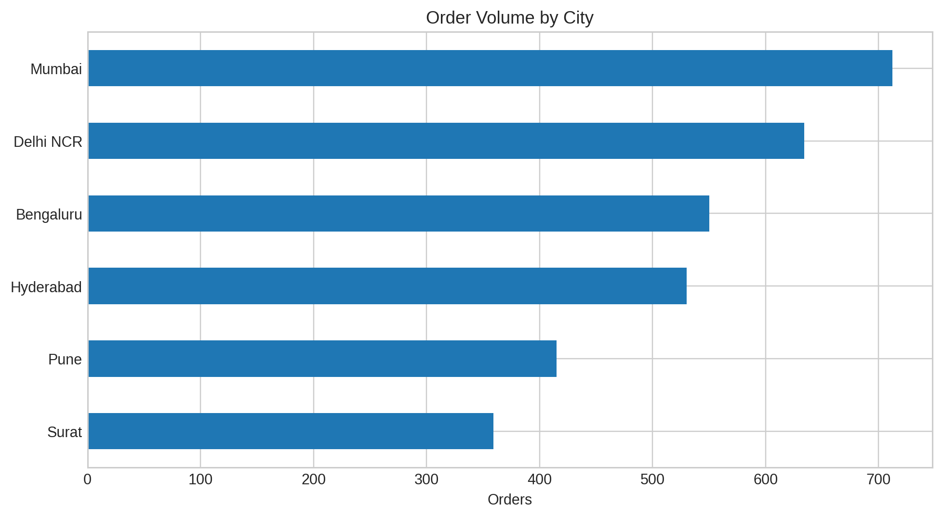
EDA Results 1
Order volume by city
Top city
Mumbai
Lowest volume
Surat
Demand is concentrated in Mumbai, Delhi NCR, and Bengaluru.
Smaller cities can be targeted with local promos.
6

Slide 7
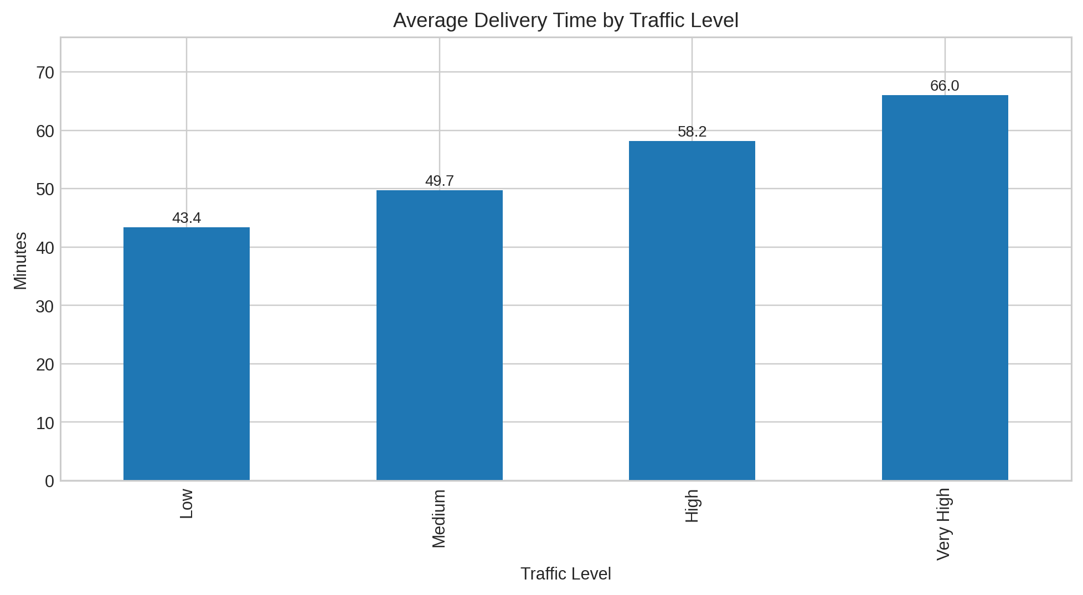
EDA Results 2
Delivery time rises with traffic
Low traffic averages about 43.4 minutes.
Very high traffic crosses 66 minutes.
Traffic control is the fastest lever for improvement.
Operational takeaway
Traffic-aware routing
7

Slide 8
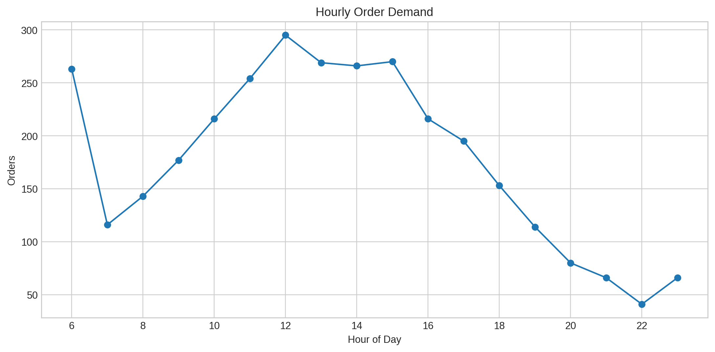
EDA Results 3
Hourly demand pattern
Orders peak around lunch and dinner hours.
Late-night demand is low and more variable.
Driver staffing should be shifted to the 12-14 and 19-21 windows.
Peak hours
12-14 and 19-21
8

Slide 9
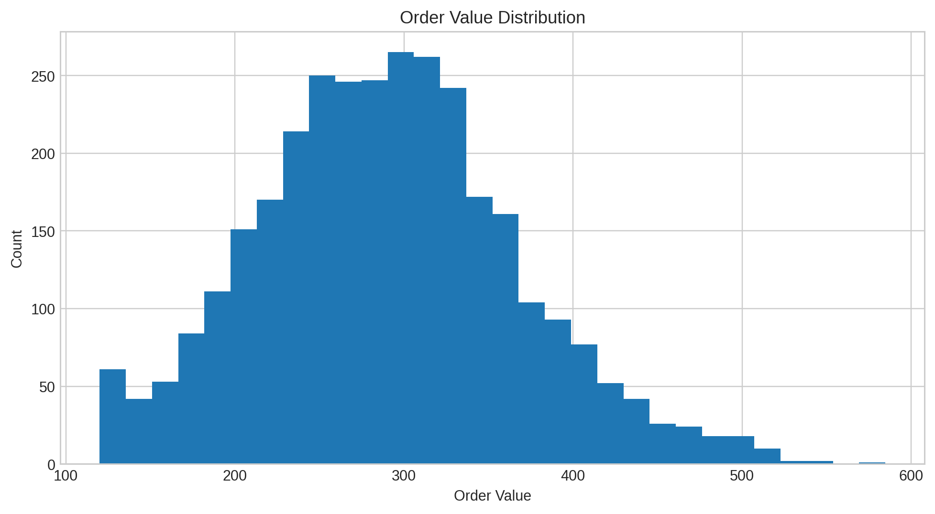
EDA Results 4
Order value distribution
Most baskets cluster around mid-range ticket sizes.
A small premium tail lifts revenue but also prep time.
Cross-sell bundles can raise average order value.
Revenue insight
Mid-range dominates
9

Slide 10
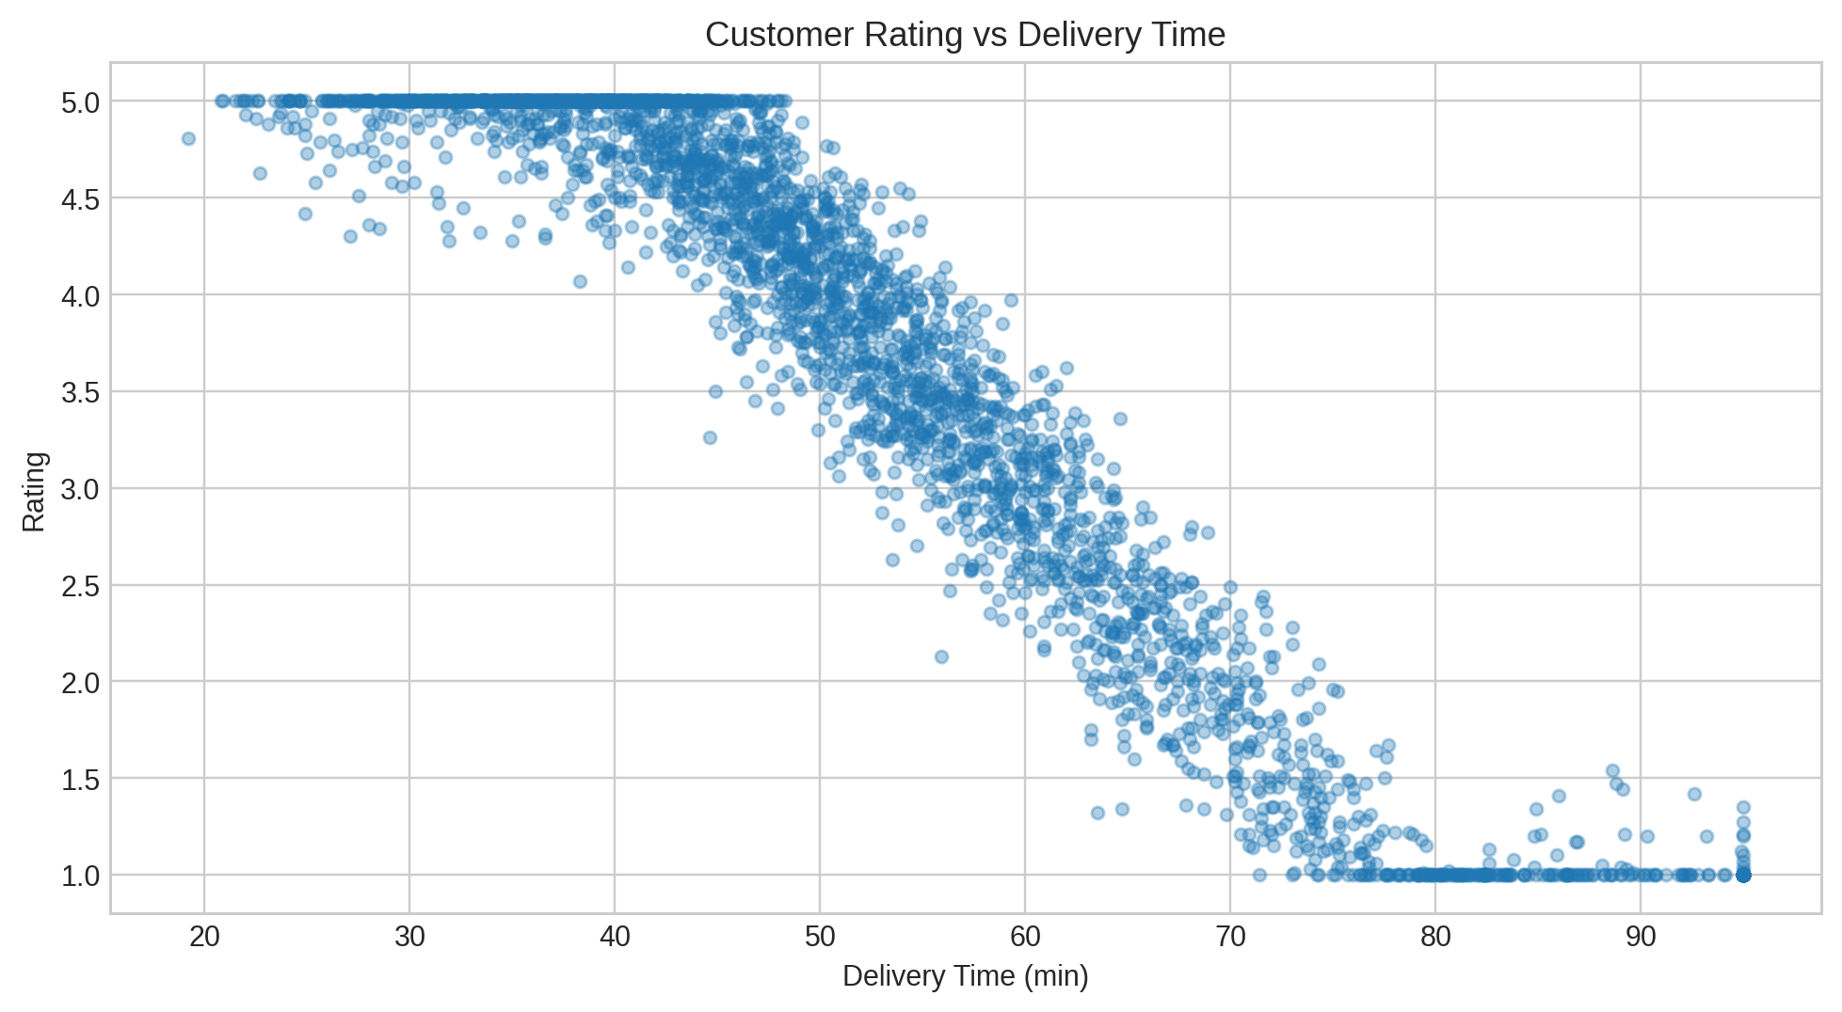
EDA Results 5
Customer rating falls as delivery time increases
The scatter trends downward as delivery time grows.
Slow deliveries hurt ratings even when food quality is stable.
Delay control is also a customer experience strategy.
Risk signal
Long waits = lower ratings
10

Slide 11
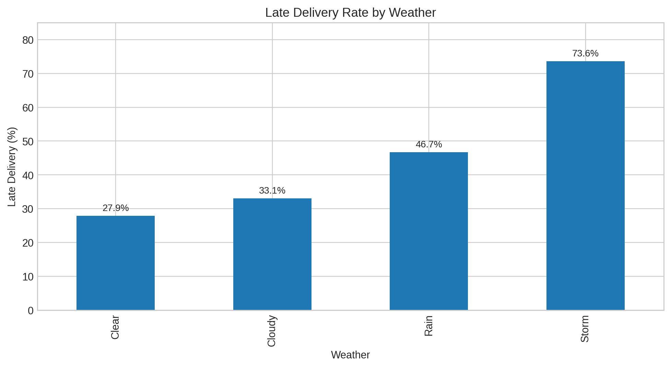
EDA Results 6
Late delivery spikes in bad weather
Storms are the worst condition for SLA breach.
Rain also raises lateness, but less severely.
Weather alerts should trigger routing buffers.
Best condition
Clear weather
11

Slide 12
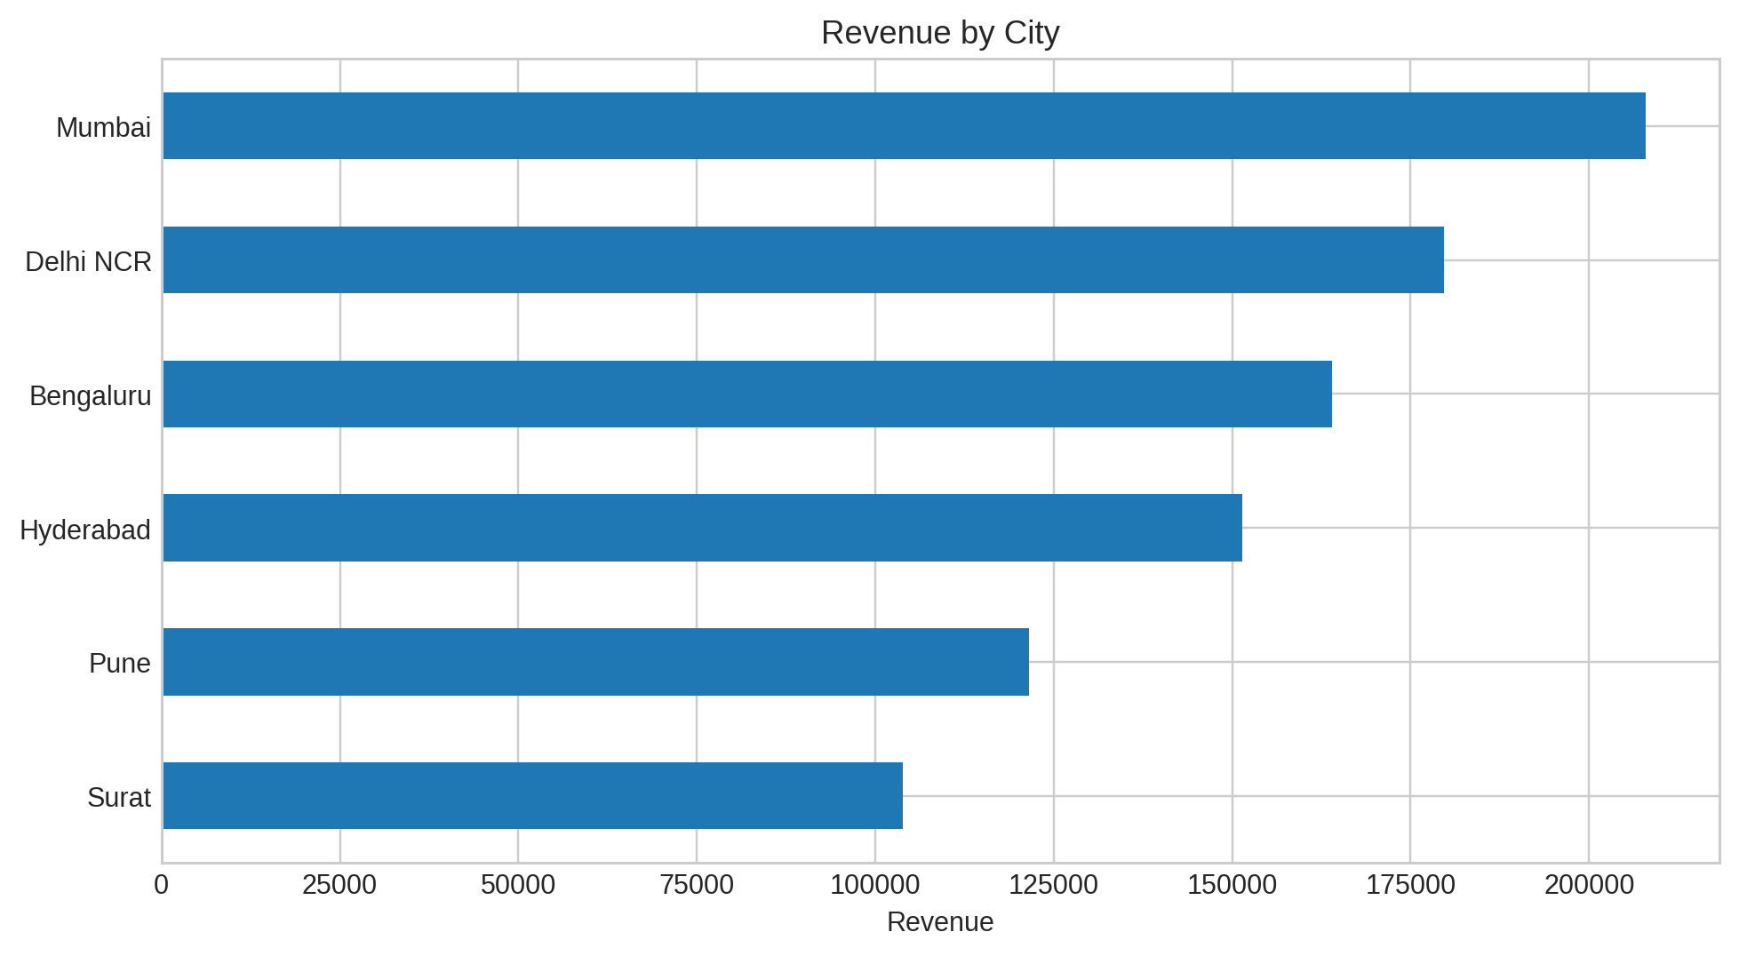
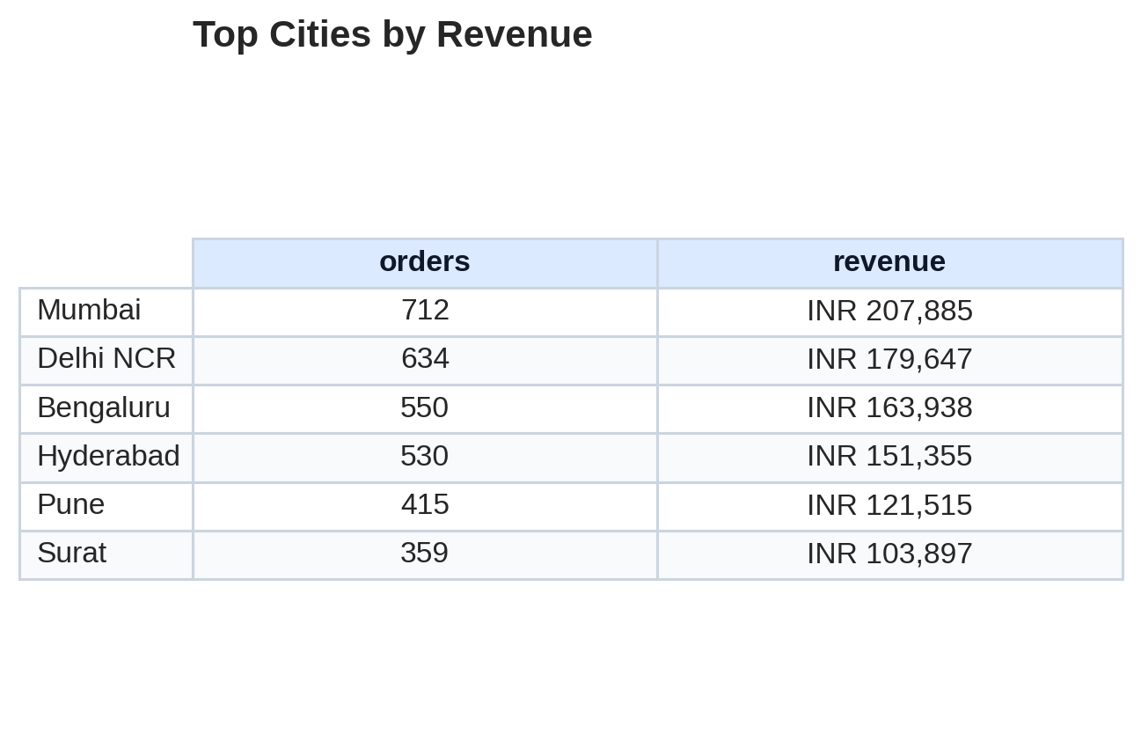
EDA with SQL Results 1
Revenue ranking by city
Mumbai produces the highest revenue.
Surat contributes the least revenue and also needs demand growth.
12

Slide 13
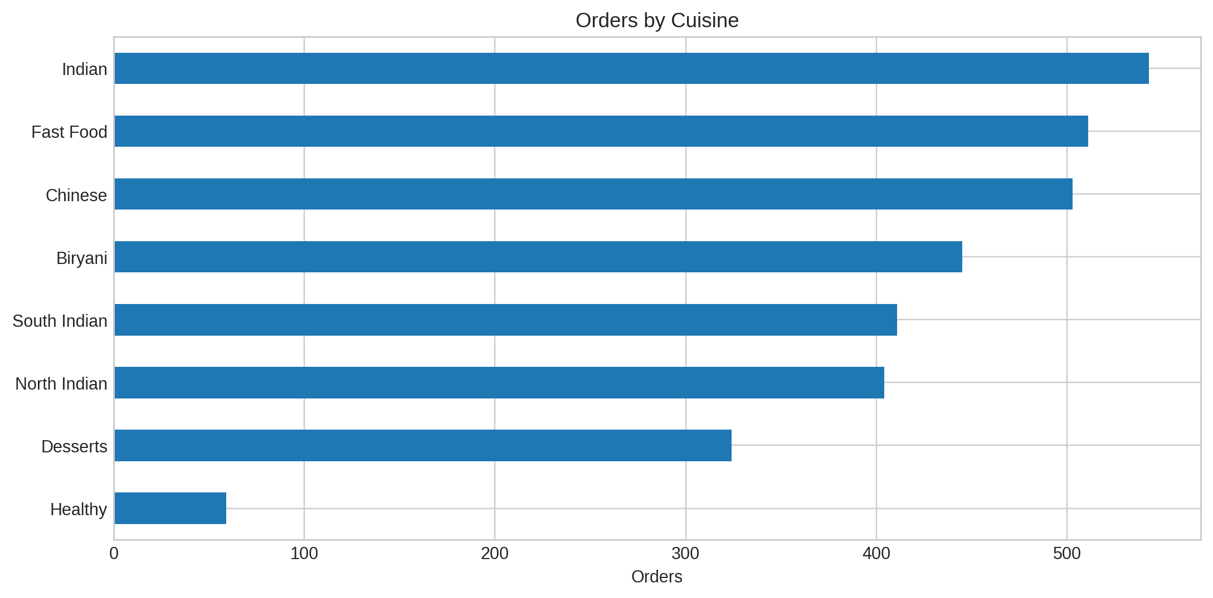
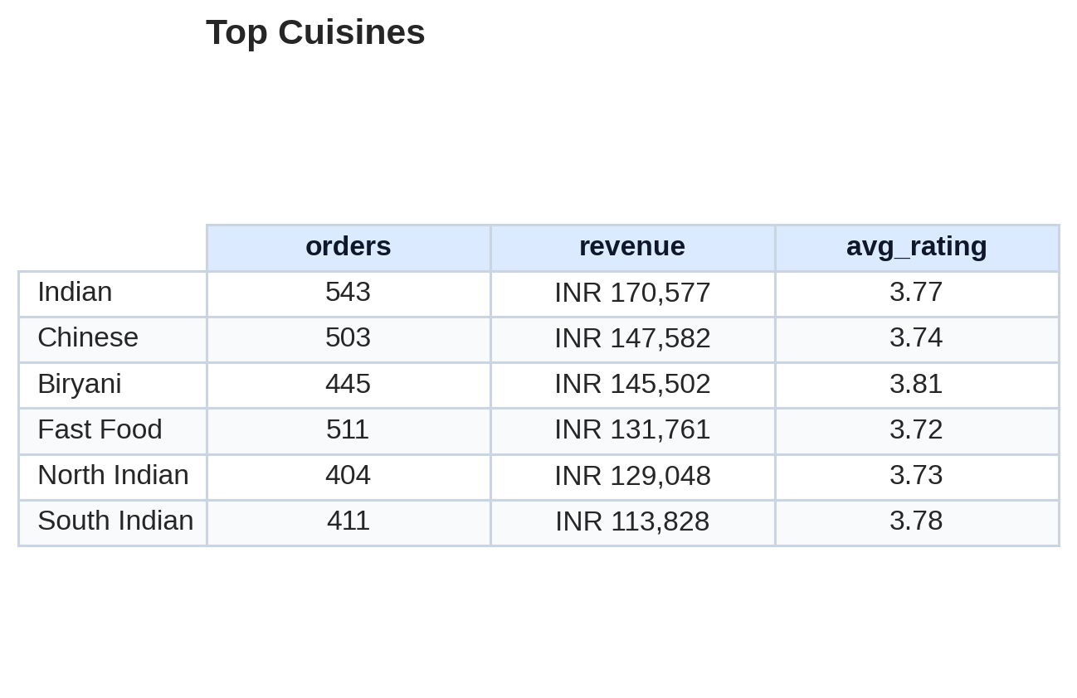
EDA with SQL Results 2
Cuisine performance
Indian and Chinese cuisines drive the biggest volume.
Biryani gives strong revenue with solid ratings.
13

Slide 14
EDA with SQL Results 3
Hourly peaks and operational timing
Top order hours
12-14 and 19-21
Lunch and dinner are the two demand spikes.
Mid-morning and late-night windows are much lighter.
Staffing should scale around these peaks.
14

Slide 15
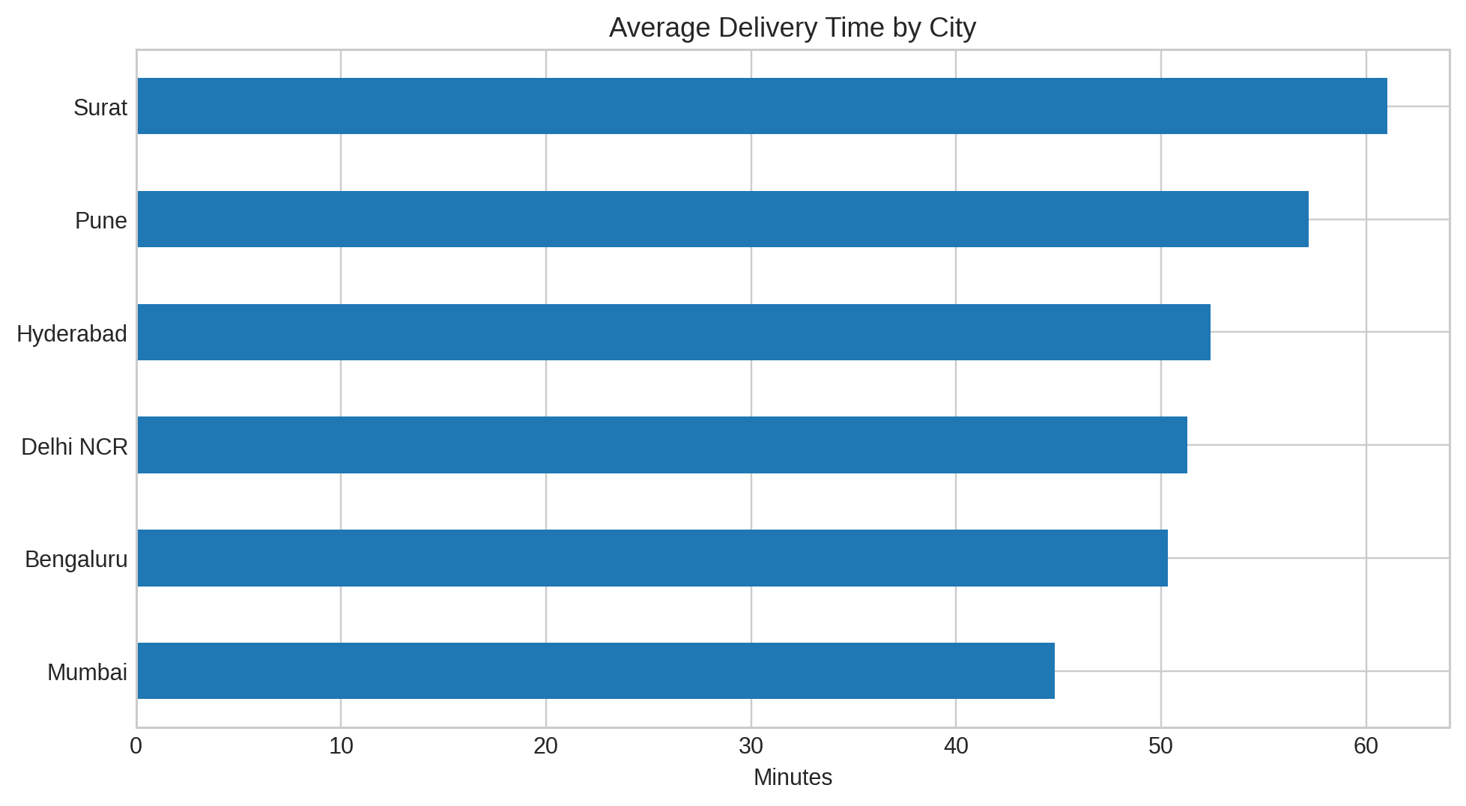
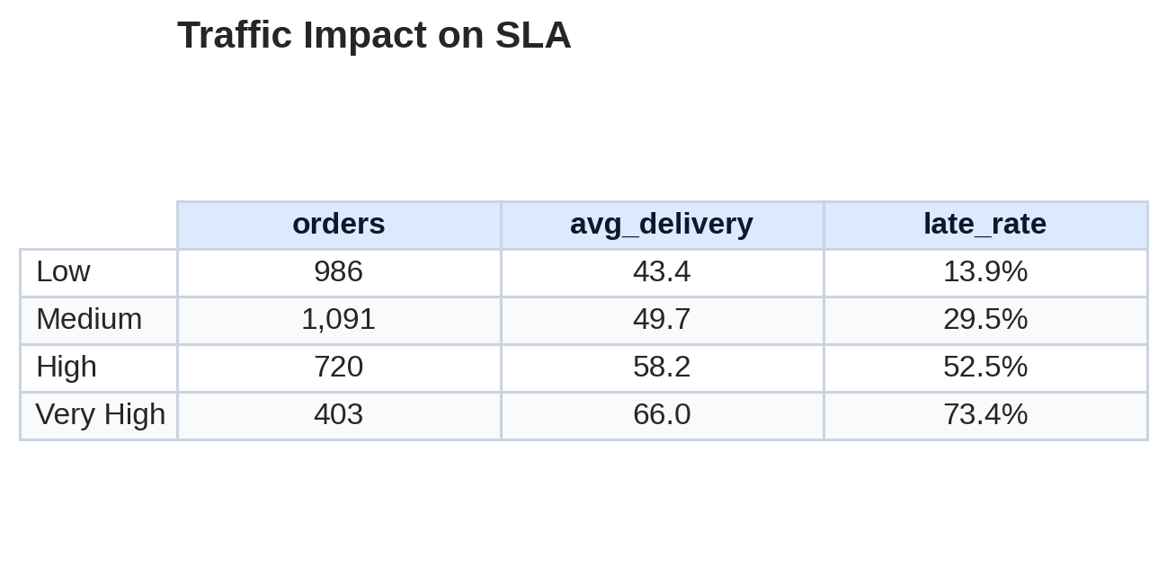
EDA with SQL Results 4
Traffic vs SLA table
Average delivery time jumps sharply when traffic moves from Medium to Very High.
This is the clearest sign that routing and batching need attention.
15

Slide 16
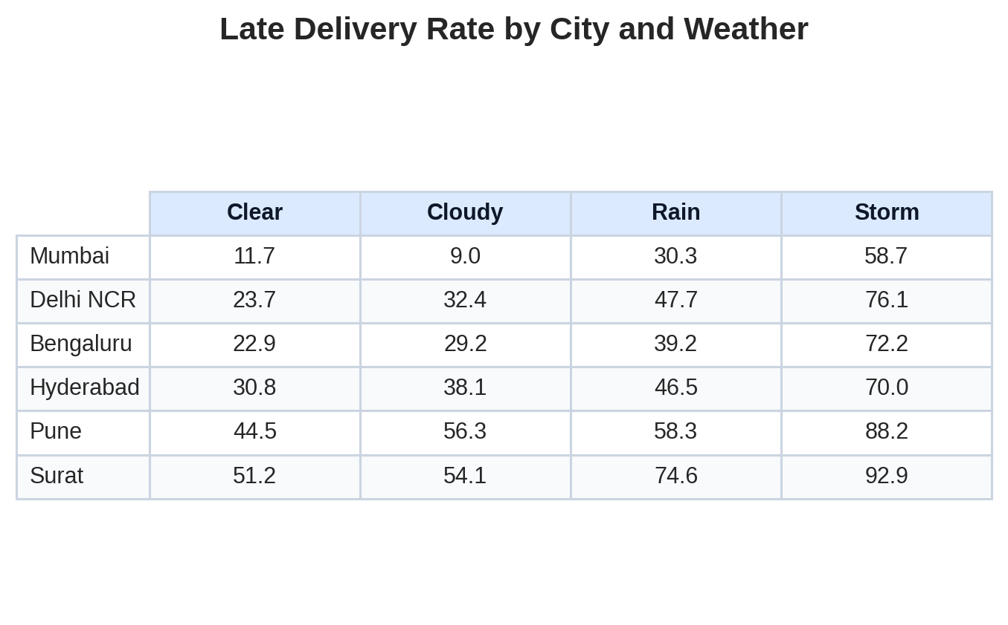
EDA with SQL Results 5
City and weather risk matrix
Surat and Pune show the sharpest weather-linked lateness.
Mumbai is comparatively resilient in every weather class.
This matrix helps set city-specific buffer rules.
Best practice
Use city buffers
16

Slide 17
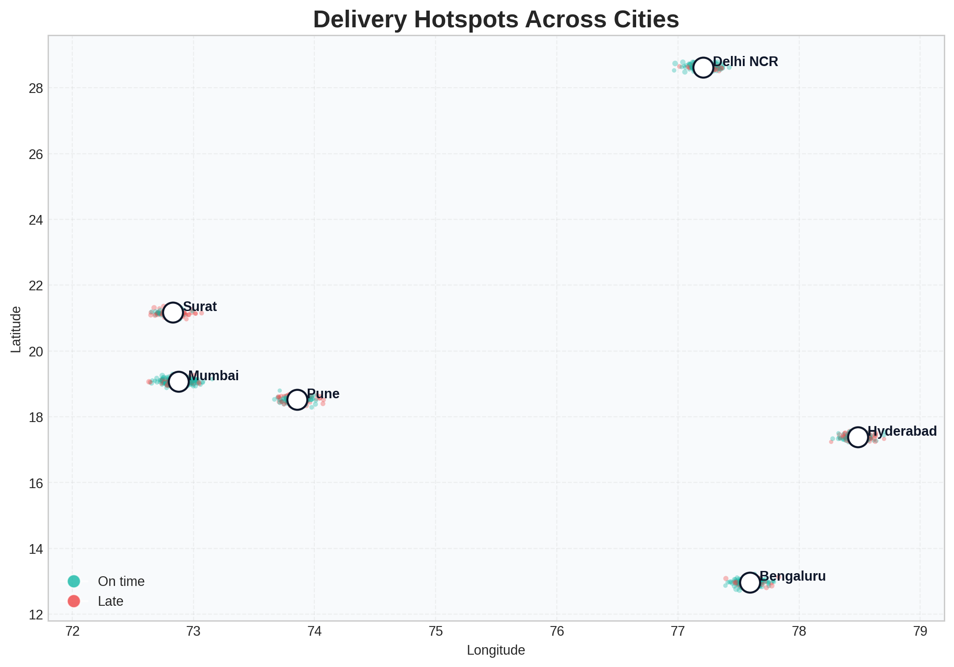
Interactive Map with Folium Results
Geospatial delivery hotspots
Hotspots cluster around major city centers.
Late orders are denser in longer-route zones.
The interactive Folium HTML is included in the project folder.
Map insight
City hotspots are visible
17

Slide 18
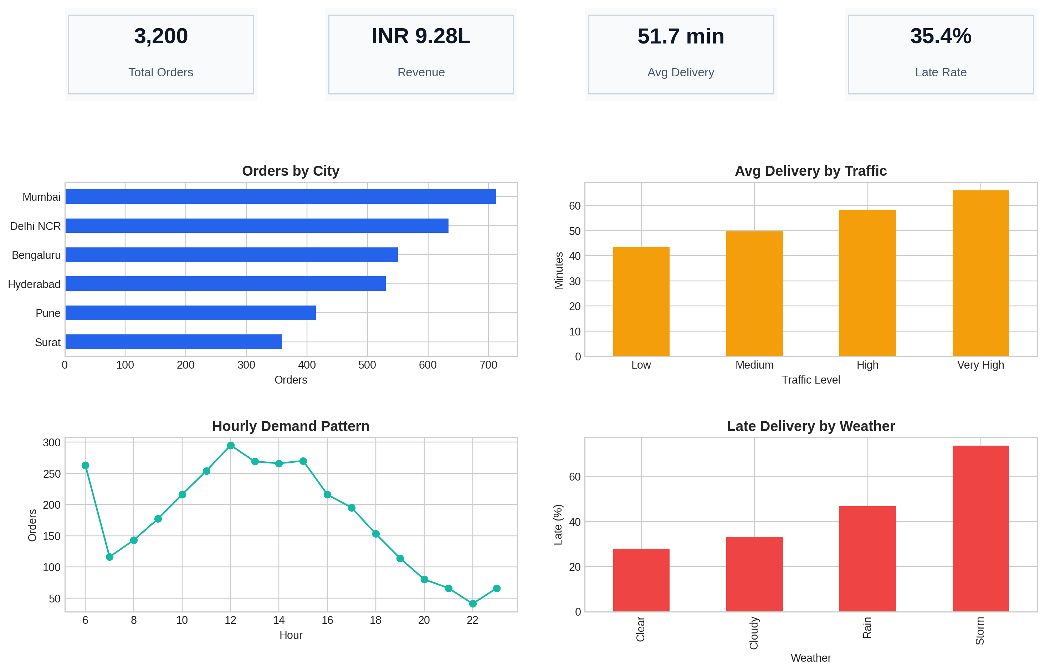
Plotly Dashboard Results
Operational snapshot
18

Slide 19
Predictive Analysis Methodology
Late delivery classification pipeline
Target
late_delivery
Model
Random Forest
Split
78 / 22
Encoding
One-hot
Features
Why this model works
It handles mixed data types well and captures non-linear delay patterns.
City, restaurant type, cuisine, channel, payment, traffic, weather
Order hour, distance, prep time, order value, weekend flag
19

Slide 20
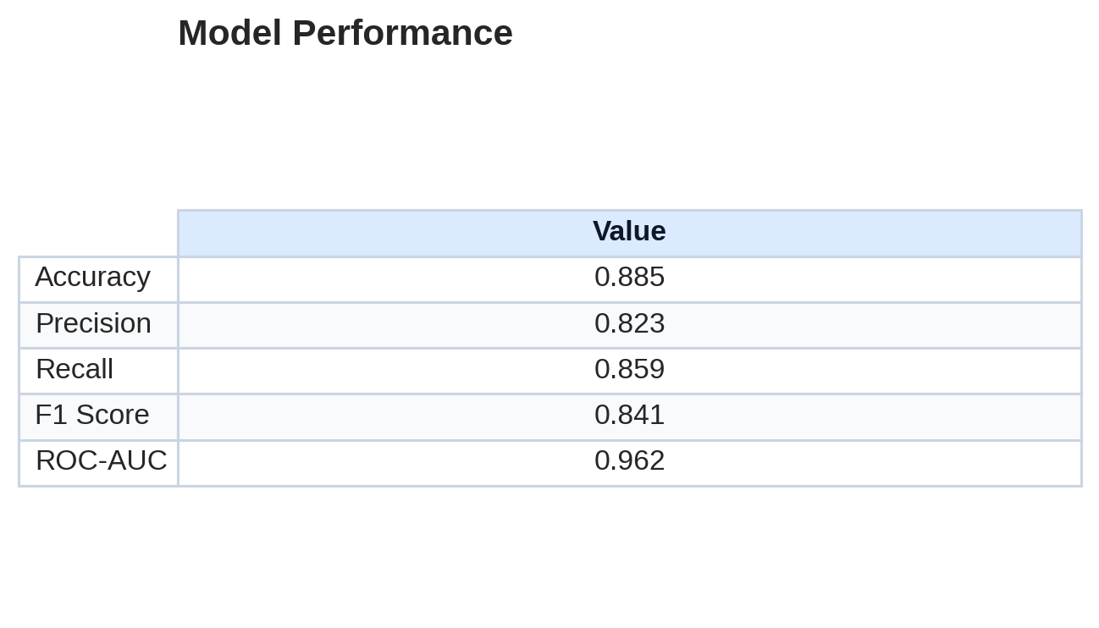
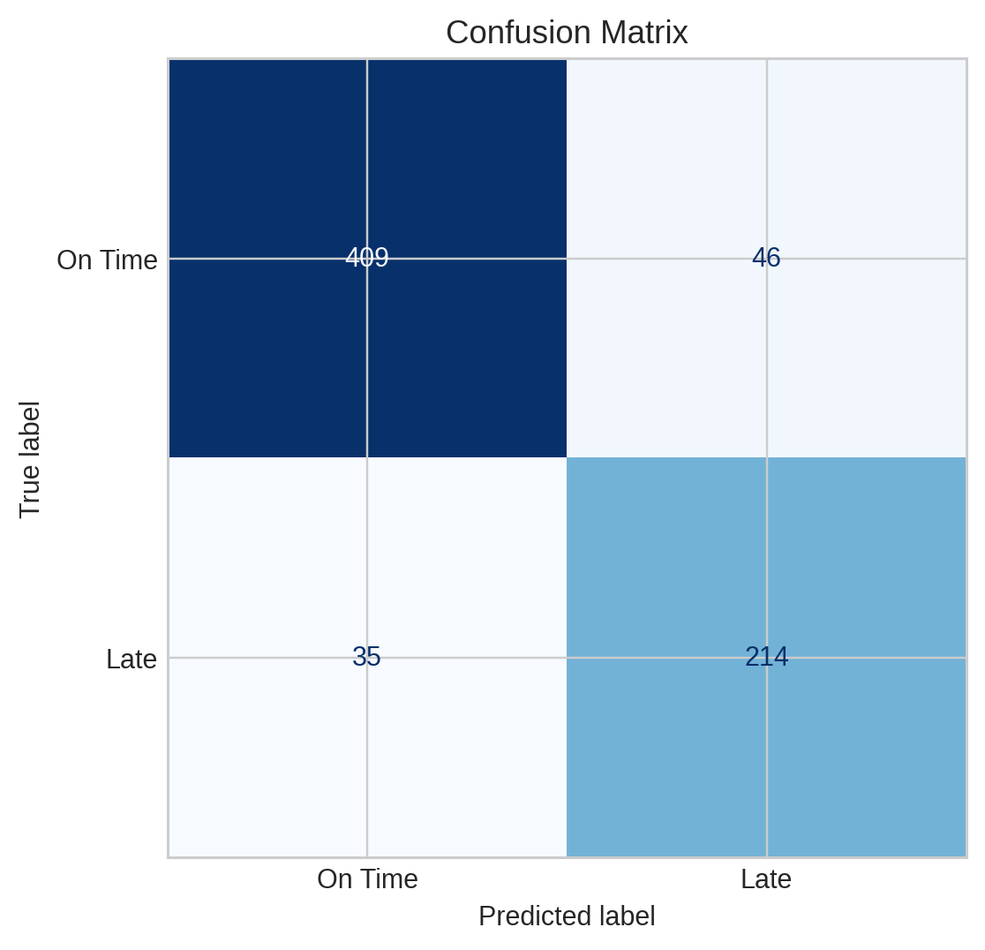
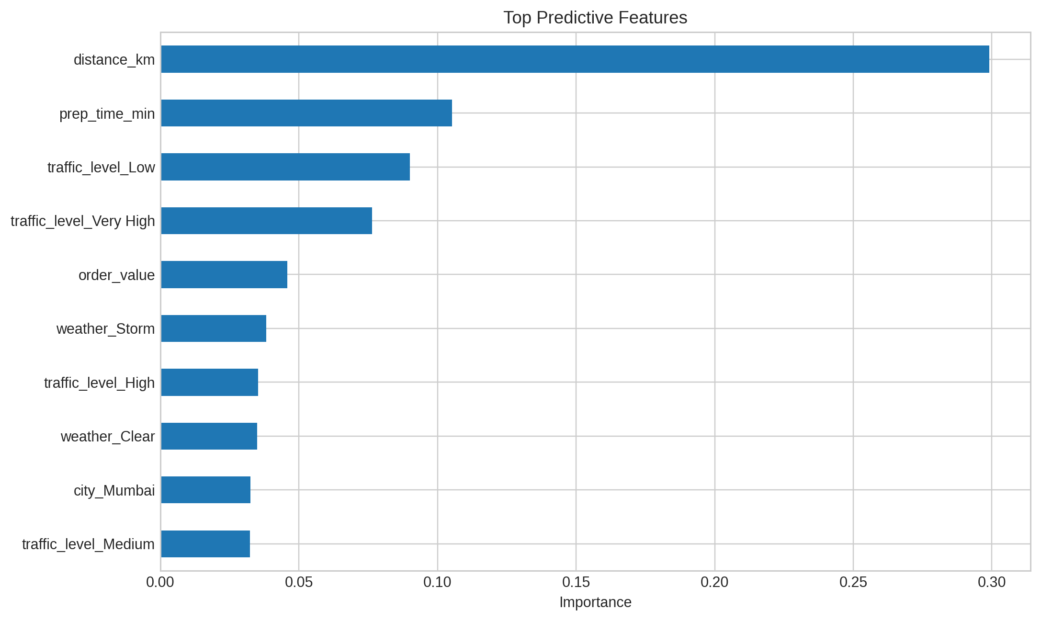
Predictive Classification Results
How well the model works
Distance and prep time are the dominant predictors.
Traffic and storm conditions push the model toward late delivery.
The model is strong enough to support early warning flags.
20

Slide 21
Creativity and Innovative Insights
Beyond the template
1. SLA scorecards
Show city-level lateness daily so managers can react fast.
2. Weather triggers
Add automatic buffers when rain or storms appear.
3. Zone balancing
Shift drivers to hotspots before the late-order spike.
Build a simple SLA alert rule: if traffic is High and weather is Rain, escalate the order.
Prioritize late-risk cities first, not just the biggest cities.
Use the map and dashboard together to move from insight to action.
21

Slide 22
Conclusion
Final takeaway
What the project shows
The workflow connects data cleaning, EDA, SQL, mapping, dashboarding, and classification into one story.
Operations should focus on traffic, weather, and route distance first.
Mumbai is the most stable city; Surat is the most vulnerable.
The predictive model can be used as an early warning layer.
Next step: replace the synthetic dataset with your real project data and keep the same presentation structure.
22

