Slide 1
JWT Token based Authentication and Authorization using Springboot By Akhilesh Pandey

Slide 2
Introduction to JWT
JWT stands for JSON Web Token.
JWTs are used to implement authentication and authorization in web applications.

Slide 3
Structure of a JWT
Header: Contains information about the token, such as type (JWT) and signing algorithm.
Payload: The main body of the token containing claims, which are statements about the user or entity.
Signature: Verifies the token's integrity, created by signing the header and payload with a secret or public/private key pair.

Slide 4
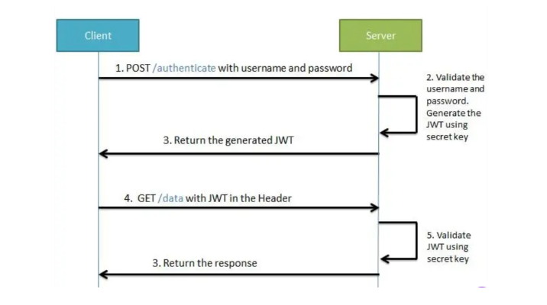

Slide 5
Step 1: Client sends a POST request to /authenticate with username and password. Step 2: Server validates the credentials and generates a JWT using a secret key. Step 3: Server returns the generated JWT to the client. Step 4: Client includes the JWT in the header of subsequent requests to the server. Step 5: Server validates the JWT using the secret key and responds accordingly.

Slide 6
Storing and Using JWTs
Storage: JWTs can be stored in local storage or session storage on the client side.
Usage: Include the JWT in the Authorization header of HTTP requests for subsequent interactions with the server.

Slide 7
Advantages of Using JWT
Stateless Authentication: No need to store session information on the server.
Scalability: Easy to scale across multiple servers or services.
Interoperability: JWTs can be used across different domains and platforms.

Slide 8
Implementing JWT with Spring Security
Use Spring Security to handle authentication and authorization.
Integrate JWT for stateless authentication.
Secure endpoints by validating JWTs in incoming requests.

Slide 9
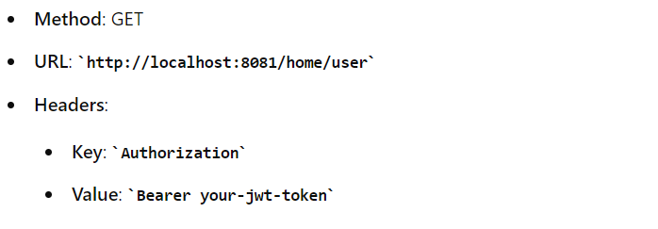
Testing
http://localhost:8081/auth/login {
"email": "prathiksha",
"password": "abc"
}
http://localhost:8081/home/user

