Slide 1
Microservices
Akhilesh Pandey

Slide 2
Agenda
Why Microservices?
What Is Microservices?
Features Of Microservice Architecture
Advantages Of Microservice Architecture
Best Practices To Design Microservices
Companies Using Microservices

Slide 3
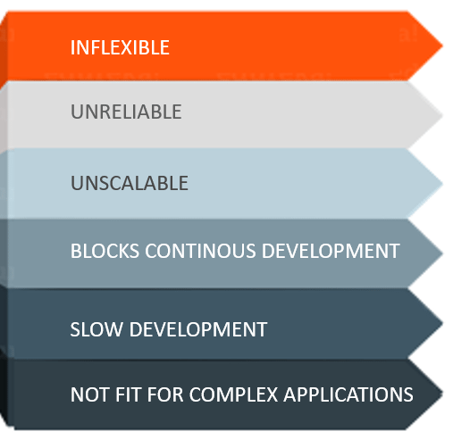
Challenges of Monolithic Architecture

Slide 4
Challenges of Monolithic Architecture
Inflexible – Monolithic applications cannot be built using different technologies
Unreliable – Even if one feature of the system does not work, then the entire system does not work
Unscalable – Applications cannot be scaled easily since each time the application needs to be updated, the complete system has to be rebuilt
Blocks Continous Development – Many features of the applications cannot be built and deployed at the same time
Slow Development – Development in monolithic applications take lot of time to be built since each and every feature has to be built one after the other
Not Fit For Complex Applications – Features of complex applications have tightly coupled dependencies

Slide 5
What Is Microservices?
Microservices, is an architectural style that structures an application as a collection of small autonomous services, modeled around a business domain.
In Microservice Architecture, each service is self-contained and implements a single business capability.
Micro Service is an architecture that allows the developers to develop and deploy services independently.
Each service running has its own process and this achieves the lightweight model to support business applications.

Slide 6
Advantages of Microservices
Easy deployment
Simple scalability
Compatible with Containers
Minimum configuration
Lesser production time

Slide 7
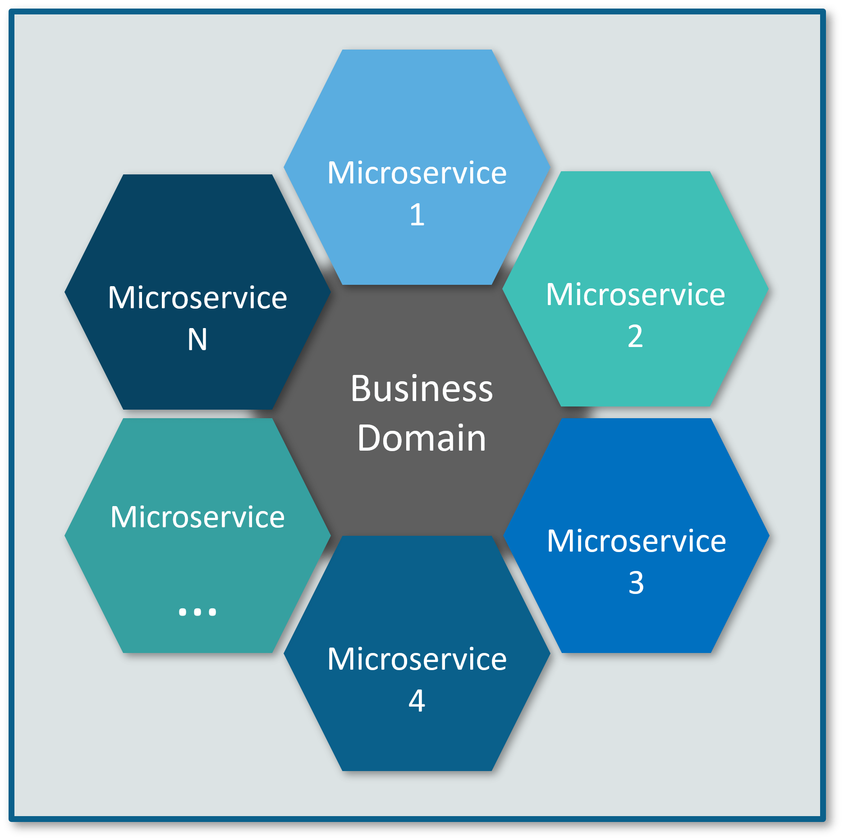
Microservices Representation

Slide 8
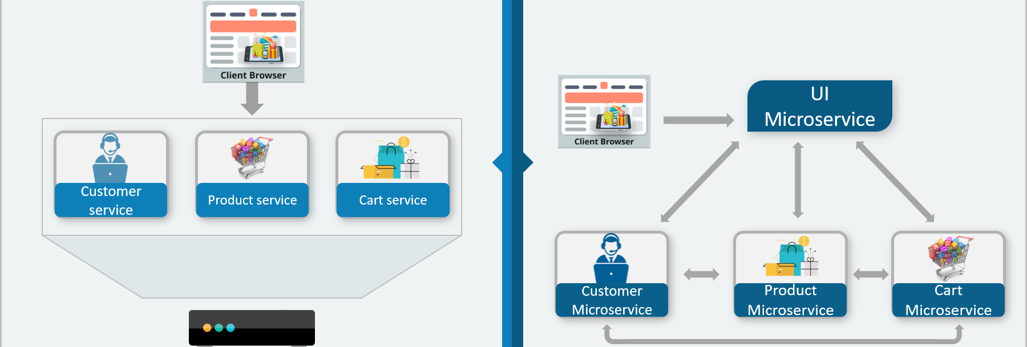
Traditional Architecture vs Microservices

Slide 9
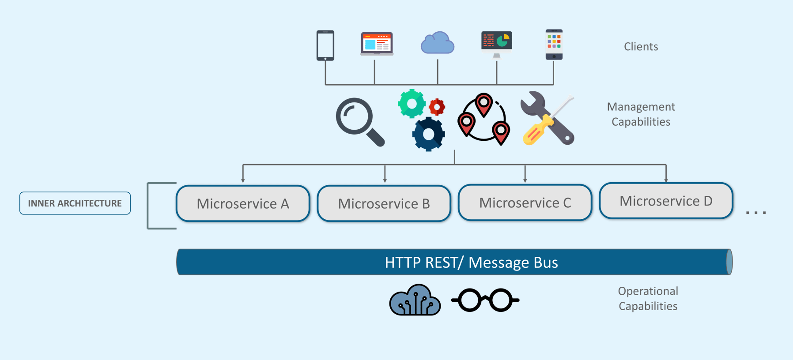
Microservice Architecture

Slide 10
Microservice Architecture
Different clients from different devices try to use different services like search, build, configure and other management capabilities
All the services are separated based on their domains and functionalities and are further allotted to individual microservices
These microservices have their own load balancer and execution environment to execute their functionalities & at the same time captures data in their own databases
All the microservices communicate with each other through a stateless server which is either REST or Message Bus
Microservices know their path of communication with the help of Service Discovery and perform operational capabilities such as automation, monitoring
Then all the functionalities performed by microservices are communicated to clients via API Gateway
All the internal points are connected from the API Gateway. So, anybody who connects to the API Gateway automatically gets connected to the complete system

Slide 11
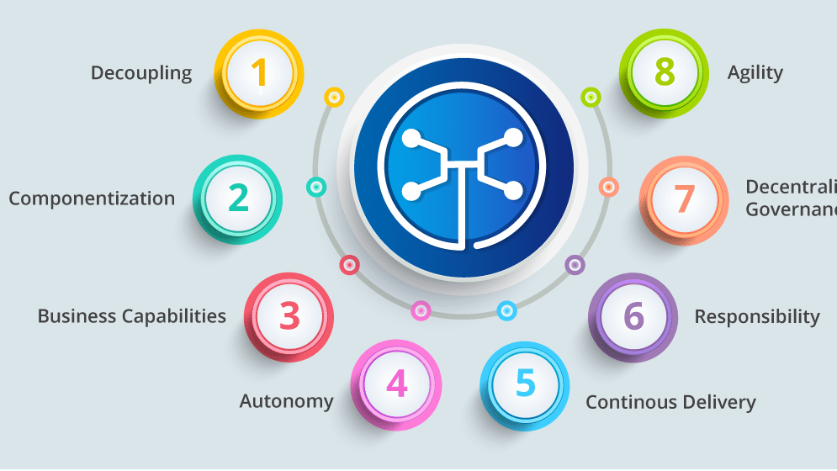
Microservices Features

Slide 12
Microservices Features
Decoupling – Services within a system are largely decoupled. So the application as a whole can be easily built, altered, and scaled
Componentization – Microservices are treated as independent components that can be easily replaced and upgraded
Business Capabilities – Microservices are very simple and focus on a single capability
Autonomy – Developers and teams can work independently of each other, thus increasing speed
Continous Delivery – Allows frequent releases of software, through systematic automation of software creation, testing, and approval
Responsibility – Microservices do not focus on applications as projects. Instead, they treat applications as products for which they are responsible
Decentralized Governance – The focus is on using the right tool for the right job. That means there is no standardized pattern or any technology pattern. Developers have the freedom to choose the best useful tools to solve their problems
Agility – Microservices support agile development. Any new feature can be quickly developed and discarded again

Slide 13
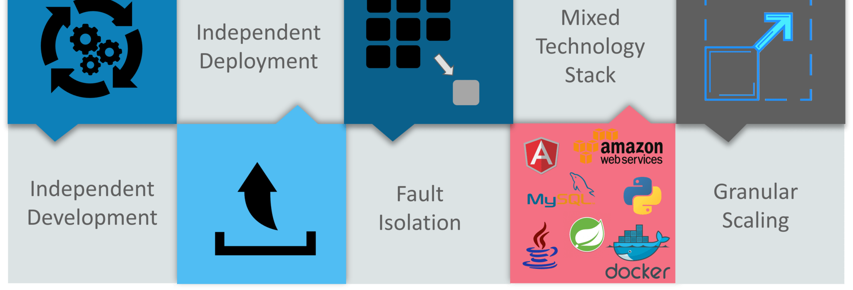
Advantages Of Microservices

Slide 14
Advantages Of Micro-services
Independent Development – All microservices can be easily developed based on their individual functionality
Independent Deployment – Based on their services, they can be individually deployed in any application
Fault Isolation – Even if one service of the application does not work, the system still continues to function
Mixed Technology Stack – Different languages and technologies can be used to build different services of the same application
Granular Scaling – Individual components can scale as per need, there is no need to scale all components together

Slide 15
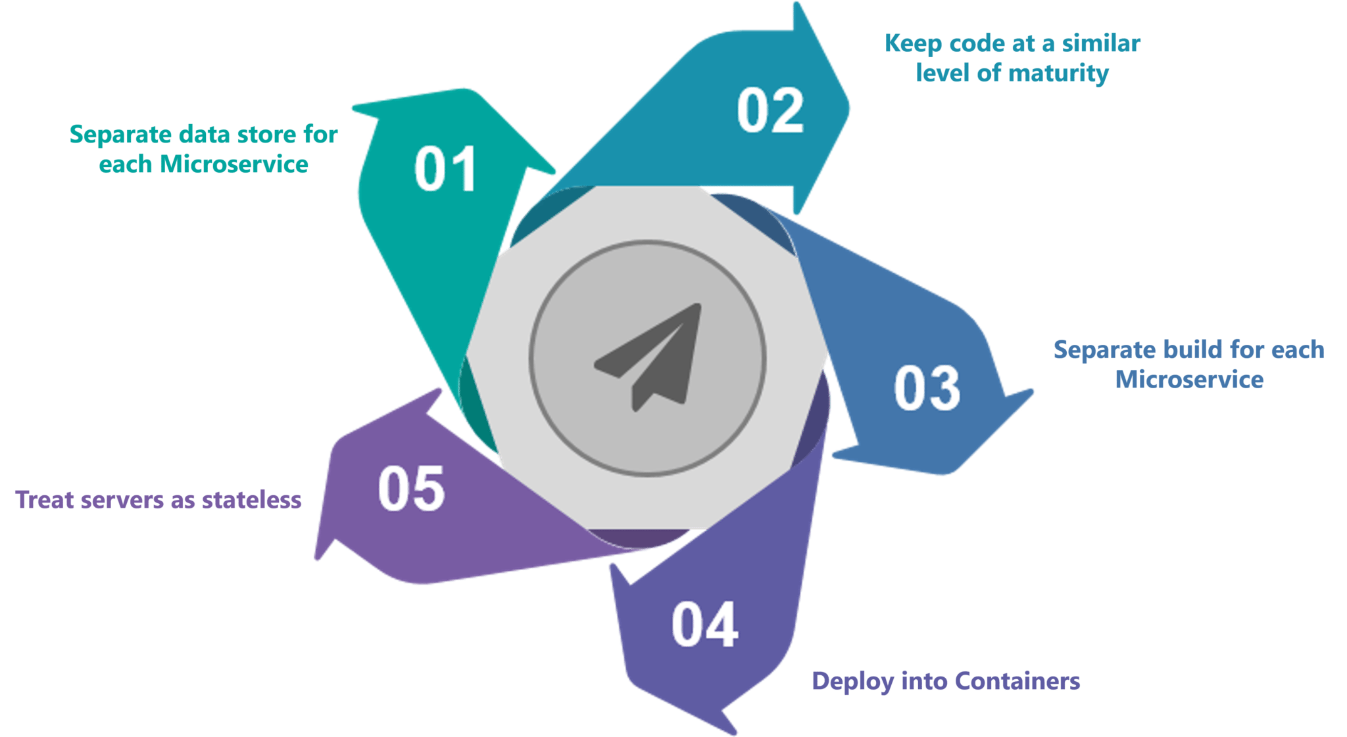
Best Practices To Design Microservices

Slide 16

Companies using Microservices

Slide 17
Thank You !

