Slide 1
Clinical Natural Language Technology
for Health Care: Past, Present & Future
Akhil Gorantala — St. Francis College
Cotiviti GenAI Science Internship · Demonstration
github.com/akhilg-9/cotiviti-cni-assessment

Slide 2
The Problem
Why clinical language technology matters to Cotiviti
~80%
• Notes, discharge summaries, path/radiology reports, scanned charts.
• That text hides coding accuracy, quality gaps, recoverable dollars.
• Reading it at scale is a direct lever on Treatment, Payment & Operations.
of healthcare data is unstructured text
$31.7B
Medicare FFS improper payments, FY2024 (CMS, 7.66%)

Slide 3
Past → Present → Future
Three eras of clinical NLP
• PAST — rule-based: dictionaries, regex, ontologies (UMLS/SNOMED/ICD), NegEx.
– Transparent and deterministic, but brittle: finds only what it was told about.
• PRESENT — LLM structured extraction: reads the note in context.
– Normalizes phrasing, codes to ICD-10, reasons about negation and uncertainty.
• FUTURE — multimodal (LMM): the model reads the scanned page image directly.
– The separate OCR stage disappears.

Slide 4
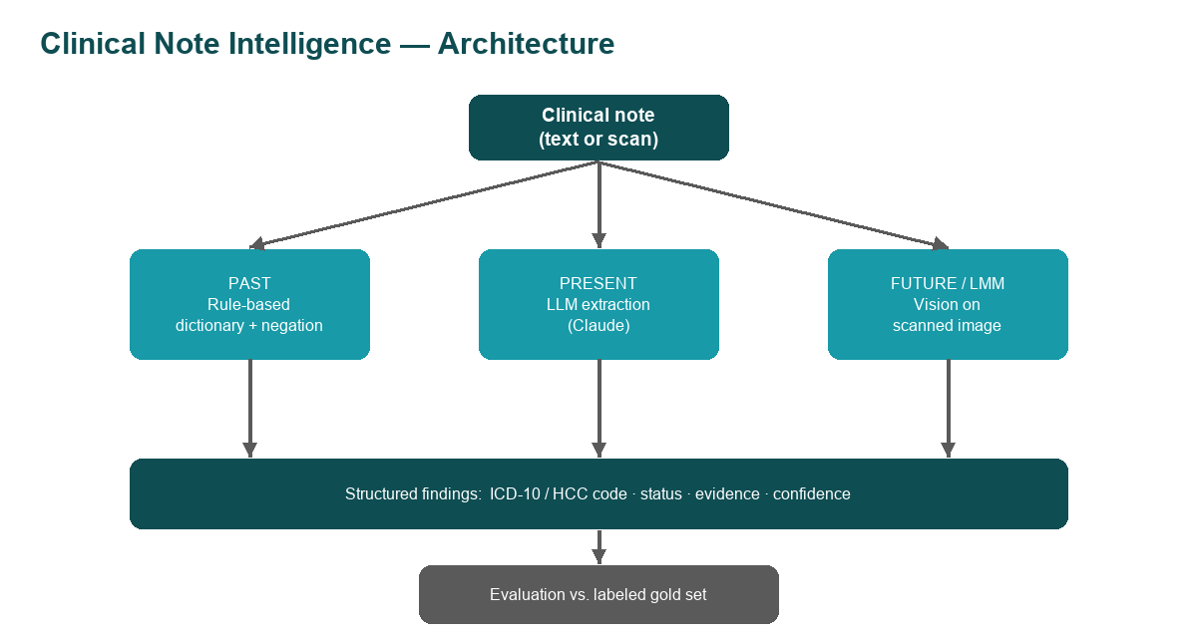
Proof of Concept
One pipeline, three eras, same note — measurable
• Free-text note → codeable ICD-10 / HCC findings.
• Every finding carries status, verbatim evidence, and confidence.
• Schema-enforced JSON — malformed model output is rejected.
• Versioned prompts, 17 unit tests, ruff-linted CI, Streamlit UI.
• Validated live on real de-identified notes (discharge
summaries, an H&P, five MTSamples transcriptions).

Slide 5
Measured Results — Labeled Gold Set
cni eval · 11 conditions across 2 notes · live claude-haiku-4-5, temperature 0
Status accuracy — where the eras separate
Era | Precision | Recall | F1 | Status accuracy
Past — rules | 1.00 | 0.82 | 0.90 | 89%
Present — LLM | 1.00 | 1.00 | 1.00 | 100%
100
89
Recall: rules miss edema and fatigue outright — terms outside the dictionary.
Status: the note says hypertension is "suspected, not yet confirmed" —
rules code it ACTIVE (backward-only negation scan); the LLM says UNCERTAIN.
rules
LLM

Slide 6
Real Notes, Real Gap
Findings per era on real de-identified notes (live runs)
17
16
10
9
8
7
2
1
0
Discharge summary (pyelonephritis)
CLL + hemolytic anemia follow-up
CAD 6-month follow-up
Past — rules
Present — LLM
Future — vision
Rules missed the discharge diagnosis itself — pyelonephritis (N10).

Slide 7
The Failure That Matters
Found organically on a real cardiology note
"…cardiac catheterization showed NO EVIDENCE OF coronary artery disease."
• Rule-based era: reports CAD as ACTIVE — the negation pattern never fires.
• LLM era: correctly omits it.
• That is a false diagnosis a payer would have had to defend.
• Pinned as a unit test — the brittleness is documented behavior, not an anecdote.

Slide 8
Guardrails Built In
A deterministic guard + audit trail on a probabilistic model
74,719
97.8%
92.1%
official ICD-10-CM codes every emitted code checked
LLM codes valid across real-note runs
vision codes valid every miss flagged
• Flagged live: R61.9, R21.9 — well-formed codes that don't exist.
• Code-set drift caught: M54.5, D59.1, C91.1 were valid in earlier fiscal
– years, since subdivided — the model codes from its training era; the FY2026 table catches it.
• Every run writes an audit artifact: note, model, prompt version, findings + evidence.

Slide 9
Opportunities & Threats
Opportunities
Threats
• Chart-to-code automation for risk adjustment (HCC) and payment integrity.
• Policy → executable rules; summarize and compare policy versions.
• Quality-measure abstraction (HEDIS) from free text.
• Clinical validation for prior authorization and appeals.
• Hallucinated codes/evidence — unacceptable when payment depends on it.
• PHI / HIPAA and data-governance obligations.
• Regulatory scrutiny (FDA, ONC); auditability demands.
• Model bias/equity; vendor cost and lock-in.

Slide 10
Recommended Actions
Differentiate on trustworthy, explainable clinical AI
• Governed, human-in-the-loop chart review with span-level evidence per code.
• Pair LLM extraction with deterministic ICD-10/HCC validation (as this POC does).
• Adopt multimodal models for scanned/faxed records — retire brittle OCR pipelines.
• Stand up evaluation + guardrail frameworks before production.

Slide 11
Key Takeaways
1
The eras separate on judgment, not detection
Status accuracy 89% → 100%; on real notes the dictionary missed the discharge diagnosis itself.
2
Trust is an architecture, not a model property
Official code-table validation + evidence spans + audit artifacts make LLM output defensible.
3
This maps directly to Cotiviti's franchise
Chart-to-code for risk adjustment and payment integrity, with $31.7B/yr of improper payments in scope.

Slide 12
Thank you
Akhil Gorantala · Cotiviti GenAI Science Internship Demonstration
github.com/akhilg-9/cotiviti-cni-assessment

