Slide 1
AKHIL (BM20BTECH11001)
YASHAS (AI20BTECH11027)

Slide 2
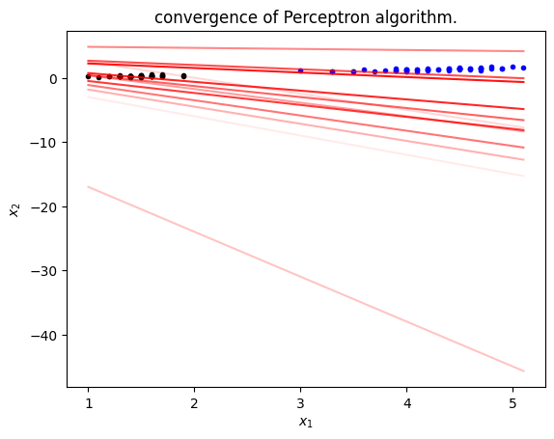
Question 1a)

Slide 3
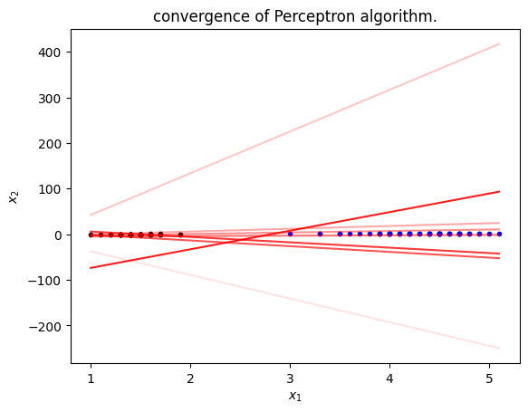
Question 1b)

Slide 4
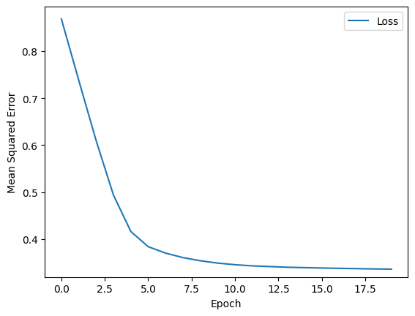
Question 1c)

Slide 5
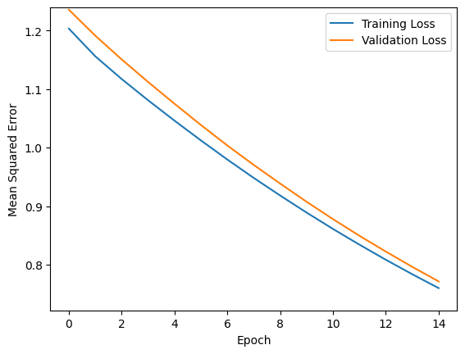
Lr 0.001 (Question 2a)

Slide 6
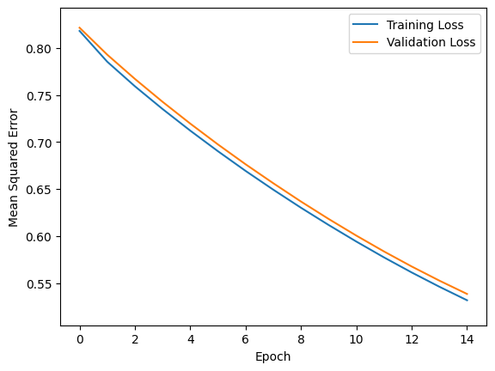
Lr 0.01 (Question 2a)

Slide 7
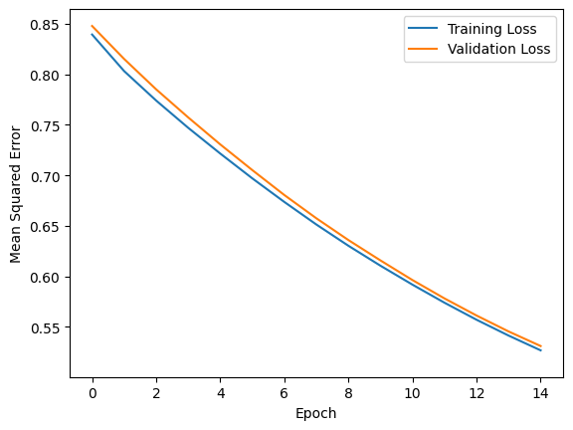
Lr 0.1 (best value, found by hit and trail!) - Question 2a

Slide 8
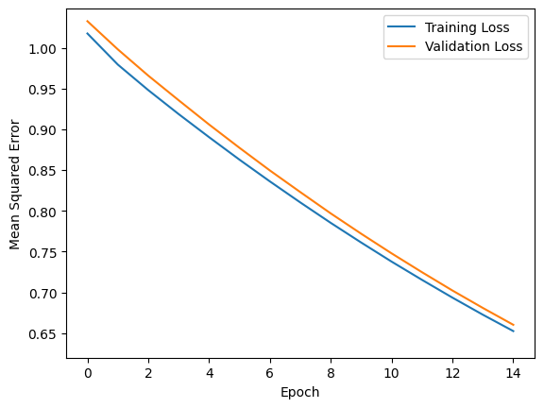
Lr 0.5 (Question 2a)

Slide 9
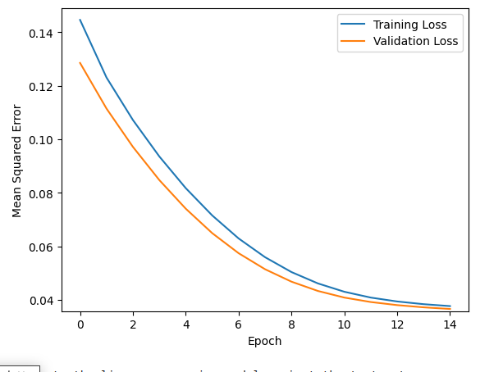
Question 2c (Min max normalization)
i)

Slide 10
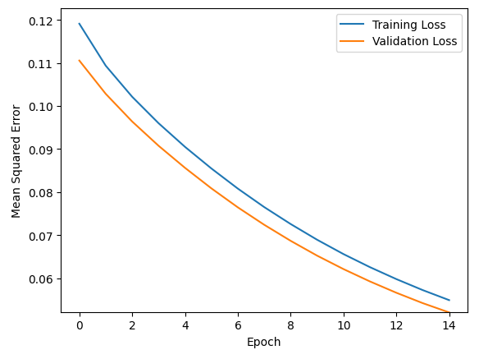
Question 2c (Mean normalization)
ii)

Slide 11
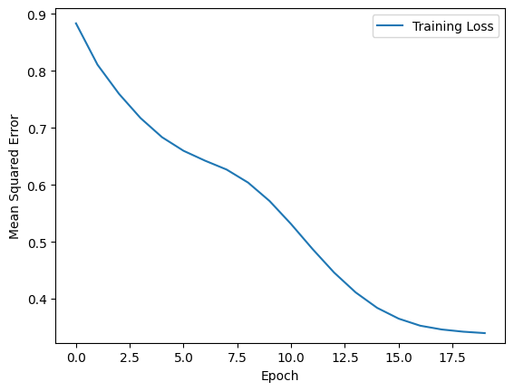
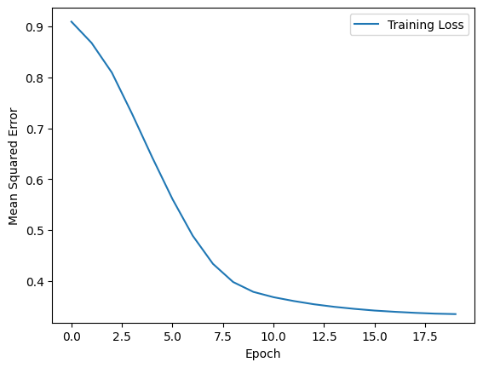
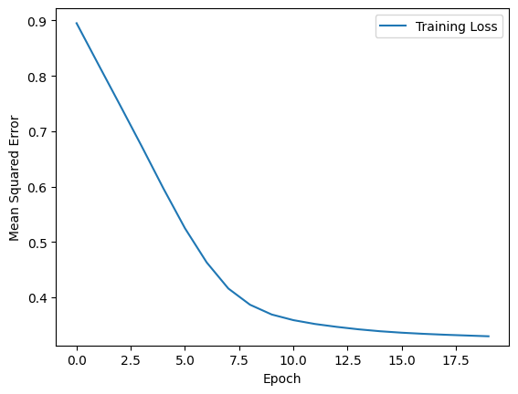
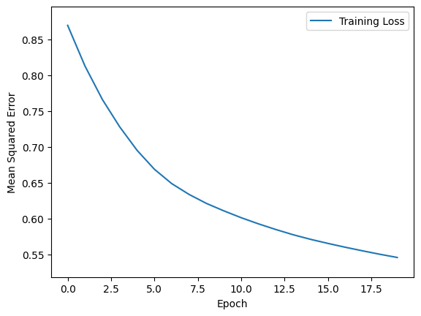
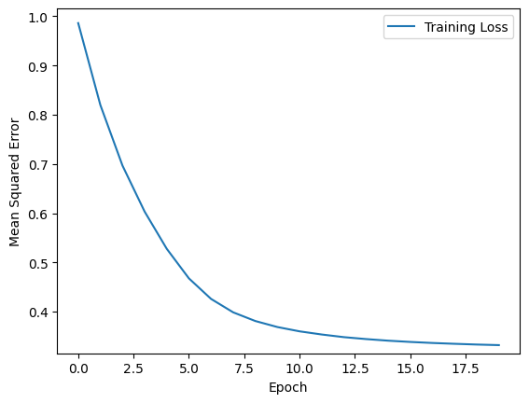
5 folds, outputs

Slide 12
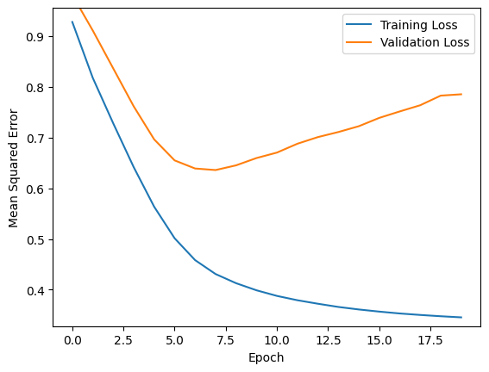
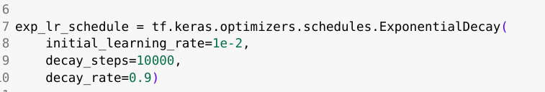
Exp learning rate

Slide 13
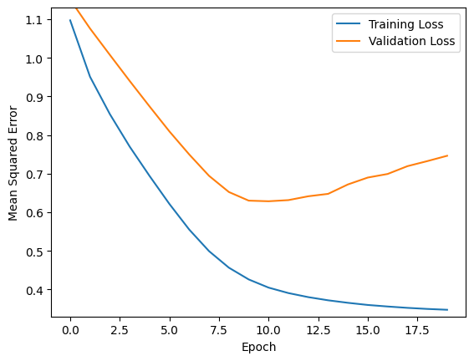
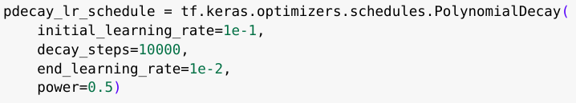
Poly decay learning rate

Slide 14
Best trails results
Clearly, Model is overfitting! We need to regularise!
 | poly decay | Exp decay
Rmse train | 0.35 | 0.27
Rmse val | 0.6 | 0.59

Slide 15
3 layers model architecture

Slide 16
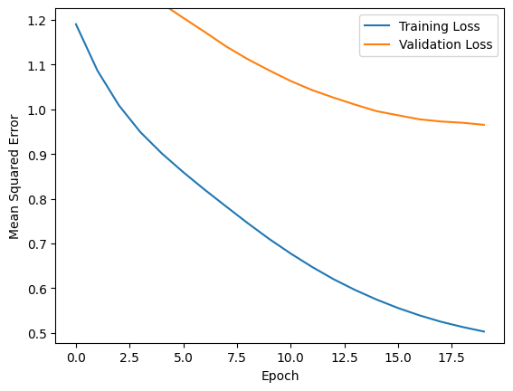
2 layers model architecture

Slide 17
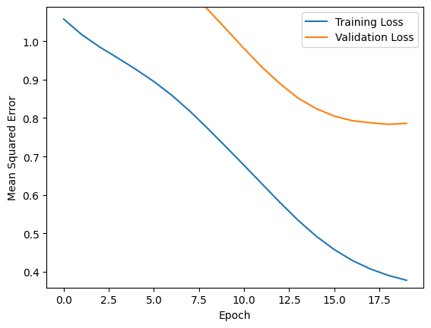
1 layers model architecture

Slide 18
Best architecture is 3 layers,
7 nodes
5 nodes
2 nodes
Rmse train: 0.27
Rmse val: 0.59
Still, clearly, its overfitting, so we have to regularize

Slide 19
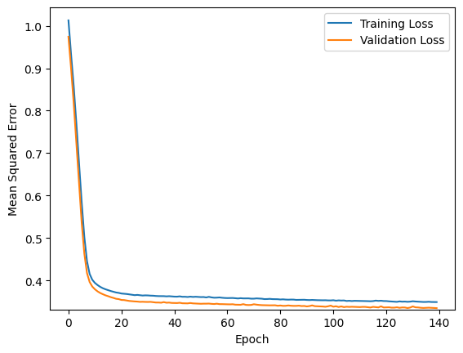
L2 (param=0.04)
Train rmse: 0.25, val rmse: 0.3

Slide 20
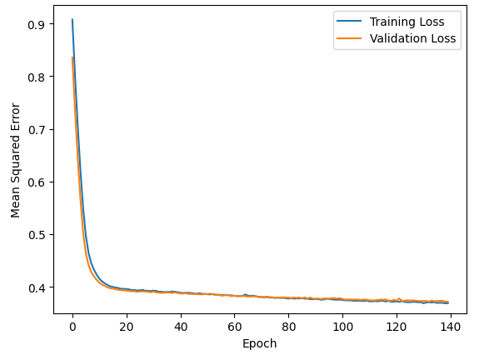
L2 (param=0.1)
Train rmse: 0.3692, val rmse: 0.3718

Slide 21
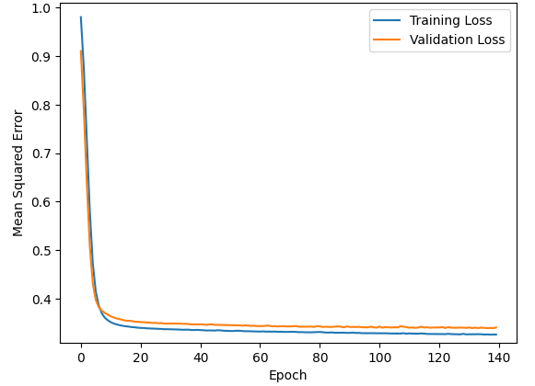
L2 (param=0.005)
Train rmse: 0.3260, val rmse: 0.3597

Slide 22
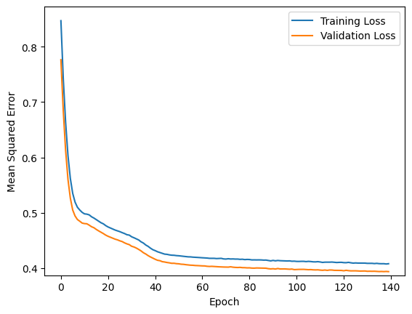
L1 (param=0.04)
Train rmse: 0.35, val rmse: 0.4

Slide 23
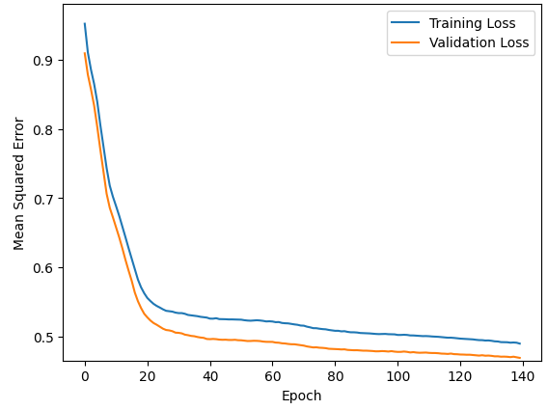
L1 (param=0.1)
Train rmse: 0.4896, val rmse: 0.4689

Slide 24
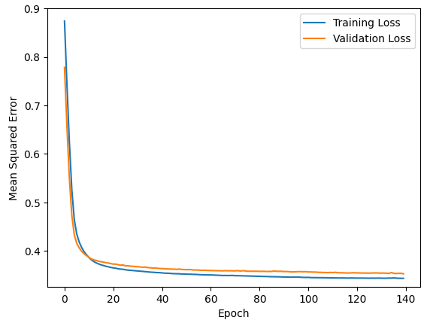
L1 (param=0.005)
Train rmse: 0.3433, val rmse: 0.3526

Slide 25
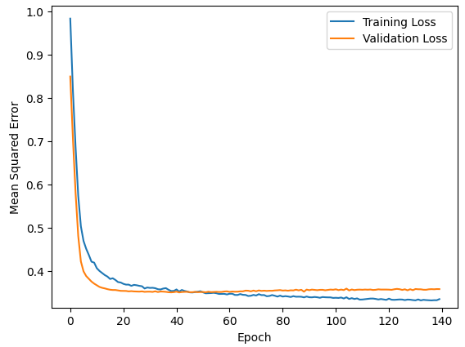
With dropout regularization
Train rmse: 0.3348, val rmse: 0.3580

Slide 26
Regularization needed, as data is less, model is complex, and overfitting!
From the above graphs, we can see that L2 regularization with L2 parameter = 0.04 gives best performance due to lower validation rmse compared to training rmse (graph plotted in the previous slides).

Slide 27
Parameters of optimal model
1 input layer, hidden layer 1 (20 neurons: regularization), hidden layer 2 (12 neurons: regularization), 1 output layer
L2 parameters: 0.04

Slide 28
Links to code
https://colab.research.google.com/drive/16eGzYeSrnq7fIQh6Egwx_vE9nq39v0qI?usp=sharing
https://colab.research.google.com/drive/1CI334W2izLAfFsuPm1Z3j70ooxZ_3LwH?usp=sharing

