Slide 1
SAP S/4HANA • GEN AI ORCHESTRATION
Integrate AI into SAP S/4HANA with ISLM
A hands-on walkthrough of Intelligent Scenario Lifecycle Management: creating, operating, and
consuming a Generative AI orchestration scenario natively inside SAP S/4HANA.
Intelligent Scenario Lifecycle Management (ISLM)

Slide 2
AGENDA
What We'll Walk Through
01
Introduction & Orchestration Modules
Why ISLM, and the 7 orchestration capabilities it governs
02
What We'll Build
The return-policy summarization use case and its business value
03
Create Intelligent Scenarios
Configuring model, orchestration flow, prompts & grounding
04
Operate Intelligent Scenario
Sync, deploy, and activate the scenario
05
Prompt Execution
Consuming the scenario via the ABAP AI SDK, incl. translation & prompt-injection defense
06
Conclusion
From experimentation to enterprise-ready GenAI
Integrate AI into SAP S/4HANA with ISLM
Agenda

Slide 3
What is ISLM?
Intelligent Scenario Lifecycle Management is SAP's standardized framework for building, training, deploying, and managing machine-learning and AI use cases directly inside SAP S/4HANA and connected systems.
Two deployment models
Embedded AI
Runs inside SAP S/4HANA using SAP HANA ML (APL / PAL) — real-time, in-memory inference with no data movement.
Think of it as a self-service control tower for every AI “scenario” running in your SAP landscape.
Built from two SAP Fiori apps
Intelligent Scenarios — browse, view, and configure available AI/ML scenarios (package, inputs, outputs, APIs).Intelligent Scenario Management — train, deploy, activate, and monitor the models tied to those scenarios.
Side-by-Side AI
Runs on a separate stack (e.g. SAP AI Core / BTP) for advanced workloads — image recognition, NLP, deep learning.

Slide 4
How AI Is Involved: The Scenario Lifecycle
ISLM automates every stage a machine-learning model goes through inside SAP
01
02
03
04
Create
Train
Deploy & Activate
Monitor & Retrain
→
→
→
Define an intelligent scenario — its inputs, outputs, and business purpose — as an ABAP representation of an ML use case.
Train the scenario on historical business data using SAP HANA ML or SAP AI Core to produce a model artifact.
Push the trained model into production so business apps can call it for live inference.
Track accuracy and drift, then retrain and version models to keep predictions reliable over time.
AI Core • HANA ML (APL/PAL) • SAP Fiori apps power every stage above

Slide 5
Key Benefits of ISLM
1
Faster time-to-value
2
One control tower
3
Real-time, in-context insight
Pre-built, out-of-the-box scenarios for finance, supply chain, and customer management mean AI can be activated without building models from zero.
A single self-service interface manages the full model lifecycle — no juggling separate tools for training, deployment, and monitoring.
Embedded AI runs inside S/4HANA, so predictions surface directly inside the transactions people already work in.
4
Governed & explainable AI
5
Scales with the workload
6
Future-proof lifecycle
Built-in monitoring and explainability keep model accuracy and compliance visible, supporting audit and trust requirements.
Choose Embedded AI for low-latency, high-volume tasks or Side-by-Side AI for heavier workloads like NLP and image recognition.
Automated retraining and versioning keep models current as business data and conditions evolve, protecting long-term accuracy.

Slide 6
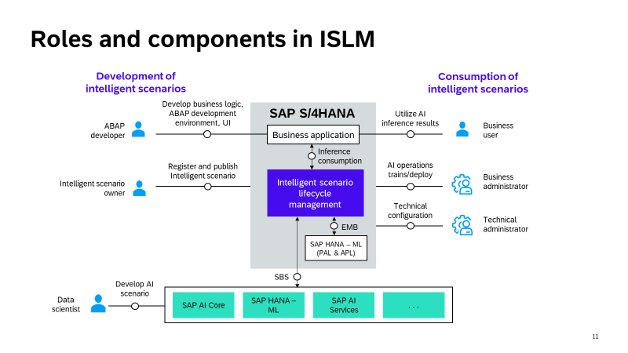
INTRODUCTION
Integrate AI into SAP S/4HANA with ISLM
Introduction

Slide 7
WHAT YOU'LL BUILD
Use Case: Return Policy Summarization
The Scenario
Typical Support Queries
Two fictional sports brands — Company Alpha and Company Beta — maintain different return policies with varying rules, timelines, and exceptions.
The Intelligent Scenario automatically extracts and summarizes key information: return criteria, validity timelines, refund processes.
This removes the need for support teams to read lengthy documents, reducing ambiguity and speeding up query responses.
“Is this item still eligible for return?”
“Are customized products refundable?”
“How long will the refund take?”
Using ISLM: policy docs are uploaded for grounding → queries flow through orchestration → the LLM extracts clauses and generates structured responses.
Integrate AI into SAP S/4HANA with ISLM
Use Case

Slide 8
PART ONE
Steps to Create Intelligent Scenarios
Configuring the model, orchestration execution flow, prompt templates, and grounding documents in the Fiori app.

Slide 9
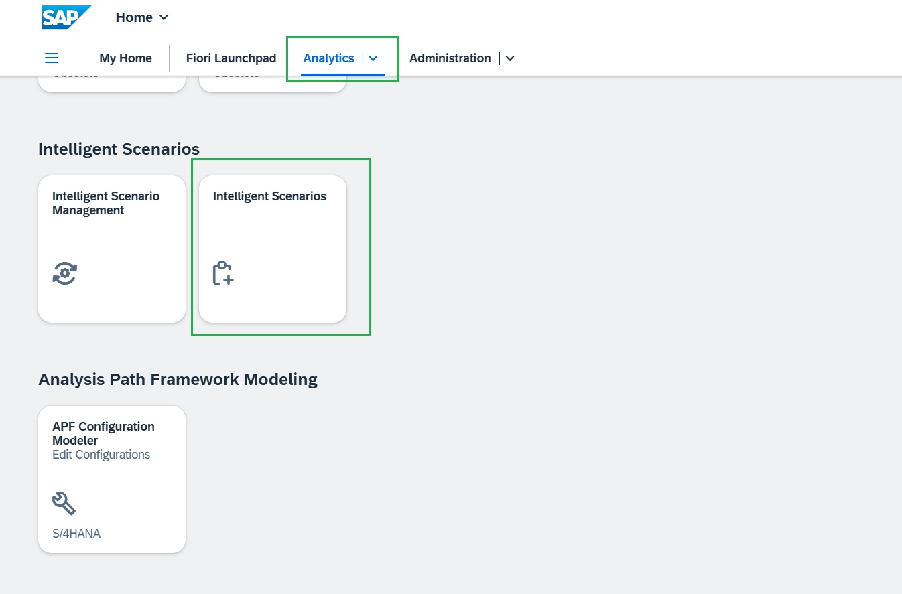
CREATE INTELLIGENT SCENARIOS
Launch the Intelligent Scenarios App
STEP 1 / 31
Open the browser and navigate to the SAP Fiori Launchpad (system already logged in).
Under the “Analytics” tab, launch the “Intelligent Scenarios” application.
Integrate AI into SAP S/4HANA with ISLM
Create Intelligent Scenarios

Slide 10
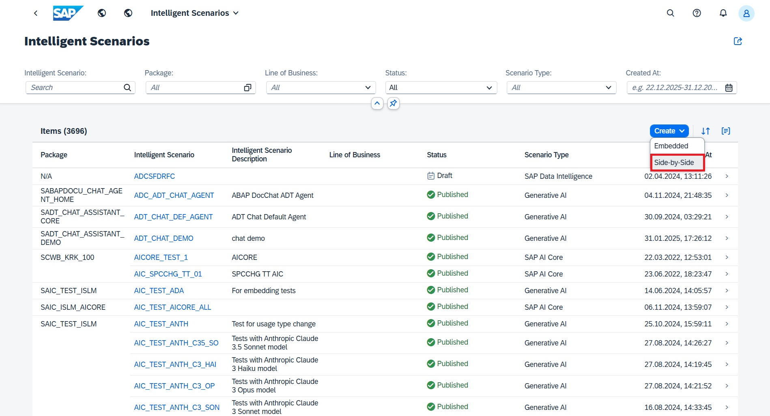
CREATE INTELLIGENT SCENARIOS
Create a Side-by-Side Scenario
STEP 2 / 31
Click the Create button.
Choose Side-by-Side as the scenario deployment type.
SCREENSHOT PLACEHOLDER
IntelligentScenario/02.png
Integrate AI into SAP S/4HANA with ISLM
Create Intelligent Scenarios

Slide 11
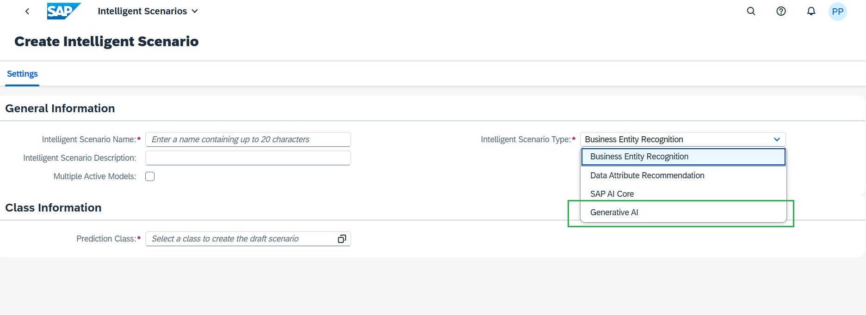
CREATE INTELLIGENT SCENARIOS
Select the Scenario Type
STEP 3 / 31
In the Settings tab, select Generative AI as the Scenario Type.
SCREENSHOT PLACEHOLDER
IntelligentScenario/02.jpg
Integrate AI into SAP S/4HANA with ISLM
Create Intelligent Scenarios

Slide 12
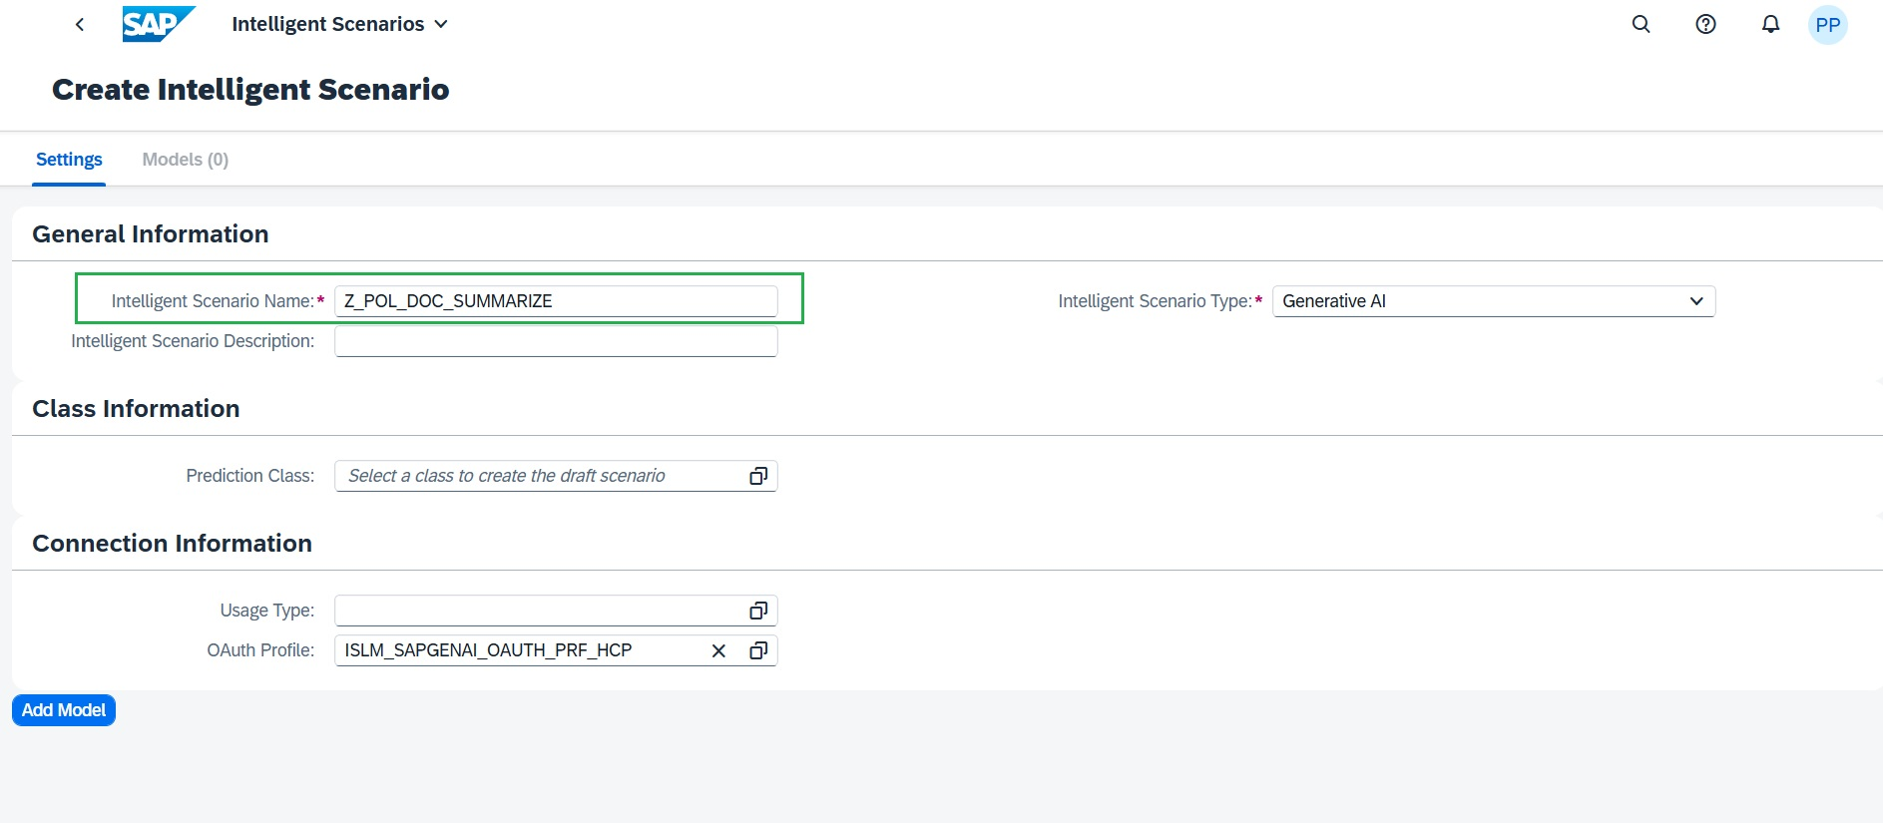
CREATE INTELLIGENT SCENARIOS
Name the Scenario
STEP 4 / 31
Enter a unique Scenario name
SCREENSHOT PLACEHOLDER
IntelligentScenario/03.jpg
Integrate AI into SAP S/4HANA with ISLM
Create Intelligent Scenarios

Slide 13
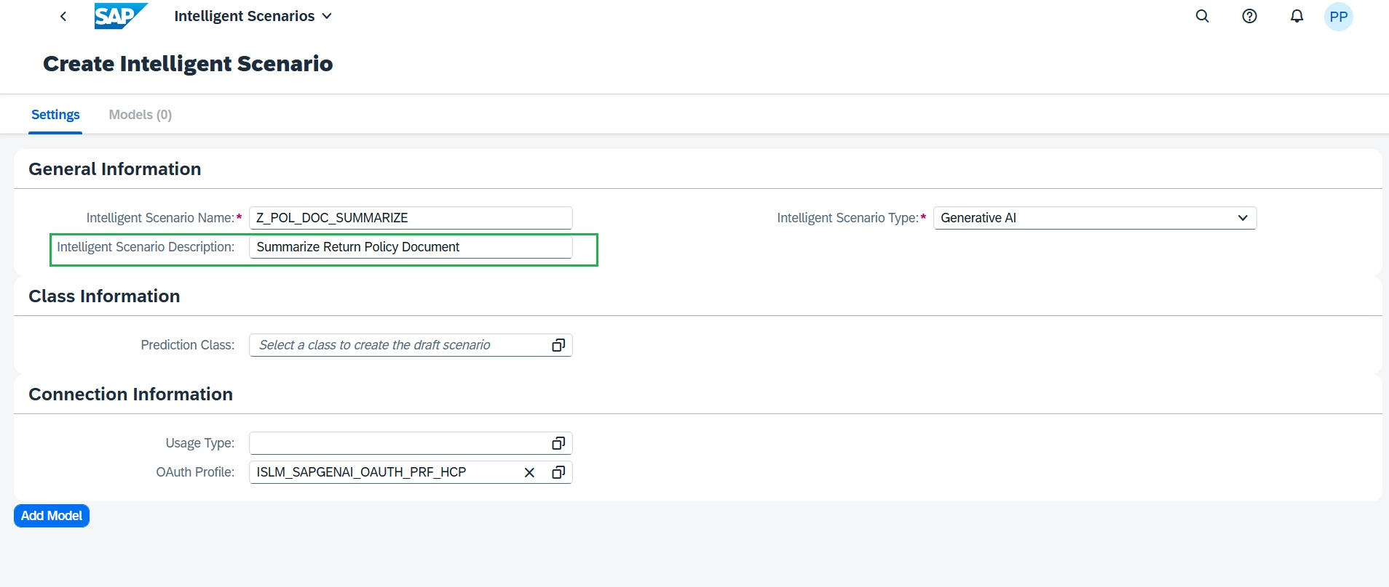
CREATE INTELLIGENT SCENARIOS
Add a Description
STEP 5 / 31
Enter the description: “Summarize Return Policy Document”.
SCREENSHOT PLACEHOLDER
IntelligentScenario/04.jpg
Integrate AI into SAP S/4HANA with ISLM
Create Intelligent Scenarios

Slide 14
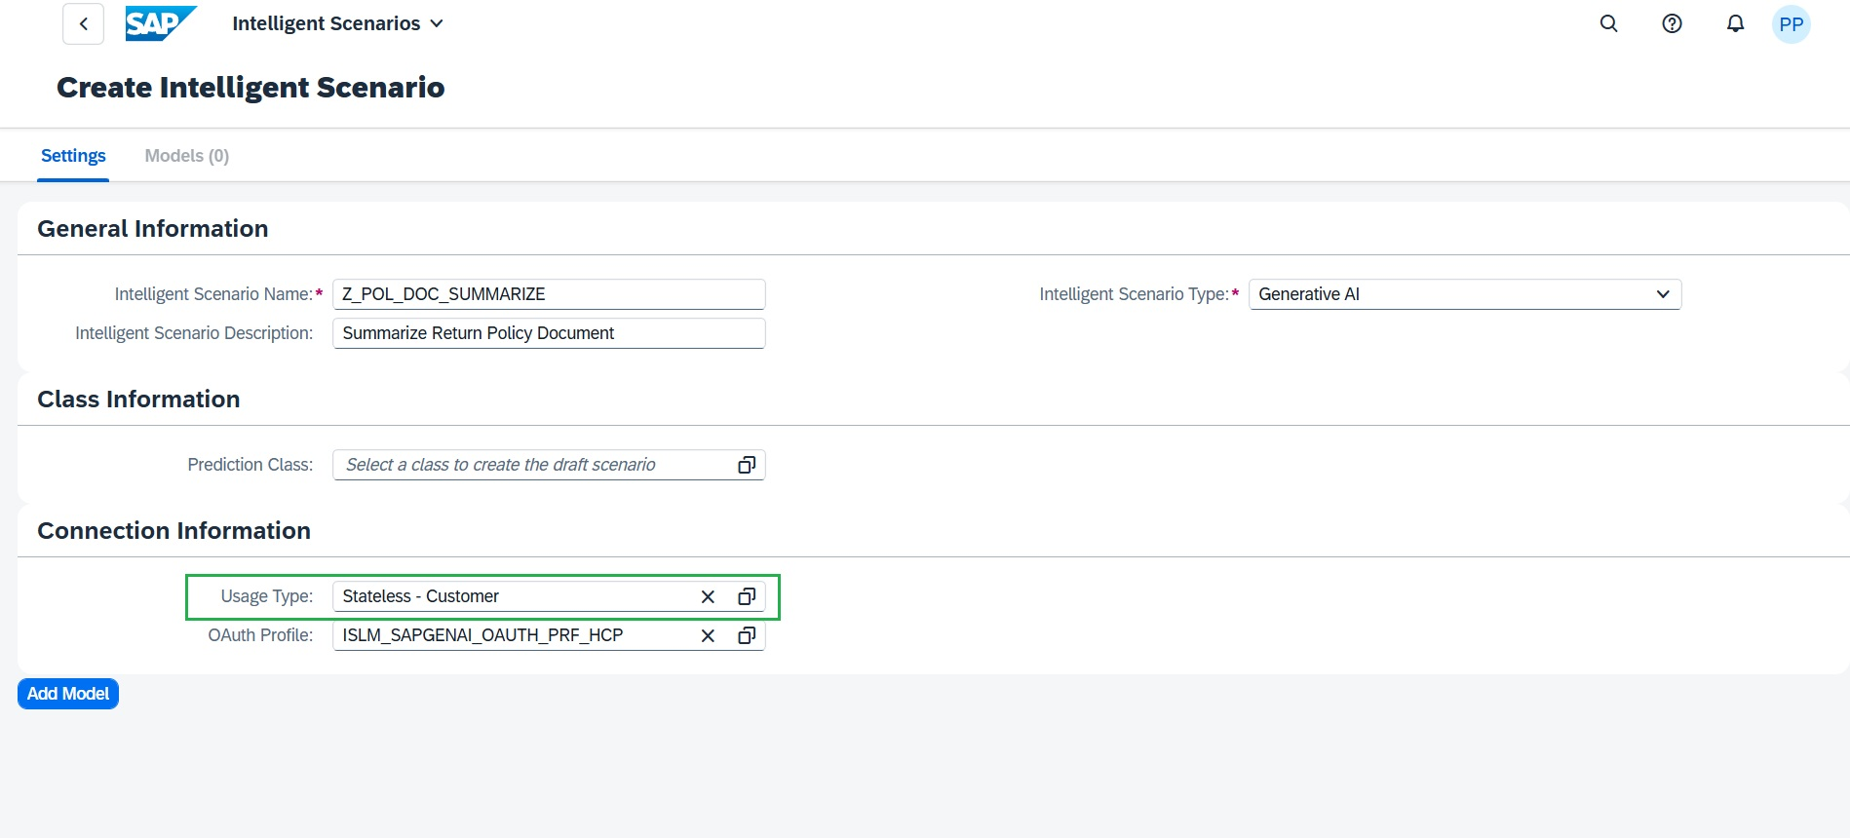
CREATE INTELLIGENT SCENARIOS
Choose the Usage Type
STEP 6 / 31
Select Stateless – Customer as the Usage Type.
This uses a shared connectivity model: one connection between ABAP and SAP Generative AI Hub, reused across use cases — simplifying admin and governance.
Integrate AI into SAP S/4HANA with ISLM
Create Intelligent Scenarios

Slide 15
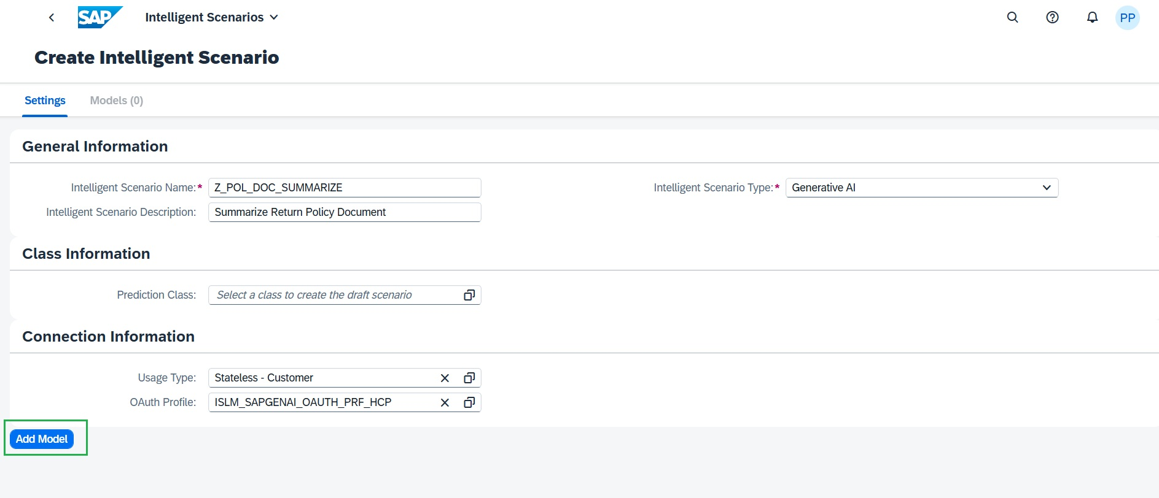
CREATE INTELLIGENT SCENARIOS
Add a Generative AI Model
STEP 7 / 31
Choose Add Model and maintain the required details.
SCREENSHOT PLACEHOLDER
IntelligentScenario/06.jpg
Integrate AI into SAP S/4HANA with ISLM
Create Intelligent Scenarios

Slide 16
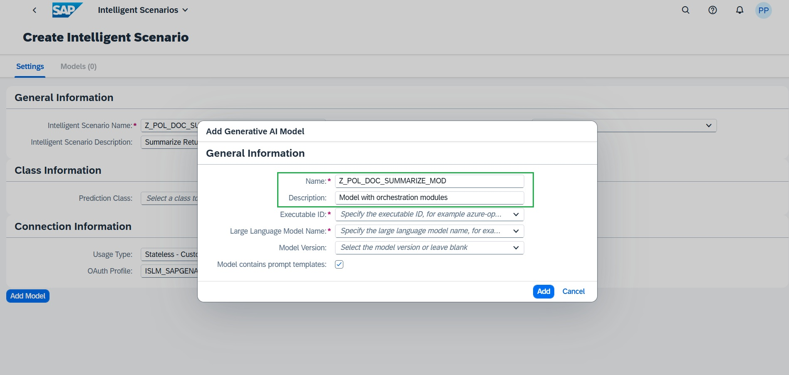
CREATE INTELLIGENT SCENARIOS
Name the Model
STEP 8 / 31
Enter model name: Z_POL_DOC_SUMMARIZE_MOD.
Enter description: “Model with orchestration modules”.
SCREENSHOT PLACEHOLDER
IntelligentScenario/07.jpg
Integrate AI into SAP S/4HANA with ISLM
Create Intelligent Scenarios

Slide 17
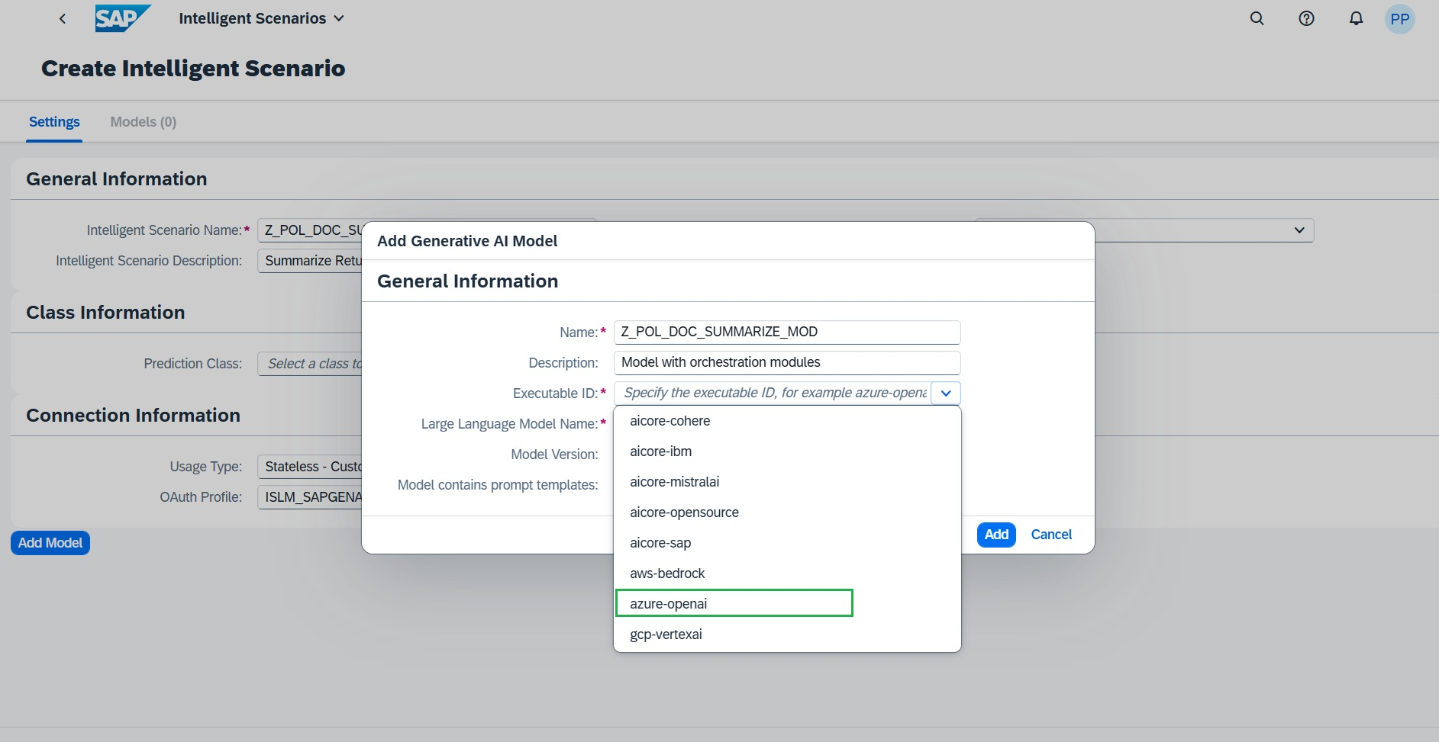
CREATE INTELLIGENT SCENARIOS
Select the Executable ID
Select the appropriate Executable ID from the dropdown — in this case, azure-openai.
STEP 9 / 31
Integrate AI into SAP S/4HANA with ISLM
Create Intelligent Scenarios

Slide 18
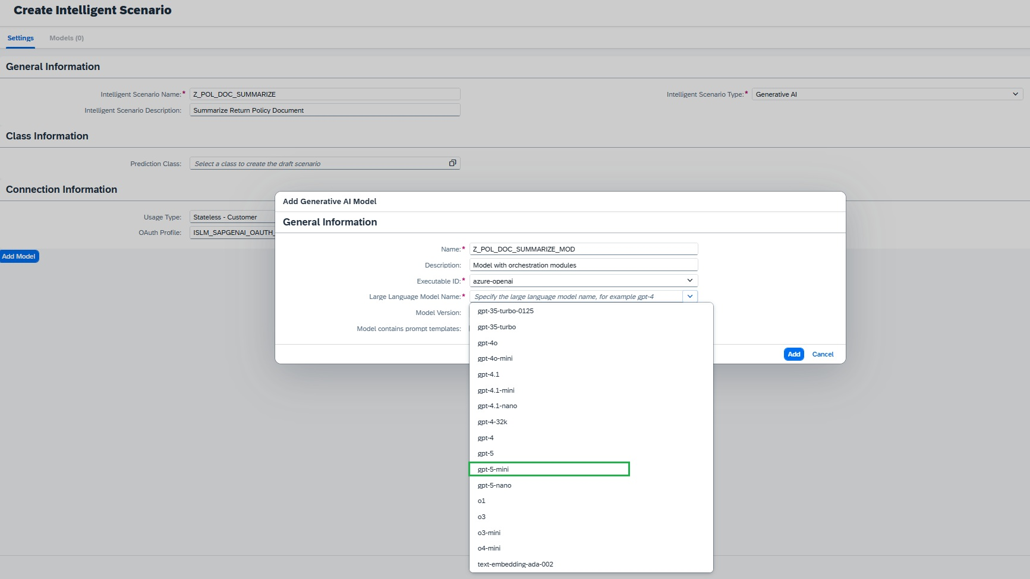
CREATE INTELLIGENT SCENARIOS
Select the Model
Select the corresponding model from the dropdown — in this exercise, gpt-5-mini.
STEP 1 / 31
Integrate AI into SAP S/4HANA with ISLM
Create Intelligent Scenarios

Slide 19
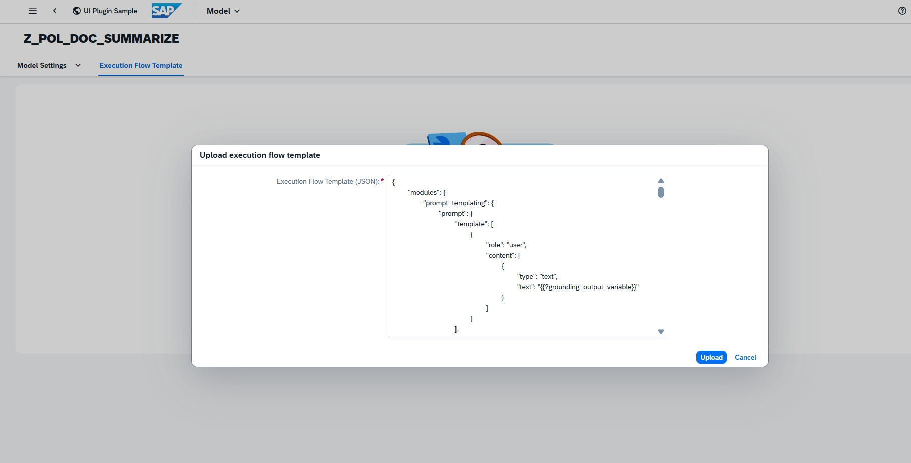
CREATE INTELLIGENT SCENARIOS
Upload the Execution Flow Template
Navigate to the Execution Flow Template on the model.
Upload the orchestration Execution Flow JSON (from config_json.txt) to integrate the orchestration service — use Upload or paste the JSON directly.
SCREENSHOT PLACEHOLDER
IntelligentScenario/4.jpg
Integrate AI into SAP S/4HANA with ISLM
Create Intelligent Scenarios

Slide 20
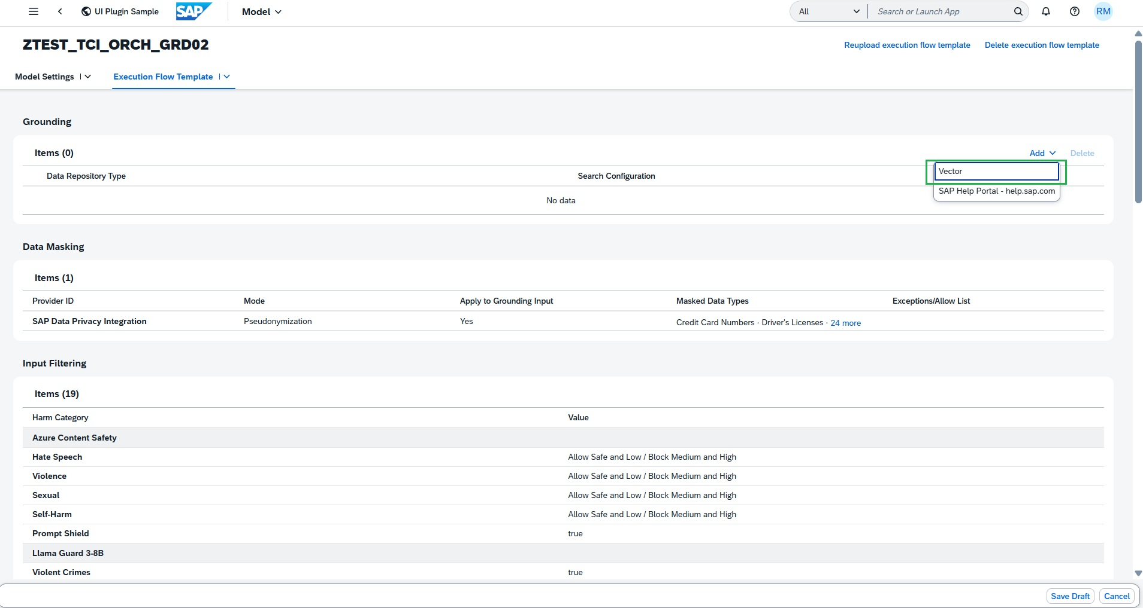
CREATE INTELLIGENT SCENARIOS
Configure Grounding — Data Repository
In the Grounding subsection, add the required data repository type: vector.
This enables grounding document addition for the scenario.
STEP 15 / 31
Integrate AI into SAP S/4HANA with ISLM
Create Intelligent Scenarios

Slide 21
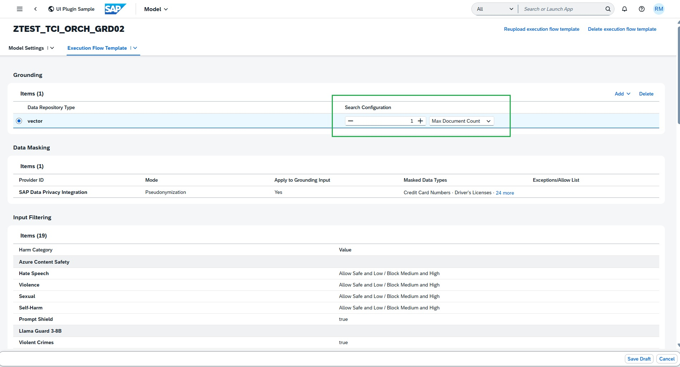
CREATE INTELLIGENT SCENARIOS
Restrict Grounding Output
Maintain the Search Configuration value to restrict grounding module output during inference.
This retrieves only relevant data instead of the entire uploaded document set.
STEP 16 / 31
Integrate AI into SAP S/4HANA with ISLM
Create Intelligent Scenarios

Slide 22
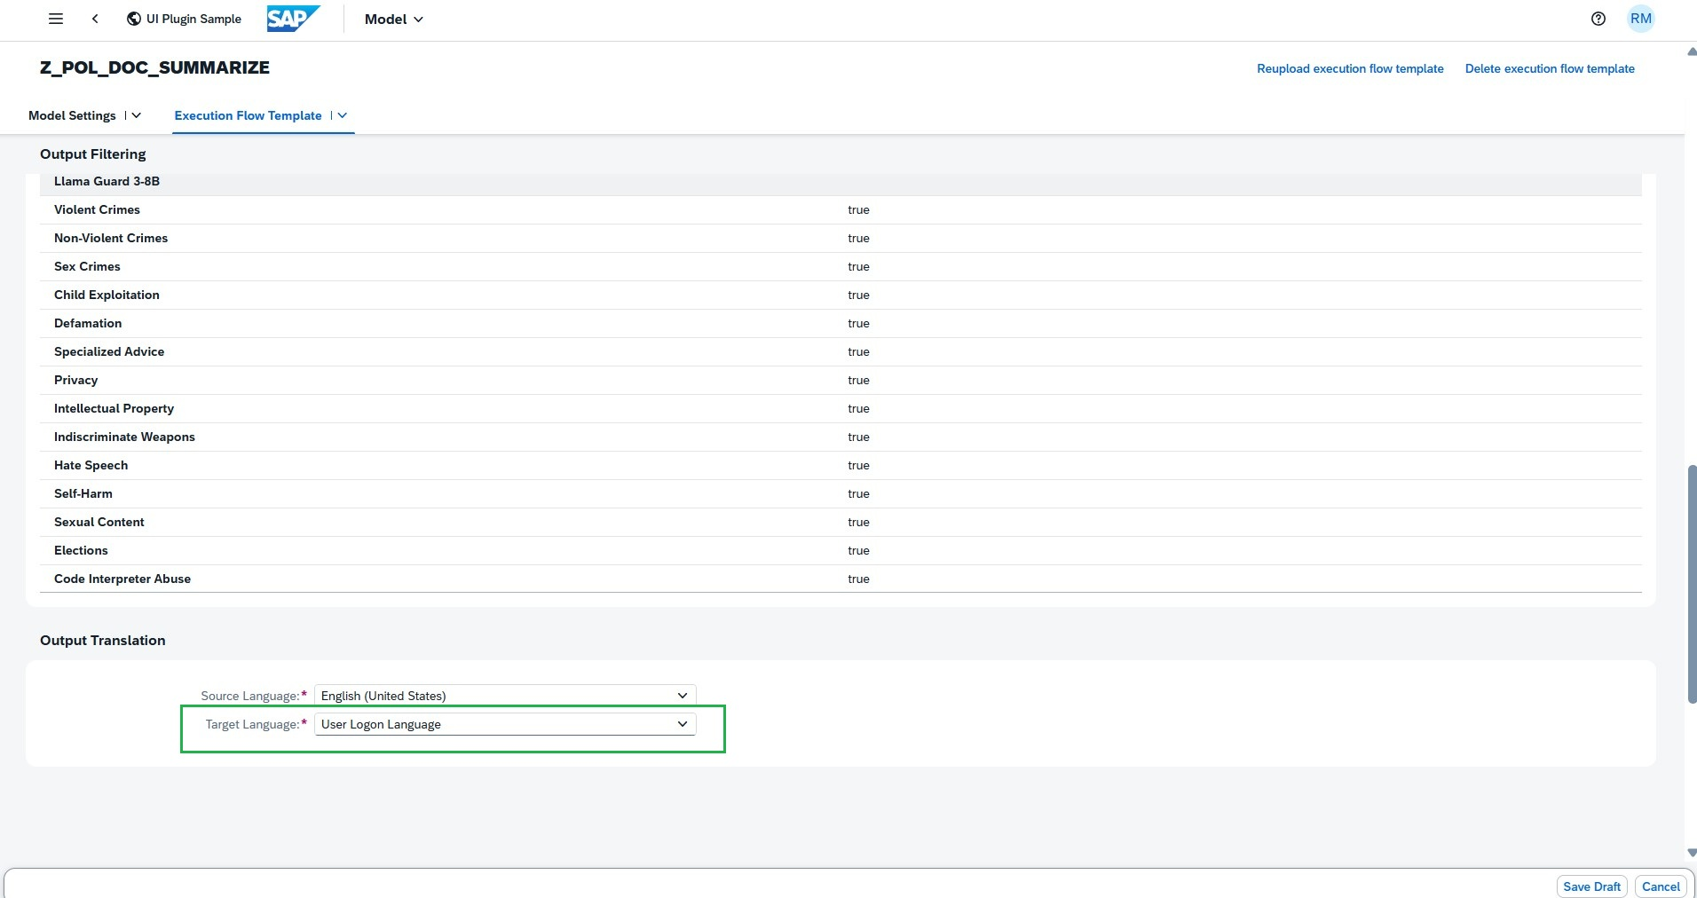
CREATE INTELLIGENT SCENARIOS
Output Filtering & Translation
Integrate AI into SAP S/4HANA with ISLM
Create Intelligent Scenarios

Slide 23
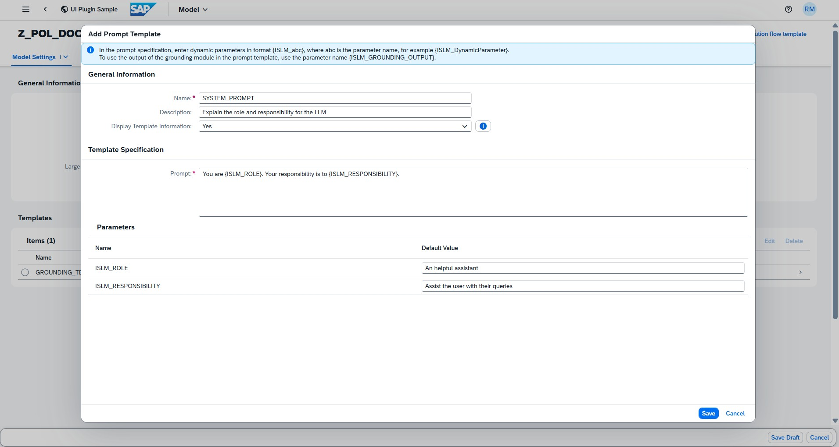
CREATE INTELLIGENT SCENARIOS
Add the User Prompt Template
STEP 23 / 31
Integrate AI into SAP S/4HANA with ISLM
Create Intelligent Scenarios

Slide 24
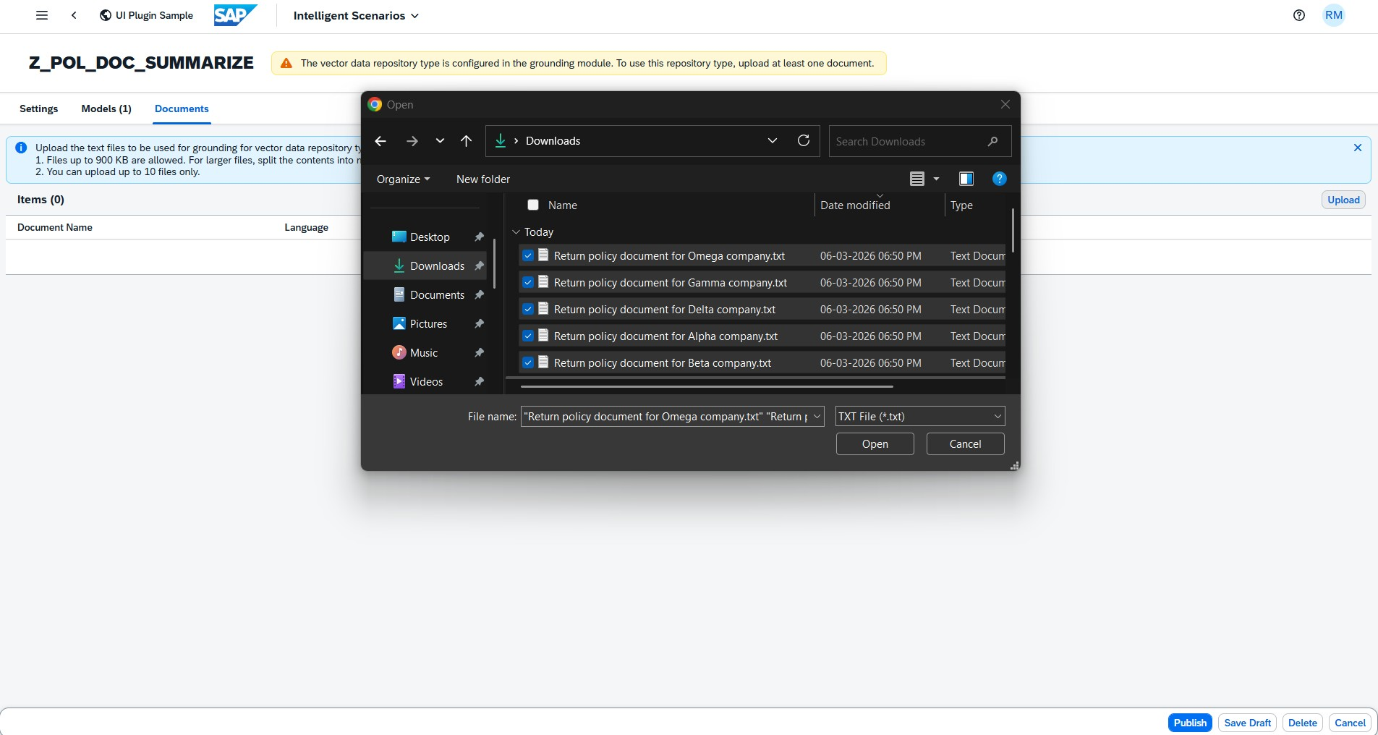
CREATE INTELLIGENT SCENARIOS
Upload Grounding Documents
Upload the grounding documents to the Intelligent Scenario.
SEP 26 / 31
Integrate AI into SAP S/4HANA with ISLM
Create Intelligent Scenarios

Slide 25
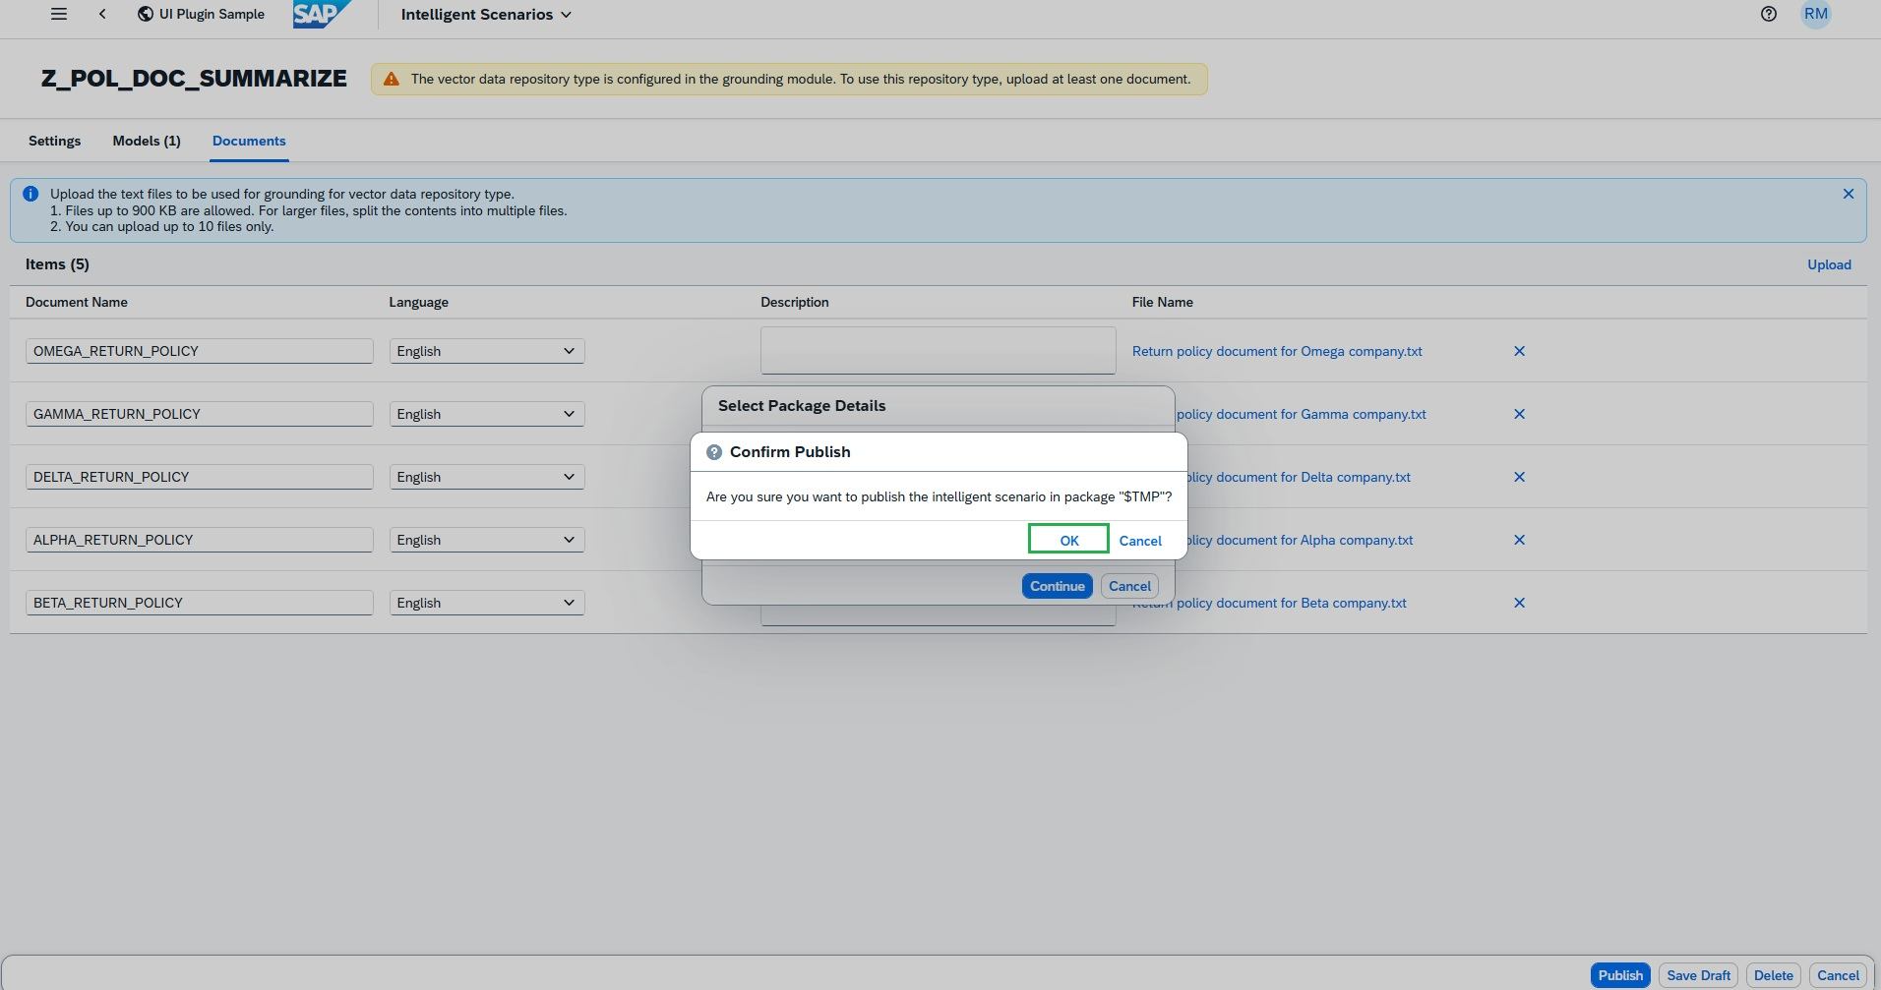
CREATE INTELLIGENT SCENARIOS
Publish the Scenario
Click Publish and enter the package as local object $TMP.
STEP 30 / 31
Integrate AI into SAP S/4HANA with ISLM
Create Intelligent Scenarios

Slide 26
PART TWO
Steps to Operate Intelligent Scenario
Syncing, deploying, and activating the scenario in Intelligent Scenario Management before it can serve inference requests.

Slide 27
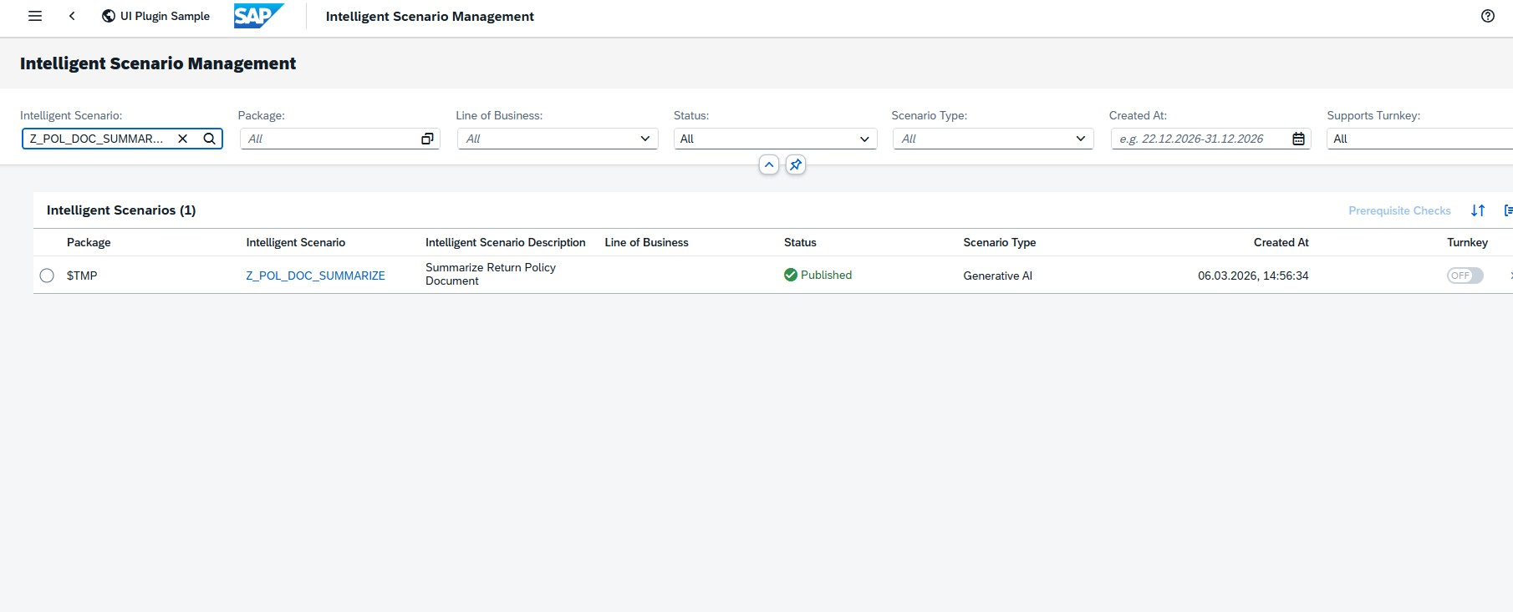
OPERATE INTELLIGENT SCENARIO
Open the Scenario in Management App
Launch the SAP Fiori Launchpad and, under “Analytics,” open the “Intelligent Scenario Management” app.
STEP 1 /
Integrate AI into SAP S/4HANA with ISLM
Operate Intelligent Scenario

Slide 28
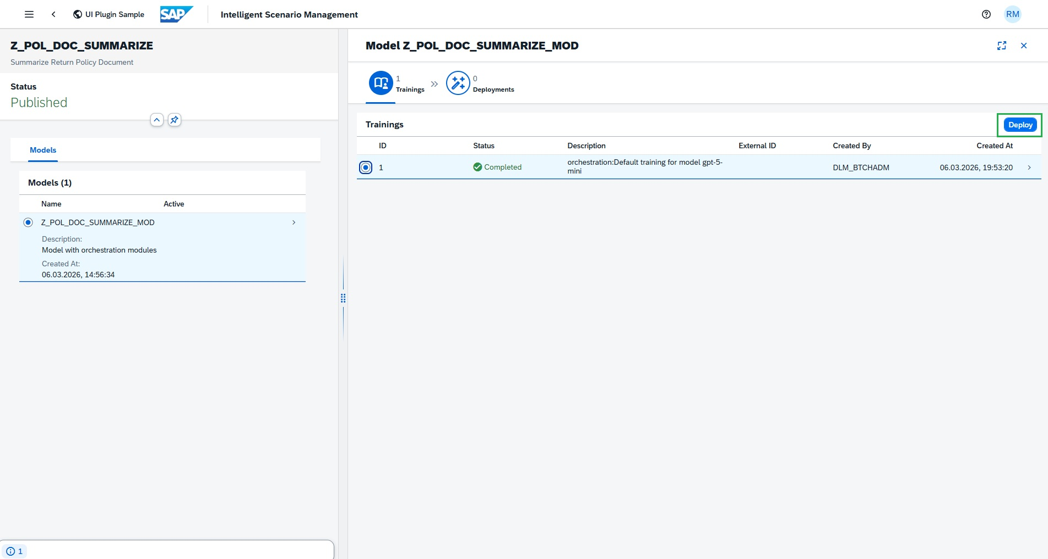
OPERATE INTELLIGENT SCENARIO
Sync the Scenario
Sync completes successfully with default training, since Gen AI is a pretrained model and reuse connectivity is already maintained.
STEP 2 / 6
Integrate AI into SAP S/4HANA with ISLM
Operate Intelligent Scenario

Slide 29
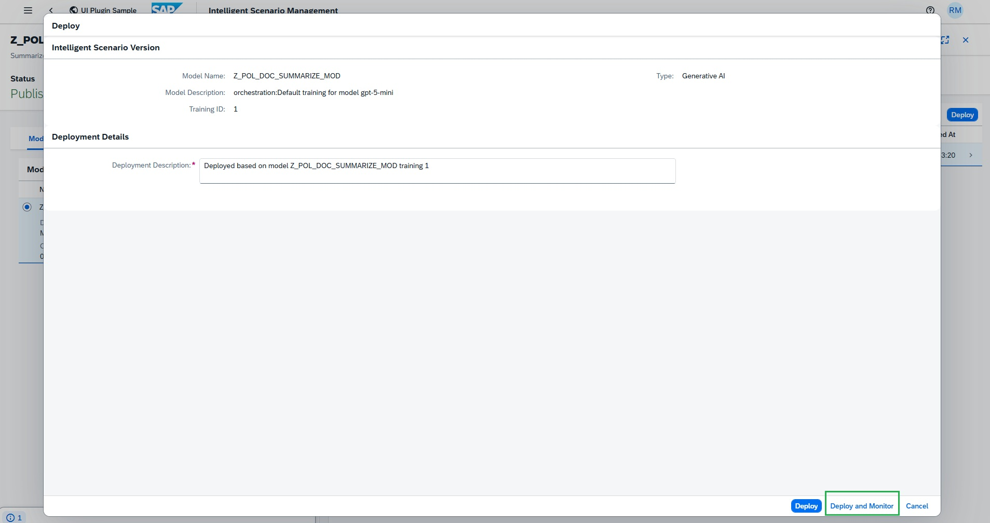
OPERATE INTELLIGENT SCENARIO
Deploy and Monitor
Click Deploy, then choose Deploy and Monitor.
STEP 3 / 6
Integrate AI into SAP S/4HANA with ISLM
Operate Intelligent Scenario

Slide 30
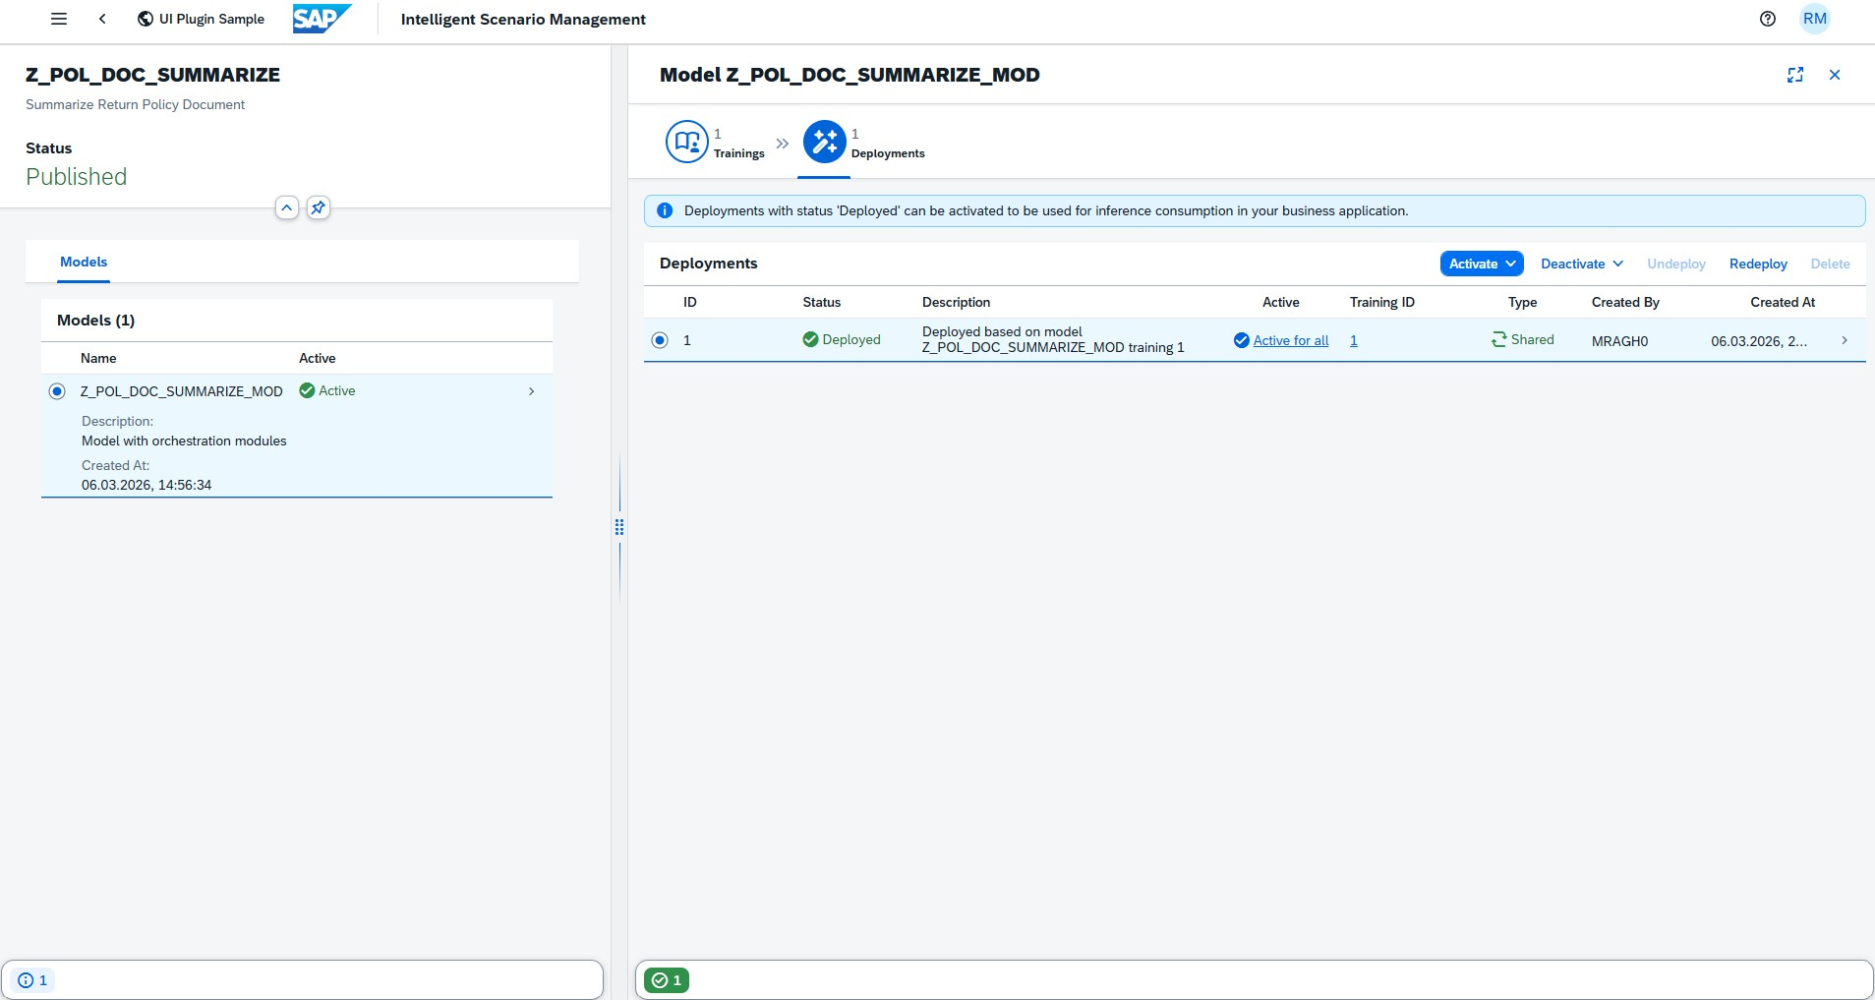
OPERATE INTELLIGENT SCENARIO
Activate the Scenario
Click Activate, then choose Activate For All.
The Intelligent Scenario is now active and ready for prompt execution.
STEP / 6
Integrate AI into SAP S/4HANA with ISLM
Operate Intelligent Scenario

Slide 31
PART THREE
Prompt Execution
Consuming the Intelligent Scenario from ABAP using the ABAP AI SDK — including multilingual output and prompt-injection defense testing.

Slide 32
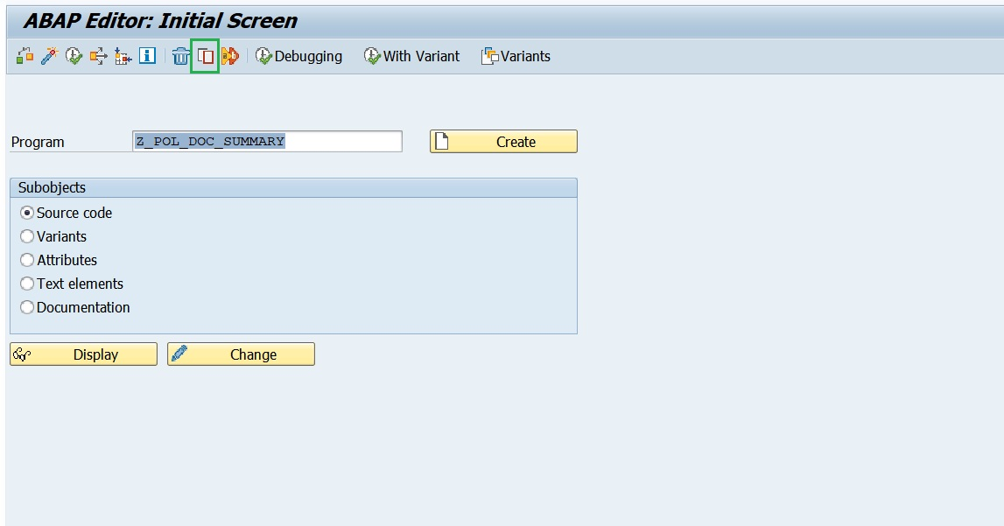
PROMPT EXECUTION (ABAP AI SDK)
Report Program
Create a report program
STEP 1 / 17
Integrate AI into SAP S/4HANA with ISLM
Prompt Execution (ABAP AI SDK)

Slide 33
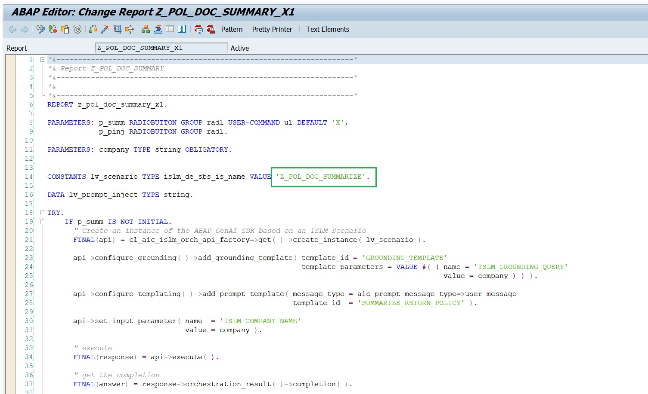
PROMPT EXECUTION (ABAP AI SDK)
Point the Program at Your Scenario
Change the Intelligent Scenario name to the one you created, Z_POL_DOC_SUMM_##, then Activate.
STEP 5 / 17
Integrate AI into SAP S/4HANA with ISLM
Prompt Execution (ABAP AI SDK)

Slide 34
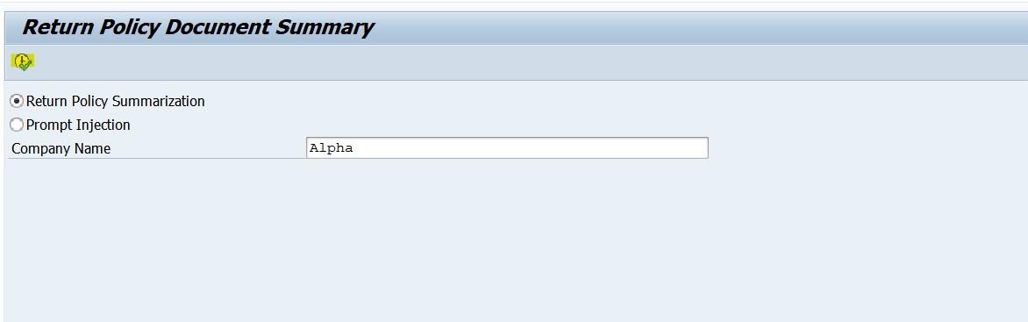
PROMPT EXECUTION (ABAP AI SDK)
Run the Base Case
Enter the Company Name = Alpha and press Execute.
Integrate AI into SAP S/4HANA with ISLM
Prompt Execution (ABAP AI SDK)

Slide 35
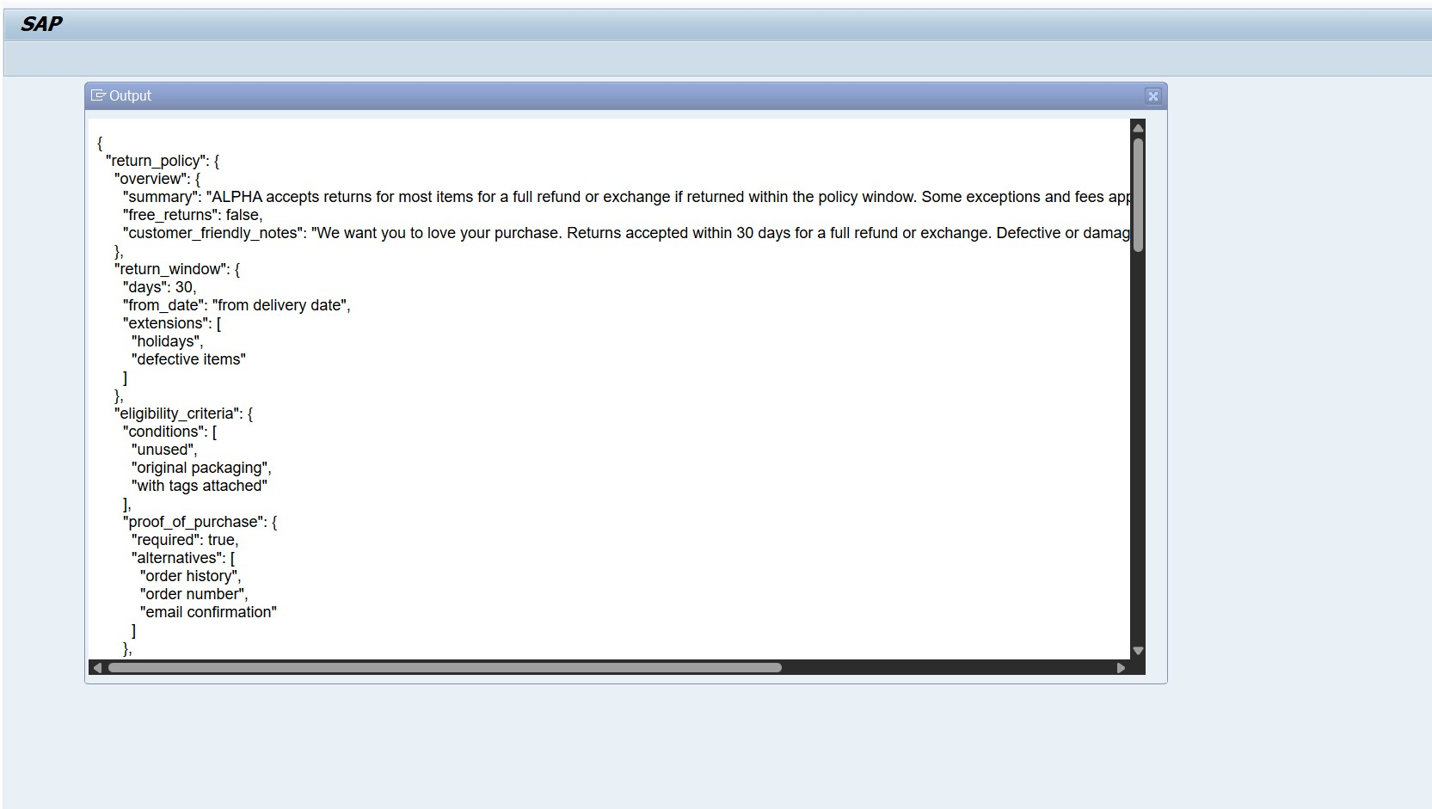
PROMPT EXECUTION (ABAP AI SDK)
Review the Output
The prompt executes with full orchestration capabilities — grounding, masking, filtering, and prompt templating all applied.
Integrate AI into SAP S/4HANA with ISLM
Prompt Execution (ABAP AI SDK)

Slide 36
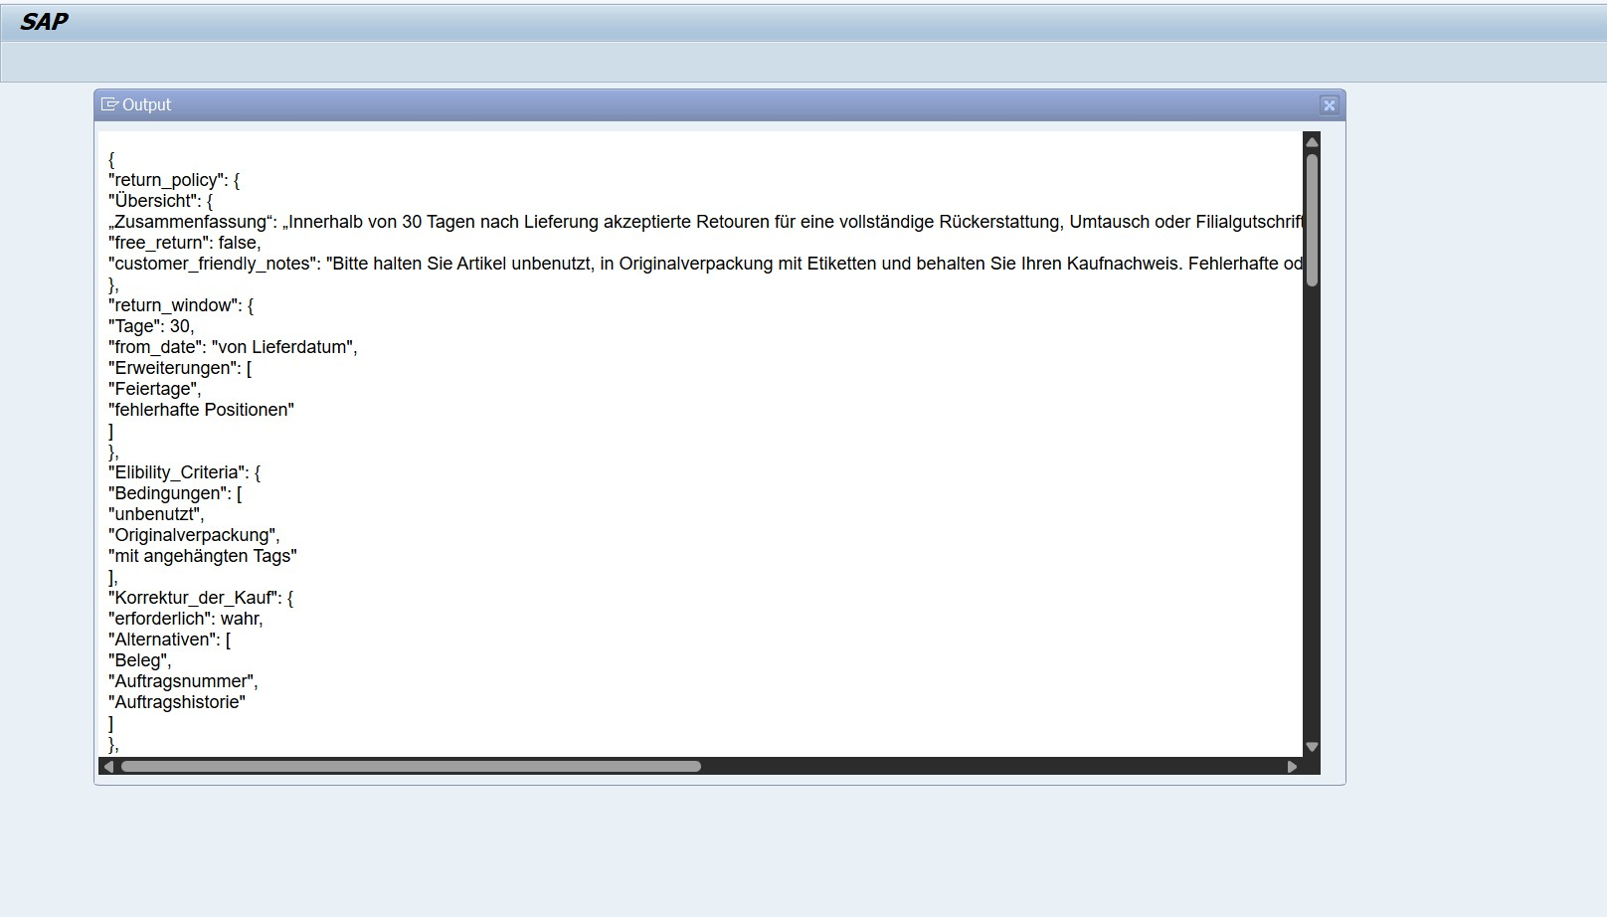
PROMPT EXECUTION (ABAP AI SDK)
Output Translation
To test output translation, log in to the system with the DE (German) language.
STEP 9 / 17
Integrate AI into SAP S/4HANA with ISLM
Prompt Execution (ABAP AI SDK)

Slide 37
CONCLUSION
From Experimentation to Operational Reality
Generative AI delivers real enterprise value when embedded directly into business processes with the right governance, scalability, and control.
ISLM provides that foundation: structured creation, orchestration, deployment, and lifecycle management of AI scenarios within SAP S/4HANA.
Document Grounding, Content Filtering, Data Masking, multilingual support, reusable connectivity, and expanded model support turn GenAI from experiment into operational reality.
Get started today and take your Generative AI innovation to the next level with ISLM.

