Slide 1

AI-Powered Standup Automation
Transform daily standups from manual overhead into intelligent insights

Slide 2



The Daily Standup Problem
30+ Minutes Lost Weekly
Teams manually compile sprint data before every standup—time that adds up fast.
Scattered Meeting Notes
Decisions and blockers live across multiple tools, making tracking nearly impossible.
Memory-Based Email Summaries
Recaps written from memory are often incomplete, inconsistent, and delayed.
No Structured Record
Blockers and progress trends go undocumented, creating blind spots for leadership.

Slide 3
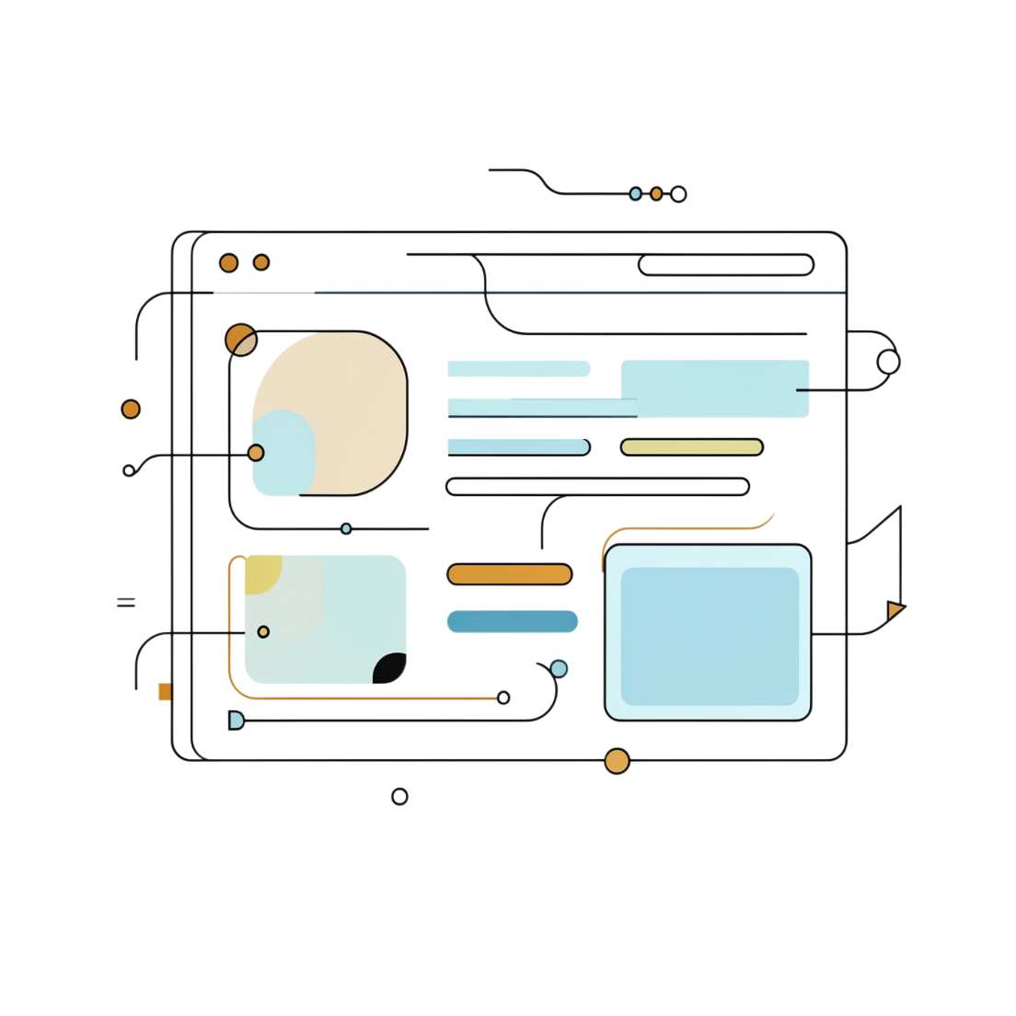
INTRODUCING
Meet the Solution: Standup AI
A fully automated pipeline that reads your sprint, understands your team's progress, and delivers a polished summary—without any manual effort.
1
Reads Azure DevOps
2
Summarizes with AI
3
Drafts to Outlook
Automatically pulls all active sprint stories and latest discussions.
Distills story discussions into clear, actionable one-liners.
Sends a professional summary directly to your Outlook drafts—ready to send.

Slide 4




What Gets Automated
Meeting Data
Story Updates
Project name, meeting name, date, time, and ADO link—structured and ready.
Story number, title, points, state, assignee, and current status in one table.
Discussion Summaries
Email Draft
AI-generated one-liner from the latest comments on each story.
A ready-to-send summary lands directly in Outlook drafts after every standup.

Slide 5
Time Savings Per Team
30 min
15 min
39 hrs
Saved Weekly
Saved Weekly
Saved Per Year
Manual data compilation eliminated entirely
Email drafting automated post-standup
Per team — multiply across your entire org
The Business Case
45 minutes saved every week per scrum team. At 10 teams, that's 390 hours returned to delivery every single year—without changing how your teams work.
No new tools. No retraining. Just time back in engineers' hands.

Slide 6
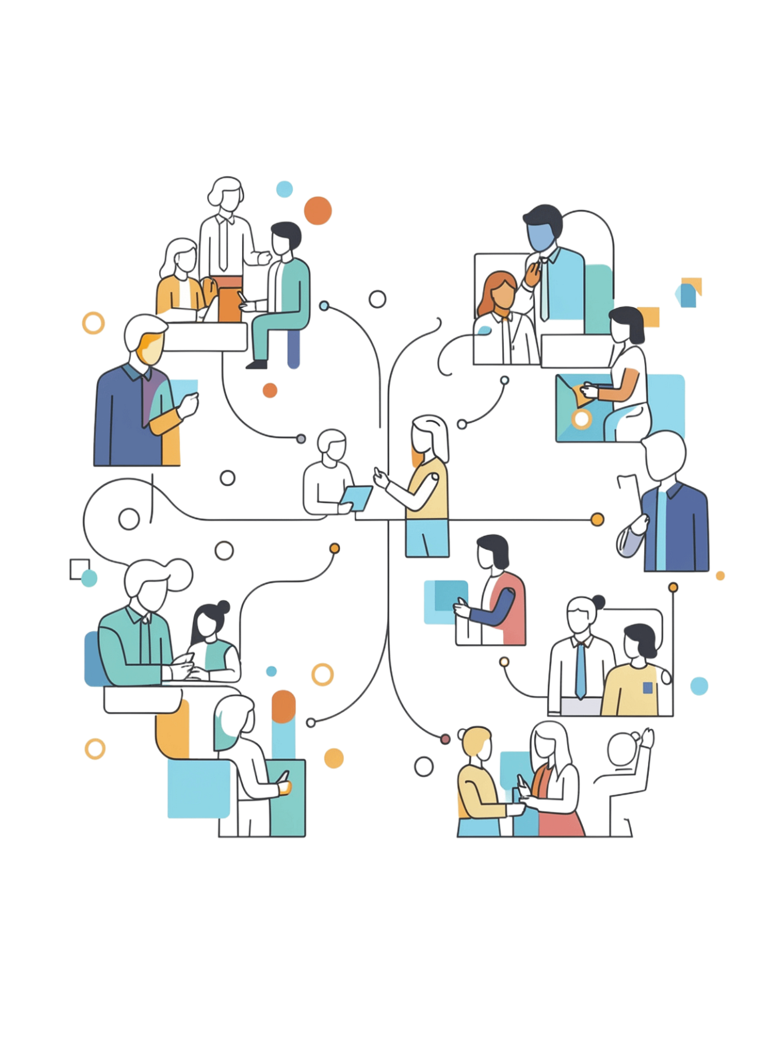



Why Every Scrum Team Needs This
Consistency
Same format, same quality every standup—regardless of who runs it.
Scalability
Works for 1 team or 50 teams instantly—no incremental setup.
Compliance
Automatic audit trail of all decisions and blockers for every sprint.
Integration
Built on Azure DevOps and Outlook—tools your teams already use daily.

Slide 7

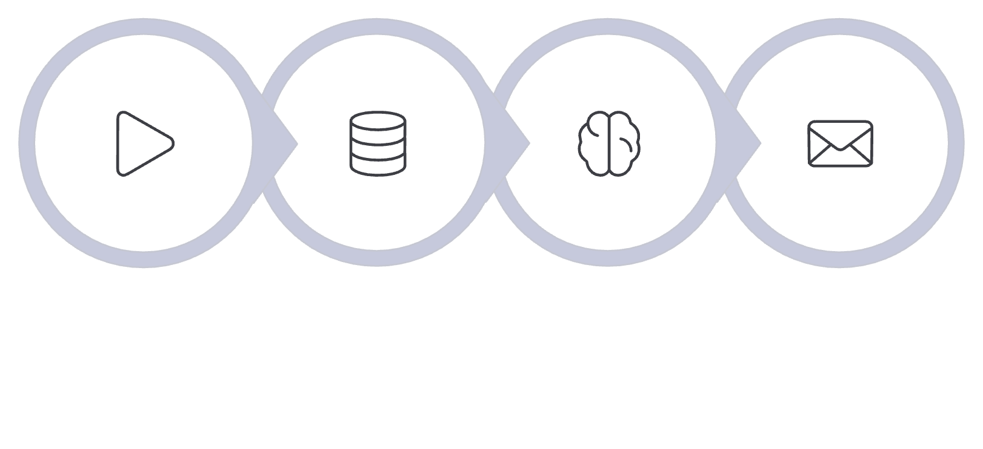
Technical Architecture
Azure DevOps MCP
Bulk reads workitems, story discussions, and full sprint data in seconds.
Claude Opus 4.7
AI summarization of discussions and professional email generation.
Trigger
Fetch
Summarize
Draft
Outlook MCP
The entire pipeline runs automatically after each standup—no manual steps required.
Draft email creation with optional auto-send capability.

Slide 8
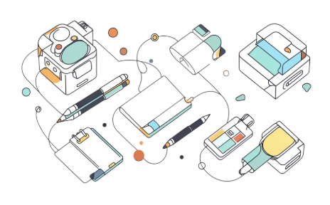


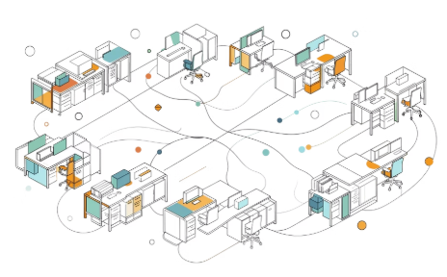
Competitive Advantages
Zero Learning Curve
True AI Summarization
Flexible Control
Org-Wide Scale
No new tools to adopt. Built entirely on Azure DevOps and Outlook—your teams are already there.
Manual review before sending, or enable auto-send. Your team decides the workflow.
Rolls out across every scrum team with no additional licensing costs.
Captures nuance from discussion threads—not a copy-paste of raw comments.

Slide 9


Next Steps
A focused pilot designed to prove value fast—then scale with confidence.
01
Pilot with 2–3 Teams
2-week trial with selected scrum teams to validate the workflow in your environment.
02
Measure & Gather Feedback
Track time saved and collect email quality feedback from team leads and stakeholders.
03
Expand Org-Wide
Roll out to all scrum teams based on pilot results—zero additional infrastructure needed.
Ready to reclaim 39 hours per team, per year? The pilot starts with your next sprint.

