Slide 1

AI Scrum Master
AI-powered assistant for automating Scrum ceremonies, reporting, and sprint management

Slide 2

The Scrum Master Challenge
Manual Data Collection
Scrum Masters spend significant time pulling updates from Azure DevOps for reports and ceremonies.
Inconsistent Reporting
Daily reports and meeting summaries are manually prepared with different formats across teams.
Untapped Insights
Story discussions contain useful status information but aren't systematically analyzed.
Coaching Time Lost
Repetitive administrative tasks reduce time available for impediment removal and team coaching.

Slide 3
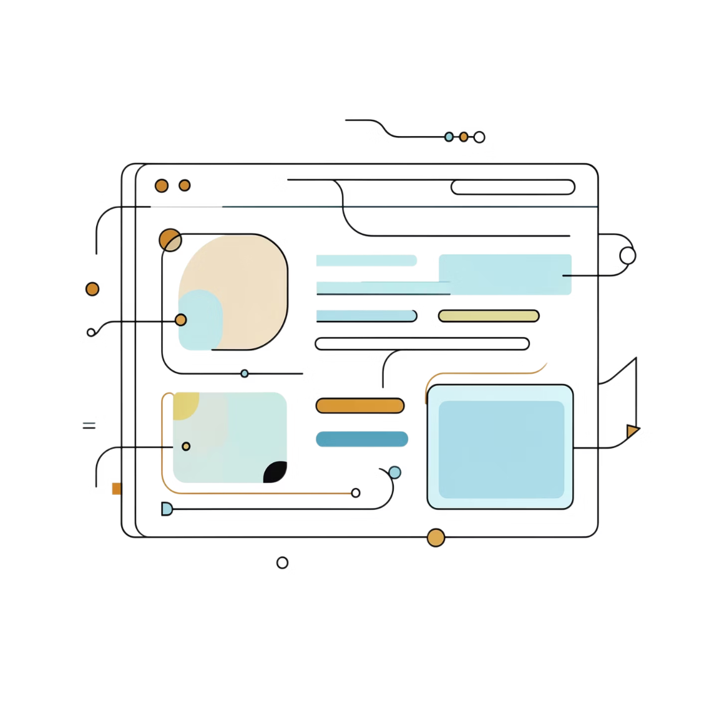
INTRODUCING
Meet the Solution: AI Scrum Master
An intelligent assistant connected to Azure DevOps and Outlook that executes multiple Scrum workflows through a simple menu—eliminating manual work across the entire sprint cycle.
Daily Standup Report
Sprint Planning Assistant
Sprint Retrospective Summary
Automatically compile a polished daily update from sprint activity.
Prepare sprint planning inputs faster with AI-supported structure.
Turn retro discussions into a clear summary of wins and improvements.
Blocker/Impediment Tracker
Backlog Grooming Assistant
Burndown & Sprint Health Report
Capture blockers and keep impediments visible across the sprint.
Organize backlog refinement with less manual effort.
Monitor sprint progress and health at a glance.
Velocity & Capacity Report
Action Item Tracker
Stakeholder Summary Report
Track delivery trends and team capacity across sprints.
Keep follow-ups and ownership organized automatically.
Generate concise progress updates for stakeholders.
Release Notes Generator
Create clean release notes from completed work.

Slide 4
What Gets Automated
Data Extraction
Intelligent Analysis
Pulls sprint data, story discussions, and team updates from Azure DevOps automatically.
AI analyzes discussions, identifies blockers, and extracts status trends and insights.
Multi-Format Output
Outlook Integration
Generates reports, summaries, and action items in the format each workflow needs.
Delivers drafts to Outlook for review and sending—or auto-sends based on team preference.

Slide 5
Time Savings Across Scrum Operations
30 min/week
20 min/week
50 hours/year
Daily Reports Saved
Sprint Ops Saved
Per Scrum Master
Daily reports and standup summaries automated
Sprint planning, retro summaries, and blocker tracking
Across all automated workflows
The Business Case
50 hours reclaimed per Scrum Master every year. At 10 Scrum Masters, that's 500 hours returned to coaching, impediment removal, and team development—without changing your sprint cadence.

Slide 6

Why Every Scrum Master Needs This
Consistency
Same format, same quality across all reports and ceremonies—regardless of team or Scrum Master.
Scalability
Works for 1 Scrum Master or 50—no incremental setup or licensing.
Compliance
Automatic audit trail of all decisions, blockers, and sprint activities.
Integration
Built on Azure DevOps and Outlook—tools your teams already use daily.

Slide 7

Technical Architecture
Azure DevOps MCP
Bulk reads workitems, discussions, sprint data, and team updates across all workflows.
Claude Opus 4.7
AI analysis, summarization, and content generation for all Scrum workflows.
Menu Selection
Data Fetch
AI Analysis
Output Generation
The entire pipeline runs automatically after each standup—no manual steps required.
Each workflow runs independently—select what you need, when you need it.
Outlook MCP
Draft creation and optional auto-send for all report types.

Slide 8
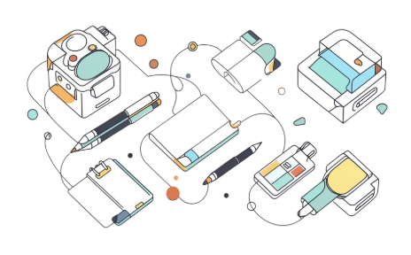


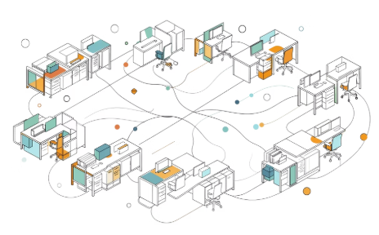
Competitive Advantages
Multi-Workflow Platform
True AI Analysis
Flexible Execution
Org-Wide Scale
Captures nuance from discussions and data—not copy-paste summaries.
Manual review before sending, or auto-send. Your team decides the workflow.
Rolls out across every Scrum Master with no additional licensing costs.
Not just daily standups—10+ reusable Scrum workflows in one tool.

Slide 9


Next Steps
A focused pilot designed to prove value fast—then scale with confidence.
01
Pilot with 2–3 Scrum Masters
2-week trial with selected Scrum Masters to validate multiple workflows in your environment.
02
Measure & Gather Feedback
Track time saved across workflows and collect feedback on report quality and usability.
03
Expand Org-Wide
Roll out to all Scrum Masters based on pilot results—zero additional infrastructure needed.
Ready to reclaim 50 hours per Scrum Master, per year? The pilot starts with your next sprint.

