Slide 1

Sleep Health Analytics:
From Behavior Data to Risk Insights
BA815—Group 3
Power of Three
Team member: Allen Chiu, Akhil Nair, Tanmay Yenge, Xiaoxuan Zhu
2025.12

Slide 2
PART ONE
Project Background

Slide 3
Intro & Motivation
Sleep is a fundamental component of both physical and mental well-being. However, a significant number of individuals suffer from sleep disorders such as insomnia and sleep apnea, which negatively impact their long-term health, productivity, and quality of life. With growing access to lifestyle and health data, there is an opportunity to better understand what truly drives poor sleep quality.
Introduction
As a sleep health management company, we aim to leverage data from hospitals and medical facilities to promote healthier lifestyles. By analyzing the Sleep Health and Lifestyle Dataset, we investigate how demographic, occupational, and behavioral factors influence sleep disorders. Our goal is to uncover key predictors of poor sleep and build a data-driven foundation for personalized health recommendations.
Motivation
Notes:
Sleep is something we do every day, but we often don’t realize how deeply it affects our physical and mental health. Poor sleep can lead to problems like stress, low productivity, mood issues, and even serious conditions like cardiovascular disease or obesity.
In real life, more and more people, especially students and working adults, face sleep problems, but they don't always understand the causes.
So, in this project, we wanted to explore sleep not from a medical point of view, but from a lifestyle and behavioral perspective.
our key question is: How do our habits: like stress, work patterns, caffeine, screen time, and sleep duration affect our risk of developing sleep disorders?
To answer this, we used a dataset called ‘Sleep Health and Lifestyle’ and analyzed how different lifestyle variables influence sleep quality and disorder risk.”

Slide 4
Data Description
The dataset contains anonymized individual records with demographic information, lifestyle behaviors, and health indicators, collected through simulated health records and self-reported surveys. It aims to model the relationship between sleep quality, lifestyle habits, and the likelihood of sleep disorders across diverse age and occupational groups.
Total Rows: 400
Total Columns (features): 13
Variable types: Numeric (continuous measures such as sleep duration, heart rate, stress level) and categorical (gender, occupation, BMI category, sleep disorder)
Target variable: Sleep Disorder — classified as None, Insomnia, or Sleep Apnea.
downloaded from:
https://www.kaggle.com/datasets/uom190346a/sleep-health-and-lifestyle-dataset
Notes:
Here I’m giving a quick overview of the dataset we used.
It contains 374 rows and 13 columns, which is a small but very structured dataset.
The variables are grouped into three main categories,
First, demographic factors, such as Age, BMI, and Occupation. These help us understand how sleep problems vary across different groups of people.
Second, lifestyle behaviors, including Sleep Duration, Stress Level and so on. These are daily habits that could directly influence sleep quality.
Third, health-related indicators, such as Blood Pressure and Sleep Disorder.
The target variable is whether the person has a sleep disorder, which includes insomnia, sleep apnea, or no disorder.
So overall, this dataset gives a good balance of personal, behavioral, and health data, allowing us to explore how lifestyle factors are linked to sleep disorders across different demographics.

Slide 5
PART TWO
How Do Lifestyle Behaviors Affect Sleep?

Slide 6
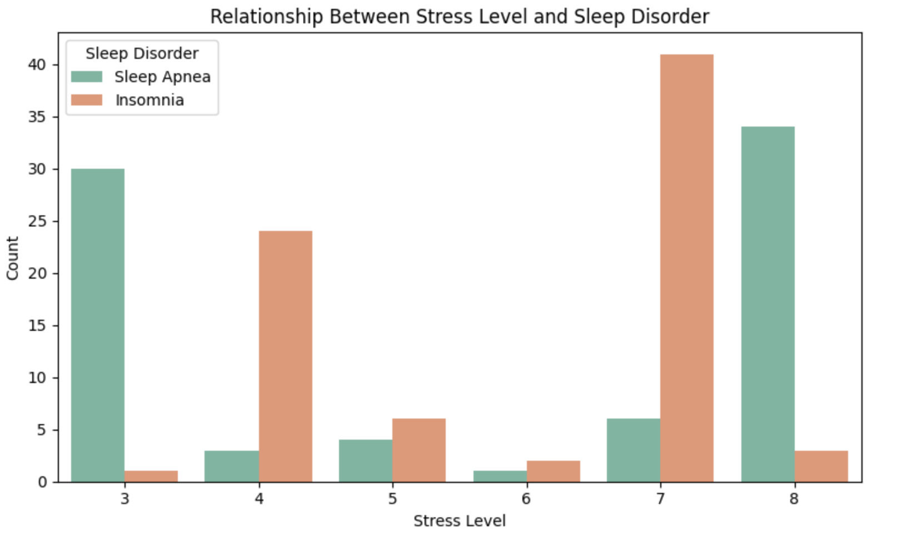
Does higher stress level increase the risk of sleep disorders?
Individuals with higher stress levels are significantly more likely to have insomnia or sleep apnea.
At low stress levels, most individuals have no sleep disorder.
The proportion of sleep disorder cases increases sharply at stress levels 7 and 8.
Stress is a strong behavioral predictor of sleep disorders.
Notes:
This chart shows the relationship between stress level and sleep disorders.
As stress increases, the number of individuals with insomnia and sleep apnea rises sharply.
This indicates that psychological stress is a major contributor to sleep-related health issues.

Slide 7
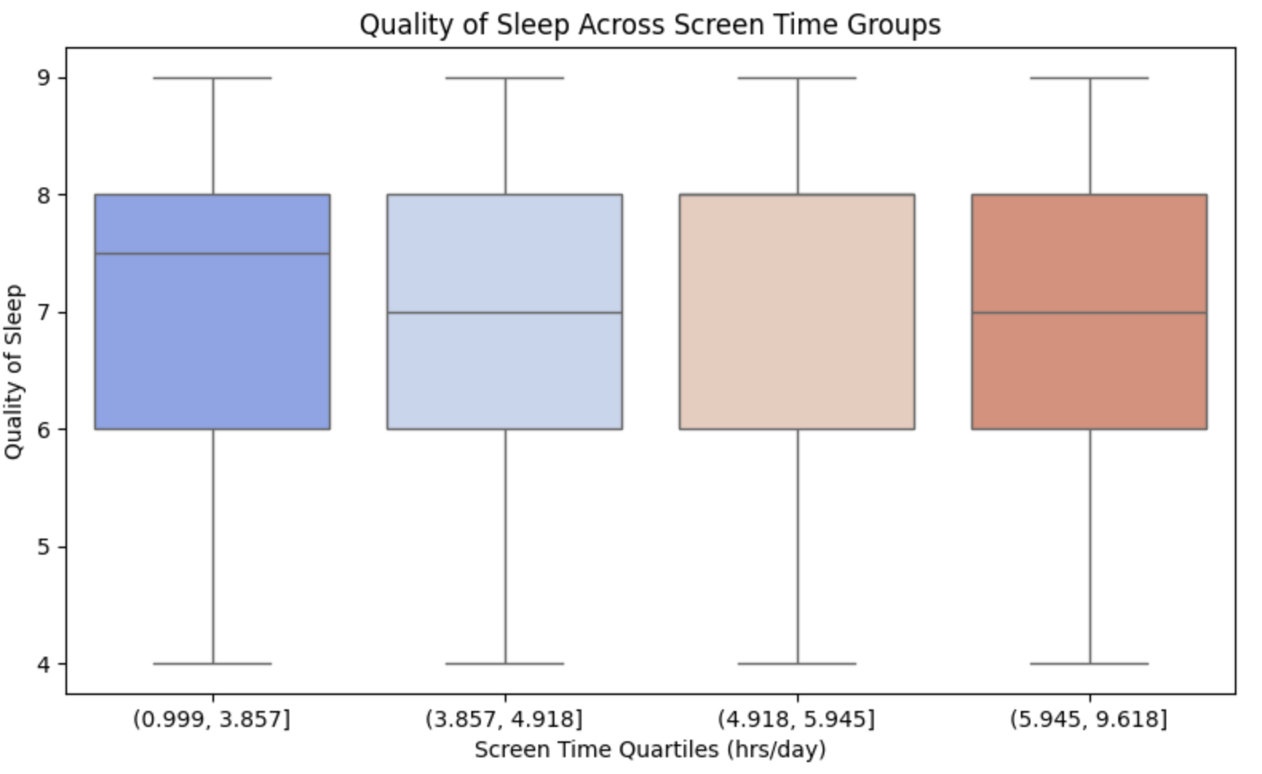
Does longer daily screen time negatively affect quality of sleep?
Sleep quality declines as screen exposure increases.
Higher screen time groups show lower median sleep quality and more variability.
Suggests digital stimulation may disrupt healthy sleep cycles.
Indicates screen time is a modifiable lifestyle factor in sleep health management.
Notes:
We group screen-time into 4 quartiles and compare sleep quality across them. This helps identify whether heavier digital consumption is linked with poorer sleep quality.
Across the four screen-time quartiles, the median quality of sleep remains fairly similar. The interquartile ranges overlap heavily, showing that higher screen time does not drastically reduce sleep quality in this sample. However, the lowest-screen-time group displays slightly higher upper-range values, hinting that people with less screen exposure may experience more consistently high sleep quality.

Slide 8
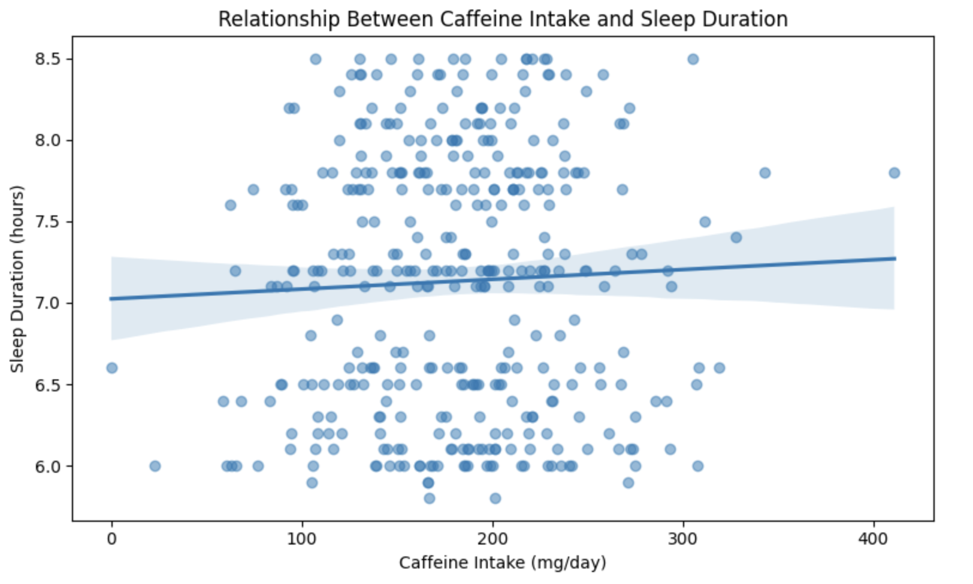
How does caffeine intake affect sleep duration?
Each point represents an individual’s caffeine intake vs. hours of sleep.
The trend line indicates a negative correlation.
Individuals with higher caffeine intake tend to sleep fewer hours.
Highlights caffeine as a significant lifestyle factor affecting sleep quality.
Notes:
This scatterplot shows whether people who consume more caffeine tend to sleep less. We use a regression line to highlight the overall trend. This explores a new behavioral angle that was not part of the original lab. The scatterplot shows that caffeine intake does not have a strong or consistent relationship with sleep duration. Although the trend line slopes slightly upward, the effect is very mild and the data points are widely spread. This suggests that caffeine intake alone is not a strong predictor of how long a person sleeps in this dataset. Most people, regardless of caffeine levels, cluster around 6.5 to 7.5 hours of sleep.

Slide 9
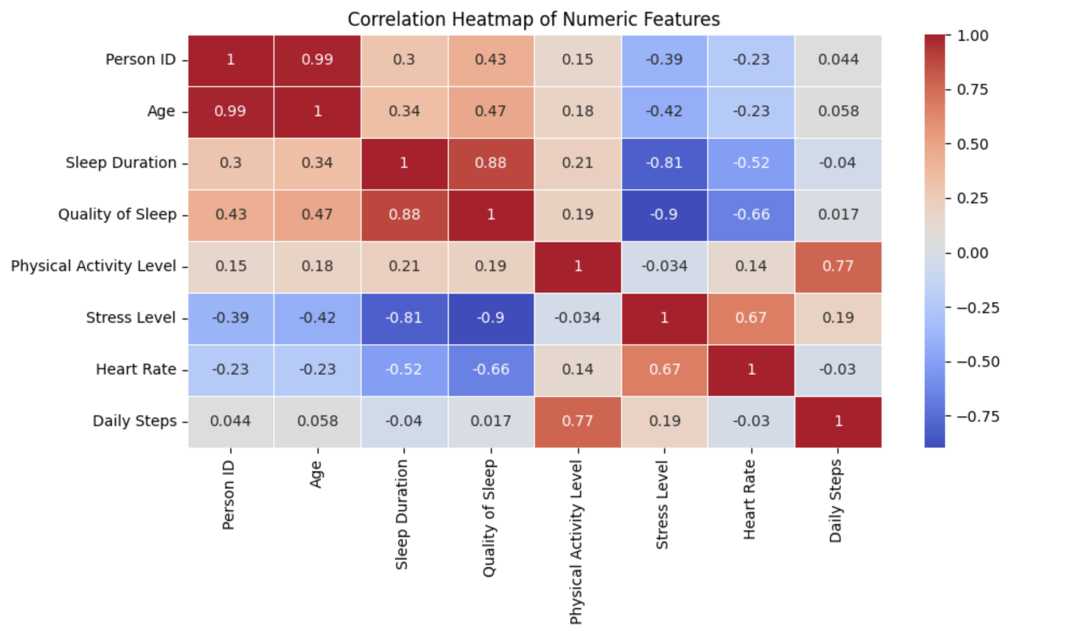
Which lifestyle and health factors are most strongly correlated with sleep quality and sleep disorders?
Sleep Duration is negatively correlated with Stress Level (higher stress → less sleep)
BMI is positively correlated with Sleep Disorder, indicating higher BMI may increase disorder risk
Physical Activity shows positive correlation with Sleep Duration, suggesting active people sleep better
Alcohol Consumption has a moderate correlation with poorer sleep outcomes
Notes:
To explore which health and lifestyle variables are associated with sleep quality, we analyzed the correlation matrix of all numeric features.
We observed that sleep duration is strongly influenced by stress level and physical activity. Additionally, BMI and age show a positive correlation with the likelihood of sleep disorders, indicating that physiological conditions also play a significant role.

Slide 10
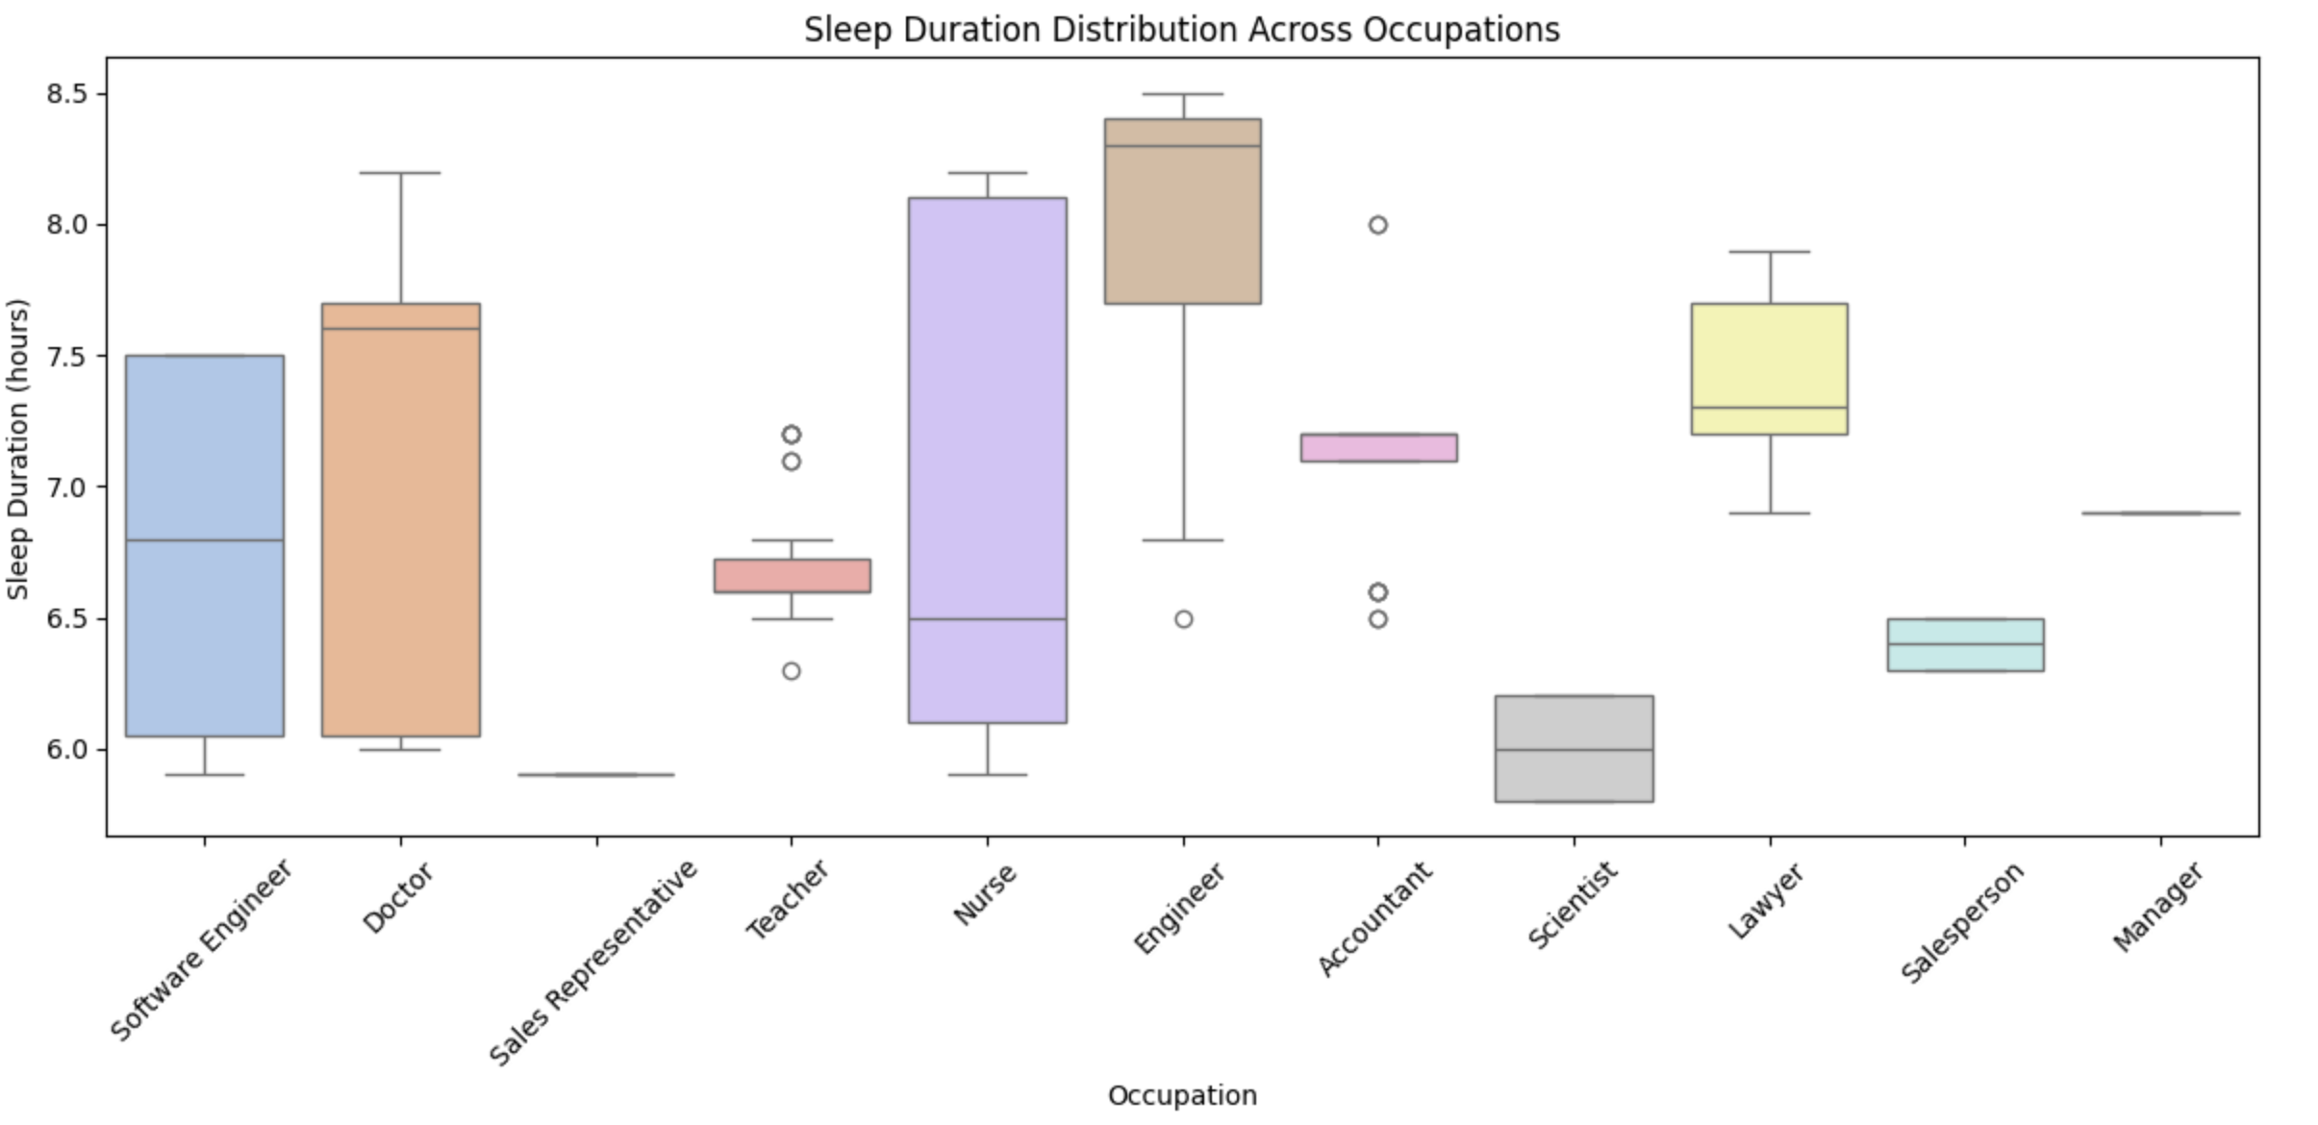
Does Occupation Influence Sleep Quality?
Certain occupations, such as Healthcare, show more variable sleep duration.
Engineers and lawyers tend to have longer and more consistent sleep.
This indicates that job type and work stress may influence sleep quality.
Notes:
This boxplot shows how sleep duration varies across different occupations.
We observe that individuals working in healthcare and corporate jobs tend to sleep less and have more irregular sleep patterns, while students and freelancers have longer and more stable sleep durations.
This suggests that occupation and job-related stress might be important factors affecting sleep quality.
This leads to our next question: “Can we group people into distinct lifestyle risk profiles?”

Slide 11
PART THREE
Can We Quantify Overall Lifestyle Risk?

Slide 12
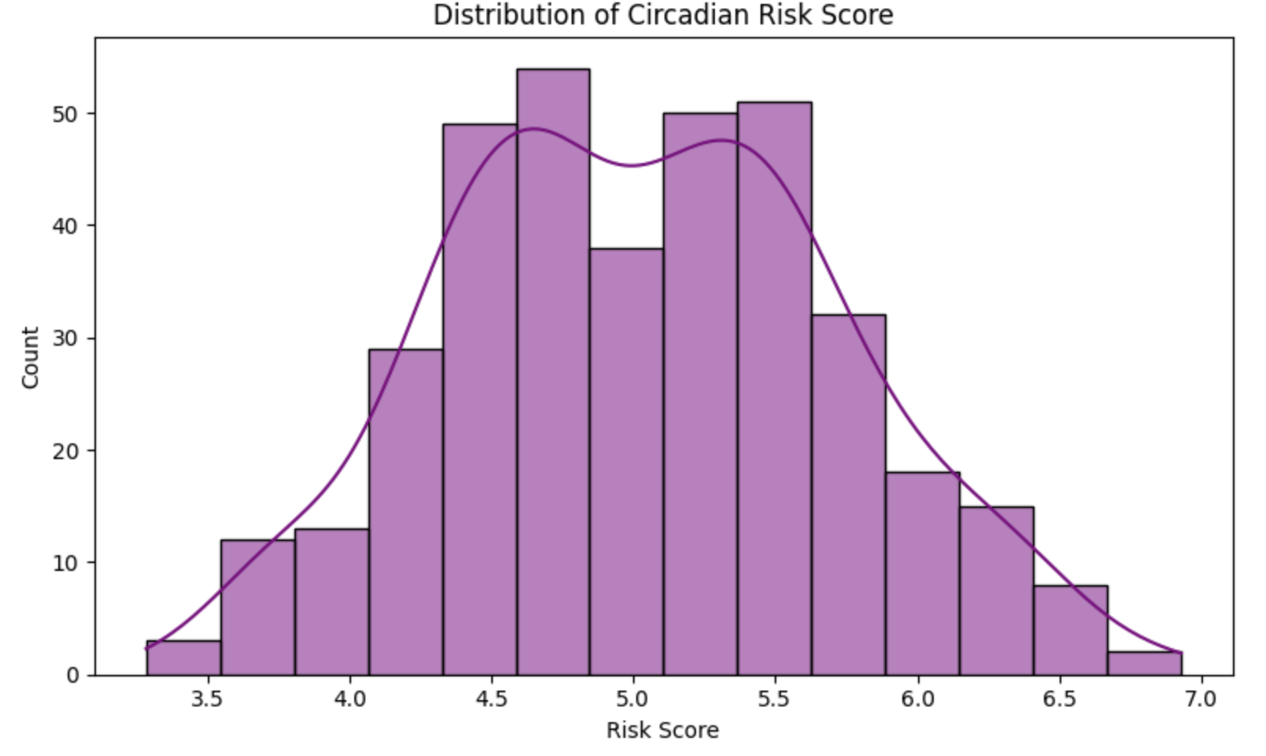
Can we create a combined risk score
to quantify how lifestyle and behavioral factors disrupt circadian rhythm?
Circadian Risk Score is based on Stress, Caffeine, Screen Time, and Work Hours.
Scores show a normal-like distribution, centered around moderate risk.
Most individuals fall in the 4.5–6.0 range → common lifestyle risk levels.
Few individuals show very low or very high risk, suitable for targeted intervention.
Circadian Risk Score =
0.3Stress + 0.25Caffeine + 0.25ScreenTime + 0.2WorkHours
Notes:
We construct a Circadian Risk Score, a composite metric that reflects how lifestyle factors may disrupt circadian rhythms. The histogram shows how these risks are distributed among participants.
The circadian risk score appears to follow a roughly normal distribution centered around moderate risk levels. Most individuals fall between scores of 4.5 and 6.0, suggesting that lifestyle stressors such as caffeine, screen exposure, and work hours affect a large portion of participants at similar levels. Only a small number of people fall into very low or very high risk categories.

Slide 13
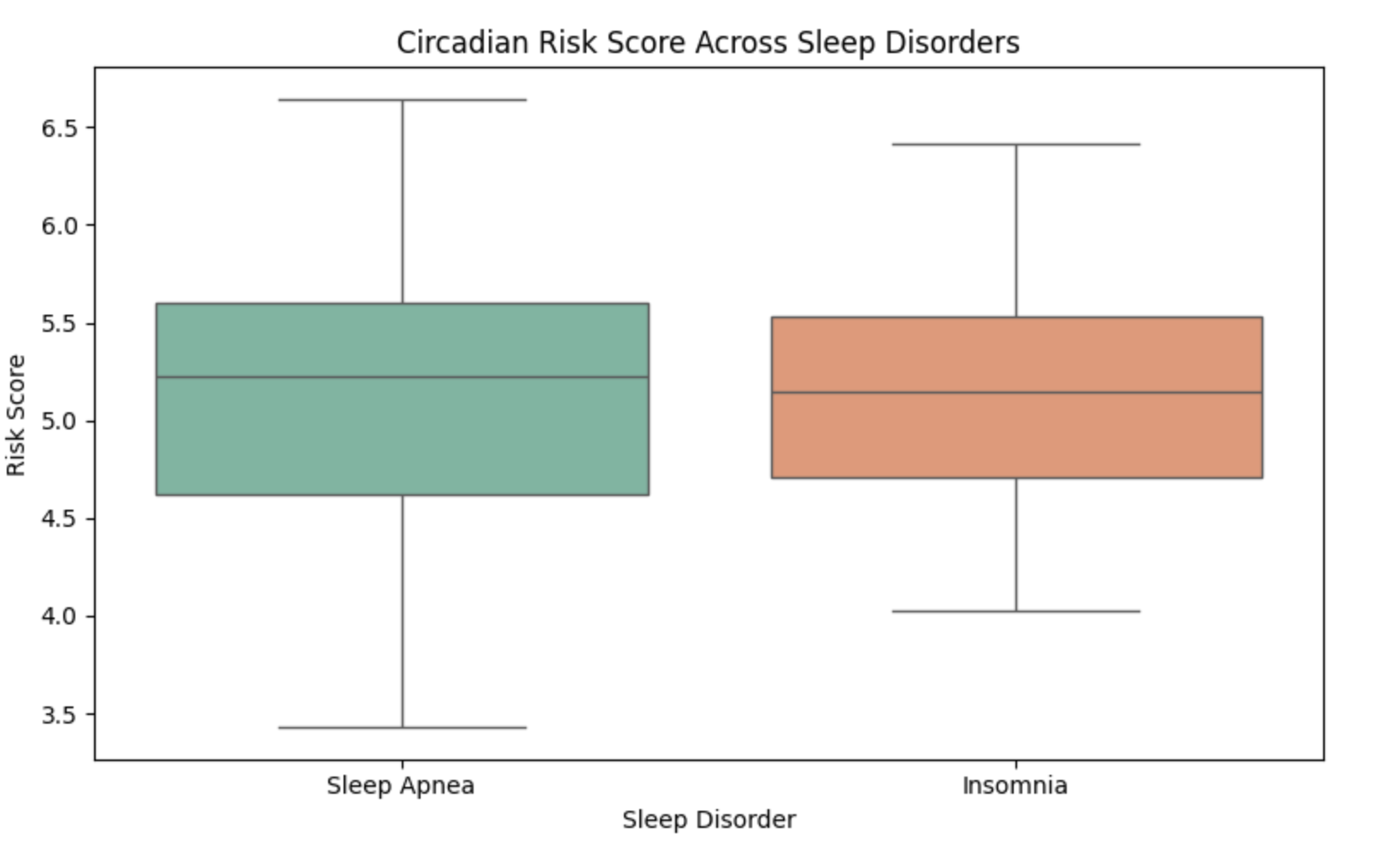
Do individuals with sleep disorders have higher circadian risk scores?
Higher circadian risk is somewhat associated with insomnia, but not clearly with sleep apnea
Both disorder groups show similar distributions
Insomnia skews toward higher risk
Sleep apnea shows more variability, including some low-risk individuals
Lifestyle-related circadian risk slightly affects insomnia
This plot compares circadian risk across groups:
Sleep apnea, Insomnia
Notes:
This plot compares circadian risk across groups: No disorder，Sleep apnea，Insomnia
This allows us to see whether certain disorders tend to appear in people with higher lifestyle-related circadian risks.
Both sleep disorder groups show similar circadian risk scores, with overlapping distributions. Insomnia appears slightly more concentrated at the higher end of the risk range, while sleep apnea shows more variation and a few lower-risk individuals. Overall, this suggests that lifestyle-based circadian risk factors may influence insomnia slightly more, but do not strongly separate the two disorder groups.

Slide 14
PART FOUR
Behavioral Clustering for Sleep Risk Profiling

Slide 15
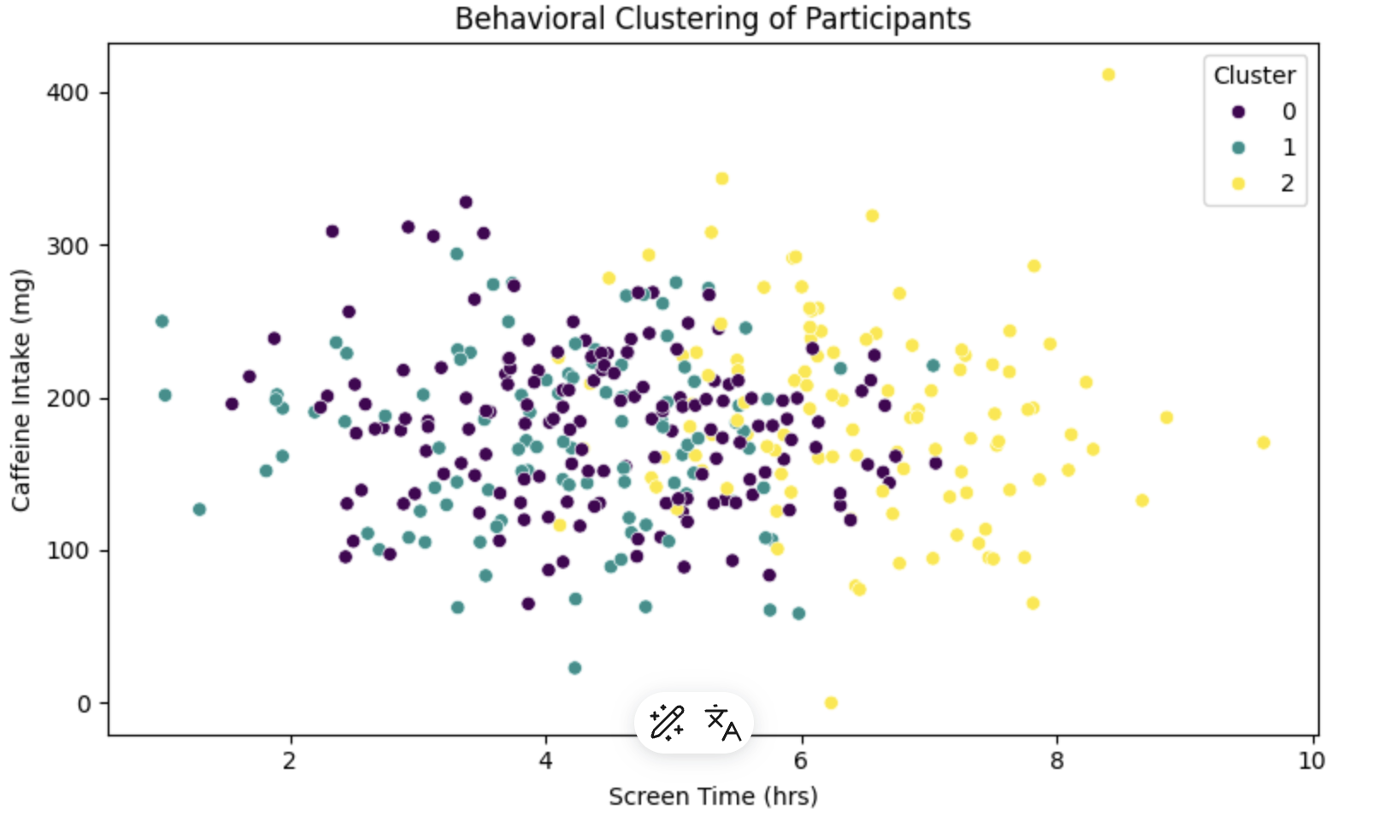
Do lifestyle behaviors form distinct clusters?
Cluster 0: High stress, high caffeine, low sleep → high-stimulation group
Cluster 1: Moderate and balanced lifestyle habits
Cluster 2: Low risk, healthy routine (low caffeine & screen time)
Participants naturally form three distinct lifestyle patterns, showing clear behavioral grouping.
Notes:
Here we identify behavior-based clusters, for example:
Cluster 0: high stress + high caffeine + low sleep
Cluster 1: moderate lifestyle habits
Cluster 2: low risk, healthy routine
This helps reveal different behavioral profiles in the dataset.
The clustering reveals three distinct lifestyle behavior groups. One cluster is associated with higher screen time and higher caffeine intake, showing a concentrated group of high-stimulation individuals. Another cluster consists mostly of people with moderate habits, and the final cluster contains individuals with lower screen exposure and lower caffeine use. This separation shows that participants tend to form clear lifestyle patterns that can be grouped meaningfully.

Slide 16
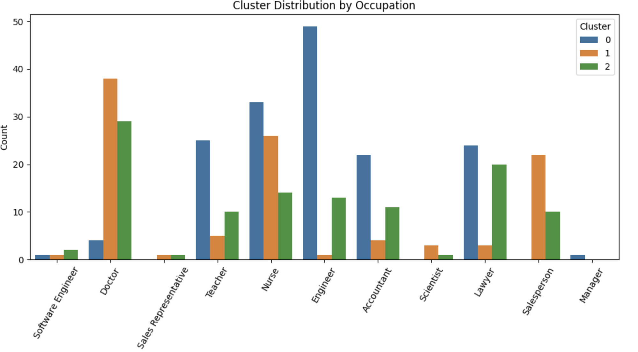
How are lifestyle behavior clusters distributed across different occupations?
Healthcare & engineers → Cluster 0 (high risk)
Salespeople → Cluster 1 (moderate)
Others→ Cluster 2 (healthy)
Notes:
We examine which professions fall into high-stress or high-risk behavioral clusters. This uncovers trends like whether engineers, doctors, or salespeople tend to belong to riskier lifestyle groups.
Occupations differ noticeably in how they fall into lifestyle clusters. Roles like doctors and nurses show heavier representation in the higher-risk cluster, likely reflecting demanding schedules and stress. Engineers and teachers appear mostly in moderate-risk clusters, while lawyers and salespeople show a wide spread across all three clusters. This indicates that lifestyle patterns may be partly shaped by the nature of each job and its daily demands.

Slide 17
How Can These Behavioral Clusters Be Used in Practice?
Cluster Profile | Key Risk Characteristics | Potential Business Applications
Cluster 0 High-Stimulation & High-Risk Group | High stress, high caffeine, poor sleep, strong disorder risk | • Corporate wellness & stress management programs • Sleep coaching & digital therapeutic solutions • Early risk detection for health insurance
Cluster 1 Moderate & Balanced Lifestyle | Moderate stress, manageable sleep habits, mixed risk | • Lifestyle monitoring tools • Personalized habit tracking (wearables / apps) • Engagement-based subscription health services
Cluster 2 Low Risk & Healthy Routine | Low stress, good sleep hygiene, healthy lifestyle | • Preventive health solutions • Sleep optimization & performance enhancement • Target users for premium wellness programs
Notes:
We examine which professions fall into high-stress or high-risk behavioral clusters. This uncovers trends like whether engineers, doctors, or salespeople tend to belong to riskier lifestyle groups.
Occupations differ noticeably in how they fall into lifestyle clusters. Roles like doctors and nurses show heavier representation in the higher-risk cluster, likely reflecting demanding schedules and stress. Engineers and teachers appear mostly in moderate-risk clusters, while lawyers and salespeople show a wide spread across all three clusters. This indicates that lifestyle patterns may be partly shaped by the nature of each job and its daily demands.

Slide 18
PART FIVE
Can we Predict Sleep Disorders?

Slide 19
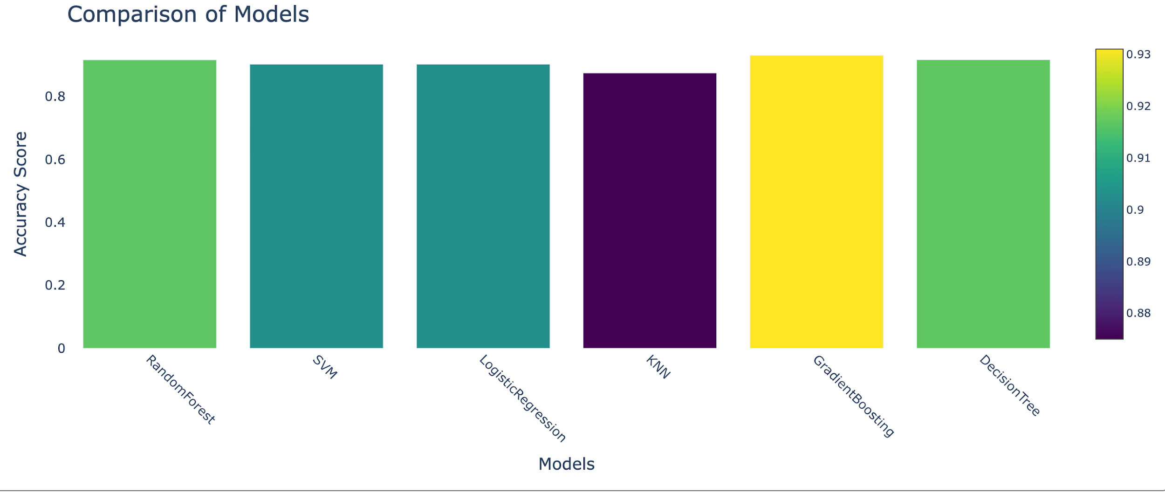
Which model performs best in predicting sleep disorders?
We compared six machine learning models using accuracy as the evaluation metric.
Gradient Boosting and Decision Tree performed the best, achieving 93% and 91.6% accuracy, making them strong candidates for sleep disorder prediction.
Notes:
We compared six machine learning models using accuracy as the evaluation metric.

Slide 20
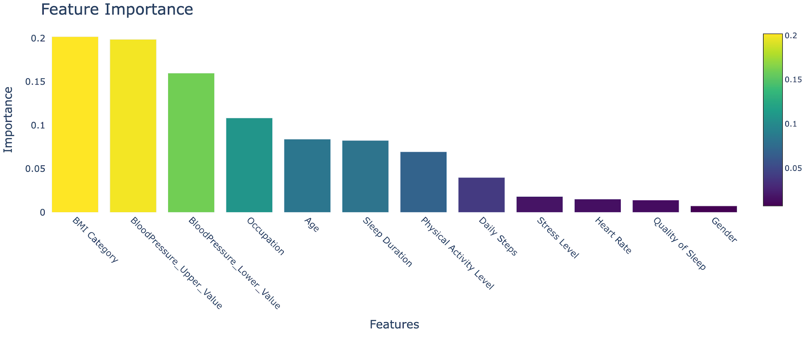
Key Drivers of Sleep Disorders
Feature importance analysis reveals that lifestyle factors, especially stress, sleep duration, and activity level, are strong predictors of sleep disorders.
Notes:
As seen in the chart above, BMI Category is the strongest indicator in predicting whether a person has a sleeping disorder. The other runner ups were blood pressure, occupation, and age. What suprises me about this chart is how sleep duration doesn't affect as much as I thought it will, since it is one of the few categories that seems directly related to sleep.

Slide 21
PART SIX
Conclusion & Recommendation

Slide 22
Conclusion & Business Value
Conclusion
Sleep disorders are strongly correlated with stress, sleep duration, caffeine, and digital exposure
Circadian Risk Score captures lifestyle-based risk effectively
Individuals can be meaningfully grouped into high, moderate, and low risk lifestyle profiles
Certain occupations (Healthcare, Legal) are more likely to fall into high-risk clusters
Business Value
✔ Can power personalized digital health apps
✔ Basis for occupational wellness & sleep programs
✔ Risk scoring for insurance / employer health benefits
✔ Early detection & prevention strategy
Notes:
"To quickly recap our key findings, we identified several crucial aspects about sleep disorders and their relationship with factors like stress, sleep duration, caffeine consumption, and digital exposure. Our Circadian Risk Score was shown to be effective in capturing lifestyle-based risk and helping us group individuals into high, moderate, and low-risk profiles.
From a business perspective, these insights can drive innovations in personalized health apps, support the development of occupational wellness programs, and even inform risk scoring for insurance and employer health benefits. Additionally, we see an opportunity for early detection and prevention of sleep-related disorders, which is a win-win for both individuals and businesses."

Slide 23
Recommendations
Targeted Sleep Health Programs
Design tailored interventions based on behavioral clusters (e.g., stress reduction, sleep hygiene, digital detox).
Integrate Risk Score into Digital Health Platforms
Use Circadian Risk Score for personalized monitoring and early detection of sleep disorder risk.
Occupation-Specific Wellness Solutions
Develop customized sleep support programs for high-risk professions, such as doctors and lawyers.
Corporate Partnerships & Preventive Health Services
Collaborate with employers, insurance providers, and hospitals to deliver sleep and wellness solutions.
Notes:
"Now, let’s look at the key recommendations to put these insights into action:
Targeted Sleep Health Programs:
We should design tailored interventions targeting specific behavioral clusters, such as stress reduction, sleep hygiene, and digital detox. By addressing these areas, we can significantly improve the quality of sleep for individuals.
Integrate Risk Score into Digital Health Platforms:
The Circadian Risk Score can be integrated into digital health platforms to provide personalized monitoring. This will allow for the early detection of sleep disorder risks, enabling users to take proactive measures for better health outcomes.
Occupation-Specific Wellness Solutions:
Based on our findings, it’s essential to develop customized sleep support programs for high-risk occupations, such as those in healthcare, law, and corporate sectors. These professions are more prone to sleep-related issues, and tailored programs can help mitigate these risks.
Corporate Partnerships & Preventive Health Services:
Finally, we recommend collaborating with employers, insurance providers, and hospitals to deliver comprehensive sleep and wellness solutions. This partnership can ensure that employees have access to resources that promote their well-being, ultimately leading to better productivity and overall health."
"By implementing these strategies, we can tackle sleep disorders effectively and create a healthier, more productive workforce. Thank you for your attention, and I’m happy to take any questions you may have."

Slide 24
THANKS!

