Slide 1
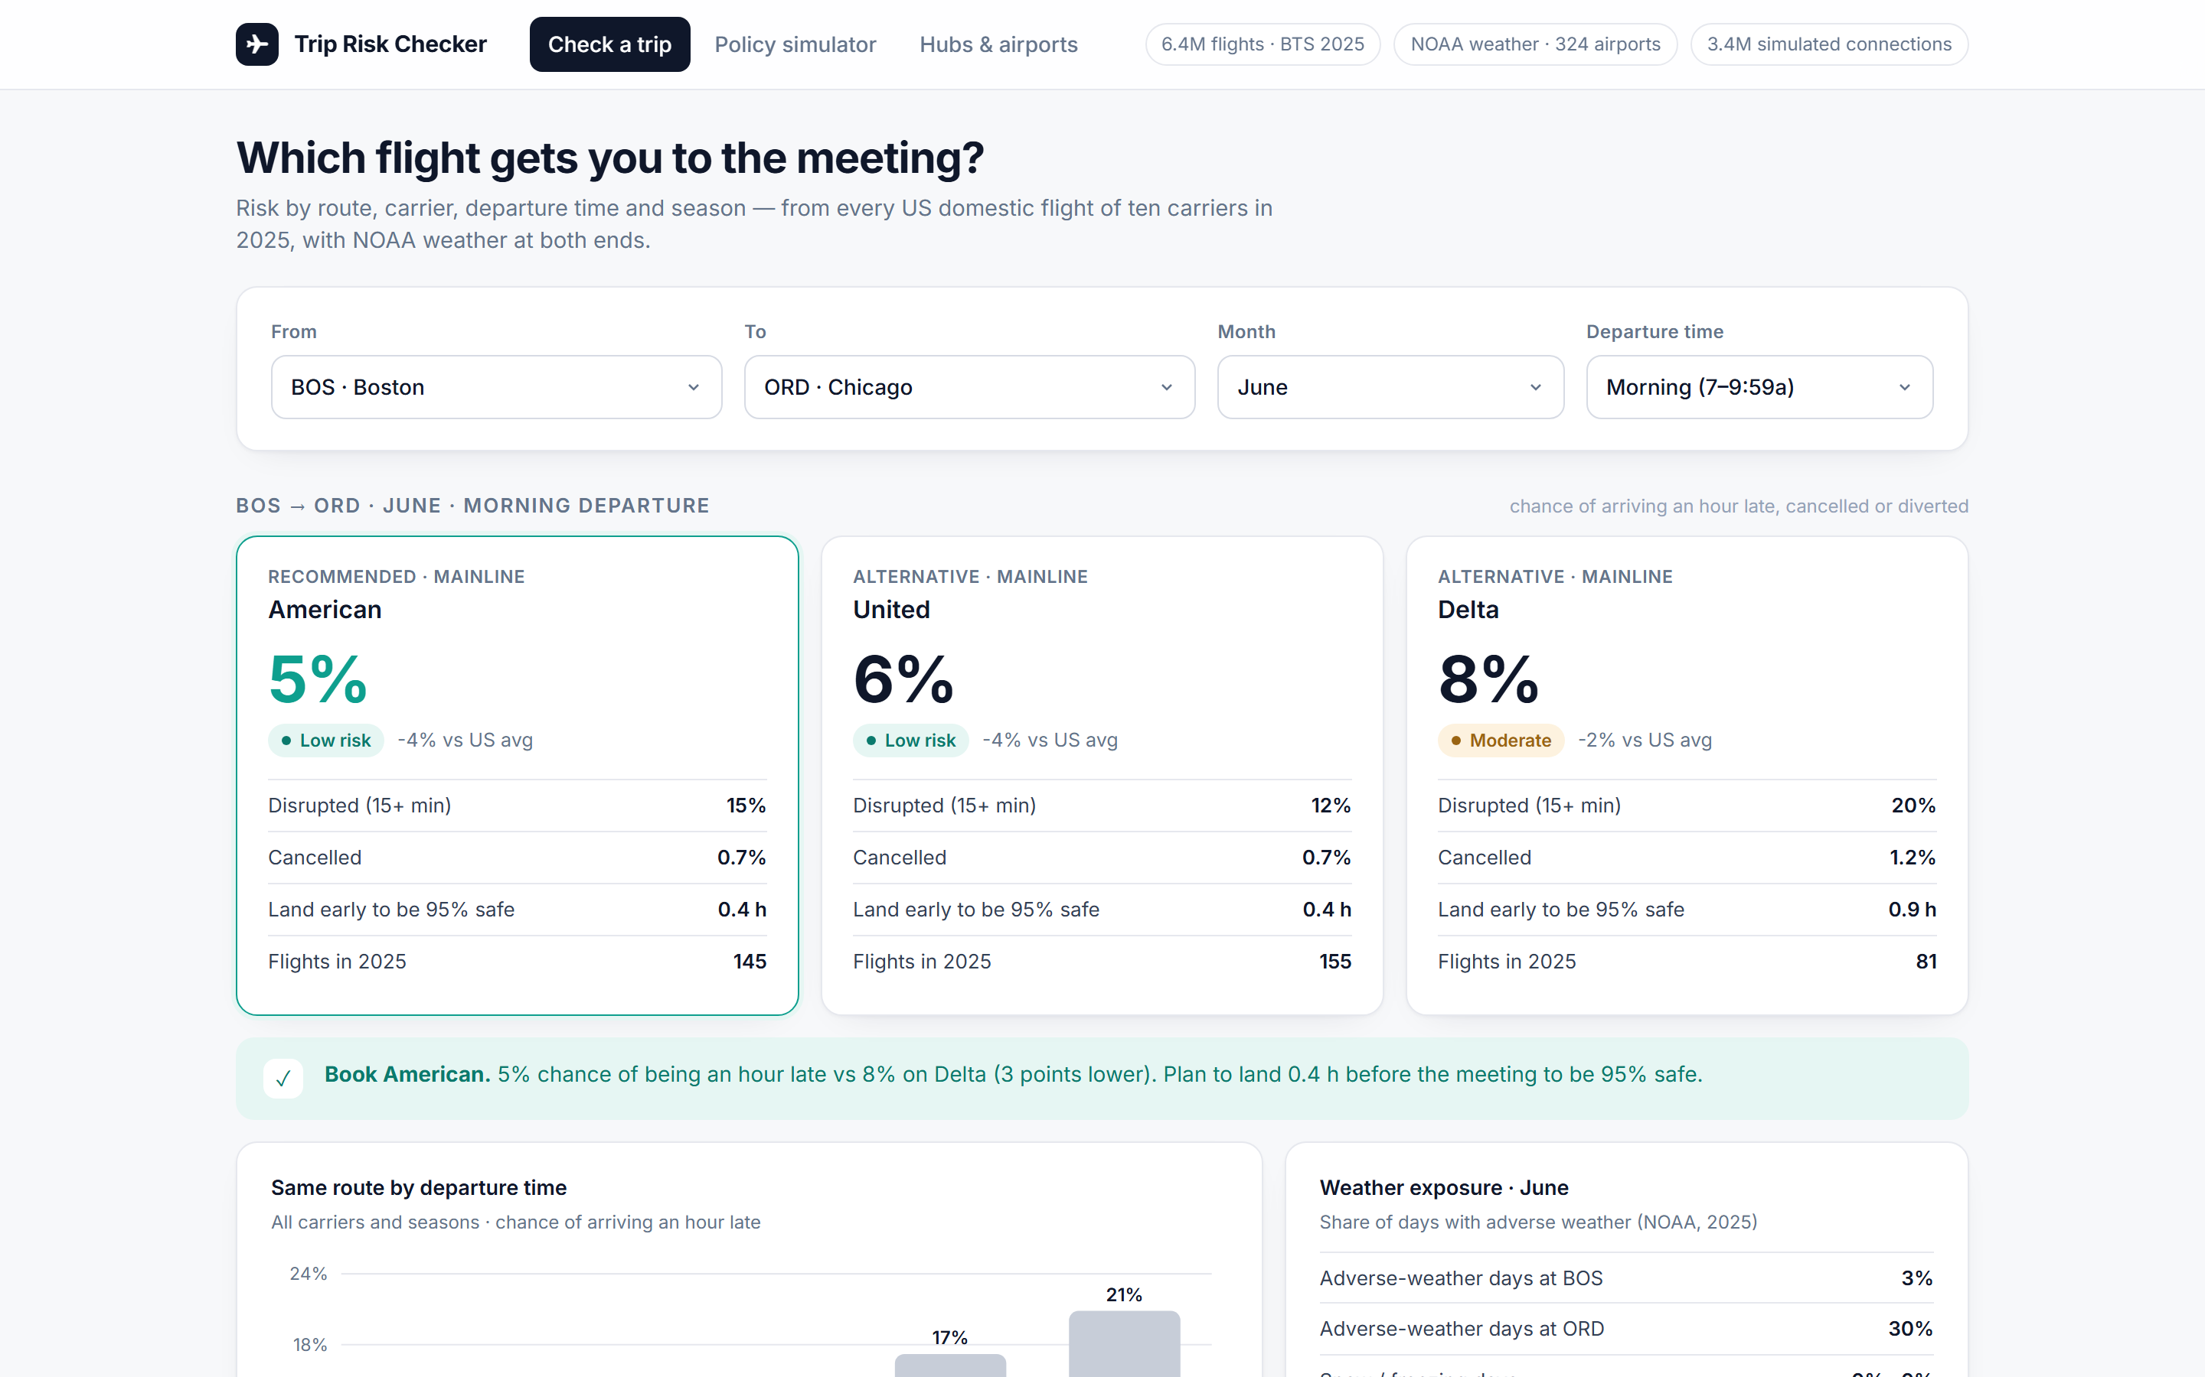
✈
Trip Risk Checker
Know the risk before you book.
A booking-time risk score for every US domestic route, carrier, departure time and season — built from 6.4 million flights and NOAA weather, delivered as a web app your travel desk and travelers can use today.
Prepared by [TEAM NAME — replace] · Questrom MSBA · 7 November 2026
Notes:
Thirty-second opener: every booking tool shows price and schedule; none shows the chance of missing the meeting. We built the one that does, from every US domestic flight in 2025.

Slide 2
Booking tools show price and schedule. They do not show the chance of missing the meeting.
23.5%
9.7%
3.2x
of flights are disrupted — 15+ min late, cancelled or diverted (6.4M US domestic flights, 2025)
arrive an hour+ late, are cancelled or diverted — the trips that cost a meeting
difference in disruption risk between a 7 p.m. and a 6 a.m. departure on the same routes
1
The traveler
2
The travel manager
3
The company
Picks by price and time, lands an hour late, misses the meeting, sleeps in an airport hotel. The cost is invisible at booking.
Has a policy about fares and class of service — and nothing about reliability, because nobody has put the numbers in front of them.
Pays roughly $98k per 1,000 trips in lost time, missed meetings and strandings (at $100/h, $500 per missed meeting, $300 per stranding).
Notes:
The data is public and the risk is predictable, but it never reaches the moment of booking. That is the gap the product closes.

Slide 3
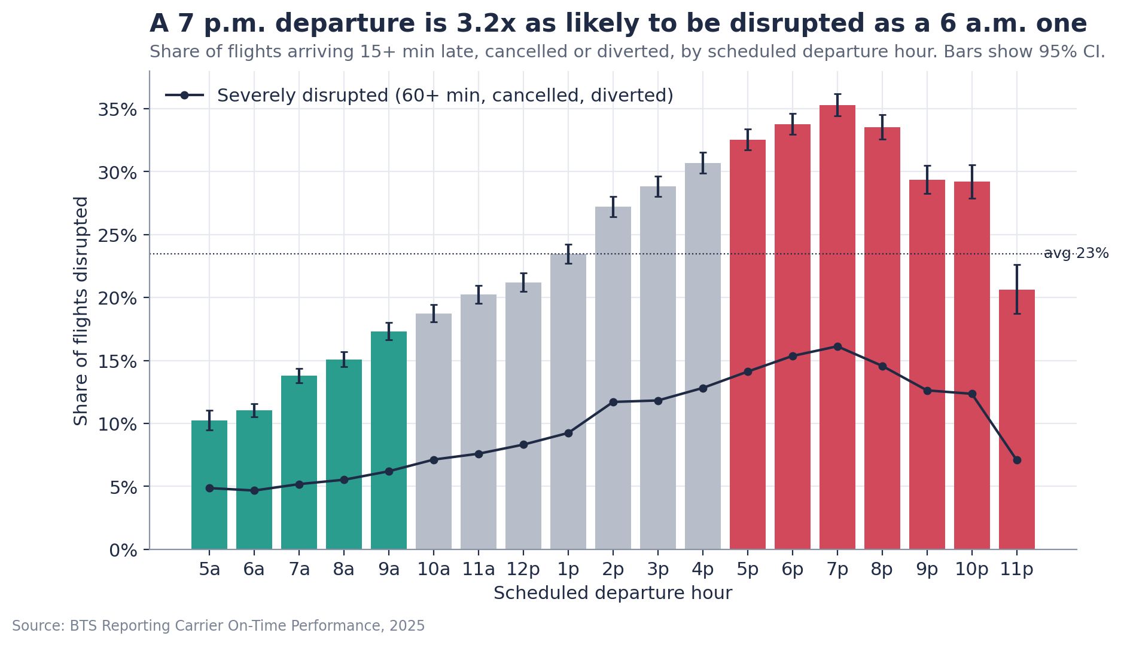
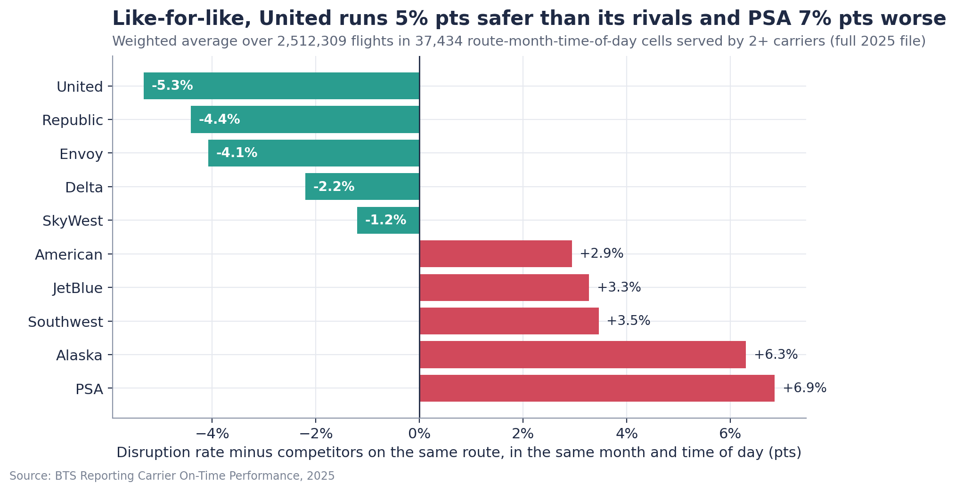
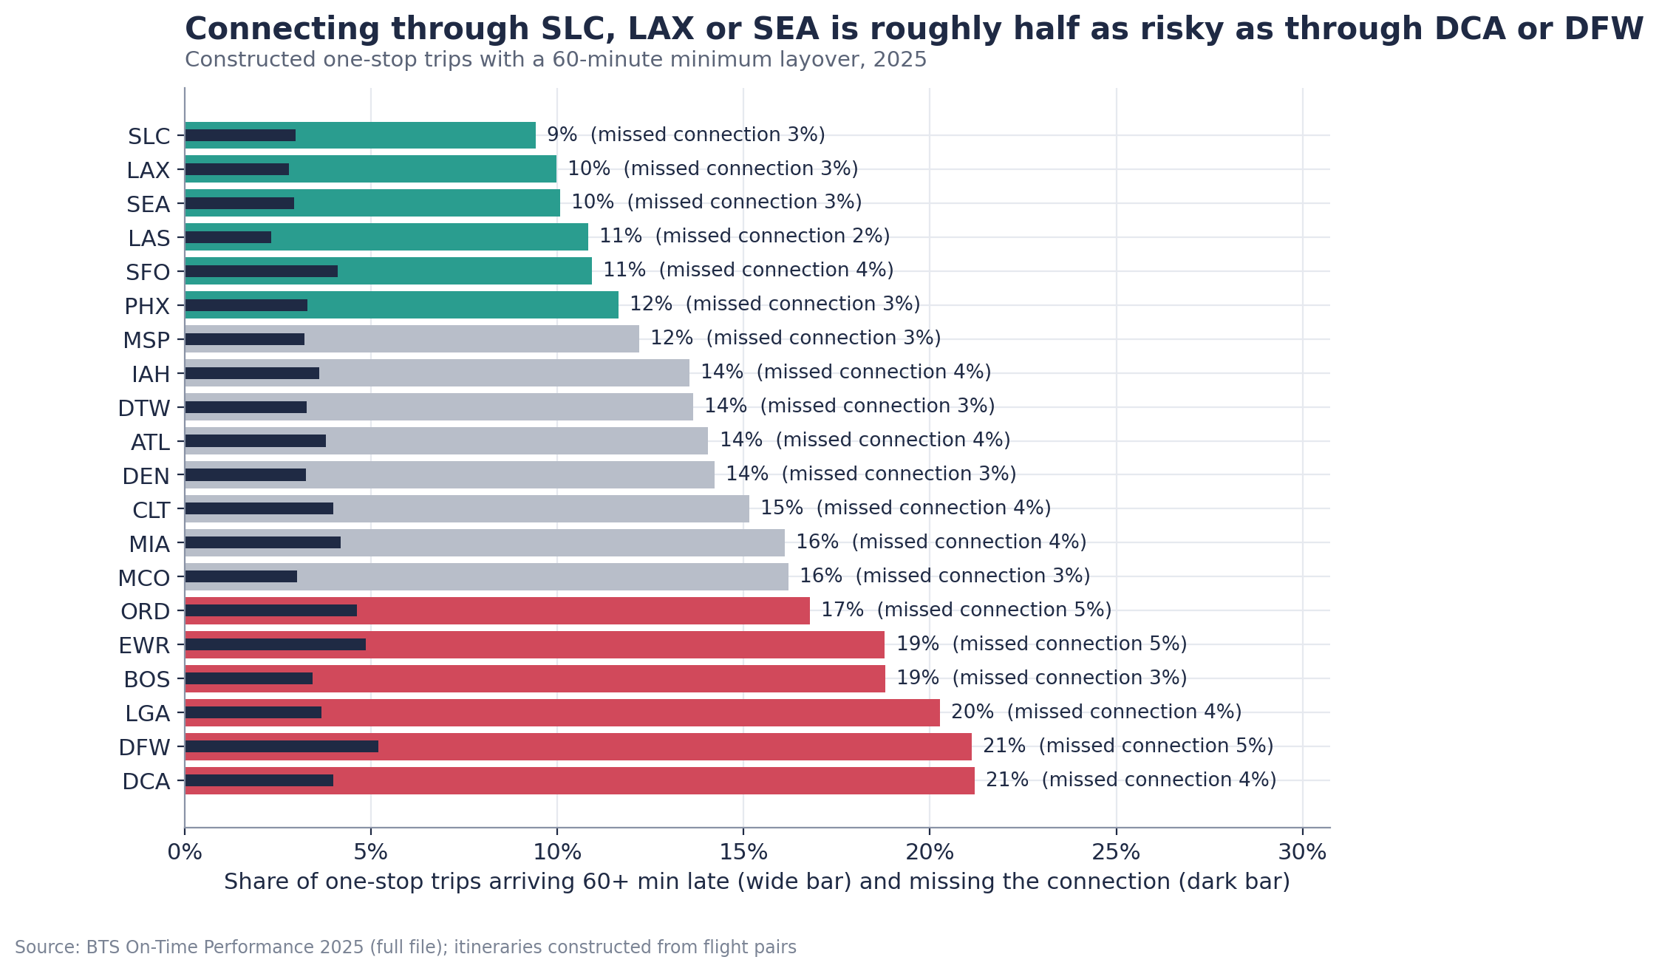
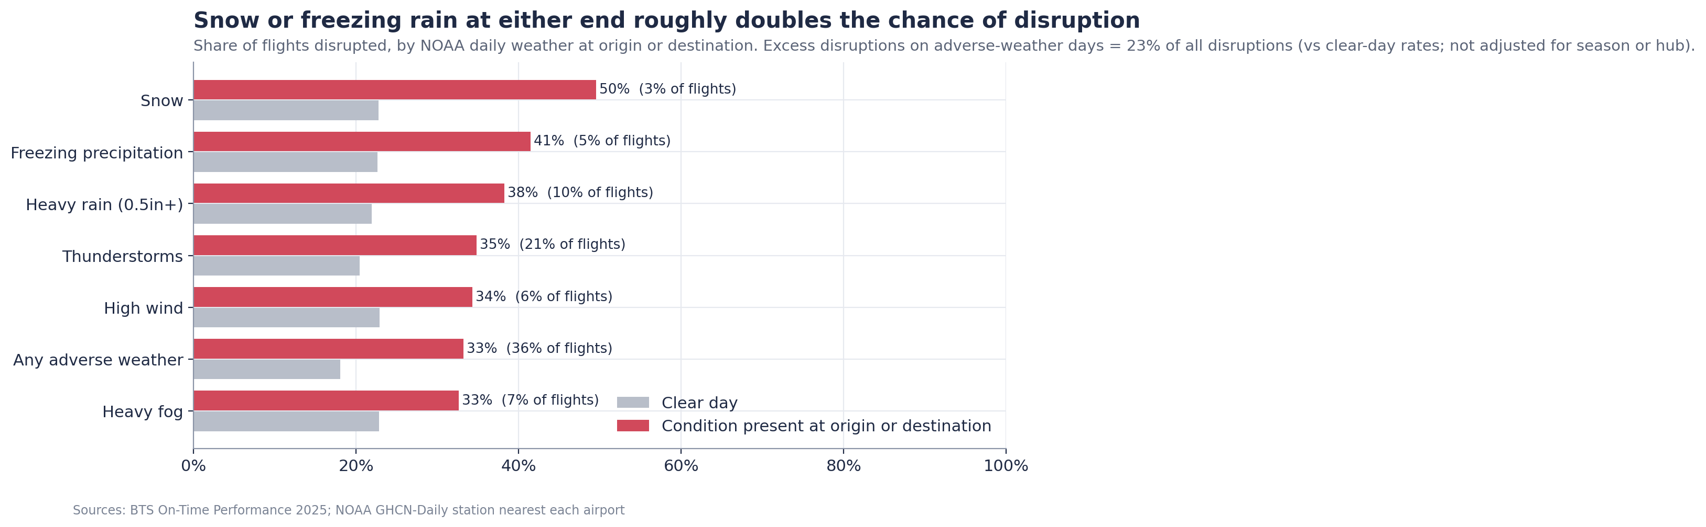
The risk is predictable at booking time — four levers the data makes visible
Departure hour
Carrier on the route
Risk climbs every hour from 5 a.m. to 7 p.m. as late aircraft cascade. Morning 5.4% vs evening 14.5% an hour late.
Like-for-like, carriers differ by 5-10 points on the same route; the right pick is route-specific, not a blanket airline.
The hub
Season and weather
One-stops via SLC, LAX or SEA: 9-10% an hour late. Via DCA, DFW or LGA: 20-21%. A 90-minute layover halves missed connections.
Flights touching adverse weather are 1.8x as likely to be disrupted; exposure by airport and month is knowable when you book.
Notes:
Four findings from the analysis, each validated like-for-like. The product turns them into a single number per option: the chance of arriving an hour late.

Slide 4
The product — one screen answers 'which flight gets me to the meeting?'
Pick a route, month and departure window; every carrier that flies it gets a risk score with a plain-English pill (low / moderate / high).
Each card shows disruption, cancellation, the buffer to land for 95% confidence, and the evidence base (flights in 2025).
A recommendation line names the safest option and the buffer in one sentence.
Below: the same route by departure time, weather exposure for that month, and nonstop vs one-stop with the fare saving needed to break even.
Notes:
Walk the screen top to bottom: inputs, carrier cards, recommendation, then the context panels. Everything is precomputed — the page loads in under a second.

Slide 5
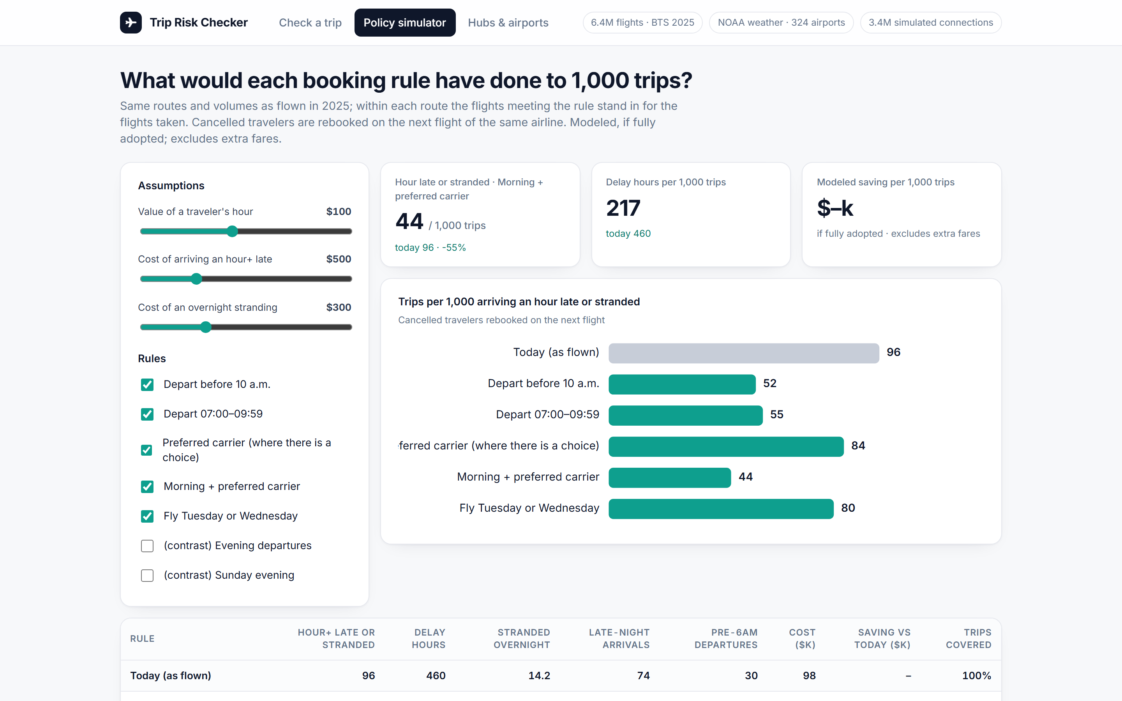
For the travel manager — a policy simulator that re-runs last year's trips under each rule
Toggle booking rules (before 10 a.m., 07:00-09:59, preferred carrier, Tue/Wed) and see trips per 1,000 arriving an hour late, delay hours and overnight strandings.
Cost assumptions are sliders — the value of an hour, a missed meeting, a stranding — so the business case is yours, not ours.
Burden metrics ride along: late-night arrivals and pre-6 a.m. departures, so policy is judged on the employee's side too.
The buffer table: hours to land before a must-attend meeting by season and departure time.
Notes:
This is the Q&A weapon: any constraint — single carrier, no early flights, budget cut — becomes a slider or a rule toggle, with the numbers recomputed live.

Slide 6
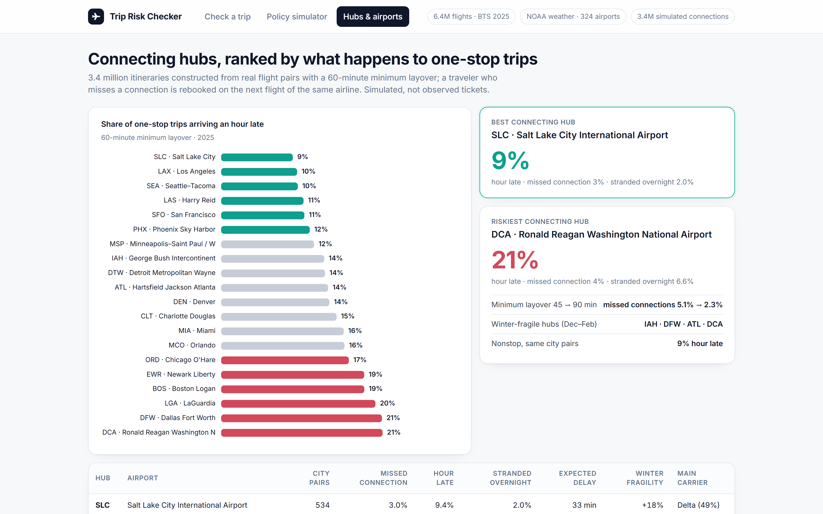
For connections — hubs ranked by what actually happens to one-stop trips
3.4 million one-stop itineraries constructed from real flight pairs, with a 30-minute connection rule and rebooking when a connection breaks.
Every major hub ranked by hour-late rate, missed connections and overnight strandings; winter fragility and dominant carrier alongside.
An airport map coloured by disruption, monthly weather exposure or winter fragility — the approved-hub list, explained.
Notes:
Constructed itineraries, not tickets sold — we say so on the screen. The ranking is refreshed from BTS data each quarter.

Slide 7
How it works — public data in, a risk score out, refreshed every quarter
1
2
3
4
5
BTS On-Time Performance
NOAA GHCN-Daily
Simulation
Lookup tables + model
Streamlit app
6.4M flights, 10 carriers, 329 airports, 2025. Cleaned with one shared function; no rows dropped.
→
Daily weather at the station nearest each of 324 airports: snow, ice, storms, wind, fog.
→
Cancelled travelers rebooked on the next flight; 3.4M one-stop trips built from flight pairs.
→
Route x carrier x time x season rates (shrunk for thin cells); a calibrated booking-time risk model (AUC 0.67-0.71).
→
Reads only the small precomputed tables; loads in under a second; deployable on Streamlit Community Cloud from a GitHub repo.
8
< 1 s
quarterly
$0
notebooks, fully reproducible from the raw files in ~20 minutes
page load — the app never touches the 6.4M rows
refresh of carrier, hub and route tables from new BTS releases
hosting on Streamlit Community Cloud; public data only
Notes:
No proprietary data, no PII, no infrastructure to run. The whole pipeline is eight notebooks and a 400-line app.

Slide 8
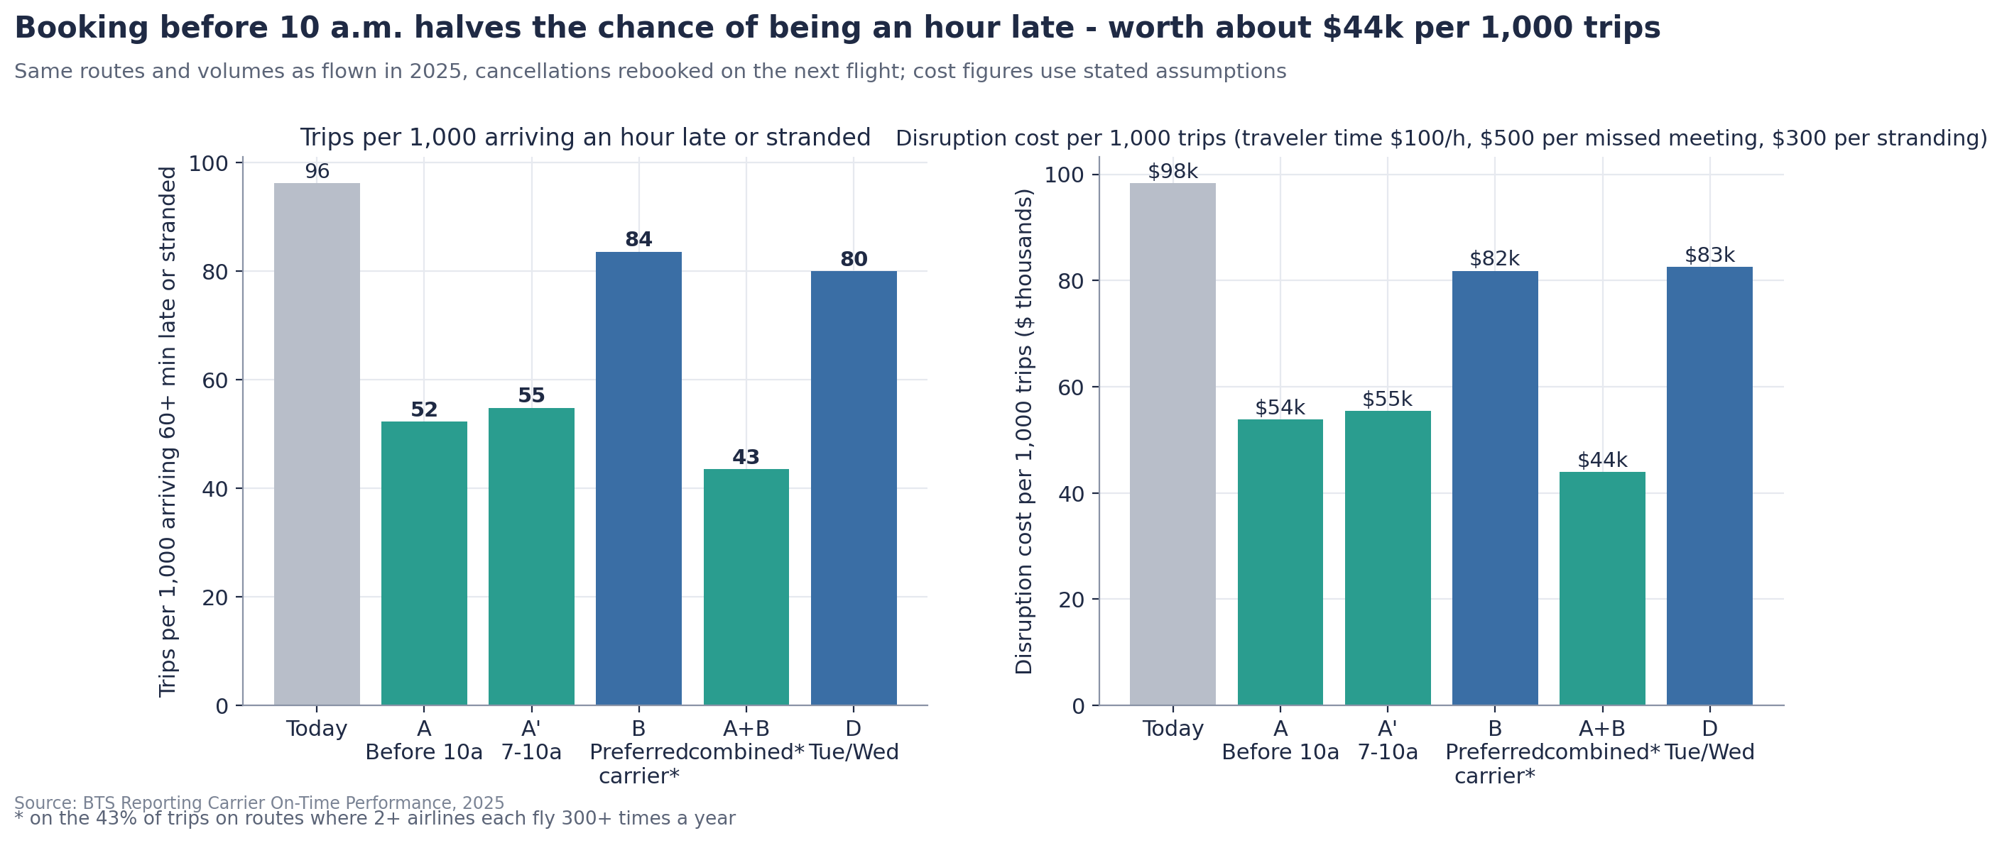
What it is worth — a modeled $13k-$76k per 1,000 trips from the first rule alone
Saving per 1,000 trips ($k) | Meeting $0 | $500 | $1,000
Traveler time $50 / h | 13 | 35 | 57
Traveler time $100 / h | 23 | 44 | 66
Traveler time $150 / h | 32 | 54 | 76
Morning preference, if fully adopted; cancelled travelers rebooked; excludes extra fares, hotels and policy costs.
Rules 1 + 3 together
Employee side
Traveler care budget
Hour-late trips 96 → 43 per 1,000 (−55%), ~$54k per 1,000 trips at the mid case.
Late-night arrivals 74 → 0.4 per 1,000; overnight strandings 14 → 3; the 07:00-09:59 variant keeps pre-6 a.m. departures at zero.
~$6k per 1,000 trips at mid assumptions, triggered by measured events — a rounding error next to the disruption cost.
Notes:
Every number is a modeled benefit under stated assumptions; the sensitivity table is the honest range. The pilot turns the model into a measured result.

Slide 9
Rollout — a one-quarter pilot, then the booking tool
Weeks 1-2 · Launch
Quarter 1 · Pilot
Quarter 2 · Integrate
Ongoing · Refresh
Host the app (Streamlit Community Cloud, free); travel desk and two business units get the link; owners named.
Morning preference and preferred-carrier defaults for time-critical trips in two units vs a control group. Track severe-disruption rate, delay hours per 100 trips, strandings, compliance, fare delta, traveler satisfaction.
Defaults and soft warnings inside the booking tool (evening departure, last flight of the day, <90-min connection, non-approved hub); override with a reason code.
Quarterly rebuild from new BTS and NOAA releases; add fares (DB1B), a forecast feed for rule 4, and the client's own trip records.
96 → ~55
4
0
hour-late or stranded trips per 1,000 — the pilot target (not the fully-adopted 52)
KPIs on one page: severe rate, delay hours, strandings, compliance — plus fare delta and satisfaction
new systems to buy: a link, then defaults in the tool you already use
Notes:
Light rollout by design: a hosted link first, policy defaults second, integration third. The quarterly refresh is scripted.

Slide 10
What we would say to a skeptical CFO — the limits are on the screen, not hidden
Simulated vs observed is labelled everywhere: one-stop trips and rebooking are constructed from real flights, not tickets sold.
One year of data (2025); associations with like-for-like controls, not proven causes. Results hold without the 15 worst days.
Operating carrier only — regional airlines fly for several brands; SkyWest / Republic assigned by a documented heuristic.
No fares in the data: the break-even fare saving is the honest substitute until DB1B fares are added.
Weather: daily, one station per airport; actual weather stands in for a forecast, so the weather rule is a watch rule.
The model ranks risk (AUC 0.67 at booking, 0.71 with day-of weather); it does not predict a specific delay.
Validated
Grouped cross-validation by date; calibration checked; the 200k sample reproduces the 6.4M population inside its confidence intervals.
Reproducible
Eight notebooks, one cleaning function, every chart and table regenerated from the raw files; sources logged with dates and licences.
Notes:
We would rather name the limitations than have a client find them. Each one has a mitigation and a next step.

Slide 11
The ask
1
Approve a one-quarter controlled pilot in two business units
owners: travel manager, travel desk lead, analytics
2
Host the Trip Risk Checker for the travel desk and travelers
Streamlit Community Cloud from the project repo — free, public data only
3
Adopt the four booking defaults as soft warnings, not bans
override with a reason code; refreshed quarterly
Modeled saving $13k-$76k per 1,000 trips depending on how a lost hour and a missed meeting are valued — the pilot replaces the model with a measurement.
Notes:
End on the decision. The app is live for any route or constraint the room wants to test.

