Slide 1


Arrive on time,
arrive ready
A data-driven travel policy for a company whose people fly constantly.
[Team name] · Questrom MSBA
Notes:
Who we are and the ask in one sentence: cut the chance that a traveler misses a meeting, without blowing up cost or convenience. We looked at every US domestic flight of ten airlines for a full year, 6.4 million flights, plus the daily weather at both ends.

Slide 2
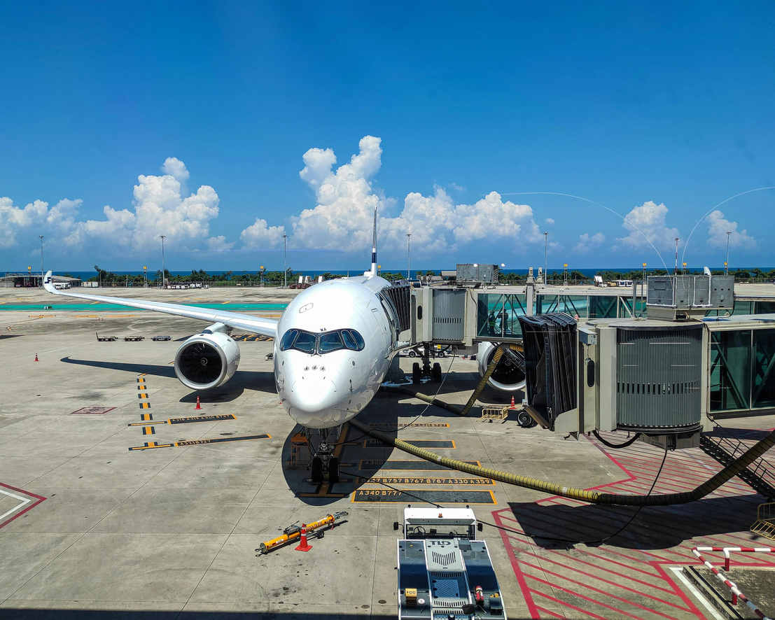
Executive summary
The problem. One flight in ten gets the traveler there an hour late or not at all (9.7%); 23.5% are disrupted. Most flights land early; the cost sits in that tail, and the tail is predictable.
What we found. Morning departures are a third as likely to be disrupted as evening ones. The right airline on a route is worth 5 to 7 points. Bad weather nearly doubles the risk and is foreseeable by month and airport. A stop lifts the chance of an hour-late arrival from 9% to 16%.
What we recommend. Four defaults in the booking tool, not bans: morning preference for time-critical trips, nonstop first with 90-minute layovers via approved hubs, the preferred airline by route, and a weather buffer in risky months.
The impact. Hour-late trips cut by about half, from 96 to roughly 50 per 1,000, and $13k to $76k saved per 1,000 trips depending on what an hour and a meeting are worth. The ask: a one-quarter pilot in two business units against a control group.
Notes:
The whole story on one slide: the size of the problem, the four findings, the four defaults and what they are worth. Everything after this is evidence.

Slide 3
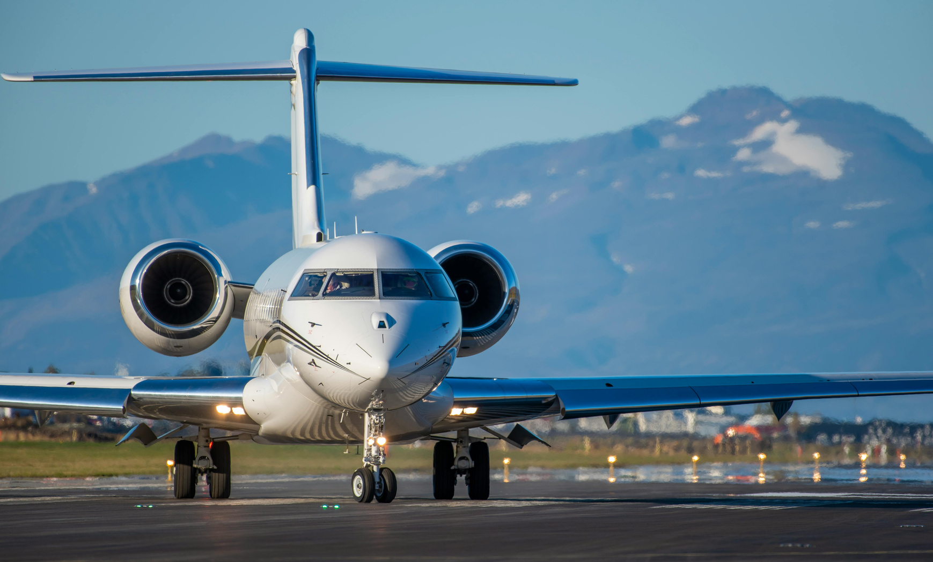
One flight in ten gets you there an hour late
What we did
We took every US domestic flight of ten airlines for a full year, 6.4 million flights, added the weather at both airports, and asked one question: which choices get a traveler to the meeting on time?
Most flights land early. The cost sits in the tail.
23.5% of flights are disrupted (15+ min late, cancelled or diverted). 9.7% arrive an hour late or not at all.
Notes:
Most flights land early; the median flight is six minutes early. The problem is the tail: the 10% that arrive an hour late, are cancelled or diverted. That tail is what costs a meeting, and it is predictable.

Slide 4
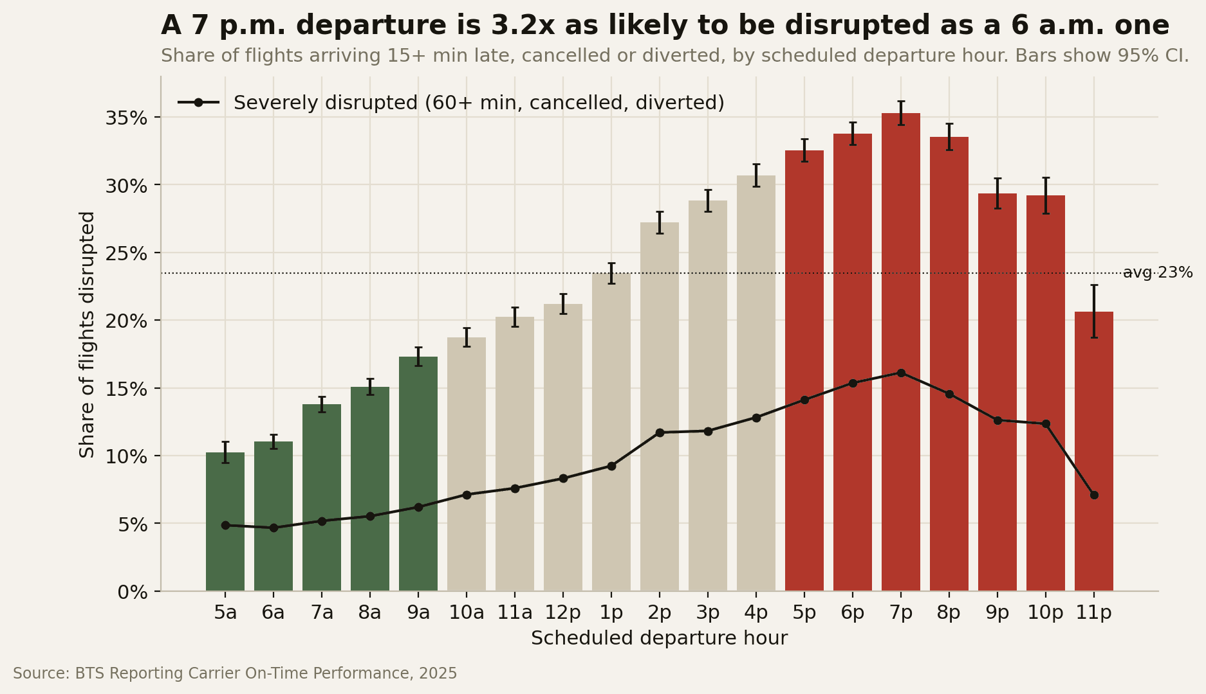

Finding 1 · Fly in the morning
What we found
A 7 p.m. departure is three times as likely to be disrupted as a 6 a.m. one. Delays snowball: every departure inherits the lateness of the aircraft before it.
Same airline, same route: evening is worse on 98% of routes.
What it means
Leaving between 7 and 10 a.m. keeps nearly all the benefit with no dawn start: 5.6% an hour late, against 14 to 15% in the evening.
Chance of disruption by scheduled departure hour, all flights.
Notes:
This is the most reliable pattern in the data and the cheapest to act on. It is not a route-mix effect: on the same airline and route, evening is worse than morning on 98% of routes, and the morning advantage holds in every month.

Slide 5
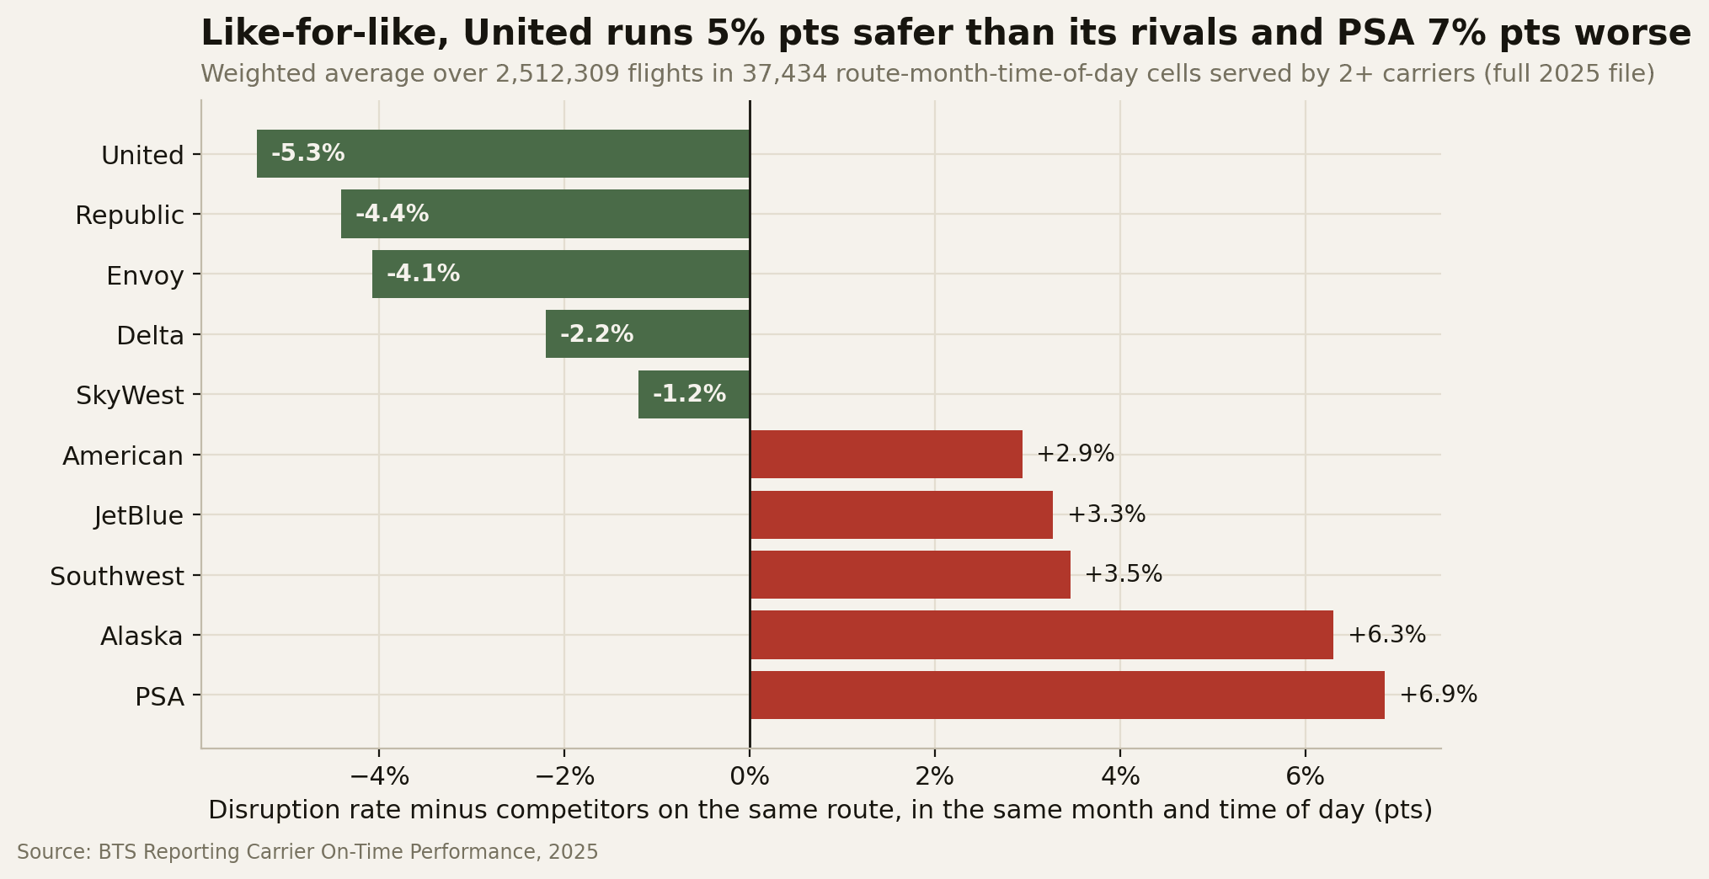

Raw rankings mislead: an airline that flies mostly in calm western skies looks better than it is. We compared airlines only on the same route, month and time of day.
Finding 2 · Pick the airline by route
What we found
Like for like, United runs about 5 points safer than its rivals on shared routes; PSA and Alaska run 6 to 7 points worse.
What it means
On the 43% of trips where two or more airlines fly the route, the gap between best and worst is typically 7 points, and up to 22 on Boston to Chicago. Prefer by route, not by brand.
Notes:
Each airline is compared only with the other airlines flying the same route in the same month and time of day. Regional airlines are shown as operated.

Slide 6
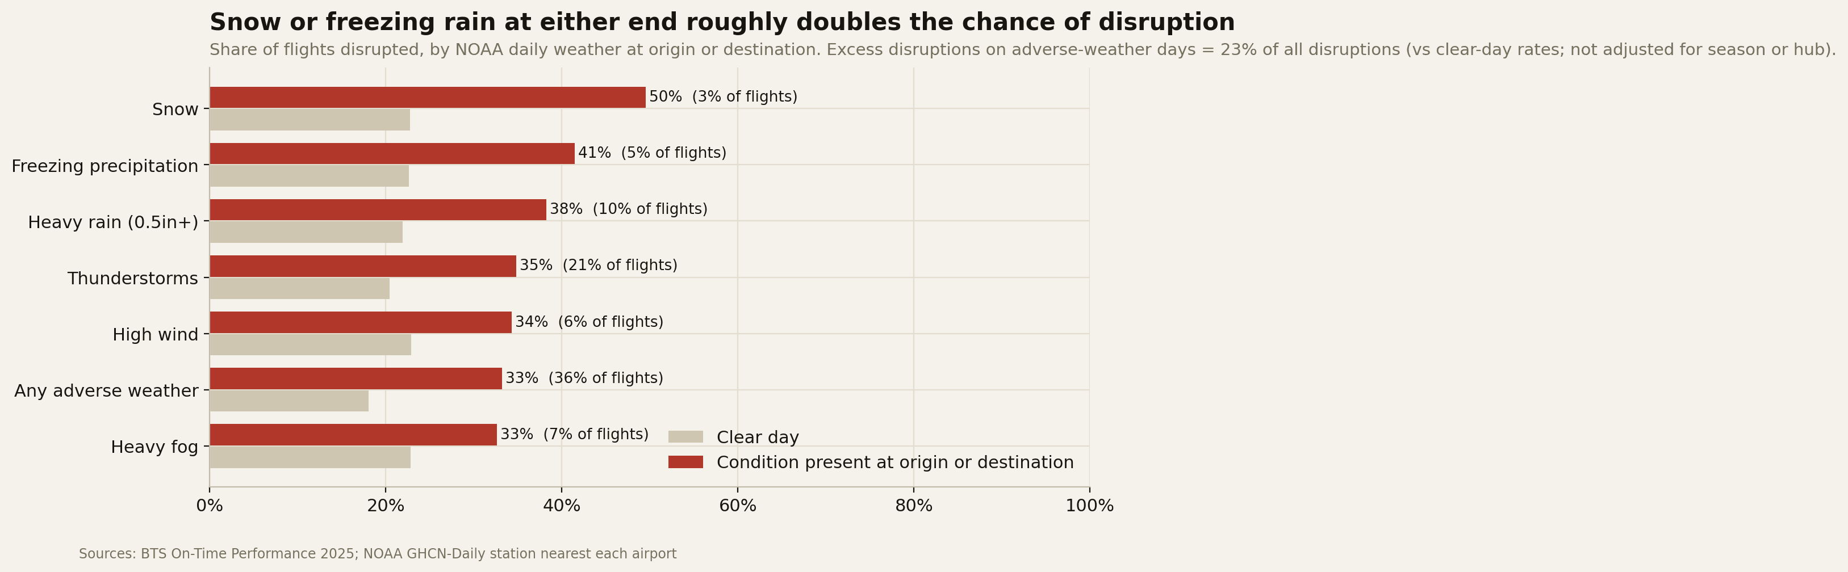

Flights touching an airport with bad weather are 1.8x as likely to be disrupted.
Finding 3 · Weather is foreseeable
What we found
33% of flights are disrupted on adverse-weather days against 18% on clear days. Snow and freezing rain roughly double the risk. The airlines' own weather code captures only a sliver of this.
What it means
June, July and December are the risky months, and each airport has its own pattern. Book around it, and watch the forecast one to three days out.
Notes:
Every flight was joined to the daily weather record at both ends. The point is not that airlines are wrong; their weather code is defined narrowly. Weather risk is foreseeable by season and airport at booking time, and from the forecast a few days out.

Slide 7
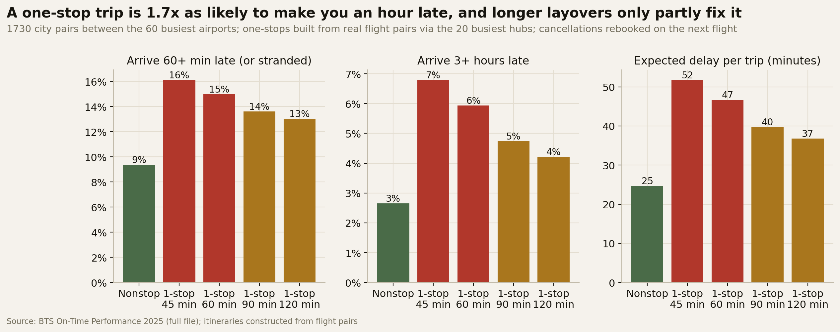

Finding 4 · A stop is a gamble
What we found
The hub decides the odds
Nonstop trips arrive an hour late 9% of the time. The same city pairs with one stop: 16%. Overnight strandings triple.
Connecting through Salt Lake City, Los Angeles or Seattle: about 10% an hour late. Through Washington National, Dallas or LaGuardia: over 20%.
Layover length matters
What it means
Raising the minimum layover from 45 to 90 minutes cuts missed connections from 51 to 23 per 1,000 connecting trips.
A one-stop needs to be about $400 cheaper one way to pay for the traveler's extra time, before counting a missed meeting. Fly nonstop when you can.
Notes:
Built from 3.4 million one-stop itineraries constructed from real flight pairs on 1,730 city pairs. Simulated trips, not tickets sold. Hub ranking and winter fragility are on the Hubs page of the website.

Slide 8
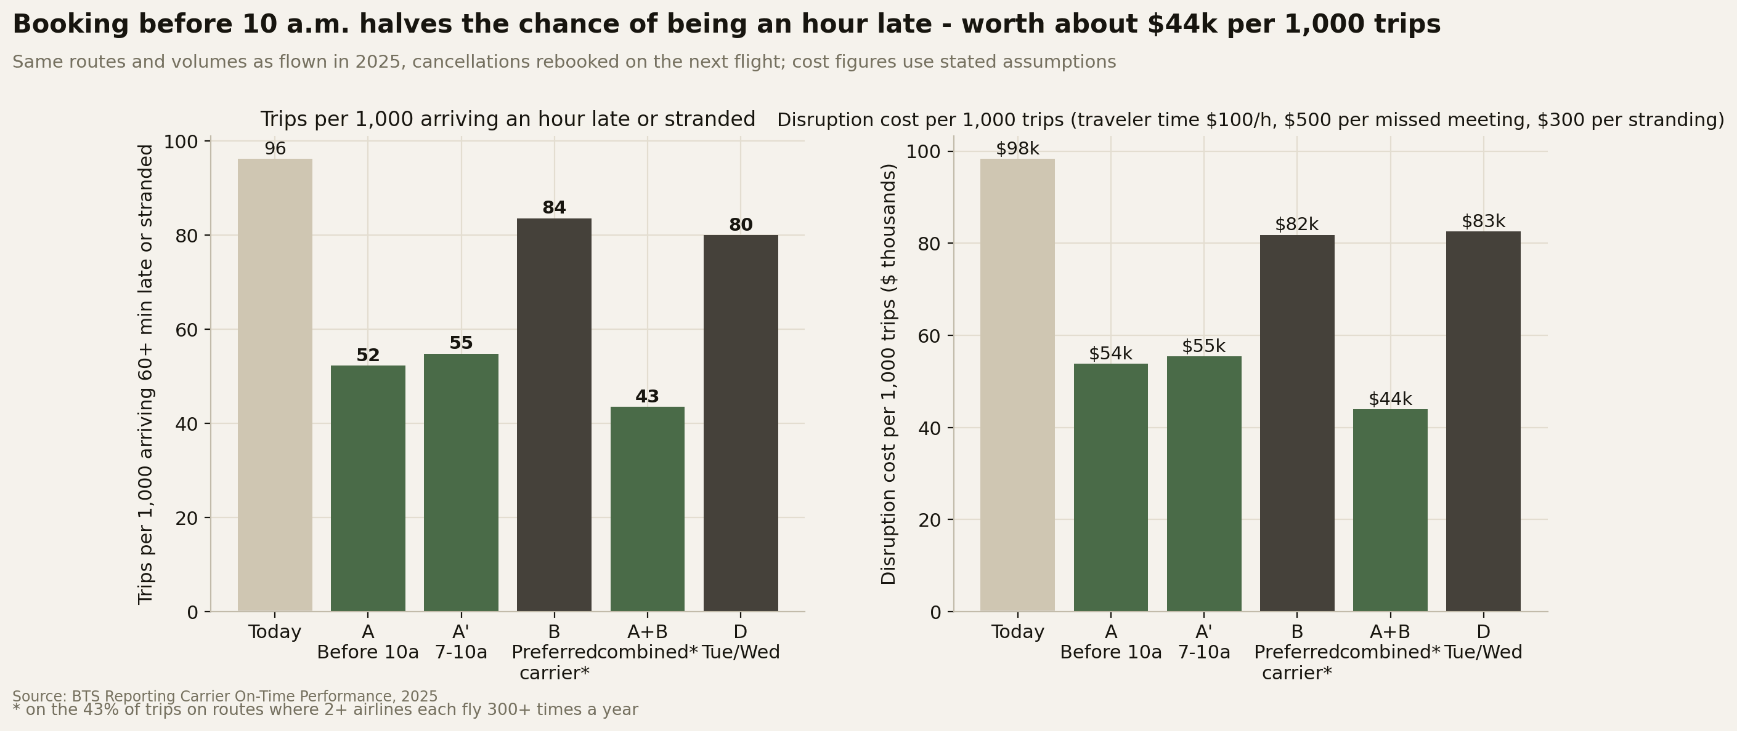

What we recommend
Four defaults in the booking tool, not bans. Modeled on the same routes and volumes as flown; per 1,000 trips. Together they halve the chance of arriving an hour late and save $13k to $76k per 1,000 trips, depending on what an hour and a missed meeting are worth.
Rule | What changes | Impact per 1,000 trips
1 · Morning preference | Time-critical trips default to 7 to 10 a.m. departures | Hour-late trips 96 to 55 (down 43%)
2 · Nonstop first | Connect only with 90+ minutes via approved hubs | Missed connections 51 to 23
3 · Airline by route | Preferred airline on routes with a real choice | Down 15% on covered routes; 55% with rule 1
4 · Weather buffer | Day-before travel in risky months; rebook on a bad forecast | Afternoon trips in summer and winter 16% to 7%
Notes:
Everything is a default or a soft warning in the booking tool, not a ban. Rule 1 alone is worth about $44k per 1,000 trips at mid assumptions. Rule 4 is the lowest-confidence rule, because actual weather stands in for a forecast.

Slide 9
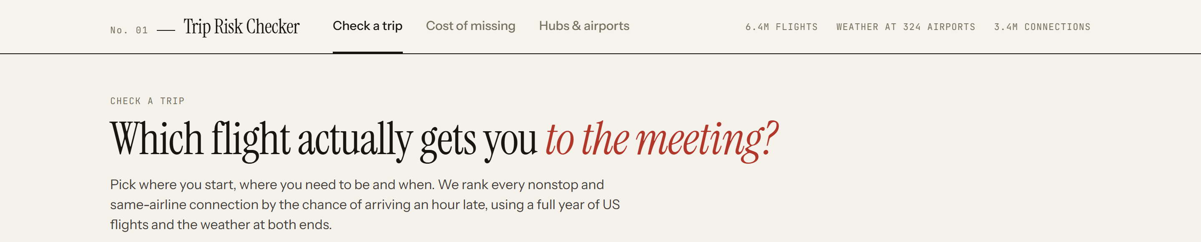
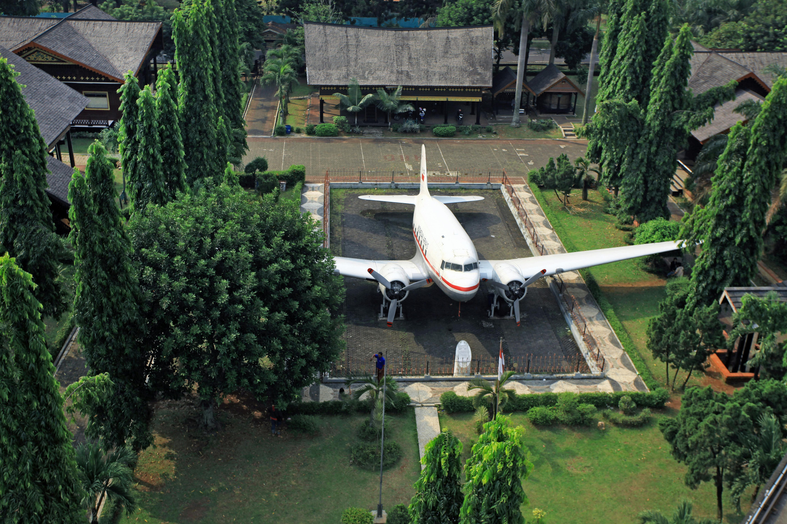
Light touch: defaults in the tool you already use.
Implementation
Booking tool
Default sort: 7 to 10 a.m. nonstops on the preferred airline. Soft warnings on evening departures, the last flight of the day, tight connections and risky hubs. Override with a reason code.
Travel desk. A weather watch 72 hours out for trips through fragile hubs, with proactive rebooking to earlier flights.
Pilot. Two business units for one quarter against a control group. Track hour-late trips, strandings, compliance and fare cost.
Keep it current. Preferred-airline and approved-hub lists refreshed every quarter from the public flight data. The pipeline is built.
Notes:
Implementation is deliberately light: defaults and warnings in the booking tool the company already uses, plus a travel-desk process. The pilot gives a before-and-after against a control group within one quarter.

Slide 10
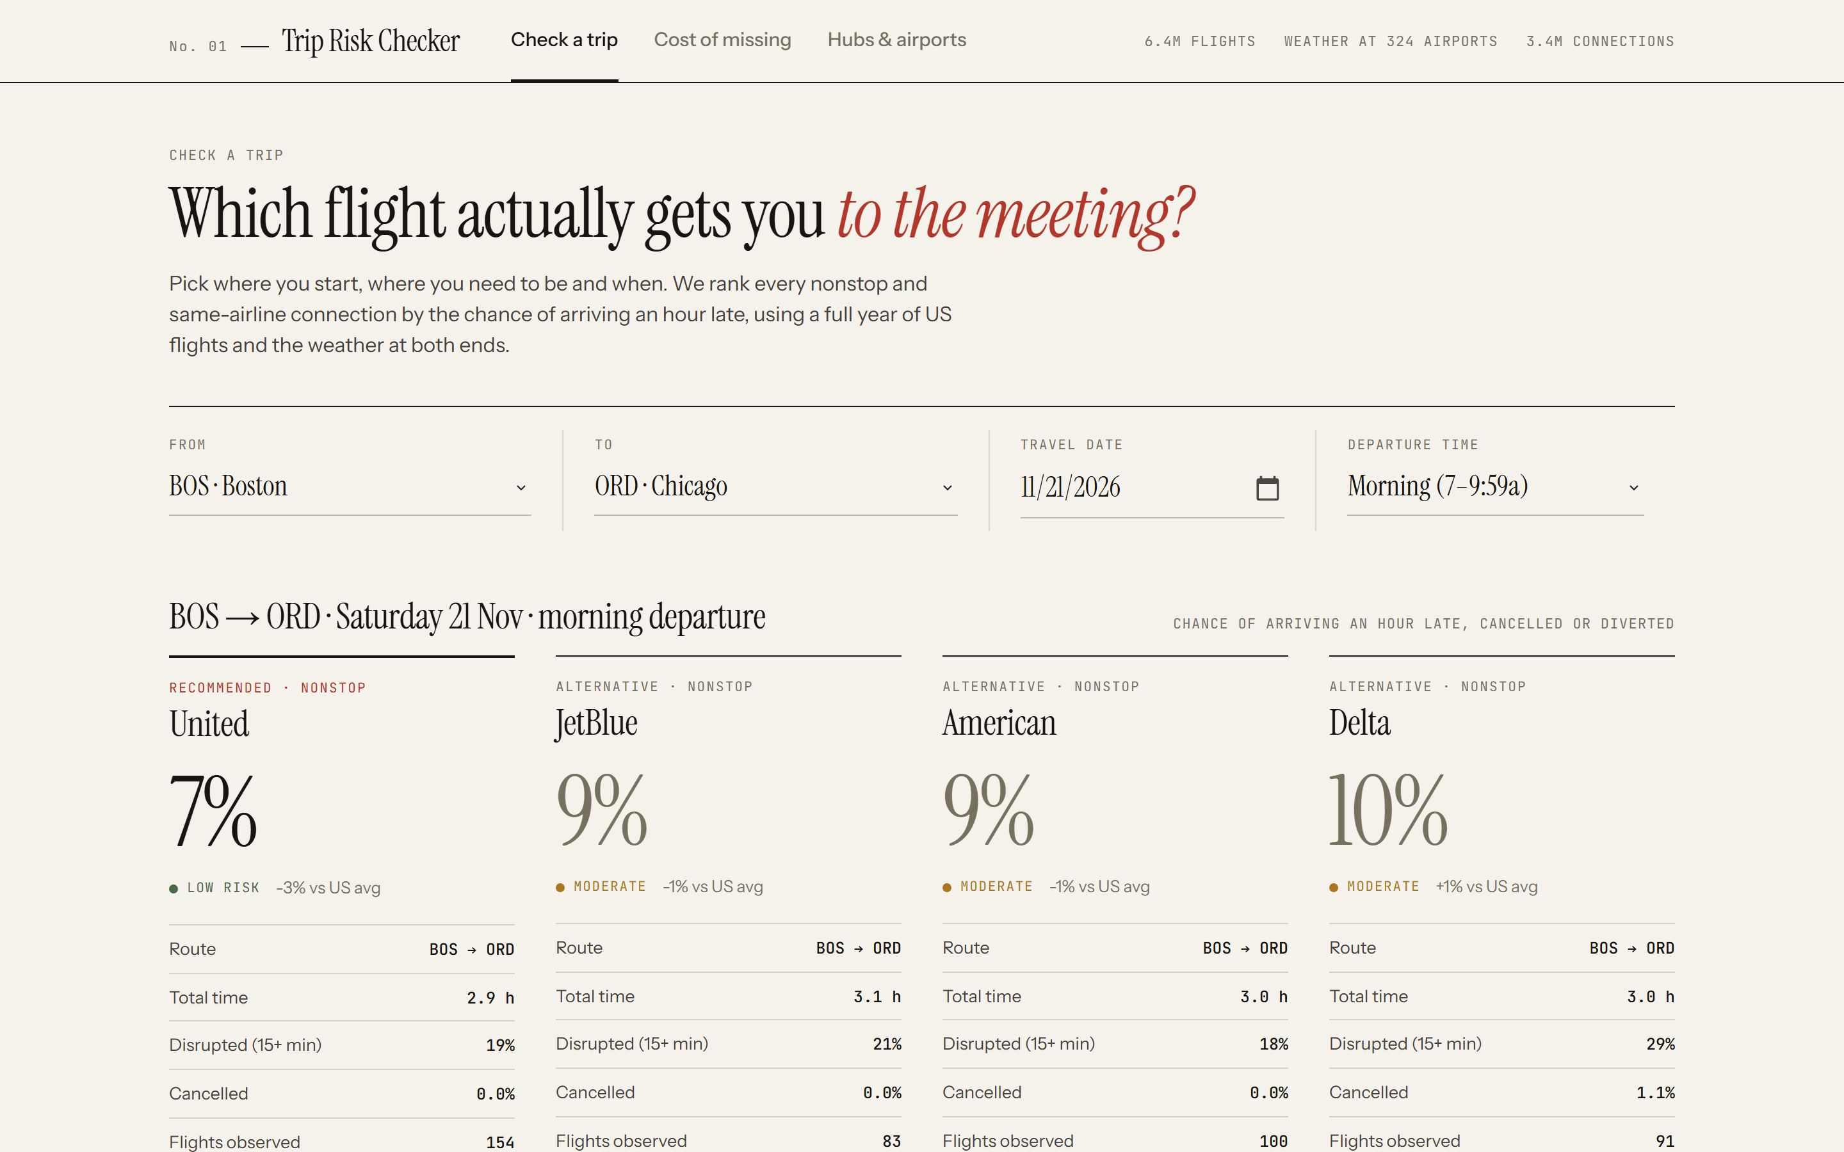
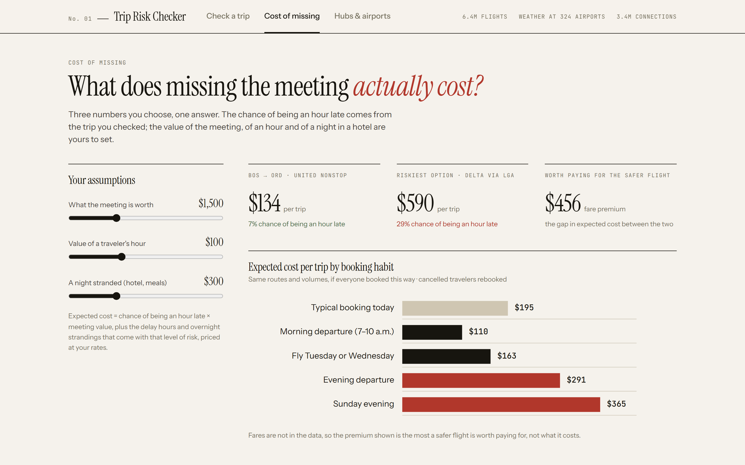


Next step · The website
Check a trip. Pick where you start, where you need to be and the date. The Trip Risk Checker ranks every nonstop and same-airline connection by the chance of arriving an hour late.
Live at trip-risk-checker.vercel.app. Hubs & airports page maps disruption, weather exposure and winter fragility.
Cost of missing. Put your own value on the meeting, an hour and a night stranded; see what each option is expected to cost and how much a safer flight is worth paying for.
Notes:
This is how the travel desk and travelers would use the analysis. It answers any route, date or constraint live, and it is our Q&A tool.

Slide 11
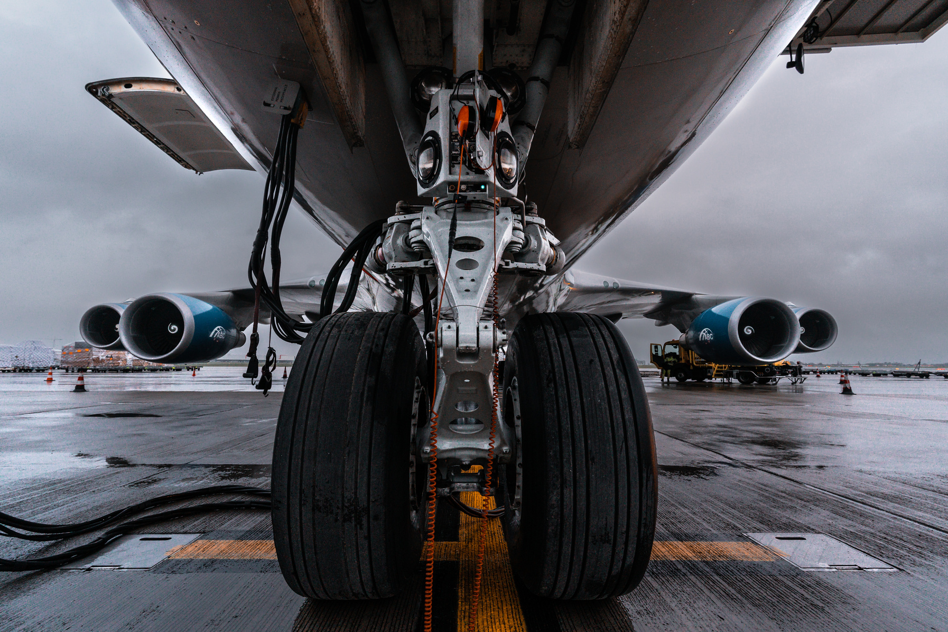
Limitations
One year of data. Calendar 2025 only, so no year-to-year variation. Newark's spring runway closure and air-traffic-control trouble are in the data and treated as a case study, not a trend.
Flights, not tickets. One-stop trips are constructed from real same-day flight pairs, not observed itineraries. SkyWest and Republic flights are assigned to an airline brand by a stated heuristic.
Hindsight stands in for a forecast. The weather rule uses the weather that actually happened. A real one-to-three-day forecast will catch less, so this is the lowest-confidence rule.
No fares. The data has no prices. Break-even figures say what a safer flight is worth paying for, not what it costs; the pilot measures the real fare premium.
Disruption is noisy. At booking time the model reaches an AUC of 0.67 to 0.68. It is calibrated and ranks choices well, which is what a policy needs, but it cannot call a single flight.
Assumptions are yours to set. Meeting value, hourly value and the cost of a night stranded drive the dollar figures; the website lets you change them. Route cells under 15 flights are hidden and thin cells are shrunk toward the route mean.
Notes:
Say these before anyone asks. None of them changes the direction of the recommendations; they change how confident we are in the size of each effect, and the pilot is how we find out.

Slide 12
Thank You
[Team name]
Questrom MSBA · Chart Champ Datathon
trip-risk-checker.vercel.app
November 2026
Questions? The Trip Risk Checker is live for any route, date or constraint you want to test.
Try it live
Created by: [Team name]

Slide 13

Appendix 1 · Data and definitions
Flight data. BTS On-Time Performance, calendar 2025, ten reporting airlines, 6.4 million US domestic flights from the full monthly files, plus the 200k-flight student sample used for exploration and the risk model.
Weather. NOAA GHCN-Daily station records matched to 324 of 326 airports. Daily flags for snow, freezing precipitation, heavy rain, thunderstorms, heavy fog and high wind; adverse = any of them. Climatology = share of such days by airport and month.
Airports. OurAirports for coordinates and runways, FAA hub tiers, and Port Authority and FAA notices for the Newark runway closure (15 April to 2 June 2025).
Outcomes. Disrupted = arrived 15+ minutes late, cancelled or diverted. Hour late (severe) = 60+ minutes late, cancelled or diverted. Traveler burden = departure before 6 a.m., landing 11 p.m. to 4 a.m., a two-hour-plus wait, or a night stranded.
Trip-level accounting. In trip tables a cancelled traveler is rebooked on the next completed flight of the same airline brand and counted at that arrival; trip delay is capped at 24 hours. Groups under 100 flights are hidden; rates carry 95% Wilson intervals.
Cleaning. One function (src/prep.py) cleans the sample and the full file identically: outcome flags, local departure hour and band, season, holiday window, route key, carrier names. The cleaning log sits in outputs/tables.

Slide 14

Appendix 2 · Models
Booking-time risk model. Logistic regression and histogram gradient boosting (scikit-learn) on carrier, origin, destination, month, weekday, departure hour, distance, holiday window and the airports' weather climatology. No delay or cause fields, no tail numbers.
Validation. Five-fold cross-validation grouped by flight date, so a storm day never sits in both folds. Disruption: AUC 0.67, Brier 0.168 against a 23.5% base rate; the riskiest tenth of bookings is disrupted 46% of the time. Hour late: AUC 0.68, Brier 0.084. The day's actual weather lifts AUC to 0.71.
Adjusted effects. Odds ratios from the logistic model (reference Delta, 8 a.m., September, Tuesday) confirm that hour, carrier, month and airport each matter after controlling for the others. Airlines are also compared only within the same route, month and time band.
Website route cells. For each route: carrier × departure band × season, with the hour-late rate, disruption, cancellations, p95 delay and scheduled time. Cells under 15 flights are hidden; thin cells are shrunk toward the route mean. Weekday factor = national hour-late rate on that weekday ÷ all days (Sunday 1.27, Tuesday 0.81).
Connecting options. Same brand, 90-minute layover, second leg in the band the traveler would actually depart in; detours over 1.5× the direct distance dropped. Risk = the larger of (either leg an hour late) and (the hub's simulated one-stop rate × 0.907 × √ leg reliability), × weekday factor.
Missed connections. Hub rate at a 60-minute layover × 0.59 (the 90-minute ratio from the simulation) × first-leg reliability, bounded between 1% and 50%. Shown as an estimate, not an observation.

Slide 15
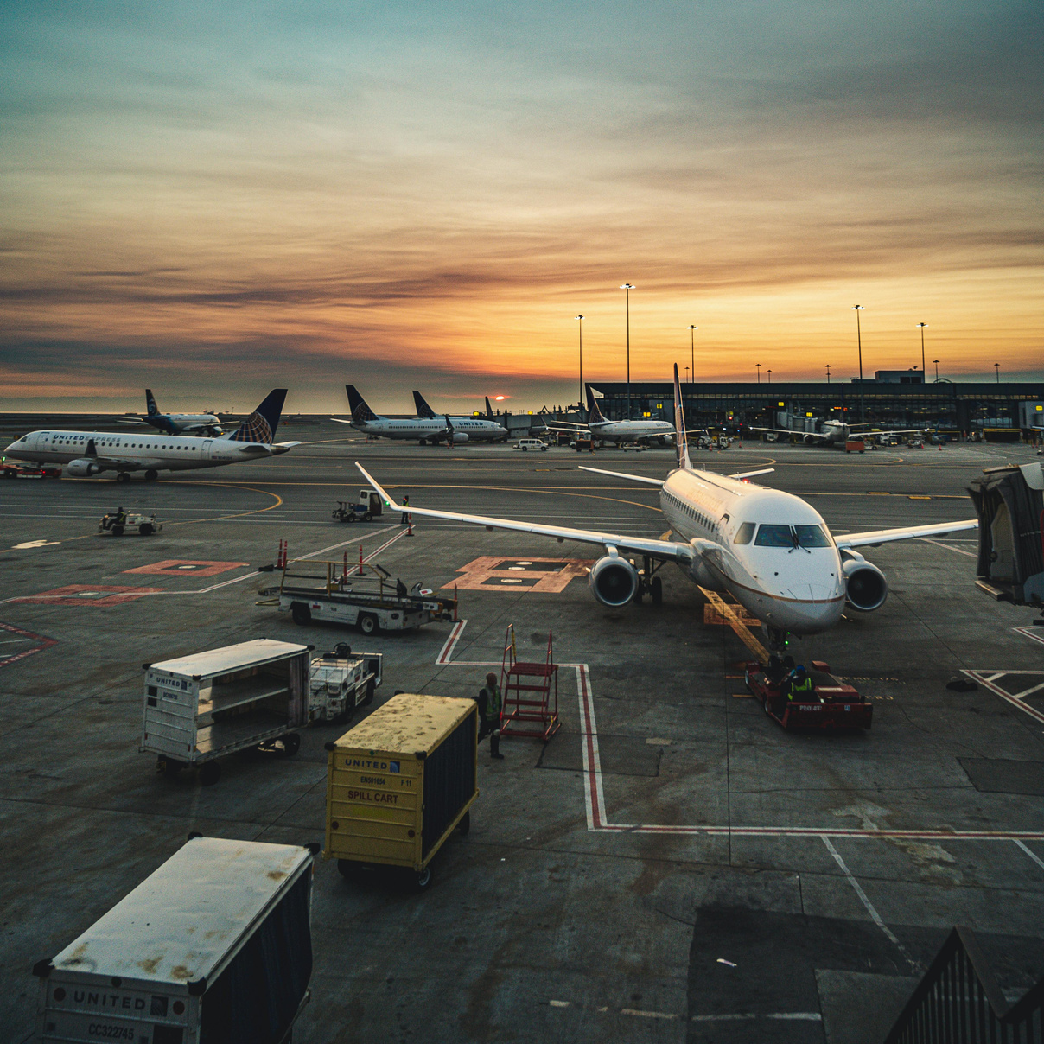
Appendix 3 · Simulations, costs and tools
Connection simulation. 3.4 million one-stop itineraries built from real same-day flight pairs on 1,730 city pairs (src/connections.py). Booked: the first same-brand onward flight at least L minutes after the scheduled arrival, L = 45, 60, 90 or 120. Realised: the connection holds if the traveler is at the hub 30 minutes before the onward flight actually leaves; otherwise the next completed flight.
Policy simulation. Each rule is replayed on the full 2025 file: within every route, the flights that satisfy the rule stand in for those actually taken, weighted by real volume. Outcomes per 1,000 trips: hour late, delay hours, two-hour waits, dawn departures, late-night landings, nights stranded.
Cost model. Expected cost per trip = chance of an hour late × meeting value + delay hours × hourly value + nights stranded × night cost. Notebook defaults: $500 meeting, $50 / $100 / $150 per hour, $300 per night. Break-even fare for a one-stop = extra hours × hourly value, plus extra risk × meeting value.
Website. Static Preact app on Vercel: Check a trip (route finder with connections, date and departure band), Cost of missing (your own values), Hubs and airports (ranking, table, map). Two decimals at trip-risk-checker.vercel.app; whole numbers at trip-risk-checker-simple.vercel.app.
Tools. Python: pandas, NumPy, pyarrow, scikit-learn, statsmodels, matplotlib, seaborn; Jupyter notebooks built from scripts; Preact and htm, d3-geo and TopoJSON for the map; Vercel hosting; HyperFrames and Playwright for the walkthrough video.
Notebooks. 01 cleaning · 02 exploratory analysis · 03 weather enrichment · 04 route-level detail on the full file · 05 nonstop vs one-stop and hubs · 06 risk model and validation · 07 policy simulation and costs · 08 Newark case study and layovers. Every chart is in outputs/figures and every number in outputs/tables.

