Slide 1

Getting Started With Typescript...

Slide 2
Agenda
What's Typescript?
Transpilation
Type Annotation
Difference Between ES5 And ES6
Difference JavaScript And Typescript
Typescript Setup
Typescript Support
Using Let In For Loops
Multi-Line Strings
Arrow Function
This
For Loops
Class
Inheritance
Access Modifiers
Constructor Shortcut
Interface
Modules
Generics
Declaration Source Files (*.d.ts)
Refrances

Slide 3
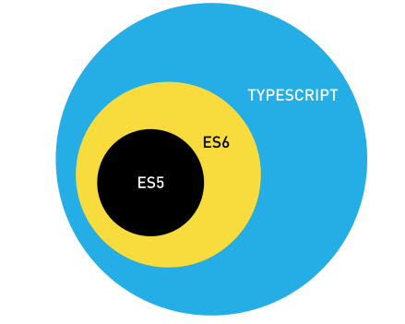
What's Typescript?
JavaScript is not originally designed for large complex applications (mostly a scripting language, with functional programming constructs), lacks structuring mechanisms like Class, Module, Interface.
Typescript is a typed superset of JavaScript that compiles to plain JavaScript.
• Adds additional features like Static Type (optional), Class, Module etc. to JavaScript
• Microsoft technology.
• Open Source.
• Versions.
• First made public in October 2012.
• Latest version - Typescript 3.7.

Slide 4
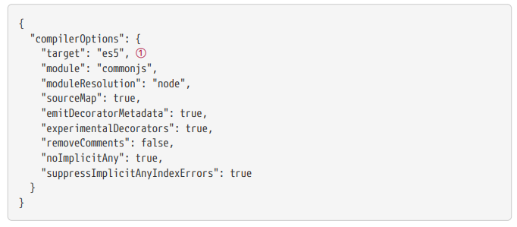
Transpilation
Browsers don’t support Typescript. Browsers barely support ES6 JavaScript. So how can we write our code in Typescript? We use something called a transpiler which converts from one language to another. We can write in Typescript and have a transpiler convert to ES6 or ES5. Since most browsers don’t support ES6 features yet we are going to transpile our Typescript into ES5.
If we look at the tsconfig.json file in our demo we can see there are a few settings we are using to convert Typescript into JavaScript.
① As you can see the target is set to ES5.

Slide 5
Typescript is just JavaScript with a few more advanced features.
Browser can’t run Typescript so we first need to transpile it into JavaScript.
The most common version of JavaScript is currently ES5 so we transpile Typescript into ES5 JavaScript.

Slide 6
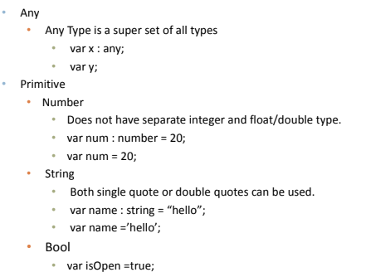
Type Annotation

Slide 7
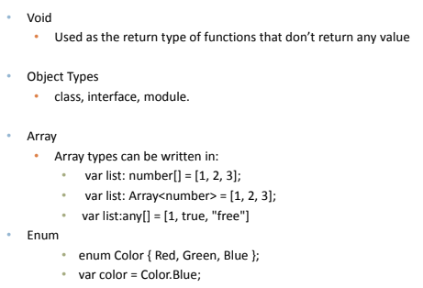

Slide 8


Slide 9
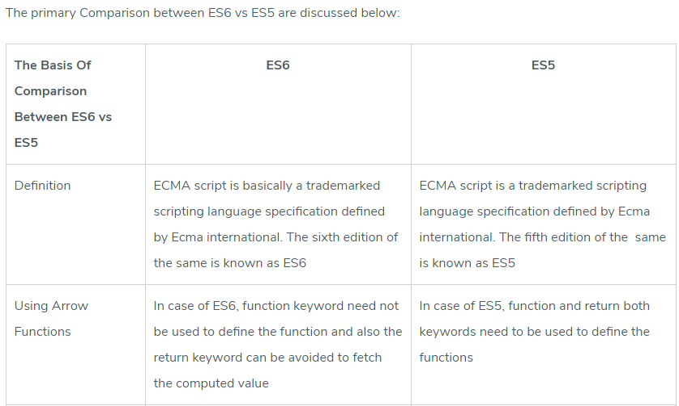
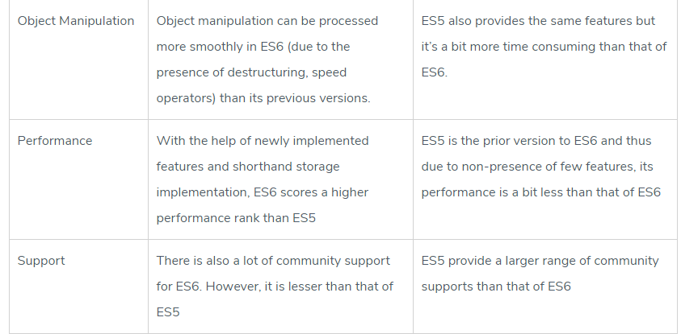
DIFFERENCE BETWEEN ES5 AND ES6

Slide 10
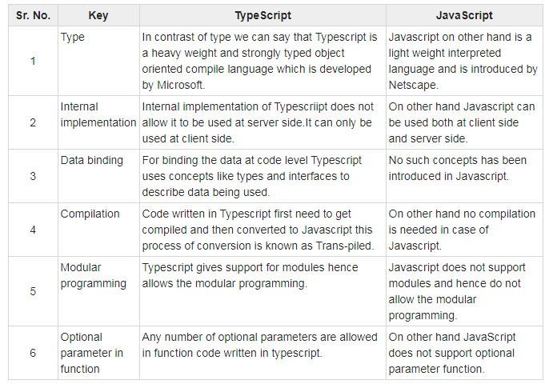
Javascript vs. Typescript

Slide 11

Typescript Setup
We can install typescript via npm
Check Version Of Typescript
Running Typescript :-
Create a file called hello.ts
Inside that file add console.log('hello world');
We can compile a typescript file into a JavaScript file by calling
This generates a file called hello.js
And we can execute that file by using node, like so:

Slide 12
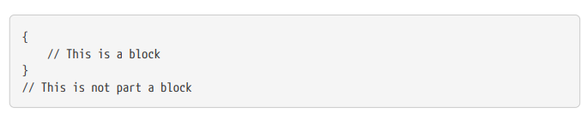
Typescript Support
Let (Block Scope):-
But in ES5 JavaScript we only have two scopes, the global scope and function scope.
Maintain block level scope use Let keyword In Typescript.
let is a very important addition the JavaScript language in ES6.
It’s not a replacement to var, var can still be used even in ES6 and has the same semantics as ES5.
However unless you have a specific reason to use var I would expect all variables you define from now on to use let.

Slide 13
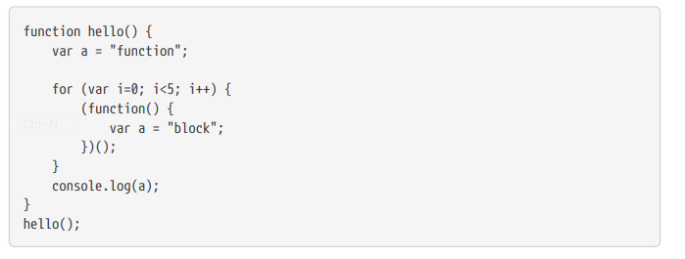
IIFE (Immediately Invoked Function Expression):-
It’s a function that we call immediately after defining it. Since functions have their own scope, using an IIFE has the same effect as if we had block level scope, the variable a inside the IIFE isn’t visible outside the IIFE.
This now prints out function.
It’s a function that we call immediately after defining it.
Since functions have their own scope, using an IIFE has the same effect as if we had block level scope, the variable a inside the IIFE isn’t visible outside the IIFE.

Slide 14
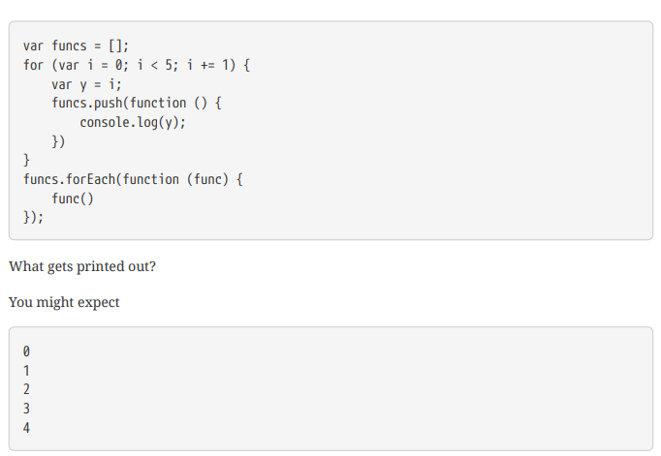
Using let in for loops
But In Fact It Prints :
5
5
5
5
5

Slide 15
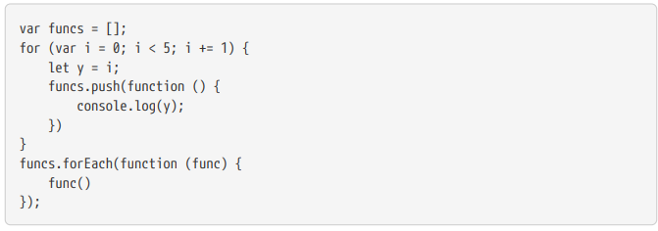
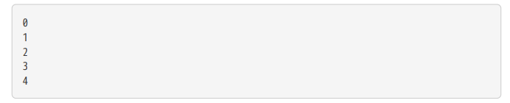
The reason for this is that the variable y is not block level, it doesn’t only exist inside its enclosing { } In fact it’s a global variable and by the time any of the functions are called it’s already been set to 5.
In the above example if we replace var y = i with let y = i then the variable y only exists inside it’s block, like so:
And so executing this now results in:

Slide 16
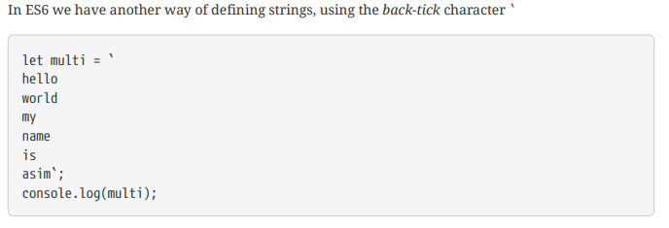
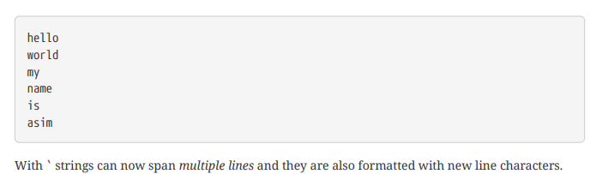
Multi-Line Strings
With ES5 and ES6 we can specify a string with either the ' or " character.
The above prints out:

Slide 17
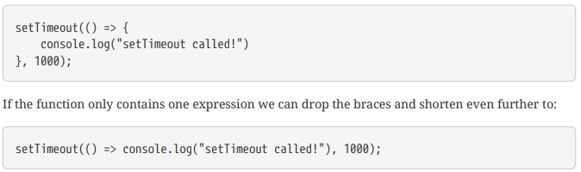
Arrow Function
The function we pass as an argument to set Timeout is called an anonymous function because it doesn’t have a name.
ES6 has introduced a slightly different syntax to define anonymous functions called the fat arrow syntax, with it we can re-write the above as:

Slide 18
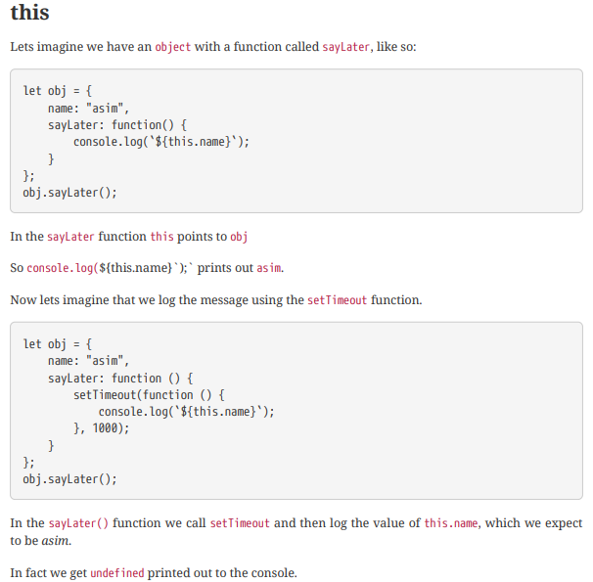
this

Slide 19
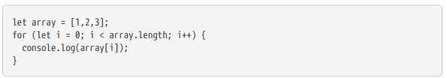
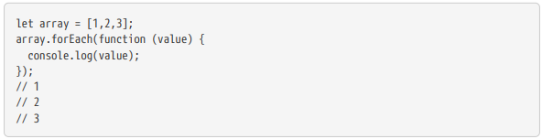
For Loops
For
For Each
For-of
For-in
For:-
For Each:-

Slide 20
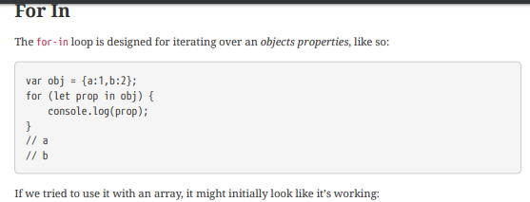
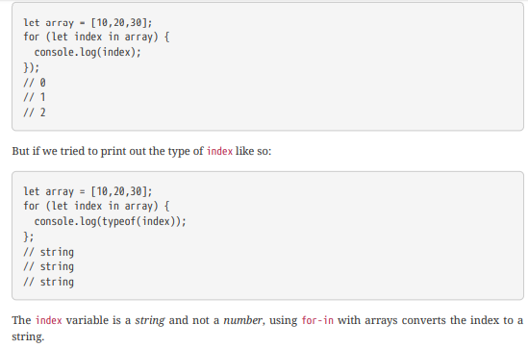
For-in:-

Slide 21
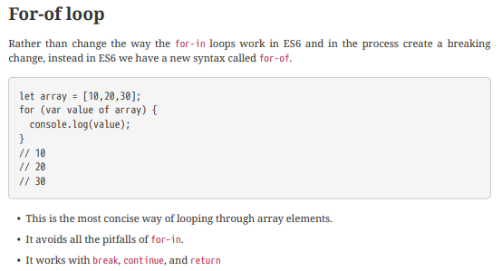
For-of:-
The for–in loop is for looping over object properties.

Slide 22
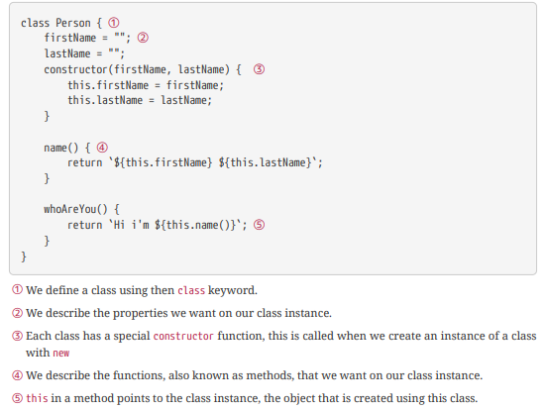
Class
Typescript supports the ES6 class syntax but also adds some other feature like access modifiers and interfaces, so in this lecture we’ll be writing Typescript rather than pure ES6.
Properties and fields to store data
Methods to define behaviour.

Slide 23

Class Instance:-
A class is a blueprint for creating an object, we call that created object an instance of a class, or a class instance or just instance for short.
We instantiate a class by using the new keyword and when that happens JavaScript calls the constructor function. We can pass to the constructer arguments which it uses to initialise properties or call other function, like so:
The above creates an instance of the Person class called asim.
The asim instance has the same properties and functions that are described on the Person class:

Slide 24
Inheritance
Typescript supports inheritance of class through extends keyword
super keyword.
A class can inherit from another class. We can create a class blue-print that extends an existing class blue-print by adding other methods or properties. We do this by using the extends keyword, like so:
We do this by using the extends keyword, like so:

Slide 25
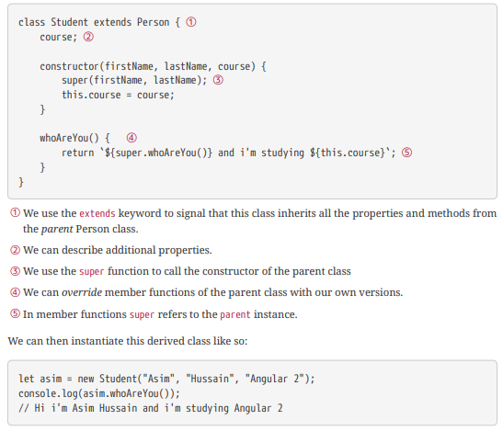

Slide 26
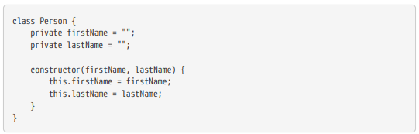
Access Modifiers
There are 3 access modifiers:
However Typescript adds some nice functionality on top of ES6 classes, namely function and property visibility via access modifiers.
Public:-
This is the default and means its visible everywhere.
private:-
Only member functions of the class it’s declared in can see this.
Protected:-
Only the class it’s declared in and any class that inherits from that class can see this.
For example we can define the properties of our Person class as private, like so:

Slide 27
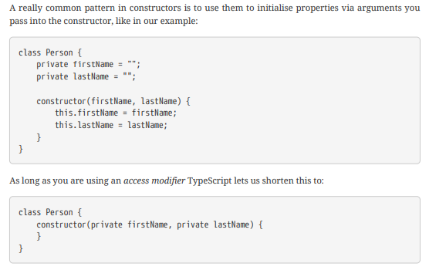
Constructor shortcut
As long as you are using an access modifier Typescript lets us shorten this to:

Slide 28

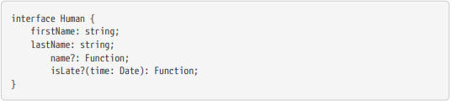
Interface
Typescript has another feature called an interface. An interface can be used in a number of scenarios but by far the most common is when used with classes.
Declared using interface keyword
TS compiler shows error when Interface signature and implementation does not match
Optional properties can be declared for an interface (using ?)
When used with classes the syntax looks like this:
Sometimes however we might want an interface to describe an optional contract. We can append ? to the name of the property or function to mark it as optional, like so:

Slide 29
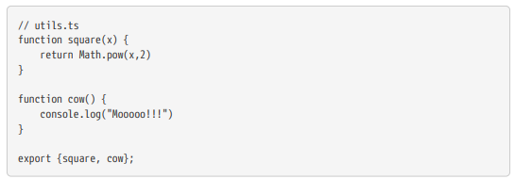
Modules
Modules can be defined using module keyword. A module can contain sub module, class, interface or enum.
Class, Interfaces , functions can be exposed using export keyword.
We can configure Typescript to use other module loaders, but the default is CommonJS.
Adding file references. - /// <reference path=“filename.ts" />

Slide 30
Generics
How can we create re-usable bits of code which can still take advantage of typescripts transpiletime type checking?
Able to create a component that can work over a variety of types rather than a single one.
function identity<T>(arg: T): T {
return arg;
}
type argument inference - we want the compiler to set the value of T for us automatically based on the type of the argument we pass in.

Slide 31
Declaration Source Files (*.d.ts)
The purpose of these files is to provide some typing information for JavaScript libraries.
These files do not compile to .js files, simply describe their JavaScript implementations, and act as their representative.
Contains typing info.

Slide 32
REFRANCES
https://codecraft.tv/courses/angular/
http://definitelytyped.org/directory/learn.html

