Slide 1

Project: Determining Lane Curvature and Its Angle Using Computer Vision Research Paper Title: Rethinking Efficient Lane Detection via Curve Modeling Author: Zhengyang Feng1, Shaohua Guo1 Group: Daksh Patel (dpate004@ucr.edu) Akhil Joshi (akhil.joshi@email.ucr.edu)

Slide 2
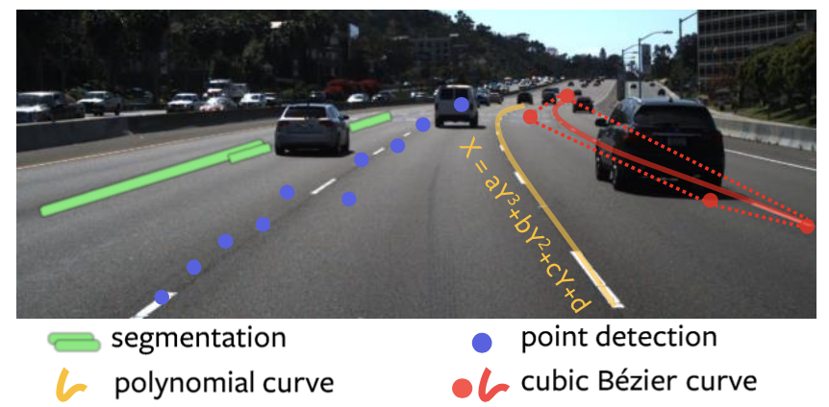
Problem Statement and Motivation
The paper addresses the limitations and comparisons of existing lane detection methods, which predominantly rely on either segmentation-based or point detection-based techniques.
Previous lane detection methods typically rely on expensive sensors such as LIDAR.
These methods often require complex post-processing, such as Non-Maximum Suppression (NMS) or heuristic anchors, and struggle with real-time performance.
This work aims to develop a lane detection method that leverages parametric Bézier curves, which are easier to optimize, computationally efficient, and provide a natural representation of lane lines.
This approach aims to improve accuracy and speed while reducing the complexity and post-processing requirements

Slide 3
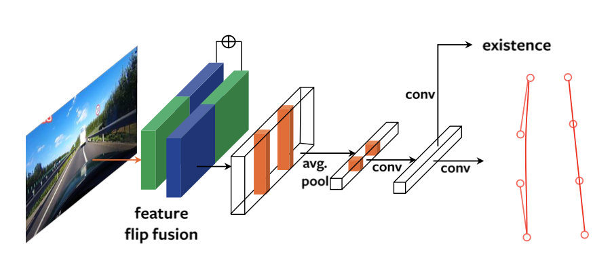
Framework Overview Figure
The framework overview of BézierLaneNet is depicted in Figure 2 of the paper. The architecture consists of the following components:
Feature Extraction: A ResNet backbone (e.g., ResNet-34) extracts features from the input image.
Feature Flip Fusion Module: This module strengthens the feature representation by leveraging the symmetry properties of lane lines observed from a front-mounted camera.
1D Convolutions and Pooling: The enriched feature map is pooled to 1D and processed with two 1D convolution layers.
Classification and Regression Branches: The final lane line predictions are made through classification and regression branches, predicting the control points for Bézier curves.
The pipeline efficiently models lane lines as parametric Bézier curves, allowing end-to-end training and inference without requiring NMS or heuristic anchors.
Figure 2. Pipeline. Feature from a typical encoder (e.g., ResNet) is strengthened by feature flip fusion, then pooled to 1D and two 1D convolution layers are applied. At last, the network predicts Be ́zier curves through classification and regression branches.

Slide 4
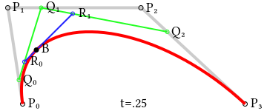
Methodology
1. BézierLaneNet:
Bézier Curve Representation: Lane lines are modelled with cubic Bézier curves using four control points.
Feature Flip Fusion: Combines original and horizontally flipped feature maps using deformable convolutions to improve alignment.
End-to-End Training: Utilizes bipartite matching loss for matching predicted and ground truth curves and sampling loss for stability.
Auxiliary Segmentation Branch: Enhances spatial feature learning and complements feature flip fusion.
2. Enet: General semantic segmentation.
Employs an encoder-decoder architecture.
Encoder: Downsamples input images to extract features, reducing spatial resolution.
Decoder: Upsamples feature maps to the original resolution for dense pixel-wise predictions.
3. SCNN (Spatial Convolutions)
Introduces spatial convolutions to capture long-range dependencies along vertical and horizontal directions.
Propagates information across rows and columns, capturing lane markings' continuous and elongated nature.
Differentiable least squares fitting module to fit a polynomial curve (e.g., x = ay3 + by2 + cy + d) to points predicted by a deep neural network.
Model | Purpose | Approach | Efficiency | Advantages | Dataset Performance
BézierLaneNet | Lane detection via curve modeling | Uses Bézier curves for lane representation | High | Efficient, robust to occlusions and lighting | Competitive on TuSimple with low computation
ENet | General semantic segmentation | Encoder-decoder architecture | Very high | Fast inference, suitable for real-time use | Good for segmentation, may miss fine details
SCNN | Lane detection with spatial awareness | Spatial convolutions for dependency capture | Moderate to high | Captures lane geometry accurately | High accuracy on TuSimple, computationally intensive

Slide 5
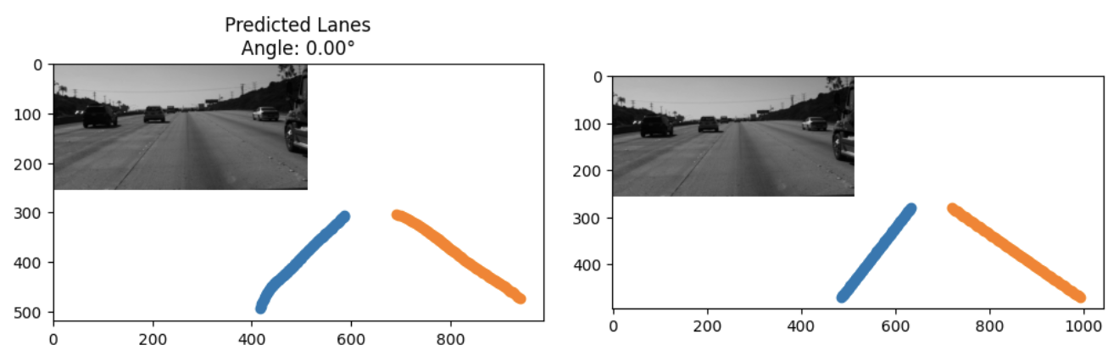
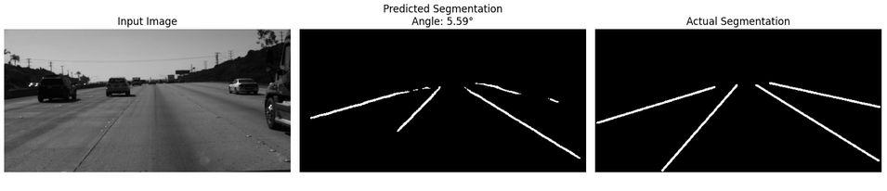
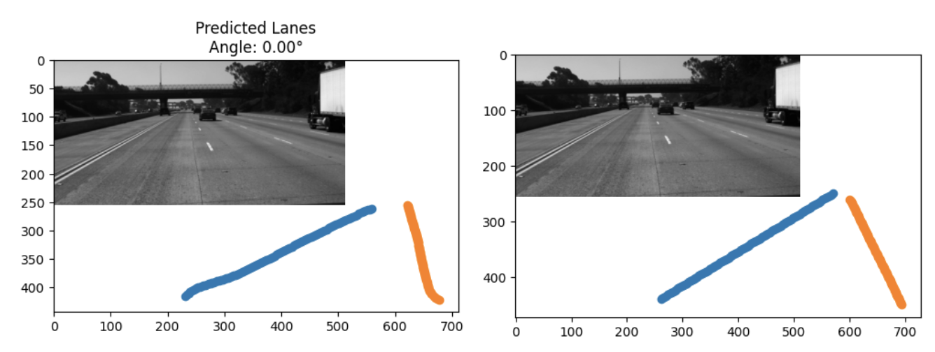
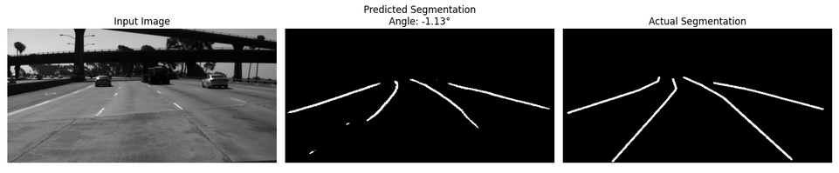
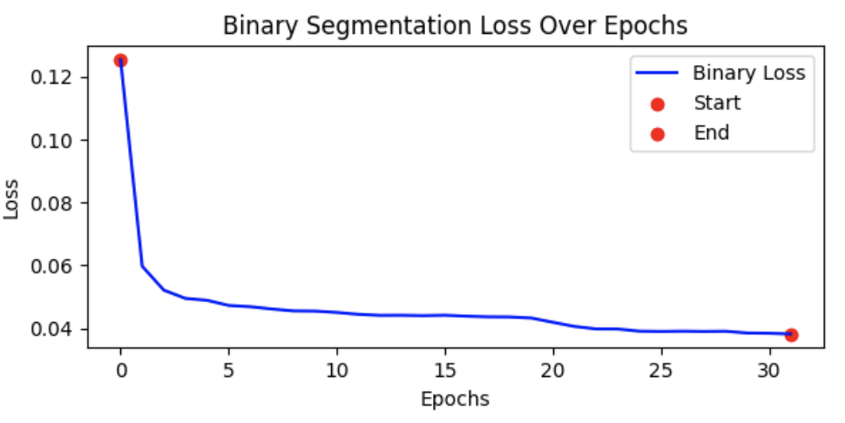
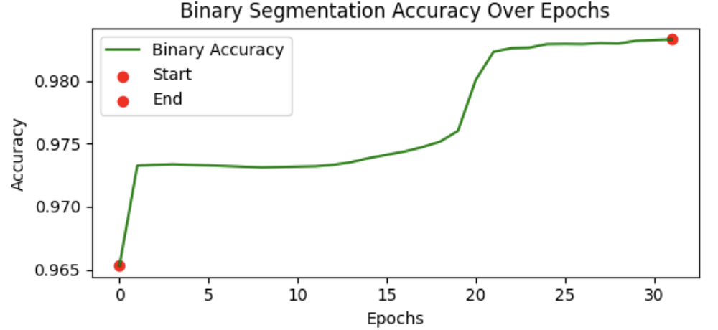
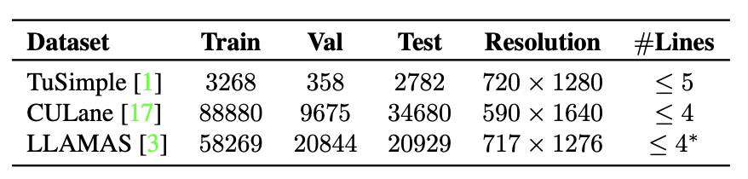
Experiments & Results
BezierLaneNet
ENet
Table: Dataset Overview

Slide 6
Thank you

