Slide 1
Data Sharing in Clouds Using Symmetric Cryptography Algorithm
Akhil Kattepogu
Mohan Siva Krishna
Nikhil Shivanand Masur
CS6030 – Fall 2019
COMPUTER SCIENCE – WESTERN MICHIGAN UNIVERSITY

Slide 2
Chapter Outline
Abstract
Introduction
System Architecture
System Model

Slide 3
Abstract
Earlier days people stored their data in any server
Purchasing and maintaining the server
Due to lack of storage unable to store the data
People are now storing Data on Cloud
Cryptographic technique is applied on the data
Time consuming and involves in storing multiple keys
Lack of security
To overcome the limitation we use symmetric cryptographic algorithm
Uses EX-OR to reduce time consuming
128-bit key size for encrypting the data
Split keys for authorization
Notes:
IOT-Internet-of-Things

Slide 4
Introduction
Cloud computing gives huge space for storing data
To provide security cryptographic techniques like encryption and decryption techniques are used
Data owner specifies the permission to the user-READ/WRITE on cloud server
Data is converted into cipher text using 128 bit key size
Secure key is shared with the user via email.
User need to login using the secure.

Slide 5
System Architecture
In this system we use AES with EX-OR operation to overcome the limitation of previous system.
Data owner uploads the file on Cloud storage and sends the split key
One key to the user in e-mail and stores the other key on Cloud storage
To access the data the user has to enter his secure key and and the cloud storage key has to be concatenated using EX-OR operation
Only if the key matches then the user will be able to decrypt the data

Slide 6
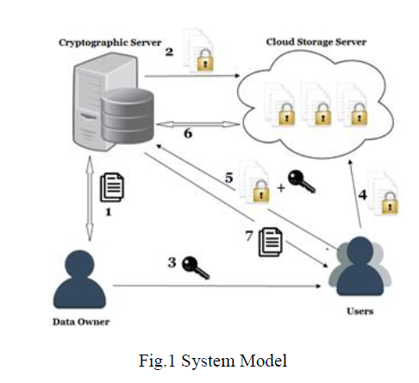
System Model

Slide 7
Thank you

