Slide 1
Sparse Logit Sampling: Accelerating Knowledge Distillation in LLMs
Anshumann*, Mohd Abbas Zaidi*, Akhil Kedia*, Jinwoo Ahn,
Taehwak Kwon, Kangwook Lee, Haejun Lee, Joohyung Lee
Jun 29, 2025
AI Model Team @ ACL 2025
* Equal Contribution

Slide 2
01
Understanding Limitations of Top-K KD in LLMS
02
Partial Remedies for Top-K KD
03
04
Random Sampling KD
Results & Future Work

Slide 3
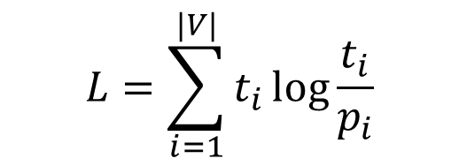
01
Understanding Knowledge Distillation in LLMS
Distribution matching
Student LLM tries to replicate the Teacher model’s output distribution
Typically uses KL Divergence Loss
$$L=\sum_{i=1}^{|V|}{t_{i}}log\frac{t_{i}}{p_{i}}$$

Slide 4
01
Understanding Knowledge Distillation in LLMS
Knowledge Distillation in practice
Running Teacher parallel to Student Training:
Expensive!
Extra overhead for multiple runs
Offline Knowledge Distillation
Pre-compute/cache teacher logits
Notes:
Teacher model’s logits computed in parallel to the student Training run
Eliminates the overhead of running the teacher repeatedly

Slide 5
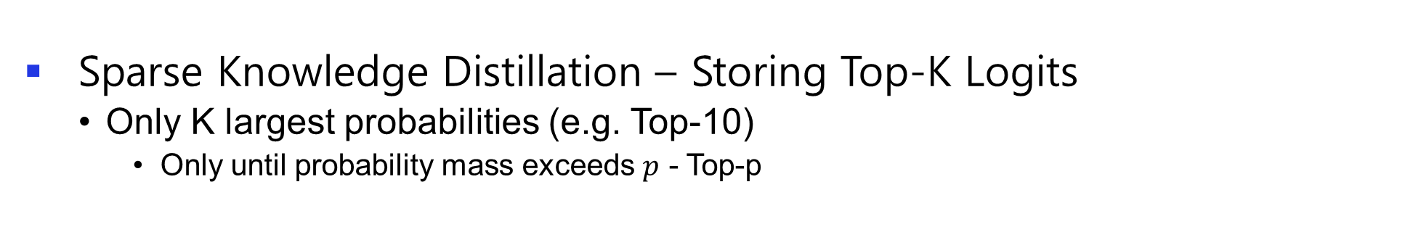
01
Understanding Knowledge Distillation in LLMS
Large Storage Requirements in Offline KD
~100K probabilities (vocab size)/token
Requires 128 PetaBytes for 1T tokens
Infeasible!
Sparse Knowledge Distillation – Storing Top-K Logits
Only K largest probabilities (e.g. Top-10)
Only until probability mass exceeds $p$ - Top-p

Slide 6
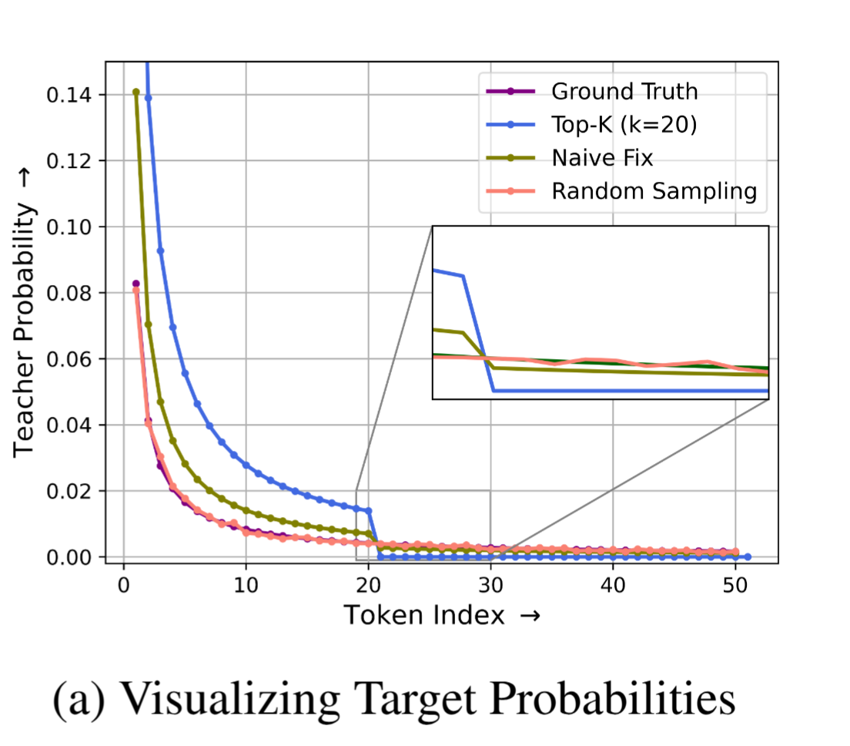
01
Limitations of Top-K KD – Fundamental Issues
Up-scaled Teacher Probabilities
Toy Example - Top-K causes scaling up of the probabilities of top k tokens
Notes:
, as the probabilities must be normalized to sum to 1

Slide 7
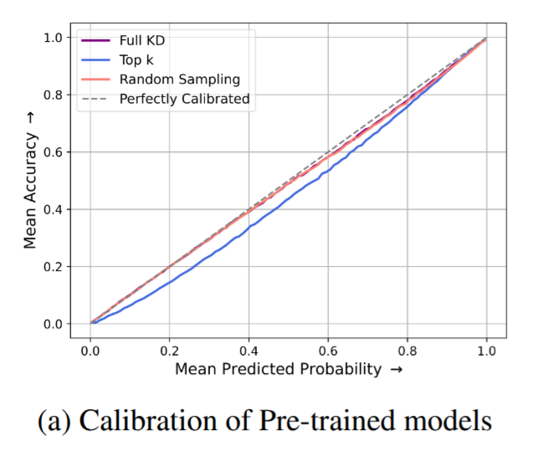
01
Limitations of Top-K KD – Fundamental Issues
Mis-Calibration in the student with Top-K KD
Persists after training
Student overconfident in head
under-confident in the tail

Slide 8
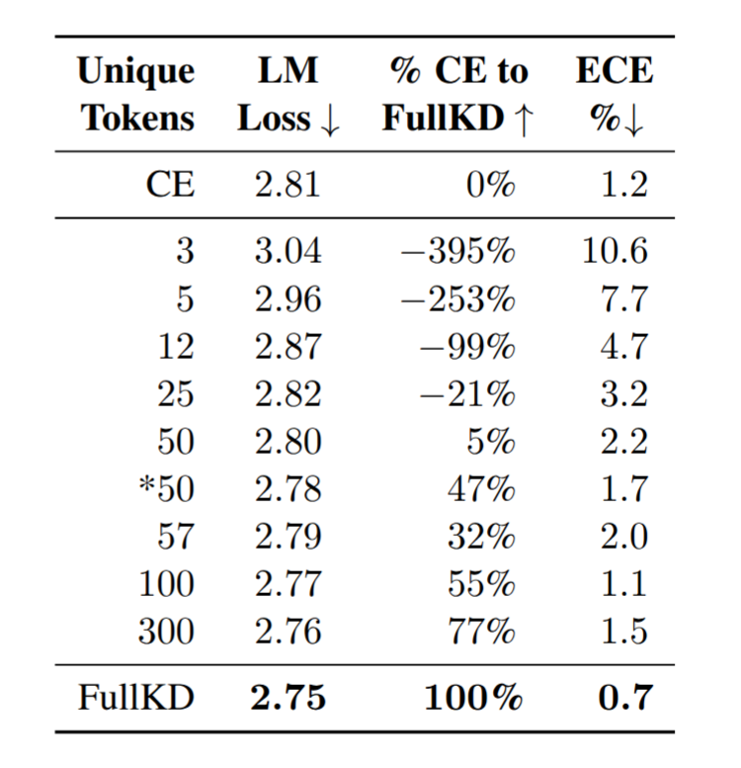
01
Limitations of Top-K Knowledge Distillation
Performance Comparison with FullKD
Vanilla Top-K KD LM Loss and ECE Comparison with FullKD
Notes:
Explain metrics

Slide 9
01
Limitations of Top-K KD – Fundamental Issues
Missing Tail Information
Tail information (non-top-k) discarded
Prior works show tail information is also important
Crucial for model performance, even though it has a small probability mass
Notes:
Summarize

Slide 10
01
Understanding Limitations of Top-K KD in LLMS
02
Partial Remedies for Top-K KD
03
04
Random Sampling KD
Results & Future Work

Slide 11
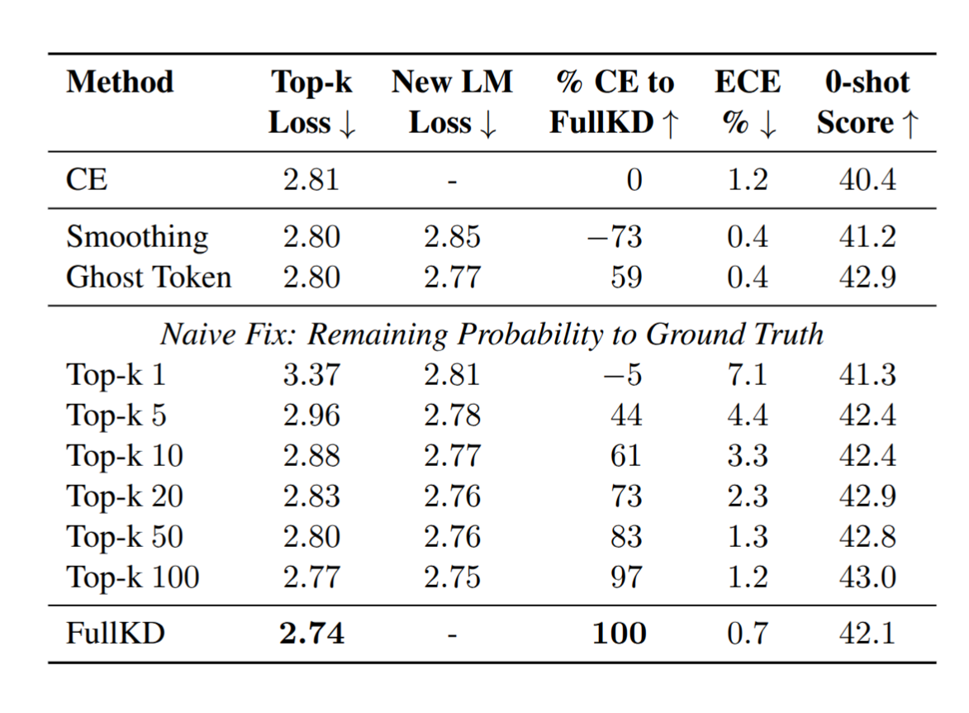
02
Proposed Remedies - Partial Solutions for Top-K KD
Label Smoothing
Distribute residual probability over entire vocab
Fixes calibration issue
Worse than Top-K overall
Expected because probabilities not uniform over vocab

Slide 12
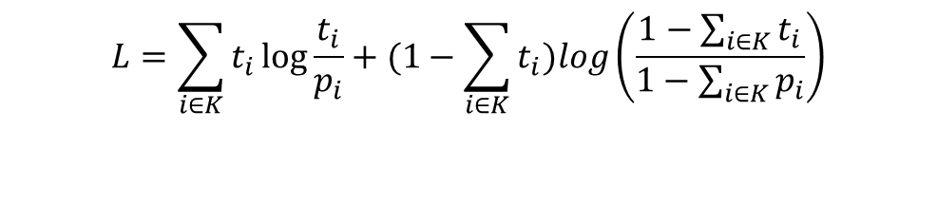
02
Proposed Remedies - Partial Solutions for Top-K KD
Ghost Token
Distribute non-Top-K probability to “ghost” token
Combined KLD Loss
Top-K Tokens and the “ghost” token
Improved LM Loss and calibration
Still worse than FullKD
Missing explicit supervision in Tail
$$\begin{aligned}L=\sum_{i∈K}^{​}{t_{i}}log\frac{t_{i}}{p_{i}}+(1−\sum_{i∈K}^{​}{t_{i}})log\left(\frac{1−\sum_{i∈K}^{​}{t_{i}}}{1−\sum_{i∈K}^{​}{p_{i}}}\right) \\ \end{aligned}$$

Slide 13
02
Proposed Remedies - Partial Solutions for Top-K KD
Naïve Fix
Assign residual probability to ground truth
Top-K distribution closer to real distribution
Large improvements in performance
Still needs ~100 tokens to achieve FullKD performance

Slide 14
01
Understanding Limitations of Top-K KD in LLMS
02
Partial Remedies for Top-K KD
03
04
Random Sampling KD
Results & Future Work

Slide 15
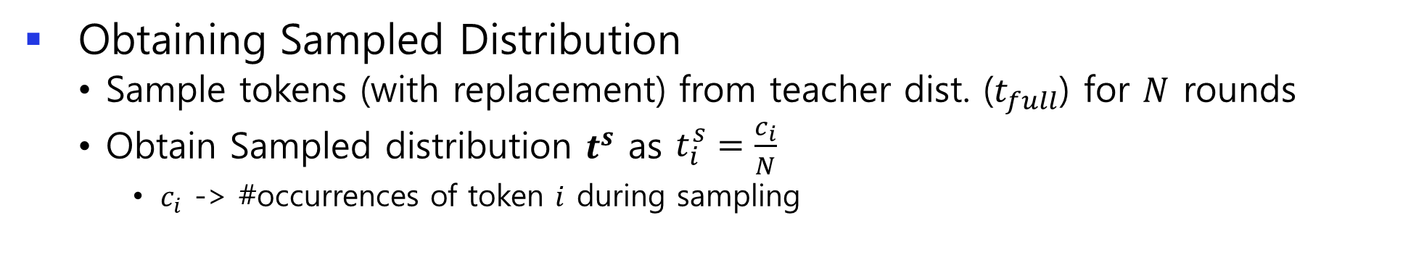
03
Random Sampling KD – Description
Based on Importance Sampling
Unbiased estimate of Full Teacher Distribution
Minimizes Variance
Obtaining Sampled Distribution
Sample tokens (with replacement) from teacher dist. ($t_{full}$) for $N$ rounds
Obtain Sampled distribution $t_{ }^{s}$ as $\begin{matrix}t_{i}^{s}=\frac{c_{i}}{N}\end{matrix}$
$c_{i}$ -> #occurrences of token $i$ during sampling

Slide 16
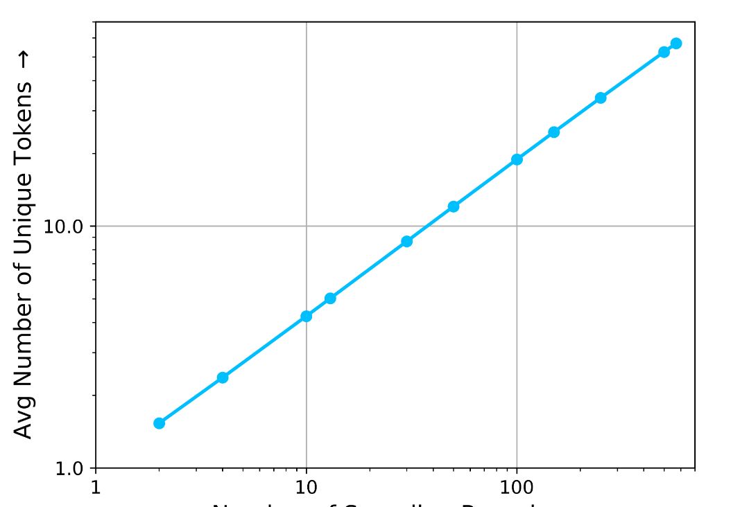
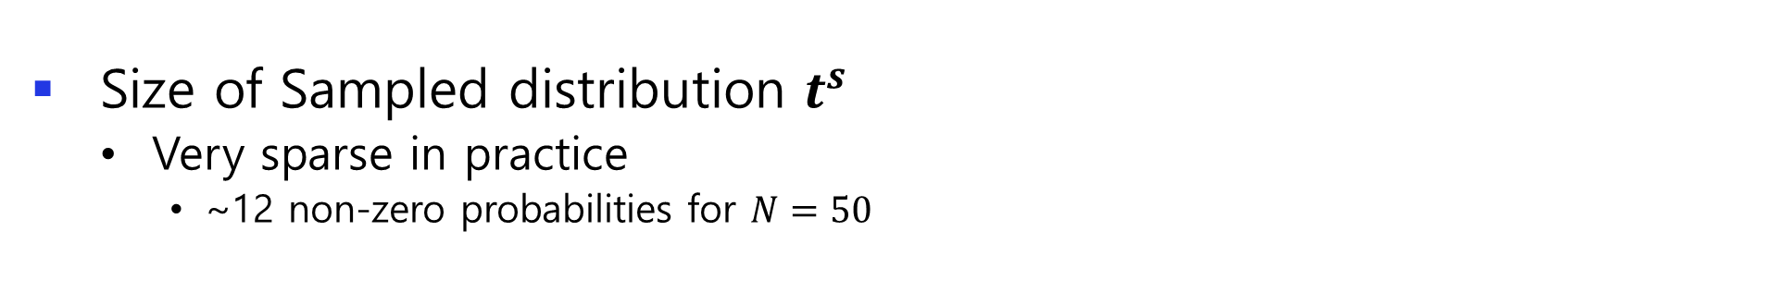
03
Random Sampling KD – Description
Size of Sampled distribution $t_{ }^{s}$
Very sparse in practice
~12 non-zero probabilities for $N=50$
Number of unique tokens vs sampling rounds ($N)$

Slide 17
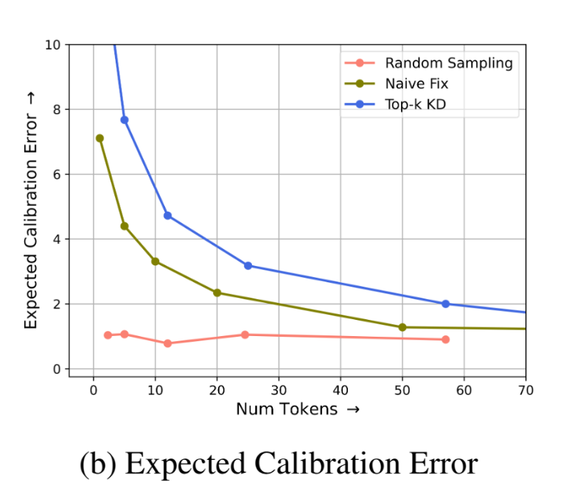
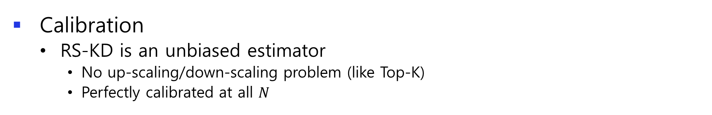
03
Random Sampling KD – Analysis
Calibration
RS-KD is an unbiased estimator
No up-scaling/down-scaling problem (like Top-K)
Perfectly calibrated at all $N$

Slide 18
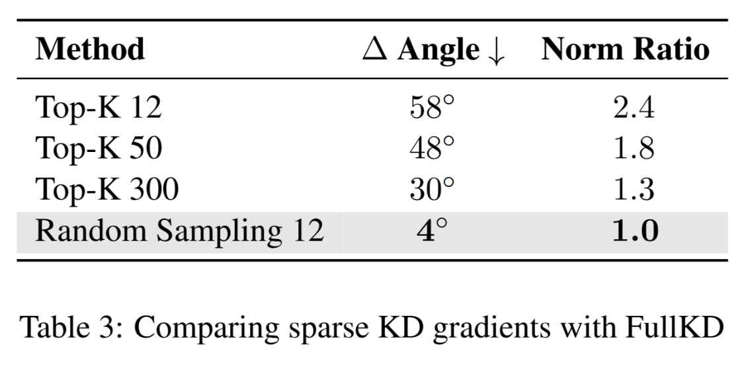
03
Random Sampling KD – Analysis
Gradient Similarity with FullKD
RS-KD preserves expected gradients w.r.t FullKD
Batch averaged gradient vector of RS-KD ~ FullKD

Slide 19
01
Understanding Limitations of Top-K KD in LLMS
02
Partial Remedies for Top-K KD
03
04
Random Sampling KD
Results & Future Work

Slide 20
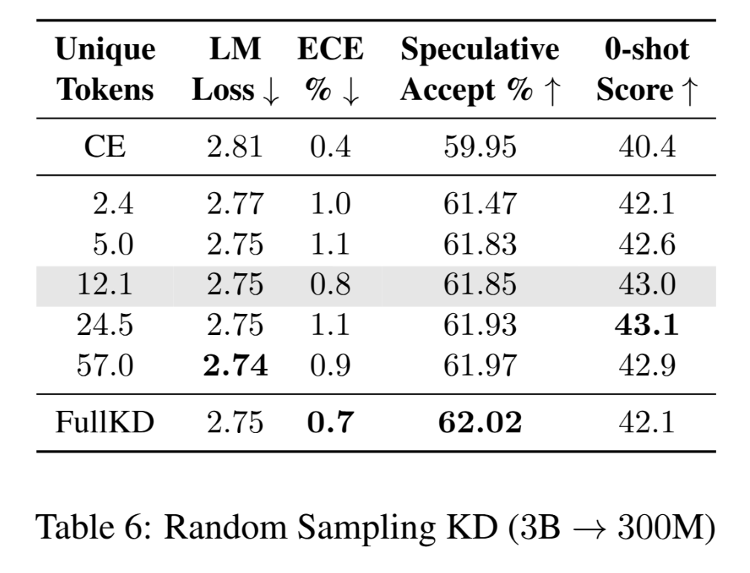
04
Results
FullKD Performance using ~12 unique tokens
Notes:
Pretraining loss on Llama-style 300M student model trained using 3B student on 10B tokens

Slide 21
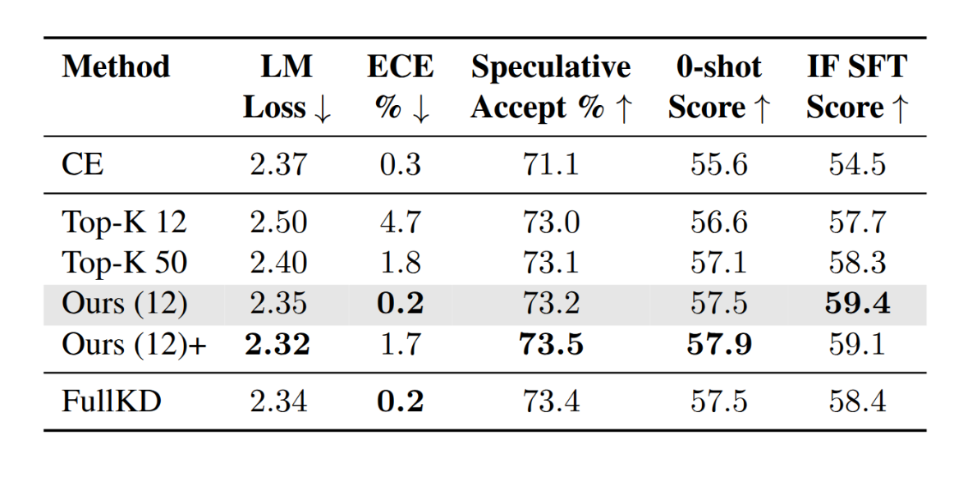
04
Results
Performance on Large-Scale Training
LLaMA-8B -> 3B distillation for 100B Tokens

Slide 22
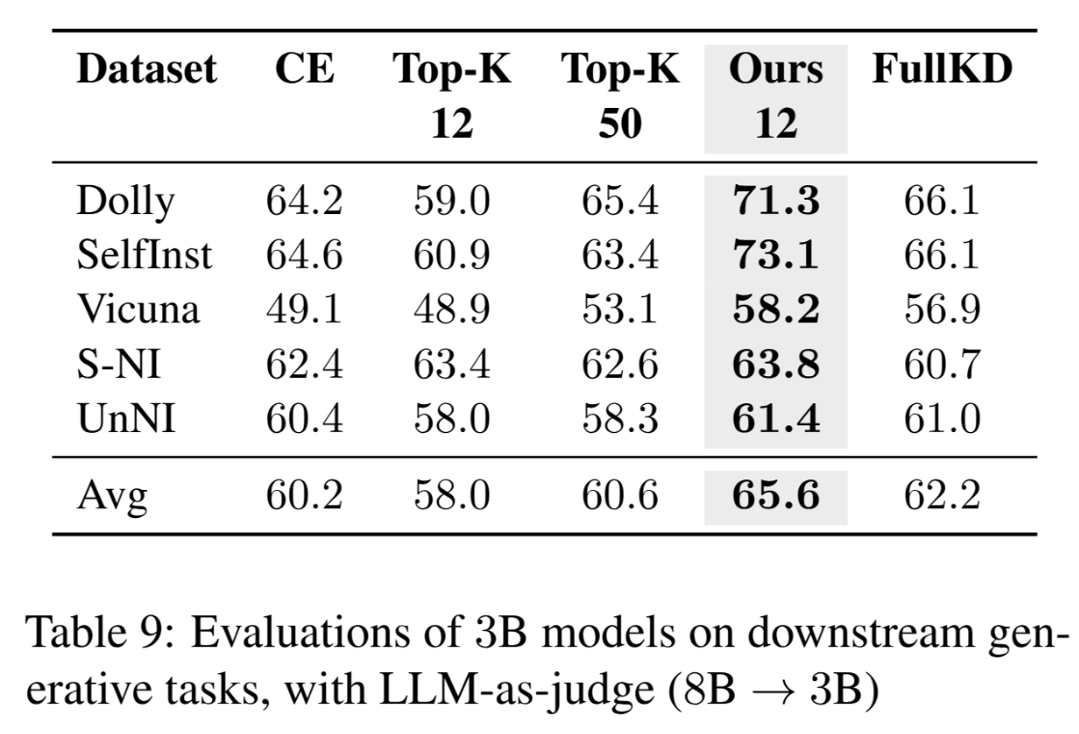
04
Results
Evaluation on Generative Tasks (LLM-as-a-judge)

Slide 23
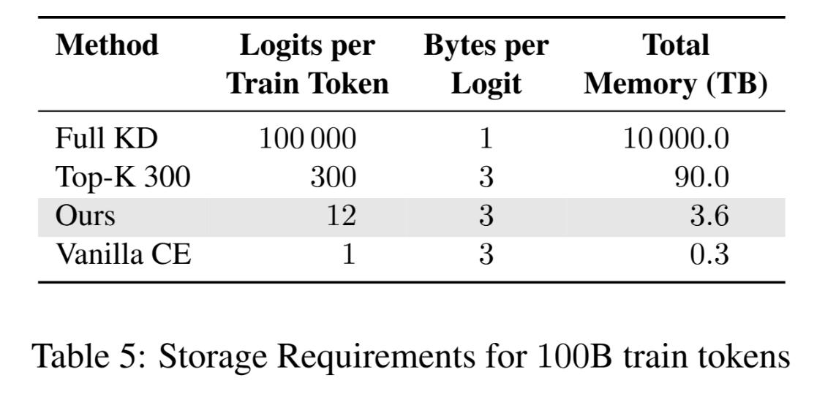
04
Storage and Compute
Additional Storage for Sampled Logits
3.6TB for 100B Tokens
25x less than Top-300 !

Slide 24
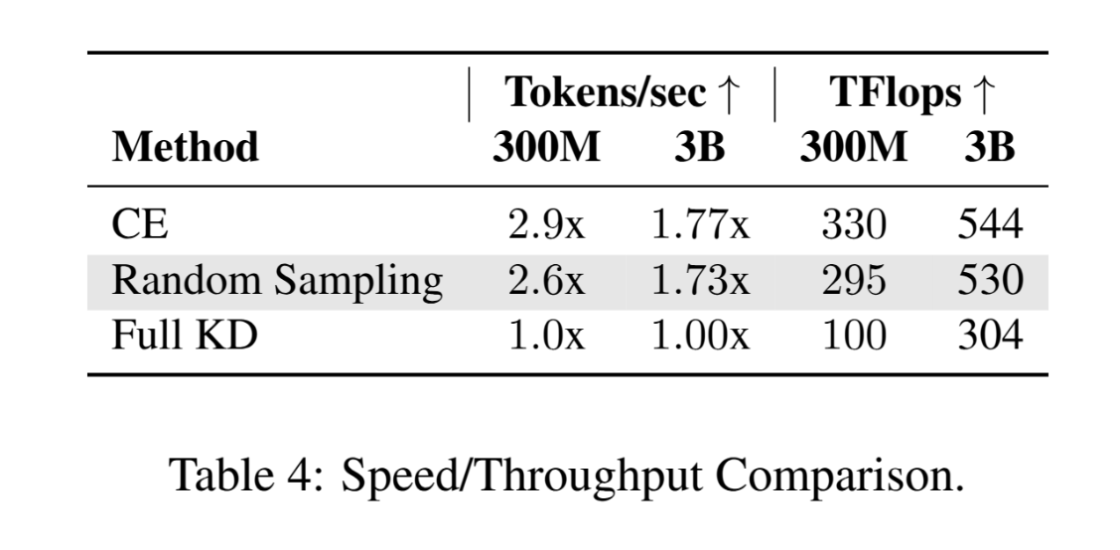
04
Storage and Compute
Speed Comparison
RS-KD 1.7 to 2.6 times faster than FullKD
Only ~10% slower than CE

Slide 25
04
Future Work
Future work
Larger Scale, Continual Pre-training, SFT/IF
Better sampling (without replacement?)
Cross-tokenizer KD
Offline KD of Hidden States
Notes:
In follow up work since the publication, we have successfully trained for 1T token using this method. This method was also successfully applied for continual pre-training of existing LLM with KD, and for applying KD to SFT training

Slide 26
Thank you!

