Slide 1
AI SURVEILLANCE SYSTEM
Use AI to make CCTV cameras smart and give it the ability to stop robbery from taking place

Slide 2
College: IIITMK, Trivandrum
Team Members
Sreehari P V
Hashim Abdulla T
Akhil K K
Arvind Haridas
Mentor
SAKIRULLAHI OP
Maker-space Manager
CISCO thingQbator IIITMK

Slide 3
First Prototype: Finished Stage
Recently there has been a surge in the robbery attempts made on homes in Kerala. Most of these attempts have involved violence and have even caused deaths. To address these life threatening situation most of the people have resorted to installing CCTV Cameras in their homes. But the existing camera infra structure being implemented just provides video records for the happenings, but lacks a crucial security feature of not being able to detect suspicious activities and take live remedial actions. So to overcome this we are proposing a system which makes use of AI. This system will make homes secure and can be successfully implemented later across organizations/public places for the prevention of all crimes in general.

Slide 4
PROPOSED SOLUTION
All operations of the system can be controlled by the residents of the house through the Eagles CCTV App
System only requires a single photo of the residents
Two modes of Operation-Day Mode and Night Mode
User can decide which mode to activate. By default the system shifts into night mode after 11.pm .
In Day Mode, the residents , get a notification or alarm combined with vibration(all based on the configurations set by them in the app) when an unknown person approaches any of the entrance to their house.
In Night mode, which is the more vigilant mode the system will sound a loud alarm inside the house and switch on all the lights of the house.

Slide 5
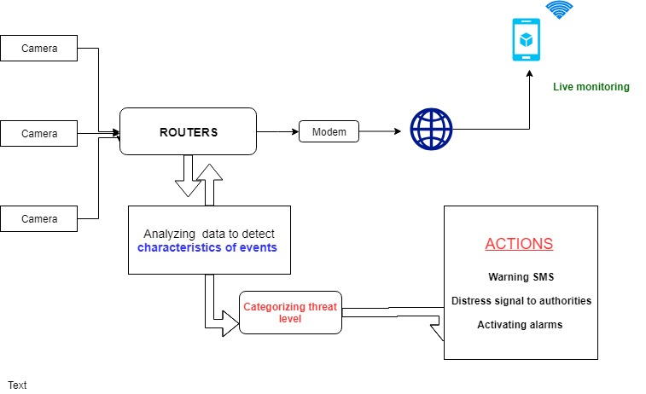
PROPOSED SOLUTION

Slide 6
Work Plan
Process | Duration
Development of Software | 1 week
Preparing Nano Board and deploying software | 2 days
Preliminary Testing | 2 days
Testing on Home/Building | 2 days

Slide 7
Competitor Study
One of our competitor operating in Kerala who is already a startup is Nueroplex
They provide services such as Receive real time alerts for restricted activities and incidents such as theft, assault or accidents to help first responders, ensure public safety, traffic surveillance, detect suspicious packages etc
We differ from them in that we are concentrating on making homes secure at least in the beginning stage.
While there seems to be a product that works over cloud, ours is more of a hardware centric approach where we provide a piece of hardware which when added to the cctv system already implemented in homes, makes homes secure
This makes our system do its job even when there is no internet connection

Slide 8
Advantages
Need just a single photo(any size) of residents for recognising them
Two modes of Operation-Day Mode and Night Mode
User can control all workings of system through mobile application
Can easily detect humans wearing all kinds of masks and costumes

Slide 9
Disadvantages
Face Recognition might not work properly from a distance. This might cause a problem of a known person being classified as unknown. However this can be solved by doing Face recognition only at close range.
Though it works without internet, it has to depend on Cloud Service Provider like Firebase for sending notification to user in Day Mode
Safety can only be guaranteed in houses having inverters as a power failure or forceful removal of fuse can shut the system down

Slide 10
Fund Breakup
Item | Cost | Purpose
Jetson Nano Board(1 qty) | Rs.8900 | Prototype
CCTV cameras (3 Qty) | Rs.4500 | Prototype
DVR(1) | RS.4500 | Prototype
Alarm module | Rs.300 | Prototype
Connection Wires | RS.1400 | Prototype
Startup Registration and Licensing, Serving 10 houses on demand without delay | Rs. 2 lakh(approx) | Startup Cost

Slide 11


