Slide 1
AtliQ Hotels
Exploratory Data Analysis in the Hospitality Domain Project
By: Akhil Kumar • Aspiring Data Analyst

Slide 2
Project Overview
• End-to-end Python-based hotel data analysis
• Involved cleaning, merging, transforming datasets
• KPI calculations: Occupancy %, ADR, Revenue
• Insights generated for business decisions

Slide 3
Datasets Used
• dim_date.csv
• dim_hotels.csv
• dim_rooms.csv
• fact_aggregated_bookings.csv
• fact_bookings.csv

Slide 4
Analysis Workflow
1. Importing Data
2. Exploratory Data Analysis (EDA)
3. Data Cleaning & Merging
4. KPI Creation
5. Trend Analysis
6. Final Insights

Slide 5
Tech Stack Used
• Python (pandas, numpy, matplotlib)
• Jupyter Notebook
• Excel/CSV Inputs

Slide 6
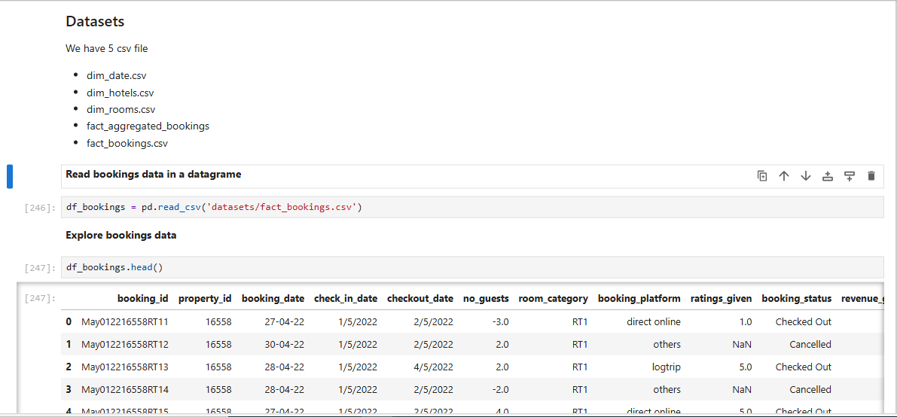
1. Data Import and Data Exploration

Slide 7
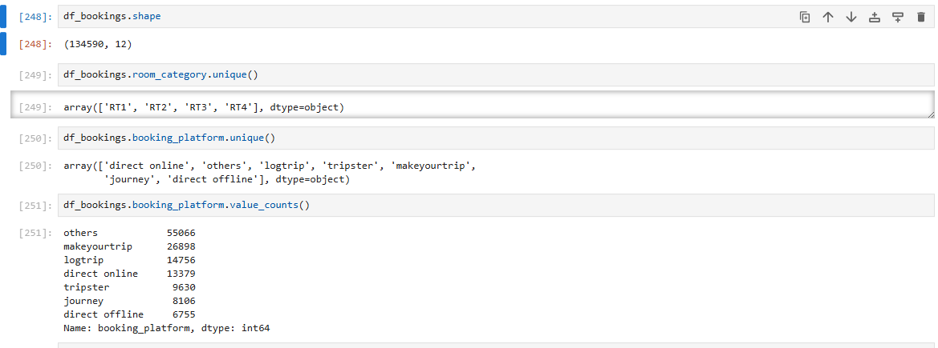

Slide 8
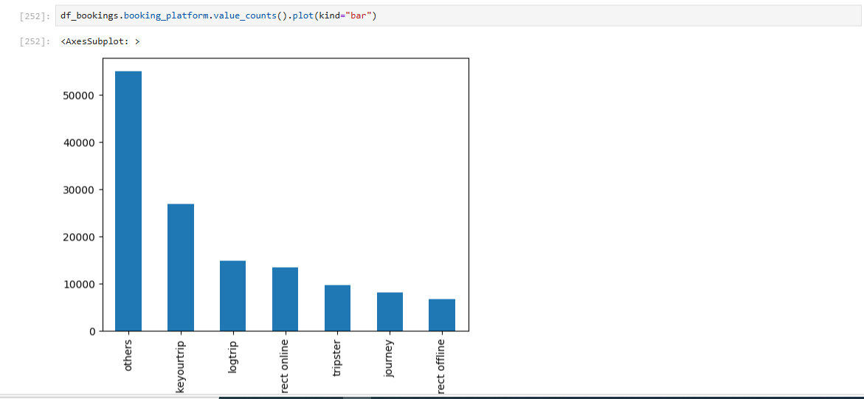
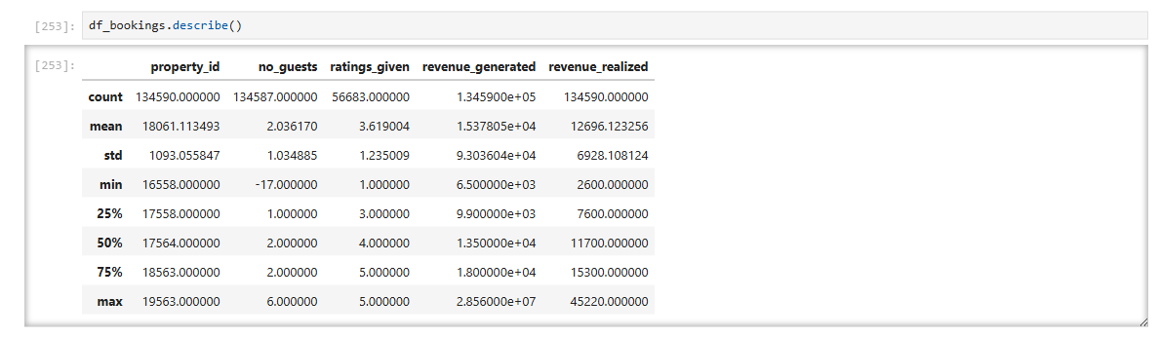

Slide 9
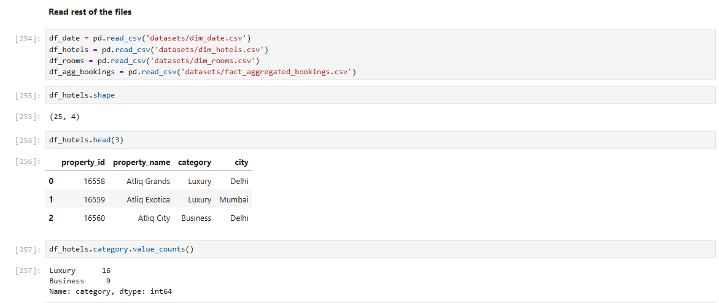
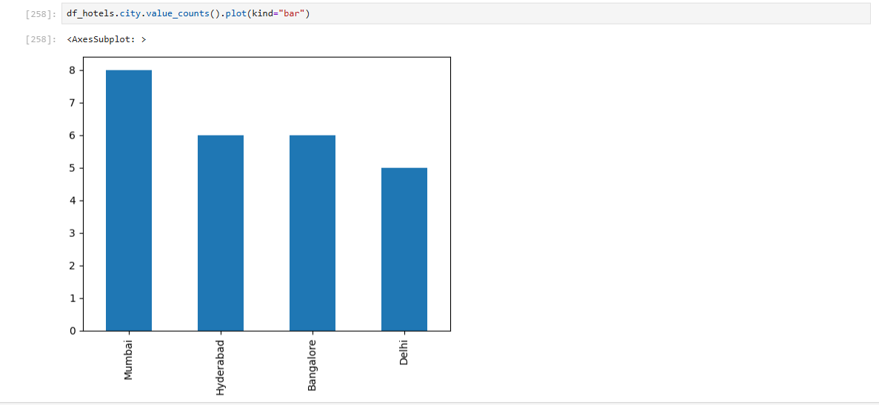

Slide 10
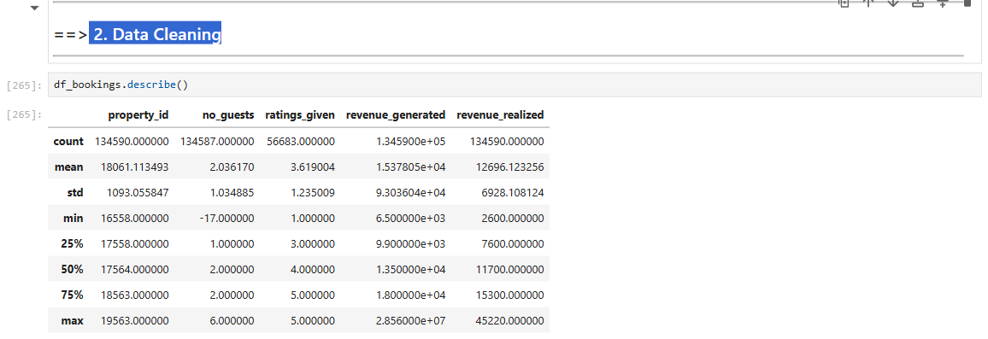
2. Data Cleaning

Slide 11
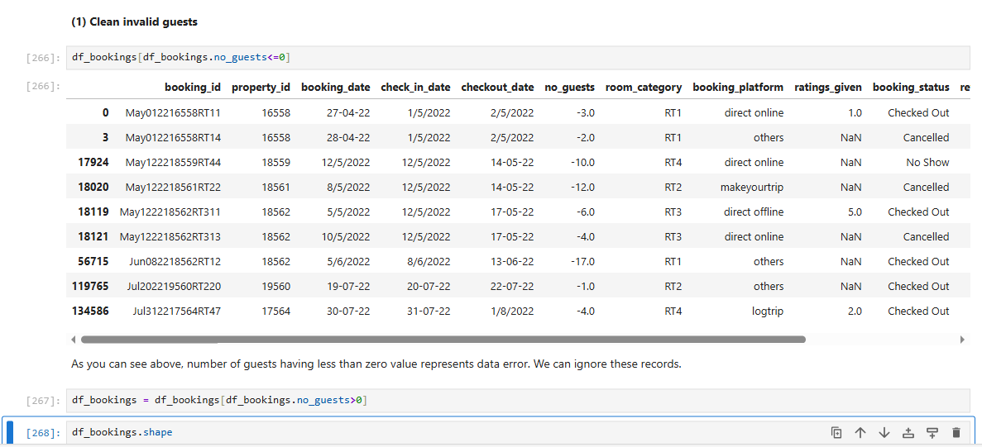

Slide 12
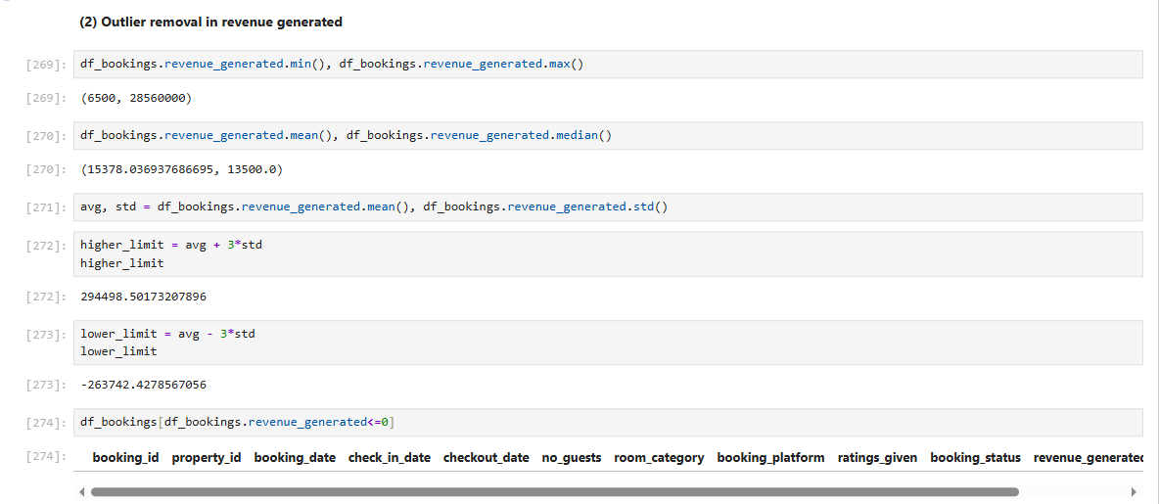

Slide 13
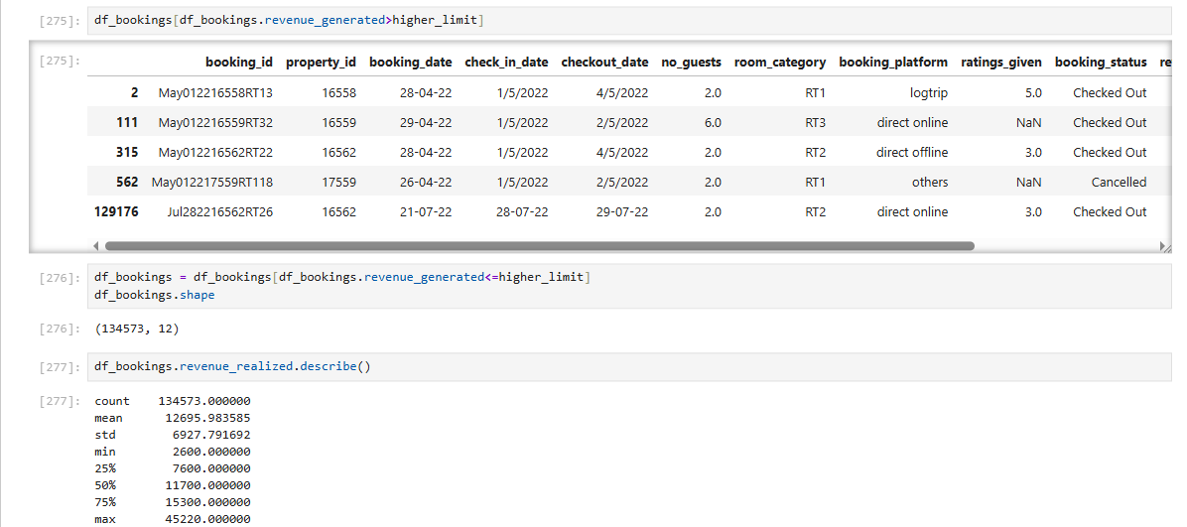
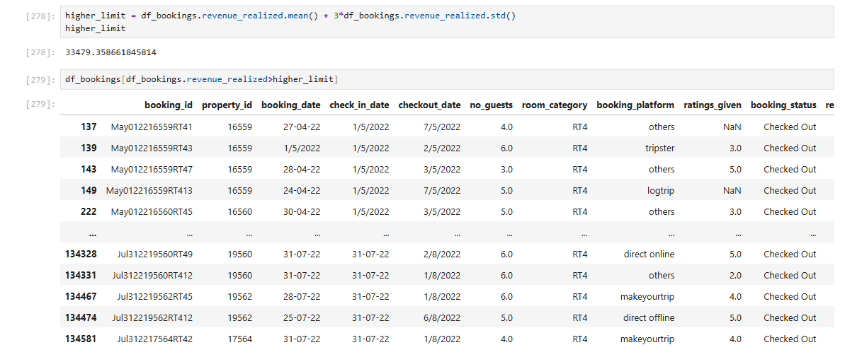

Slide 14
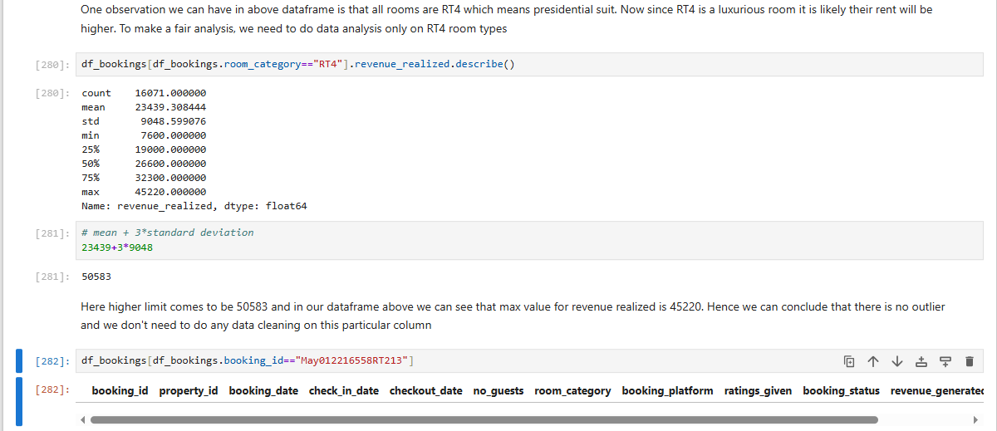
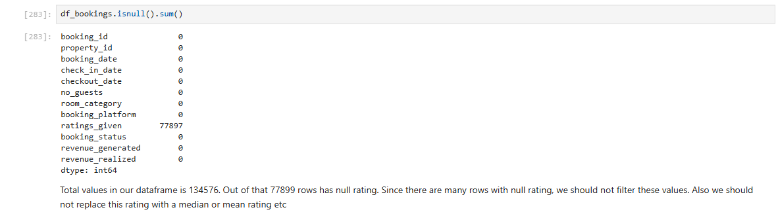

Slide 15
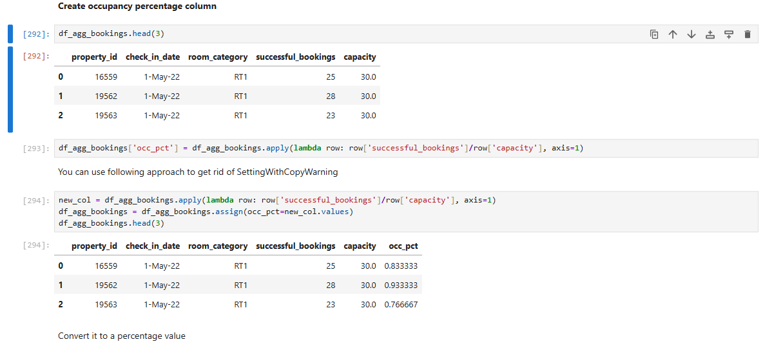
3. Data Transformation

Slide 16
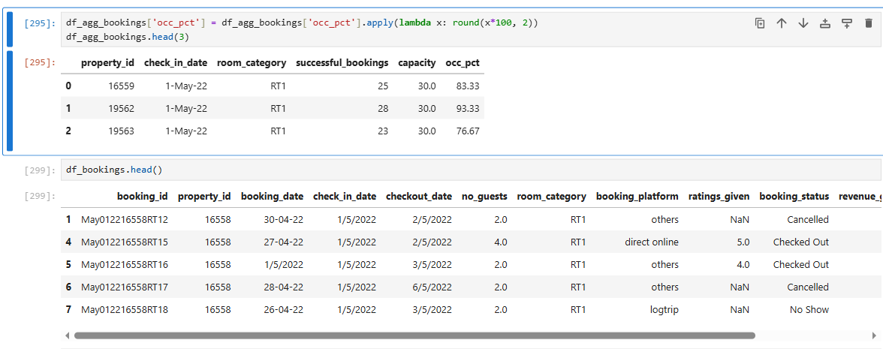
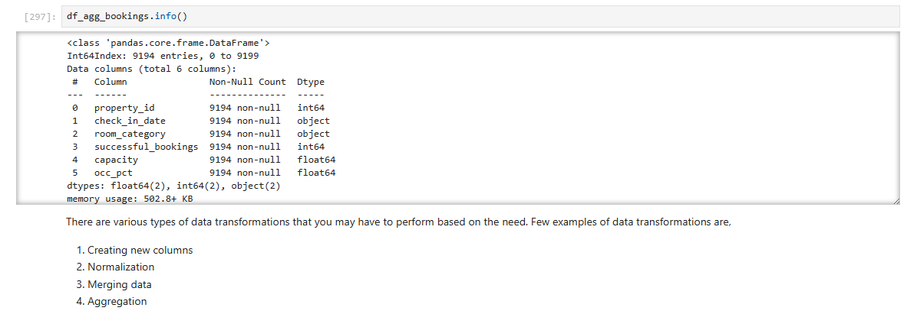

Slide 17
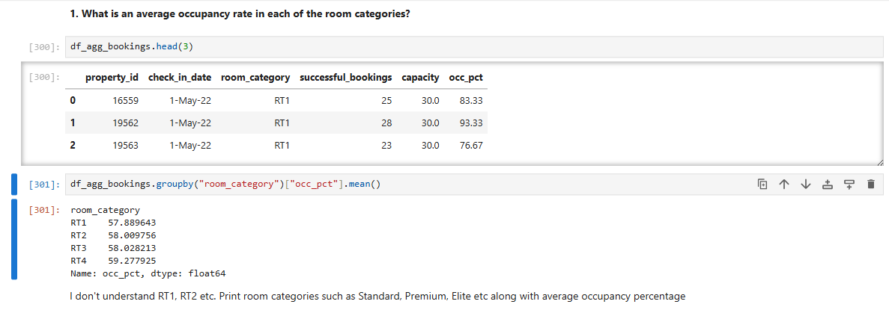
4. Insights Generation

Slide 18
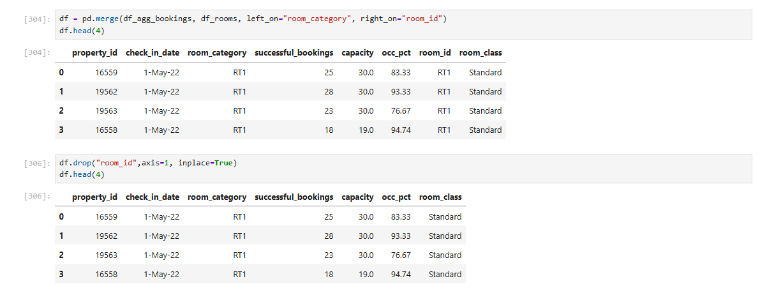
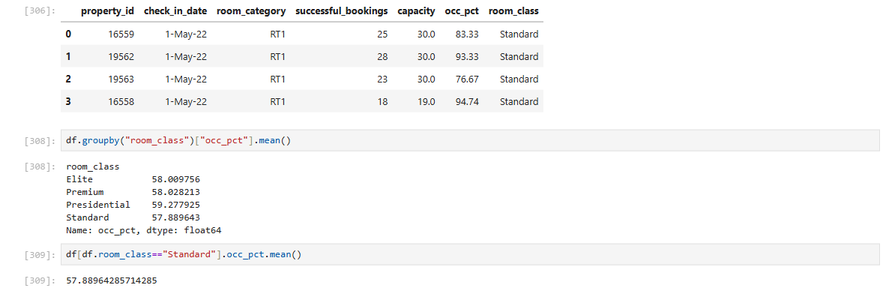

Slide 19
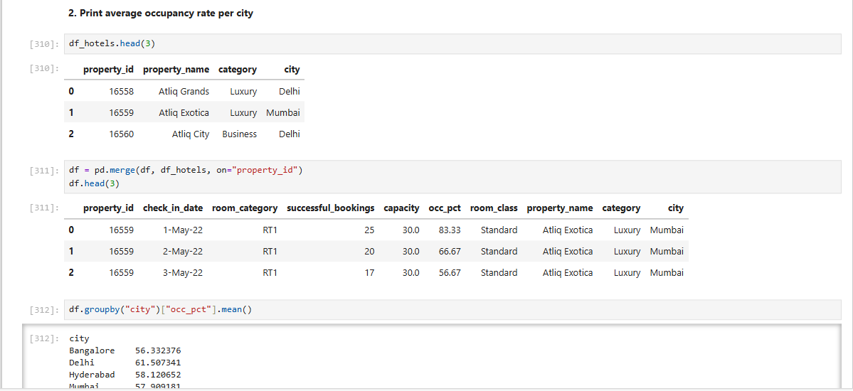
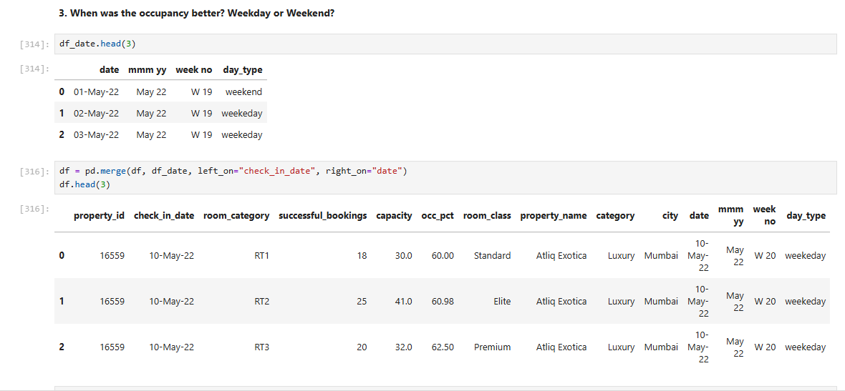

Slide 20
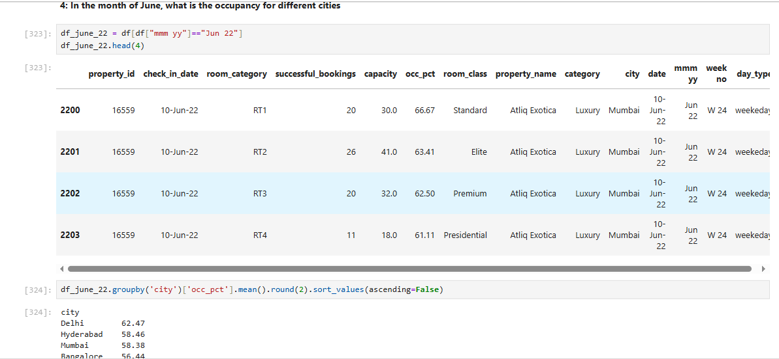

Slide 21
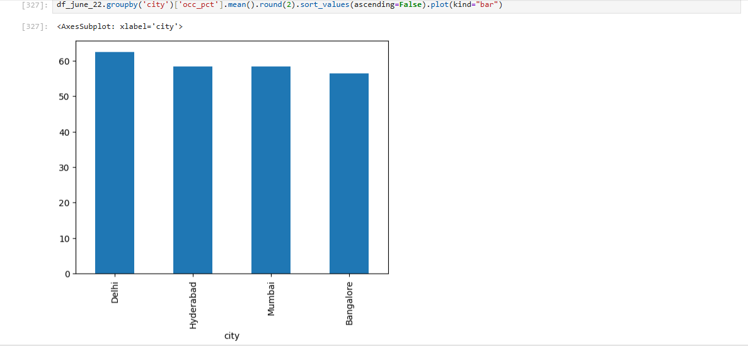

Slide 22
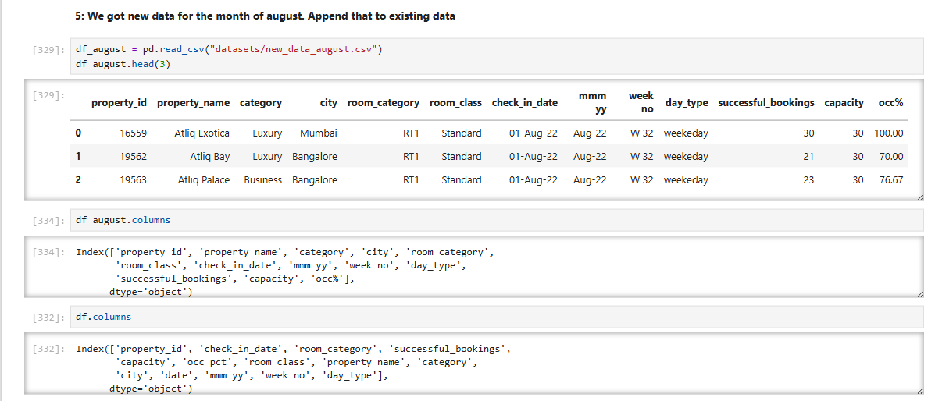
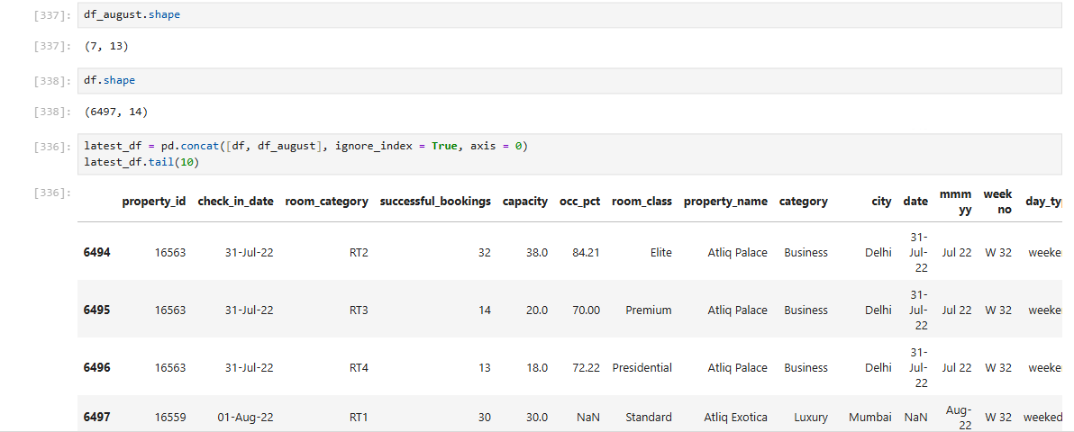

Slide 23
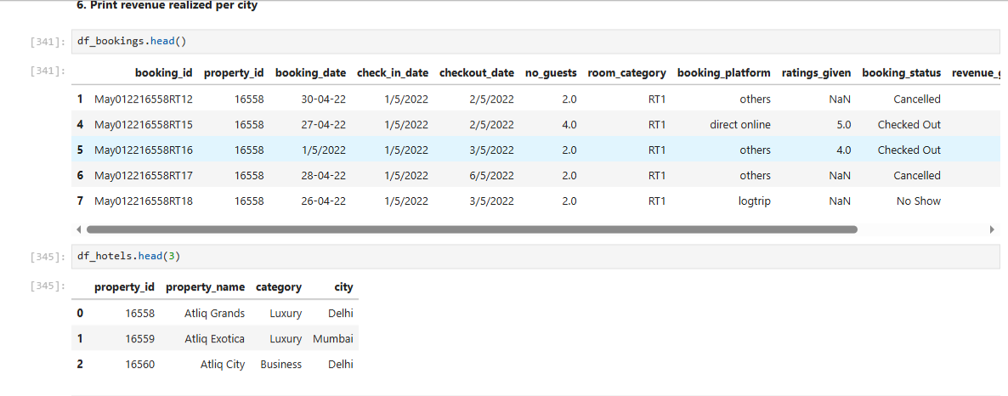
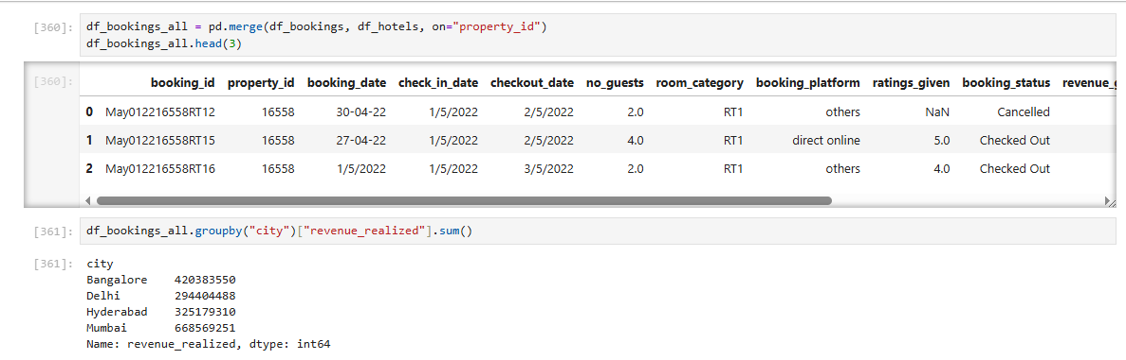

Slide 24
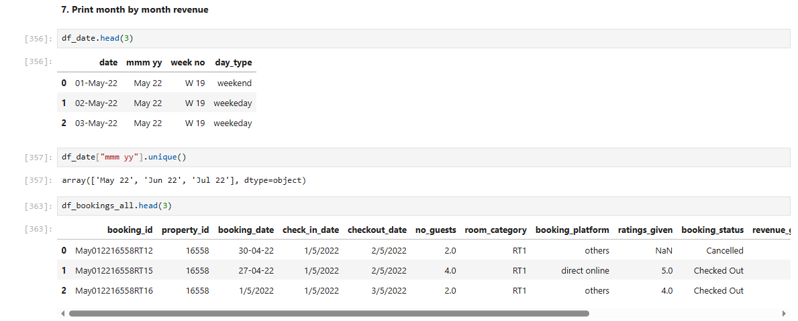
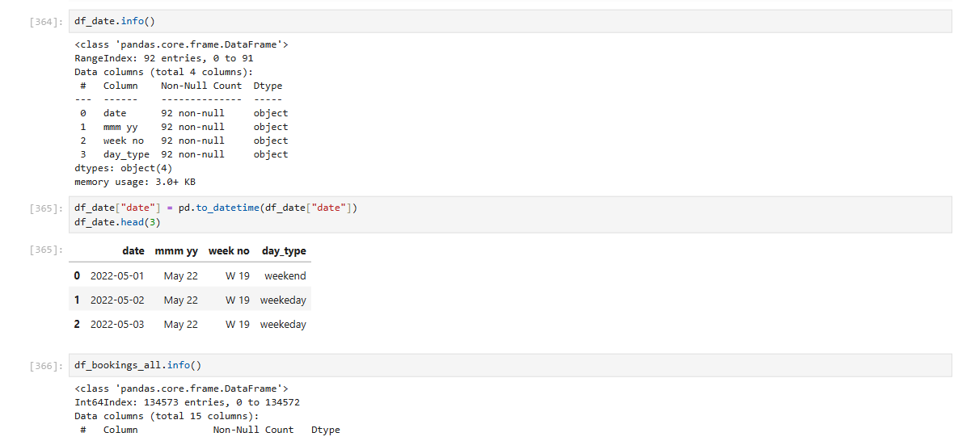

Slide 25
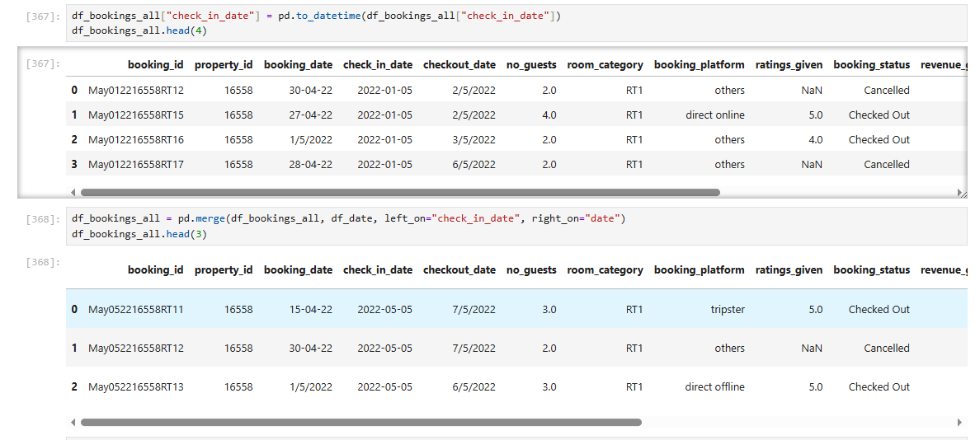

Slide 26
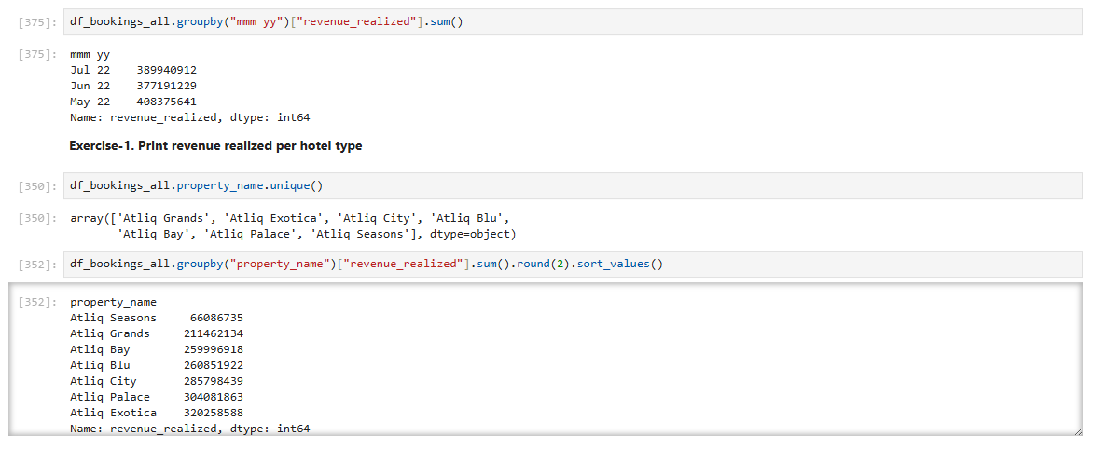
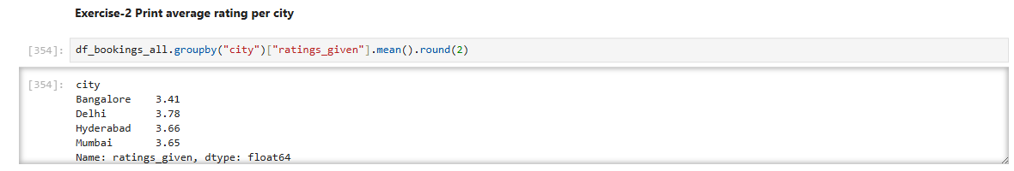

Slide 27
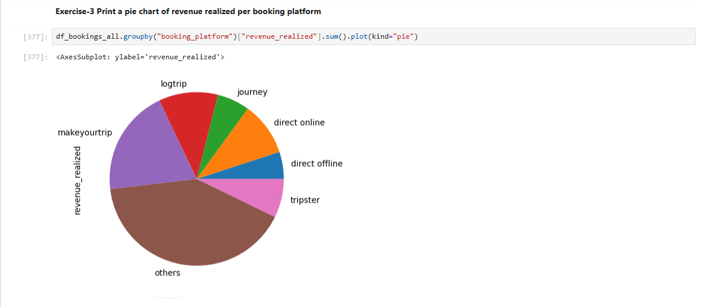

Slide 28
Key Insights & Findings
• Identified occupancy trends across hotels
• Analyzed booking patterns & seasonal variations
• Revenue drivers highlighted using KPIs
• Found data-quality issues and cleaned them

Slide 29
Conclusion
• The project demonstrates end-to-end analytical workflow
• Shows strong data cleaning + transformation skills
• Provides insights relevant for hotel business strategy

Slide 30
Connect with Me
LinkedIn : https://www.linkedin.com/in/akhilkumar-ak/
GitHub: https://github.com/akhilkumar-dataAnalyst
Email: akhilkumar55077@gmail.com

