Slide 1
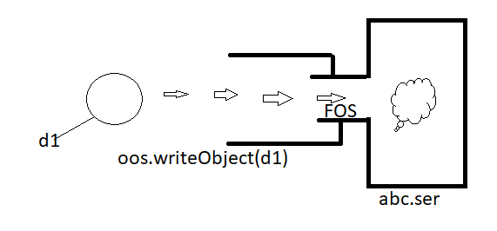
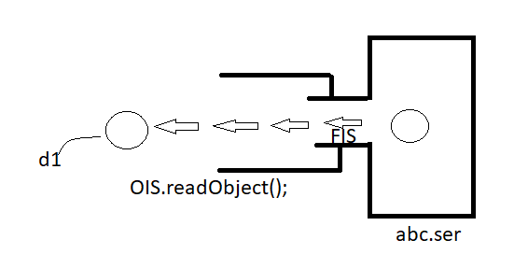
Serialization :
Introduction:
Serialization
The process of writing state of an object to a file is called serialization But strictly speaking it is the process of converting an object from java supported form into either file supported form or network supported form .
By using FileOutputStream and ObjectOutputStream classes we can implement Serailaization
DeSerialization
The process of reading state of an object from the file is called deserialization
But strictly speaking It is the process of converting an object from either file
Supported form or network supported form into java supported form
By using FileInputStream and ObjectInputStream classes we can implement Deserialization

Slide 2
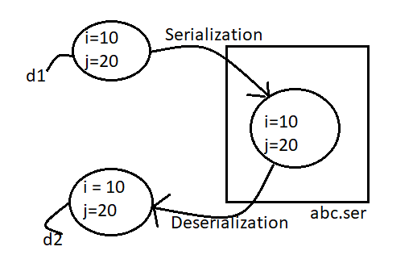
Serialization and Deserialization Example :
import java.io.*;
class Dog implements Serializable{
int i = 10;
int j = 20;
}
class SerializeDemo{
public static void main(String[] args) throws Exception{
Dog d1 = new Dog();
FileOutputStream fos = new FileOutputStream("abc.ser");
ObjectOutputStream oos = new ObjectOutputStream(fos); Serialization
oos.writeObject(d1);
FileInputStream fis = new FileInputStream("abc.ser");
ObjectInputStream ois = new ObjectInputStream(fis); Deserialization
Dog d2 = (Dog)ois.readObject();
System.out.println(d2.i+"---"+d1.i);
}
}
we can serialize only serializable objects .An object is said to be serializable if and only if the corresponding class implements serializable interface . Serializable interface present in java.io package and it doesn’t contain any methods . It is marker interface. If we are trying to serialize a non-serializable object then we will get runtime exception saying NotSerializableException.

Slide 3
Transient Keyword :
transient keyword (modifier) applicable only for variables but not for methods and classes .
At the time of serialization if we don’t want to save the value of a particular variable to meet security constraints then we should declare that variable as transient. While performing serialization jvm ignores the original value of transient variable and save the default value to the file .Hence transient means not to serialize
Transient vs static :
Static variable is not part of object state and Hence it won’t participate in serialization, due to this declaring static variable as transient there is no use .
Final vs Transient
Final variables will be participated in serialization directly by the value , Hence declaring a final variable as transient there is no impact

Slide 4
Declaration | O/p
Int I = 10; Int j = 20 | 10---20
transient int i =10; int j =20 | 0---20
transient static int i=10; transient int j =20; | 10---0
transient int i =10; transient final int j =20; | 0----20
transient static int i = 10; transient final int j = 20; | 10---- 20

Slide 5
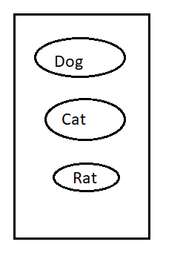
we can serialize any number of objects to the file but in which order we serialize in the same order only we have to deserialize i.e. order of objects is important in serialization
Example :
Dog d1 = new Dog();
Cat c1 = new Cat();
Rat r1 = new Rat();
FileOutputStream fos = new FileOutputStream("abc.ser");
ObjectOutputStream oos = new ObjectOutputStream(fos);
oos.writeObject(d1);
oos.writeObject(c1);
oos.writeObject(r1);
FileInputStream fis = new FileImageInputStream("abc.ser");
ObjectInputStream ois = new ObjectInputStream(fis);
Dog d2 = (Dog)ois.readObject();
Cat c2 = (Cat)ois.readObject();
Rat r2 = (Rat)ois.readObject();

Slide 6
If we don’t know order of objects in serialization. How we can handle?
Solution ===
FileInputStream fis = new FileInputStream("abc.ser");
ObjectInputStream ois = new ObjectInputStream(fis);
Object o = ois.readObject();
if(o instanceof Dog){
Dog d2 = (Dog) o;
// Perform Dog Specific functionality
}else if(o instanceof Cat){
Cat c2 = (Cat)o;
// Perform Cat speccific functionality
}else if(o instanceof Rat){
Rat r2 = (Rat) o;
// perform Rat speccific functionality
}
--
-

Slide 7
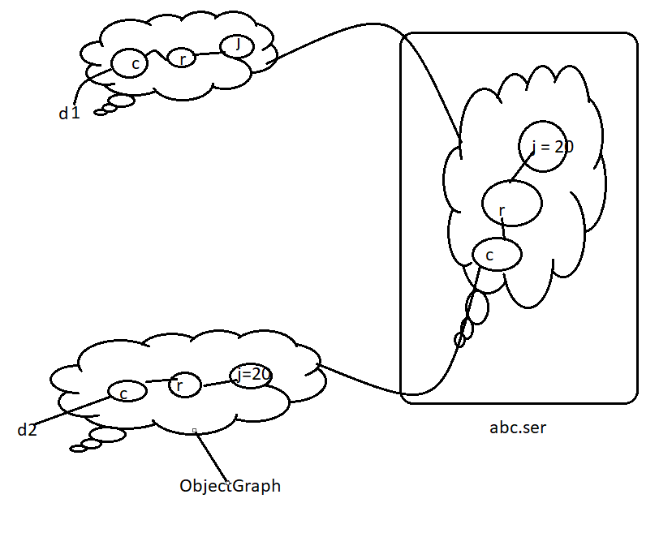
Object Graphs in Serialization :
Whenever we are serializing an object the set of all objects which are reachable from that object will be serialized automatically this group of object is nothing but Object graph . In Object graph every object should be serializable if atleast one object is not serializable then we will get RuntimeException saying NotSerializableException
Example :
import java.io.*;
class Dog implements Serializable{
Cat c = new Cat();
}
class Cat implements Serializable{
Rat r = new Rat();
}
class Rat implements Serializable{
int j = 20;
}
class SerializeDemo2{
public static void main(String[] args) throws Exception{
Dog d1 = new Dog();
FileOutputStream fos = new FileOutputStream("abc.ser");
ObjectOutputStream oos = new ObjectOutputStream(fos);
oos.writeObject(d1);
FileInputStream fis = new FileInputStream("abc.ser");
ObjectInputStream ois = new ObjectInputStream(fis);
Dog d2 = (Dog)ois.readObject();
System.out.println(d2.c.r.j);
}
}

Slide 8
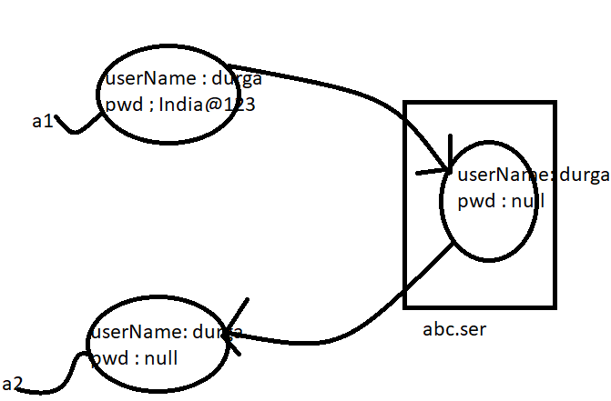

In the above program whenever we are serializing dog object automatically cat and rat object got serialized because these are part of object graph of dog
Among dog ,cat and Rat object if atleast one object is not serializable then we will get Runtime Exception saying NotSerializableException .
Customized Serialization :
import java.io.*;
class Account implements Serializable{
String userName = "durga";
transient String pwd = "India@123";
}
class SerializeDemo3{
public static void main(String[] args) throws Exception{
Account a1 = new Account();
System.out.println(a1.userName+"===="+a1.pwd);
FileOutputStream fos = new FileOutputStream("abc.ser");
ObjectOutputStream oos = new ObjectOutputStream(fos);
oos.writeObject(a1);
FileInputStream fis = new FileInputStream("abc.ser");
ObjectInputStream ois = new ObjectInputStream(fis);
Account a2 = (Account)ois.readObject();
System.out.println(a2.userName+"------"+a2.pwd);
}
}

Slide 9
In the above example we see that
During default serialization there may be a chance of loss of information because of transient keyword .
Before Serialization the account Object can provide proper username and password but after deserialization account object can provide only username but not password . This is due to declaring password variable as transient
Hence during default serialization there may be a chance of loss of information because of transient keyword . To recover this loss of information we should go for Customized serialization .
We can implement customizedSerialization by using the following two methods :
private void writeObject(ObjectOutputStream os) throws Exception .
This method will be executed automatically at the time of Serialization Hence at the time of serialization if you want to perform any activity we have to define that in this method only .
private void readObject(ObjectInputStream is) throws Exception
This method will be executed automatically at the time of deserialization Hence at the time of Deserialization. If we want to perform any activity we have to define that in this method only .
Note ***
The above methods are call back methods because these are executed automatically by the jvm

Slide 10
While performing each object serialization we have to do extra work In the corresponding class we have to define above methods. For e.g. while performing account object serialization if we required to do extra work in the account class we have to define above methods .

