Slide 1

Trust Layer: AI-Driven Fraud Prevention Across Web, Voice, and Payments

Slide 2
Introduction
Overview
Trust Layer is an AI-assisted security system built around one idea: before a user clicks a link, scans a QR code, answers a call, or accepts a payment screenshot as proof, the system checks whether what's being presented matches what it claims to be. It combines a browser extension, an Android module for real-time AI-voice detection on phone calls, and a payment-screenshot verifier — all built on the same underlying principle of consistency checking rather than static blocklists, so it can catch novel attacks that signature-based tools miss.
Importance of the topic:
UPI-related fraud crossed 13.4 lakh reported cases in FY 2023-24 alone, with losses exceeding ₹1,087 crore, and AI voice cloning has made the threat harder to spot — around 69% of people cannot tell a cloned voice from a real one. In one recent case, an Indore resident lost ₹1.83 lakh after scammers used an AI-cloned voice of his relative to fake a legal emergency. Existing tools treat phishing, voice fraud, and payment fraud as separate problems; Trust Layer addresses them as one.

Slide 3
Literature Review
Name | Date | Summary | Link
Korkmaz, M., Sahingoz, O. K., & Diri, B. | 2020 | Proposes a machine-learning phishing detection system using eight algorithms trained on lexical and host-based URL features across three datasets, showing strong classification performance for identifying phishing websites from URL structure alone. | https://doi.org/10.1109/ICCCNT49239.2020.9225561
Trad, F., & Chehab, A. | 2025 | Introduces the first framework for detecting QR-code phishing ("quishing") by analyzing the QR code's structural/pixel patterns directly, without decoding the embedded URL — avoiding the risk of exposing the user to malicious content during analysis. Achieves strong detection performance using XGBoost. | https://arxiv.org/abs/2505.03451
Yamagishi, J., Wang, X., Todisco, M., et al. | 2021 | Describes the ASVspoof 2021 challenge, the standard benchmark for detecting synthetic, converted, and deepfake speech; introduces a dedicated "deepfake speech" detection task and evaluates countermeasure robustness across many participating systems. | https://arxiv.org/abs/2109.00537
Gupta, A., Joshi, R., & Laban, R. | 2022 | Combines Error Level Analysis (ELA) with a Convolutional Neural Network to detect tool-edited/tampered images, showing that compression-artifact patterns from ELA are strong input features for a forgery classifier. | https://arxiv.org/abs/2204.09075

Slide 4
Problem Definition
Users cannot reliably verify the authenticity of links, QR codes, phone calls, or payment proofs before acting on them, leaving them exposed to phishing, voice-cloning, and payment fraud that current tools detect only after the fact, if at all. A unified, pre-action verification system is needed to close this gap before financial or personal harm occurs.
Significance of Addressing the Problem:
Financial and psychological harm from these scams disproportionately affects less tech-savvy users — elderly people, first-time UPI users, small sellers.
The gap between fraud sophistication and user awareness will keep widening as generative AI improves.
No existing consumer tool unifies detection across web, voice, and payment surfaces under one investigative framework.

Slide 5
Objectives
To design and implement an AI-assisted, pre-action verification system that helps users assess the trustworthiness of links, QR codes, phone calls, and payment proofs before they act on them. The system aims to combine rule-based and machine-learning detection to flag potential fraud in real time, while explaining its reasoning in plain language the user can act on.
Specific Objectives:
Detect phishing and impersonation attempts in real time by analyzing redirect chains and brand-vs-domain mismatches.
Build a real-time voice analysis module that flags AI-generated/cloned speech during live phone calls.
Develop a Payment Proof Verifier that detects tampered UPI/bank payment screenshots using compression and layout analysis.
Present findings as clear, plain-language explanations rather than opaque risk scores.

Slide 6
Methodology
Design: Trust Layer uses a client-server architecture — a Chrome extension (browser checks) and an Android app (calls/payments) as lightweight clients, both calling a shared backend that runs the detection logic centrally.
  QR Guardian: Client-side camera/image capture decodes the QR payload locally (no data sent until decoding); the resulting URL is routed into the same backend pipeline used for regular links.
  Redirect X-Ray: Backend traces the destination URL hop-by-hop via HTTP requests (without rendering), logging each redirect to reconstruct the full chain before it reaches the user's browser.
  Impersonation Radar: Backend performs a safe, script-free HTML fetch of the destination, extracts claimed branding (title/meta tags), and compares it against a curated list of known official domains using string-similarity matching.
  Real-Time Voice Detection: A standalone Android module captures call audio via speakerphone/microphone, extracts MFCC features from rolling audio chunks, and classifies them using a model trained on the ASVspoof dataset to flag likely AI-generated speech.
  Payment Proof Verifier: Uploaded payment screenshots are analyzed through Error Level Analysis (to detect recompression artifacts from editing), OCR-based field extraction (amount, UPI ID, transaction ID), and layout comparison against known payment-app templates.
Data collection methods:
  Links/QR: PhiUSIIL Phishing URL Dataset (or PhishTank + Tranco)
  Voice Detection: ASVspoof, re-recorded through your speaker-mic demo setup
  Payment Verifier: self-collected genuine + edited UPI/bank screenshots (optionally CASIA for extra tamper-detection data)
Tools and resources used: Chrome Extension APIs (Manifest V3), Python (scikit-learn) for model training, Android SDK for the voice-detection module, OpenCV/PIL for image forensics (ELA), and public datasets referenced in the literature review.

Slide 7
Methodology
Data analysis techniques:
  Link/URL detection: classification metrics (accuracy, precision, recall, F1, AUC) on held-out phishing vs. legitimate URLs; compare rule-engine score vs. ML classifier score to measure agreement/divergence.
  Voice Detection: accuracy, precision, recall, and Equal Error Rate (EER — the standard ASVspoof metric) on held-out re-recorded test set; separately compare performance on clean vs. speaker-recorded audio to quantify the real-world degradation.
  Payment Proof Verifier: accuracy on labeled genuine-vs-edited screenshot set; also track ELA-region detection rate against manually marked "edited" regions, and OCR field-extraction accuracy (correct amount/UPI ID/transaction ID reads vs. ground truth).

Slide 8
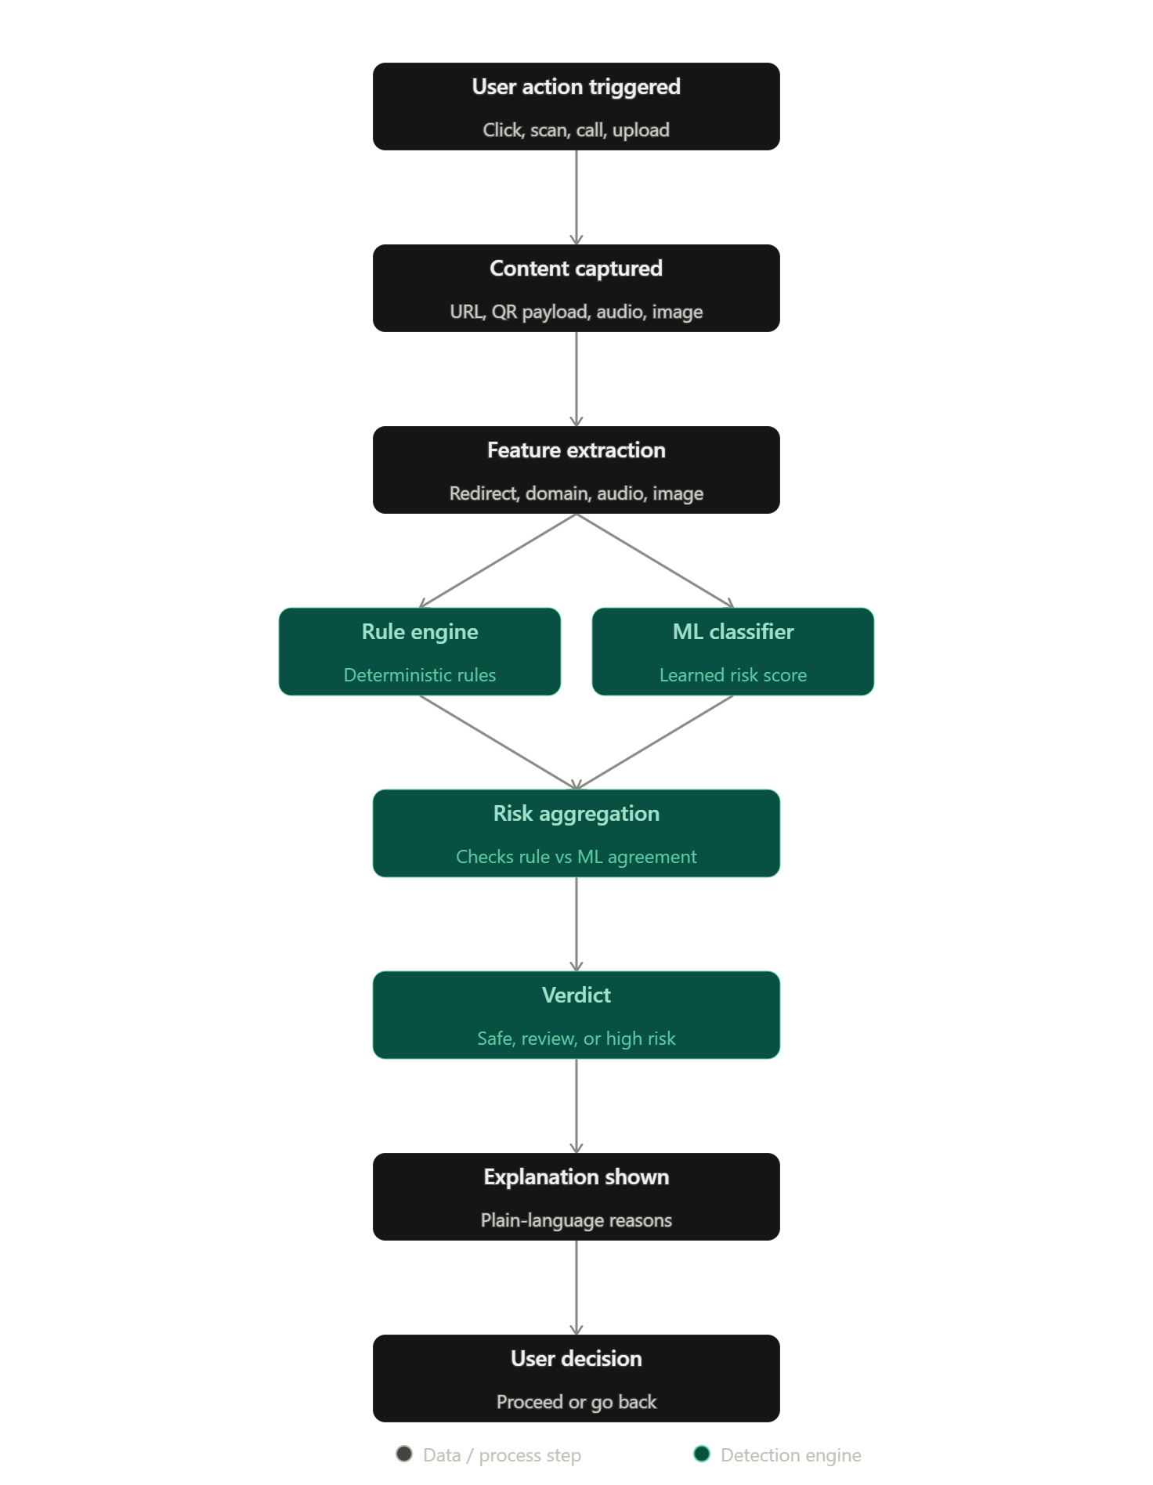
Flowchart

Slide 9
Proposed Outcomes
Expected results: A working prototype demonstrating real-time detection across three fraud surfaces — a Chrome extension flagging phishing/QR/login risk, an Android module flagging suspected AI-cloned voices on calls, and a verifier flagging tampered payment screenshots — each with measurable accuracy on benchmark datasets.
Potential impact on the field: Demonstrates that a single "claim vs. reality" detection philosophy can generalize across very different data types (text, audio, image), offering a template for future cross-modal fraud-detection systems rather than single-purpose tools.
Future research directions: Extending detection to other call platforms and languages, building a shared threat-intelligence layer across users (with privacy safeguards), and exploring adversarial robustness as voice/image generation models improve.

Slide 10
Conclusion
Summary of key points: Trust Layer addresses phishing, voice-cloning, and payment fraud through one consistent detection philosophy — checking whether a claim matches reality — rather than treating each as a separate problem.
Final thoughts: As AI-generated content becomes harder to distinguish from the real thing, the most durable defense isn't a bigger blocklist — it's giving users a fast, explainable way to verify before they trust.
Call to action / next steps: Complete prototype development for all three modules, validate against benchmark datasets, and pilot the system with a small user group to measure real-world usability and detection accuracy.

Slide 11
References
Gupta, A., Joshi, R., & Laban, R. (2022). Detection of tool-based edited images from error level analysis and convolutional neural network. arXiv. https://arxiv.org/abs/2204.09075
Korkmaz, M., Sahingoz, O. K., & Diri, B. (2020). Detection of phishing websites by using machine learning-based URL analysis. In 2020 11th International Conference on Computing, Communication and Networking Technologies (ICCCNT) (pp. 1–7). IEEE. https://doi.org/10.1109/ICCCNT49239.2020.9225561
Trad, F., & Chehab, A. (2025). Detecting quishing attacks with machine learning techniques through QR code analysis. arXiv. https://arxiv.org/abs/2505.03451
Yamagishi, J., Wang, X., Todisco, M., Sahidullah, M., Patino, J., Nautsch, A., Liu, X., Lee, K. A., Kinnunen, T., Evans, N., & Delgado, H. (2021). ASVspoof 2021: Accelerating progress in spoofed and deepfake speech detection. arXiv. https://arxiv.org/abs/2109.00537

Slide 12


