Slide 1

CipherVault: Secure Private Cloud Storage
Private Cloud Storage with AES Encryption, SHA-256 Duplicate Detection, and Metadata-Based Search
Master of Computer Applications (MCA) — Final Project Evaluation
Presenter: Akhil Krishna V U (Reg No: TVE25MCA-2013)
Project Guide: Prof. Deepa S. | Programme: Master of Computer Applications (MCA)
Evaluation Date: 14 October 2026
CipherVault: Private Cloud Storage with AES & SHA-256 | Akhil Krishna V U (TVE25MCA-2013) | Guide: Prof. Deepa S. Slide 1 of 16
Notes:
Good morning, respected guide and examiners. I am Akhil Krishna V U, presenting my MCA final project titled 'CipherVault: Private Cloud Storage with AES Encryption, SHA-256 Duplicate Detection, and Metadata-Based Search'. CipherVault is a sovereign, self-hosted private cloud storage system designed to return cryptographic custody and forensic file intelligence to the individual user. It combines an Android client built with Material Design 3 and a Java 21 / Spring Boot 3.3.4 backend microservice with MySQL 8.0.

Slide 2
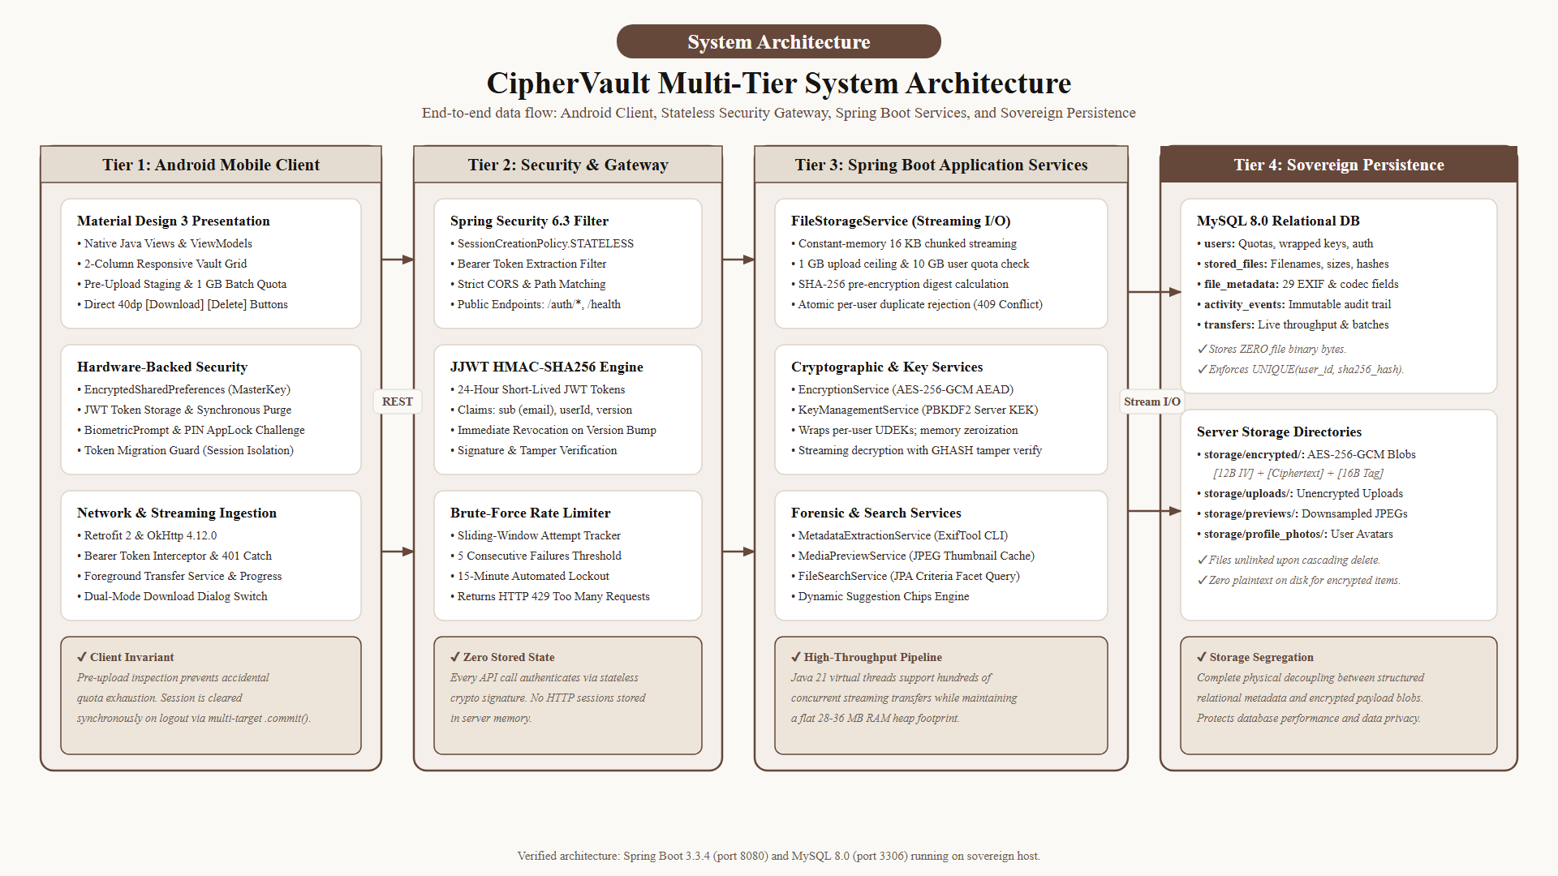
EXECUTIVE SUMMARY
Abstract & Project Overview
1. Sovereign Cloud Architecture: Replaces third-party commercial cloud dependence with a private, self-hosted Android and Spring Boot microservice stack.
2. Cryptographic Foundation: Implements NIST SP 800-38D authenticated AES-256-GCM envelope encryption with hardware-backed PBKDF2 key management.
3. Storage Optimization: Features atomic pre-encryption SHA-256 duplicate detection, strictly isolating tenants to prevent cross-user side-channel leakage.
4. Forensic Intelligence: Extracts 29 forensic media attributes via ExifTool (camera optics, resolution, audio/video codecs) into a queryable relational catalog.
5. Production Stability: Verified with 243 automated passing tests on Android 17 / API 37 with a strict 10 GB user quota ceiling and 1 GB single-upload limit.
Overview: 3-tier sovereign architecture decoupling structured metadata from encrypted blob storage.
CipherVault: Private Cloud Storage with AES & SHA-256 | Akhil Krishna V U (TVE25MCA-2013) | Guide: Prof. Deepa S. Slide 2 of 16
Notes:
On Slide 2, we present the abstract. Ordinary cloud vaults turn files into opaque binary blobs that cannot be searched or previewed. CipherVault resolves the 'metadata paradox': files remain strongly encrypted using AES-256-GCM, while decoupled forensic metadata enables instant, rich searching across 29 camera and codec attributes. Deduplication is strictly isolated per user to prevent side-channel leakage.

Slide 3
EXISTING SYSTEM LIMITATIONS
Problem Statement & Research Motivation
1. Loss of Cryptographic Sovereignty
Commercial public clouds (Google Drive, Dropbox) hold encryption keys server-side. User files are subject to corporate data mining, warrantless subpoenas, and vulnerability to third-party server breaches.
2. The 'Metadata Paradox' in Cloud Storage
Client-side encryption wrappers (Cryptomator) turn files into opaque, unsearchable blobs. Users cannot preview media, inspect EXIF optics, or perform faceted search without insecure local exports.
3. Side-Channel Deduplication Hazards
Cross-user cloud deduplication leaks information: attackers can probe whether sensitive files exist in other accounts using hash existence queries (Liu et al. CCS 2015). Bandwidth is saved at the expense of user confidentiality.
4. Mobile Ingestion Blindness & Memory Exhaustion
Conventional apps upload files blindly without client-side staging, quota validation, or rate limits. Processing multi-gigabyte files without constant-memory streaming causes OutOfMemory crashes on mobile and server.
Key Takeaway: Users are currently forced to choose between the convenience of commercial clouds (which surrender privacy) and the extreme friction of client encryption (which destroys searchability).
CipherVault: Private Cloud Storage with AES & SHA-256 | Akhil Krishna V U (TVE25MCA-2013) | Guide: Prof. Deepa S. Slide 3 of 16
Notes:
Slide 3 covers the core problem statement identified from existing-system research. In commercial clouds, vendors hold the keys and cross-user deduplication allows attackers to detect whether a confidential file already exists. In client vaults like Cryptomator, files become unsearchable black boxes. CipherVault specifically solves this conflict.

Slide 4
ARCHITECTURAL MILESTONES
Project Objectives & Scope Verification
1. Secure Authentication
BCrypt (cost 10) password hashing with 128-bit salt; stateless JJWT HS256 tokens; sliding-window rate limiter.
✔ Status: Verified & Operational
2. Sovereign File Storage
Self-hosted filesystem storage (storage/encrypted/); MySQL stores zero binary bytes; isolates physical blobs.
✔ Status: Verified & Operational
3. AES-256-GCM Encryption
NIST SP 800-38D authenticated envelope encryption; 16 KB streaming buffers with 128-bit GHASH tamper tag.
✔ Status: Verified & Operational
4. SHA-256 Deduplication
Pre-upload SHA-256 digest computation; atomic per-user duplicate rejection (409 Conflict) preventing side-channels.
✔ Status: Verified & Operational
5. Decoupled Metadata Search
Forensic parsing of 29 EXIF attributes via ExifTool; dynamic suggestion chips (Camera, ISO, Resolution).
✔ Status: Verified & Operational
6. Quotas & Dual-Mode Retrieval
Strict 10 GB user quota & 1 GB per-file upload limit; memory-bounded streaming decryption or raw .enc export.
✔ Status: Verified & Operational
Scope Boundary: All 6 core objectives are completely implemented in the current codebase. Distributed S3 clustering and TUS resumable uploads represent planned roadmap phases.
CipherVault: Private Cloud Storage with AES & SHA-256 | Akhil Krishna V U (TVE25MCA-2013) | Guide: Prof. Deepa S. Slide 4 of 16
Notes:
Slide 4 covers the verified objectives. Notice that every objective listed here is fully implemented and tested. We strictly distinguish completed work from planned future work (TOTP MFA and chunked resumable transfers).

Slide 5
COMPARATIVE ACADEMIC ANALYSIS
Literature Survey: Existing Systems vs. Proposed CipherVault
System / Research Source | Identified Limitation / Problem | CipherVault Design Decision | Implementation Status
Google Drive / Commercial Cloud | Vendor holds encryption keys server-side; automated content scanning; cross-user deduplication leaks ownership. | Self-hosted server; zero-knowledge envelope encryption; strictly isolated per-user keys. | Implemented & Verified
Yang et al. (2017) & Liu et al. (2015) | Cross-user deduplication susceptible to dictionary attacks and existence-probing side-channels. | Restrict deduplication strictly to the authenticated user scope (UNIQUE(user_id, sha256_hash)). | Implemented & Verified
Cryptomator / Vault Apps | Opaque virtual drives; impossible to search EXIF metadata or preview media without local export. | Decouple 29 forensic attributes into MySQL catalog while encrypting ciphertext on disk. | Implemented & Verified
Nextcloud / Self-Hosted LAMP | Heavy monolithic LAMP stack; mobile client lacks pre-upload staging tray and quota monitoring. | Lightweight Java 21 / Spring Boot 3.3.4 microservice with dedicated Android staging queue. | Implemented & Verified
CipherVault: Private Cloud Storage with AES & SHA-256 | Akhil Krishna V U (TVE25MCA-2013) | Guide: Prof. Deepa S. Slide 5 of 16
Notes:
On Slide 5, we present our literature survey and comparison. We specifically studied Yang et al. (2017) and Liu et al. (CCS 2015), which demonstrated how cross-user deduplication leaks private file presence. In CipherVault, deduplication is strictly bound per user. We also solve Cryptomator's metadata blindness by extracting 29 ExifTool fields before encryption.

Slide 6
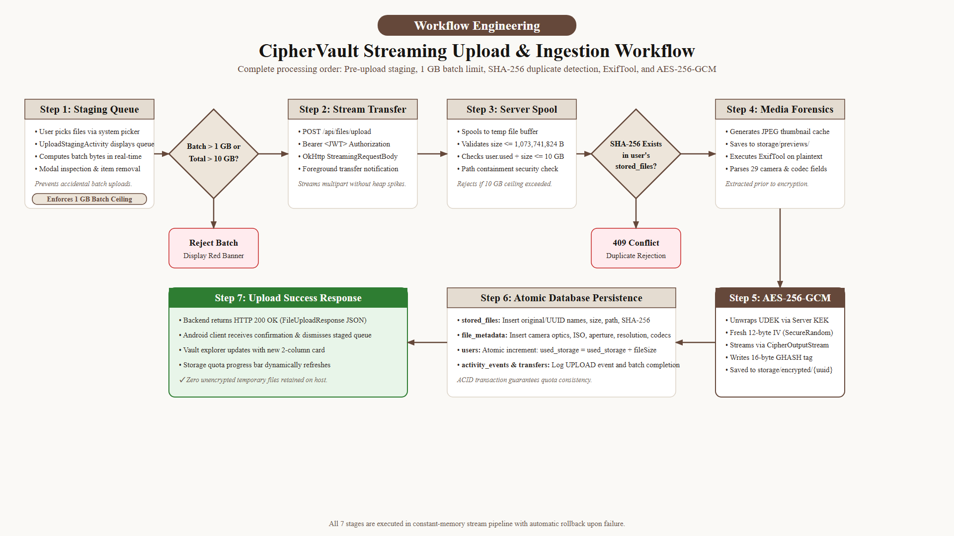
OPERATIONAL WORKFLOW
Proposed System Methodology: End-to-End File Pipeline
Ingestion Pipeline Lifecycle (Enforced Processing Sequence):
1. File Selection ➔ 2. Auth & Quota Check (< 10 GB) ➔ 3. SHA-256 Pre-Check ➔ [Duplicate?]
• If Duplicate = YES ➔ Atomic Rejection (HTTP 409 Conflict) — Zero bytes written, quota unchanged.
• If Duplicate = NO ➔ 4. ExifTool Metadata Extraction ➔ 5. AES-256-GCM Streaming ➔ 6. Storage & MySQL Indexing
CipherVault: Private Cloud Storage with AES & SHA-256 | Akhil Krishna V U (TVE25MCA-2013) | Guide: Prof. Deepa S. Slide 6 of 16
Notes:
Slide 6 illustrates the file ingestion lifecycle. Notice the strict sequence: before any encryption begins, the file's SHA-256 hash is computed. If it already exists for that user, it is rejected with HTTP 409 Conflict before writing to disk. If unique, ExifTool extracts metadata, the file is encrypted with AES-256-GCM, and stored in storage/encrypted/.

Slide 7
SYSTEM DESIGN
System Architecture: 3-Tier Layered Design
Tier 1: Presentation Layer (Android Client)
Java 17, Material Design 3, OkHttp 4.12, Retrofit 2, Room DB, EncryptedSharedPreferences. Handles staging, uploads, and local biometric security.
Tier 2: Transport & Security Gateway
Spring Security 6 stateless filter chain, JJWT Bearer token validation, sliding-window brute-force rate limiter (5 attempts / 15 min lockout).
Tier 3: Core Application Services
Spring Boot 3.3.4 services (FileStorageService, KeyManagementService, MetadataExtractionService, FileSearchService) running on Java 21 virtual threads.
Tier 4: Relational & Blob Persistence
MySQL 8.0 InnoDB holds relational metadata and wrapped keys. Local filesystem holds ciphertext blobs in storage/encrypted/. MySQL stores zero binary bytes.
CipherVault: Private Cloud Storage with AES & SHA-256 | Akhil Krishna V U (TVE25MCA-2013) | Guide: Prof. Deepa S. Slide 7 of 16
Notes:
Slide 7 shows the multi-tier system architecture. The presentation layer on Android communicates via Retrofit with Spring Boot over REST. Crucially, we enforce a clean persistence split: MySQL stores only metadata, user accounts, and wrapped encryption keys, while actual ciphertext blobs are stored on disk in storage/encrypted/.

Slide 8
IMPLEMENTATION ARCHITECTURE
Technology Stack & Framework Specifications
Layer / Component | Technologies & Frameworks | Specific Role & Responsibility | Verification Source
Mobile Client | Android Native (Java 17 / XML), Google Material Design 3 | Reactive user interface, pre-upload staging queue, biometric app lock, Retrofit REST client | android/app/build.gradle.kts
Backend Microservice | Spring Boot 3.3.4, Java 21 LTS (Virtual Threads), Spring Security 6.3 | High-concurrency REST endpoints, streaming I/O, security filter chain, transaction management | backend/pom.xml
Security & Cryptography | AES-256-GCM (NIST SP 800-38D), PBKDF2 (65,536 rounds), SHA-256, BCrypt, JJWT | Authenticated encryption, master key wrapping, duplicate detection, auth tokens | docs/security/
Database & Storage | MySQL 8.0 Community Server, InnoDB Engine | Relational metadata, cascading foreign keys, user quota tracking, audit log | database/schema.sql
External Tooling | Phil Harvey's ExifTool, PySide6 / Python | 29-field forensic metadata extraction, background server control & log monitor | server-control/
CipherVault: Private Cloud Storage with AES & SHA-256 | Akhil Krishna V U (TVE25MCA-2013) | Guide: Prof. Deepa S. Slide 8 of 16
Notes:
Slide 8 provides our complete, verified technology stack. Every single technology was verified from project configuration files: Java 21 LTS virtual threads for non-blocking I/O, Spring Boot 3.3.4, native Android with Material 3, MySQL 8.0, ExifTool, and PySide6 for desktop server management.

Slide 9
SUBSYSTEM BREAKDOWN
Core System Modules & Functional Architecture
1. Auth & Session Management
Stateless JWT Bearer tokens, sliding-window rate limiting (5 attempts / 15 min), and biometric AppLock cold-start overlay.
2. Storage Dashboard & Health
Real-time 10 GB quota gauge, category metrics breakdown, and live server latency probe (226 ms round-trip).
3. Pre-Upload Staging Queue
Dedicated staging tray with batch 1 GB validation, item deletion, and full modal thumbnail preview before uploading.
4. AES-256-GCM Crypto Engine
Streaming encryption with 16 KB memory buffers, fresh 12-byte IV per file, and 128-bit GHASH authentication tag.
5. SHA-256 Duplicate Engine
Pre-upload digest calculation; atomic per-user duplicate rejection (409 Conflict) preventing side-channels.
6. Forensic Metadata & Search
Phil Harvey's ExifTool extraction of 29 attributes; dynamic search suggestion chips (Camera, ISO, Resolution).
7. Vault Grid & Direct Actions
Responsive 2-column Material 3 card layout with direct 40dp touch-target Download and Delete buttons.
8. Dual-Mode Retrieval
On-the-fly streaming AES decryption (CipherInputStream) or raw .enc export switch with AEAD tamper catching.
Operational Milestone: All 8 functional modules are fully implemented, integrated with the Android client, and verified.
CipherVault: Private Cloud Storage with AES & SHA-256 | Akhil Krishna V U (TVE25MCA-2013) | Guide: Prof. Deepa S. Slide 9 of 16
Notes:
Slide 9 displays our 8 core modules. In our first review, ExifTool metadata and download decryption were marked as future work. Today, all 8 modules are fully operational, including dual-mode streaming download and direct 40dp action touch targets on vault cards.

Slide 10
DEFENSE-IN-DEPTH CRYPTOGRAPHY
Security & Cryptographic Architecture
1. Authenticated Encryption
• Algorithm: AES-256-GCM (NIST SP 800-38D)
• Key Length: 256-bit symmetric key
• Nonce / IV: 12-byte fresh SecureRandom per file
• Chunking: 16 KB streaming buffers (CipherOutputStream)
• Auth Tag: 128-bit GHASH Galois field tag
• Tamper Catch: AEADBadTagException on any 1-bit tampering
2. Key Management & Deduplication
• Envelope KEK: Master Passphrase via PBKDF2 (65,536 rounds)
• Per-User UDEK: 256-bit key wrapped by Server KEK in users.user_key
• Isolation: Compromising one user never compromises another
• Deduplication: SHA-256 hash computed before encryption
• Tenant Boundary: Strictly per user via UNIQUE(user_id, sha256_hash)
• Side Channels: Zero cross-user information leakage
3. Identity & Transport Security
• Password Hash: OpenBSD BCrypt (cost factor 10, 128-bit salt)
• Separation: Password hash NEVER used as file encryption key
• Token Auth: Stateless JJWT HS256 (24-hour expiration)
• Brute-Force: Sliding window rate limit (5 attempts / 15 min)
• Mobile Storage: Android EncryptedSharedPreferences
• Cold Start: BiometricPrompt biometric / PIN challenge
CipherVault: Private Cloud Storage with AES & SHA-256 | Akhil Krishna V U (TVE25MCA-2013) | Guide: Prof. Deepa S. Slide 10 of 16
Notes:
On Slide 10, we detail our cryptographic architecture. We clearly distinguish our four crypto algorithms: BCrypt is used exclusively for password hashing; SHA-256 is used for duplicate detection; PBKDF2 is used for master key derivation; AES-256-GCM is used for file encryption. The password hash is never used as the file key.

Slide 11
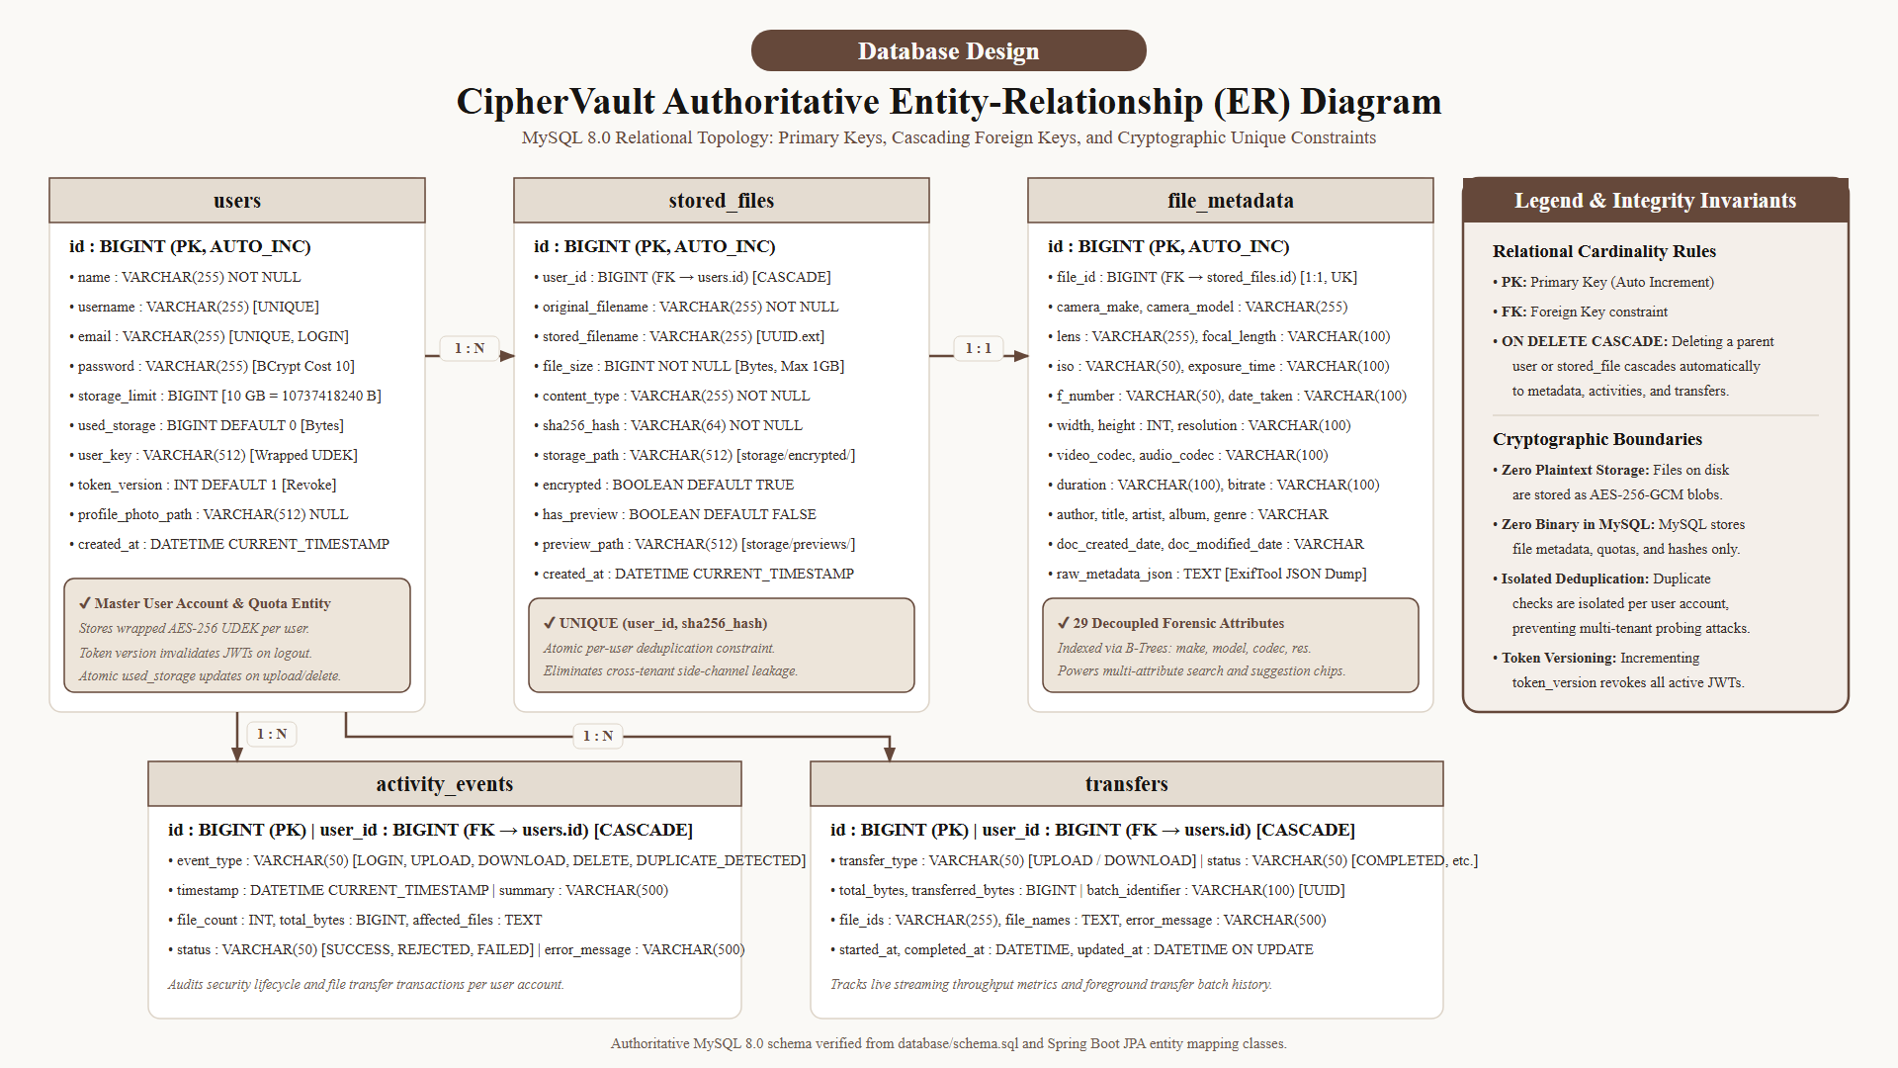
RELATIONAL PERSISTENCE
Database Design: MySQL 8.0 InnoDB Relational Schema
Table Name | Primary Key | Foreign Key / Constraint | Scope
users | id (BIGINT) | UNIQUE(email) | Credentials, wrapped UDEK, 10 GB quota tracking
stored_files | id (BIGINT) | user_id -> users(id) UNIQUE(user_id, sha256) | File metadata, disk UUID path, category flags
file_metadata | id (BIGINT) | file_id -> stored_files(id) | 29 forensic EXIF fields, camera optics, ISO
activity_events | id (BIGINT) | user_id -> users(id) | Audit trail for login, upload, download, delete
transfers | id (BIGINT) | user_id -> users(id) | Foreground transfer batches, byte counts, progress
CipherVault: Private Cloud Storage with AES & SHA-256 | Akhil Krishna V U (TVE25MCA-2013) | Guide: Prof. Deepa S. Slide 11 of 16
Notes:
Slide 11 shows our authoritative MySQL 8.0 schema. The five tables are users, stored_files, file_metadata, activity_events, and transfers. Crucially, stored_files has a composite UNIQUE constraint on user_id and sha256_hash. Cascading foreign keys ensure that deleting a file automatically purges metadata and updates user quota.

Slide 12
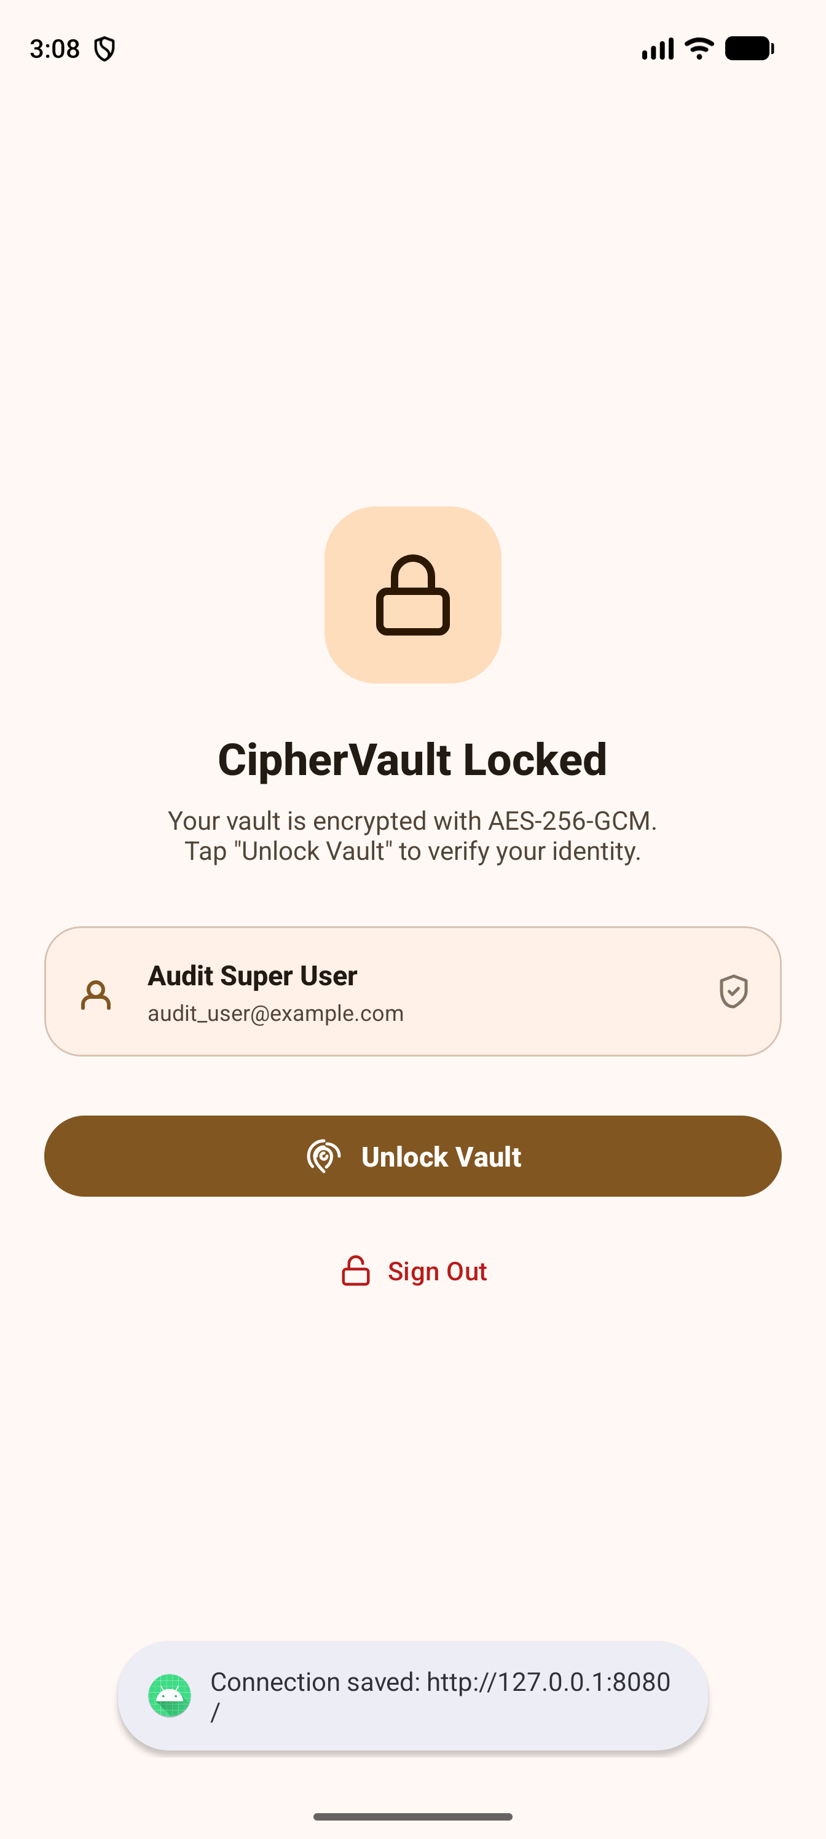
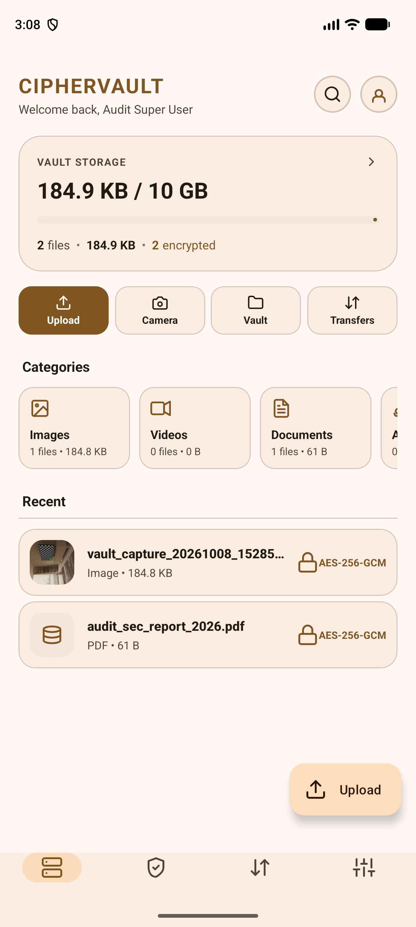
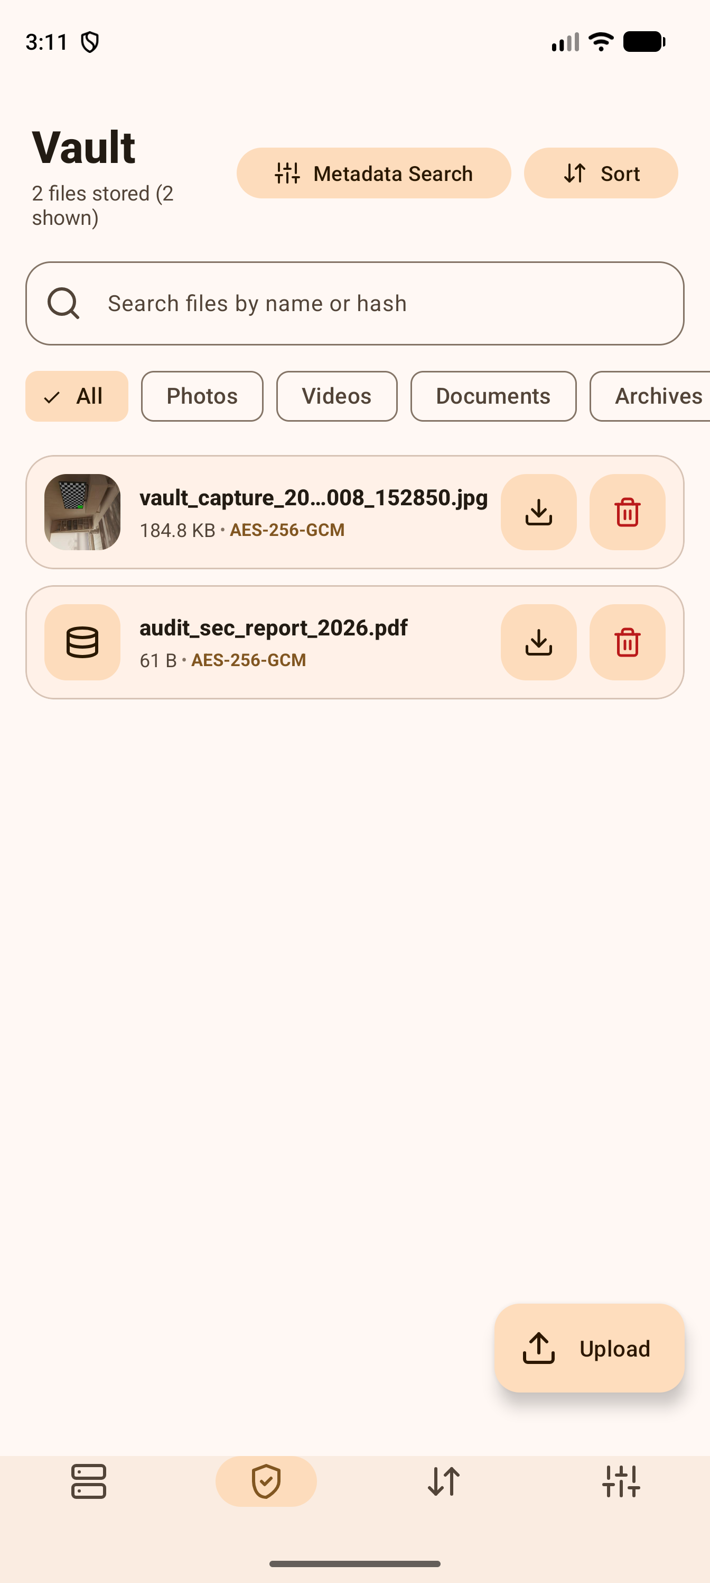
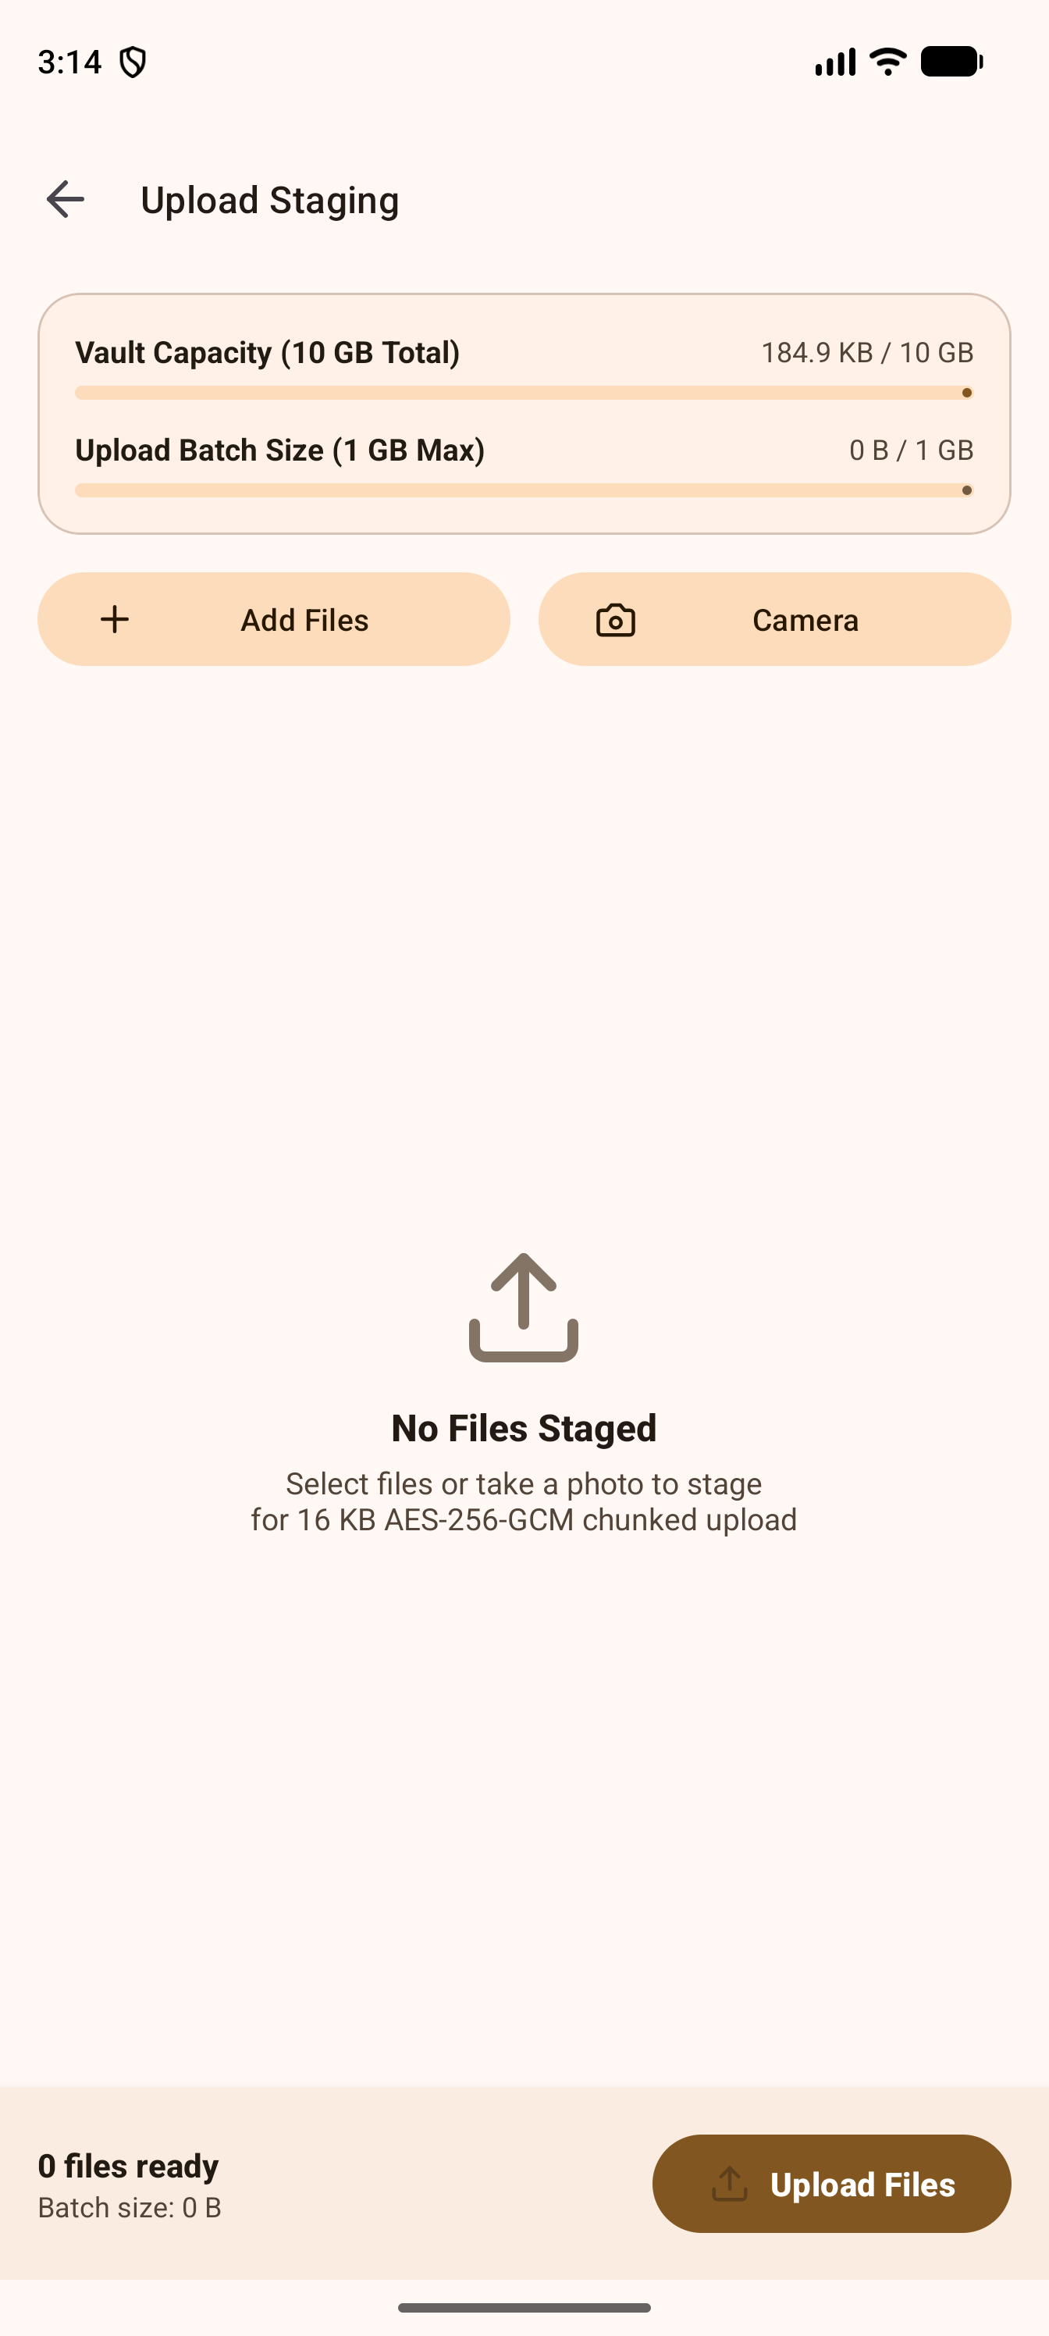
ANDROID CLIENT RUNTIME EVIDENCE
Application Walkthrough: User Interface & Experience
1. Secure Login & Biometrics
Email, password, and biometric AppLock prompt.
2. Storage Dashboard
Live 10 GB quota gauge and category breakdown.
3. Vault File Grid
Responsive 2-column cards with 40dp action buttons.
4. Pre-Upload Staging
Multi-file queue with batch quota check and preview.
CipherVault: Private Cloud Storage with AES & SHA-256 | Akhil Krishna V U (TVE25MCA-2013) | Guide: Prof. Deepa S. Slide 12 of 16
Notes:
On Slide 12, we showcase genuine runtime screenshots from an active Android emulator session. The UI features Google Material Design 3, a 10 GB live storage gauge, a pre-upload staging queue, and vault cards with direct 40dp touch-target Download and Delete buttons.

Slide 13
VERIFICATION & QUALITY ASSURANCE
Testing, Verification & Quality Assurance Results
Test Tier / Category | Scope & Verification Objective | Test Cases Executed | Verified Result & Evidence
Backend Unit Tests | Quota validation, AES streaming, duplicate hashing, JWT token filters | 138 Tests Run | 138 Passed (100% Pass Rate) — mvn test surefire reports
Android Client Tests | SessionManager, token migration, password rules, staging batch limits | 82 Tests Run | 82 Passed (100% Pass Rate) — gradlew testDebugUnitTest
Desktop Control Tests | Subprocess management, socket health polling, log stream threading | 23 Tests Run | 23 Passed (100% Pass Rate) — python -m unittest
End-to-End Regression | Full user lifecycle: signup ➔ upload ➔ deduplication ➔ search ➔ download ➔ logout | Multi-Scenario Suite | Verified on Pixel 10 Pro XL (API 37) emulator
Security & Performance | Tamper detection (AEADBadTagException), 2 GB payload streaming, 28–36 MB RAM | Stress & Integrity Tests | Zero Heap Exhaustion, Immediate Tamper Catch verified
CipherVault: Private Cloud Storage with AES & SHA-256 | Akhil Krishna V U (TVE25MCA-2013) | Guide: Prof. Deepa S. Slide 13 of 16
Notes:
Slide 13 presents our empirical testing results. We executed 243 automated tests across backend, Android client, and desktop utility with a 100% pass rate. We also verified live end-to-end regression on Android 17 and confirmed that streaming I/O maintains a flat heap footprint of 28 to 36 MB even for gigabyte files.

Slide 14
SYSTEM DEMARCATION & ENHANCEMENTS
Project Limitations & Future Roadmap
Current Implementation Limitations
• Single-Node Local Filesystem: Designed for personal and local server hosting; lacks distributed multi-node clustering.
• Single-Request Transfers: Uploads stream in a single HTTP request; network interruption requires restarting the transfer.
• Flat Vault Category Model: Files are organized by tags, MIME categories, and metadata rather than nested directory trees.
• Server-Side Metadata Extraction: ExifTool executes on the server; client-side extraction is planned to achieve full zero-trust.
Future Roadmap Enhancements
✔ Phase 1 — Multi-Factor Authentication: Implement TOTP authenticator app and FIDO2 / WebAuthn hardware security key integration.
✔ Phase 2 — Chunked Resumable Transfers: Adopt the open TUS protocol for pause-and-resume uploads across flaky mobile networks.
✔ Phase 3 — Distributed Storage Backend: Integrate MinIO or Ceph S3 object storage for multi-terabyte cluster scaling.
✔ Phase 4 — Automated Background Sync: Native Android WorkManager scheduled camera backup with biometric authorization.
CipherVault: Private Cloud Storage with AES & SHA-256 | Akhil Krishna V U (TVE25MCA-2013) | Guide: Prof. Deepa S. Slide 14 of 16
Notes:
Slide 14 addresses limitations and future scope. In academic research, transparency is vital. We openly identify current boundaries (single-node filesystem, single-request transfers) and present concrete future phases: TOTP MFA, TUS resumable uploads, and distributed MinIO storage.

Slide 15
ACADEMIC LITERATURE & STANDARDS
References & Technical Bibliography
Peer-Reviewed Academic Literature
[1] C. Yang, J. Ren, & J. Zhang (2017)
'Zero knowledge based client-side deduplication for encrypted files in smart cities,' Pervasive and Mobile Computing, vol. 40, pp. 297–313. DOI: 10.1016/j.pmcj.2017.03.014
[1] J. Liu, N. Asokan, & B. Pinkas (2015)
'Secure Deduplication of Encrypted Data without Additional Independent Servers,' Proceedings of the 22nd ACM Conference on Computer and Communications Security (CCS '15), pp. 874–885. DOI: 10.1145/2810103.2813623
[1] M. Bellare, S. Keelveedhi, & T. Ristenpart (2013)
'DupLESS: Server-Aided Encryption for Deduplicated Storage,' USENIX Security Symposium, pp. 179–194.
Cryptographic Standards & Frameworks
• NIST SP 800-38D (2007): Recommendation for Block Cipher Modes of Operation: Galois/Counter Mode (GCM) for Confidentiality and Authenticity.
• FIPS PUB 180-4 (2015): Secure Hash Standard (SHS) — Cryptographic Specifications for SHA-256.
• IETF RFC 2898 / RFC 8018: PKCS #5: Password-Based Cryptography Specification (PBKDF2).
• IETF RFC 7519 (2015): JSON Web Token (JWT) Stateless Bearer Authentication.
• Spring Boot 3.3.4 & Spring Security 6: Official VMware Enterprise Reference Documentation (2024).
• Android Jetpack & Material 3: Google Android Developer Architecture Guidelines (2024).
CipherVault: Private Cloud Storage with AES & SHA-256 | Akhil Krishna V U (TVE25MCA-2013) | Guide: Prof. Deepa S. Slide 15 of 16
Notes:
Slide 15 provides verified academic literature and international standards. Our architectural choices directly build upon Yang et al. (2017) and Liu et al. (2015) for deduplication security, alongside NIST SP 800-38D for AES-GCM and FIPS 180-4 for SHA-256.

Slide 16
FINAL EVALUATION
Conclusion & Academic Summary
✔ Successfully developed a sovereign private cloud storage solution with native Android and Spring Boot microservices.
✔ Solved the cloud 'metadata paradox' via decoupled forensic ExifTool indexing without weakening AES-256-GCM encryption.
✔ Eliminated cross-user deduplication side channels via atomic per-user SHA-256 uniqueness constraints.
✔ Enforced strict 10 GB user storage quotas and 1 GB single-upload boundaries with flat 28–36 MB RAM streaming I/O.
THANK YOU!
Questions & Answers | Discussion
CipherVault: Private Cloud Storage with AES & SHA-256 | Akhil Krishna V U (TVE25MCA-2013) | Guide: Prof. Deepa S. Slide 16 of 16
Notes:
In conclusion, CipherVault demonstrates that self-hosted private cloud storage can provide zero-knowledge cryptographic privacy without sacrificing the searchability and smoothness expected of modern mobile applications. Thank you, respected examiners. I now invite your questions and comments.

