Slide 1
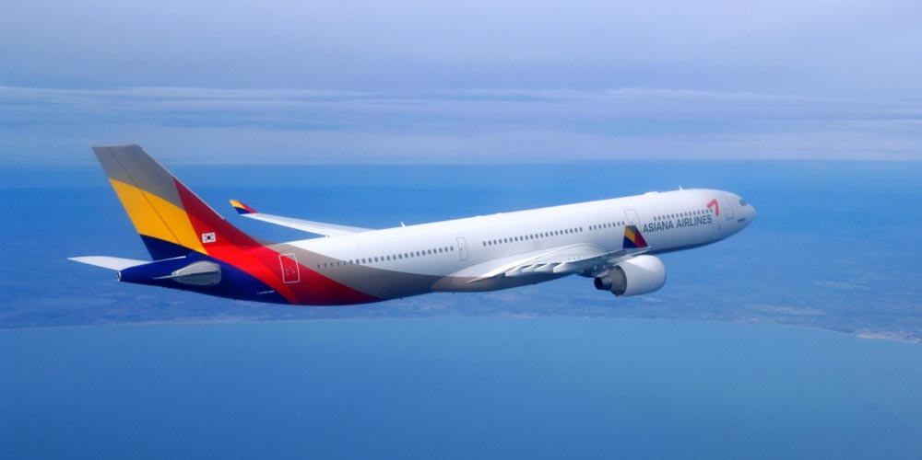
TITLE
Airlytics:
Uncover Airlines from Surface to Insights
Hyejin Kim, Xiaochen Li, Akhil Mathew, Pengfei (Alex) Song
Hyejin Kim, Xiaochen Li, Akhil Mathew, Pengfei (Alex) Song

Slide 2
Agenda
Project Goals
Data
Methodologies
Findings
Recommendations

Slide 3
Four Project Goals
Be familiar with exploratory analytics methodologies and tools
Discover meaningful clusters for airlines
Compare customer reviews among clusters to find out the underlining differences
Provide actionable solutions to underperforming airlines
Notes:
HK

Slide 4

Data
Source
362 airlines → chose 63 airlines based on self-defined criteria
As a result, our data set consists of 21,781 rows of airline data as well and the seat data from a separate file
Airline | Aircraft | Review Comments | Route | Overall Rating | Seat Comfort Rating | Cabin Staff Rating | Food Beverages Rating | Inflight Entertainment Rating | Value Money Rating
Notes:
HK
Remember to mention data cleaning and outlier detection in this slide.

Slide 5
Methodology
Data Pre-processing
> Outlier/Error detection
Airline Segmentation
> Choosing Distance metric
Topic Modelling
> Preprocessing ( Stemming,
Removing numbers, stopwords,
Converting to lowercase)
> Latent Dirichlet Allocation
> Wordcloud (Shiny)
> Descriptive Statistics
> Imputing Missing Values
> Data reduction
> Principal Component Analysis
> Attribute selection
> Hierarchical Clustering
> K-means Clustering
> Dbscan Clustering
> Evaluating Cluster Performance
Notes:
AK

Slide 6
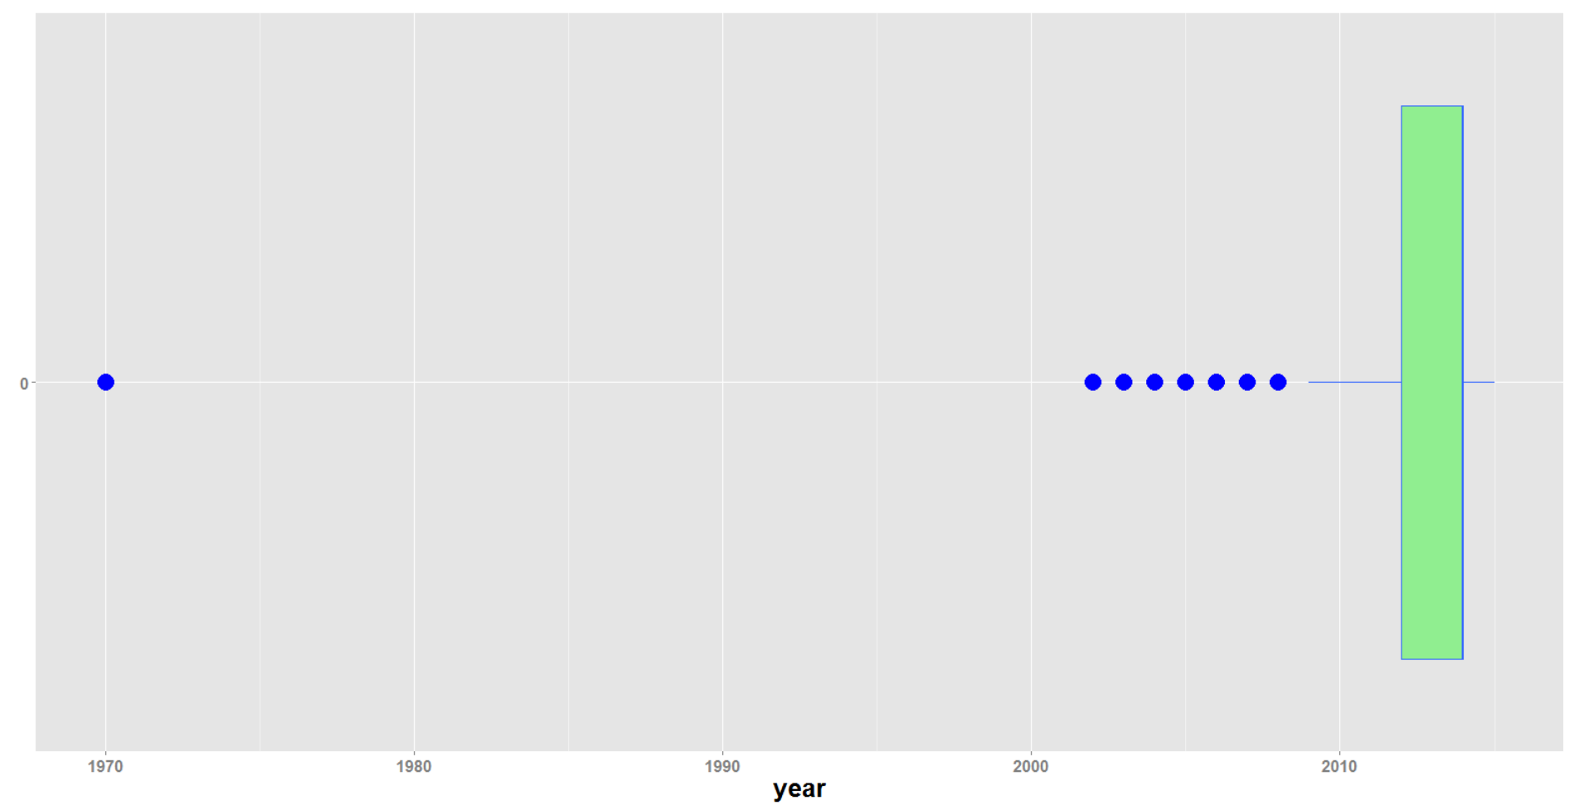
Year – Data Entry Error Detected and Removed
Notes:
HK

Slide 7
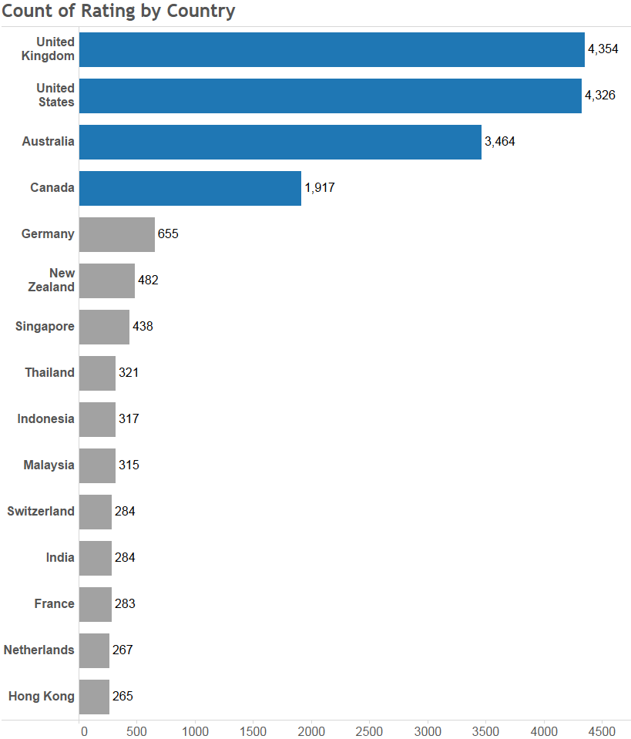
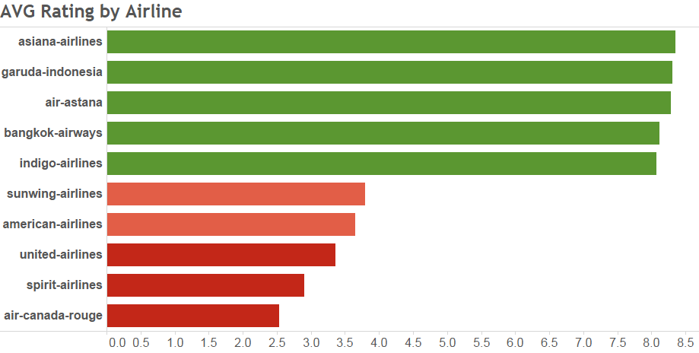
People from U.K. like rating & Asian Airlines Are on the Top
68% of all reviews

Slide 8
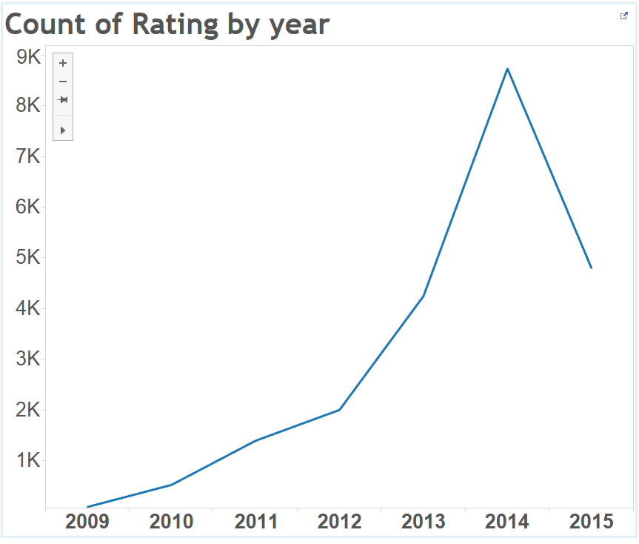
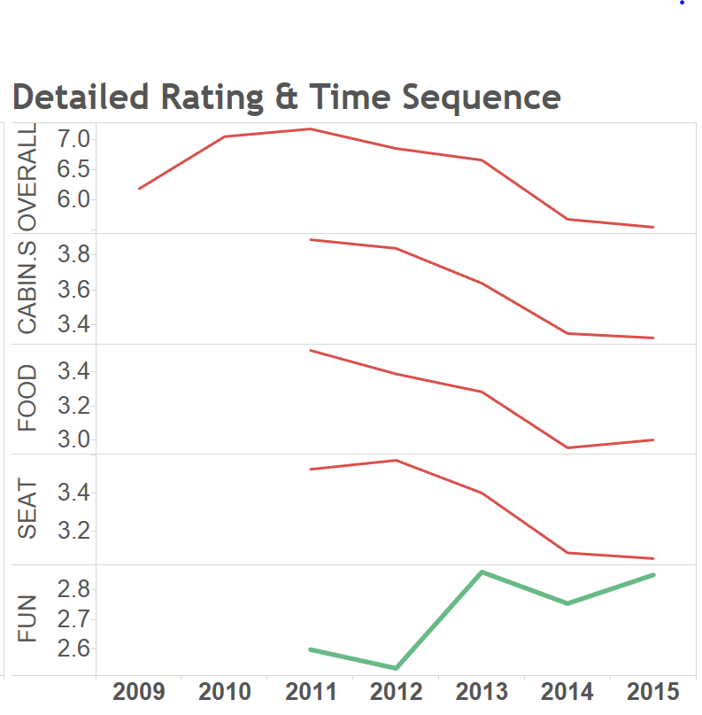
METHODOLOGY
Rating Patterns from 2009 to 2015
The amount of ratings posted got its peak in 2014 and suddenly dropped in 2015
Overall/Food/Cabin/Seat ratings tend to decrease, but entertainment rating goes up
Notes:
HK

Slide 9
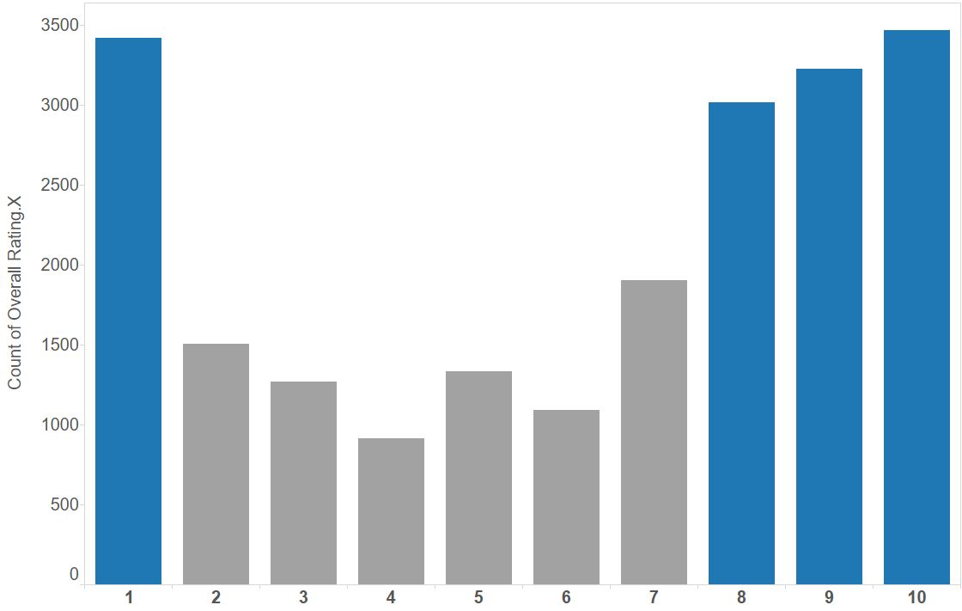
Counts of Ratings Are High on Two Extremes
The number of people that give very low rating and very high ratings are both high
Potentially indicates there are clusters among airlines

Slide 10
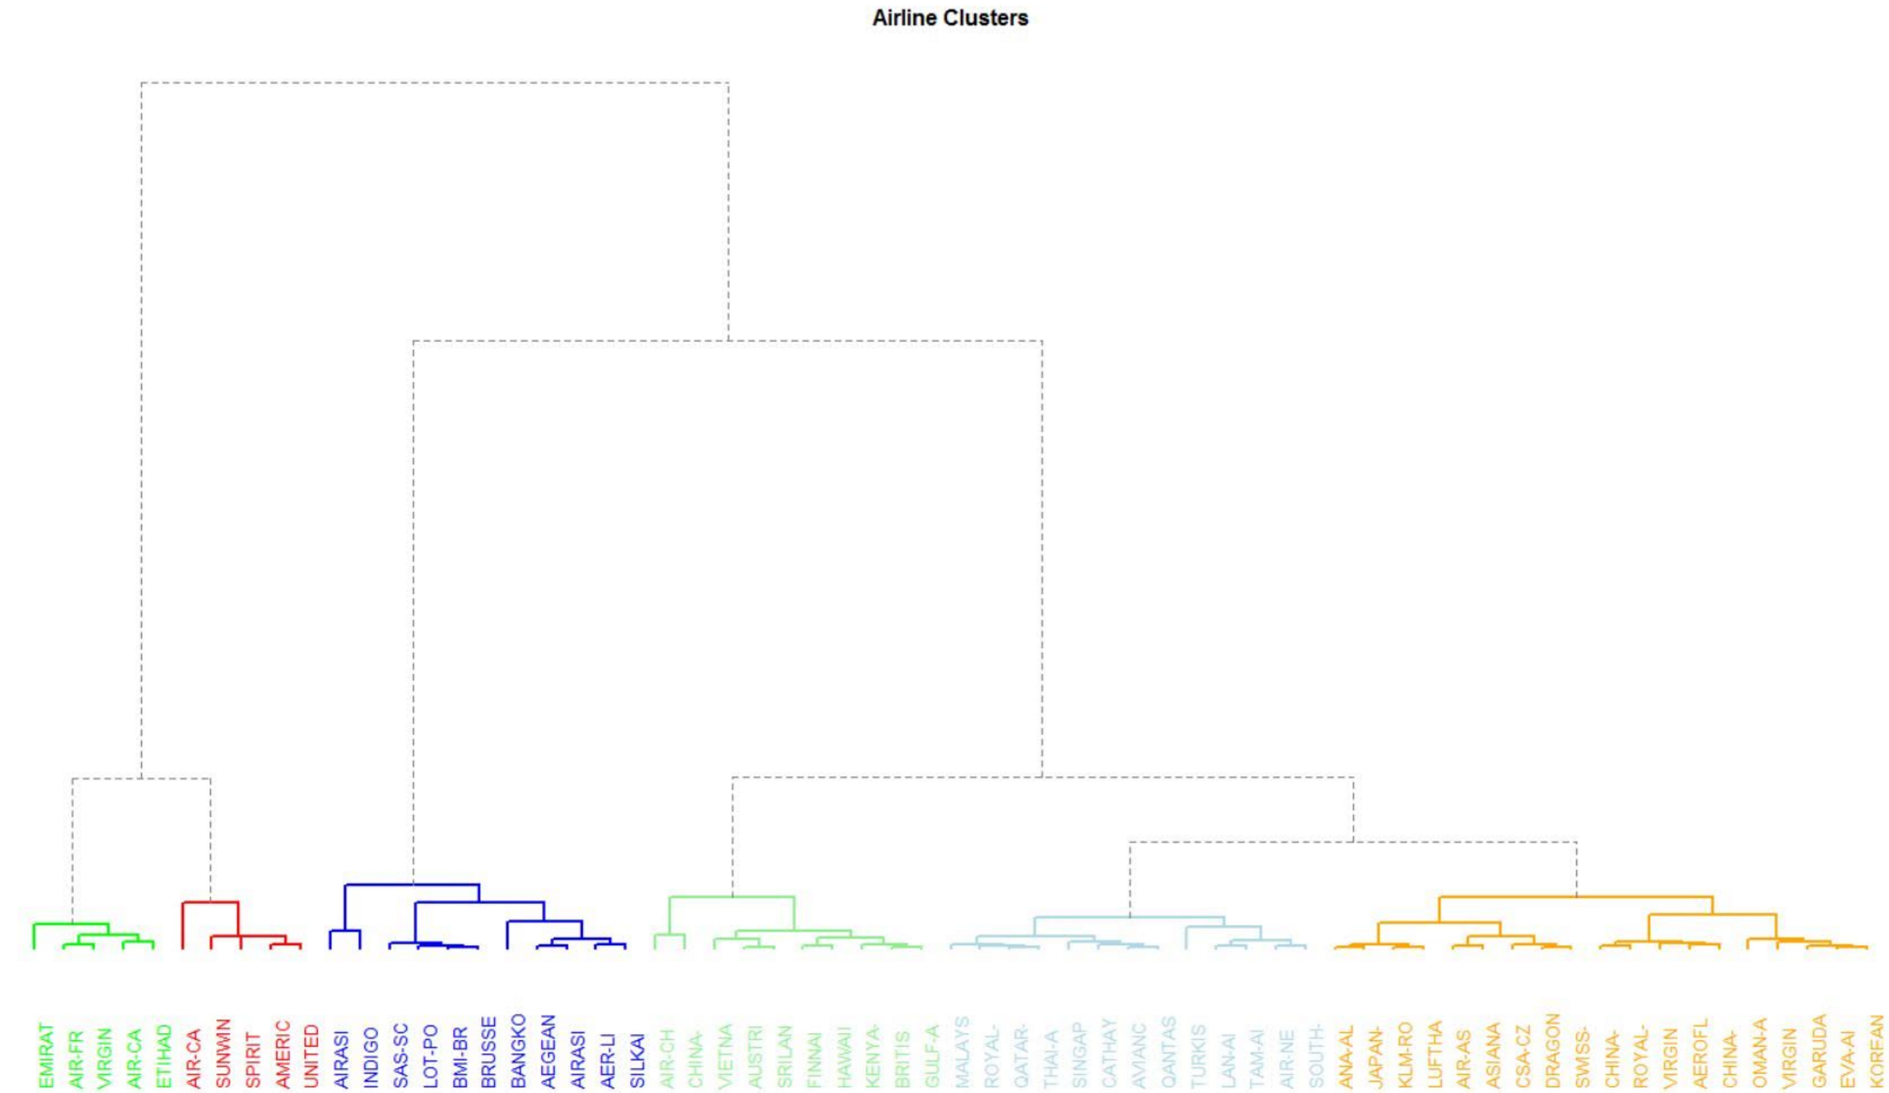
METHODOLOGY
Hierarchical Clustering
Notes:
AK

Slide 11
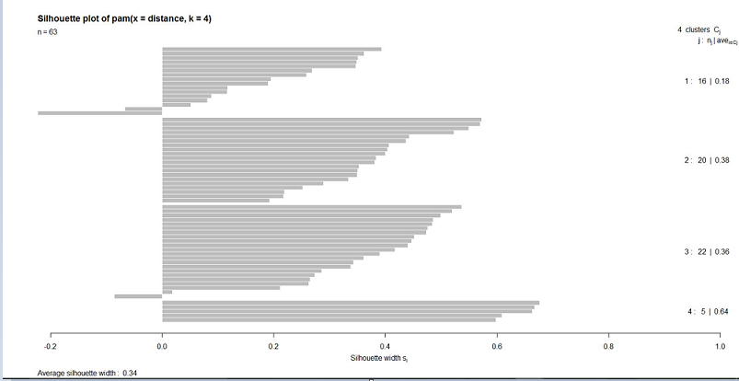
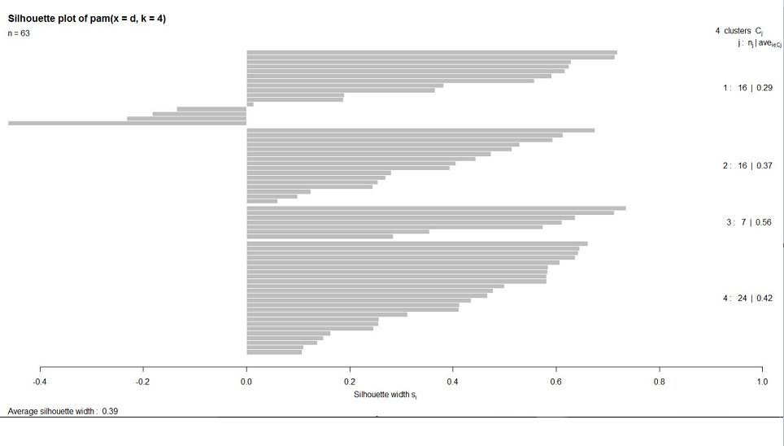
METHODOLOGY
Cosine Similarity Performed Better Than Euclidean
EUCLIDEAN
COSINE
AVERAGE SILHOUETTE WIDTH: 0.34
AVERAGE SILHOUETTE WIDTH: 0.39
Notes:
AK

Slide 12
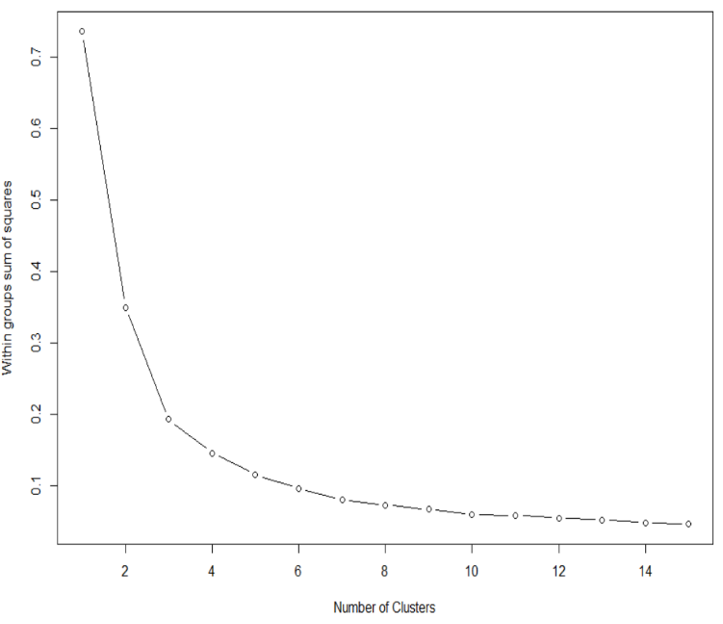
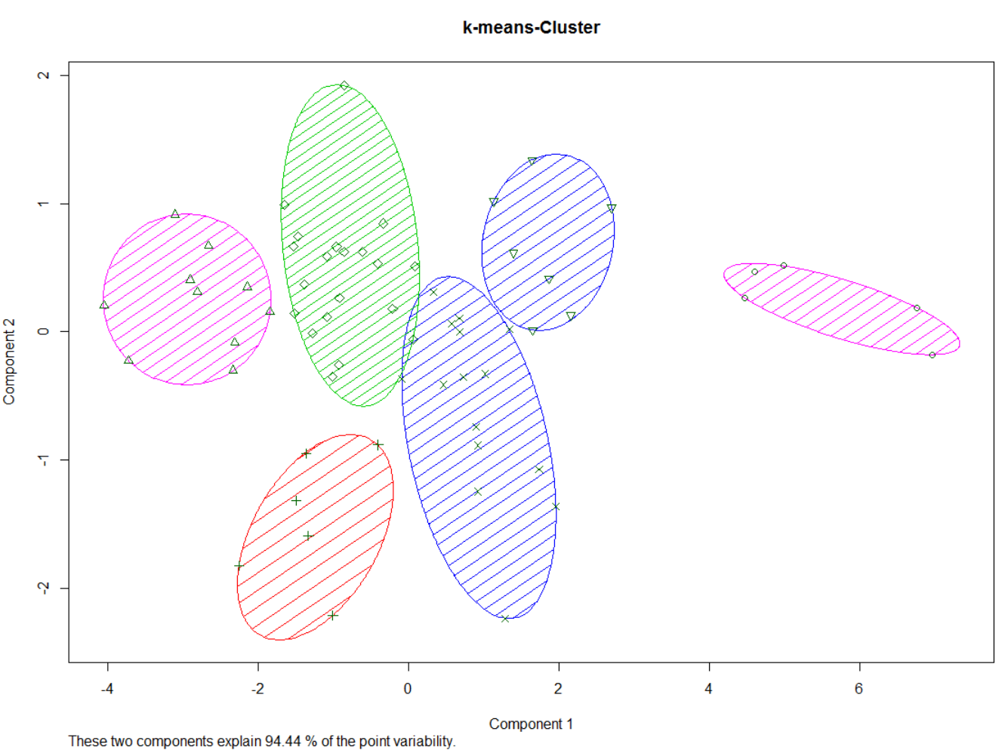
METHODOLOGY
K-means Clustering
SSE Plot
Notes:
AK

Slide 13
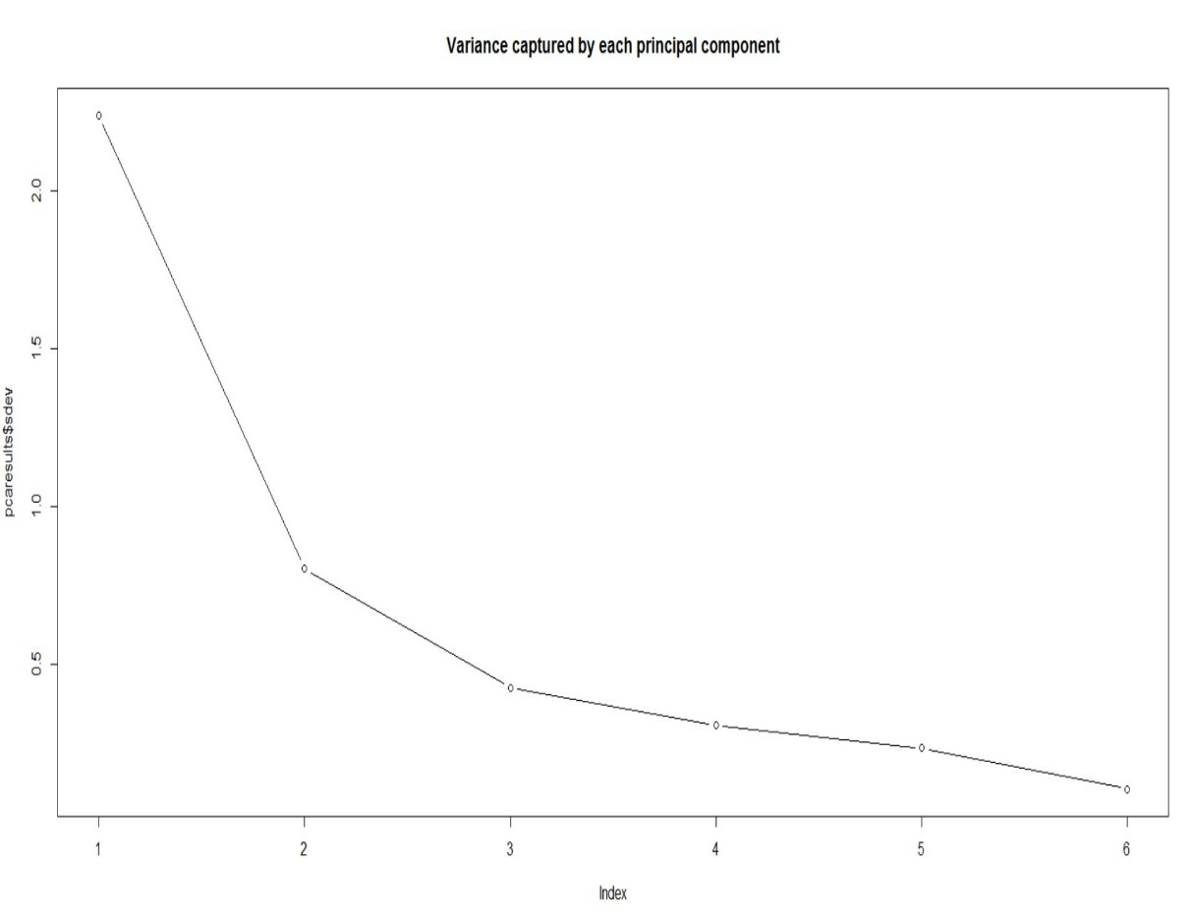
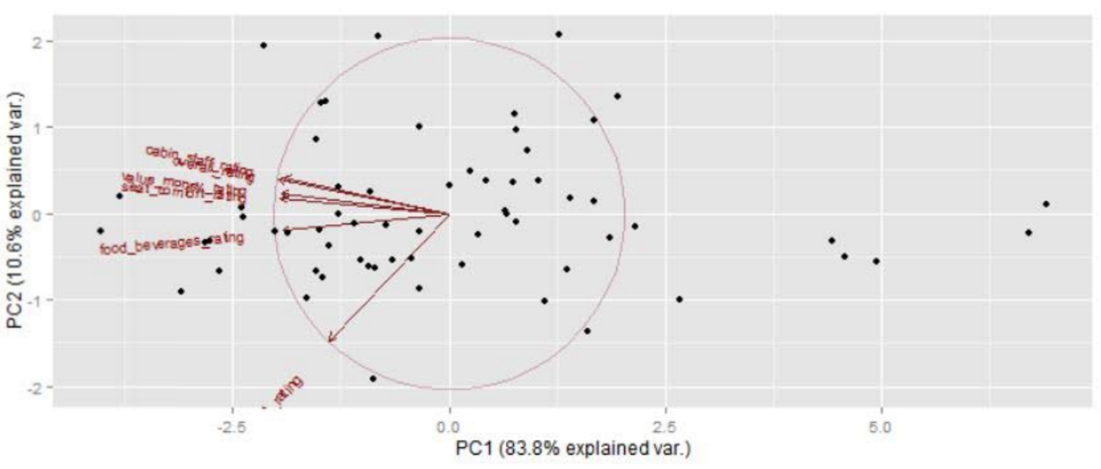
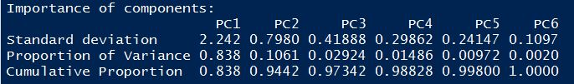
METHODOLOGY
Principal Component Analysis
Notes:
AK

Slide 14
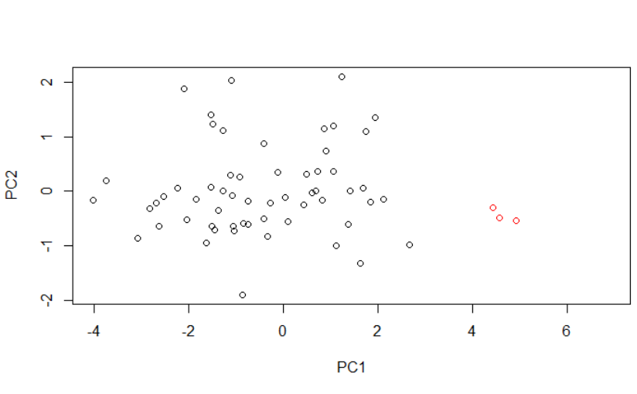
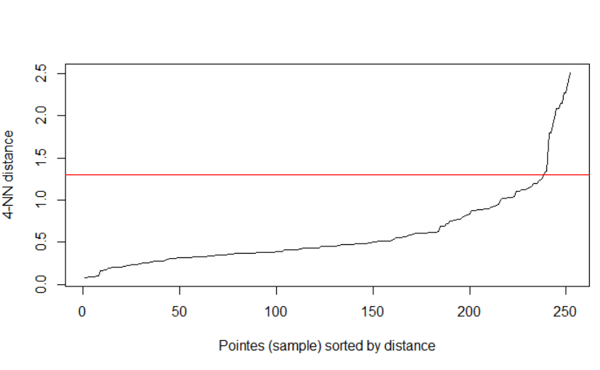
METHODOLOGY
Dbscan Clustering
Notes:
AK

Slide 15
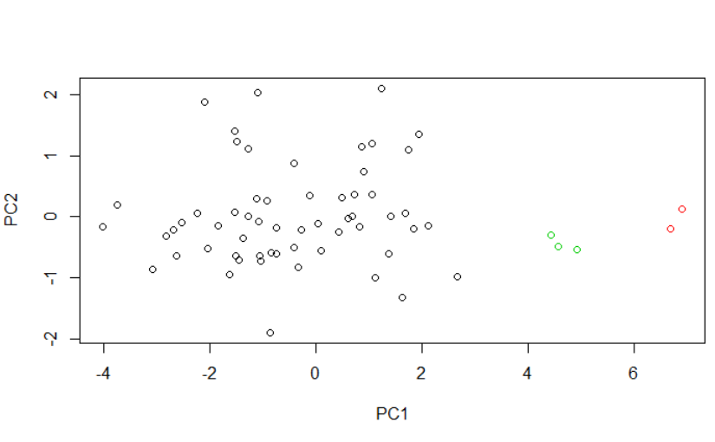
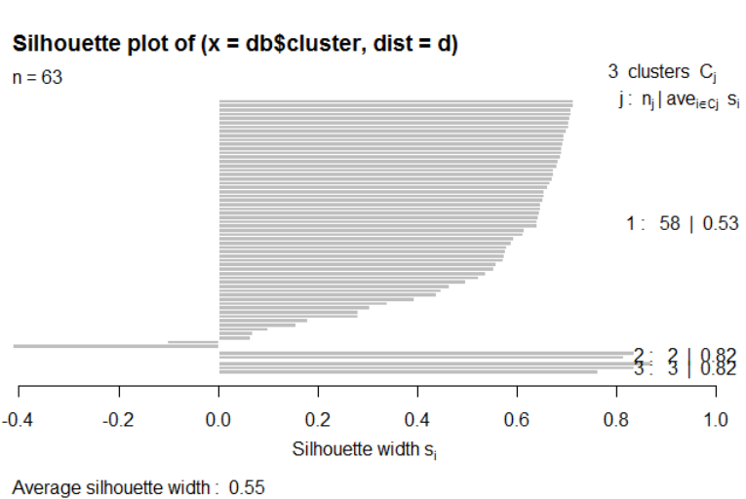
METHODOLOGY
Dbscan Clustering
Notes:
AK

Slide 16
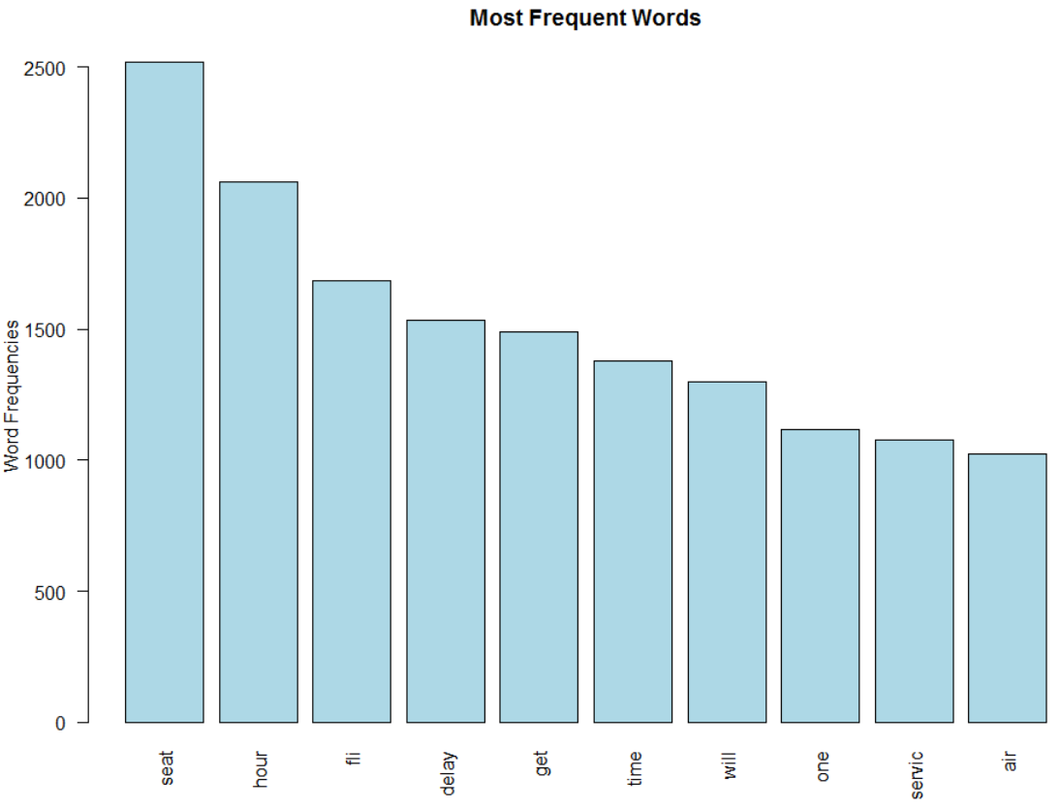
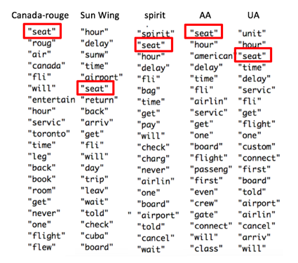
METHODOLOGY
Topic Modelling
Word Cloud for 5 underperforming airlines
– AA/Canada/Spirit/ Sunwing/UA
Notes:
ALEX

Slide 17
Over A Dozen of Negative Words Are Associated with “Seat”
Associated Words | Correlation
abysmal | 0.99
atrocious | 0.99
shame | 0.98
squeeze | 0.98
painfully | 0.97
uncomfortable | 0.97
unfortunate | 0.97
awkward | 0.96
dissatisfaction | 0.96
lack | 0.96
aggravating | 0.95
leg | 0.95
pitiful | 0.95
unhappy | 0.95

Slide 18
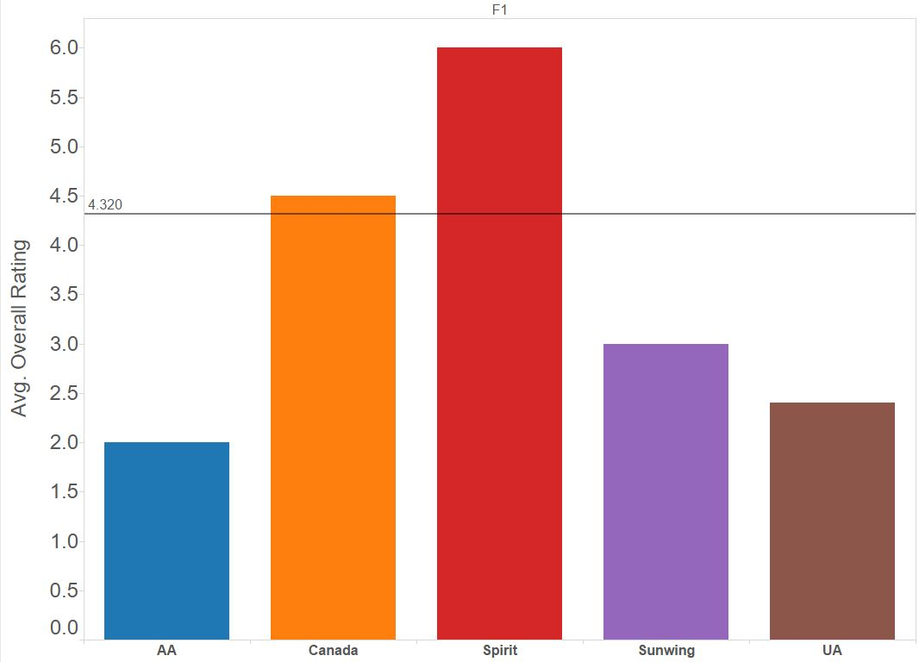
Overall Ratings - Seat
Notes:
Xiaochen

Slide 19
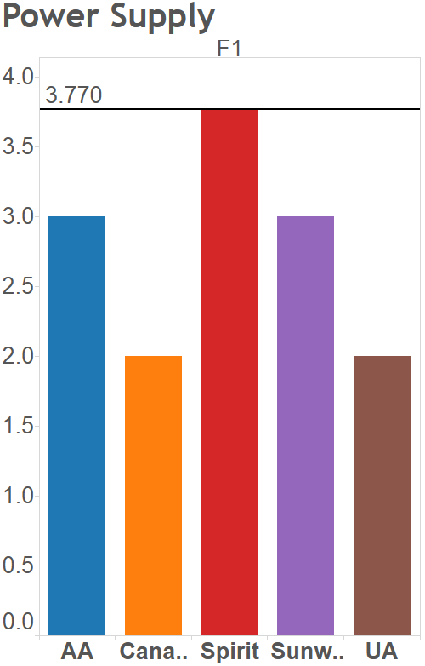
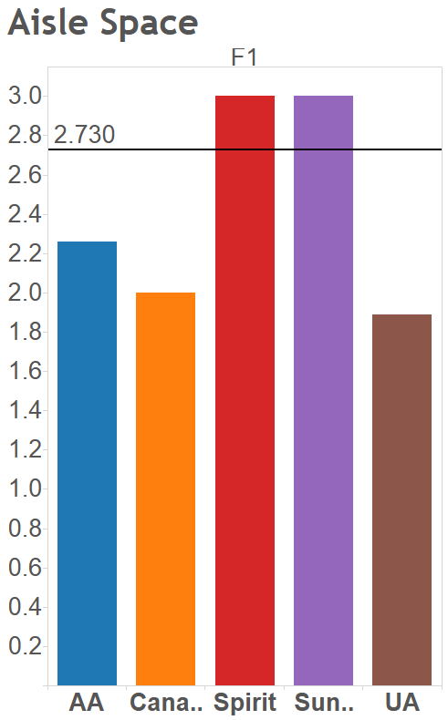
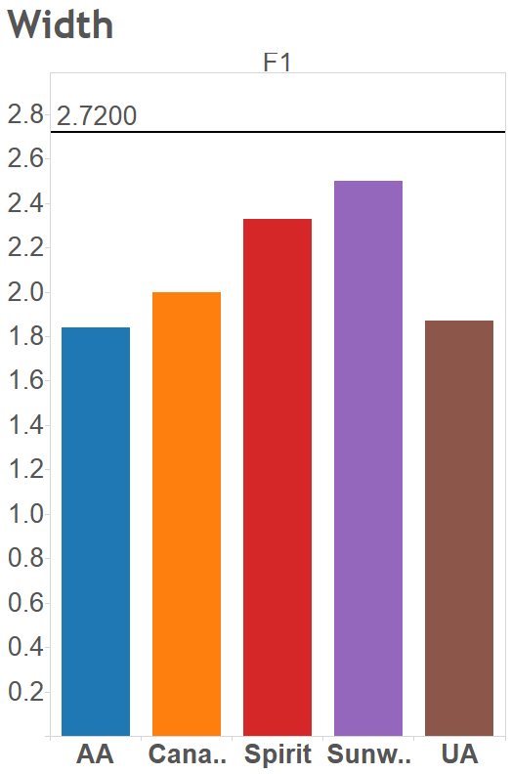
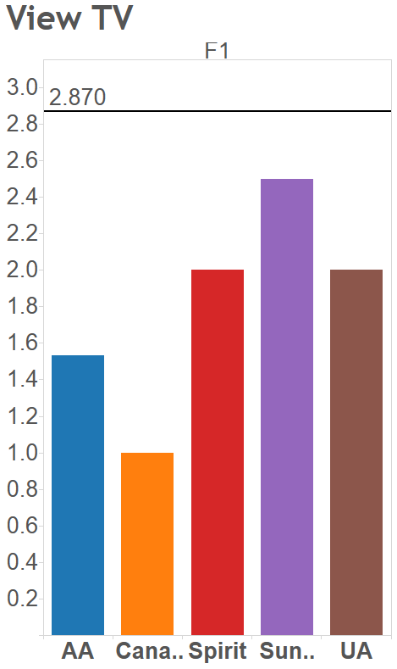
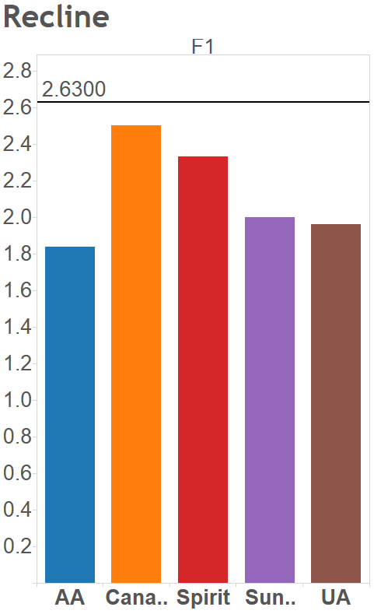
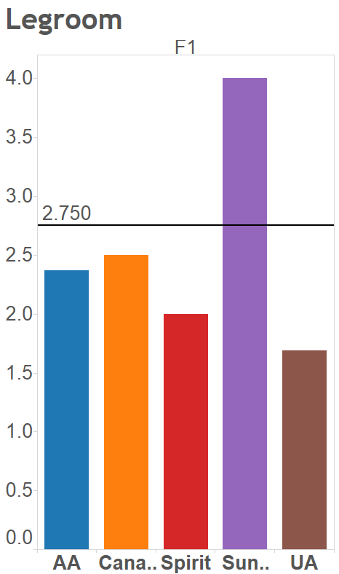
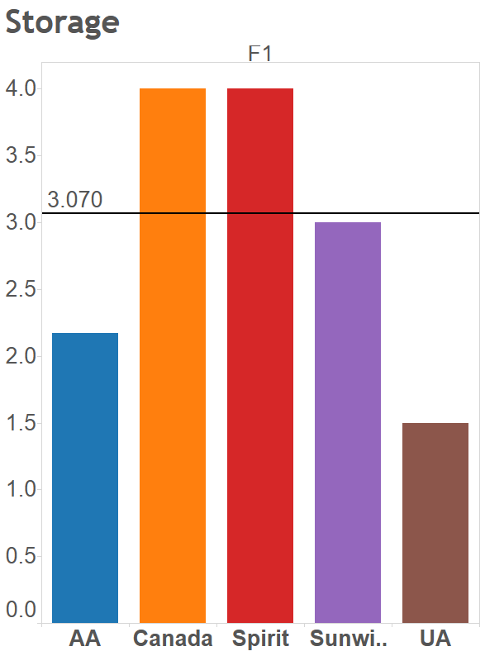
Rating Breakdowns within the Topic of Seat
Notes:
Xiaochen

Slide 20





Recommendations
Airline Name
Areas of Improvement
Route
18 routes
LA - London
San Jose - NY
Tokyo – Chicago
American Airline
Seat services cannot reach industrial average in any aspect and service such as width and recline is the worst among all airlines.
Air
Canada Rouge
9 routes
La – Vancouver
Toronto – Las Vegas
Ottawa – Dublin
Seat services - cannot reach industrial average width, aisle space, viewing TV and power supply – urged to improve problems
40 routes
LA – Houston
Dallas - NY
Denver - Minneapolis
Sprit
Seat problems with leg room, viewing TV and slightly width problem.
Priority should be solving seat problems such as viewing TV, power supply and recline.
2 routes
Holguin to Montreal
Vancouver to Vallarta Mexico
Sunwing
Seat services cannot reach industrial average in any aspect
and service such as width and recline is the worst among all airlines.
37 routes
Chicago – Millan
Miami – London
Minneapolis – San Jose
United Airline
Seat services cannot reach industrial average in any aspect and services such as Storage, Leg Room, Width Aisle and Power Supply are the worst among all airlines.
Notes:
X

Slide 21
Questions?
Notes:
ALL

Slide 22
Thank You

