Slide 1
Estimation
Estimation & confidence intervals

Slide 2
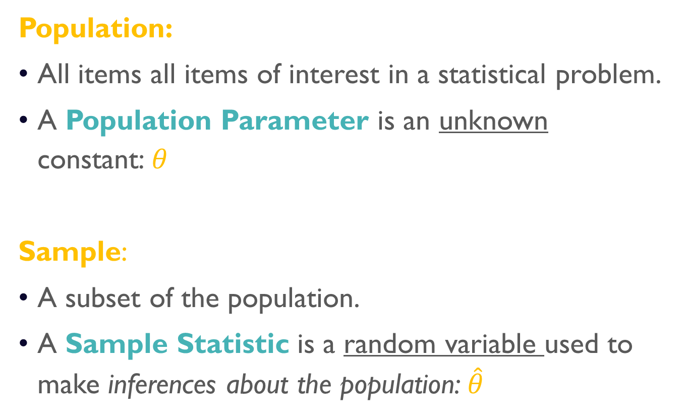
Parameters vs statistics
Population:
All items all items of interest in a statistical problem.
A Population Parameter is an unknown constant:$θ$
Sample:
A subset of the population.
A Sample Statistic is a random variable used to make inferences about the population: $\hat{θ}$

Slide 3
Estimator vs. Estimates
Estimator:
A sample statistic used to estimate a population parameter.
Estimate:
A particular value of the estimator.

Slide 4
Properties of point estimators
Unbiased:
A point estimator is unbiased if its expected value equals the unknown population parameter.
Efficient:
An unbiased point estimator is efficient if its standard error is lower than that of other unbiased estimators.
Consistent:
A point estimator is consistent if approaches the unknown population parameter as the sample size grows larger.

Slide 5
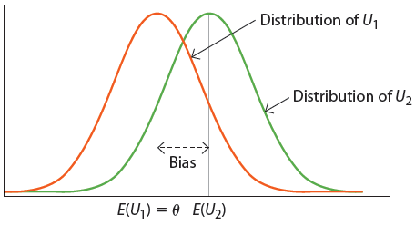

unbiasedness
$U_{1}$ is an unbiased estimator of the true population parameter $θ.$
$U_{2}$ is a biased estimator of the true population parameter $θ.$

Slide 6
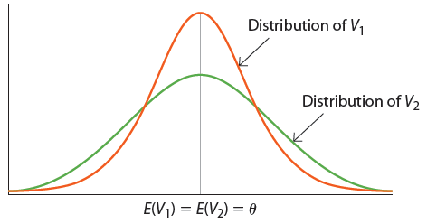

Efficiency
Both $V_{1}$ and $V_{2}$ are unbiased estimators of the true population parameter $θ.$
Yet, $V_{1}$ is more efficient as it is less variable as it has smaller variance (and smaller standard error).

Slide 7
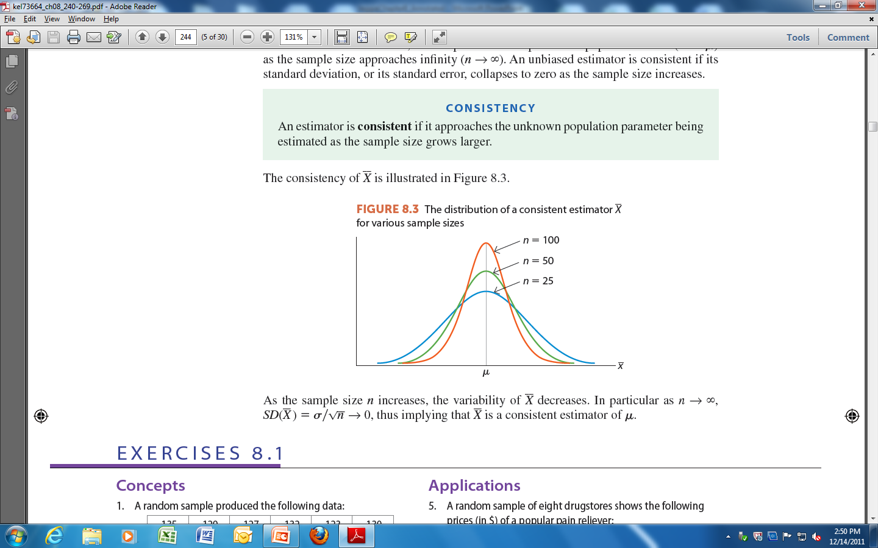

Consistency
As the sample size increases the variability the sample mean $\overline{X}$decreases, until it becomes bunched around the population mean, $μ$.
In particular, as $n→∞, SD\left(\overline{X}\right)=σ/{\sqrt{n}}→0$. Thus, $\overline{X}$is a consistent estimator of $μ$.

Slide 8
Point vs. interval estimation
Point Estimator:
A function of the random sample used to make inferences about a single value of an unknown population parameter.
Interval Estimator:
A function of the random sample used to make inferences about the range of plausible values of an unknown population parameter.

Slide 9

Confidence interval of the mean, $σ$ known
Estimation & confidence intervals

Slide 10
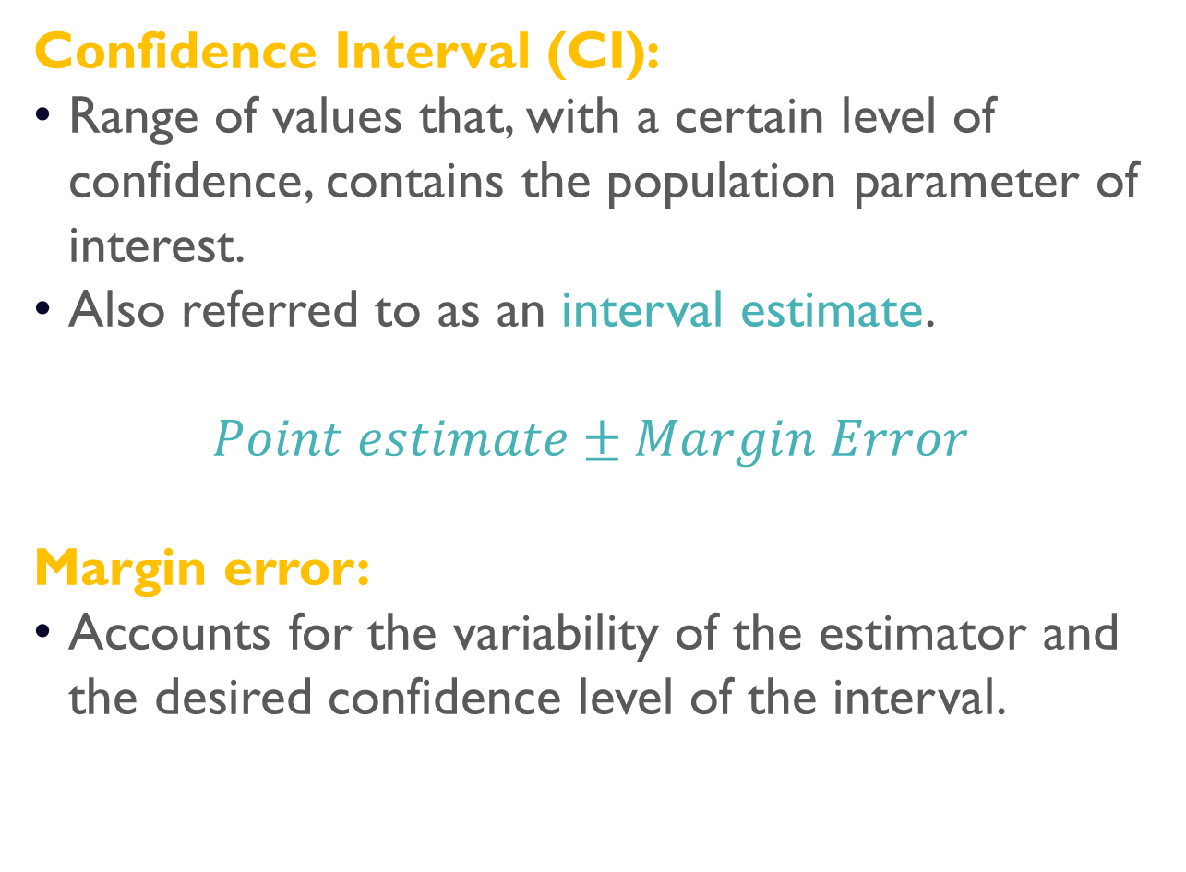
Confidence interval
Confidence Interval (CI):
Range of values that, with a certain level of confidence, contains the population parameter of interest.
Also referred to as an interval estimate.
$$Point estimate±Margin Error$$
Margin error:
Accounts for the variability of the estimator and the desired confidence level of the interval.

Slide 11
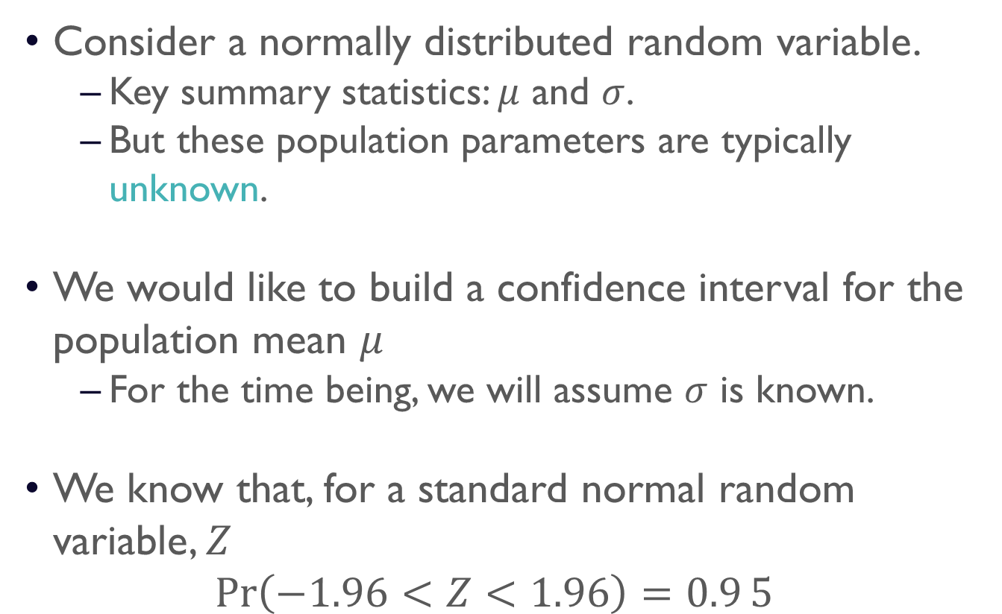
Confidence interval
Consider a normally distributed random variable.
Key summary statistics: $μ$ and $σ$.
But these population parameters are typically unknown.
We would like to build a confidence interval for the population mean $μ$
For the time being, we will assume $σ$ is known.
We know that, for a standard normal random variable, $Z$
$$\operatorname{Pr}\left(−1.96<Z<1.96\right)=0.95$$

Slide 12










Confidence interval
95% of observations are within 2 SDs of the mean.
$$\operatorname{Pr}\left(−1.96<Z<1.96\right)=0.95$$
$$\operatorname{Pr}\left(Z<−1.96\right)=0.025$$
$$\operatorname{Pr}\left(Z>1.96\right)=0.025$$
$$z$$
$$−1.96$$
$$0$$
$$1.96$$
$$\overline{x}$$
$$μ−1.96 σ/\sqrt{n}$$
$$μ$$
$$μ+1.96 σ/\sqrt{n}$$

Slide 13
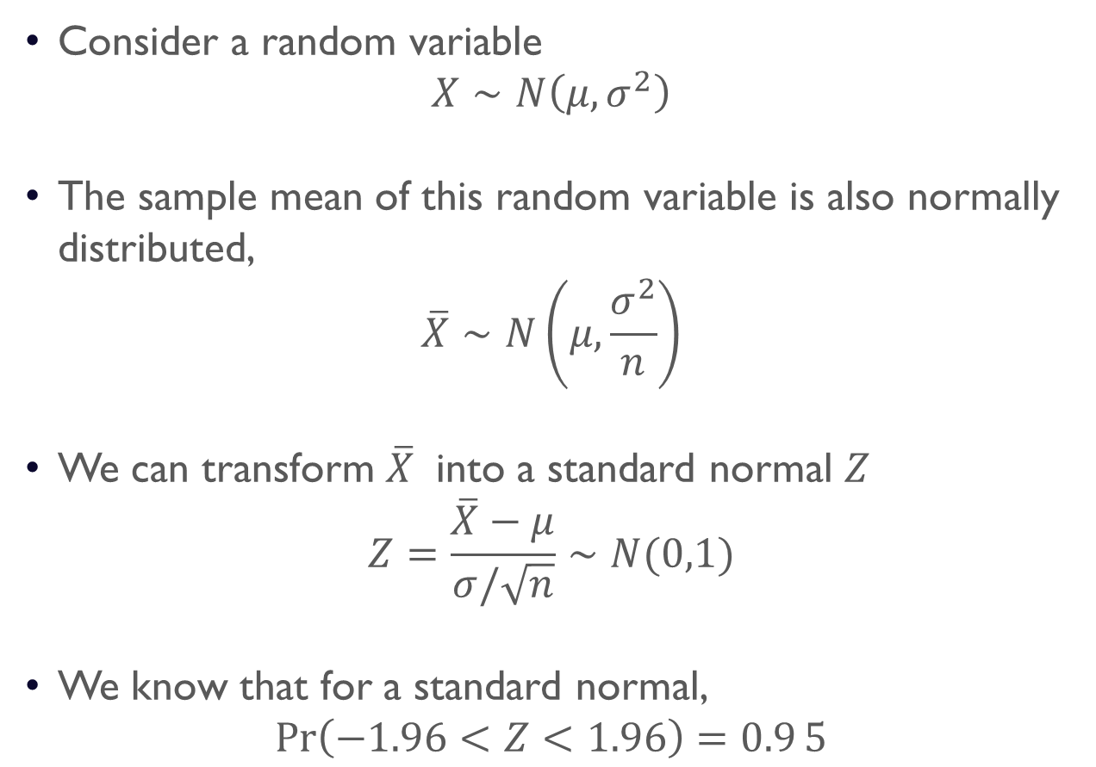
Confidence interval of the mean
Consider a random variable
$$X∼N\left(μ,σ^{2}\right)$$
The sample mean of this random variable is also normally distributed,
$$\overline{X}∼N\left(μ,\frac{σ^{2}}{n}\right)$$
We can transform $\overline{X}$ into a standard normal $Z$
$$Z=\frac{\overline{X}−μ}{σ/\sqrt{n}}∼N(0,1)$$
We know that for a standard normal,
$$\operatorname{Pr}\left(−1.96<Z<1.96\right)=0.95$$

Slide 14
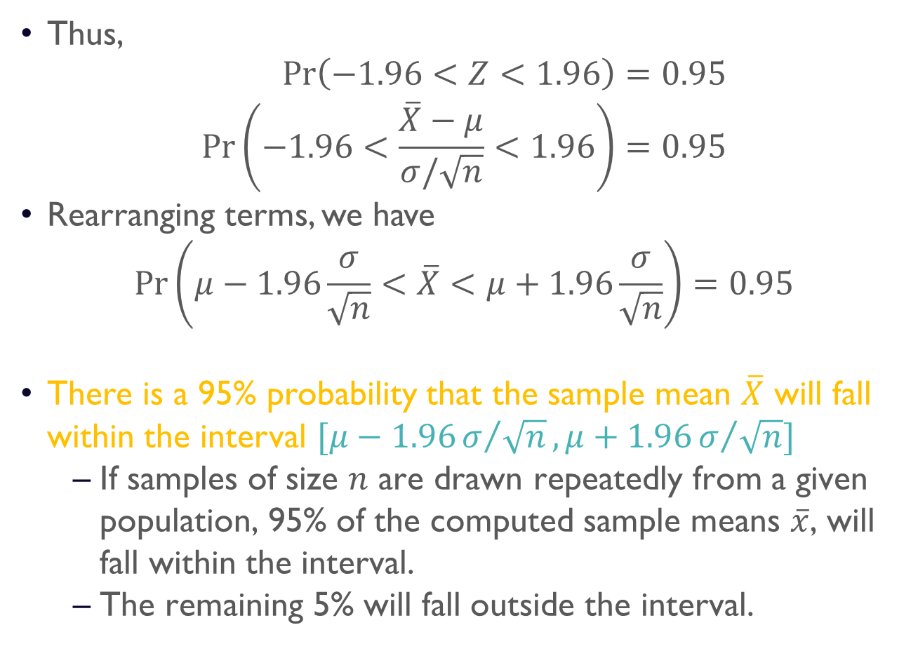
Confidence interval of the mean
Thus,
$$\begin{aligned}\operatorname{Pr}\left(−1.96<Z<1.96\right)&=0.95 \\ \operatorname{Pr}\left(−1.96<\frac{\overline{X}−μ}{σ/\sqrt{n}}<1.96\right)&=0.95\end{aligned}$$
Rearranging terms, we have
$$\operatorname{Pr}\left(μ−1.96\frac{σ}{\sqrt{n}}<\overline{X}<μ+1.96\frac{σ}{\sqrt{n}}\right)=0.95$$
There is a 95% probability that the sample mean $\overline{X}$ will fall within the interval $[μ−1.96σ/{\sqrt{n}},μ+1.96σ/{\sqrt{n}}]$
If samples of size $n$ are drawn repeatedly from a given population, 95% of the computed sample means $\overline{x}$, will fall within the interval.
The remaining 5% will fall outside the interval.

Slide 15
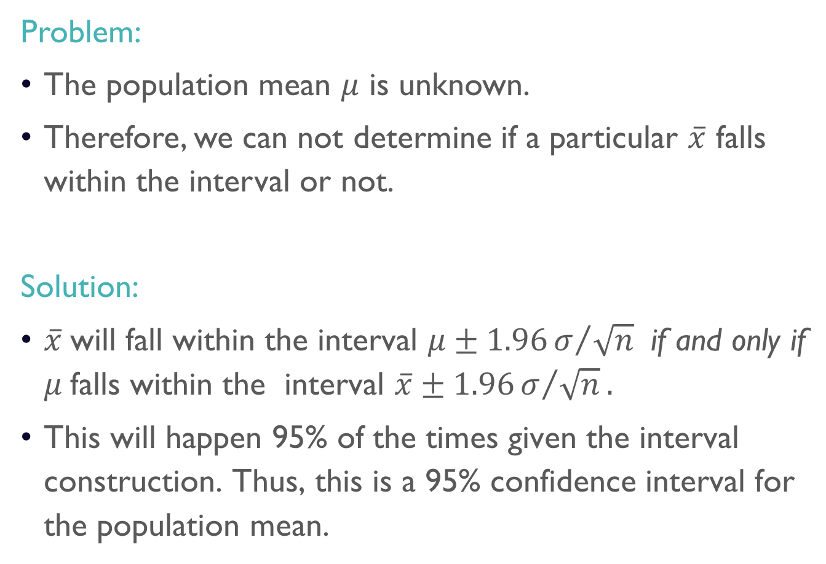
Confidence interval of the mean
Problem:
The population mean $μ$ is unknown.
Therefore, we can not determine if a particular $\overline{x}$ falls within the interval or not.
Solution:
$\overline{x}$will fall within the interval $μ±1.96σ/{\sqrt{n}}$ if and only if $μ$falls within the interval $\overline{x}±1.96σ/{\sqrt{n}}.$
This will happen 95% of the times given the interval construction. Thus, this is a 95% confidence interval for the population mean.

Slide 16
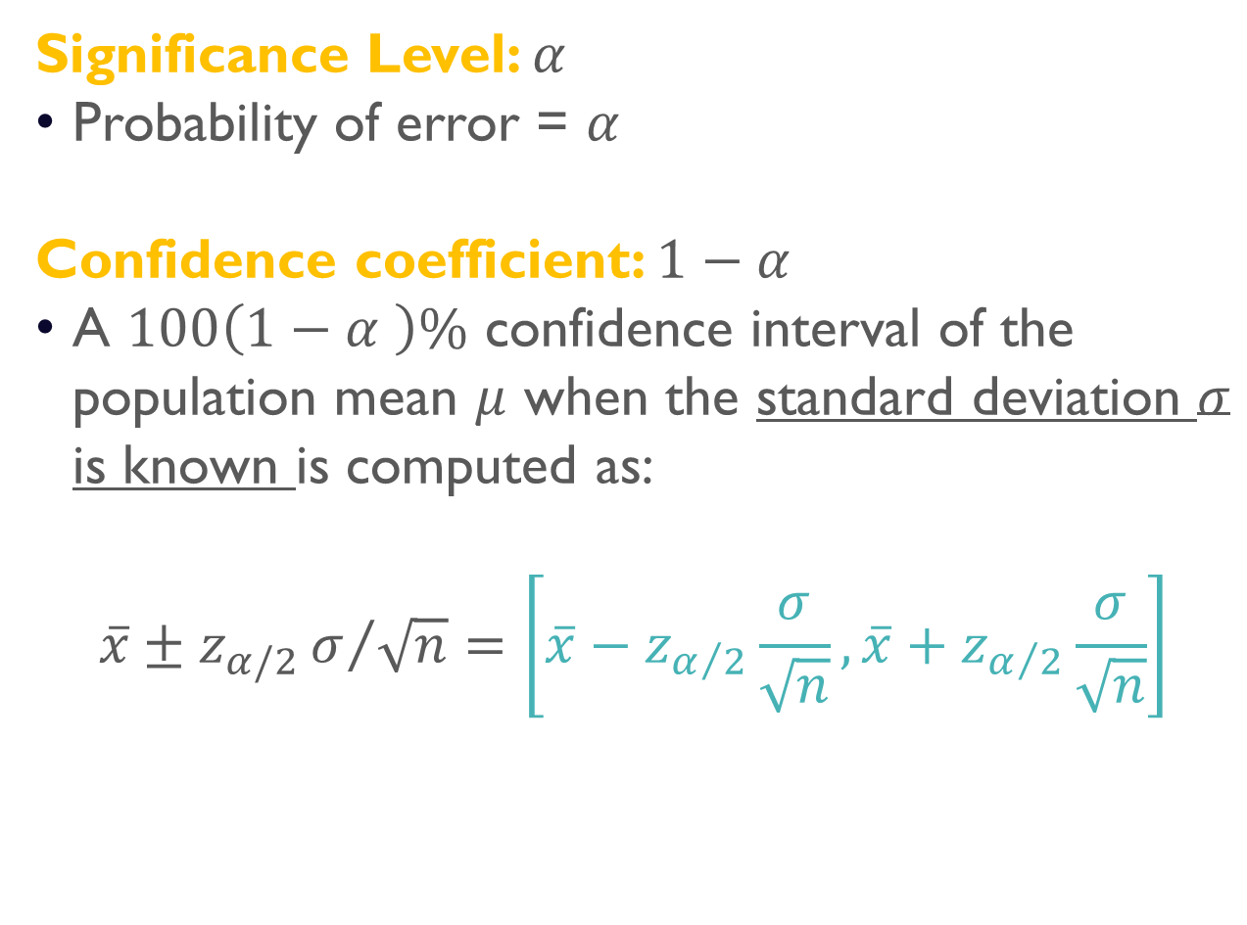
Confidence coefficient
Significance Level: $α$
Probability of error = $α$
Confidence coefficient: $1−α$
A $100\left(1−α \right)\%$ confidence interval of the population mean $μ$ when the standard deviation $σ$ is known is computed as:
$$\overline{x}±z_{α/2}σ/{\sqrt{n}}=\left[\overline{x}−z_{α/2}\frac{σ}{\sqrt{n}}, \overline{x}+z_{α/2}\frac{σ}{\sqrt{n}}\right]$$

Slide 17








Confidence coefficient
$z_{α/2}$ is the value associated with a probability$α/2$ in the upper tail, and $α/2$ in the lower tail.
$$\operatorname{Pr}\left({−z}_{α/2}<Z<z_{α/2}\right)$$
$$α/2$$
$$α/2$$
$$z$$
$${−z}_{α/2}$$
$$0$$
$$z_{α/2}$$
$$\overline{x}$$
$$μ−z_{α/2}σ/\sqrt{n}$$
$$μ$$
$$μ+z_{α/2}σ/\sqrt{n}$$

Slide 18
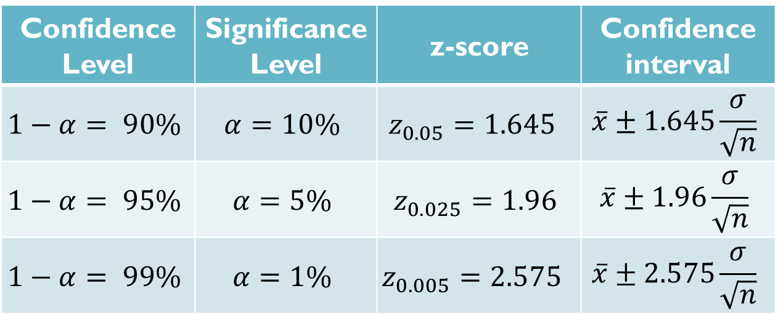
Confidence coefficient
Confidence Level | Significance Level | z-score | Confidence interval
$$1−α= 90\%$$ | $$α=10\%$$ | $$z_{0.05}=1.645$$ | $$\overline{x}±1.645\frac{σ}{\sqrt{n}}$$
$$1−α= 95\%$$ | $$α=5\%$$ | $$z_{0.025}=1.96$$ | $$\overline{x}±1.96\frac{σ}{\sqrt{n}}$$
$$1−α= 99\%$$ | $$α=1\%$$ | $$z_{0.005}=2.575$$ | $$\overline{x}±2.575\frac{σ}{\sqrt{n}}$$

Slide 19
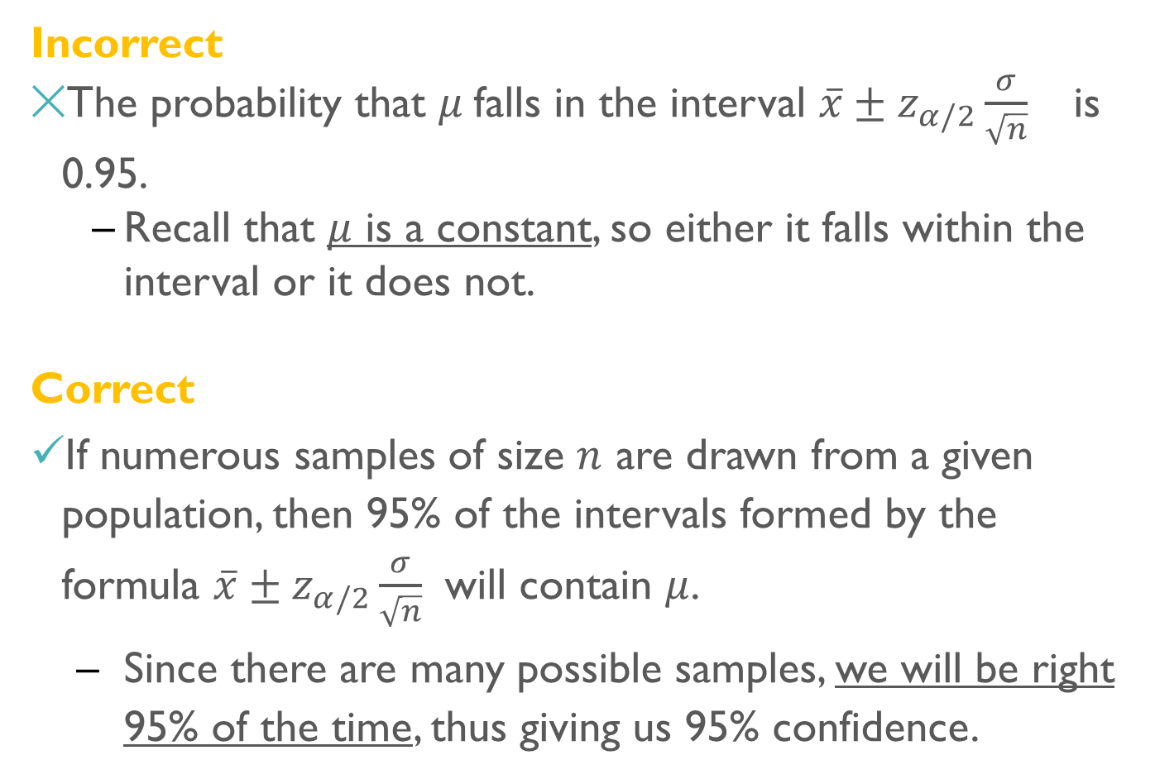
CI Interpretation
Incorrect
The probability that $μ$falls in the interval $\overline{x}±z_{α/2}\frac{σ}{\sqrt{n}}$ is 0.95.
Recall that $μ$ is a constant, so either it falls within the interval or it does not.
Correct
If numerous samples of size $n$ are drawn from a given population, then 95% of the intervals formed by the formula $\overline{x}±z_{α/2}\frac{σ}{\sqrt{n}}$ will contain $μ$.
Since there are many possible samples, we will be right 95% of the time, thus giving us 95% confidence.

Slide 20
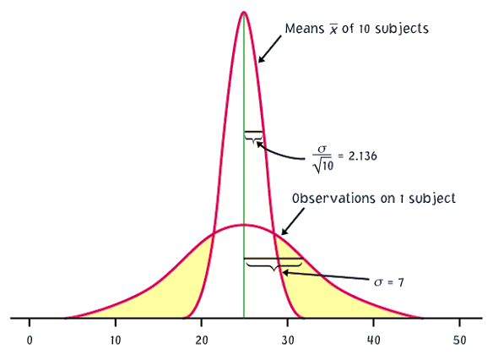
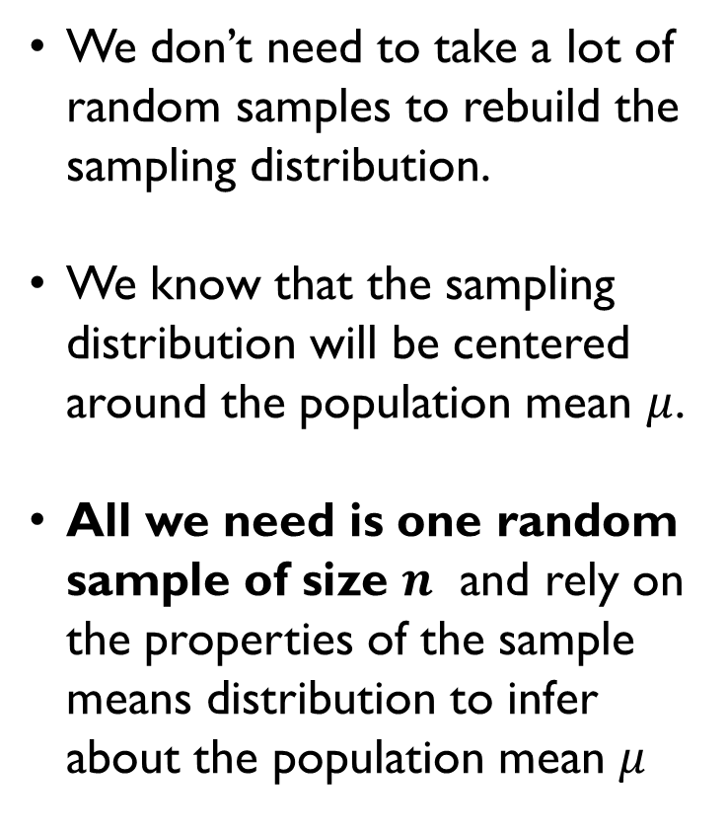
Sampling distribution
We don’t need to take a lot of random samples to rebuild the sampling distribution.
We know that the sampling distribution will be centered around the population mean $μ$.
All we need is one random sample of size $n$ and rely on the properties of the sample means distribution to infer about the population mean $μ$
n
n
μ

Slide 21
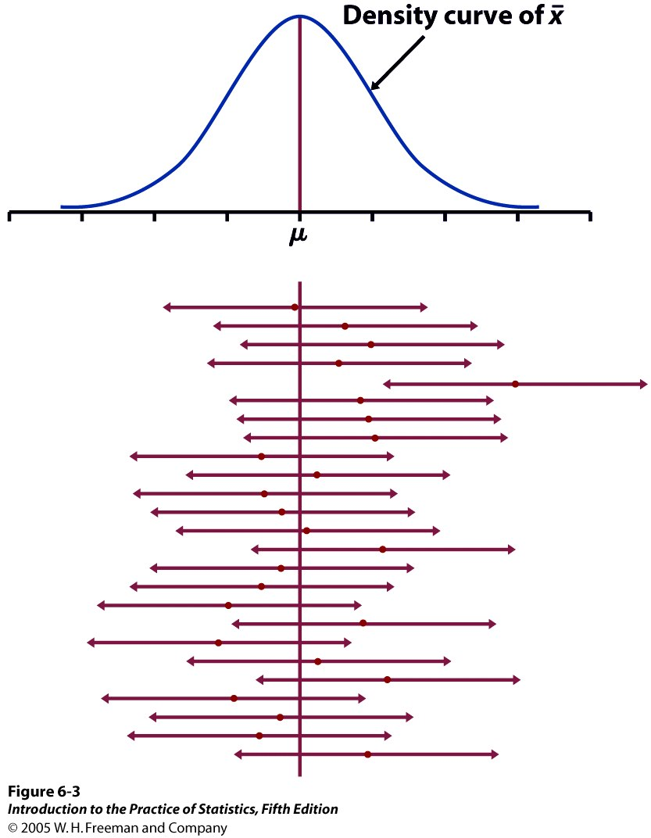
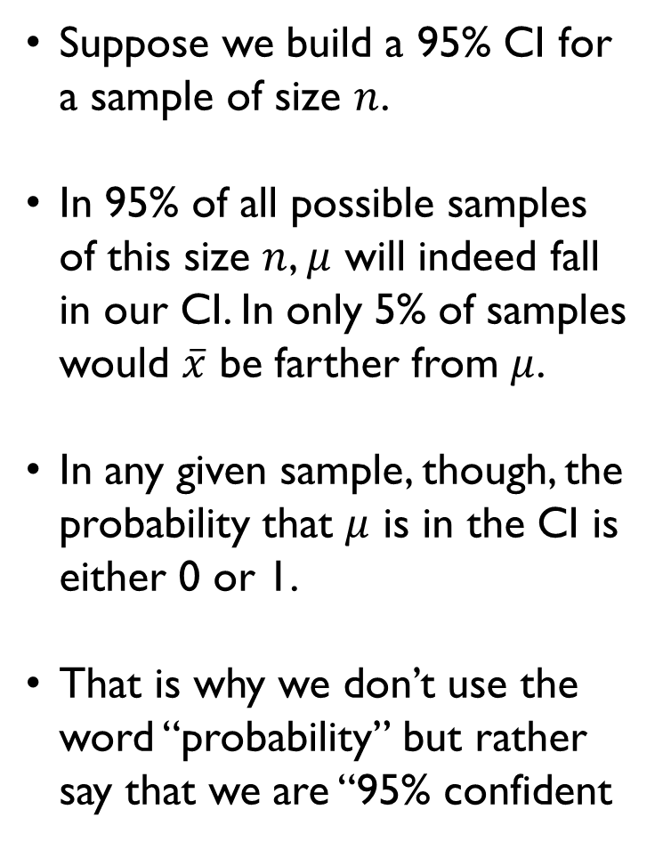
Sampling distribution & CI
Suppose we build a 95% CI for a sample of size $n$.
In 95% of all possible samples of this size $n$, $μ$ will indeed fall in our CI. In only 5% of samples would $\overline{x}$ be farther from $μ$.
In any given sample, though, the probability that $μ$ is in the CI is either 0 or 1.
That is why we don’t use the word “probability” but rather say that we are “95% confident
Sampling Distribution of the Sample Mean

Slide 22
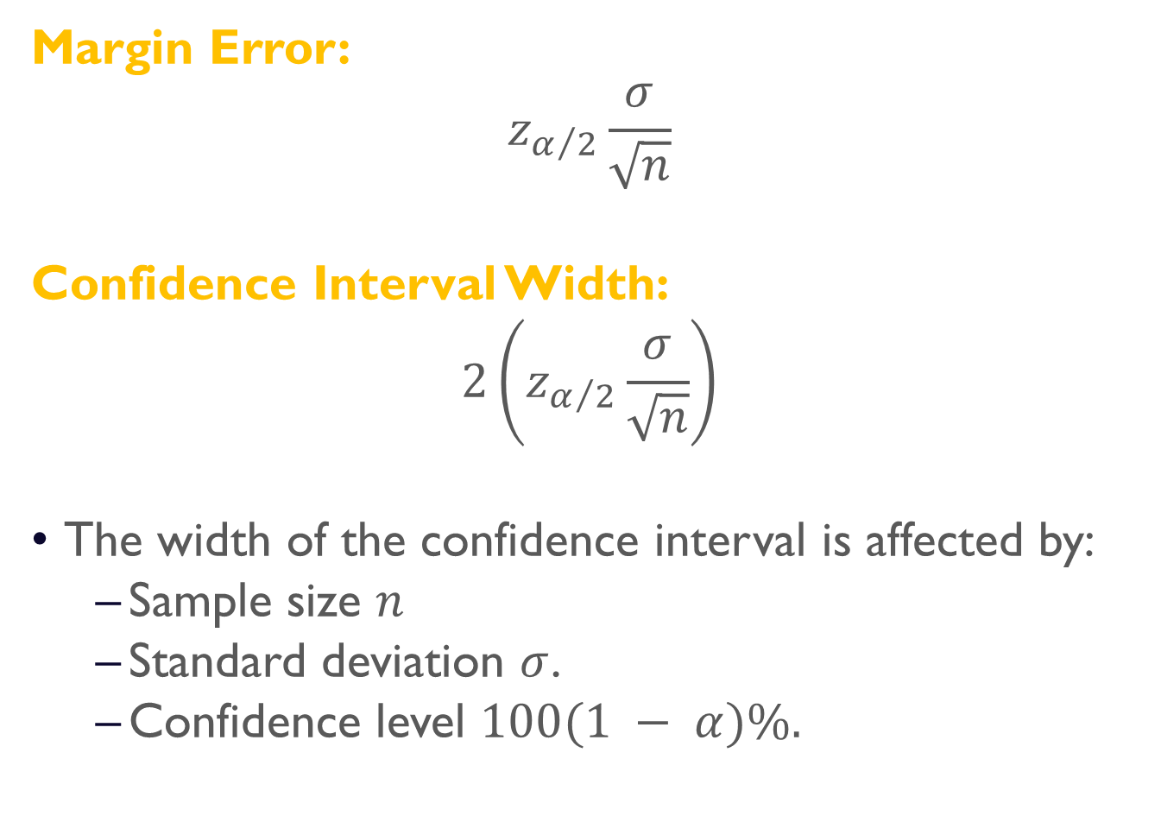
Width of Confidence intervals
Margin Error:
$$z_{α/2}\frac{σ}{\sqrt{n}}$$
Confidence Interval Width:
$$2\left(z_{α/2}\frac{σ}{\sqrt{n}}\right)$$
The width of the confidence interval is affected by:
Sample size $n$
Standard deviation $σ$.
Confidence level $100(1 − α)\%.$

Slide 23
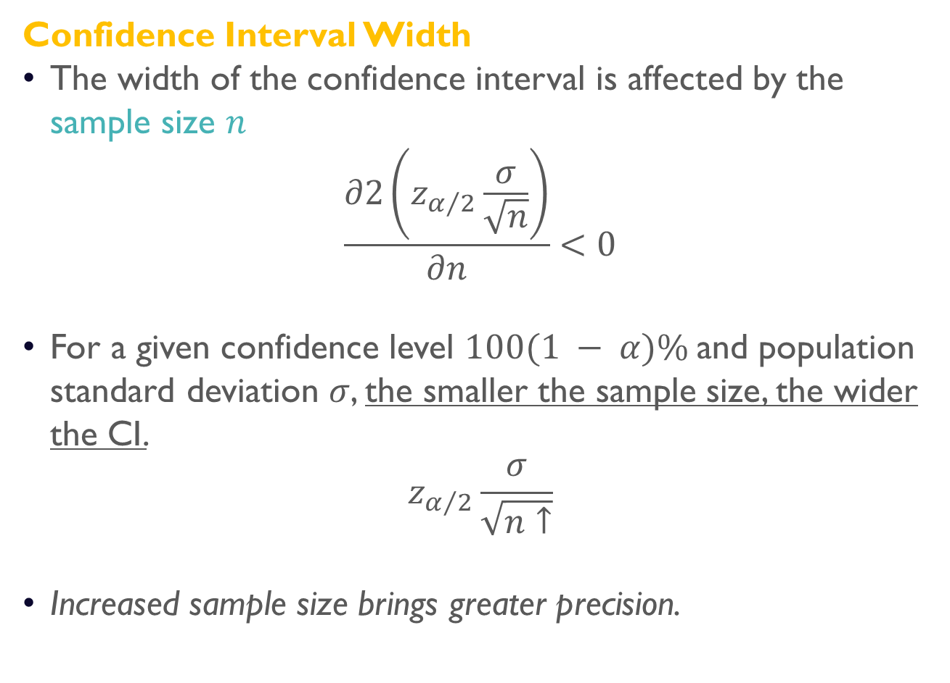
Width of Confidence intervals
Confidence Interval Width
The width of the confidence interval is affected by the sample size $n$
$$\frac{∂2\left(z_{α/2}\frac{σ}{\sqrt{n}}\right)}{∂n}<0$$
For a given confidence level $100(1 − α)\%$and population standard deviation $σ$, the smaller the sample size, the wider the CI.
$$z_{α/2}\frac{σ}{\sqrt{n↑}}$$
Increased sample size brings greater precision.

Slide 24
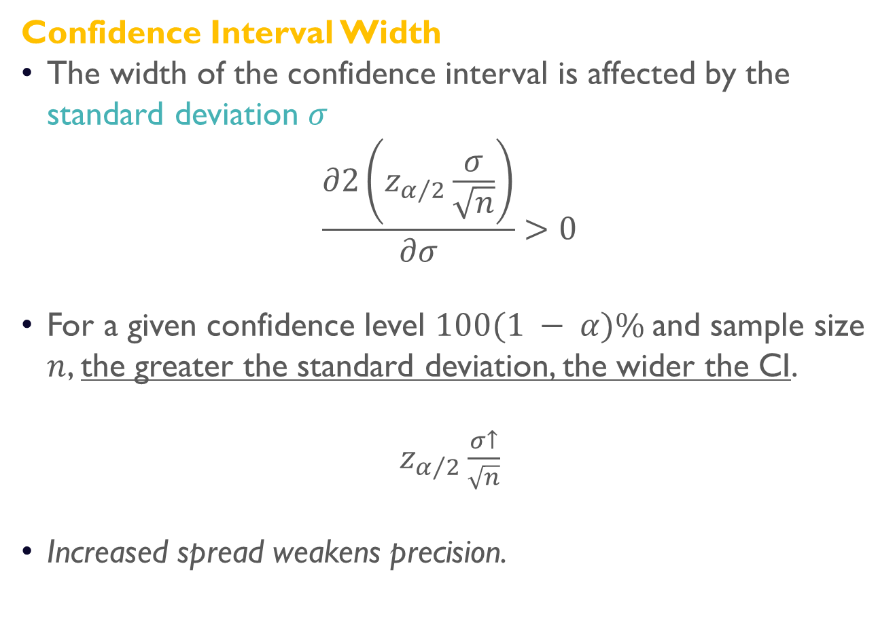
Width of Confidence intervals
Confidence Interval Width
The width of the confidence interval is affected by the standard deviation $σ$
$$\frac{∂2\left(z_{α/2}\frac{σ}{\sqrt{n}}\right)}{∂σ}>0$$
For a given confidence level $100(1 − α)\%$and sample size $n$, the greater the standard deviation, the wider the CI.
$z_{α/2}\frac{σ↑}{\sqrt{n}}$
Increased spread weakens precision.

Slide 25
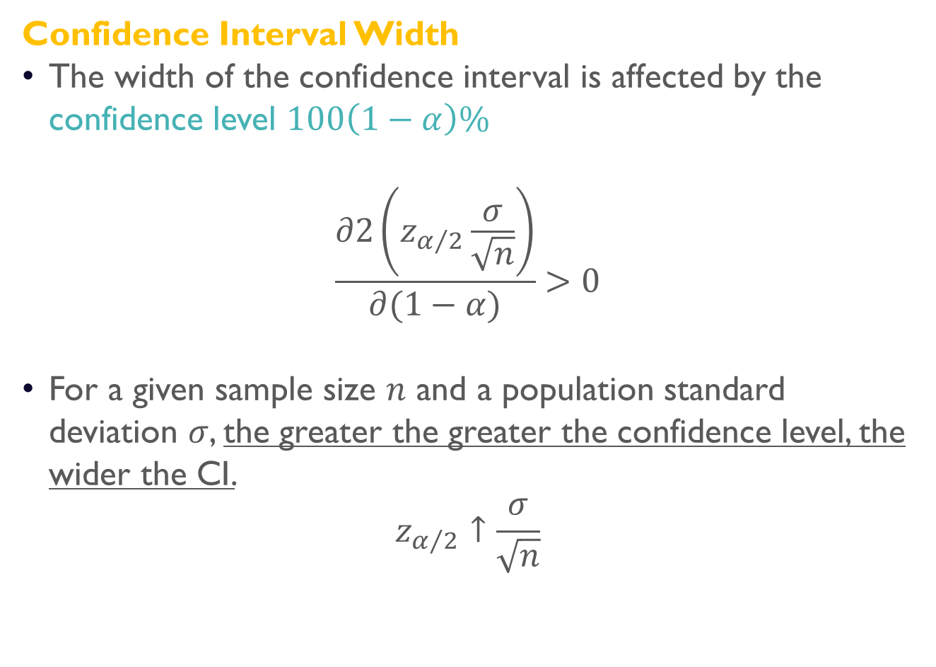
Width of Confidence intervals
Confidence Interval Width
The width of the confidence interval is affected by the confidence level $100\left(1−α\right)\%$
$$\frac{∂2\left(z_{α/2}\frac{σ}{\sqrt{n}}\right)}{∂(1−α)}>0$$
For a given sample size $n$ and a population standard deviation $σ$, the greater the greater the confidence level, the wider the CI.
$$z_{α/2}↑\frac{σ}{\sqrt{n}}$$

Slide 26

Confidence interval of the mean, $σ$ unknown
Estimation & confidence intervals

Slide 27
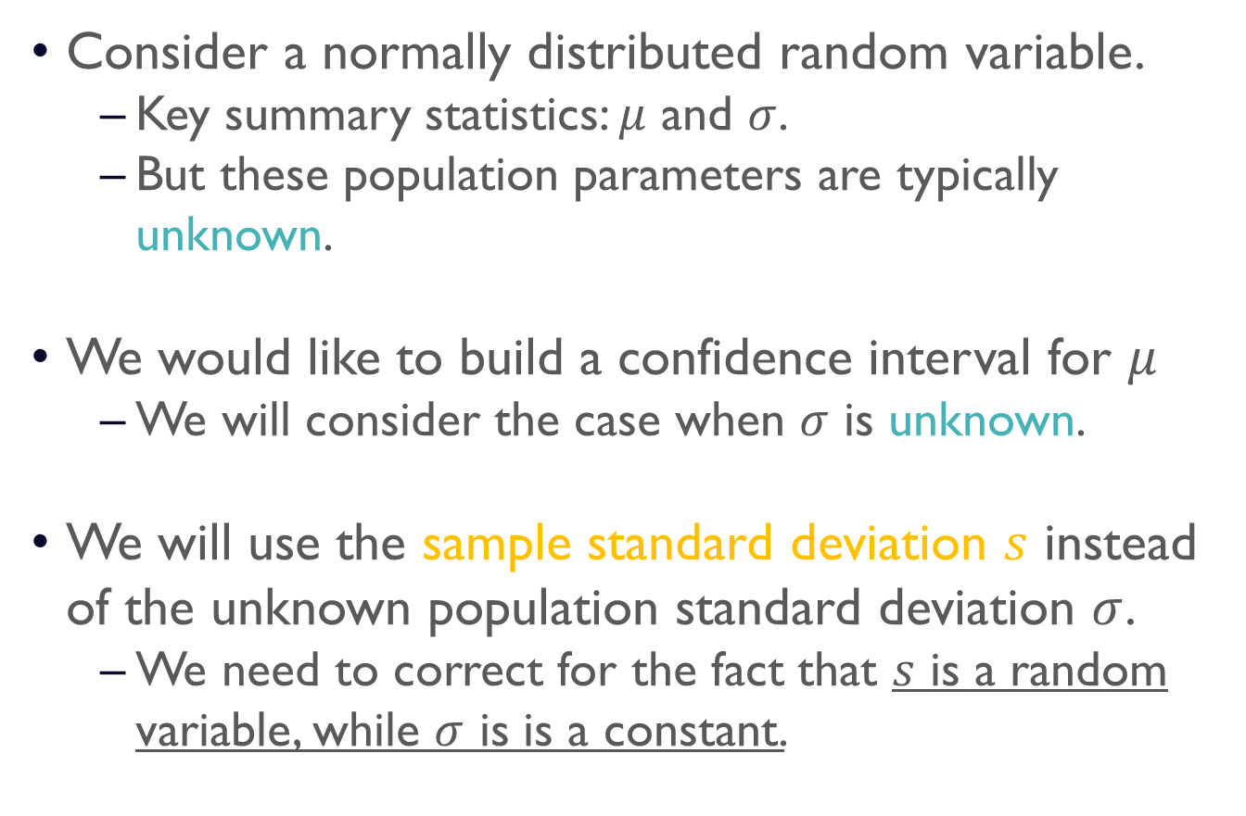
Confidence interval of the mean
Consider a normally distributed random variable.
Key summary statistics: $μ$ and $σ$.
But these population parameters are typically unknown.
We would like to build a confidence interval for $μ$
We will consider the case when $σ$ is unknown.
We will use the sample standard deviation $s$ instead of the unknown population standard deviation $σ$.
We need to correct for the fact that $s$ is a random variable, while $σ$ is is a constant.

Slide 28
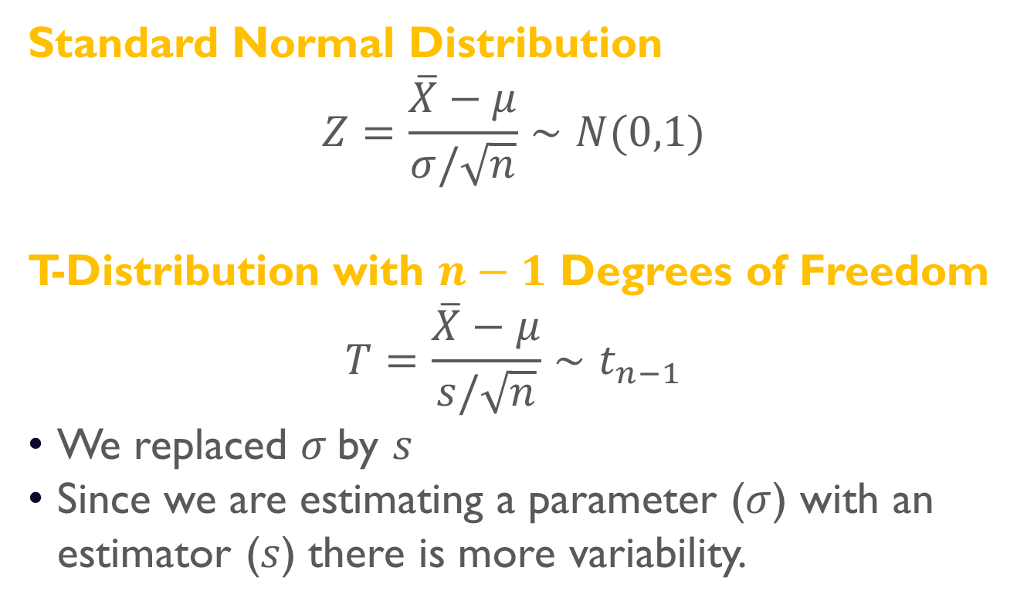
T-Distribution
Standard Normal Distribution
$$Z=\frac{\overline{X}−μ}{σ/\sqrt{n}}∼N(0,1)$$
T-Distribution with $n−1$ Degrees of Freedom
$$T=\frac{\overline{X}−μ}{s/\sqrt{n}}∼t_{n−1}$$
We replaced $σ$by $s$
Since we are estimating a parameter ($σ$) with an estimator ($s$) there is more variability.

Slide 29
T-Distribution
Lower peak
Standard Normal Distribution
Heavier tails
t-Distribution with 1 DF
As the degrees of freedom increase, the t-distribution tends towards the standard normal distribution.

Slide 30
T-Distribution
As the degrees of freedom increase, the t-distribution tends towards the standard normal distribution.

Slide 31
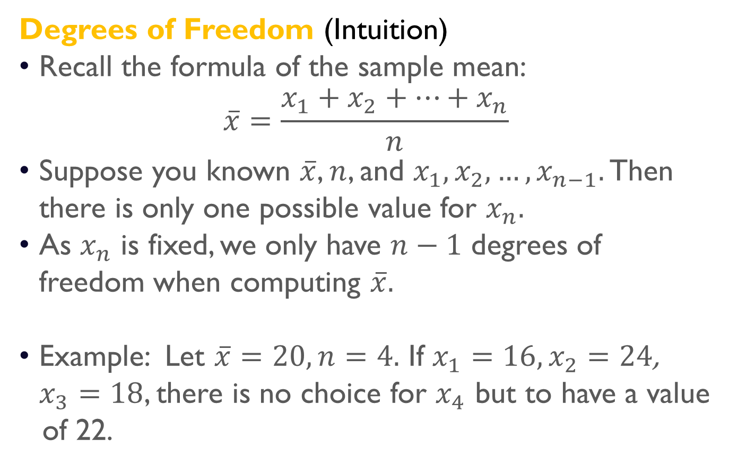
T-Distribution
Degrees of Freedom (Intuition)
Recall the formula of the sample mean:
$$\overline{x}=\frac{x_{1}+x_{2}+…+x_{n}}{n}$$
Suppose you known $\overline{x}$, $n$, and $x_{1},x_{2}, …, x_{n−1}.$ Then there is only one possible value for $x_{n}.$
As $x_{n}$ is fixed, we only have $n−1$ degrees of freedom when computing $\overline{x}.$
Example: Let $\overline{x}=20, n=4.$ If $x_{1}=16, x_{2}=24$,
$x_{3}=18$, there is no choice for $x_{4}$ but to have a value of 22.

Slide 32
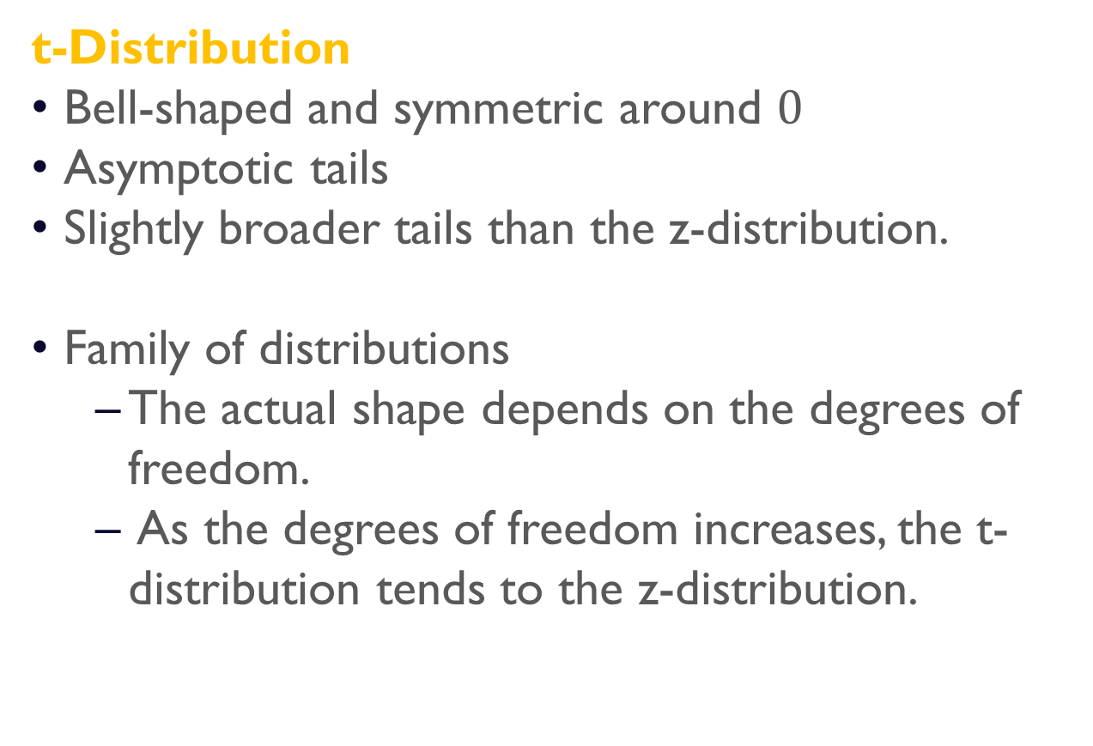
T-Distribution
t-Distribution
Bell-shaped and symmetric around $0$
Asymptotic tails
Slightly broader tails than the z-distribution.
Family of distributions
The actual shape depends on the degrees of freedom.
As the degrees of freedom increases, the t-distribution tends to the z-distribution.

Slide 33
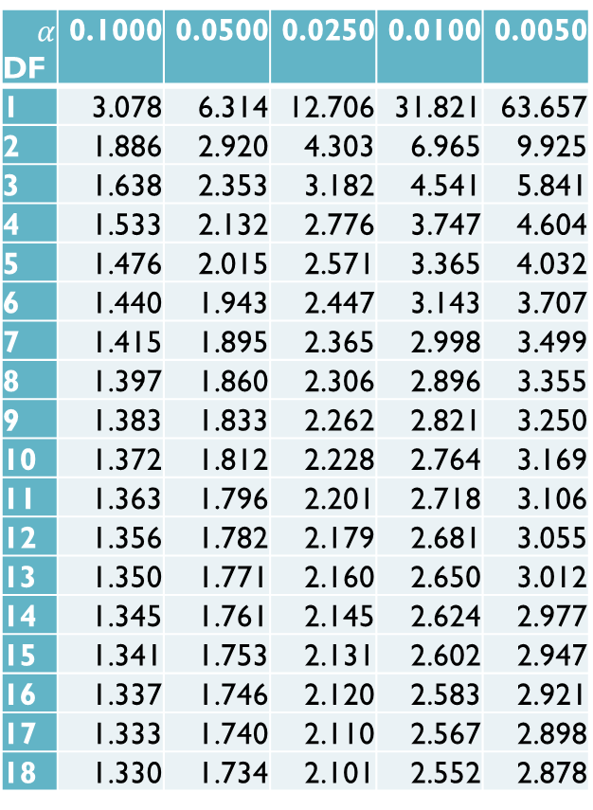

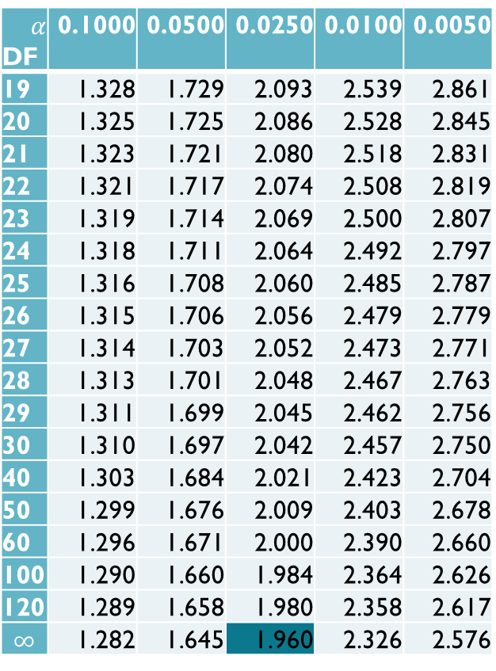
T-Table, Upper tail
$$\operatorname{Pr}\left(T_{df}>t_{α,df}\right)=α$$
$$α$$ DF | 0.1000 | 0.0500 | 0.0250 | 0.0100 | 0.0050
1 | 3.078 | 6.314 | 12.706 | 31.821 | 63.657
2 | 1.886 | 2.920 | 4.303 | 6.965 | 9.925
3 | 1.638 | 2.353 | 3.182 | 4.541 | 5.841
4 | 1.533 | 2.132 | 2.776 | 3.747 | 4.604
5 | 1.476 | 2.015 | 2.571 | 3.365 | 4.032
6 | 1.440 | 1.943 | 2.447 | 3.143 | 3.707
7 | 1.415 | 1.895 | 2.365 | 2.998 | 3.499
8 | 1.397 | 1.860 | 2.306 | 2.896 | 3.355
9 | 1.383 | 1.833 | 2.262 | 2.821 | 3.250
10 | 1.372 | 1.812 | 2.228 | 2.764 | 3.169
11 | 1.363 | 1.796 | 2.201 | 2.718 | 3.106
12 | 1.356 | 1.782 | 2.179 | 2.681 | 3.055
13 | 1.350 | 1.771 | 2.160 | 2.650 | 3.012
14 | 1.345 | 1.761 | 2.145 | 2.624 | 2.977
15 | 1.341 | 1.753 | 2.131 | 2.602 | 2.947
16 | 1.337 | 1.746 | 2.120 | 2.583 | 2.921
17 | 1.333 | 1.740 | 2.110 | 2.567 | 2.898
18 | 1.330 | 1.734 | 2.101 | 2.552 | 2.878
$$α$$ DF | 0.1000 | 0.0500 | 0.0250 | 0.0100 | 0.0050
19 | 1.328 | 1.729 | 2.093 | 2.539 | 2.861
20 | 1.325 | 1.725 | 2.086 | 2.528 | 2.845
21 | 1.323 | 1.721 | 2.080 | 2.518 | 2.831
22 | 1.321 | 1.717 | 2.074 | 2.508 | 2.819
23 | 1.319 | 1.714 | 2.069 | 2.500 | 2.807
24 | 1.318 | 1.711 | 2.064 | 2.492 | 2.797
25 | 1.316 | 1.708 | 2.060 | 2.485 | 2.787
26 | 1.315 | 1.706 | 2.056 | 2.479 | 2.779
27 | 1.314 | 1.703 | 2.052 | 2.473 | 2.771
28 | 1.313 | 1.701 | 2.048 | 2.467 | 2.763
29 | 1.311 | 1.699 | 2.045 | 2.462 | 2.756
30 | 1.310 | 1.697 | 2.042 | 2.457 | 2.750
40 | 1.303 | 1.684 | 2.021 | 2.423 | 2.704
50 | 1.299 | 1.676 | 2.009 | 2.403 | 2.678
60 | 1.296 | 1.671 | 2.000 | 2.390 | 2.660
100 | 1.290 | 1.660 | 1.984 | 2.364 | 2.626
120 | 1.289 | 1.658 | 1.980 | 2.358 | 2.617
$$∞$$ | 1.282 | 1.645 | 1.960 | 2.326 | 2.576
Notes:
Upper tail tables

Slide 34
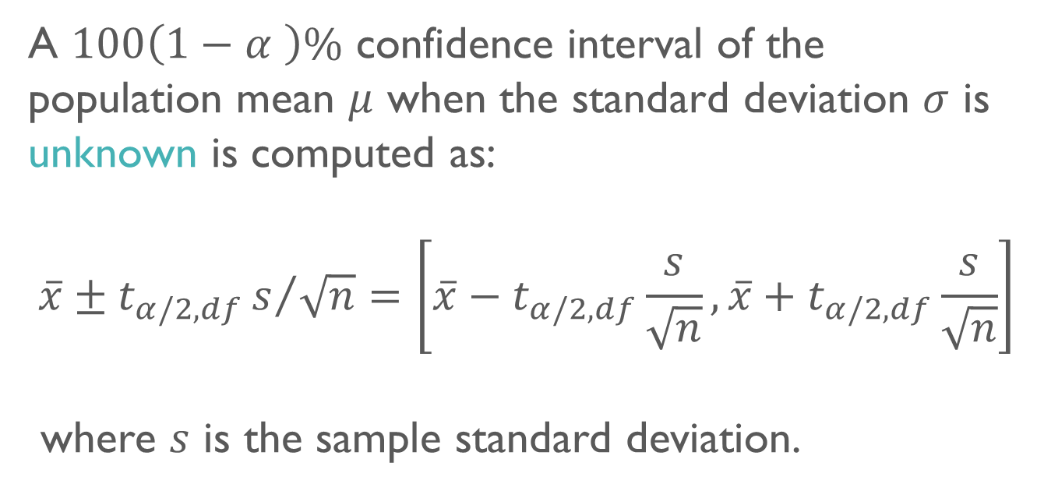
Confidence interval of the mean
A $100\left(1−α \right)\%$ confidence interval of the population mean $μ$ when the standard deviation $σ$ is unknown is computed as:
$$\overline{x}±t_{α/2,df}s/{\sqrt{n}}=\left[\overline{x}−t_{α/2,df}\frac{s}{\sqrt{n}}, \overline{x}+t_{α/2,df}\frac{s}{\sqrt{n}}\right]$$
where $s$ is the sample standard deviation.

Slide 35
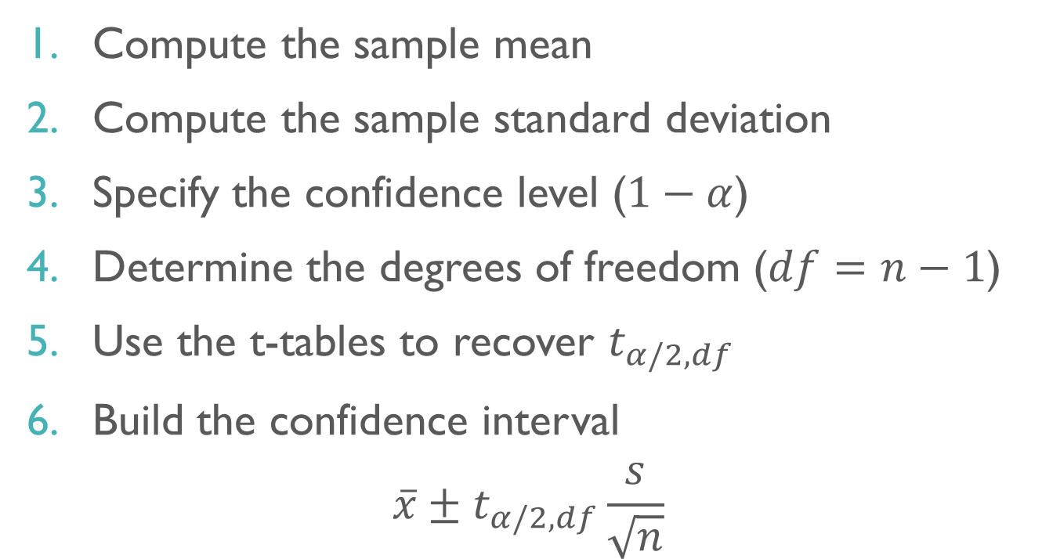
Confidence interval of the mean
Compute the sample mean
Compute the sample standard deviation
Specify the confidence level ($1−α$)
Determine the degrees of freedom ($df=n−1$)
Use the t-tables to recover $t_{α/2,df}$
Build the confidence interval
$$\overline{x}±t_{α/2,df}\frac{s}{\sqrt{n}}$$

Slide 36
Confidence interval of the proportion
Estimation & confidence intervals

Slide 37
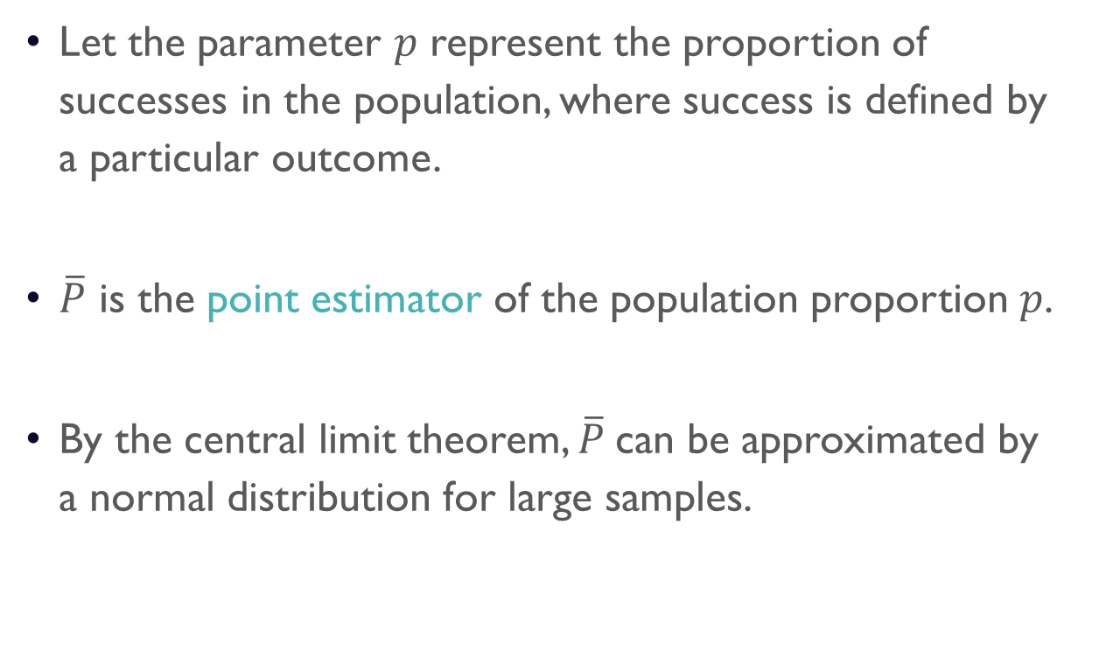
Confidence interval of proportions
Let the parameter $p$ represent the proportion of successes in the population, where success is defined by a particular outcome.
$\overline{P}$ is the point estimator of the population proportion $p$.
By the central limit theorem, $\overline{P}$can be approximated by a normal distribution for large samples.

Slide 38
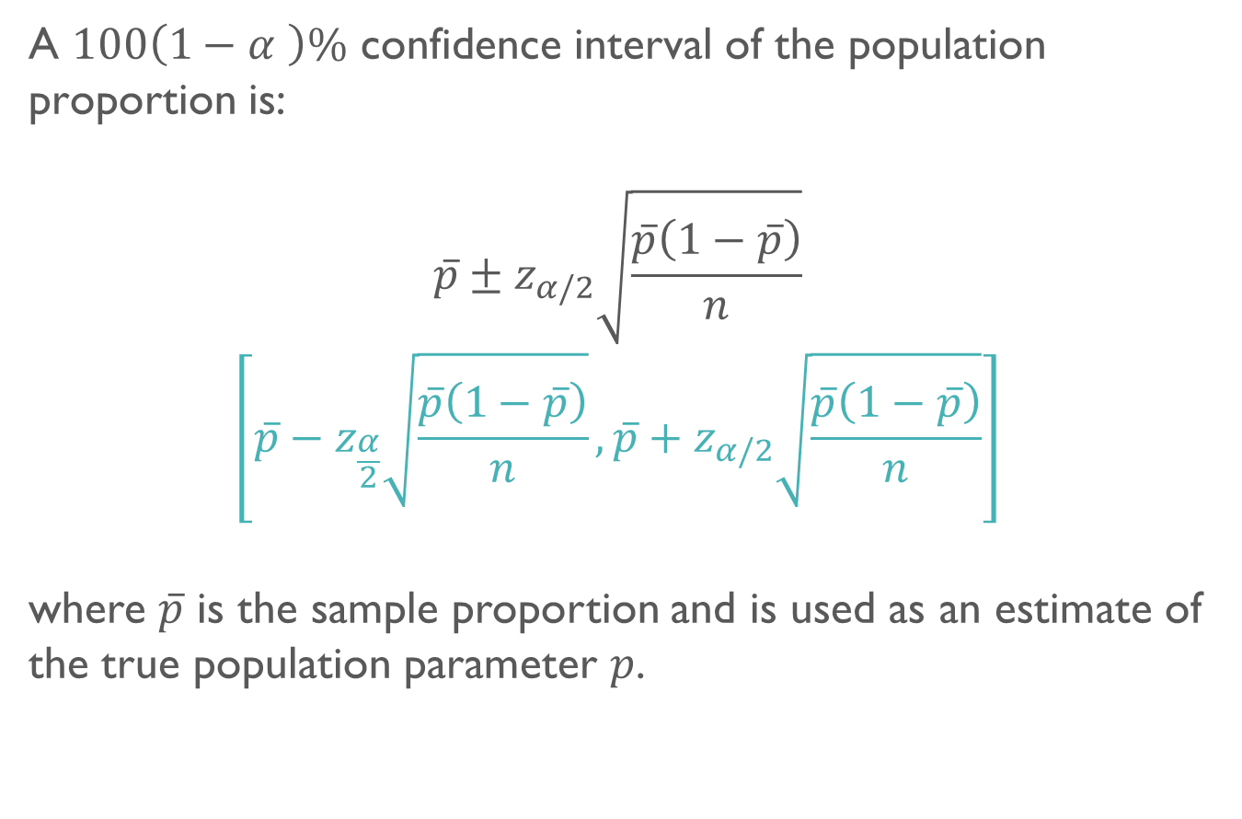
Confidence interval of proportions
A $100\left(1−α \right)\%$ confidence interval of the population proportion is:
$$\overline{p}±z_{α/2}\sqrt{\frac{\overline{p}\left(1−\overline{p}\right)}{n}}$$
$$\left[\overline{p}−z_{\frac{α}{2}}\sqrt{\frac{\overline{p}\left(1−\overline{p}\right)}{n}},\overline{p}+z_{α/2}\sqrt{\frac{\overline{p}\left(1−\overline{p}\right)}{n}}\right]$$
where $\overline{p}$ is the sample proportion and is used as an estimate of the true population parameter $p$.

Slide 39
Sample size
Estimation & confidence intervals

Slide 40
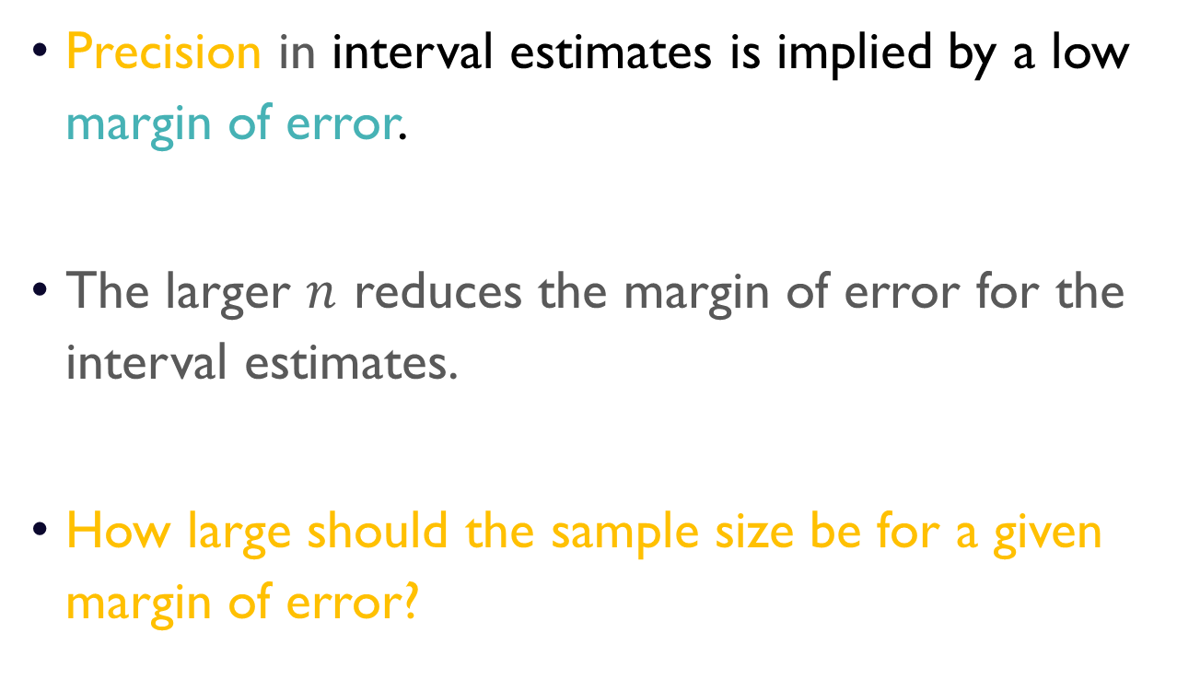
Sample size
Precision in interval estimates is implied by a low margin of error.
The larger $n$ reduces the margin of error for the interval estimates.
How large should the sample size be for a given margin of error?

Slide 41
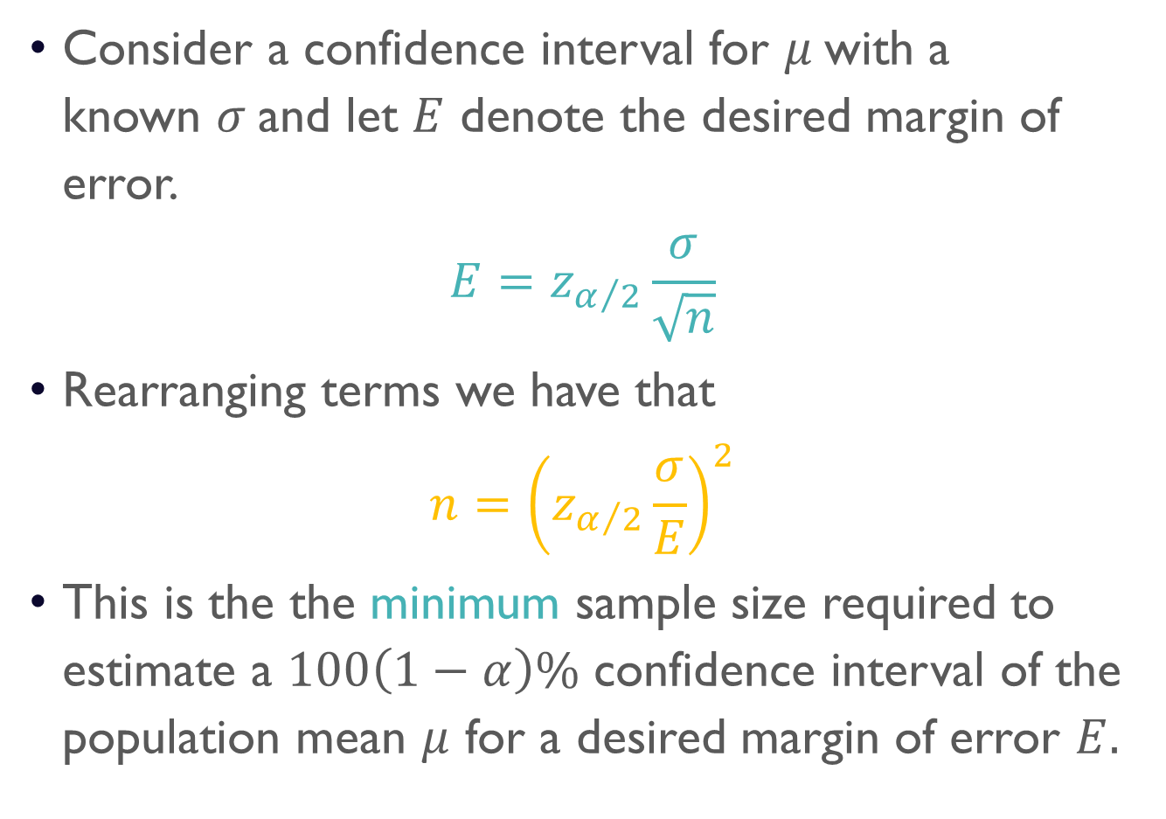
Sample size for the mean
Consider a confidence interval for $μ$with a known $σ$and let $E$ denote the desired margin of error.
$$E=z_{α/2}\frac{σ}{\sqrt{n}}$$
Rearranging terms we have that
$$n={\left(z_{α/2}\frac{σ}{E}\right)}^{2}$$
This is the the minimum sample size required to estimate a $100\left(1−α\right)\%$ confidence interval of the population mean $μ$ for a desired margin of error $E.$

Slide 42
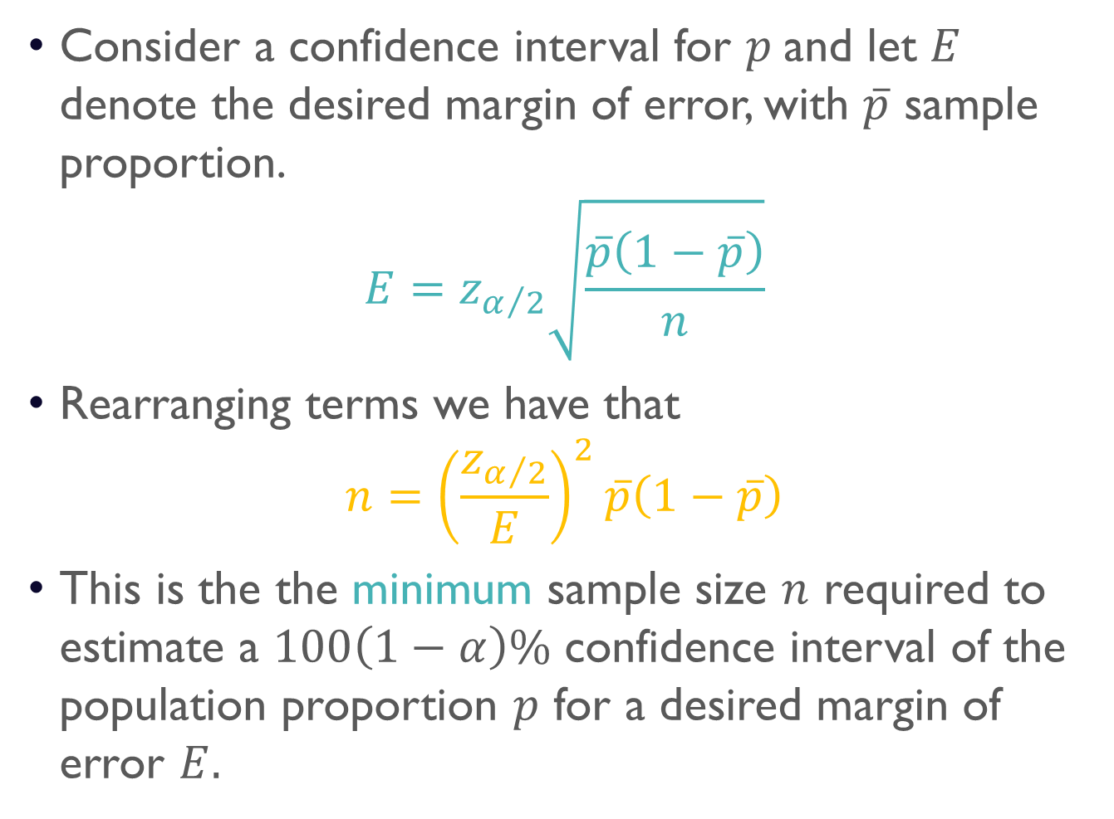
Sample size for proportions
Consider a confidence interval for $p$and let $E$ denote the desired margin of error, with $\overline{p}$ sample proportion.
$$E=z_{α/2}\sqrt{\frac{\overline{p}\left(1−\overline{p}\right)}{n}}$$
Rearranging terms we have that
$$n={\left(\frac{z_{α/2}}{E}\right)}^{2}\overline{p}\left(1−\overline{p}\right)$$
This is the the minimum sample size $n$ required to estimate a $100\left(1−α\right)\%$ confidence interval of the population proportion $p$ for a desired margin of error $E.$

