Slide 1
Z-test

Slide 2
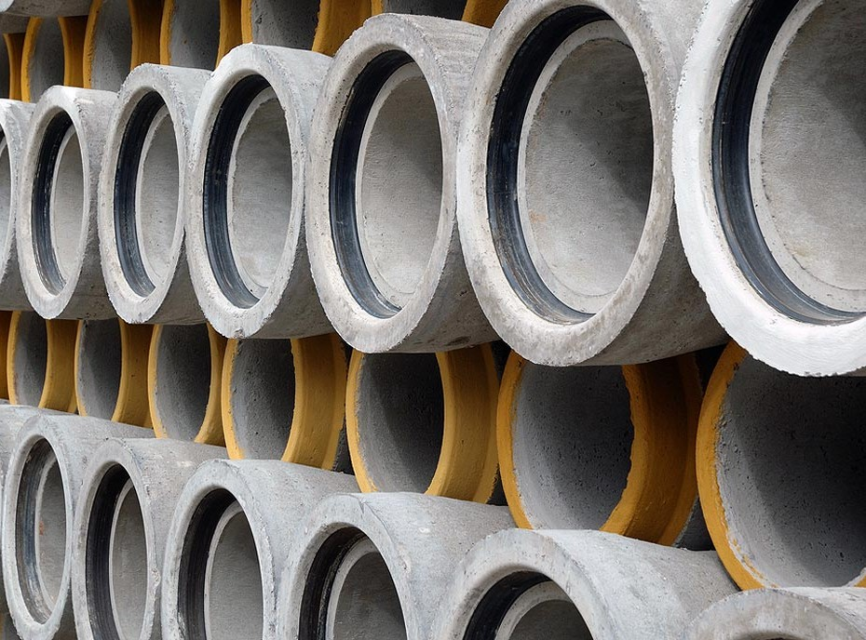
Hypothesis example
Recall
Suppose:
Public contract to supply sewage pipes to a city
Breaking strength of residential sewer pipe should be more than 125 metric tonnes per square metre (t/m²)
Each manufacturer who wants to sell pipes in that city must demonstrate that its product meets this specification
Want to decide whether the mean breaking strength of the pipe exceeds 125 t/m²
Image source: Balkan Plumbing.

Slide 3
Null hypothesis
Recall
Null Hypothesis:
(H₀): μ ≤ 125
The manufacturer’s pipe does not meet specifications
Mean population breaking strength is less than or equal to 125 t/m²
Image source: Balkan Plumbing.

Slide 4
Null hypothesis
Recall
Null Hypothesis:
(H₁): μ > 125
The manufacturer’s pipe meets specifications
Mean population breaking strength is greater than 125 t/m²
Image source: Balkan Plumbing.

Slide 5
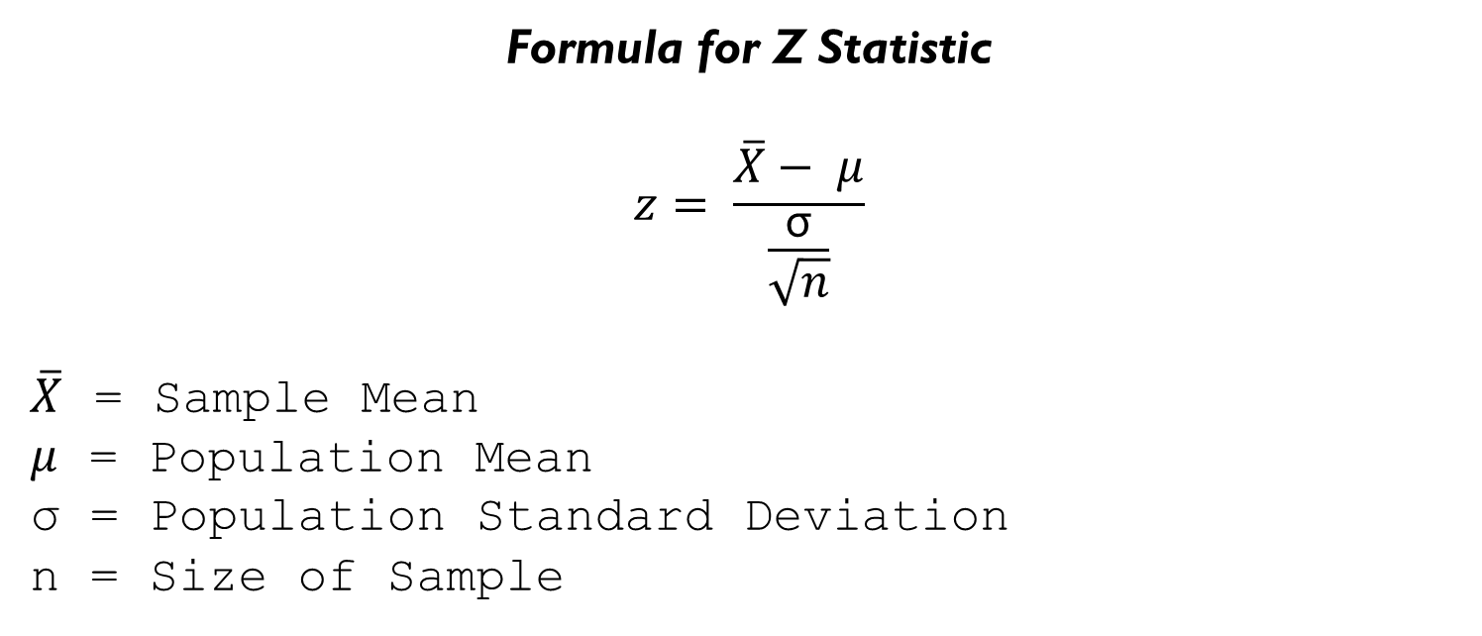
Calculate z
Recall
Formula for Z Statistic
$$z= \frac{\overline{X}− μ}{\frac{\text{σ}}{\sqrt{n}}}$$
$\overline{X}$ = Sample Mean
$μ$ = Population Mean
σ = Population Standard Deviation
n = Size of Sample
Standard Error of the Mean (SEM)

Slide 6
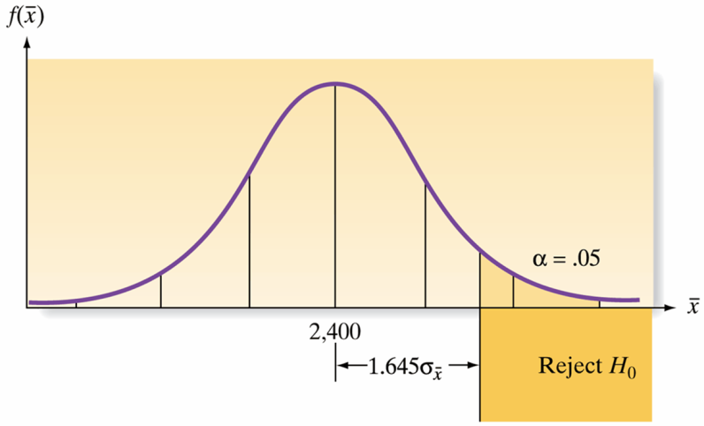
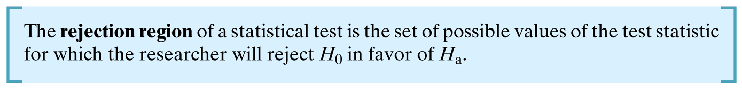
example
In our example:
α = p(z > 1.645 when in fact µ = 125) = 0.05
We now summarize the elements of the test:
H₀: µ ≤ 125 (Pipe does not meet specifications)
H₁: µ > 125 (Pipe does meet specifications)
µ = 125
Rejection region: z > 1.645, which corresponds to α = 0.05

Slide 7
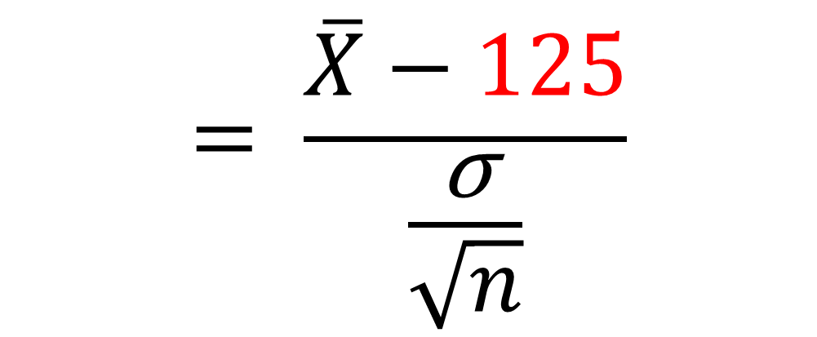
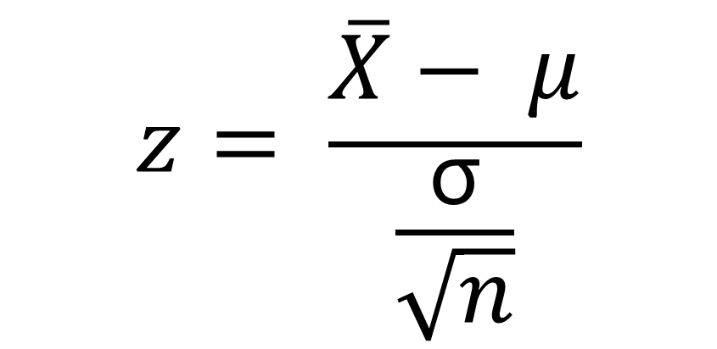
calculations
(H₀): μ ≤ 125
(H₁): μ > 125
$$z= \frac{\overline{X}− μ}{\frac{\text{σ}}{\sqrt{n}}}$$
$$= \frac{\overline{X}−125}{\frac{\text{σ}}{\sqrt{n}}}$$

Slide 8
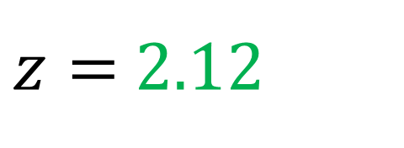
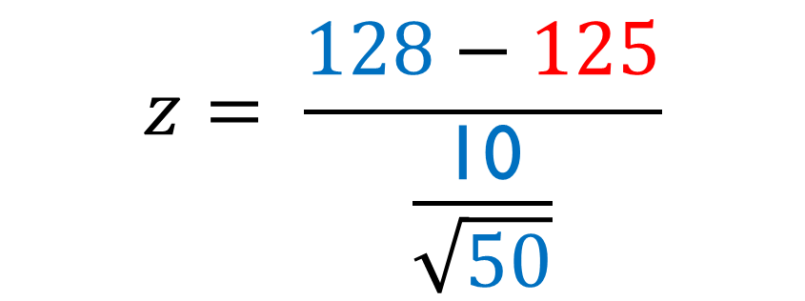
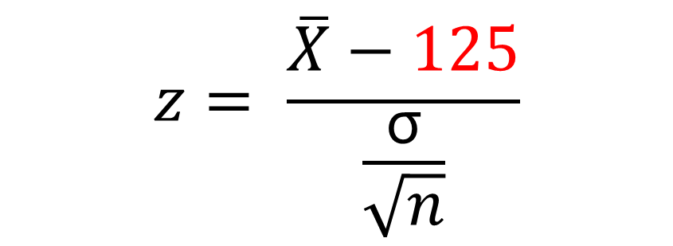
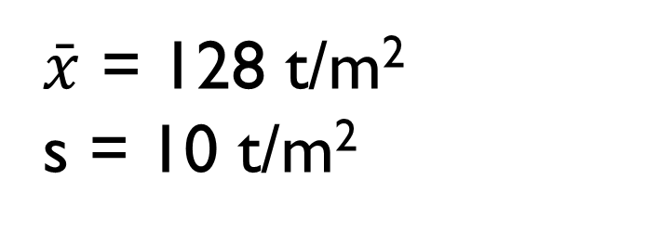
illustration
$$z= \frac{\overline{X}−125}{\frac{\text{σ}}{\sqrt{n}}}$$
To illustrate use of the test, suppose we test 50 pipes (n = 50) and find the mean and standard deviation to be:
Use s to approximate σ when s is calculated from a large set of sample measurements
$$z= \frac{128−125}{\frac{\text{10}}{\sqrt{50}}}$$
$\bar{x}$ = 128 t/m²
s = 10 t/m²
$z=$ 2.12

Slide 9
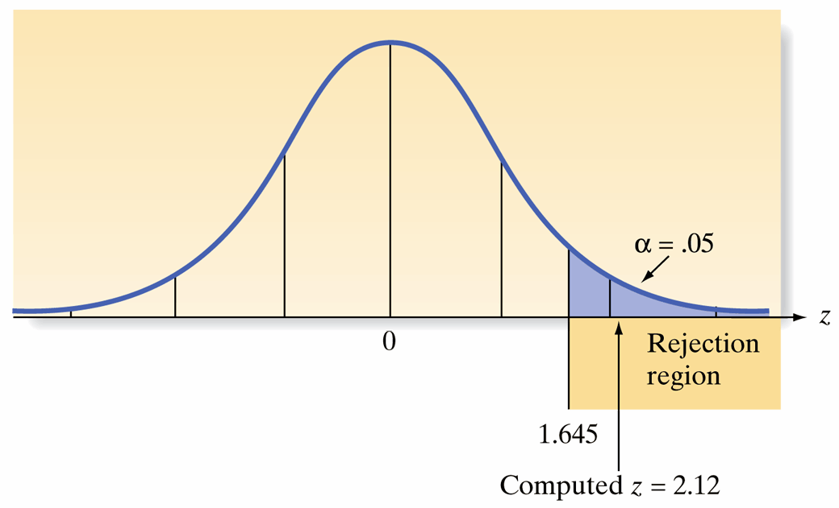
Placing the test statistic
Location of the test statistic for a test of the hypothesis H₀: µ = 125 t/m²
The sample mean lies 2.12 σ above the hypothesized value of μ (125)
Because z exceeds 1.645, it falls into the rejection region
We reject the null hypothesis that µ = 125 and concluded that µ > 125
Thus it appears that the company’s pipe has a mean strength that exceeds 125 tonnes/square metre

Slide 10
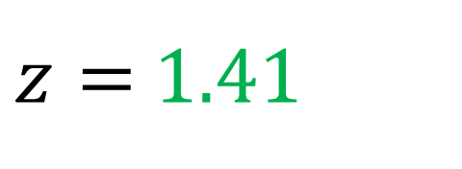
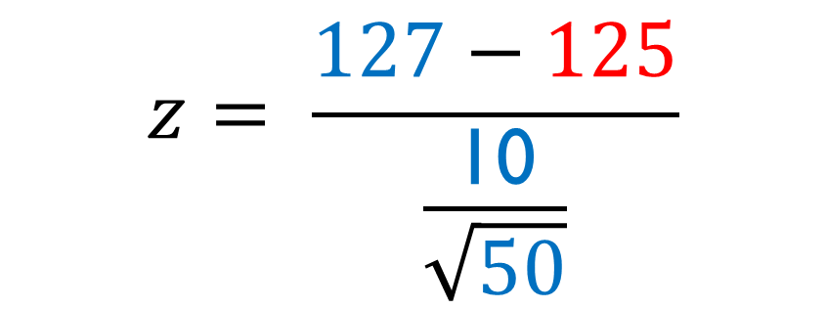
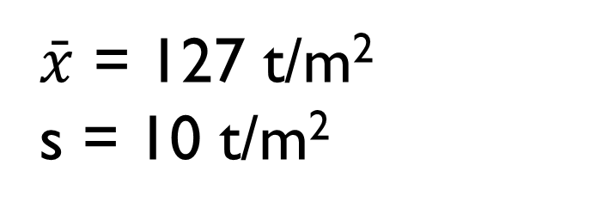
What if…?
$$z= \frac{\overline{X}−125}{\frac{\text{σ}}{\sqrt{n}}}$$
To illustrate use of the test, suppose we test 50 pipes (n = 50) and find the mean and standard deviation to be:
$$z= \frac{127−125}{\frac{\text{10}}{\sqrt{50}}}$$
$\bar{x}$ = 127 t/m²
s = 10 t/m²
$z=$ 1.41

Slide 11
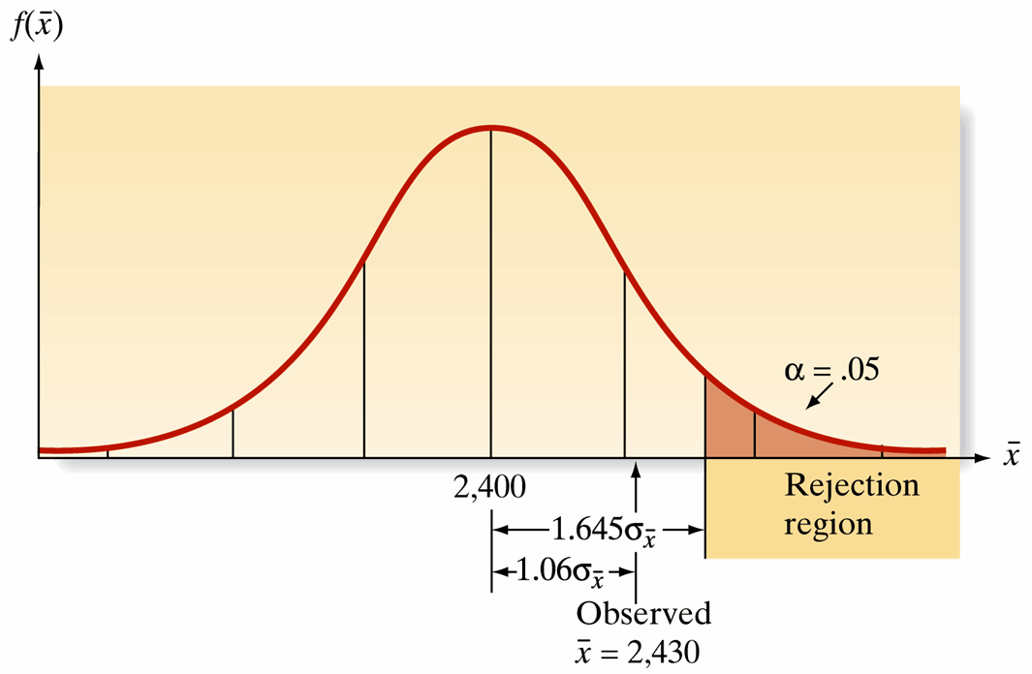

What if…?
Location of test statistic when = 127
z value of 1.41 does not fall into the rejection region
We cannot reject the null hypothesis
“fail to reject H₀”
“retain the H₀”
“the H₀ is true”
$$\bar{x}$$
1.41
127

Slide 12

Convincing evidence
We cannot reject H₀ using α = 0.05
Even though the sample mean ( ) of 127 exceeds city specification (125) by 2 t/m²
It does not exceed the specification by enough to provide convincing evidence that the population mean (µ) exceeds 125.
$$\bar{x}$$
1.41
127

Slide 13
How do you know you’ve made the right decision?
Reject…
(H₀): μ ≤ 125

Slide 14
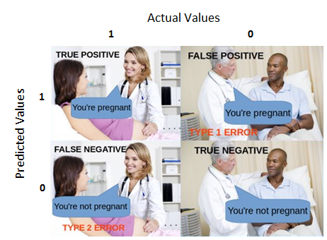
What about errors?
True Positive:
You predicted positive and it’s true
You predicted that a woman is pregnant and she actually is
True Negative:
You predicted negative and it’s true
You predicted that a man is not pregnant and he actually is not
False Positive: (Type 1 Error)
You predicted positive and it’s false
You predicted that a man is pregnant but he actually is not
False Negative: (Type II Error)
You predicted negative and it’s false
You predicted that a woman is not pregnant but she actually is
Image source: Understanding Confusion Matrix (Narkhede, 2018)

Slide 15

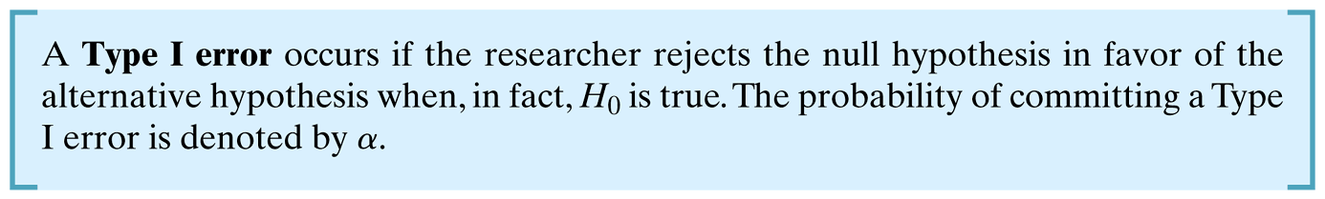
Accept/Reject Hypothesis?
What is the probability that this procedure will lead us to an incorrect decision?

Slide 16
Type I error
The risk of making a Type I error is denoted by the symbol α – that is:
α = p(Type I error) = p(rejecting the null hypothesis when in fact the null hypothesis is true)

Slide 17
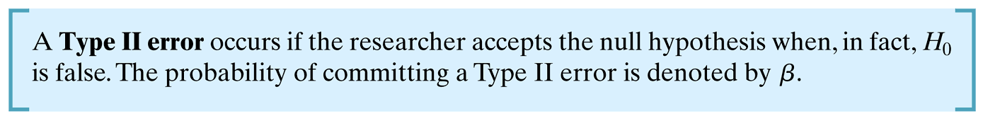
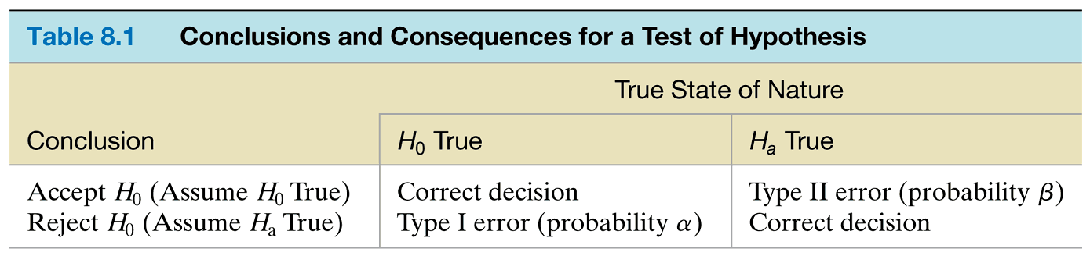
conclusions

