Slide 1
Statistical tests

Slide 2
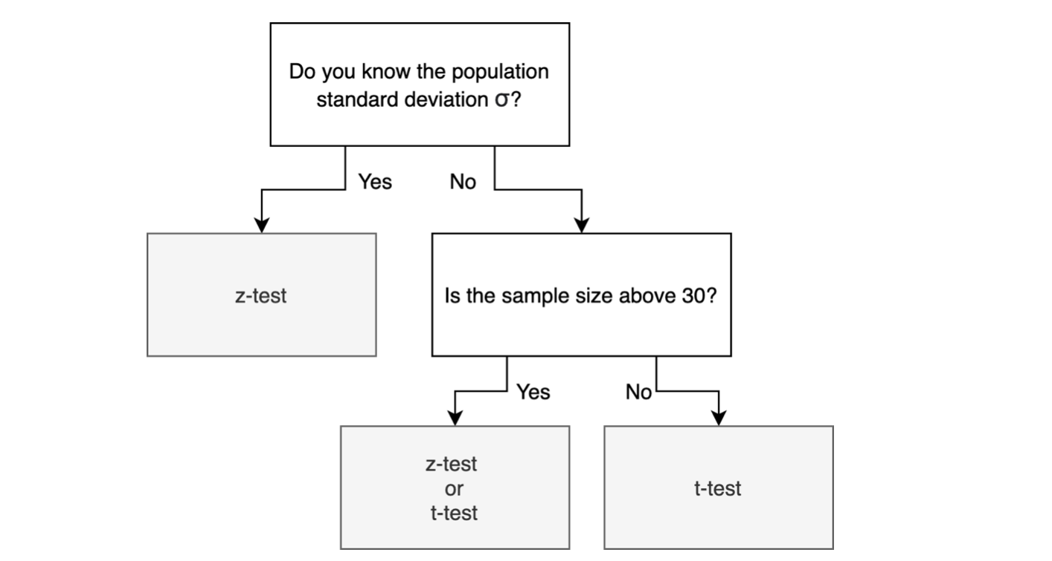
One sample test

Slide 3

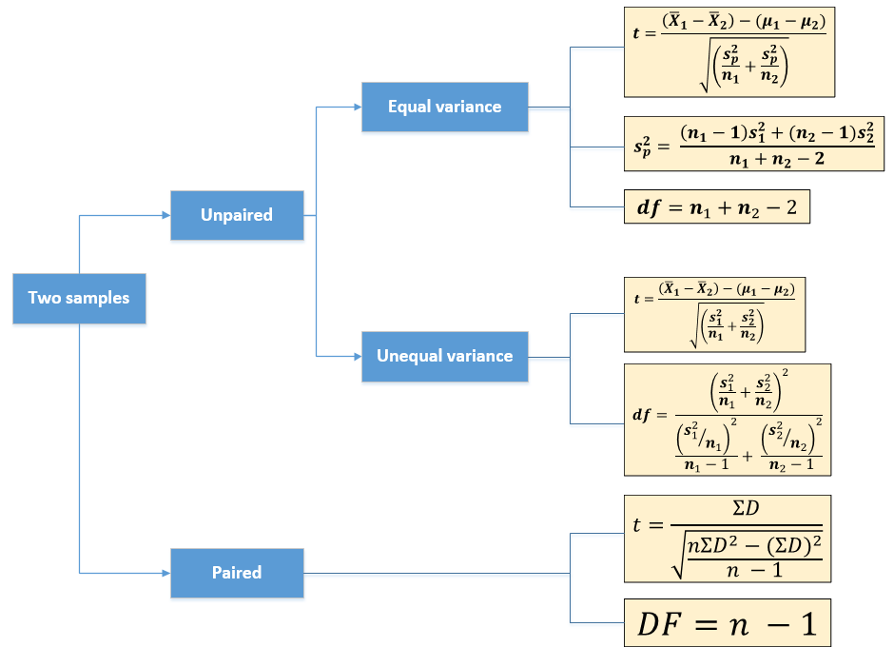
Two samples

Slide 4

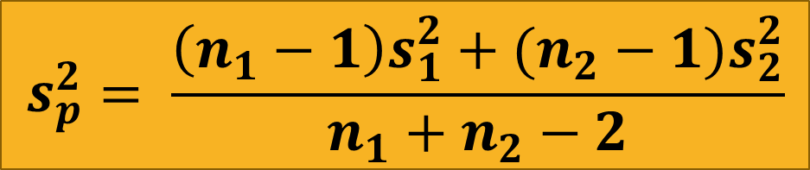

Unpaired t-Test (Equal Variance)
$$t=\frac{\left({\overline{X}}_{1}−{\overline{X}}_{2}\right)−(μ_{1}−μ_{2})}{\sqrt{\left(\frac{s_{p}^{2}}{n_{1}}+\frac{s_{p}^{2}}{n_{2}}\right)}}$$
Formula:
Pooled Variance:
Degrees of Freedom:
$$s_{p}^{2}= \frac{\left(n_{1}−1\right)s_{1}^{2}+(n_{2}−1)s_{2}^{2}}{n_{1}+n_{2}−2}$$
$$df=n_{1}+n_{2}−2$$

Slide 5
Degrees of Freedom
Degrees of freedom (df) are defined as the number of scores in a sample that are free to vary
Visual explanation:
There are five balloons: one blue, one red, one yellow, one pink, & one green
If 5 students (n=5) are each to select one balloon only 4 will have a choice of colour (df = 4)
The last person will get whatever colour is left
Different formulas for each test

