Slide 1
What is Agility
30-09-2016
According to Ivar Jacobson
An agile team is a nimble team able to appropriately respond to changes.
Changes in the software being built.
Changes to the team members.
Changes because of new technology.
Changes of all kinds that may have an impact on the product they build or the project that creates the product.

Slide 2
It emphasizes rapid delivery of operational software and de-emphasizes the importance of intermediate work products.
It adopts the customer as a part of the development team and works to eliminate the “us and them” attitude.

Slide 3
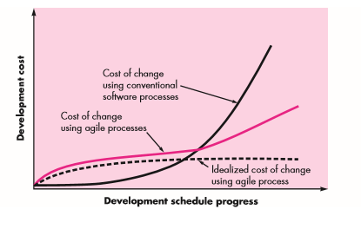
Agility and Cost of Change

Slide 4
Well-designed agile process “flattens” the cost of change curve , allowing a software team to accommodate changes late in a software project without dramatic cost and time impact.
When incremental delivery is coupled with other agile practices such as continuous unit testing and pair programming , the cost of making a change is attenuated

Slide 5
What is an Agile Process
Any agile software process is characterized in a manner that addresses a number of key assumptions about the majority of software projects.
1. It is difficult to predict in advance which software requirements will persist and which will change. It is equally difficult to predict how customer priorities will change as the project proceeds.

Slide 6
For many types of software, design and construction are interleaved. That is, both activities should be performed in tandem so that design models are proven as they are created. It is difficult to predict how much design is necessary before construction is used to prove the design.
Analysis, design, construction, and testing are not as predictable (from a planning point of view) as we might like.

Slide 7
Agile process must be adaptable.
An agile software process must adapt incrementally.
To accomplish incremental adaptation, an agile team requires customer feedback
An effective catalyst for customer feedback is an operational prototype or a portion of an operational system

Slide 8
Agility Principles
1. Our highest priority is to satisfy the customer through early and continuous delivery of valuable software.
2. Welcome changing requirements, even late in development. Agile processes harness change for the customer’s competitive advantage.
3. Deliver working software frequently, from a couple of weeks to a couple of months, with a preference to the shorter timescale.

Slide 9
4.Business people and developers must work together daily throughout the project.
5. Build projects around motivated individuals. Give them the environment and support they need, and trust them to get the job done.
6. The most efficient and effective method of conveying information to and within a development team is face-to-face conversation.

Slide 10
7. Working software is the primary measure of progress.
8. Agile processes promote sustainable development. The sponsors, developers, and users should be able to maintain a constant pace indefinitely.
9. Continuous attention to technical excellence and good design enhances agility.

Slide 11
10. Simplicity—the art of maximizing the amount of work not done—is essential.
11. The best architectures, requirements, and designs emerge from self– organizing teams.
12. At regular intervals, the team reflects on how to become more effective, then tunes and adjusts its behavior accordingly.

Slide 12
Extreme Programming
04-10-2016
Extreme Programming (XP) is the most widely used approach to agile software development.

Slide 13
Extreme Programming
XP Values
Kent Beck defines a set of five values that establish a foundation for all work performed as part of XP—
Communication
Simplicity
Feedback
Courage
Respect

Slide 14
Communication
In order to achieve effective communication between software engineers and other stakeholders , XP emphasizes:
Close, yet informal (verbal) collaboration between customers and developers,
The establishment of effective metaphors for communicating important concepts.
Continuous feedback, and the avoidance of voluminous documentation as a communication medium

Slide 15
Simplicity
To achieve simplicity, XP restricts developers to design only for immediate needs, rather than consider future needs.
The intent is to create a simple design that can be easily implemented in code. If the design must be improved, it can be refactored at a later time.

Slide 16
Feedback
Feedback is derived from three sources:
The implemented software itself,
The customer,
Other software team members.
By designing and implementing an effective testing strategy , the software (via test results) provides the agile team with feedback.

Slide 17
XP makes use of the unit test as its primary testing tactic. As each class is developed, the team develops a unit test to exercise each operation according to its specified functionality.
As an increment is delivered to a customer, the user stories or use case that are implemented by the increment are used as a basis for acceptance tests.

Slide 18
Courage
Beck argues that strict adherence to certain XP practices demands courage. A better word might be discipline.
For example, there is often significant pressure to design for future requirements.
Most software teams succumb, arguing that “designing for tomorrow” will save time and effort in the long run.
An agile XP team must have the discipline (courage) to design for today, recognizing that future requirements may change dramatically, thereby demanding substantial rework of the design and implemented code.

Slide 19
Respect
By following each of these values, the agile team inculcates respect among it members, between other stakeholders and team members, and indirectly, for the software itself.
As they achieve successful delivery of software increments, the team develops growing respect for the XP process.

Slide 20
The XP Process
Extreme Programming uses an object-oriented approach and encompasses a set of rules and practices that occur within the context of four framework activities:
Planning
Design
Coding
Testing

Slide 21
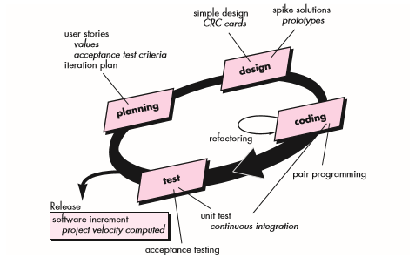
The XP Process

Slide 22
The XP Process
Planning. The planning activity (also called the planning game) begins with listening—
A requirements gathering activity that enables the technical members of the XP team to understand the business context for the software and major features and functionality.
Listening leads to the creation of a set of “stories” (also called user stories) that describe required output, features, and functionality for software to be built.
Each story is written by the customer and is placed on an index card.

Slide 23
The customer assigns a value (i.e., a priority) to the story based on the overall business value of the feature or function.
Members of the XP team then assess each story and assign a cost—measured in development weeks—to it.
If the story is estimated to require more than three development weeks, the customer is asked to split the story into smaller stories and the assignment of value and cost occurs again.
It is important to note that new stories can be written at any time.

Slide 24
Once a basic commitment (agreement on stories to be included, delivery date, and other project matters) is made for a release, the XP team orders the stories that will be developed in one of three ways:
(1) All stories will be implemented immediately (within a few weeks),
(2) The stories with highest value will be moved up in the schedule and implemented first, or
(3) The riskiest stories will be moved up in the schedule and implemented first.

Slide 25
After the first project release (also called a software increment) has been delivered, the XP team computes project velocity.
Project velocity is the number of customer stories implemented during the first release.
Project velocity can then be used to
(1) help estimate delivery dates and schedule for subsequent releases
(2) determine whether an over commitment has been made for all stories across the entire development project.
If an over commitment occurs, the content of releases is modified or end delivery dates are changed

Slide 26
As development work proceeds, the customer can add stories, change the value of an existing story, split stories, or eliminate them.
The XP team then reconsiders all remaining releases and modifies its plans accordingly.

Slide 27
Design.
XP design rigorously follows the keep it simple principle. A simple design is always preferred over a more complex representation.
In addition, the design provides implementation guidance for a story as it is written—nothing less, nothing more.
The design of extra functionality (because the developer assumes it will be required later) is discouraged.

Slide 28
XP encourages the use of CRC cards as an effective mechanism for thinking about the software in an object-oriented context.
CRC (class-responsibility collaborator) cards identify and organize the object-oriented classes that are relevant to the current software increment.

Slide 29
If a difficult design problem is encountered as part of the design of a story, XP recommends the immediate creation of an operational prototype of that portion of the design called a spike solution.
The design prototype is implemented and evaluated. The intent is to lower risk when true implementation starts.

Slide 30
Refactoring is the process of changing a software system in such a way that it does not alter the external behavior of the code yet improves the internal structure.
It is a disciplined way to clean up code [and modify/simplify the internal design] that minimizes the chances of introducing bugs. In essence, when you refactor you are improving the design of the code after it has been written.
Refactoring improves the internal structure of a design (or source code) without changing its external functionality or behavior.

Slide 31
Coding
A key concept during the coding activity is pair programming.
XP recommends that two people work together at one computer workstation to create code for a story.
It also keeps the developers focused on the problem at hand. In practice, each person takes on a slightly different role.

Slide 32
For example, one person might think about the coding details of a particular portion of the design while the other ensures that coding standards (a required part of XP) are being followed or that the code for the story will satisfy the unit test that has been developed to validate the code against the story.

Slide 33
Testing
Integration and validation testing of the system can occur on a daily basis. This provides the XP team with a continual indication of progress and also can raise warning flags early if things go awry.
Wells [Wel99] states: “Fixing small problems every few hours takes less time than fixing huge problems just before the deadline.”

Slide 34
XP acceptance tests, also called customer tests, are specified by the customer and focus on overall system features and functionality that are visible and reviewable by the customer.
Acceptance tests are derived from user stories that have been implemented as part of a software release

Slide 35
Scrum
05-10-2016
Scrum is an agile software development method that was conceived by Jeff Sutherland and his development team in the early 1990s.
Further development on the Scrum methods has been performed by Schwaber and Beedle .

Slide 36
Scrum principles are consistent with the agile manifesto and are used to guide development activities within a process that incorporates the following framework activities:
Requirements
Analysis
Design
Evolution, and
Delivery framework activity.
Work tasks occur within a process pattern called a sprint

Slide 37
Scrum emphasizes the use of a set of software process patterns that have proven effective for projects with :
Tight timelines, Changing requirements, and Business criticality.
Each of these process patterns defines a set of development actions:

Slide 38
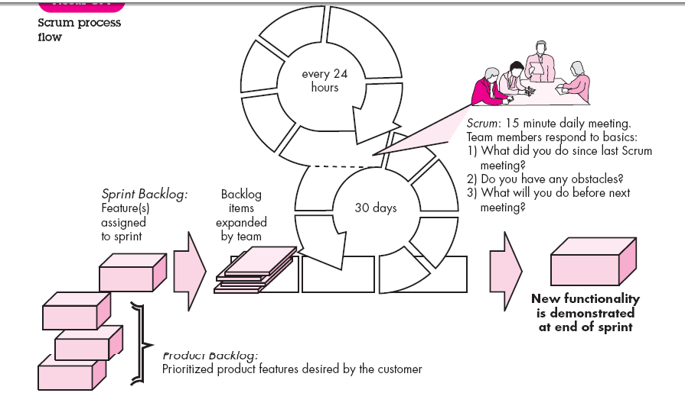

Slide 39
Backlog—a prioritized list of project requirements or features that provide business value for the customer. Items can be added to the backlog at any time (this is how changes are introduced).
The product manager assesses the backlog and updates priorities as required.

Slide 40
Sprints—consist of work units that are required to achieve a requirement defined in the backlog that must be fit into a predefined time-box (typically 30 days).
Changes (e.g., backlog work items) are not introduced during the sprint. Hence, the sprint allows team members to work in a short-term, but stable environment.

Slide 41
Scrum meetings—are short (typically 15 minutes) meetings held daily by the Scrum team. Three key questions are asked and answered by all team members :
• What did you do since the last team meeting?
• What obstacles are you encountering?
• What do you plan to accomplish by the next team meeting?

Slide 42
A team leader, called a Scrum master, leads the meeting and assesses the responses from each person.
The Scrum meeting helps the team to uncover potential problems as early as possible.
Also, these daily meetings lead to “knowledge socialization”
and thereby promote a self-organizing team structure.

Slide 43
Demos—deliver the software increment to the customer so that functionality that has been implemented can be demonstrated and evaluated by the customer.
It is important to note that the demo may not contain all planned functionality, but rather those functions that can be delivered within the time-box that was established.

Slide 44
Beedle and his colleagues present a comprehensive discussion of these patterns in which they state:
The Scrum process patterns enable a software team to work successfully in a world where the elimination of uncertainty is impossible.

Slide 45
Feature Driven Development
06-10-2016
Feature Driven Development (FDD) was originally conceived by Peter Coad and his colleagues as a practical process model for object-oriented software engineering.
Stephen Palmer and John Felsing have extended and improved Coad’s work, describing an adaptive, agile process that can be applied to moderately sized and larger software projects.

Slide 46
FDD adopts a philosophy that
emphasizes collaboration among people on an FDD team;
(2) manages problem and project complexity using feature-based decomposition followed by the integration of software increments, and
(3) communication of technical detail using verbal, graphical, and text-based means.

Slide 47
FDD emphasizes software quality assurance activities by
Encouraging an incremental development strategy,
The use of design and code inspections,
The application of software quality assurance audits
The collection of metrics, and the use of patterns

Slide 48
In the context of FDD, a feature “is a client-valued function that can be implemented in two weeks or less” .
The emphasis on the definition of features provides the following benefits:

Slide 49
Because features are small blocks of deliverable functionality, users can
describe them more easily; understand how they relate to one another more
readily; and better review them for ambiguity, error, or omissions.
Features can be organized into a hierarchical business-related grouping.
Since a feature is the FDD deliverable software increment, the team develops operational features every two weeks.

Slide 50
Because features are small, their design and code representations are easier
to inspect effectively.
Project planning, scheduling, and tracking are driven by the feature hierarchy, rather than an arbitrarily adopted software engineering task set.

Slide 51
Coad and his colleagues suggest the following template for defining a feature:
<action> the <result> <by for of to> a(n) <object>

Slide 52
Examples of features for an e-commerce application might be:
Add the product to shopping cart
Display the technical-specifications of the product
Store the shipping-information for the customer

Slide 53
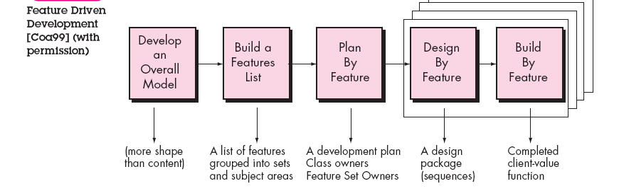

Slide 54
FDD provides greater emphasis on project management guidelines and techniques than many other agile methods.
FDD defines six milestones during the design and implementation of a feature: “design walkthrough, design, design inspection, code, code inspection, promote to build”

Slide 55
Lean Software Development (LSD)
Lean Software Development (LSD) has adapted the principles of lean manufacturing to the world of software engineering.

Slide 56
The lean principles that inspire the LSD process can be summarized as
Eliminate waste
Build quality in
Create knowledge
Defer commitment
Deliver fast
Respect people, and
Optimize the whole.

Slide 57
Eliminate waste within the context of an agile software project can be interpreted to mean :
(1) Adding no extraneous features or functions.
(2) Assessing the cost and schedule impact of any newly requested requirement.
(3) Removing any superfluous process steps.

Slide 58
(4) Establishing mechanisms to improve the way team members find information.
(5) Ensuring the testing finds as many errors as possible.

Slide 59
(6) Reducing the time required to request and get a decision that affects the software or the process that is applied to create it, and
(7) Streamlining the manner in which information is transmitted to all stakeholders involved in the process

Slide 60
AGILE DESIGN

Slide 61
The Symptoms of Poor Design
Rigidity
Rigidity is the tendency for software to be difficult to change, even in simple ways.
A design is rigid if a single change causes a cascade of subsequent changes in dependent modules.
The more modules that must be changed, the more rigid the design.

Slide 62
Fragility
Fragility is the tendency of a program to break in many places when a single change is made.
Often, the new problems are in areas that have no conceptual relationship with the area that was changed.
Fixing those problems leads to even more problems, and the development team begins to resemble a dog chasing its tail

Slide 63
Immobility
A design is immobile when it contains parts that could be useful in other systems, but the effort and risk involved with separating those parts from the original system are too great.

Slide 64
Viscosity
Viscosity comes in two forms: viscosity of the software and viscosity of the environment.
When faced with a change, developers usually find more than one way to make that change.
Some of the ways preserve the design; others do not . When the design-preserving methods are more difficult to use , the viscosity of the design is high.

Slide 65
Needless Complexity
A design smells of needless complexity when it contains elements that aren't currently useful.
This frequently happens when developers anticipate changes to the requirements and put facilities in the software to deal with those potential changes.

Slide 66
Needless Repetition
Cut and paste may be useful text-editing operations, but they can be disastrous code-editing operations.
All too often, software systems are built on dozens or hundreds of repeated code elements.

Slide 67
Opacity
Opacity is the tendency of a module to be difficult to understand. Code can be written in a clear and expressive manner, or it can be written in an opaque and convoluted manner.
Code that evolves over time tends to become more and more opaque with age. A constant effort to keep the code clear and expressive is required in order to keep opacity to a minimum.

Slide 68
The Single-Responsibility Principle (SRP)
The Single-Responsibility Principle
A class should have only one reason to change.
This principle was described in the work of Tom DeMarco and Meilir Page-Jones. They called it cohesion.

Slide 69
If a class has more than one responsibility, the responsibilities become coupled.
Changes to one responsibility may impair or inhibit the class's ability to meet the others.
This kind of coupling leads to fragile designs that break in unexpected ways when changed.

Slide 70
For example, consider the design in Figure. The Rectangle class has two methods shown.
One draws the rectangle on the screen, and the other computes the area of the rectangle

Slide 71
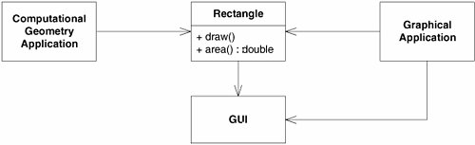
More than one responsibility

Slide 72
Two different applications use the Rectangle class.
One application does computational geometry but never drawing the rectangle on the screen.
The other application is graphical in nature and may also do some computational geometry, but it definitely draws the rectangle on the screen

Slide 73
This design violates SRP.
The Rectangle class has two responsibilities. The first responsibility is to provide a mathematical model of the geometry of a rectangle.
The second responsibility is to render the rectangle on a GUI.

Slide 74
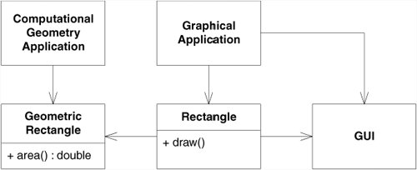
Separated responsibilities

Slide 75
Open/Closed Principle
Bertrand Meyer coined the famous open/closed.
To create designs that are stable in the face of change and that will last longer than the first version

Slide 76
The Open/Closed Principle (OCP)
The Open/Closed Principle (OCP)
Software entities (classes, modules, functions, etc.) should be open for extension but closed for modification.

Slide 77
When a single change to a program results in a cascade of changes to dependent modules, the design smells of rigidity.
OCP advises us to refactor the system so that further changes of that kind will not cause more modifications, If OCP is applied well, further changes of that kind are achieved by adding new code, not by changing old code that already works

Slide 78
Description of OCP
Modules that conform to OCP have two primary attributes.
They are open for extension.
This means that the behavior of the module can be extended. As the requirements of the application change, we can extend the module with new behaviors that satisfy those changes.
In other words, we are able to change what the module does

Slide 79
They are closed for modification.
Extending the behavior of a module does not result in changes to the source, or binary, code of the module.
The binary executable version of the Module whether in a linkable library, a DLL, or a .EXE file remains untouched

Slide 80
It would seem that these two attributes are at odds. The normal way to extend the behavior of a module is to make changes to the source code of that module.
A module that cannot be changed is normally thought to have a fixed behavior
How is it possible that the behaviors of a module can be modified without changing its source code? Without changing the module, how can we change what a module does?

Slide 81
The answer is abstraction.
In C# or any other object-oriented programming language (OOPL), it is possible to create abstractions that are fixed and yet represent an unbounded group of possible behaviors.
The abstractions are abstract base classes, and the unbounded group of possible behaviors are represented by all the possible derivative classes

Slide 82

The Client class uses the Server class. If we want for a Client object to use a different server object, the Client class must be changed to name the new server class.
Client is not open and closed

Slide 83
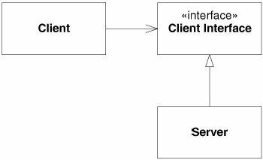
STRATEGY pattern: Client is both open and closed.

Slide 84
In this case, the ClientInterface class is abstract with abstract member functions.
The Client class uses this abstraction. However, objects of the Client class will be using objects of the derivative Server class.
If we want Client objects to use a different server class, a new derivative
of the ClientInterface class can be created. The Client class can remain unchanged.

Slide 85
The Liskov Substitution Principle
Barbara Liskov wrote this principle in 1988
Subtypes must be substitutable for their base types.

Slide 86
The Interface Segregation Principle (ISP)
Clients should not be forced to depend upon methods that they do not use. Interfaces belong to clients, not to hierarchies.

Slide 87
The Interface Segregation Principle (ISP)
The interfaces of the class can be broken up into groups of methods. Each group serves a different set of clients.
Thus, some clients use one group of methods, and other clients use the other groups.

Slide 88
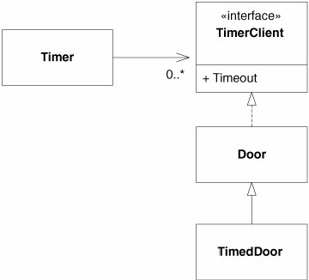

Slide 89
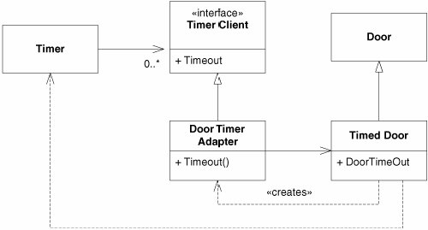
Door timer adapter

Slide 90
The Dependency-Inversion Principle
The Dependency-Inversion Principle
High-level modules should not depend on low-level modules. Both should depend on abstractions.
Abstractions should not depend upon details. Details should depend upon abstractions.

Slide 91
It is the high-level modules that contain the important policy decisions and business models of an application.
These modules contain the identity of the application. when these modules depend on the lower-level modules, changes to the lower-level modules can have direct effects on the higher-level modules and can force them to change in turn.

Slide 92
The modules that contain the high-level business rules should take precedence over, and be independent of, the modules that contain the implementation details

Slide 93
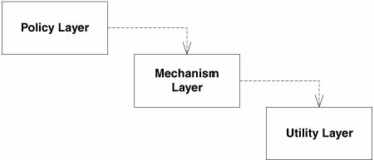

Slide 94
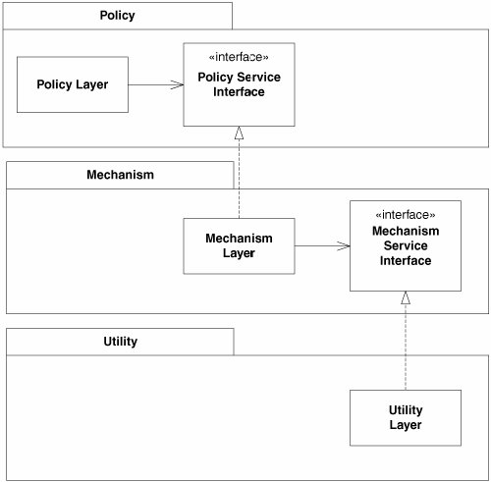

Slide 95
Each higher-level class uses the next-lowest layer through the abstract interface. Thus, the upper layers do not depend on the lower layers.
Instead, the lower layers depend on abstract service interfaces declared in the upper layers.

