Slide 1
Introduction
Data can be a facts related to any object in consideration
Eg:
Name, Age, Height,.. are related to human
Student, Faculty, Classroom… are related to college

Slide 2
Introduction…
Data Base
Data base is a systematic collection of data.
Since data in the database is organized, it makes the data management easy.
Eg:
For a college database might contains information about the following data
Rollno, Student, Branch,..
The relation ship between data such as student rollno in which branch etc.

Slide 3
Introduction…
A DBMS is a collection of interrelated data and a set of programs to access those data.
Collection of data usually referred to as the database, contains information relevant to an enterprise.
The primary goal of a DBMS is to provide a way to store and retrieve database information that is both convenient and efficient.

Slide 4
Introduction…
DATABASE-SYSTEM APPLICATIONS
Enterprise Information
Banking and Finance
Universities
Airlines etc…

Slide 5
DBMS
History
DBMS first implemented in 1960 by Charles Bachman
Called the Integrated Data Store(IDS).
It is the basis for the network data model
In the late 1960s, IBM developed the Information Management System (IMS) used even today in many major installations.
It formed the basis for the hierarchical data model.

Slide 6
History
In 1970, Edgar Codd, proposed a new data representation framework called the relational data model.
In the 1980s, The SQL query language for relational databases, developed as part of IBM's System
SQL was standardized in the late 1980s.
Current standard, SQL:1999, was adopted by the American National Standards Institute (ANSI) and International Organization for Standardization (ISO).

Slide 7
History
In the late 1980^{s} and the 1990^{s} Several vendors (e.g., IBM‘sDB2, Oracle 8, Informix2 UDS) developed their systems with the ability to store new data types such as images and text, and to ask more complex queries.

Slide 8
Purpose of DBMS
File System Versus DBMS
Concurrent access Anomalies
Data redundancy
Difficulty in accessing data
Data isolation
Atomicity Problem
Security Problem

Slide 9
Purpose of DBMS(contd..)
File System Versus DBMS
Concurrent access Anomalies
File system will not allow to access the same data by multiple users at same time- it leads to inconsistent (not correct) of data
Data redundancy (repetition of data)
Data is repeated in file system it needs more storage
For different data, the application program may be changed – it need more storage

Slide 10
Purpose of DBMS(contd..)
Difficulty in accessing data
No efficient way to access data. Write more lines of code for retrieving data from file system
Data isolation
Difficulty in retrieving appropriate data
Data may be in different format
Go through the application program and change the code for retrieving different data in file system

Slide 11
Purpose of DBMS(contd..)
File System Versus DBMS
Atomicity Problem
File system cannot restored to a consistent stage after a failure or crash
Security Problem
User can access any part of the file system

Slide 12
Advantages of DBMS
Data Integrity
Roll Back
Security
Concurrency Control
Backup
Data Independence

Slide 13
Advantages of DBMS
Data Integrity (Accuracy or correctness of Data)
DBMS can enforce integrity constraints.
For example, before inserting information DBMS can check the data.
Roll Back
Undo an executed statement

Slide 14
Advantages of DBMS
Security
No unauthorized user access
it can enforce access controls
Concurrency Control
Multiple user access can access of change same data at same time

Slide 15
Purpose of DBMS (contd..)
Advantages of DBMS
Backup
Copies for security, can take copy of data
Data Independence
The DBMS provides an abstract view of the data that hides some details which are related with.

Slide 16
View of Data
A major purpose of a DB system is to provide users with an abstract view of the data.
i.e., the system hides certain details of how the data are stored and maintained.

Slide 17
View of Data
Data Abstraction
For efficient retrieval of complex data, database need a good data structure to represent data .
Developers hide the complexity from users through several levels of abstraction, to simplify users’ interactions with the system:

Slide 18
Levels of Abstraction in a DBMS(cntd. )
The data in a DBMS is described at 3 levels of abstraction.
The database description consists of a schema at each of these 3 levels of abstraction:
Physical schema
Logical schema
External schema

Slide 19
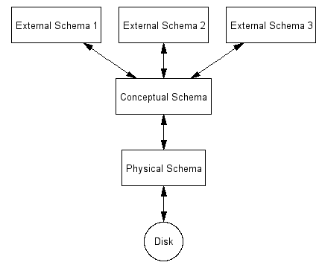
Levels of Abstraction in a DBMS(cntd. )

Slide 20
Data Abstraction
1. Physical Schema(Level) :
The lowest level of abstraction describes how the data are actually stored.
The physical level describes complex low-level data structures in detail.

Slide 21
Physical Schema(Level) :
Physical schema summarizes how the relations described in the conceptual schema are actually stored on secondary storage devices such as disks & tapes.
A sample physical schema for the university DB:
Store all relations as unsorted files of records.
Create indexes on the first column of the Students, faculty, and courses relations.

Slide 22
Data Abstraction
2. Logical (Conceptual )Level :
The next-higher level of abstraction describes what data are stored in the database.
And what relationships exist among those data.
The logical level describes the entire database in terms of simple structures.
The user of the logical level does not need to be aware of this complexity.
Database administrators, who must decide what information to keep in the database, use the logical level of abstraction.

Slide 23
Data Abstraction
Conceptual Schema
The conceptual schema (logical schema) describes the stored data in terms of the data model of the DBMS.
In a relational DBMS, the conceptual schema describes all relations that are stored in the database.
Eg: for conceptual schema
Students(sid: int, name: char(20), age: int)

Slide 24
Data Abstraction
3. View (External)Level:
The highest level of abstraction describes only part of the entire database.
Many users of the database system do not need all this information; instead, they need to access only a part of the database.
The view level of abstraction exists to simplify users interaction with the system.
The system may provide many views for the same database.

Slide 25
View (External)Level:
Any given DB has exactly one conceptual schema & one physical schema because it has just one set of stored relations;
But it has several external schemas designed for particular group of users.

Slide 26
Data Models
A data model is a collection of high-level data description
constructs that hide many low-level storage details.
A data model provides a way to describe the design of a
database at the physical, logical and view levels.

Slide 27
Data Models (contd…)
1. Relational Model
The relational model is a collection of tables to represent both data and the relationships among those data.
Each table has multiple columns, and each column has a unique name.
Tables are also known as relations.

Slide 28
Data Models (contd…)
2. Entity-Relationship Model (E-R Model)
It uses a collection of basic objects called entities and relationships among these objects.

Slide 29
Data Models (contd…)
3. Object Based Data Model
OOP led to the development of this model that can be seen as extending the E-R model.
Data are stored in the form of objects
Objects are store in the form of attributes

Slide 30
Data Models (contd…)
4. Semistructured Data Model
This model permits the specification of data where individual data items of the same type may have different sets of attributes.
Eg; XML

Slide 31
Instances
The collection of information stored in the database at a
particular time is called an instance.

Slide 32
Schemas
The overall design of the database is called the database schema.
The different types of schemas:
Physical – describes the db design at the physical level
Conceptual/Logical - describes the db design at the logical level
Subschemas- schemas at the view level, that describe different views of the db.

Slide 33
The people who work with databases include
database users,
system analysts,
application programmers, and
database administrators (DBA).

Slide 34
Database users are those who interact with the database in order to query and update the database, and generate reports.
Database users are further classified into
Naive users:
Sophisticated users:
Specialized users:

Slide 35
Naive users: The users who maintain the database by invoking some already written application programs.
For example, super market s/w user.
- end user.
Sophisticated users: The users, who are interact DBMS without writing any application programs.
For example writing SQL
- eg:- users in DBMS LAb

Slide 36
Specialized users: The users who write specialized database programs,
Specialized users write applications such as computer-aided design systems, knowledge-base, expert systems that store data having complex data types.
- eg: - users who write artificial intelligence programs like prolog, Lisp, etc,.. (eg: - nested queries.)

Slide 37
System analysts determine the requirements of the database users (especially naive users) to create a solution for their business need, and focus on non-technical and technical aspects.
The non-technical aspects involve defining system requirements, interaction between business users and technical staff, etc.
Technical aspects involve developing the specification for user interface (application programs).

Slide 38
Application programmers are the computer professionals who implement the specifications given by the system analysts, and develop application programs For the naive users.
Eg:- PHP programmers, Java programmers…
Develop packages that facilitate data access for end users.

Slide 39
Database administrator (DBA) is a person who has central control over both data and application programs.
Some of the responsibilities of DBA are:
1. Schema Definition: The DBA creates the original db schema by executing a set of DDL statements.
2. Schema and Physical Organization Modification: The DBA carries out the changes to the schema and physical organization to reflect the changing needs of the organization.

Slide 40
3. Storage and Access –method modification: Creates the appropriate storage structure and access methods by writing a set of definitions which is translated by the data storage and DDL compiler.
4. Granting of authorization for data access: Different types of authorization, the DBA can regulate which parts of the database, various users can access.

Slide 41
5. Routine Maintenance:
:Backing up the database periodically.
:Ensuring enough space is available
:Monitoring the performance

Slide 42
Database Languages
DDL : To specify the db schema
DML : To express database queries and updates.

Slide 43
DML
DML : Enables users to access or manipulate data as organized by the appropriate data model.
The types of access include:
Retrieval
Insertion
Deletion
Modification

Slide 44
DMLs are classified into two:
Procedural DMLs : require a user to specify what data are needed and how to get those data.
Declarative DMLs : require a user to specify what data are needed without specifying how to get those data.

Slide 45
DDL :
Used to specify the database schema by a set of definitions called a DDL.
Used to specify the storage structure
Facility to specify constraints

Slide 46
Constraints:
Domain Constraints: A domain of possible values must be associated with every attribute.
Eg; integer types, character types etc.

Slide 47
Referential Integrity: It ensure that a value that appears in one relation for a given set of attributes also appears in a certain set of attributes in other relation.
Eg; the dept_name in a course record must appear in the dept_name attribute of some record of the department relation.

Slide 48
Assertions: An assertion is a condition that the database must always satisfy.

Slide 49
Authorization: Differentiating users based on
read authorization: allows only reading, but not modification
Insert authorization: insertion of new data, no modification
Update: allows updation, not deletion
Delete: deletion of data

Slide 50
Overview of DB Design
Database design is the process of producing a detailed data model of a database.
This physical & logical data model contains all the needed logical and physical design
A fully designed data model contains detailed attributes for each entity.
Data base design describe overall database system

Slide 51
Overview of DB Design
The design process
The design process consists of the following steps:
1) Determine the purpose of database
This helps to prepare the remaining steps.
2) Find and organize the information required
Gather all types of information to record in the database.
3) Divide the information into tables
Divide the information items into major entities or subjects, to form a table.

Slide 52
Overview of DB Design
The design process
4) Turn information items into columns
Decide what information, want to store in each table.
What are the items becomes a field, in the table.
5) Specify primary keys
Decide each table’s primary key.
The primary key :- used to uniquely identify each row

Slide 53
Overview of DB Design
6) Set up the table relationships
Decide how the data in one table is related to the data in other tables.
Connect tables using reference key
7) Refine the design
Analyze the design for errors.
Create the tables and add a few sample data.

Slide 54
Entity-Relationship Model (E-R Model)
The E-R Model constitutes:
Entity
Entity Sets
Attributes/Properties

Slide 55
E-R Diagram
ER Diagram (Entity-Relationship Diagram)
In 1976 proposed by Peter Chen
ER diagram is detailed, logical representation of the data for an organization or business area
Three principal components of ER Diagram
Entity set
Attribute
Relationship

Slide 56
E-R Diagram
ER Diagram symbols
Entity weak entity
Attribute Key attribute
Derived attribute
Relationship
Identifying relationship

Slide 57
E-R Model
Entity
A thing or object in the real world , i.e., distinguishable from or other objects.
An Entity can be a person, place, object or concept in the real world
Object with physical existence : person, car, book, etc
Object with conceptual existence: university, course, loan etc
Eg; each student in a student information DB

Slide 58
E-R Model
Entity Set
Collection of entities of same type that shares a common properties or characteristics or attributes.
Eg
Student: Name, Phone no etc.
Book : entity collection of book → entity set

Slide 59
E-R Model
Attribute
Is the property or characteristics of the entity
Eg:
Employee is an entity with following attributes
Name, Age, Sex
Age
Name
Sex
Employee

Slide 60
E-R Model
Types of Attributes
1) Simple Attribute
2) Composite Attribute
3) Single valued Attribute
4) Multi valued Attribute
5) Derived Attribute
6) Null Attribute

Slide 61
E-R Model
Simple Attribute
It cannot be divided into sub parts
Eg;
Student rollno

Slide 62
E-R Model
2. Composite Attributes
Can be divided into subparts or other attributes.
Eg;
Student Name can be further divided into
Firstname
Lastname
Middlename

Slide 63
E-R Model
3. Single valued Attribute
This will be having single values for a particular attribute.
Eg;
Age, Id etc.

Slide 64
E-R Model
4. Multivalued Attribute
This will be having multiple values for a particular attribute.
Eg;
Student->Phno

Slide 65
E-R Model
5. Derived Attribute
That are not stored directly, but can be derived from the stored attribute
Eg
For an employee, emp_year attribute is an example, because year of service can be calculated from the current date and emp_joined date
The value of age can be derived from the attribute DOB

Slide 66
E-R Model
6. Null Attribute
Some case a particular entity may not have a value for an attribute
Eg;
Apartment number attribute of an address applies only to address that are in apartments, not to other residential address

Slide 67
E-R Model
Stored Attribute
Attributes which are already stored in the DB and from which values of another attribute is derived.
Eg,
Date of Birth

Slide 68
E-R Model
Attribute Value:
is a real data of particular entity for all of its
attributes.

Slide 69
E-R Model
Key attribute of an entity set
An attribute whose value is unique for each individual entity in the entity set
Eg: Rollno number is Unique for each students in the class

Slide 70
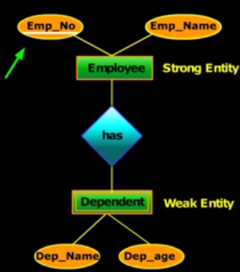
E-R Model
Strong & weak Entity types
Strong Entity
It contains a key attribute
It is an independent entity set
It is used to identify entity uniquely
Weak entity it does not contain a key attribute
It is a dependent entity set
It cannot be used to identify entity uniquely
Eg
Employee → strong entity type, because it contains Emp_no as a key attribute
Dependent→ weak entity type, because it has no key attribute

Slide 71
Relationship and Relationship-Sets
Relationship
It is an association among several entities.
Eg;
Anjana works in MCA department
Anjana-entity
Works in-relationship
MCA department-entity

Slide 72
Relationship and Relationship-Sets
Relationship Set
Collection of similar relations.
Degree of a relationship set:
It is the no. of entity sets that participate in a relation set.
Relationship that involves 2 entity sets are called binary (degree-2).
Relationship that involves 3 entity sets are called ternary(degree-3).

Slide 73
Simple relationship-binary

Slide 74
Ternary Relationship

Slide 75
Relationship and Relationship-Sets
Relationship cardinality (Mapping Cardinalities)
Express the No of entity to which another entity can be associated via a relationship.
Based on the cardinality, binary relationship can be classified into
One-to-one
One-to-Many
Many-to-one
Many-to many

Slide 76
Relationship and Relationship-Sets
One-to-One
Each entity in a relationship will have exactly one relationship
Eg: one college can have at most one principal and one principal can assigned to only one college

Slide 77
Relationship and Relationship-Sets
One-to-Many
An entity in A is associated with any number of entities in B & an entity in B is associated with at most one entity in A.
Eg;
One department can appoint any number of faculty members but one faculty member is assigned to only one department

Slide 78
Relationship and Relationship-Sets
Many-to-One
An entity in A is associated with at most one entity in B, and an entity in B is associated with any number of entities in A
Example
Course has many students but a student can be opt for only one course

Slide 79
Relationship and Relationship-Sets
Many-to-Many
Entities of both sides of the relationship can have many related entities on the other side
Example
One faculty member can be assigned to teach many courses and one course may be taught by many facility members

Slide 80
Participation Constraints
Two types
Total participation
When all the entities from an entity set E participate in at least one relationship in R is called total participation.
It is represented by double arrow
Partial participation
When it is not necessary for all entities in entity set E participate in a relationship R is called partial participation.

Slide 81
Keys
Key is defined as the column or attribute of the database table, used to identify one or more instances of the table.
Superkey : A superkey is a set of one or more attributes that can uniquely identify an entity in the entity set.
Eg: rollno for the entity set student will uniquely identify a student. So rollno is a superkey. The combination of studentname and rollno is also a superkey for the entity set student.

Slide 82
Candidate key
It is a set of one or more fields that can uniquely identify an entity in the entity set.
There can be multiple candidate keys in one table.
Each candidate key can work as primary key.
Only one candidate key can work as primary key.

Slide 83
Eg;
In student table id, rollno, regno are candidate keys since all these 3 fields can be worked as primary keys.

Slide 84
Alternate key or Secondary key
It is a key that can be used as a primary key.
Basically it is any candidate key which is currently not selected as the primary key.
Eg; in the student table if id is taken as primary key, then rollno and regno will be alternate keys.

Slide 85
Composite keys
It is the combination of more than one fields or columns of a table.

Slide 86
Extended E-R features
Subclasses, Super classes & Inheritance
Sub groupings of entities that are meaningful.
Ex: EMPLOYEE may be further grouped into
SECRETARY, ENGINEER, MANAGER, TECHNICIAN, and so on.
Set of entities in each subgroups is a subset of the EMPLOYEE entity set.
Each is called a subclass of EMPLOYEE
EMPLOYEE is the superclass for each of these subclasses
Subclass entity inherits all attributes and relationships of superclass

Slide 87
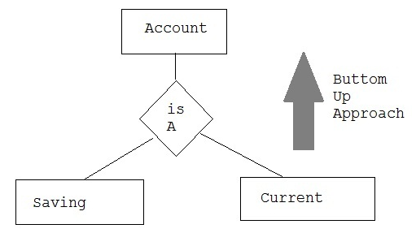
Extended E-R features
Generalization
Bottom-up approach
2 lower level entities combined to form a higher level entity
The higher level entity
can also combine with
other entity to make
further higher level
entity

Slide 88
Extended E-R features
Generalization
several entity types which have some common features into a single super class
Process of defining a generalized entity type from the given entity types

Slide 89
Extended E-R features
Specialization
The process of designating subgroupings within an entity is called specialization.
For eg;
The person allows to distinguish among person entities according to whether they correspond to employees or students: in general a person can be employee,student etc..

Slide 90
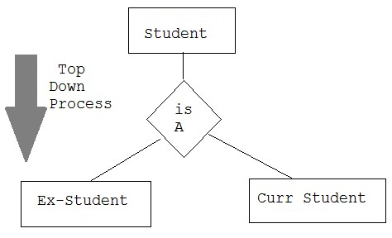
Extended E-R features
Specialization
Opposite to generalization
Top-down approach
Higher level entity can be broken down into 2 lower level entity
Represented by a triangle
Labeled ISA
Eg: Curr-Student is a Student

Slide 91
Extended E-R features
Aggregation
The E-R model cannot express relationships among relationships.
Consider a DB with information about employees who work on a particular project and use a number of machines doing that work.
Relationship work and uses could be combined into a single set.
we treat the relationship work and the entity sets employee and project as a higher-level entity set called work.

Slide 92
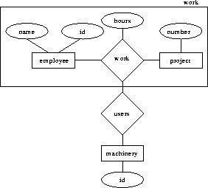
Extended E-R features

Slide 93
Extended E-R features
Aggregation
Process when relation between 2 entity is treated as a single entity.
Eg
Relation between Center & Course is acting as an entity relation with visitor

Slide 94
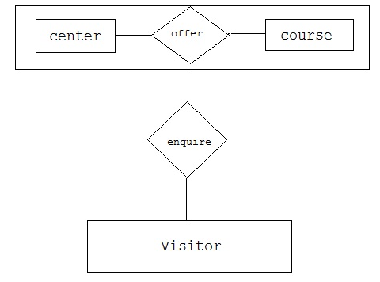

Slide 95
Attribute Inheritance
A crucial property of the higher- and lower-level entities created by specialization and generalization is attribute inheritance.
The attributes of the higher-level entity sets are said to be inherited by the lower-level entity sets.
Eg; student and employee inherit the attributes of person.

Slide 96
Participation inheritance
A lower-level entity set also inherits participation in the relationship sets in which its higher-level entity participates.
Eg; Suppose the person entity participates in a relationship person_dept with department.then the student, employee,instructor and secretary entity sets implicitly participate in the person_dept relationship with department.

Slide 97
Constraints on Generalization
One type of constraint involves determining which entities can be members of a given lower-level entity set. Such membership may be one of the following:
Condition-defined :- In this, lower-level entity sets, membership is evaluated on the basis of whether or not an entity satisfies an explicit condition or predicate.

Slide 98
Eg; Assume that the higher-level entity set account has the attribute account-type. All account entities are evaluated on the defining account-type attribute. Only those entities that satisfy the condition account-type = “savings account” are allowed to belong to the lower-level entity set person. All entities that satisfy the condition account-type = “checking account” are included in checking account. Since all the lower-level entities are evaluated on the basis of the same attribute (in this case, on account-type), this type of generalization is said to be attribute-defined.

Slide 99
User-defined. User-defined lower-level entity sets are not constrained by a membership condition; rather, the database user assigns entities to a given entity set.

Slide 100
For instance, let us assume that, after 3 months of employment, bank employees are assigned to one of four work teams. We therefore represent the teams as four lower-level entity sets of the higher-level employee entity set. A given employee is not assigned to a specific team entity automatically on the basis of an explicit defining condition. Instead, the user in charge of this decision makes the team assignment on an individual basis. The assignment is implemented by an operation that adds an entity to an entity set.

Slide 101
A second type of constraint relates to whether or not entities may belong to more than one lower-level entity set within a single generalization. The lower-level entity sets may be one of the following:

Slide 102
Disjoint. A disjointness constraint requires that an entity belong to no more than one lower-level entity set.
In our example, an account entity can satisfy only one condition for the account-type attribute; an entity can be either a savings account or a checking account, but cannot be both.

Slide 103
• Overlapping. In overlapping generalizations, the same entity may belong to more than one lower-level entity set within a single generalization.
For an illustration, consider the employee work team example, and assume that certain managers participate in more than one work team. A given employee may therefore appear in more than one of the team entity sets that are lower-level entity sets of employee. Thus, the generalization is overlapping.

Slide 104
Completeness constraint
Completeness constraint on a generalization or specialization, specifies whether or not an entity in the higher-level entity set must belong to at least one of the lower-level entity sets within the generalization/specialization. This constraint may be one of the following:
Total generalization or specialization. Each higher-level entity must belong to a lower-level entity set.
Partial generalization or specialization. Some higher-level entities may not belong to any lower-level entity set

