Slide 1
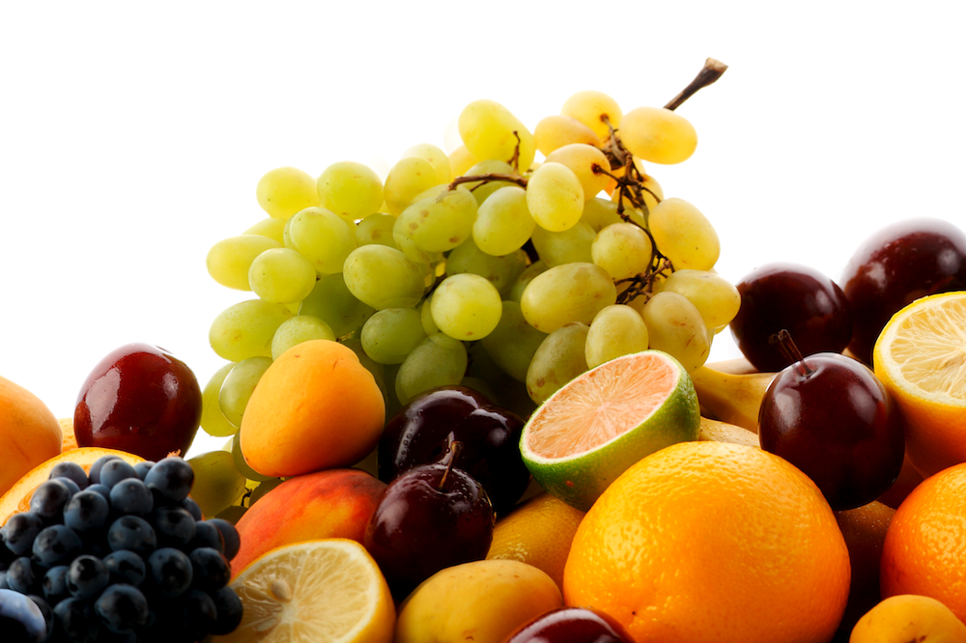
NUTRITIONAL ANALYZER
BAN693 Members: Akhil Mohan Pruthvi Aala Megh Dave Swati Sharma

Slide 2
The Personal Nutritional Analyzer project addresses the growing need for personalized nutritional monitoring. Modern lifestyles often lead to inadequate dietary practices, contributing to various health issues. This system leverages image recognition to bridge the gap between food consumption and nutritional awareness. By capturing food images and inputting portion sizes, users can access real-time evaluations of their nutritional choices and get recommendations. The project aligns with the increasing demand for health-conscious applications that utilize advanced technologies to empower users to take control of their well-being.

Slide 3
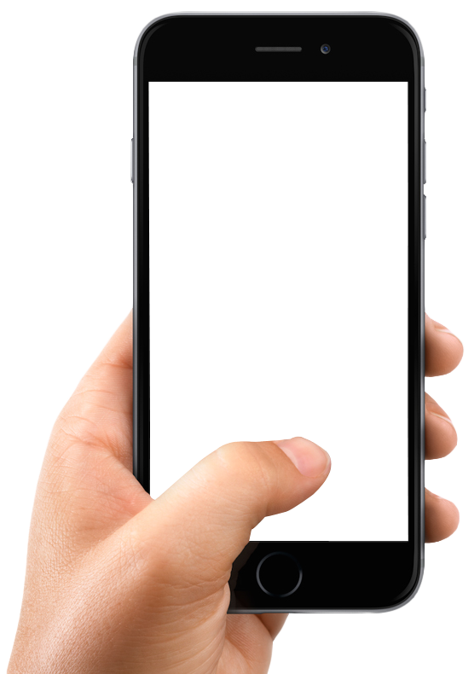

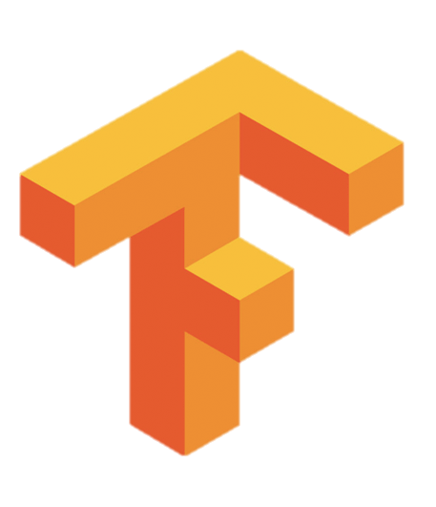
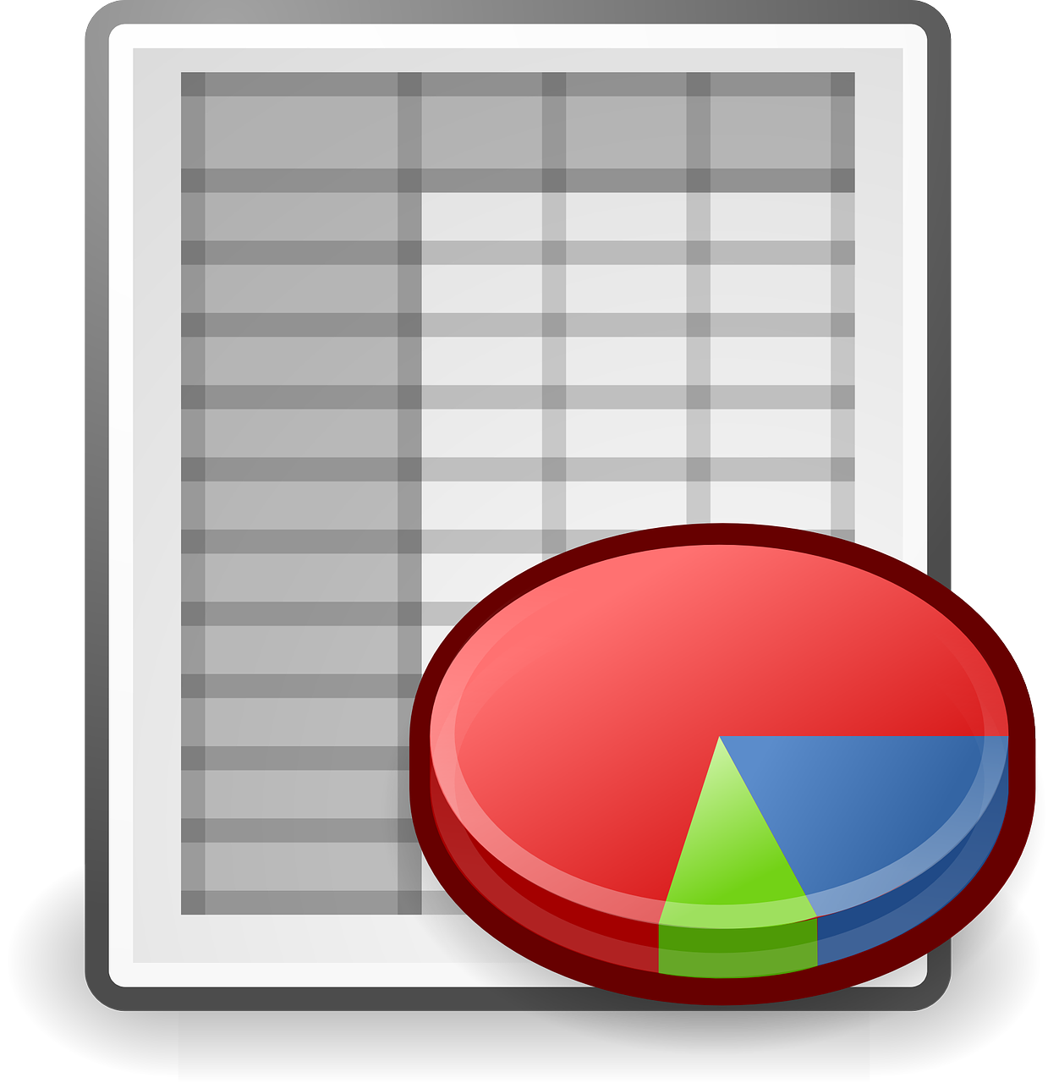
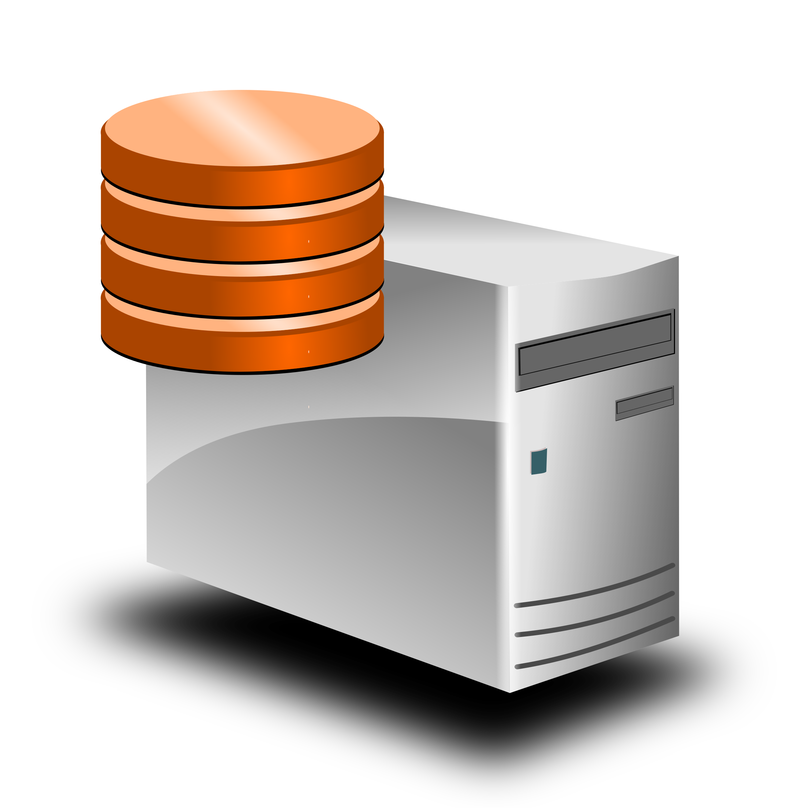
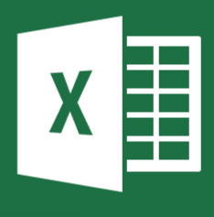
The app also provides recommendations based on your previous meals so you can meet your daily intake goals. We used Chat GPT API to get recipes based on the optimization models outputs.
The tensorflow model (MobilNet V1) recognizes the food item. Inputs are expected to be 3-channel RGB color images of size 224 x 224, scaled to [0, 1]. A probability vector of dimension 2024, corresponding to a background class and one of 2023 food dishes in the labelmap.
Using APIs we get the nutritional profile for the food from the USDA database.
We store the data in a Spreadsheet. We calculate the Macros.
The user can view the history of their consumption through the same app. We use this data and created a optimization model that would provide recommendations.
User Takes pictures and uploads a few details about themselves. The application uses Python (Flask) and html.

Slide 4
DEMONSTRATION

Slide 5
Future Scopes
Track macro nutrients as well as micronutrients.
An Improved UI.
The Ability to track Activity such as steps and workouts.
Create customized optimization models based on the user’s eating habits.
Custom LLM for recommendations that tracks eating habits.

Slide 6
THANK YOU

