Slide 1


IMDB domain model in XML.
Lokesh, Nikhil, Akhil, Avinash, Anirudh, Dinesh, Shyam

Slide 2
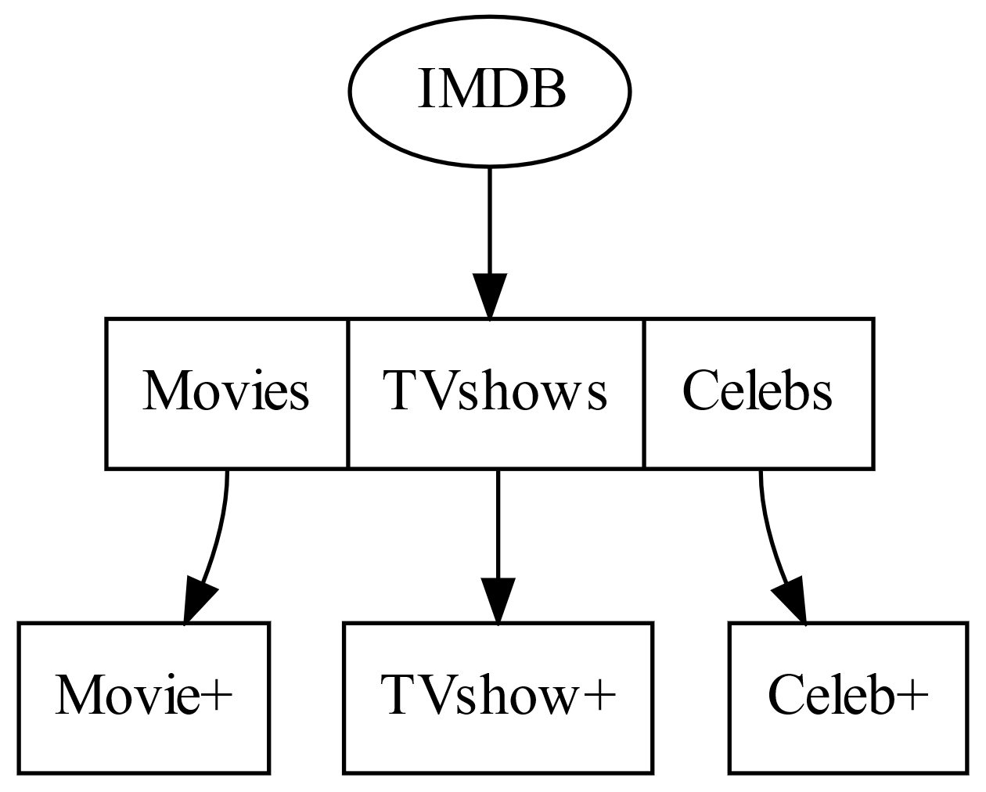
IMDB
IMDB contains Movies, Tvshows, Celebs.

Slide 3
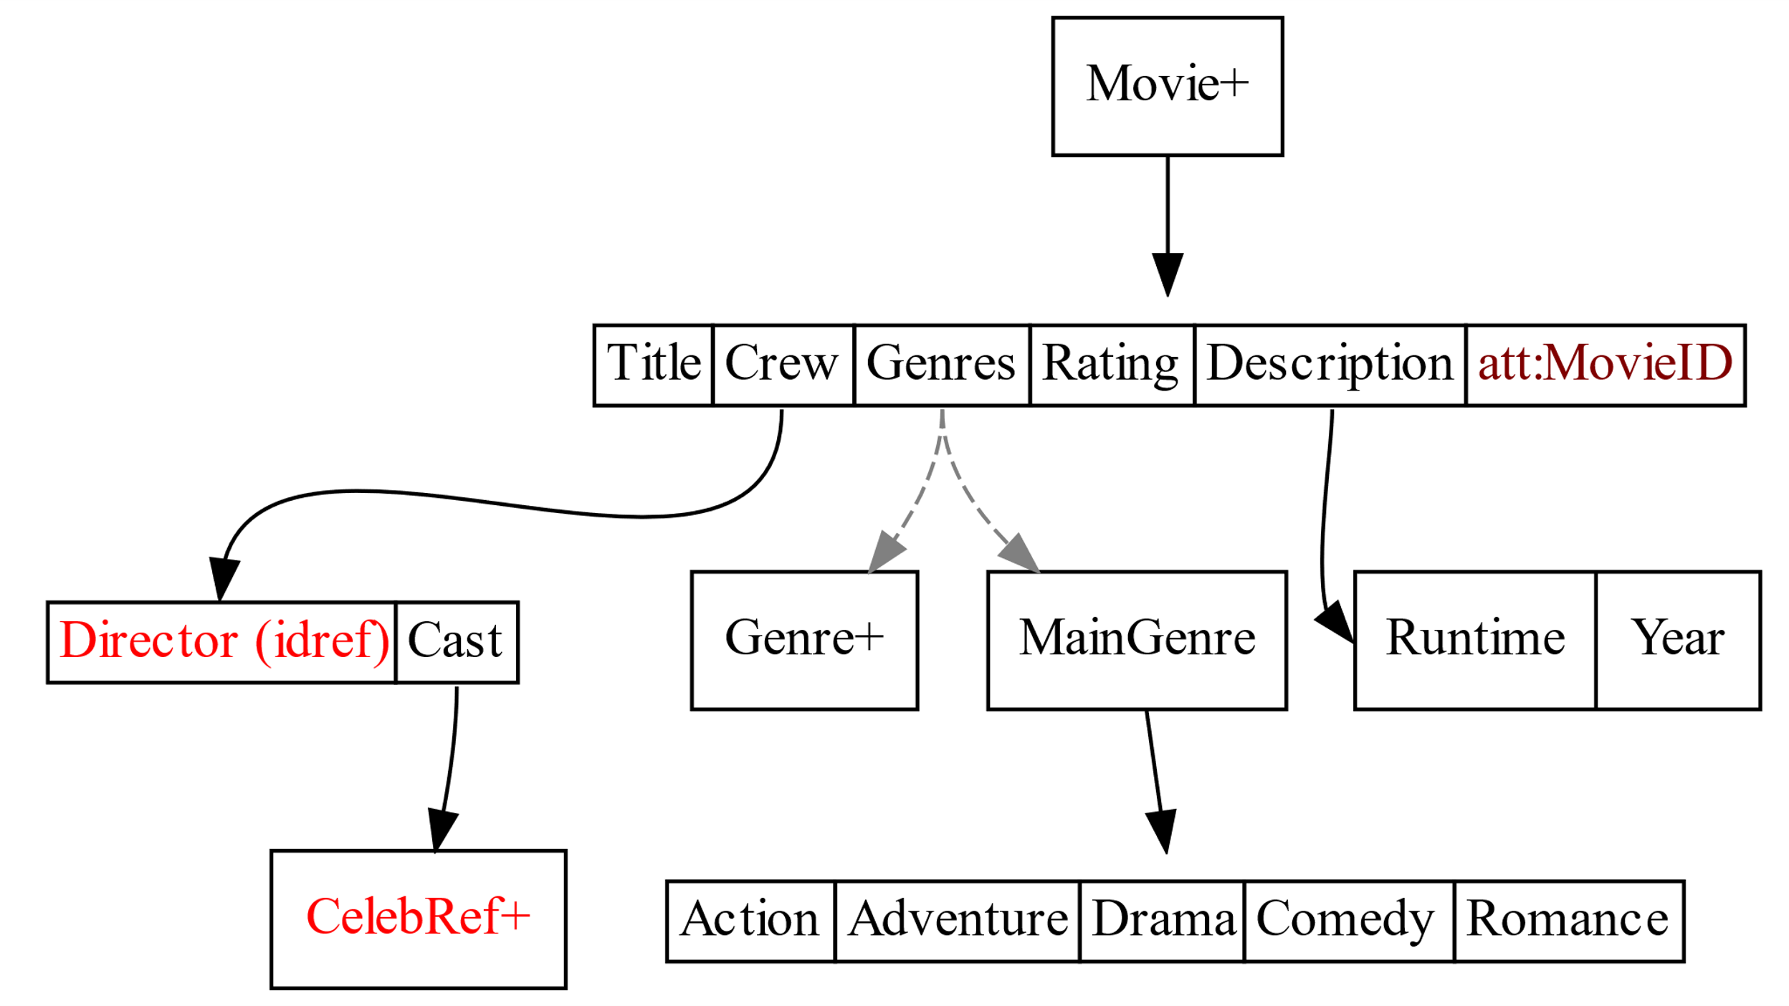
Movie
Movie contains, Title, Crew, Genres, Description, Rating, ID.

Slide 4
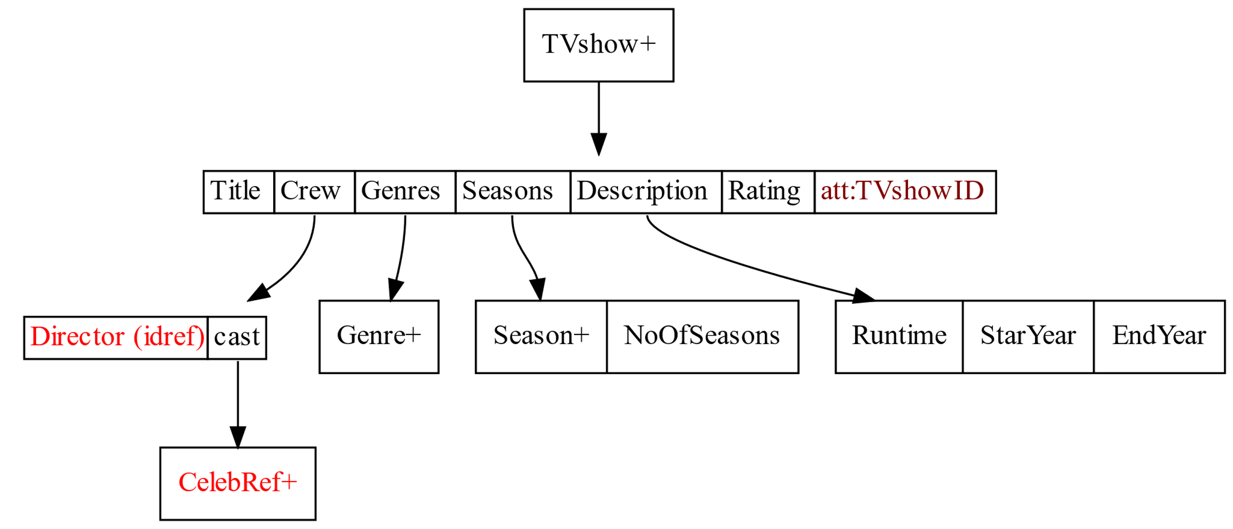
Tvshow
Tvshow contains, Title, Crew, Genres, Seasons, Description, Rating, ID.

Slide 5
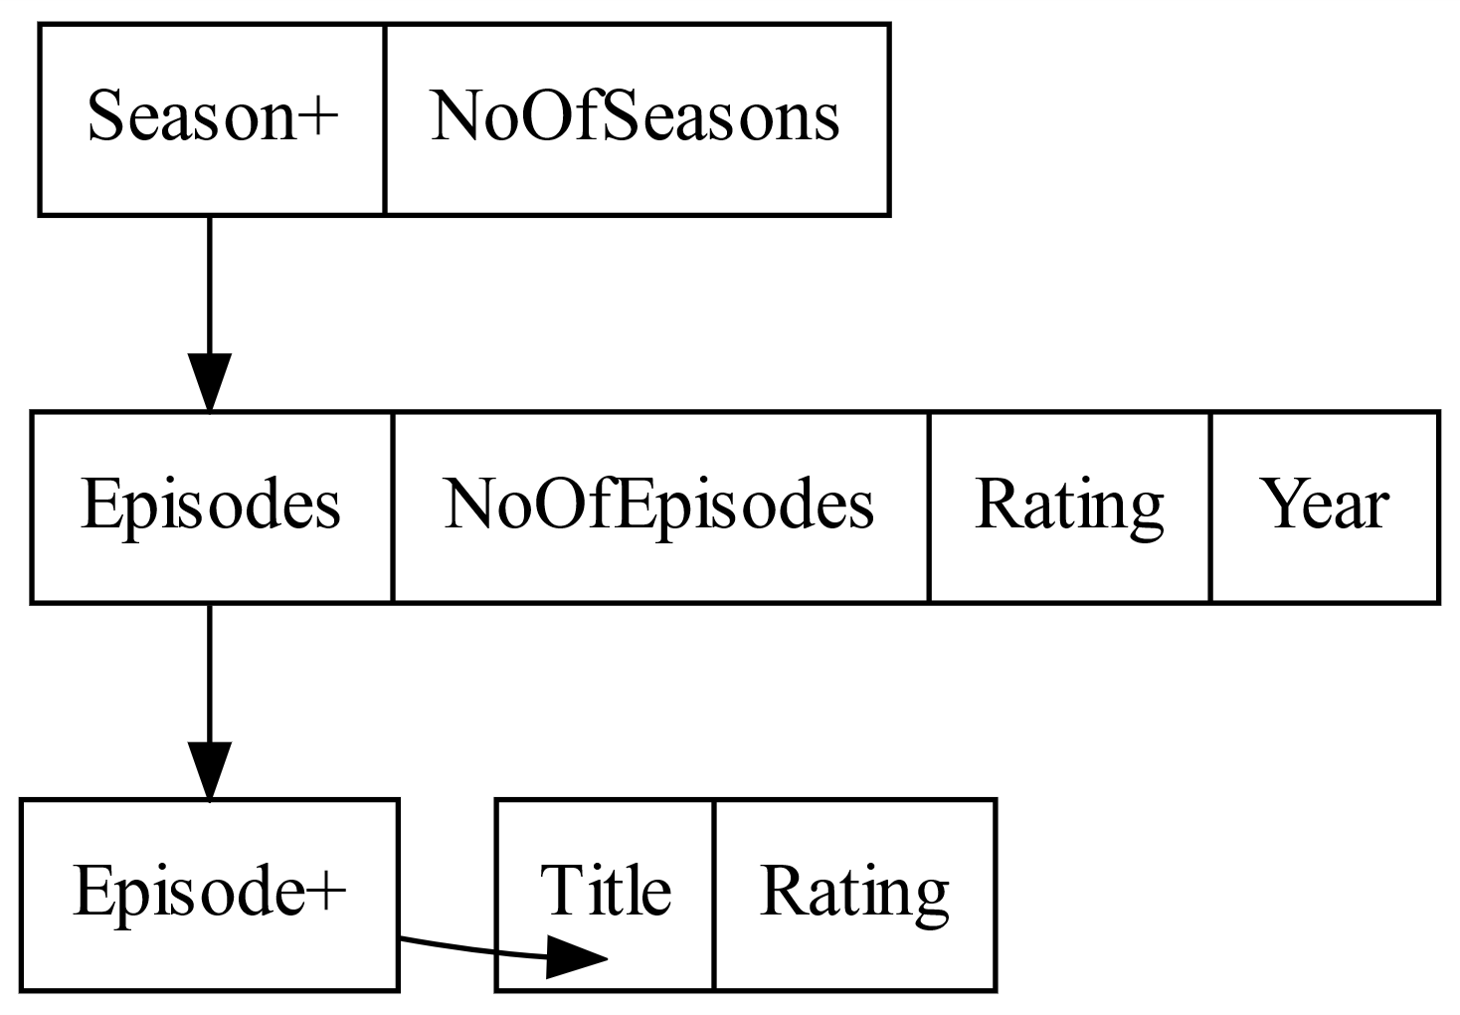
Continue Tvshow

Slide 6
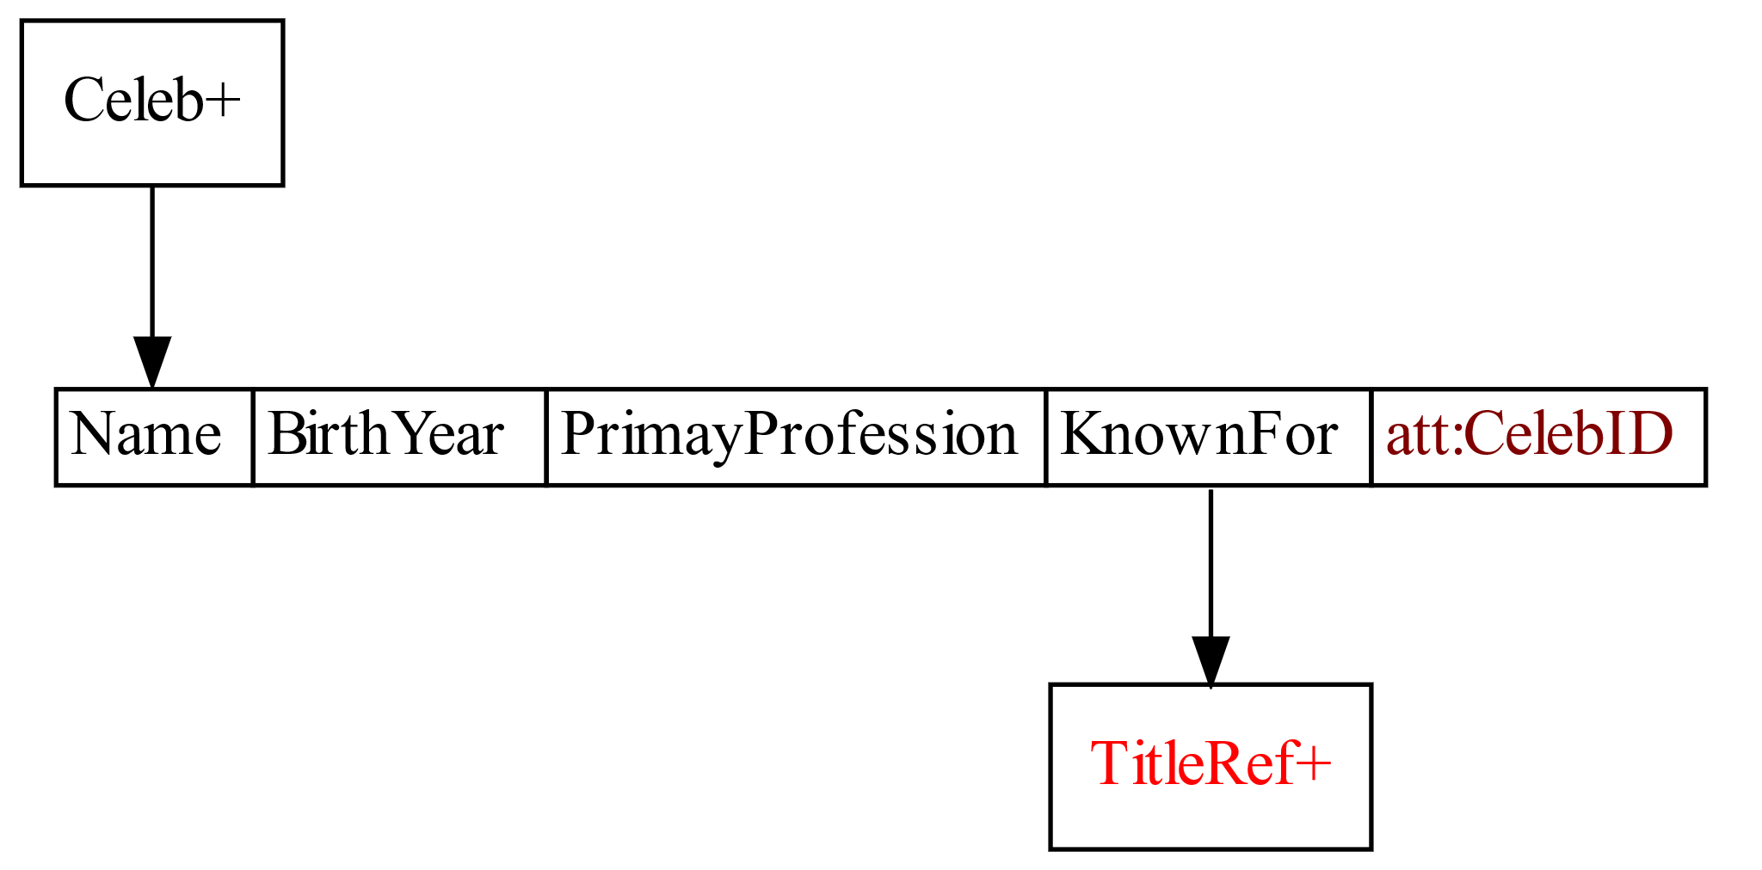
Celeb
Celeb contains, Name, BirthYear, PrimaryProfession, KnownFor, ID.

Slide 7
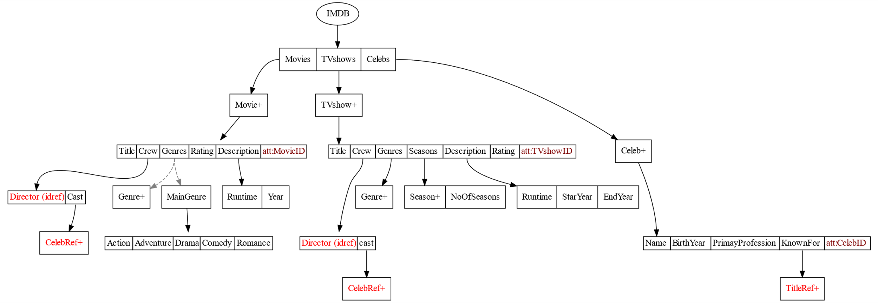

Slide 8
SSD properties
Heterogeneity
Genres can have multiple Genre tags or a single MainGenre tag in which there is a tag for each type of genre.
Cross-Referencing
Tvshows, Movies has reference to Celebs.
Celebs has reference to Tvshows, Movies.

Slide 9
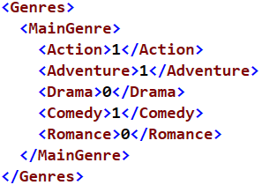
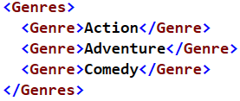
Heterogeneity
Genres may contain many Genre tags or a single MainGenre.

Slide 10
Generating xml data
We got data from datasets.imdbws.com.
We used pandas and xml.etree.ElementTree for generating xml data.
Data Validation:
We used xmllint, visual studio, Liquid Studio 2017 for data validation.

Slide 11
Thank You

