Slide 1
IMDB
IMDB domain model in XML.
By CS15B008, CS15B028, CS15B029, CS15B035, CS15B040, CS15B049, CS13B045

Slide 2
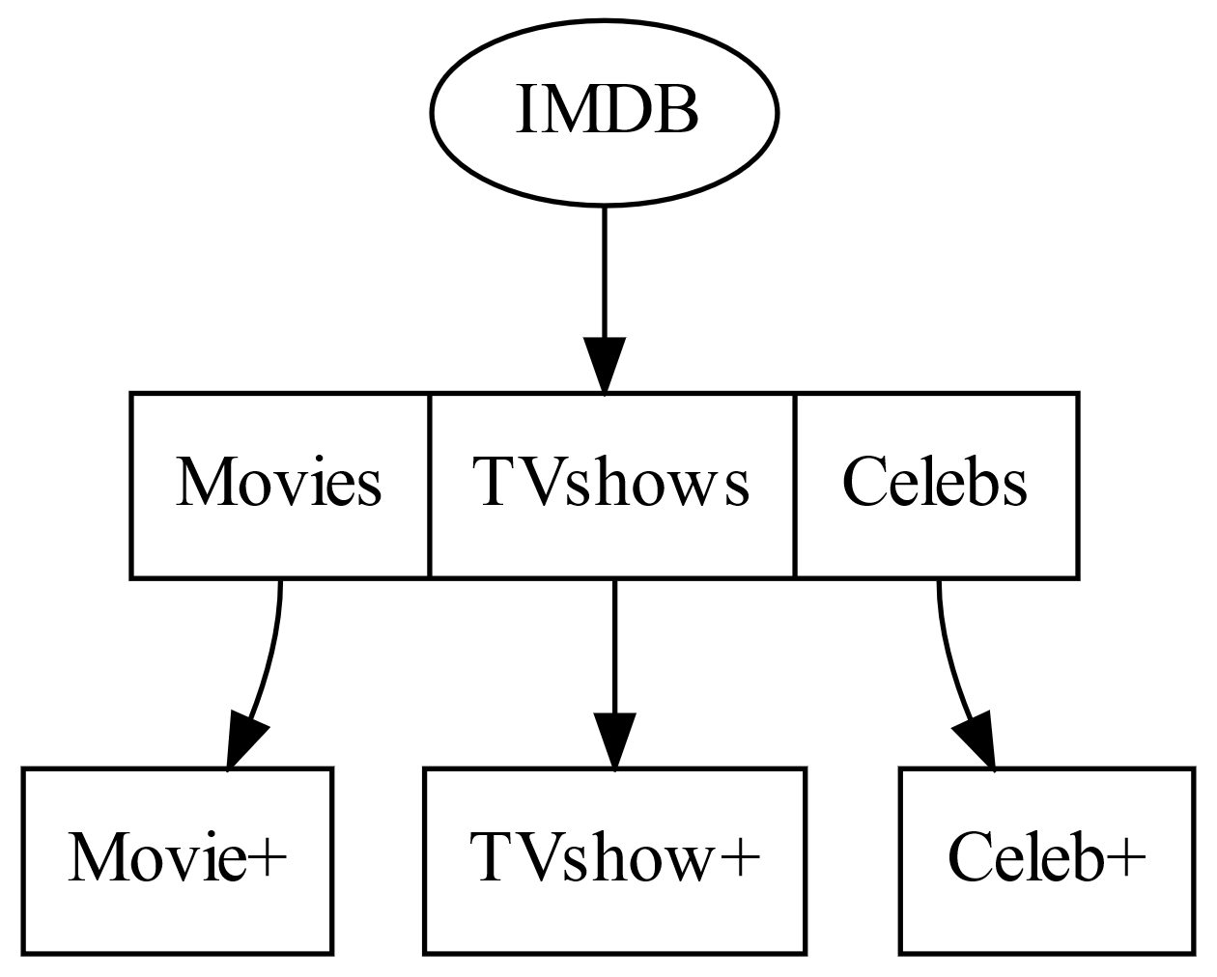
IMDB
IMDB contains Movies, Tvshows, Celebs.

Slide 3
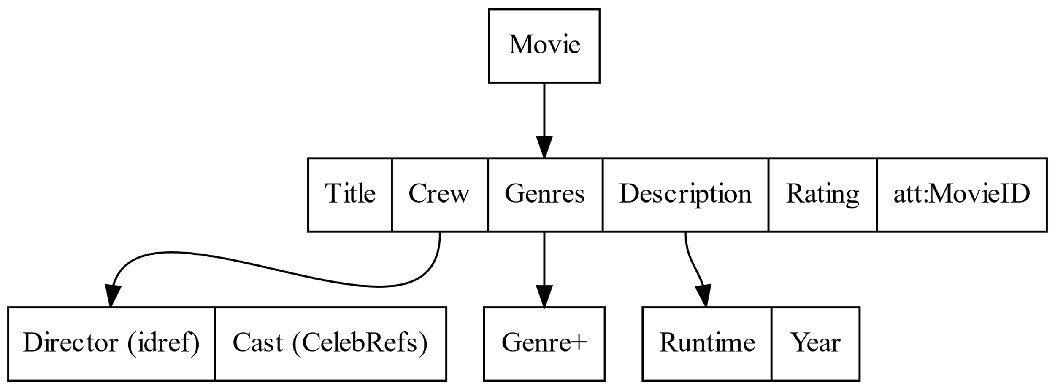
Movie
Movie contains, Title, Crew, Genres, Description, Rating, ID.

Slide 4
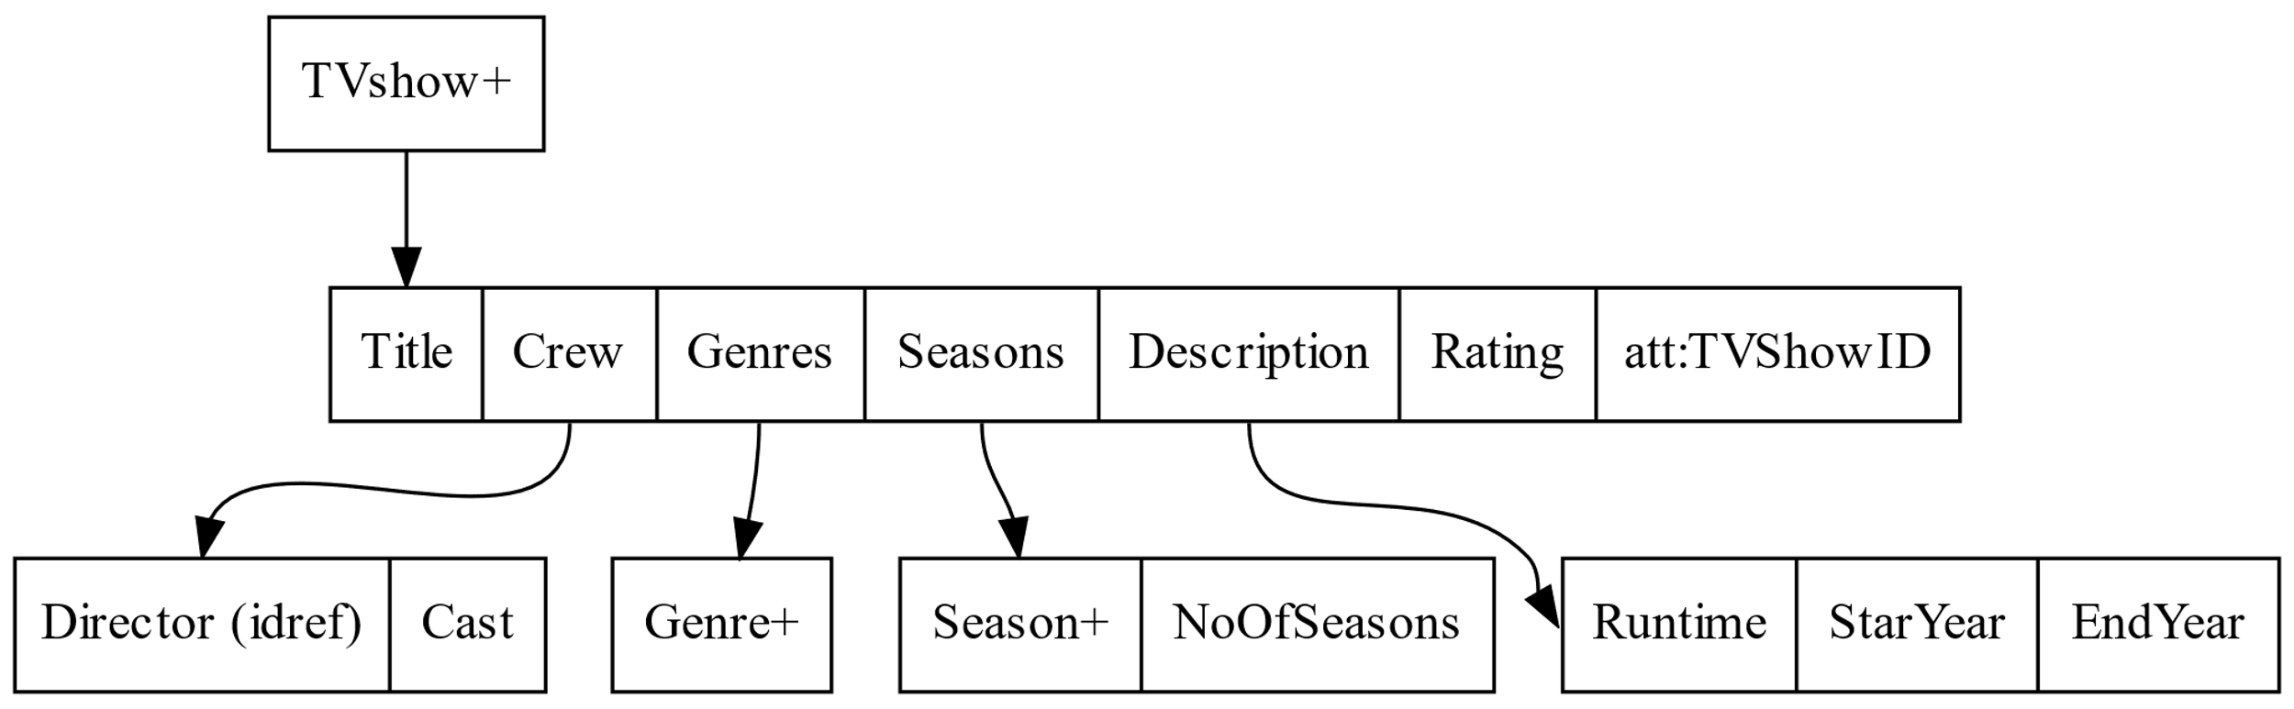
Tvshow
Tvshow contains, Title, Crew, Genres, Seasons, Description, Rating, ID.

Slide 5
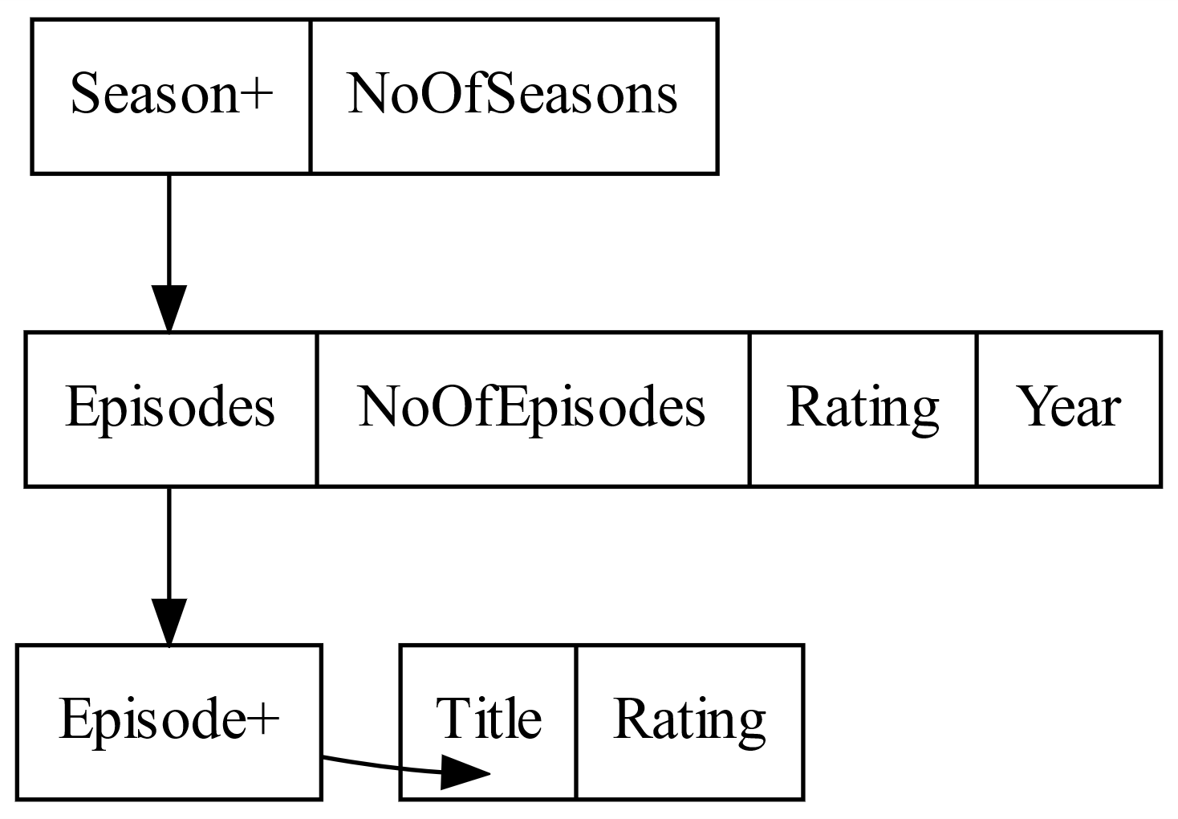
Continue Tvshow

Slide 6
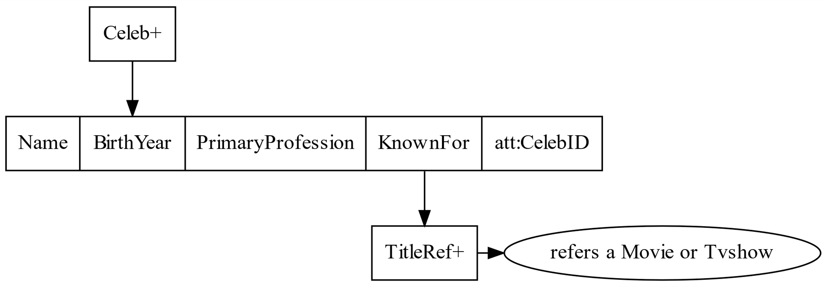
Celeb
Celeb contains, Name, BirthYear, PrimaryProfession, KnownFor, ID.

Slide 7
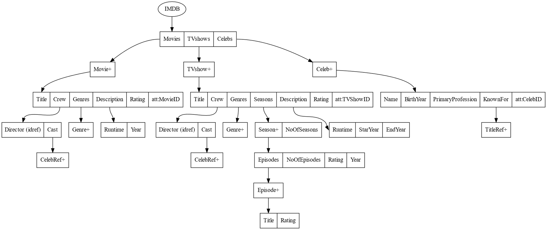

Slide 8
SSD properties
Heterogeneity
Description in movies contains Runtime and Year where as in Tvshows it contains StartYear and EndYear.
Cross-Referencing
Tvshows, Movies has reference to Celebs.
Celebs has reference to Tvshows, Movies.

Slide 9
Generating xml data
We got data from datasets.imdbws.com.
We used pandas and xml.etree.ElementTree for generating xml data.
Data Validation:
We used xmllint, visual studio for data validation.

Slide 10
Data Analysis

