Slide 1
Mashup
Google Maps, TVshows and Movies

Slide 2
Domain
Tvshows on Air and now playing Movies.
In Map we showing approximately top 250 Tvshows and top 450 movies around the globe.
We display content according to its popularity in that specific region.
We are getting data from two API’s
Google Maps API
TMDB API

Slide 3

Source
Data source: The Movie DB
The Movie Database (TMDb) is a community built movie and TV database
It provides a public API to access its database.
Documentation is at developers.themoviedb.org
Usage :
Authorization is required to access the data.
The request rate limit is 4 hits/sec.
Limitation:
The data is available for only certain countries.

Slide 4

Source
For displaying map we used google maps JavaScript API. It provides functionality for
Marking places and labeling places on the map.
Getting location (lat, lon) for a given address
Getting address of a location.
We used it for marking Tvshows and movies.

Slide 5

On the air Tvshow
API: https://API.themoviedb.org/3/tv/on_the_air?API_key={}
We can add various conditions for querying the data.
Region wise
Page wise
User wise
Language wise

Slide 6
Sample Tvshow
{
"original_name": "The Walking Dead",
"genre_ids": [18,10759,10765],
"name": "The Walking Dead",
"popularity": 248.813492,
"origin_country": ["US"],
"vote_count": 3099,
"first_air_date": "2010-10-31", "original_language": "en",
"id": 1402,
"vote_average": 7.4,
},

Slide 7

Now playing Movies
API: https://API.themoviedb.org/3/movie/now_playing?API_key={}
We can add various conditions for querying the data.
Region wise
Page wise
User wise
Language wise

Slide 8
Sample Movie
{
"vote_count": 2234,
"id": 399055,
"video": false,
"vote_average": 7.4,
"title": "The Shape of Water",
"popularity": 452.295995, "original_language": "en",
"original_title": "The Shape of Water",
"genre_ids": [18,14,10749],
"adult": false, "release_date": "2017-12-01"
},

Slide 9

JSON object for movies doesn’t contain Region. But it is possible to specify region in the query.
So we chose some regions around the world (regions with sufficient number of movie releases). Hit the API by specifying these regions in the query.
https://api.themoviedb.org/3/movie/now_playing?api_key=mykey&page=1&region=‘DE’

Slide 10

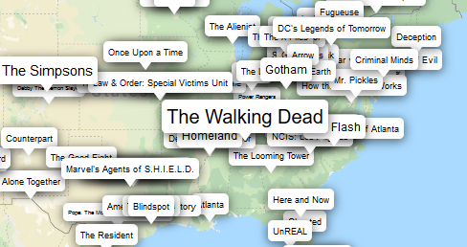
We used custom class for displaying labels like popups,
The font size reflects its popularity.

