Slide 1
STATISTICAL MODELING
N.Akhil Reddy
Cse
Vnr Vjiet

Slide 2
What is Statistical Model?
A statistical model is a special class of mathematical model, which includes a set of assumptions about the generation of some sample data, and similar data from a larger population.
Statistical model is non-deterministic(non-deterministic algorithm is an algorithm that, even for the same input, can exhibit different behaviours on different runs).
In mathematical terms, a statistical model is usually thought of as a pair (S,P), where S is the set of possible observations and P is a set of probability distributions on S.

Slide 3
Three purpose for a statistical model
Creating Predicted values
Extraction of information
Description of stochastic structures(stochastic is having a random probability distribution or pattern that may be analysed statistically but may not be predicted precisely).

Slide 4
Example
Height and age are each probabilistically distributed over humans.
They are stochastically related: when we know that a person is of age 10, this influences the chance of the person being 5 feet tall.
We could formalize that relationship in a linear regression model with the following form: height_{i} = b₀ + b₁age_{i} + ε_{i},
where b₀ is the intercept, b₁ is a parameter that age is multiplied by to get a prediction of height, ε is the error term, and i identifies the person.
This implies that height is predicted by age, with some error.

Slide 5
Statistical Modeling can be used
To characterize numerical data to help one to concisely describe the measurements and to help in the development of conceptual models of a system or process.
To help estimate uncertainties in observational data and uncertainties in calculation based on observational data.
To estimate probabilistic future behavior of a system based on past statistical information, a statistical prediction model. This is often a method use in climate prediction.

Slide 6
Difference between Machine Learning & Statistical Modeling
They came up in different eras.
Both objectives are Learning from Data.
Machine Learning is an algorithm that can learn from data without relying on rules-based programming.
Statistical Modeling is formalization of relationships between variables in the form of mathematical equations.

Slide 7
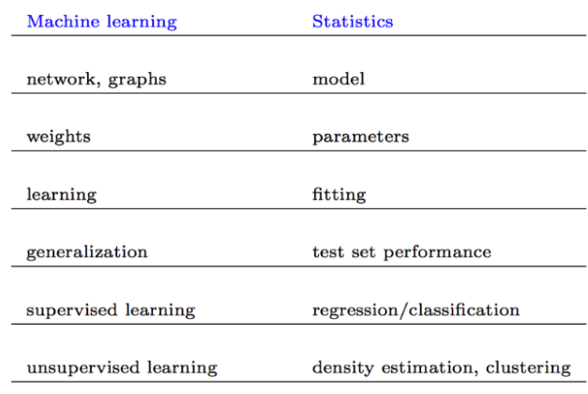
Naming Convention

Slide 8
Types of data they deal with
Machine learning does really well with high number of attributes and high number of observations.
Statistical modeling are generally applied for smaller data with less attributes or they end up over fitting.

Slide 9
Formulation
In a statistical model, we basically try to estimate the function f in
Dependent Variable ( Y ) = f(Independent Variable) + error function
Machine Learning takes away the deterministic function f out of the equation. It simply becomes
Output(Y) ----- > Input (X)

Slide 10
Conclusion
Machine learning and statistical modeling are two different branches of predictive modeling.
Predictive Power and Human Effort:
The lesser assumptions in a predictive model, higher will be the predictive power.
Machine learning has strong predictive power as the machine is fit and trained to find out patterns hidden in data.
Statistical model is based on coefficient estimation and it requires the modeler to understand the relation between variable before putting it in.

