Slide 1
Summary of current tasks and StegoHunt work
Akhilesh Nevatia, Research Meeting, 30th October 2023

Slide 2
What is the overall goal ?
Apply the StegoHunt Software to all the data in the StegoApp DB and retrieve the results
To analyze and comprehend the results obtained from the StegoHunt Software
.

Slide 3
StegoHunt tutorial
I will go through the following:
1. How to load data into StegoHunt.
2. Which options to select while loading data.
3. Understanding the contents of each report generated.

Slide 4
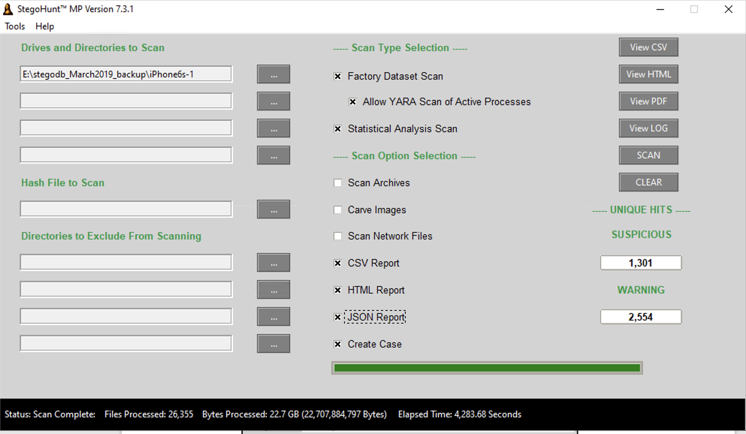
This slide needs a title

Slide 5
Explanations of screen elements, taken directly/paraphrased from the StegoHunt MP user manual
Factory Dataset Scan – scan using the factory datasets provided monthly in the Customer Support Portal.
( Default selected )
Statistical Analysis Scan – scan using the included statistical analysis checks to detect embedded data in files. ( Default selected )
Etc.- Akhilesh, make the remaining points

Slide 6
Defining elements on the the StegoHunt screen
Factory Dataset Scan – scan using the factory datasets provided monthly in the Customer Support Portal.
( Default selected )
Statistical Analysis Scan – scan using the included statistical analysis checks to detect embedded data in files. ( Default selected )
Scan Archives – choose whether to allow StegoHunt MP to extract and scan archive files.
Carve Images – choose whether to carve images from within other files—e.g., photos embedded a Microsoft
Word document
Scan Network Files – choose whether to download and scan files in a cloud provider—e.g., OneDrive
Create Case – choose whether to create a case directory that includes all suspicious and warning file
detections, as well as a hash file ( Default selected )
( All this data is taken directly/paraphrased from the StegoHunt MP user manual)

Slide 7
Different kind of Reports Generated
( SHOW EXAMPLE REPORTS GENERATED)
CSV report:
Most used by us to analyze results given out as raw data
easy to filter and work with
HTML Report:
more defined, same raw data is present with the images and a graph representing different kind of warnings
Creates multiple Html reports for if large amount of data passed in
JSON Report:
Same raw data as the csv but in a Json format per image / file
Easier to analyze the csv format
( All this data is taken directly/paraphrased from the StegoHunt MP user manual)

Slide 8
Responses in the StegoHunt CSV Report
We ran on a small batch of data, around ?? Stegos and ?? Covers and ?? Inputs and ?? originals
These are representative of the responses we get :
“PixelKnot/Passlok Quantization Table detected” ( on both Stegos and Covers ) (Most Observed Warning)
“JPEG PEDIGREE OBFUSCATION”
“TIFF NAME OBFUSCATION: TIFF DATA APPENDING“(Warning)
No output message ( for most originals, inputs, csv, etc (non-cover/stego classified images) )
Follow-up Questions for warning 1:
1. What does the warning "Quantization Table detected" mean?
2. How can I extract the Quantization Tables for an image and compare Cover Quantization with corresponding Stego Quantizations?

Slide 9
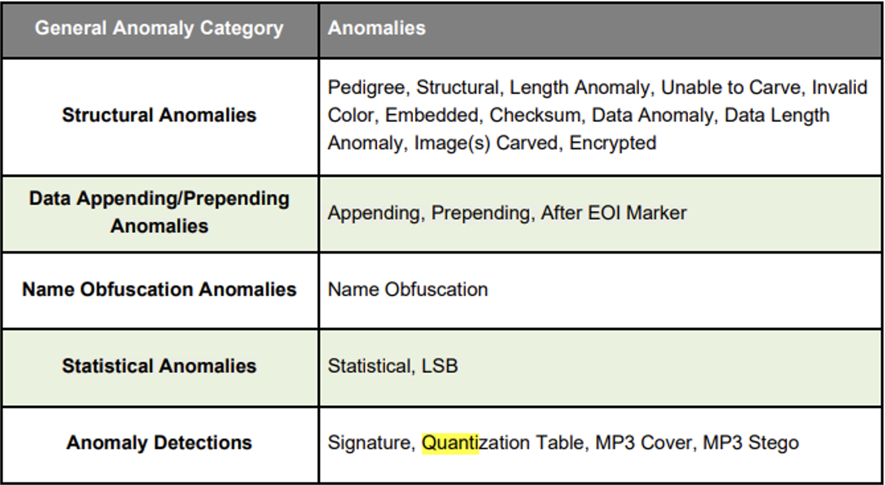
Quantization Table Warning
Image below is a list of anomalies the manual lists software gives out which includes the Quantization Table anomaly which we observed in the Report:

Slide 10
Quantization Table Warning and Exif Tool
Note we get the same Quantization Table detected warning on a Stego and its corresponding cover, thus it is not possible to use the warnings to classify an image as a Stego/Cover in certain cases mainly observed in images involved with PixelKnot and Passlok embedding algorithms
Experiments done with Exiftool:
We used the Exif tool to extract Quantization Tables for 1 Cover and 5 corresponding stegos with the different embedding rates and observed all of them have the same Quantization Table.
We compared Quantization Table of 5 unrelated Covers from PixelKnot and Passlok and all gave the same extracted Quantization Table.
We compared Quantization Tables of 5 PixelKnot Stegos with 5 Passlok Stegos and they too gave out the same Quantization Table.
RESULT: The Quantization Table is not very useful in classifying the image as Stego/Cover as they both give out the same value ( for the images tested above )

Slide 11
TO DO:
"To apply the same process to larger data, as Wetstone appears to have fixed the problem of passing large data."
"To comprehend the meaning of each response message."

