Slide 1
Quantifying Combined Heritability of a Trait Based on a Multi-Ethnic LD Panel with Equal Distribution of Individuals among Ancestry Groups
By
Team HeriVar
Notes:
Good Evening Everyone,
Today I am going to present on the project which we have worked on together as part of Hackathon 2022. Thank you for the time and lets dive in to the moon shall we?

Slide 2
Hypothesis
Number of variants among each ancestry accounts for LD structure for that group.
When there is an equal distribution of individuals per ancestry group, chances of identifying the combined heritability of a trait will be maximized
Notes:
- Heritability - Heritability is a measure of how well differences in people's genes account for differences in their traits.
= It always very per ancestry some may have 30 % heritability in European and 50% heritable in African ancestry.
- There is no way to calculate combined heritability of a trait if a population is multi ethnic.
- With advents of large datasets like All of us, pan genome project - there is always a need to understand how much heritable the trait is if in multi ethnic population.
- This method we proposed is never been used before so would be a good experiment to pursue.
Our Hypothesis is
` Given a dataset, if there are equal number of individuals randomly selected among different ancestry groups - There is a chance that we can calculate combined heritability of a trait`
We were testing this hypothesis as part of the hackathon.

Slide 3
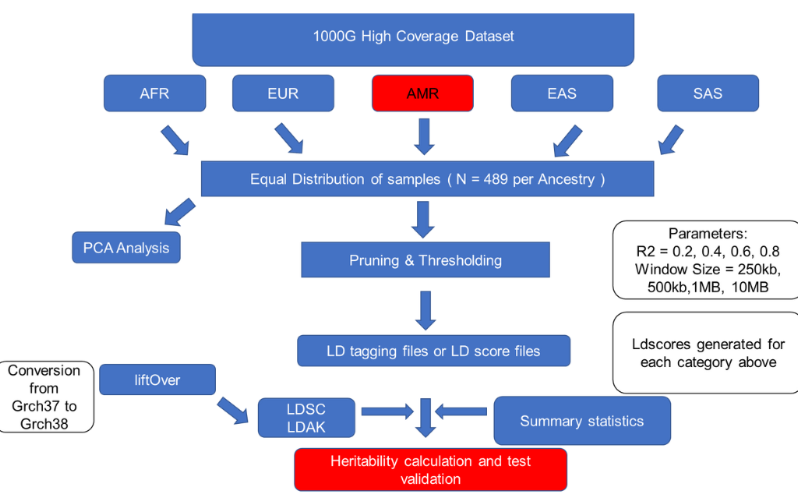
Notes:
- We took 1000g dataset and randomly chose 489 unrelated individuals per ancestry group such as AFR, EUR , EAS, SAS.
- We decided to exclude admixture population and related individuals to avoid overlaps between the ancestry groups.
- We also removed variants with Overall AF < 1% & missingness > 5% from the dataset.
- We tested the distribution based on PCA and plotted as a QC
- We did pruning and thresholding based on different parameters as shown in the work flow.
- Once pruning and thresholding was done, We use LDSC & LDAK to calculated LD score files and LD tagging files.
- The panel or tagging files generated are used to calculate heritability using LDAK & LDSC.
- We used GWAS summary statistics of phenotypes and processed the files for heritability calculations.
Liftover was used to liftover dataset from grch37 to grch38.
- We used NTproBNP, BP & Serum urate which we know have an estimate of heritability when we ran based on gwas analysis.

Slide 4
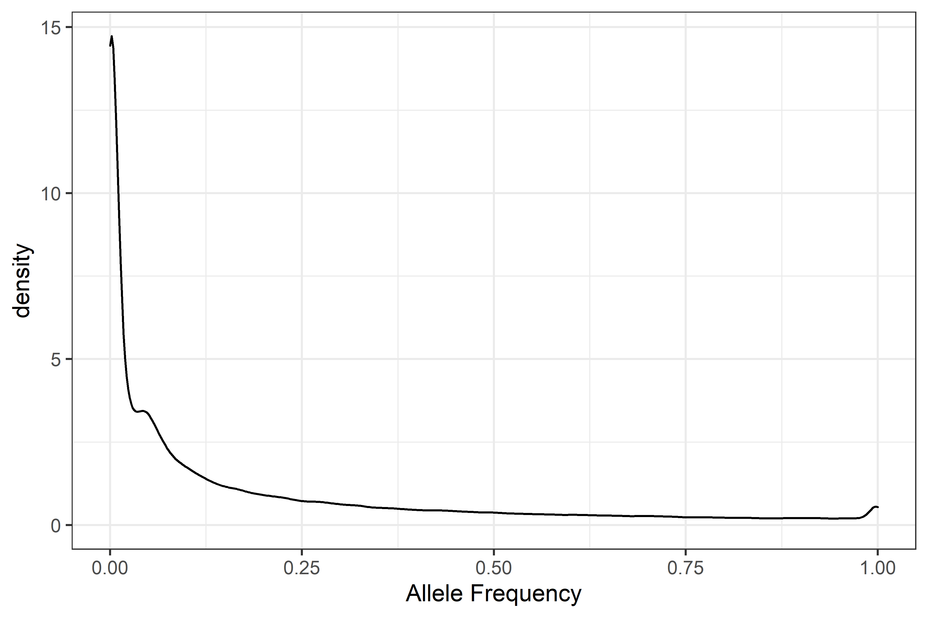
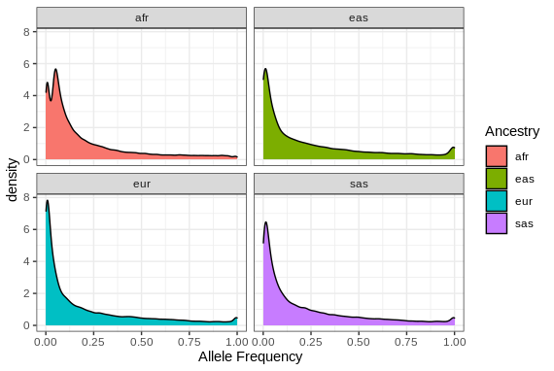
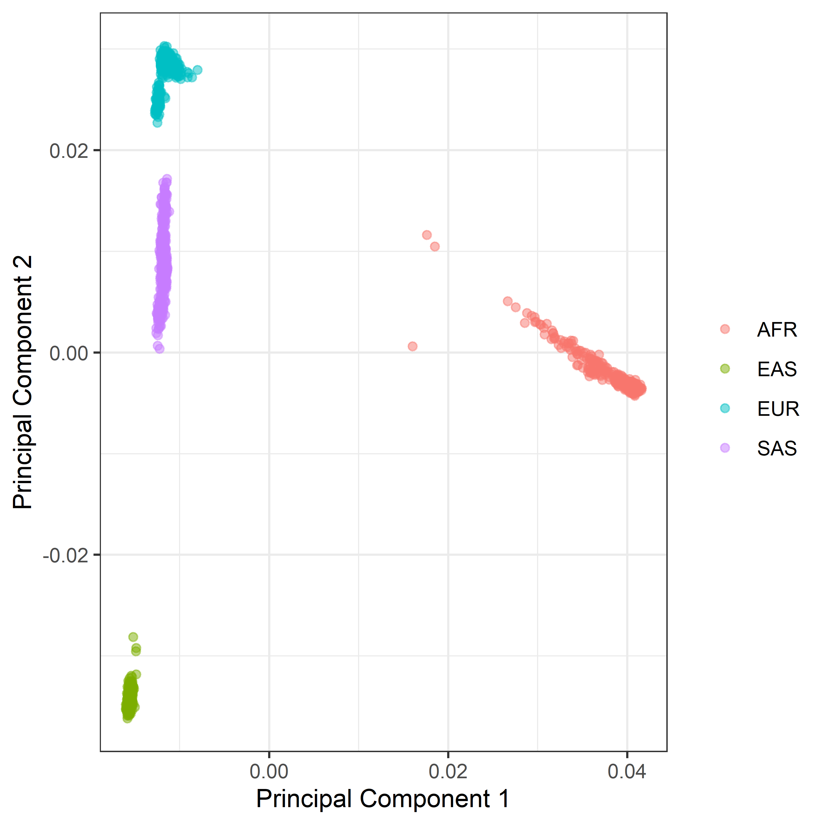
A
B
C
Notes:
A & B shows Allele frequency distribution for Overall 1000g dataset and among different ancestry groups.
C shows PCs distribution between PC1 & PC2

Slide 5
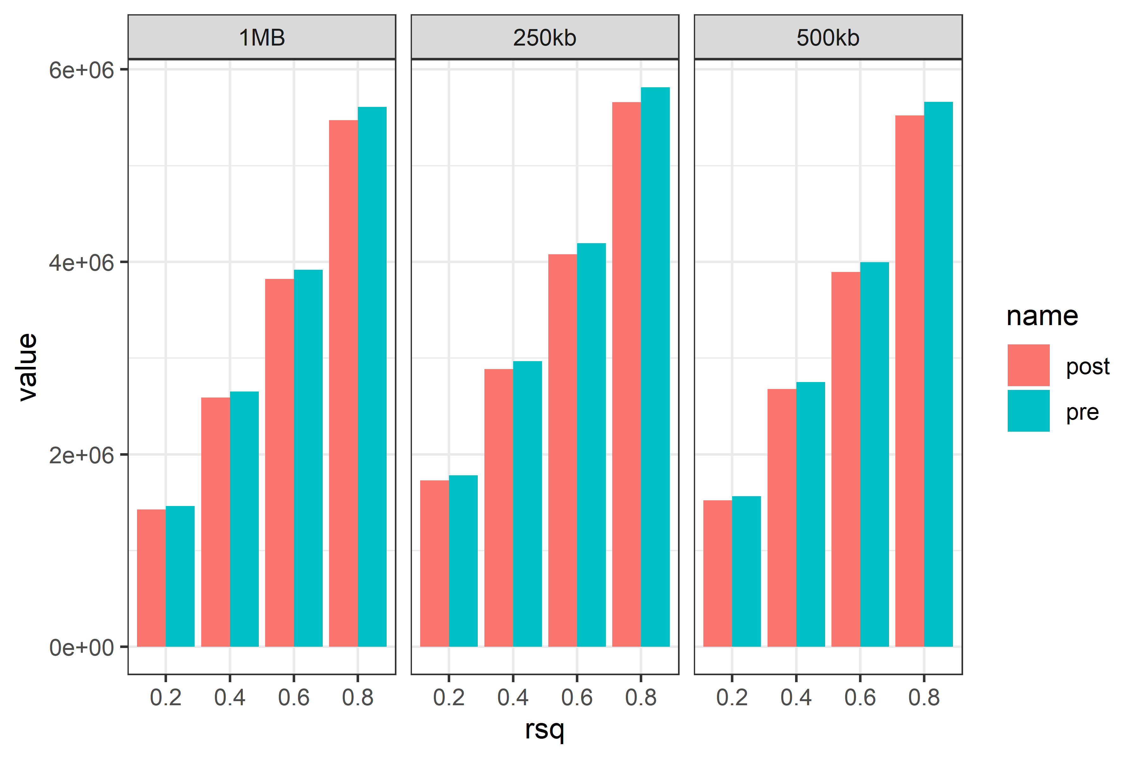
Pruning & Thresholding
Variants After Pruning & Thresholding
R2 | Window Size | Variants Pre High LD regions removed | Variants Post High LD regions removed
0.2 | 1MB | 1464882 | 1428081
 | 10MB | 1419960 | Couldn’t complete
 | 250kb | 1781998 | 1729865
 | 500kb | 1564861 | 1522257
0.4 | 1MB | 2654295 | 2589766
 | 10MB | 2614719 | Couldn’t complete
 | 250kb | 2969688 | 2887059
 | 500kb | 2749811 | 2678502
0.6 | 1MB | 3917502 | 3822824
 | 10MB | 3886309 | Couldn’t complete
 | 250kb | 4192945 | 4079616
 | 500kb | 3996646 | 3895068
0.8 | 1MB | 5608699 | 5471764
 | 10MB | 5588520 | Couldn’t complete
 | 250kb | 5814383 | 5660504
 | 500kb | 5662838 | 5519777
We did pruning and thresholding based on coefficient of determination ( R2 ) and window size parameters as below
R2 cutoff: 0.2, 0.4, 0.6, and 0.8.
Window size: 250kb, 500kb, 1Mb & 10Mb.
Notes:
- Distribution of Variants we got for each category of P + T we did.
- We decided to remove high LD regions as recommended.

Slide 6
Reference Panel Generation
We generated LD scores for pre/post pruned datasets using LDSC and worked on tagging files using LDAK.
Heritability Calculations
Data needed for heritability calculation were generated.
We could not able to complete the project because of time constraints.

Slide 7
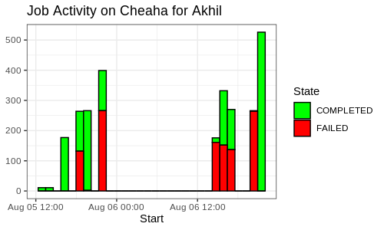
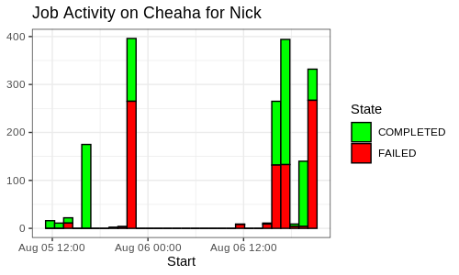
Technical Milestones
We ran 4469 task array jobs over the span of two days.
93 jobs per hour ➔ 1.5 jobs per minute
90 % of the project was completed in the span of two days.
We managed to replicate each step in JetStream2 and credit goes to Frank.
Notes:
Even though project is not completed
We had managed to complete 90% of the analysis we planned to do.
We also did ran 4469 task array jobs in the span of two days among which 56% of our jobs were a success.
We could also able to rectify our task array errors and get it done.
We also managed to replicate analysis in jetstream2
Its a overall learning experience for me eventhough the project is not completely done due to technicalities

