Slide 1

NETFLIX STOCK PRICE PREDICTION

Slide 2

AGENDA
OBJECTIVE
DATASET
TRAINING AND TESTING
METHODOLOGY
RESULTS AND DISCUSSION

Slide 3
OBJECTIVE
TO BUILD A MODEL WHICH WILL PREDICT THE STOCK PRICE OF THE COMPANY

Slide 4

DATASET
STOCK PRICES FROM 2013 – 2017
ALL COMPANIES ON S&P 500 INDEX
61900 OBSERVATIONS ACROSS 7 ATTRIBUTES
2016-17 TESTING SET
2013-16 TRAINING SET
619,000
OBSERVATIONS

Slide 5
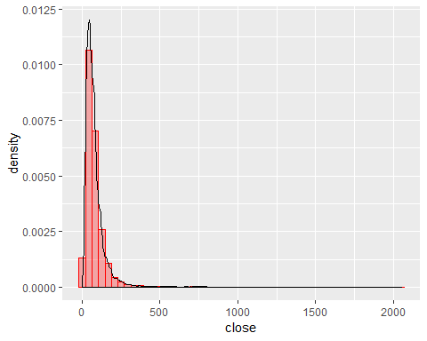
EXPLORING THE DATASET
Distribution of Closing Prices
Maximum Stock Prices around USD 800

Slide 6

DATA CLEANING
Checking for NA values
Removing the columns for opening, high and low
Remove Stock data of Companies other Than ‘NFLX’

Slide 7
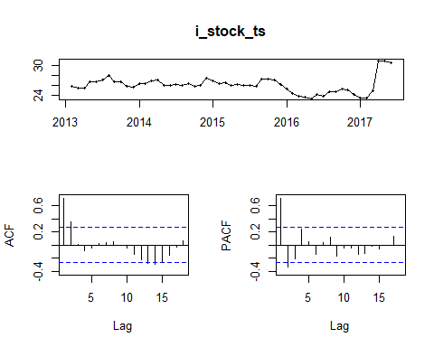
EXPLORATORY DATA ANALYSIS
KPSS indicates non-stationary

Slide 8
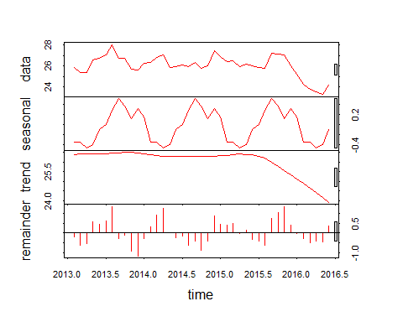
DECOMPOSITION
Seasonality is present
Needs First Order Differencing

Slide 9
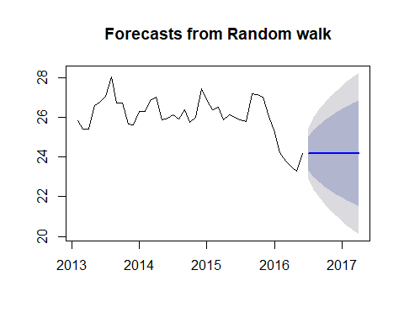
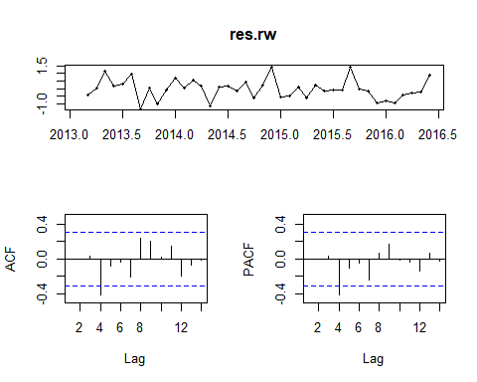
METHODOLOGY
RANDOM WALK
We apply the random walk model just to get a base line for accuracy
No seasonality and trend Noise & stationary time series.
RMSE of the training set is 0.66

Slide 10
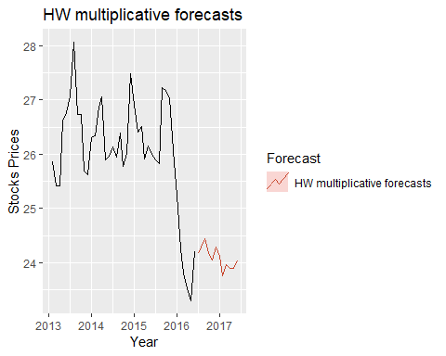
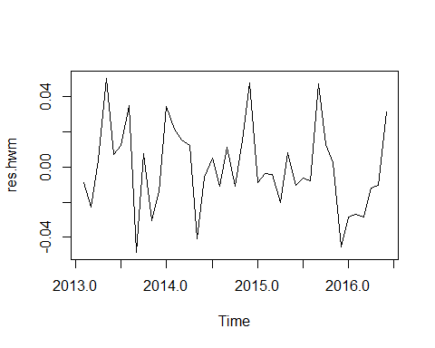
METHODOLOGY
HOLT’S FORECASTING
HW MULTIPLICATIVE FORECAST
RMSE of the training set is 0.63
Some cyclic behaviour

Slide 11
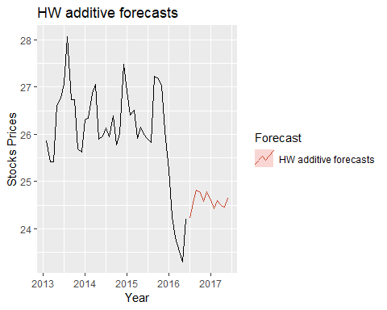
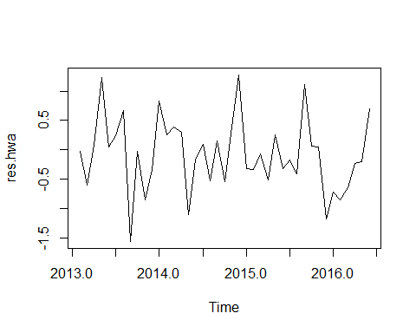
METHODOLOGY
HOLT’S FORECASTING
HW ADDITIVE FORECAST
RMSE of the training set is 0.63
Cyclic Behaviour

Slide 12
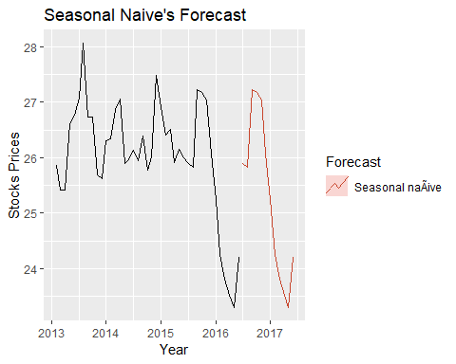
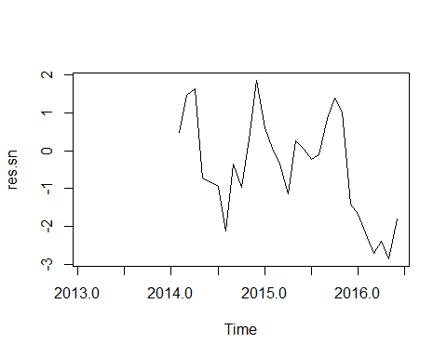
METHODOLOGY
SEASONAL NAIVE
Performs poorly given the variation in the data
RMSE of the training set is 1.32

Slide 13
METHODOLOGY
SELECTING PARAMETER FOR ARIMA MODEL
ADJUSTED BY AIC CRITERIA
One of the metrics that determines quality of econometric model is AIC criteria.
We use auto.arima algorithm to gain model with the lowest possible AIC score which gives us best possible model
We do not need to difference time series
Auto ARIMA give us AIC of 79.64 for ARIMA(0,1,0)(0,0,1)[12]

Slide 14
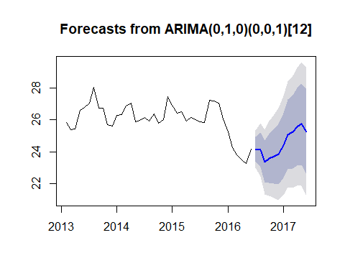
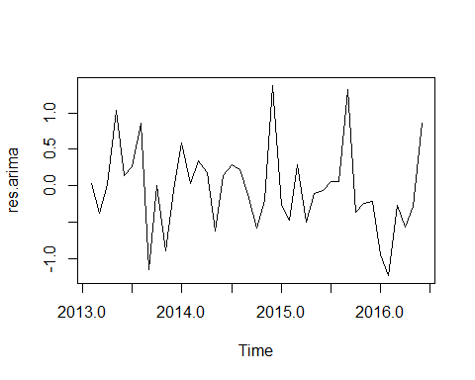
METHODOLOGY
FITTING ARIMA MODEL
RMSE = 0.580
Non-Seasonal component - first order difference
Seasonal -Moving Average - first order
Seasonal component 12 seasons

Slide 15
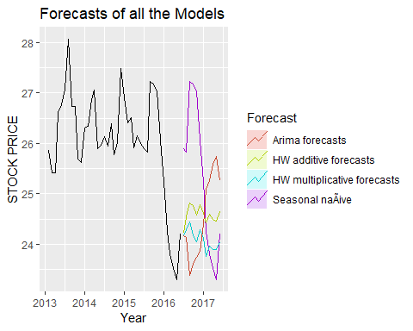
ACCURACY OF THE MODEL
Plot all the models to view the performance

Slide 16
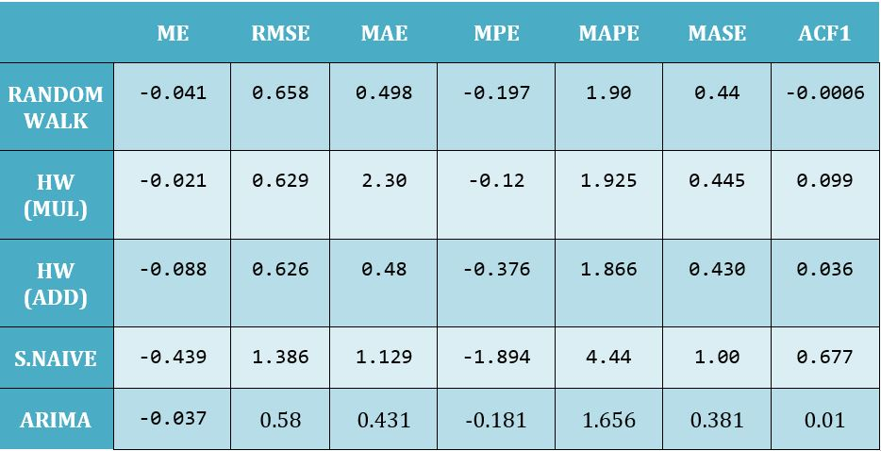
ACCURACY OF THE MODEL
Use ERROR values to compare the accuracy of all models

Slide 17
CONCLUSION & CHALLENGES
CONCLUSION
Using Auto ARIMA we got the model with a low RMSE (0.58) compared to other models
Can be used for good enough predictions
This model can be improved with more data which includes a larger proportion of training set

Slide 18
THANK YOU!

