Slide 1
Kernel Methods for Deep Learning
Akhil P M
SC14M044

Slide 2
Deep Architectures
Deep architectures learn complex mappings by transforming their inputs through multiple layers of non-linear processsing.
These architectures are compositions of many layers of adaptive non-linear components.
A wide range of functions can be parameterized by composing weakly nonlinear transformations.
The potential for combining unsupervised and supervised methods is an important feature of deep architectures.

Slide 3
Deep Architectures
In deep architecures, the features produced by the lower layers represent lower-level abstractions, that are combined to form high level features at the next layer, representing higher-level abstractions. So the fuctions at lower levels of abstractions should capture some simple aspects of data distribution, so that it is possible to learn first the simple functions and then compose them to learn more abstract concepts.
The parameters at all levels of the model are trainable.

Slide 4
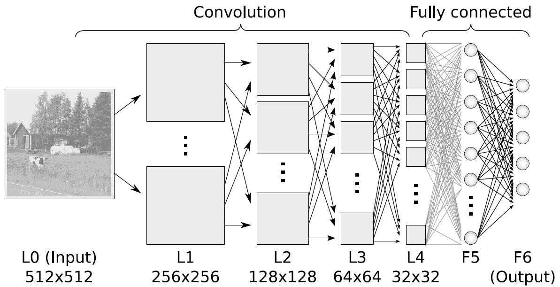
Deep Architectures

Slide 5
Shallow Architectures
Shallow architecures are generally classfied into 3
1. Type-1 architecutures - fixed preprocessing in the 1st layer
  Eg:- Perceptrons
2. Type-2 architectures – template matchers in the 1st layer
  Eg:- kernel machines
3. Type-3 architectures – simple trainable basis functions in the 1st layer Eg:- Neural Network with single hidden layer.

Slide 6
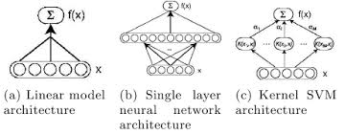
Shallow Architectures

Slide 7
The tradeoff
Deep architectures are genarally more difficult to train than shallow ones. They involve difficult nonlinear optimizations and many heuristics.
Deep architectures support broad priors, which can favour a wide set of functions. Whereas shallow architectures like SVMs favour a small set of functions.
Optimization problem associated with Deep Neural Networks etc are non-convex, but SVMs are solving convex optimization problem, hence global minimum can be attained.
Generally the rule of thumb is to use a deep architecture, if the decision function involves many variations. If the decision function if smooth, then shallow architectures like SVMs can be used.

Slide 8
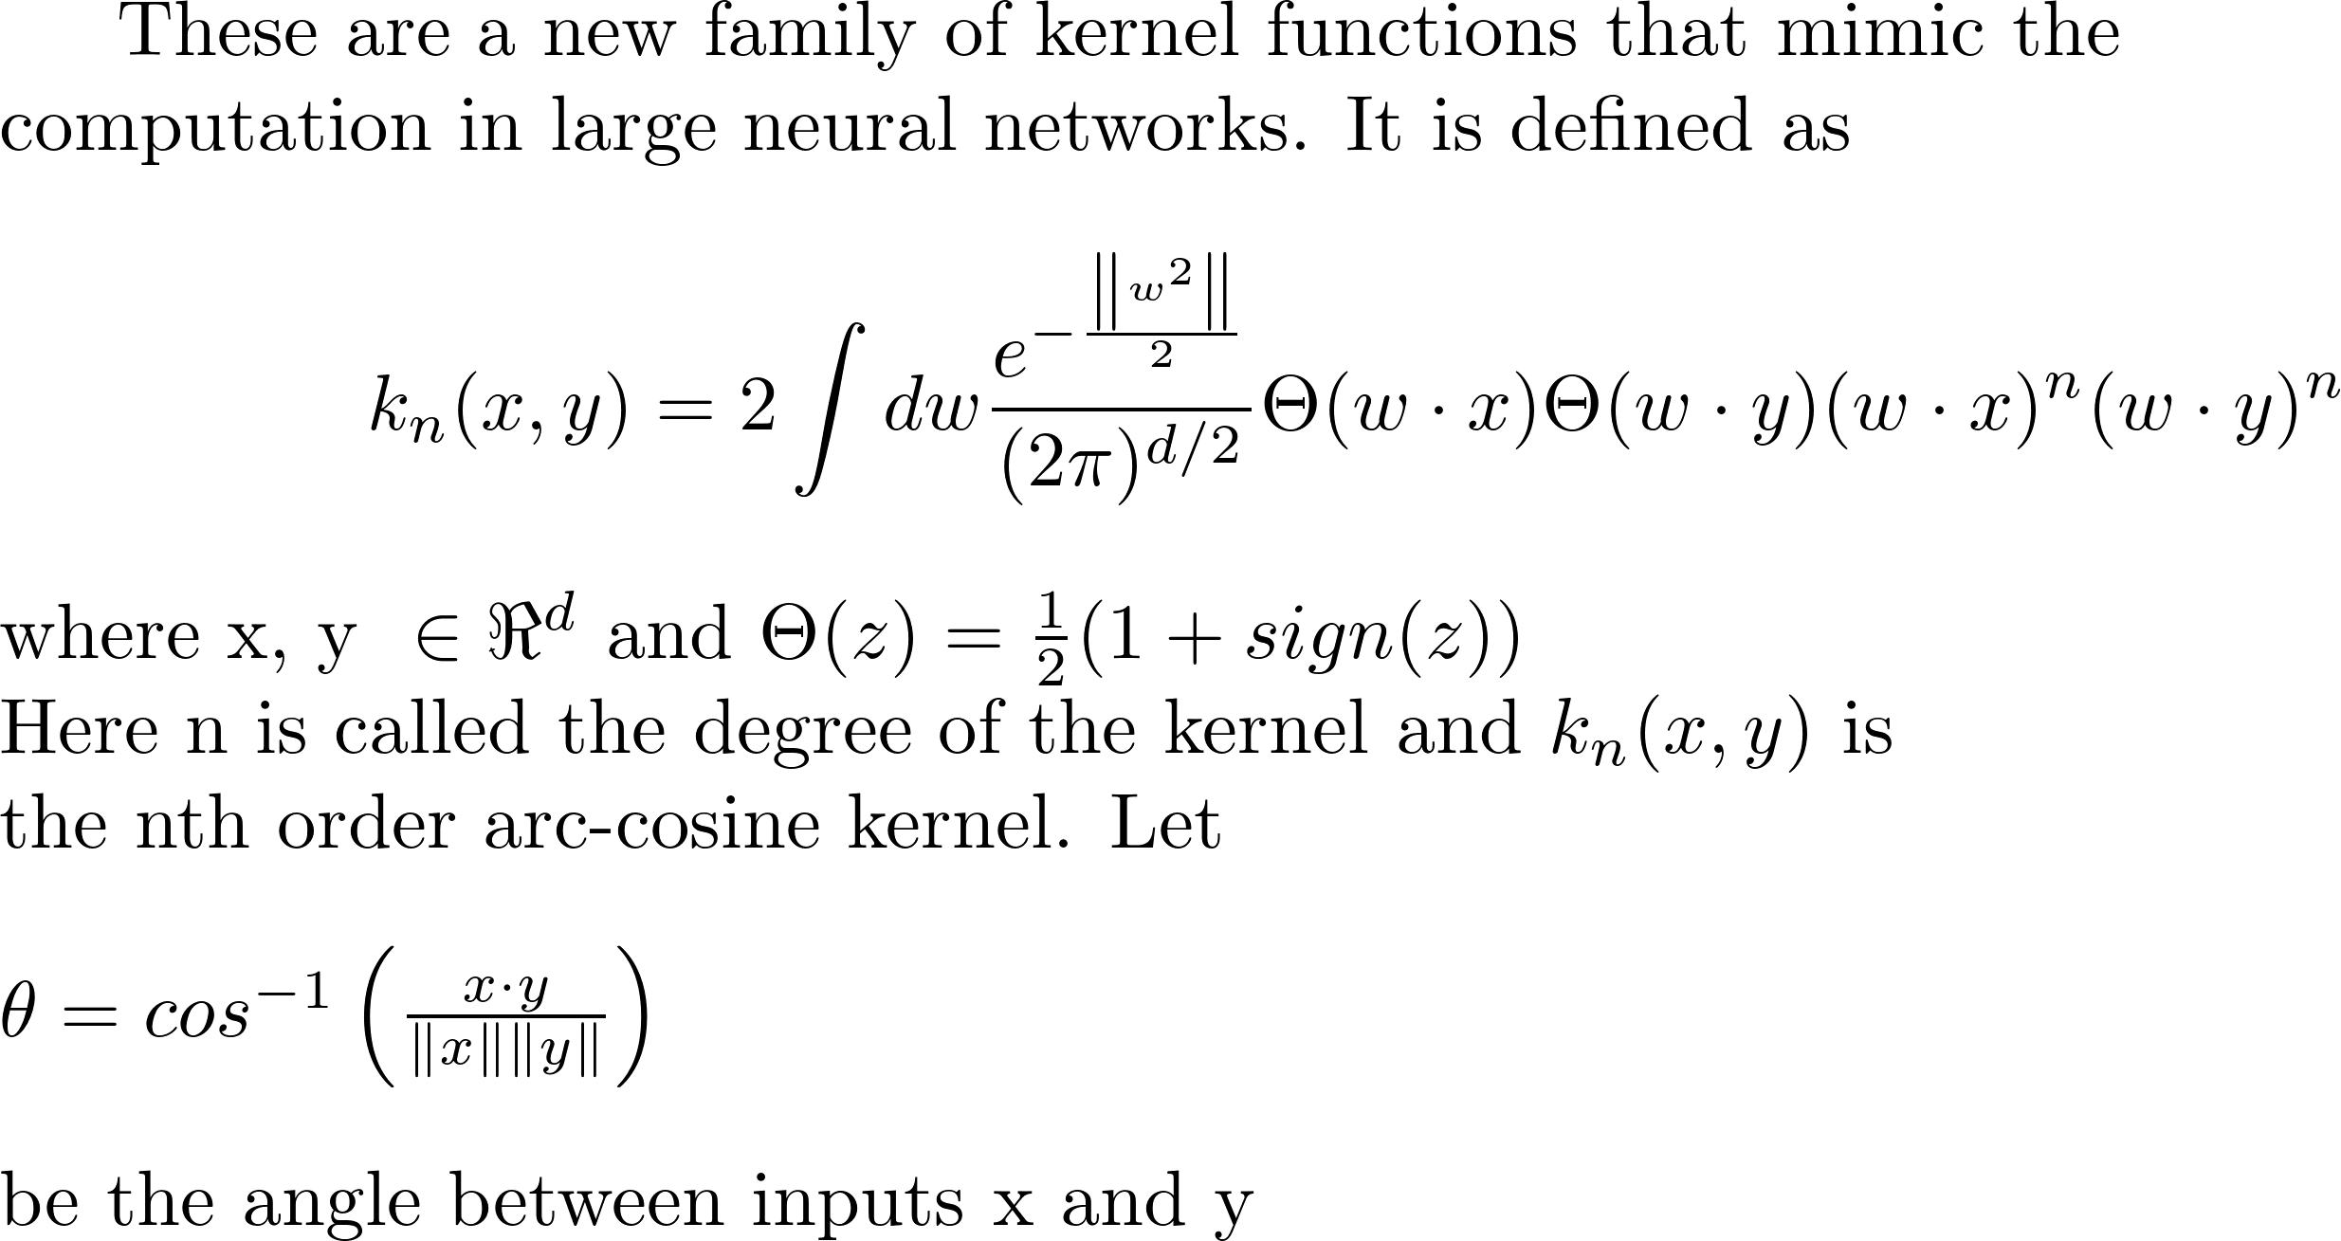
Arc-cosine Kernels

Slide 9
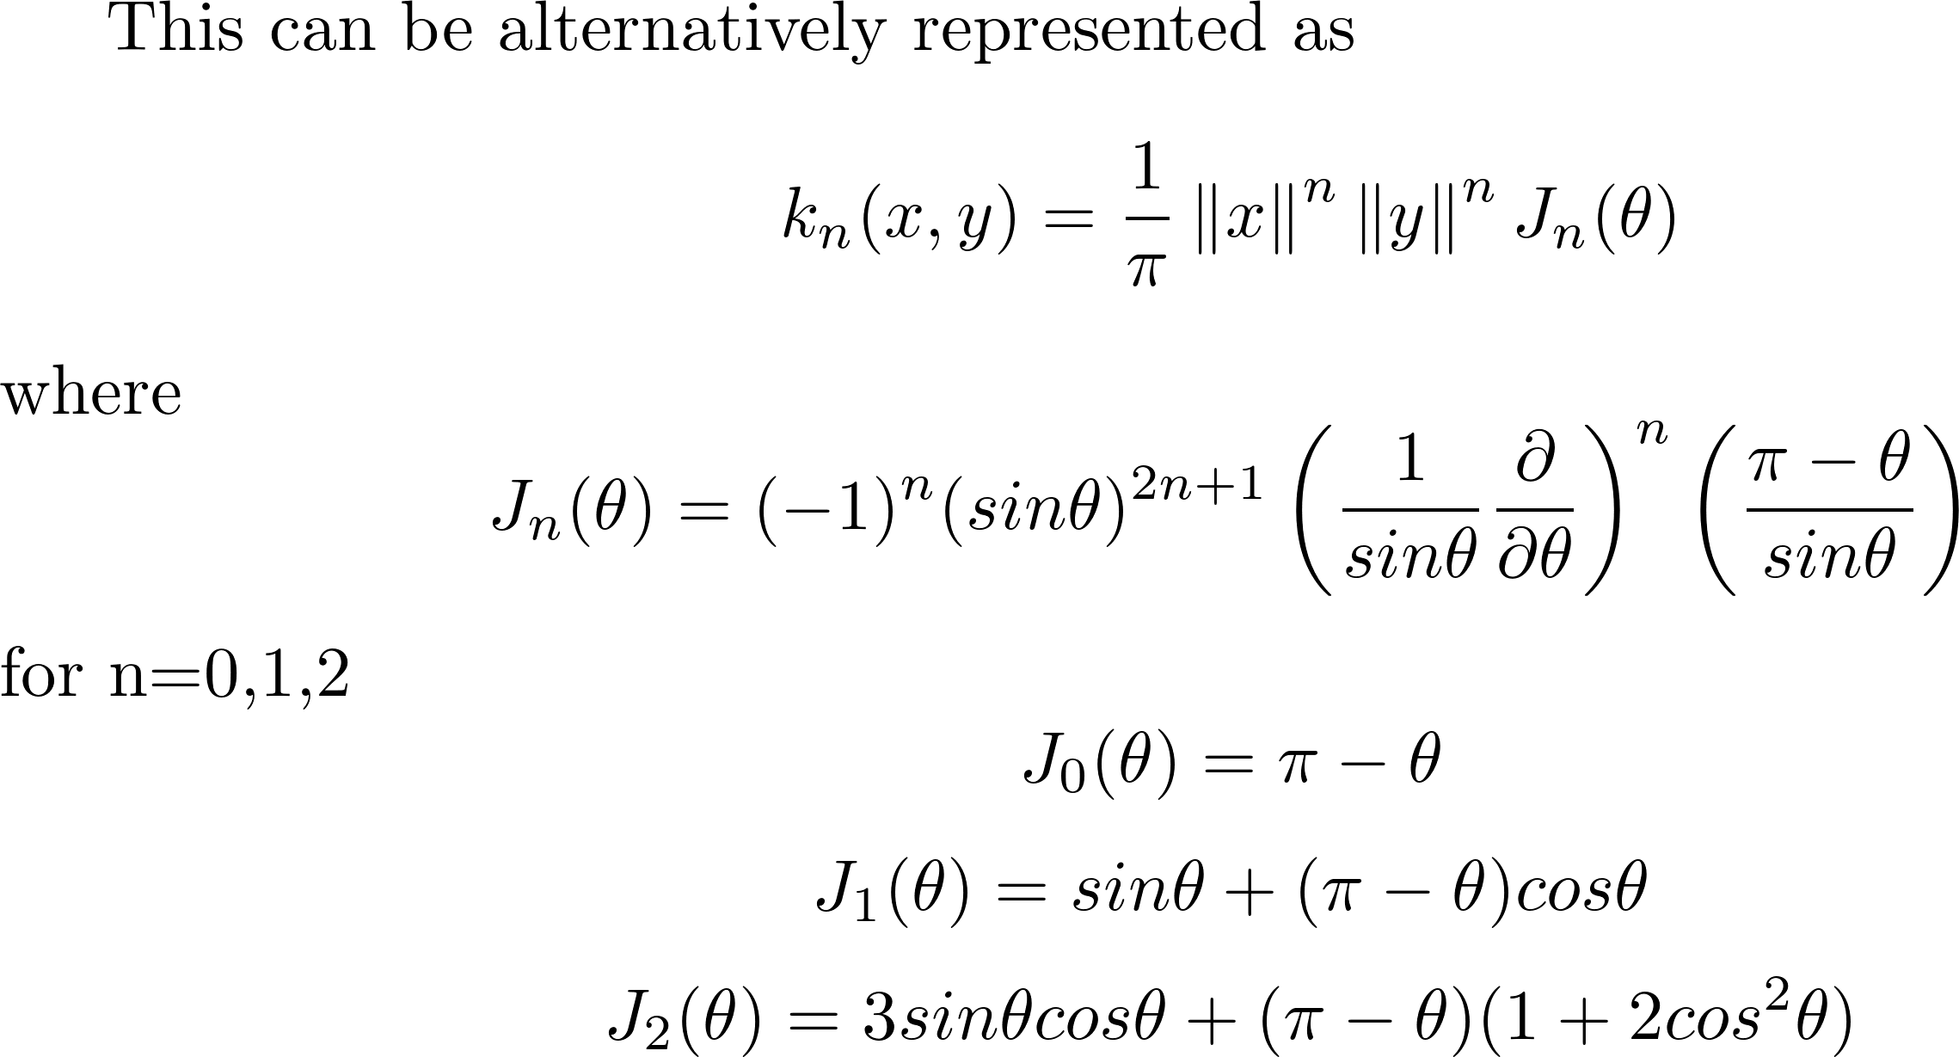
Arc-cosine Kernels

Slide 10
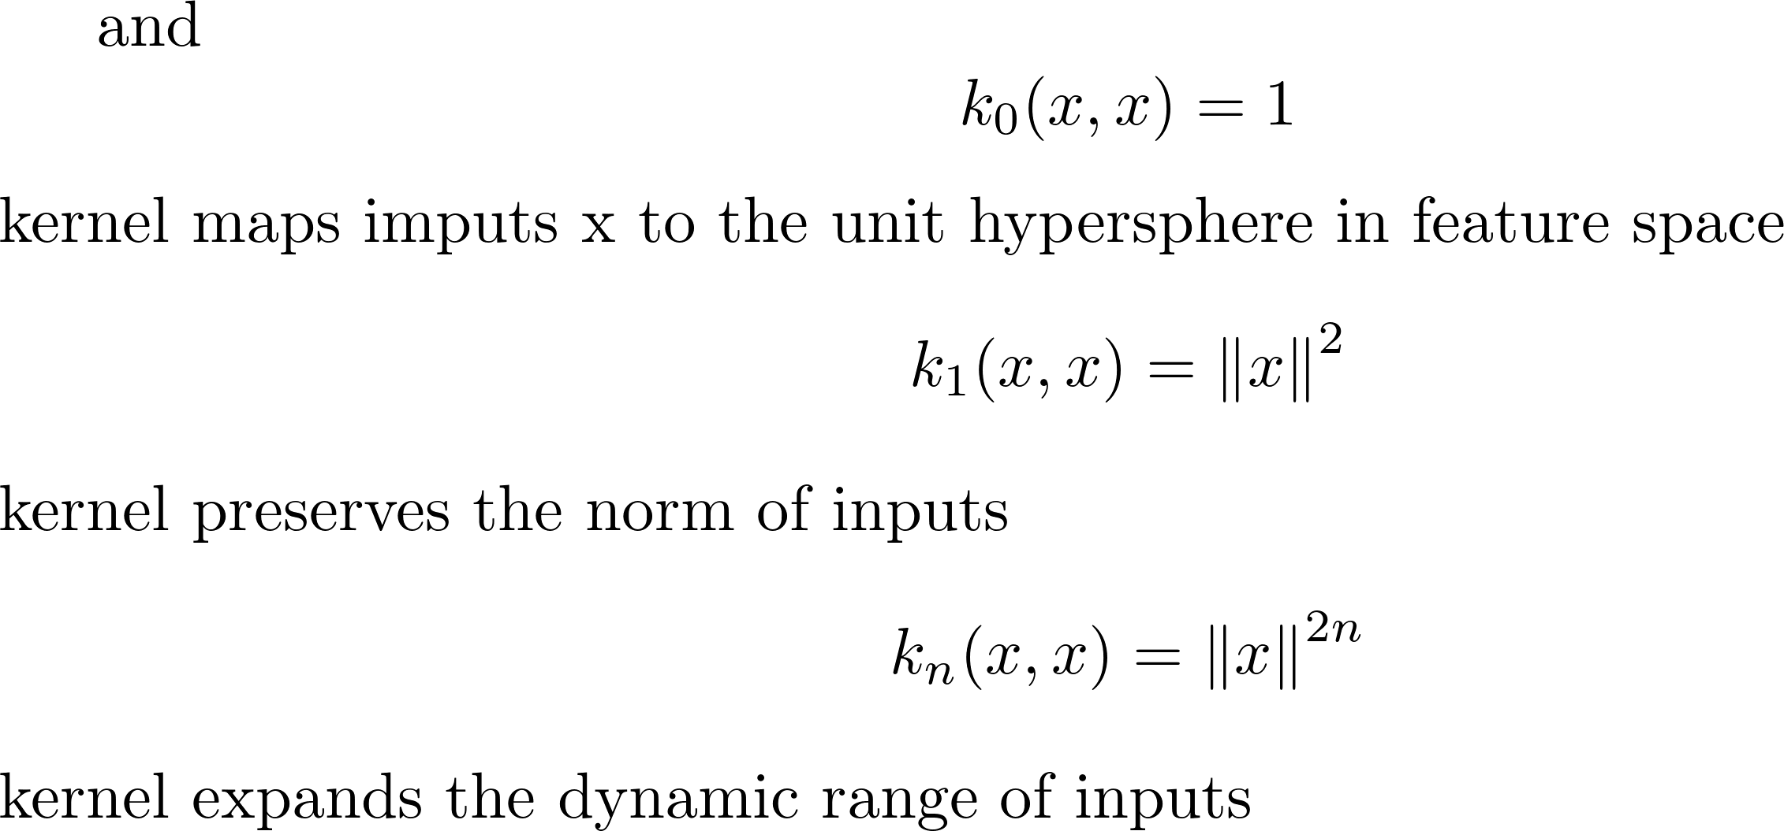
Arc-cosine Kernels

Slide 11
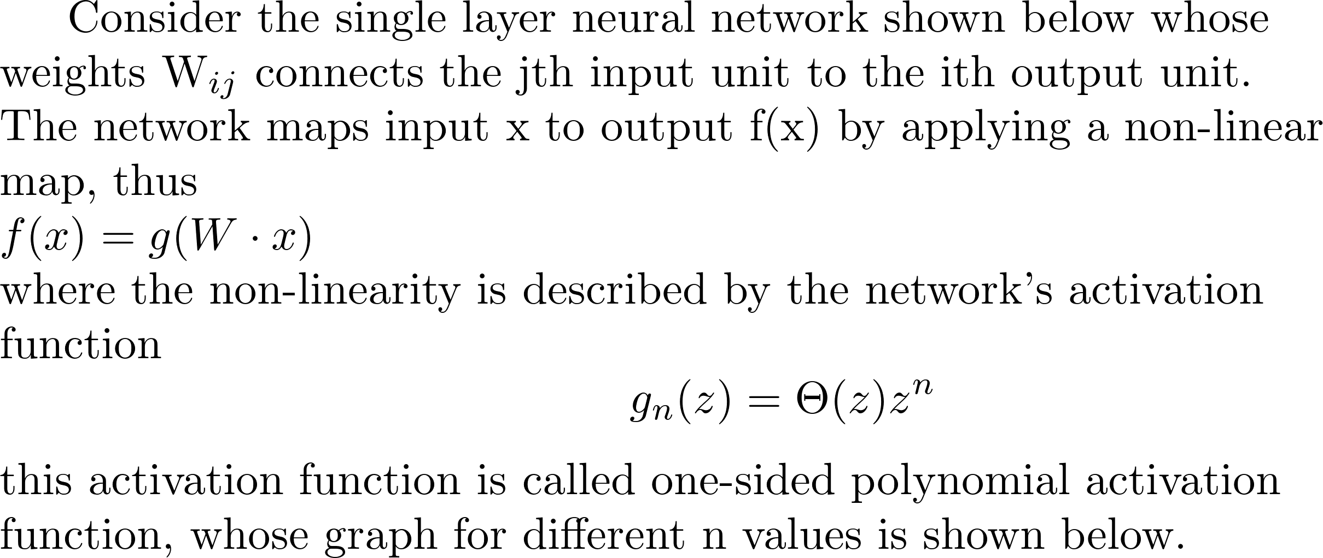
Relationship with Neural Networks

Slide 12
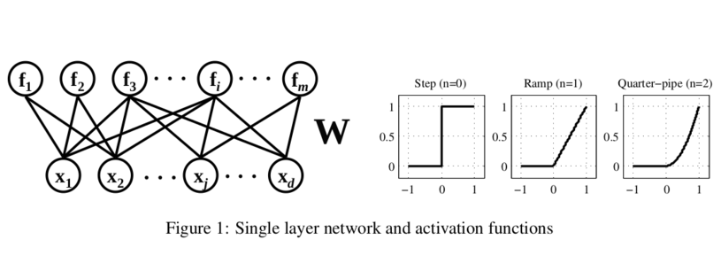
Relationship with Neural Networks

Slide 13
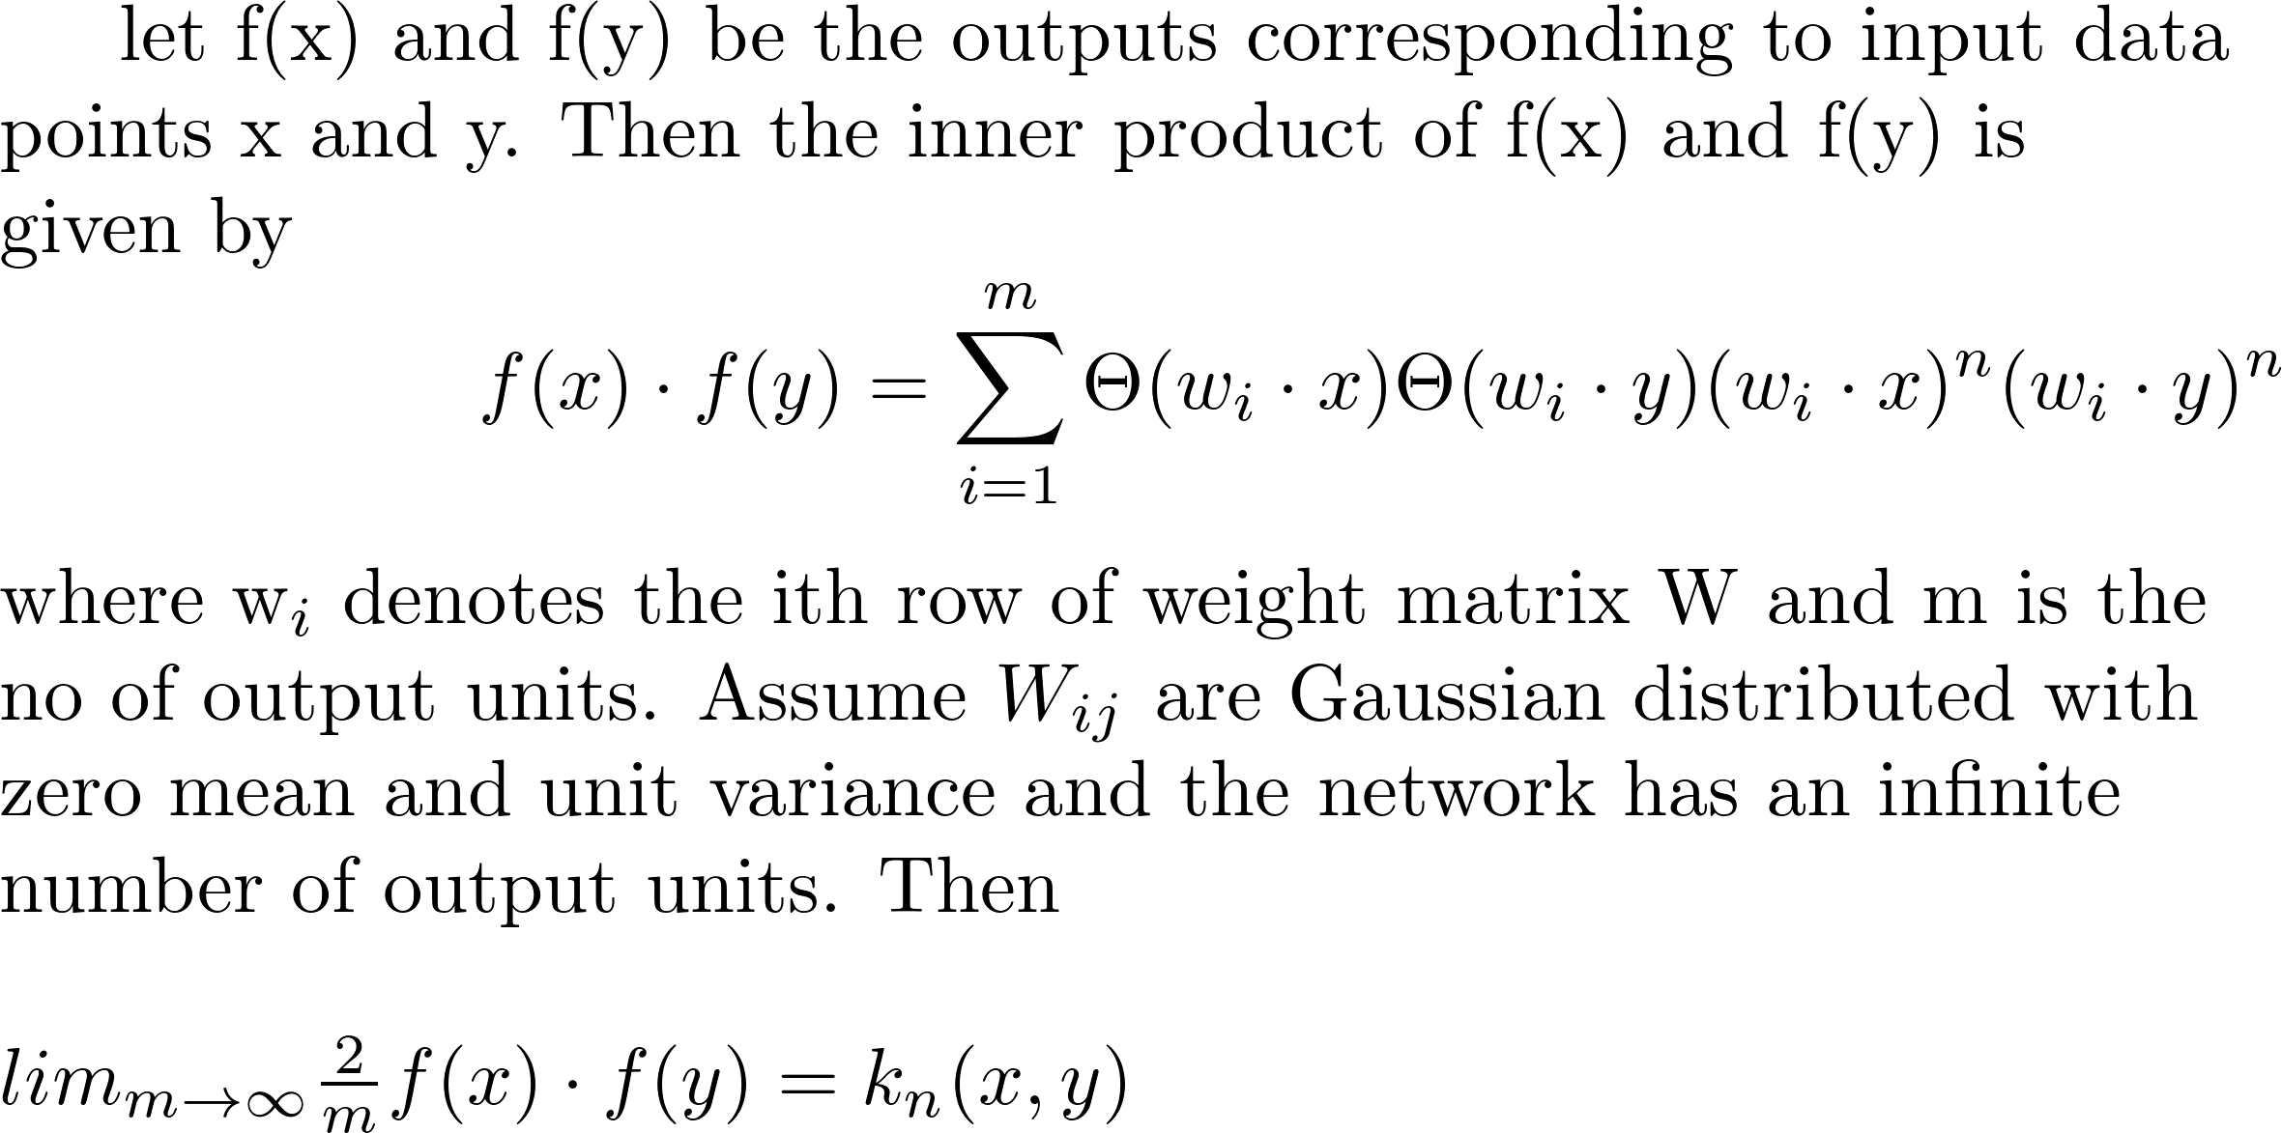
Relationship with Neural Networks

Slide 14
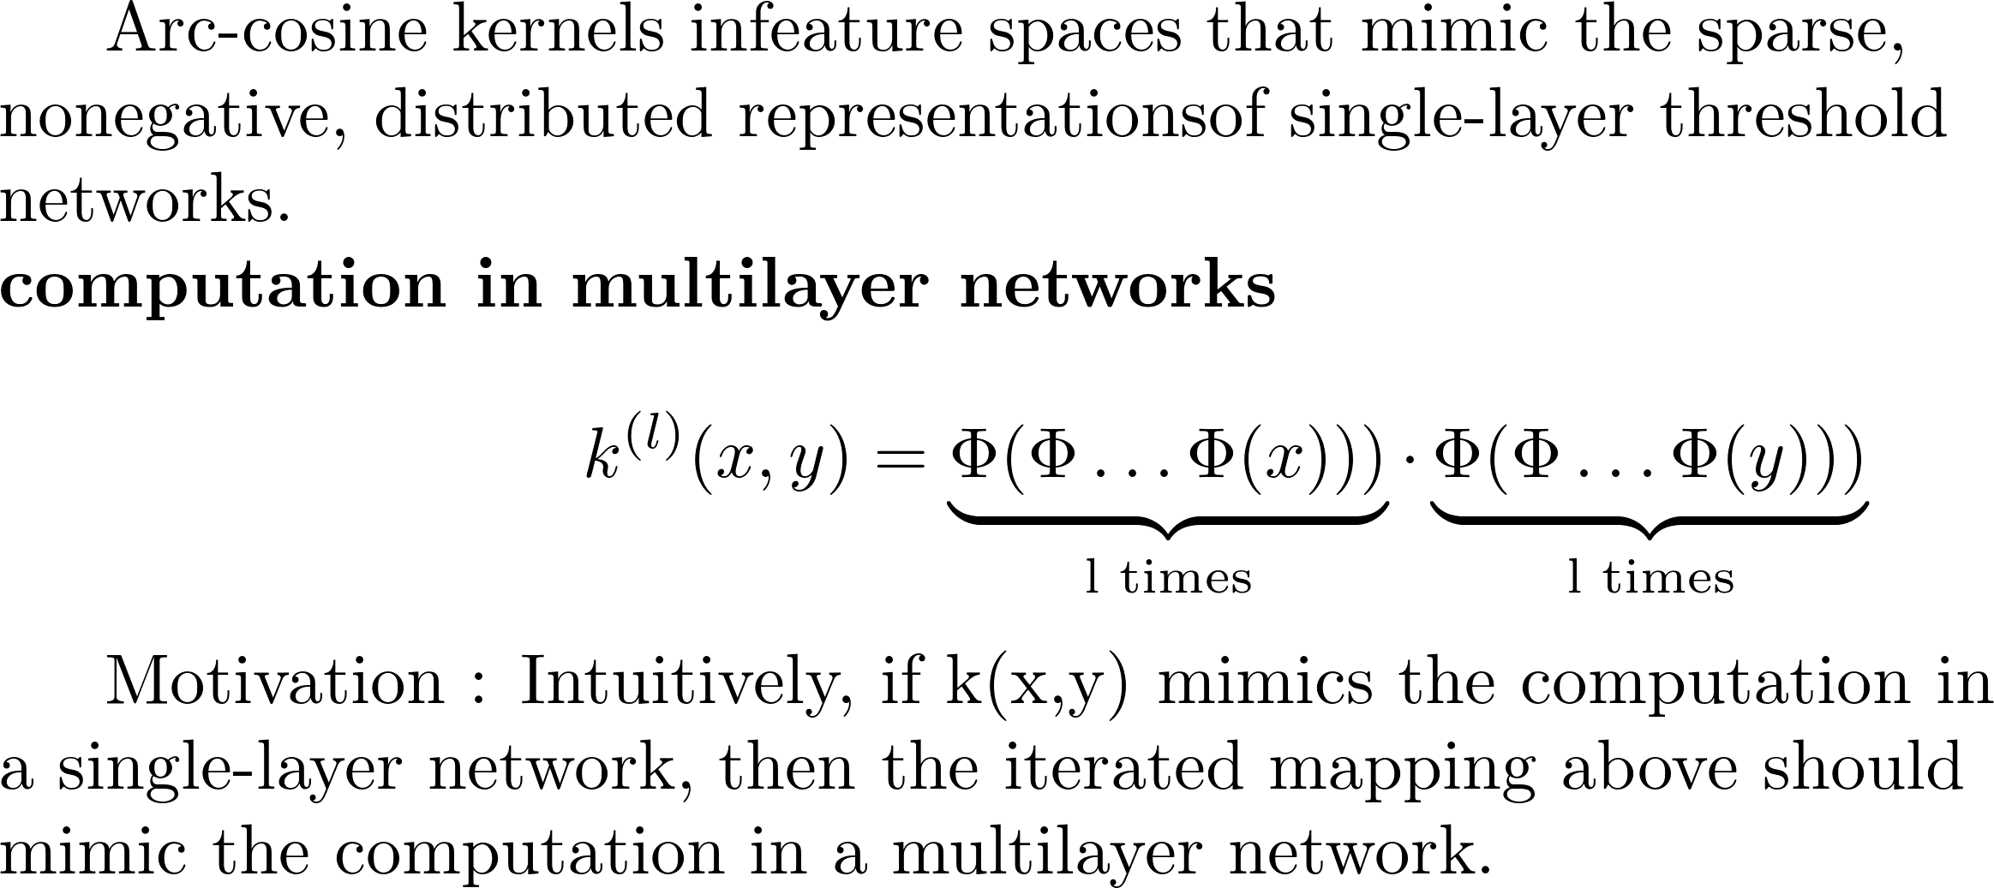
Relationship with Neural Networks

Slide 15
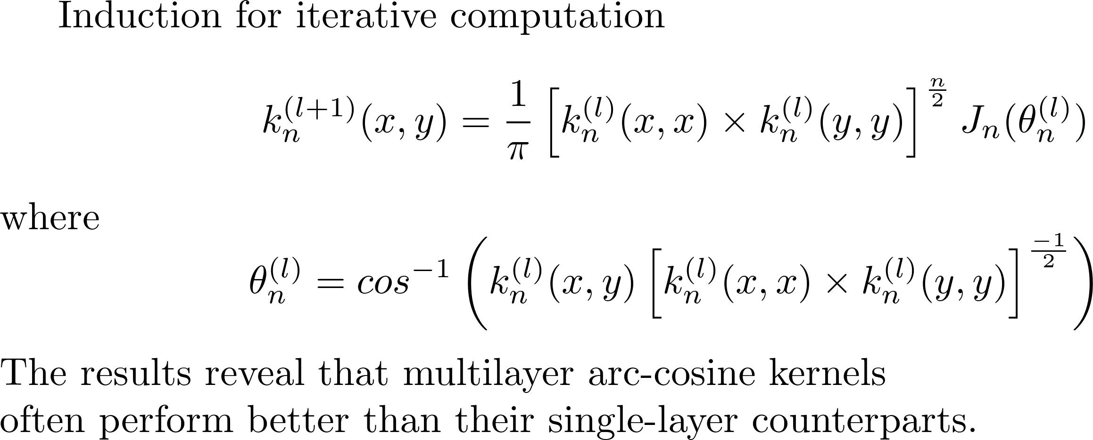
Relationship with Neural Networks

Slide 16
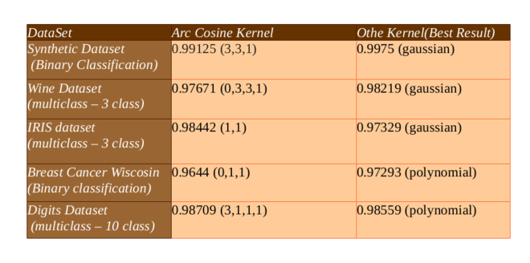
Experimental Results

Slide 17
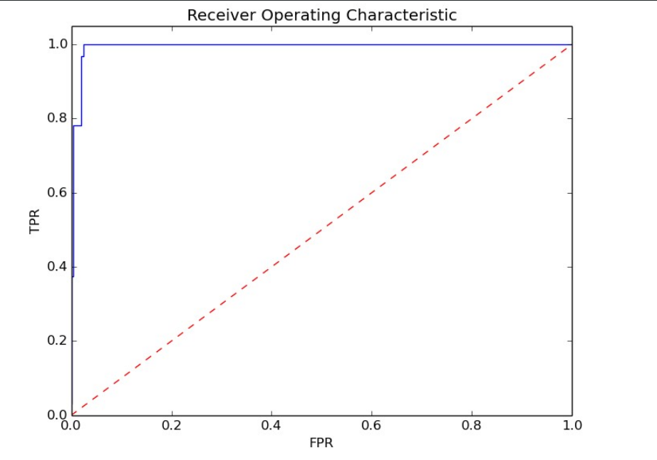
ROC Analysis of Breast Cancer Data
AUC = 0.99385

Slide 18
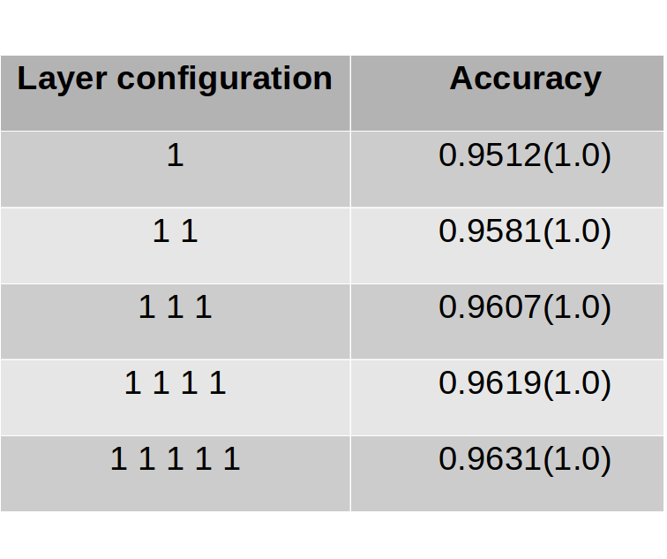
MNIST Dataset

Slide 19
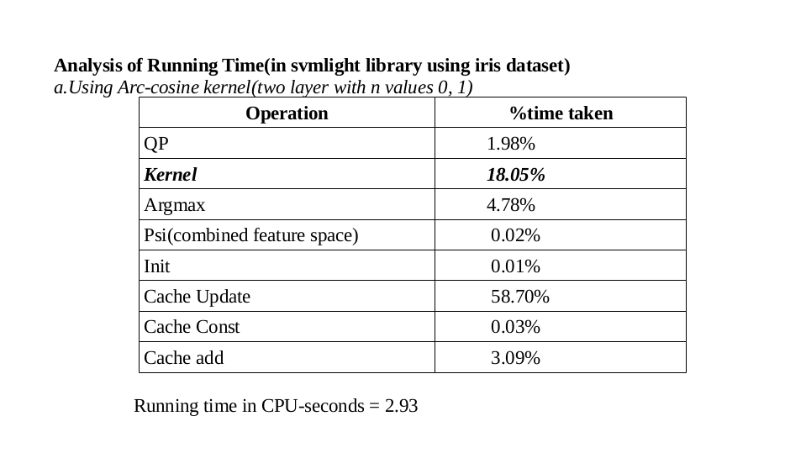
Running time Analysis

Slide 20


