Slide 1
Sparse Autoencoder
Akhil P M
SC14M044

Slide 2
Autoenoder
An autoencoder is a neural network trained with backpropagation algorithm (using unsupervised learning) by gradient descent.
The aim of an auto-encoder is to learn a compressed, distributed representation (encoding) for a set of data, typically for the purpose of dimensionality reduction.
The autoencoder learns a nonlinear approximation of the identity function which reconstructs the output from its input itself.

Slide 3
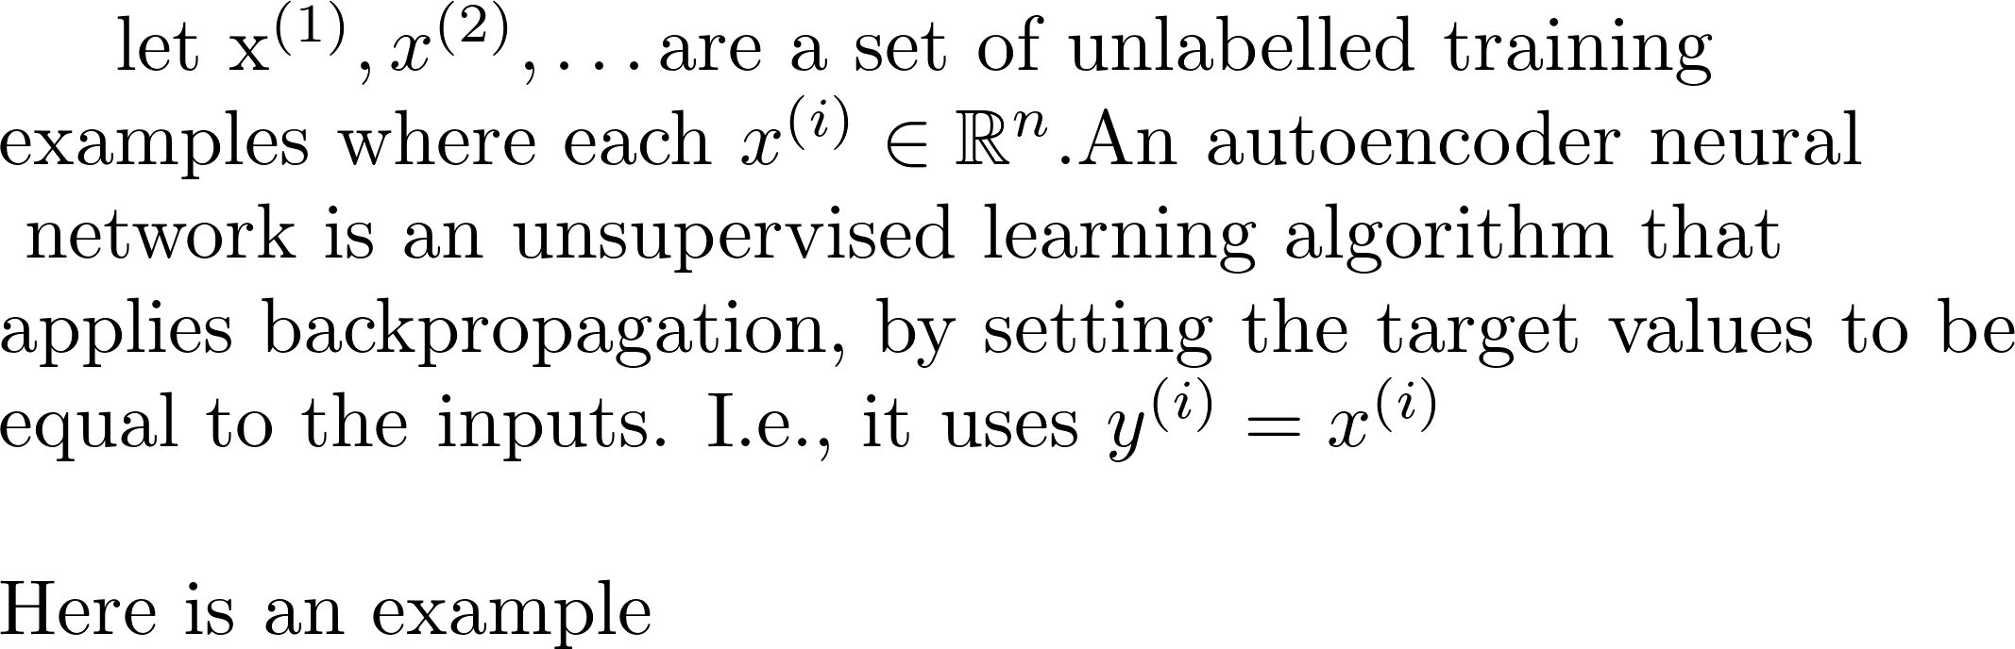
Autoencoder

Slide 4
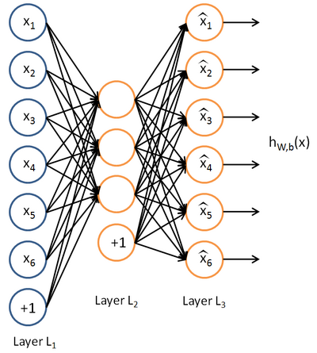
Autoencoder

Slide 5
Autoencoder
by placing constraints on the network, such as by limiting the number of hidden units, we can discover interesting structure about the data.
Autoencoders can implement any of several variations of dimensionality reduction. A linear autoencoder will learn the principal variance directions (Eigenvectors) of the data, equivalent to applying PCA to the inputs.
A nonlinear autoencoder is capable of discovering more complex, multi-modal structure in the data.
Hinton and Salakhutdinov have shown that nonlinear autoencoder networks can produce low-dimensional codes that outperform PCA for handwriting and face recognition

Slide 6
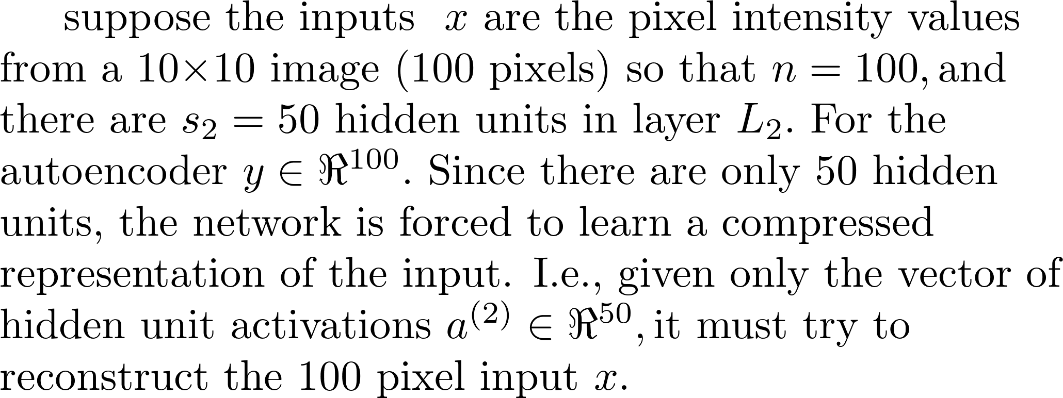
Example

Slide 7
Autoencoder
even when the number of hidden units is large (perhaps even greater than the number of input pixels), we can still discover interesting structure, by imposing other constraints on the network. In particular, if we impose a sparsity constraint on the hidden units, then the autoencoder will still discover interesting structure in the data, even if the number of hidden units is large.

Slide 8
Sparse coding
A coding is said to be sparse when each item is encoded by the strong activation of a relatively small set of neurons.
By enforcing sparse coding requirement, we can limit the number of hidden units that can be activated by each input pattern.
Given a potentially large set of input patterns, sparse coding algorithms (e.g. Sparse Autoencoder) attempt to automatically find a small number of representative patterns which, when combined in the right proportions, reproduce the original input patterns. The sparse coding for the input then consists of those representative patterns.

Slide 9
Sparse coding
For example, the very large set of English sentences can be encoded by a small number of symbols (i.e. letters, numbers, punctuation, and spaces) combined in a particular order for a particular sentence, and so a sparse coding for English would be those symbols.
A sparse autoencoder includes a sparseness constraint on hidden layer activation that is enforced by the addition of the Kullback-Leibler (KL) divergence term to the objective function.

Slide 10
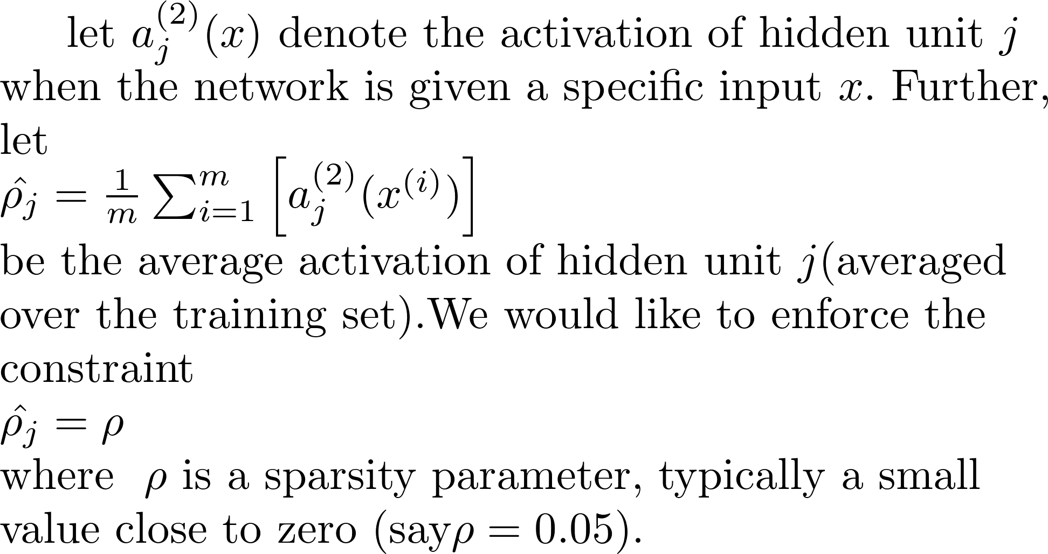
Sparse Autoencoder

Slide 11
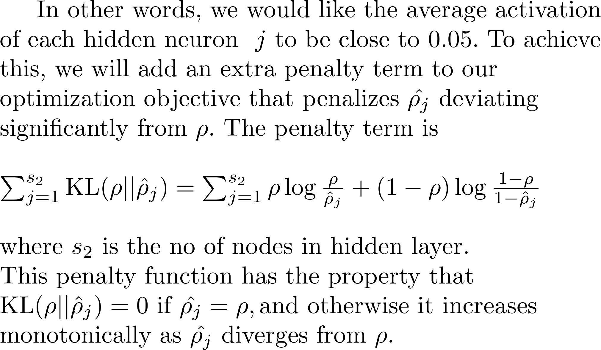
Sparse Autoencoder

Slide 12
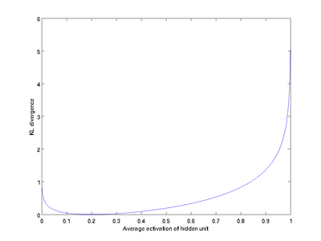
Sparse Autoencoder

Slide 13
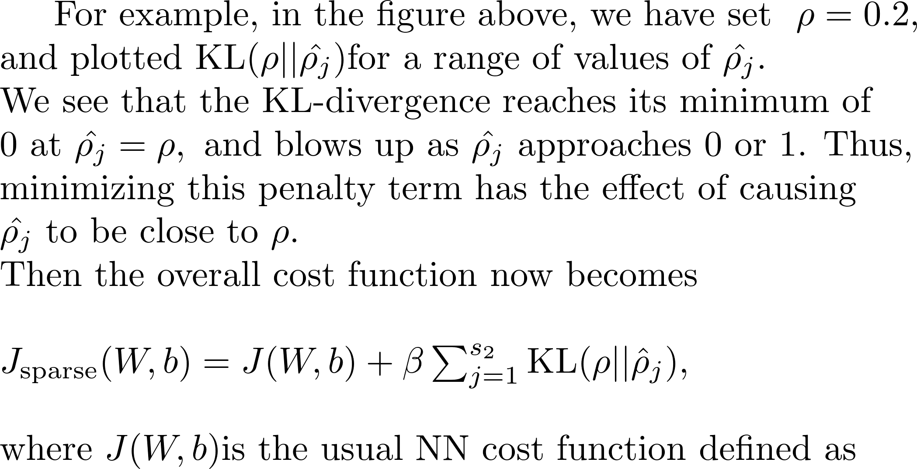
Sparse Autoencoder

Slide 14
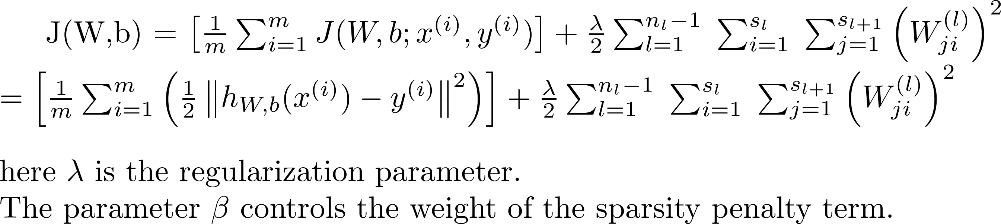
Sparse Autoencoder

Slide 15
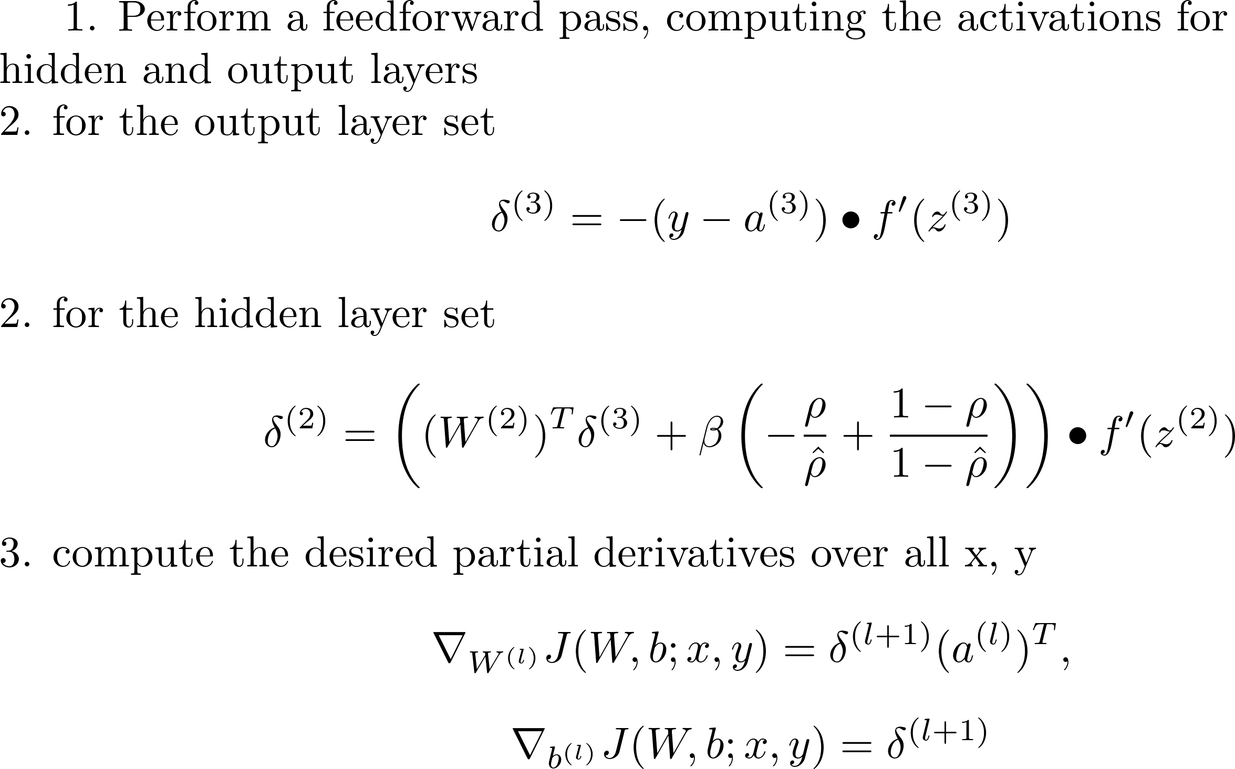
Algorithm

Slide 16
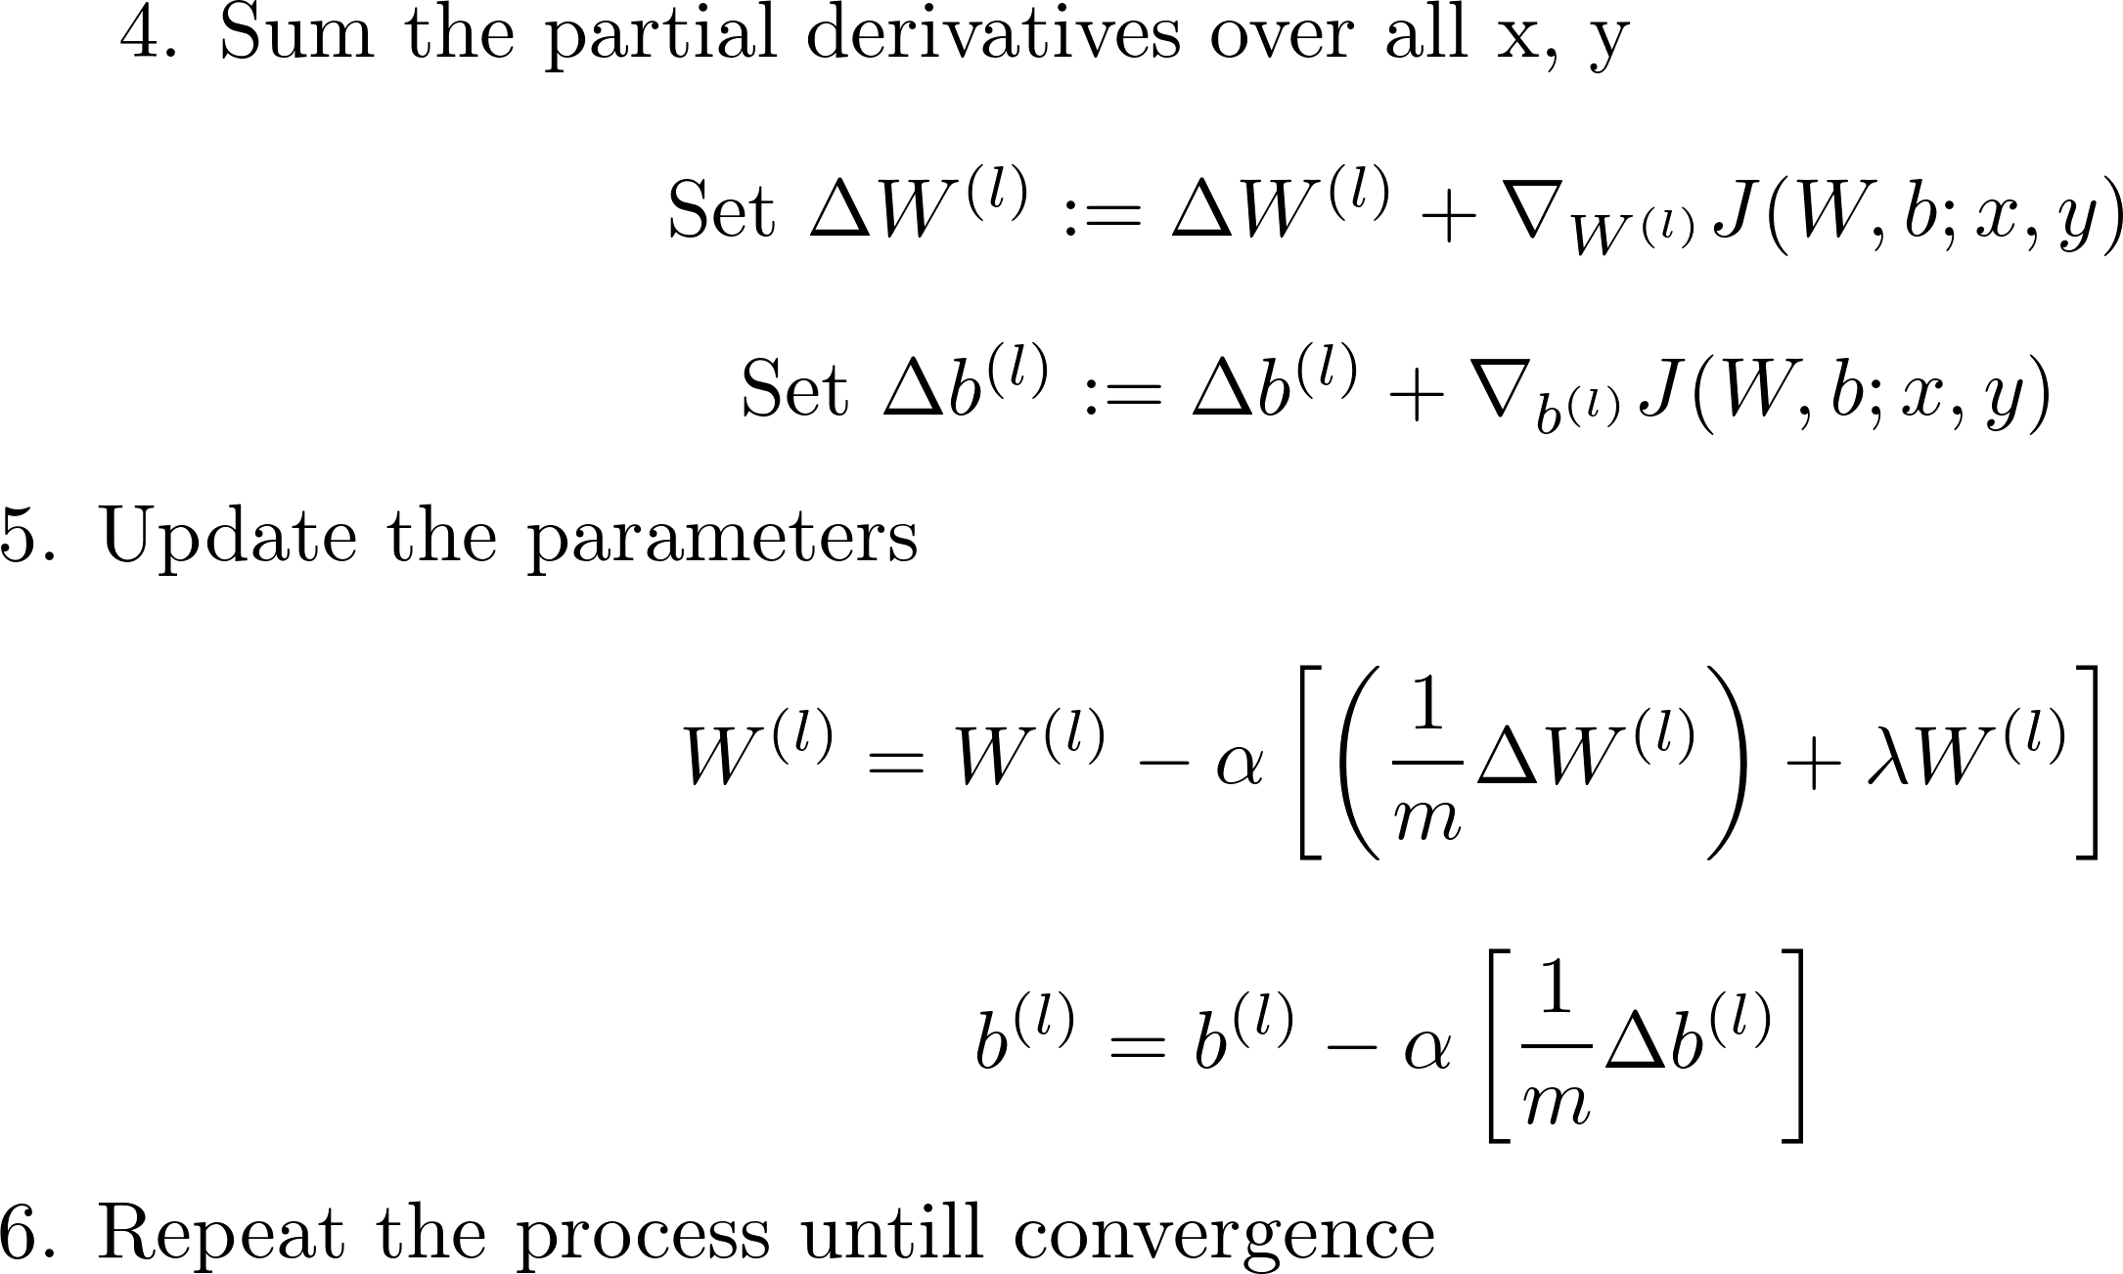
Algorithm

Slide 17
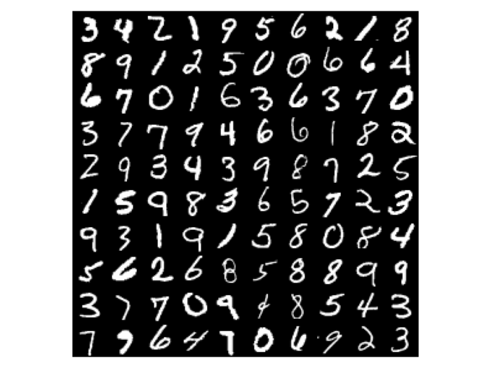
Lessons from MNIST dataset
The Dataset

Slide 18
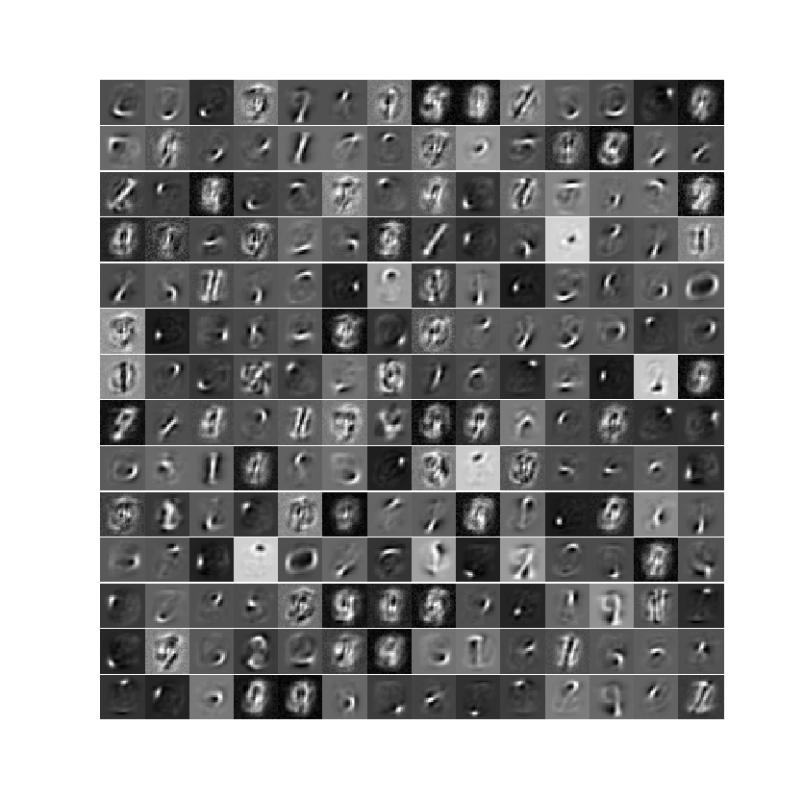
Lessons from MNIST dataset
Trained autoencoder output

Slide 19
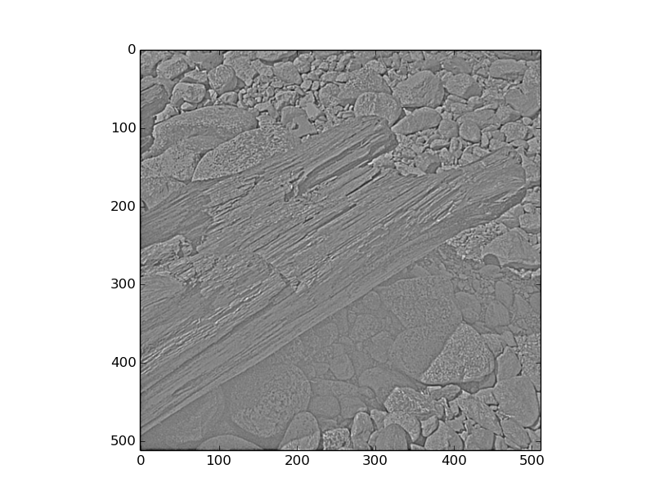
Natural Images Dataset
Sample Images

Slide 20
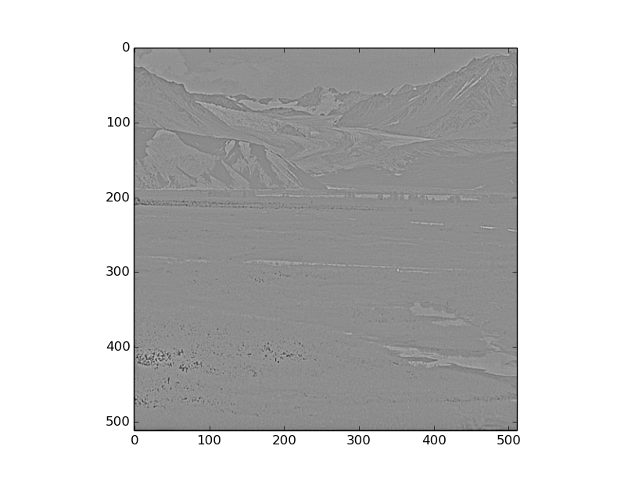
Natural Images Dataset
Sample Images

Slide 21
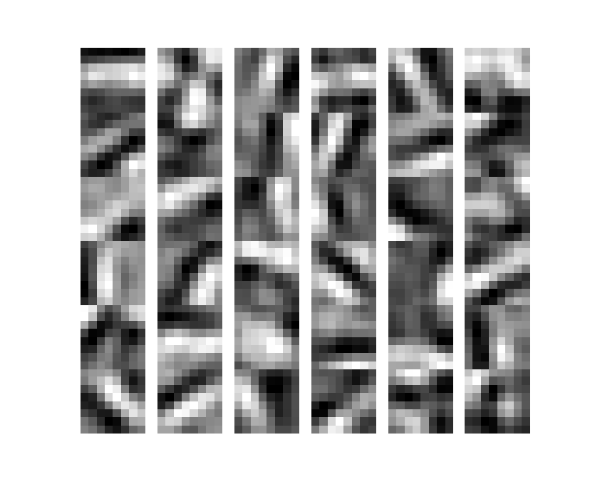
Natural Images Dataset
Trained Autoencoder Output

Slide 22
References
1. Michelle Shu, Alona Fyshe “ Sparse Autoencoders for Word Decoding from Magnetoencephalography ”, Proceedings of the third NIPS Workshop on Machine Learning - 2013 \
2. UFLDL tutorial, Stanford University http://ufldl.stanford.edu/wiki/index.php/UFLDL_Tutorial
3. Wikipedia – Autoencoder, Sparse coding
https://en.wikipedia.org/wiki/Autoencoder
https://en.wikipedia.org/wiki/Neural_coding#Sparse_coding

Slide 23


